Slide 1
https://www.youtube.com/watch?v=PFJNJQCU_lo&list=WL&index=4&t=19s
Control Google Sheets with Node.js / JavaScript (2021)

Slide 2
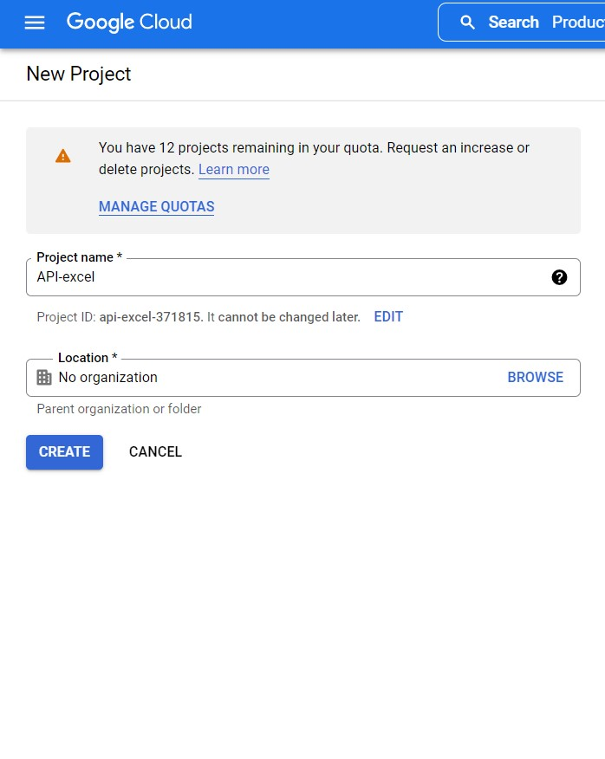
Select a project > new project

Slide 3
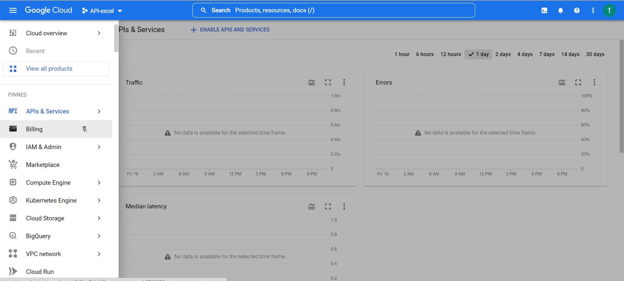
Toogle > Apis & service > enabled apis

Slide 4
Search > gosheet > enable
Credentials > create credentials > service account

Slide 5
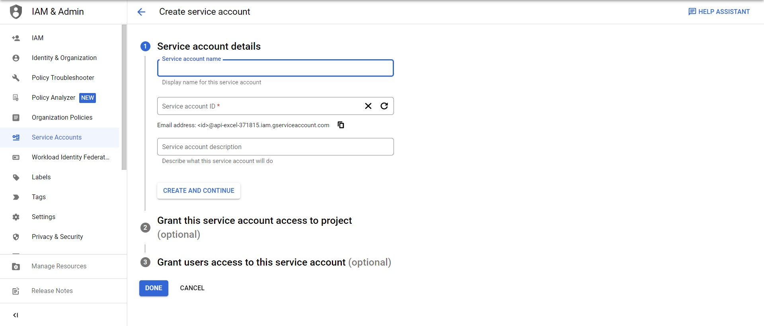
Create service account > micode sheet > done

Slide 6
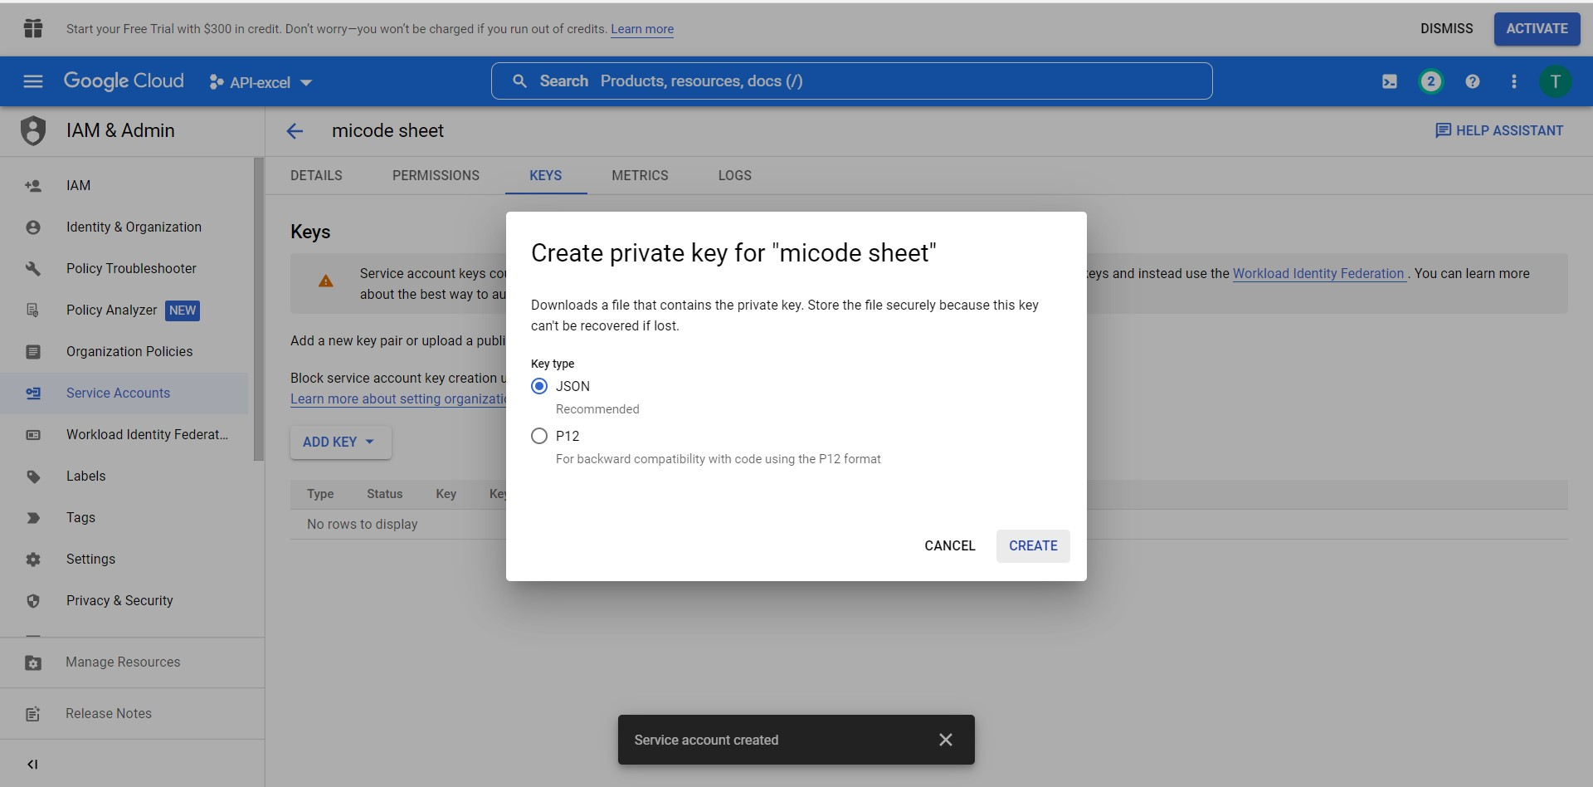
micode-sheet@api-excel-371815.iam.gserviceaccount.com

Slide 7
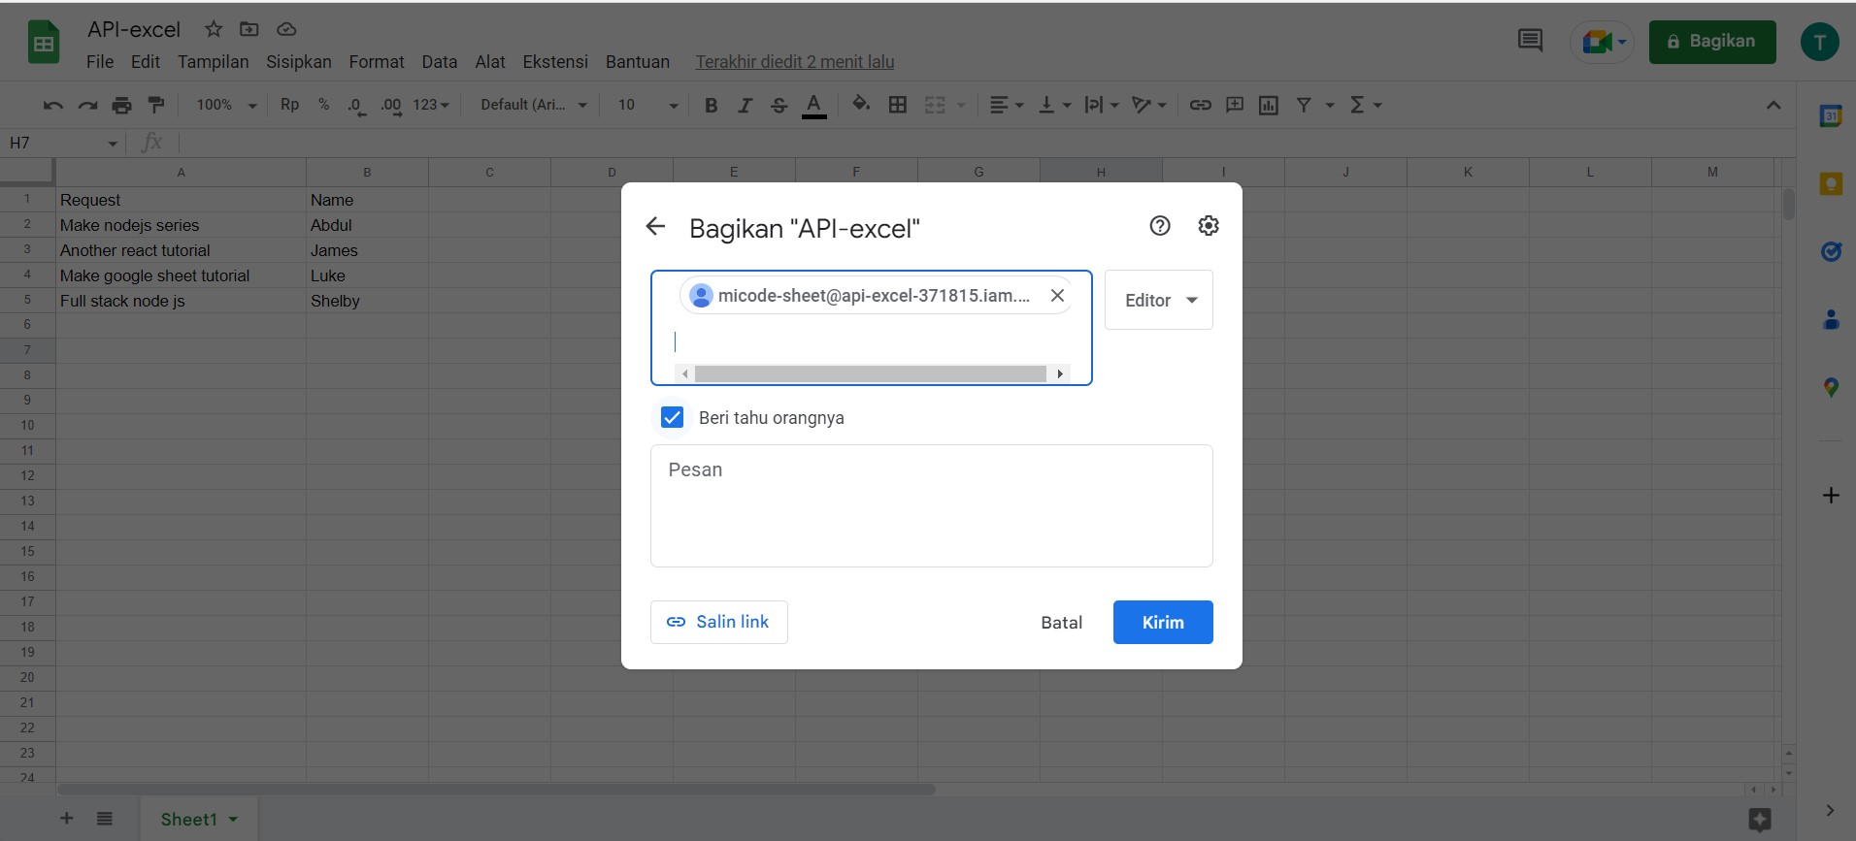
Share to service account > tidak dicentang

Slide 8
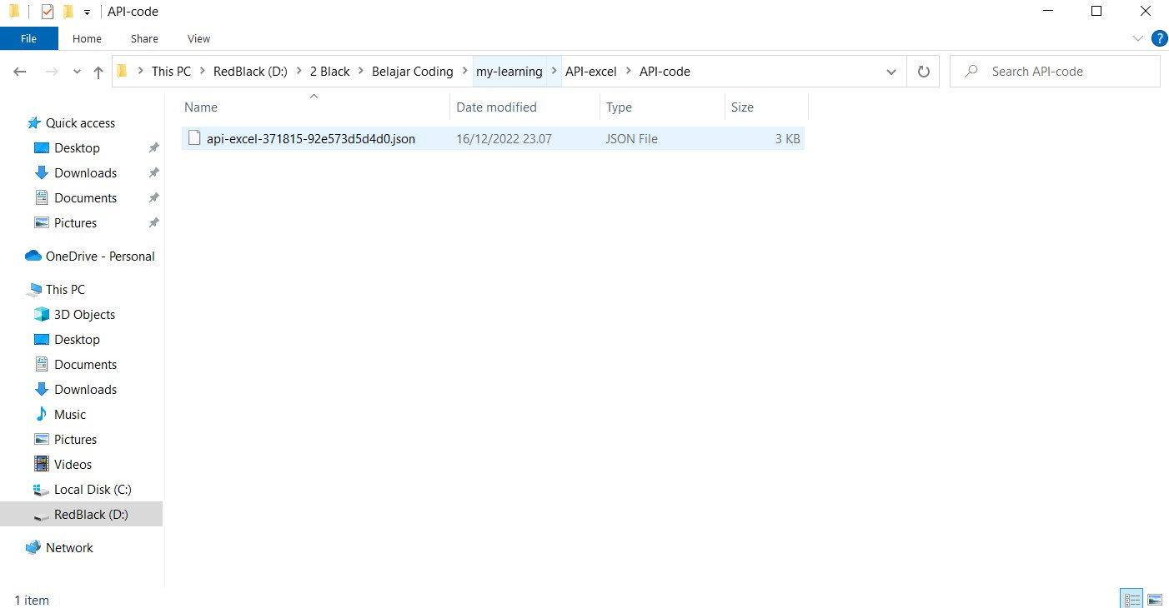
Taruh file json key dan buka code .

Slide 9
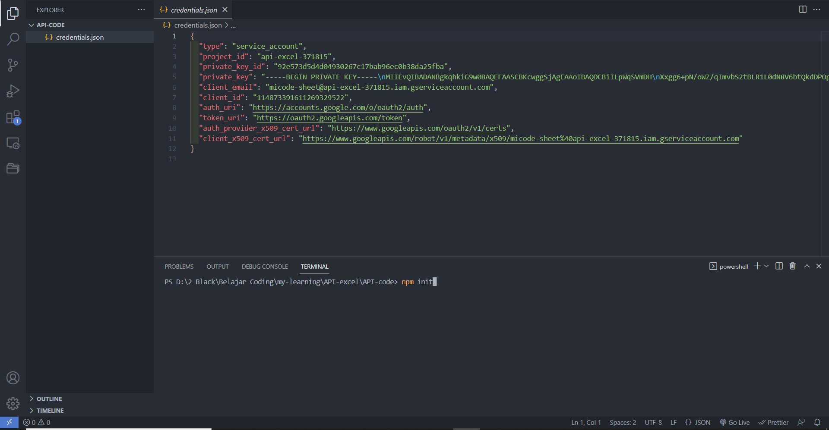
Setup npm init enter2

Slide 10
Setup nodejs & expressjs
Npm I express ejs googleapis
( ejs = node modules )
Npm I –g nodemon
Nodemon index

Slide 11
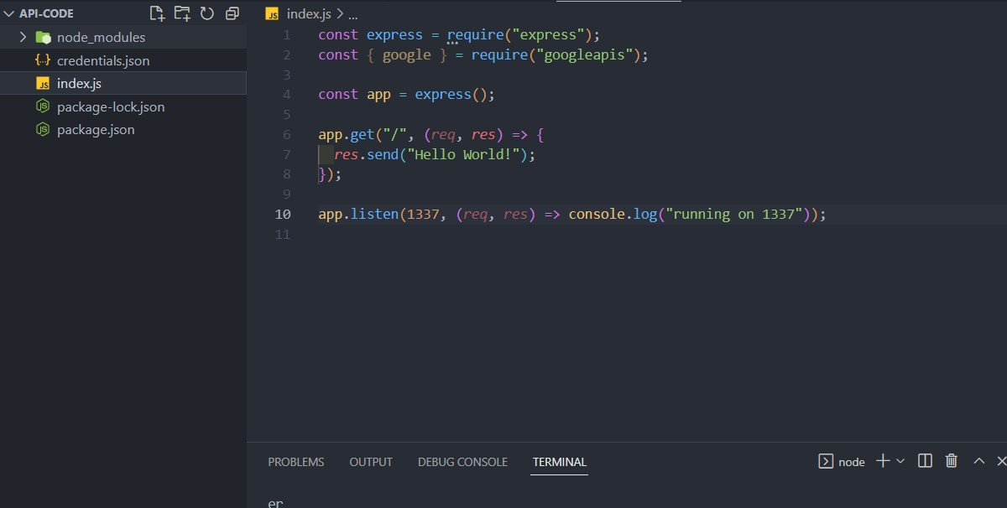

Slide 12
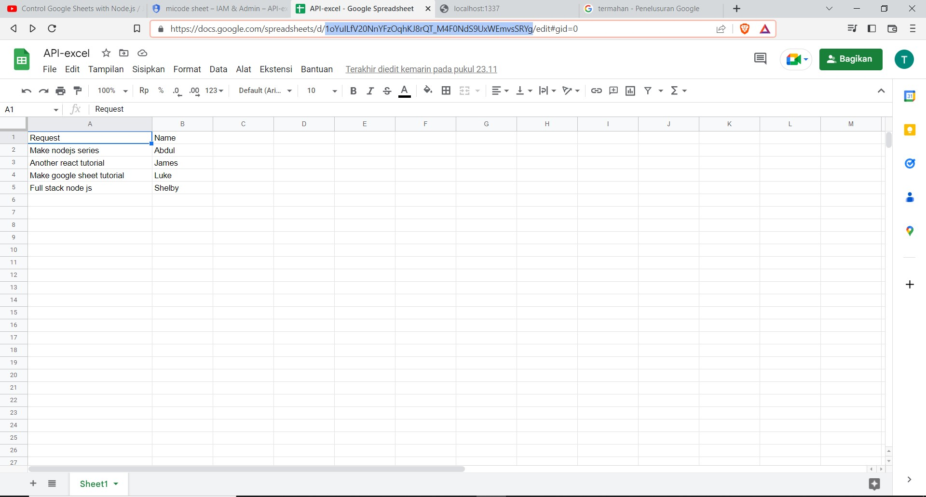

Slide 13
