Slide 1
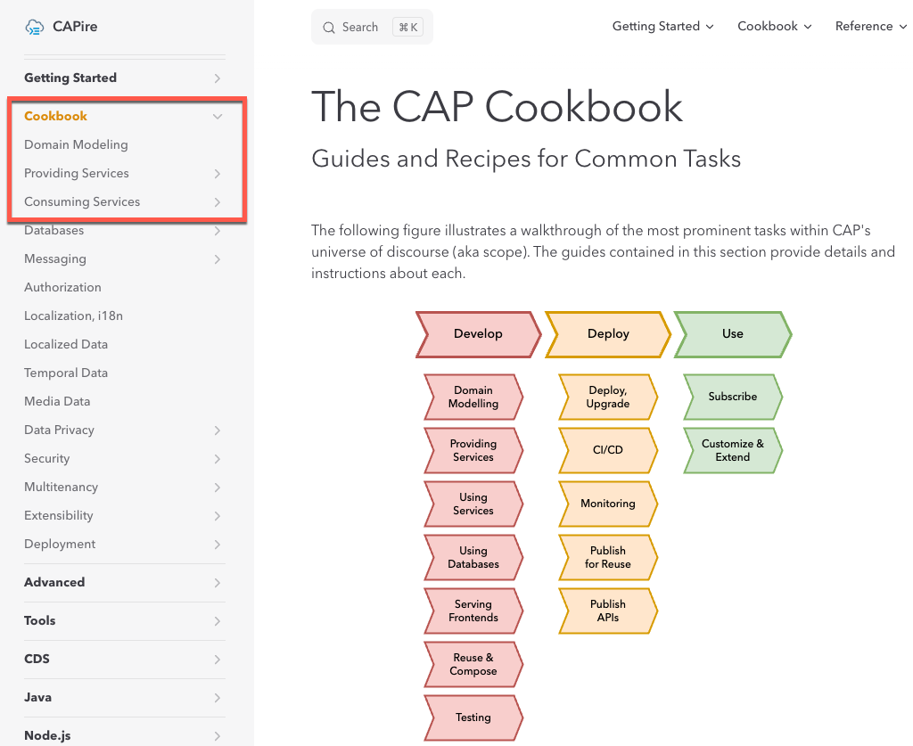
Cookbook 소개

Slide 2
Domain Modeling & Providing Service Hands-on

Slide 3
Capture intent → What, not How
Entity-Relationship Modeling
using { cuid, managed } from '@sap/cds/common’;
entity Books : cuid, managed
{
title : localized String;
descr : localized String;
author : Association to Authors;
}
using { cuid } from '@sap/cds/common';
entity Books : cuid {
title : String;
descr : String;
genre : Genre;
author : Association to Authors;
}
entity Authors : cuid {
name : String;
books : Association to many Books on books.author = $self;
}
type Genre : String enum {
Mystery; Fiction; Drama;
}

Slide 4
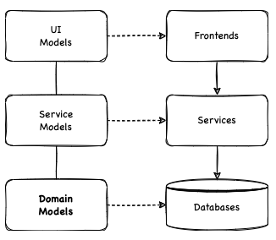
Fueling Generic Providers, Domain-Driven Design Keep it Simple, Stupid Aspect-oriented Modeling
CAP shares these goals and approaches with Domain-driven Design:
Placing projects' primary focus on the core domain
Close collaboration of developers and domain experts
Iteratively refining domain knowledge

Slide 5
CAP Composition of many
CDS – Data modeling
Postman - POST
Postman – GET
Schema.cds
/hkmc/XTBL003
/hkmc/XTBL003(FLOWUUID=50a79a4e-834f-4294-9d4c-c415fbc572c4,FLOWCODE='MH001',STATUS='01')?$expand=DETAIL
entity XTBL003 {
key FLOWUUID : UUID @(Core.Computed : true);
key FLOWCODE : String(5);
key STATUS : String(2);
DETAIL : Composition of many XTBL004
on DETAIL.FLOWUUID = FLOWUUID
and DETAIL.FLOWCODE = FLOWCODE
and DETAIL.STATUS = STATUS;
FIELD01 : String(100);
FIELD02 : String(100);
}
entity XTBL004 {
key FLOWUUID : UUID @(Core.Computed : true);
key FLOWCODE : String(5);
key NO1 : String(2);
STATUS : String(2);
APPROVAL_NAME : String(100);
}
{
"FLOWCODE": "MH001",
"STATUS": "01",
"FIELD01": "07199782",
"FIELD02": "K0121120",
"DETAIL" : [
{
"FLOWCODE": "MH001",
"NO1": "2",
"STATUS": "01",
"APPROVAL_NAME": "JHAN"
},{
"FLOWCODE": "MH001",
"NO1": "3",
"STATUS": "01",
"APPROVAL_NAME": "JHAN"
}]
}
{
"@odata.context": "$metadata#XTBL003(DETAIL())/$entity",
"FLOWUUID": "79e8d3e8-ef0d-401f-a586-a15f59789b62",
"FLOWCODE": "MH001",
"STATUS": "01",
"DETAIL": [
{
"FLOWUUID": "79e8d3e8-ef0d-401f-a586-a15f59789b62",
"FLOWCODE": "MH001",
"NO1": "2",
"STATUS": "01",
"APPROVAL_NAME": "JHAN"
},
{
"FLOWUUID": "79e8d3e8-ef0d-401f-a586-a15f59789b62",
"FLOWCODE": "MH001",
"NO1": "3",
"STATUS": "01",
"APPROVAL_NAME": "JHAN"
}
],
"FIELD01": "07199782",
"FIELD02": "K0121120"
}

Slide 6
CAP Composition
OData Metadata
Postman – PUT
/hkmc/XTBL003(FLOWUUID=79e8d3e8-ef0d-401f-a586-a15f59789b62,FLOWCODE='MH001',STATUS='01')
<EntityType Name="XTBL003">
<Key>
<PropertyRef Name="FLOWUUID"/>
<PropertyRef Name="FLOWCODE"/>
<PropertyRef Name="STATUS"/>
</Key>
<Property Name="FLOWUUID" Type="Edm.Guid" Nullable="false"/>
<Property Name="FLOWCODE" Type="Edm.String" MaxLength="5" Nullable="false"/>
<Property Name="STATUS" Type="Edm.String" MaxLength="2" Nullable="false"/>
<NavigationProperty Name="DETAIL" Type="Collection(hkmc.XTBL004)">
<OnDelete Action="Cascade"/>
</NavigationProperty>
<Property Name="FIELD01" Type="Edm.String" MaxLength="100"/>
<Property Name="FIELD02" Type="Edm.String" MaxLength="100"/>
</EntityType>
<EntityType Name="XTBL004">
<Key>
<PropertyRef Name="FLOWUUID"/>
<PropertyRef Name="FLOWCODE"/>
<PropertyRef Name="NO1"/>
</Key>
<Property Name="FLOWUUID" Type="Edm.Guid" Nullable="false"/>
<Property Name="FLOWCODE" Type="Edm.String" MaxLength="5" Nullable="false"/>
<Property Name="NO1" Type="Edm.String" MaxLength="2" Nullable="false"/>
<Property Name="STATUS" Type="Edm.String" MaxLength="2"/>
<Property Name="APPROVAL_NAME" Type="Edm.String" MaxLength="100"/>
</EntityType>
{
"FLOWUUID": "79e8d3e8-ef0d-401f-a586-a15f59789b62",
"FLOWCODE": "MH001",
"STATUS": "01",
"FIELD01": "VVV",
"FIELD02": "SSS",
"DETAIL" : [{
"FLOWUUID": "79e8d3e8-ef0d-401f-a586-a15f59789b62",
"FLOWCODE": "MH001",
"NO1": "2",
"STATUS": "01",
"APPROVAL_NAME": "JHANS"
},{
"FLOWUUID": "79e8d3e8-ef0d-401f-a586-a15f59789b62",
"FLOWCODE": "MH001",
"NO1": "3",
"STATUS": "01",
"APPROVAL_NAME": "JHANQ"
}]
}
Postman – DELETE
/hkmc/XTBL003(FLOWUUID=79e8d3e8-ef0d-401f-a586-a15f59789b62,FLOWCODE='MH001',STATUS='01')

Slide 7
CAP Composition of one
CDS – Data modeling
Postman - POST
Postman – GET
Schema.cds
/hkmc/XTBL0030
XTBL0030(FLOWUUID=3f96b199-6f98-4160-844d-06795360e697,FLOWCODE='MH001',STATUS='01')?$expand=DETAIL
entity XTBL0030 {
key FLOWUUID : UUID @(Core.Computed : true);
key FLOWCODE : String(5);
key STATUS : String(2);
DETAIL : Composition of one XTBL004
on DETAIL.FLOWUUID = FLOWUUID
and DETAIL.FLOWCODE = FLOWCODE
and DETAIL.STATUS = STATUS;
FIELD01 : String(100);
FIELD02 : String(100);
}
entity XTBL0040 {
key FLOWUUID : UUID @(Core.Computed : true);
key FLOWCODE : String(5);
key NO1 : String(2);
STATUS : String(2);
APPROVAL_NAME : String(100);
}
{
"FLOWCODE": "MH001",
"STATUS": "01",
"FIELD01": "07199782",
"FIELD02": "K0121120",
"DETAIL" :
{
"FLOWCODE": "MH001",
"NO1": "2",
"STATUS": "01",
"APPROVAL_NAME": "JHAN"
}
}
{
"@odata.context": "$metadata#XTBL0030(DETAIL())/$entity",
"FLOWUUID": "3f96b199-6f98-4160-844d-06795360e697",
"FLOWCODE": "MH001",
"STATUS": "01",
"FIELD01": "07199782",
"FIELD02": "K0121120",
"DETAIL": {
"FLOWUUID": "3f96b199-6f98-4160-844d-06795360e697",
"FLOWCODE": "MH001",
"NO1": "2",
"STATUS": "01",
"APPROVAL_NAME": "JHAN"
}
}

Slide 8
CAP Composition
<EntityType Name="XTBL0030">
<Key>
<PropertyRef Name="FLOWUUID"/>
<PropertyRef Name="FLOWCODE"/>
<PropertyRef Name="STATUS"/>
</Key>
<Property Name="FLOWUUID" Type="Edm.Guid" Nullable="false"/>
<Property Name="FLOWCODE" Type="Edm.String" MaxLength="5" Nullable="false"/>
<Property Name="STATUS" Type="Edm.String" MaxLength="2" Nullable="false"/>
<NavigationProperty Name="DETAIL" Type="hkmc.XTBL0040">
<OnDelete Action="Cascade"/>
<ReferentialConstraint Property="FLOWUUID" ReferencedProperty="FLOWUUID"/>
<ReferentialConstraint Property="FLOWCODE" ReferencedProperty="FLOWCODE"/>
<ReferentialConstraint Property="STATUS" ReferencedProperty="STATUS"/>
</NavigationProperty>
<Property Name="FIELD01" Type="Edm.String" MaxLength="100"/>
<Property Name="FIELD02" Type="Edm.String" MaxLength="100"/>
</EntityType>
<EntityType Name="XTBL0040">
<Key>
<PropertyRef Name="FLOWUUID"/>
<PropertyRef Name="FLOWCODE"/>
<PropertyRef Name="NO1"/>
</Key>
<Property Name="FLOWUUID" Type="Edm.Guid" Nullable="false"/>
<Property Name="FLOWCODE" Type="Edm.String" MaxLength="5" Nullable="false"/>
<Property Name="NO1" Type="Edm.String" MaxLength="2" Nullable="false"/>
<Property Name="STATUS" Type="Edm.String" MaxLength="2"/>
<Property Name="APPROVAL_NAME" Type="Edm.String" MaxLength="100"/>
</EntityType>

Slide 9
CAP Association(to one)
CDS – Data modeling
Postman - POST
Postman – GET
Schema.cds
/hkmc/XYTBL003
/hkmc/XYTBL003(FLOWUUID= 170e3c5e-d3cf-4f0a-97ee-bf68f971d8d9,FLOWCODE='MH001',STATUS=‘02')?$expand=DETAIL
entity XYTBL003 {
key FLOWUUID : UUID @(Core.Computed : true);
key FLOWCODE : String(5);
key STATUS : String(2);
DETAIL : Association to XYTBL004
on DETAIL.FLOWUUID = FLOWUUID
and DETAIL.FLOWCODE = FLOWCODE
and DETAIL.STATUS = STATUS;
FIELD01 : String(100);
FIELD02 : String(100);
}
entity XYTBL004 {
key FLOWUUID : UUID @(Core.Computed : true);
key FLOWCODE : String(5);
key NO1 : String(2);
STATUS : String(2);
APPROVAL_NAME : String(100);
}
{
"FLOWUUID": "170e3c5e-d3cf-4f0a-97ee-bf68f971d8d9",
"FLOWCODE": "MH001",
"STATUS": "02",
"FIELD01": "07199782",
"FIELD02": "K0121120"
}
{
"@odata.context": "$metadata#XYTBL003(DETAIL())/$entity",
"FLOWUUID": "170e3c5e-d3cf-4f0a-97ee-bf68f971d8d9",
"FLOWCODE": "MH001",
"STATUS": "02",
"FIELD01": "07199782",
"FIELD02": "K0121120",
"DETAIL": {
"FLOWUUID": "170e3c5e-d3cf-4f0a-97ee-bf68f971d8d9",
"FLOWCODE": "MH001",
"NO1": "2",
"STATUS": "02",
"APPROVAL_NAME": "JHAN"
}
}
/hkmc/XYTBL004
{
"FLOWUUID": "170e3c5e-d3cf-4f0a-97ee-bf68f971d8d9",
"FLOWCODE": "MH001",
"NO1": "2",
"STATUS": "02",
"APPROVAL_NAME": "JHAN" }
Detail이 한건만 나옴
{
"FLOWUUID": "170e3c5e-d3cf-4f0a-97ee-bf68f971d8d9",
"FLOWCODE": "MH001",
"NO1": "2",
"STATUS": "02",
"APPROVAL_NAME": "JHAN9" }

Slide 10
CAP Association to many
CDS – Data modeling
Postman - POST
Postman – GET
Schema.cds
/hkmc/XYZTBL003
/hkmc/XYZTBL003(FLOWUUID= 170e3c5e-d3cf-4f0a-97ee-bf68f971d8d9,FLOWCODE='MH001',STATUS=‘02')?$expand=DETAIL
entity XYZTBL003 {
key FLOWUUID : UUID @(Core.Computed : true);
key FLOWCODE : String(5);
key STATUS : String(2);
DETAIL : Association to many XYTBL004
on DETAIL.FLOWUUID = FLOWUUID
and DETAIL.FLOWCODE = FLOWCODE
and DETAIL.STATUS = STATUS;
FIELD01 : String(100);
FIELD02 : String(100);
}
entity XYZTBL004 {
key FLOWUUID : UUID @(Core.Computed : true);
key FLOWCODE : String(5);
key NO1 : String(2);
STATUS : String(2);
APPROVAL_NAME : String(100);
}
{
"FLOWUUID": "170e3c5e-d3cf-4f0a-97ee-bf68f971d8d9",
"FLOWCODE": "MH001",
"STATUS": "02",
"FIELD01": "07199782",
"FIELD02": "K0121120"
}
{
"@odata.context": "$metadata#XYZTBL003(DETAIL())/$entity",
"FLOWUUID": "170e3c5e-d3cf-4f0a-97ee-bf68f971d8d9",
"FLOWCODE": "MH001",
"STATUS": "02",
"FIELD01": "07199782",
"FIELD02": "K0121120",
"DETAIL": [
{
"FLOWUUID": "170e3c5e-d3cf-4f0a-97ee-bf68f971d8d9",
"FLOWCODE": "MH001",
"NO1": "3",
"STATUS": "02",
"APPROVAL_NAME": "JHAN9"
},
{
"FLOWUUID": "170e3c5e-d3cf-4f0a-97ee-bf68f971d8d9",
"FLOWCODE": "MH001",
"NO1": "4",
"STATUS": "02",
"APPROVAL_NAME": "JHAN90"
}
]
}
/hkmc/XYZTBL004
{
"FLOWUUID": "170e3c5e-d3cf-4f0a-97ee-bf68f971d8d9",
"FLOWCODE": "MH001",
"NO1": "2",
"STATUS": "02",
"APPROVAL_NAME": "JHAN" }
{
"FLOWUUID": "170e3c5e-d3cf-4f0a-97ee-bf68f971d8d9",
"FLOWCODE": "MH001",
"NO1": "2",
"STATUS": "02",
"APPROVAL_NAME": "JHAN9" }
Detail이 N건이 나옴

Slide 11
CAP Association
<EntityType Name="XYTBL003">
<Key>
<PropertyRef Name="FLOWUUID"/>
<PropertyRef Name="FLOWCODE"/>
<PropertyRef Name="STATUS"/>
</Key>
<Property Name="FLOWUUID" Type="Edm.Guid" Nullable="false"/>
<Property Name="FLOWCODE" Type="Edm.String" MaxLength="5" Nullable="false"/>
<Property Name="STATUS" Type="Edm.String" MaxLength="2" Nullable="false"/>
<NavigationProperty Name="DETAIL" Type="hkmc.XYTBL004">
<ReferentialConstraint Property="FLOWUUID" ReferencedProperty="FLOWUUID"/>
<ReferentialConstraint Property="FLOWCODE" ReferencedProperty="FLOWCODE"/>
</NavigationProperty>
<Property Name="FIELD01" Type="Edm.String" MaxLength="100"/>
<Property Name="FIELD02" Type="Edm.String" MaxLength="100"/>
</EntityType>
<EntityType Name="XYTBL004">
<Key>
<PropertyRef Name="FLOWUUID"/>
<PropertyRef Name="FLOWCODE"/>
<PropertyRef Name="NO1"/>
</Key>
<Property Name="FLOWUUID" Type="Edm.Guid" Nullable="false"/>
<Property Name="FLOWCODE" Type="Edm.String" MaxLength="5" Nullable="false"/>
<Property Name="NO1" Type="Edm.String" MaxLength="2" Nullable="false"/>
<Property Name="STATUS" Type="Edm.String" MaxLength="2"/>
<Property Name="APPROVAL_NAME" Type="Edm.String" MaxLength="100"/>
</EntityType>
<EntityType Name="XYZTBL003">
<Key>
<PropertyRef Name="FLOWUUID"/>
<PropertyRef Name="FLOWCODE"/>
<PropertyRef Name="STATUS"/>
</Key>
<Property Name="FLOWUUID" Type="Edm.Guid" Nullable="false"/>
<Property Name="FLOWCODE" Type="Edm.String" MaxLength="5" Nullable="false"/>
<Property Name="STATUS" Type="Edm.String" MaxLength="2" Nullable="false"/>
<NavigationProperty Name="DETAIL" Type="Collection(hkmc.XYZTBL004)"/>
<Property Name="FIELD01" Type="Edm.String" MaxLength="100"/>
<Property Name="FIELD02" Type="Edm.String" MaxLength="100"/>
</EntityType>
<EntityType Name="XYZTBL004">
<Key>
<PropertyRef Name="FLOWUUID"/>
<PropertyRef Name="FLOWCODE"/>
<PropertyRef Name="NO1"/>
</Key>
<Property Name="FLOWUUID" Type="Edm.Guid" Nullable="false"/>
<Property Name="FLOWCODE" Type="Edm.String" MaxLength="5" Nullable="false"/>
<Property Name="NO1" Type="Edm.String" MaxLength="2" Nullable="false"/>
<Property Name="STATUS" Type="Edm.String" MaxLength="2"/>
<Property Name="APPROVAL_NAME" Type="Edm.String" MaxLength="100"/>
</EntityType>

Slide 12
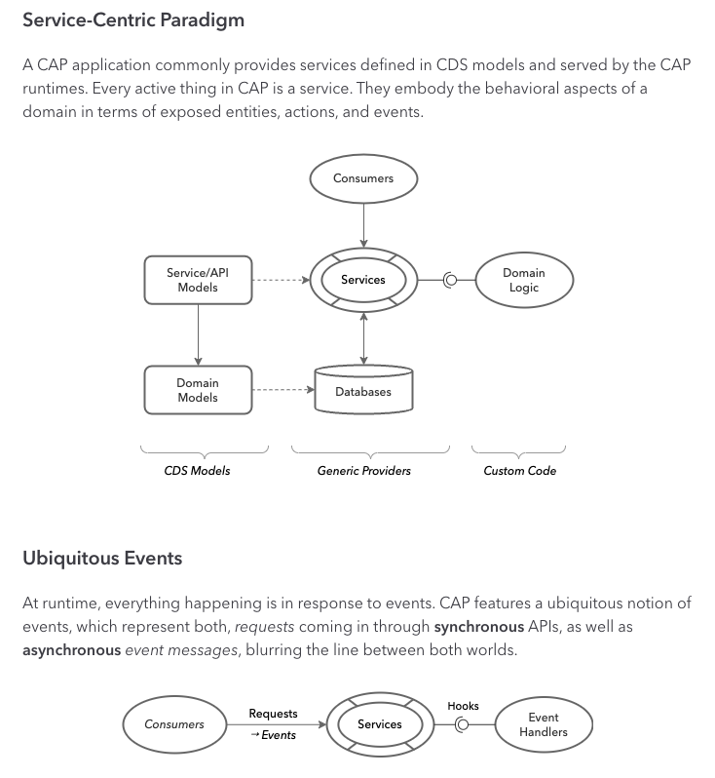
Providing Services
Modeling Services
Services Act as Facades
Generic Providers
Serve most requests automatically with OOTB solutions
Pagination & Sorting
Implicit Pagination & Reliable Pagination - @cds.query.xxxx
Input Validation
Implicit Pagination & Reliable Pagination - @mandatory, @assert
Managed Data
Using {managed} from ‘@sap/cds/common’
$user, $now
Concurrency Control
Optimistic concurrency
Etags - @odata.etag
Adding Custom Logic
Optimistic concurrency
Etags - @odata.etag
Custom Actions & Functions
Action(input params) returns value
Function (input params) returns value

Slide 13
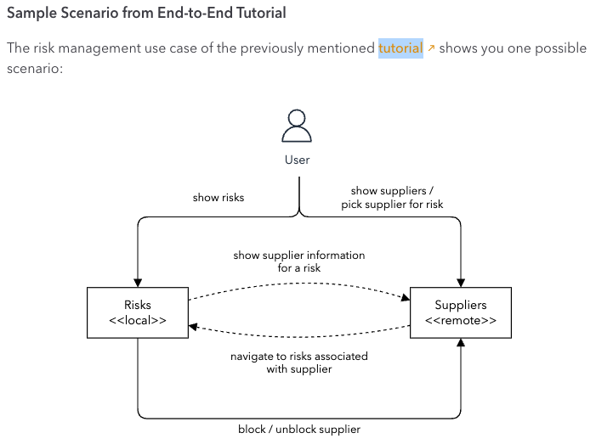
Consuming Services
Import APIs
cds import <input file> --as cds
Srv/external
Mocking
Srv/external/data
cds watch
Querying
Cds.connect.to(‘cds_dest_in_pkg.json’)
Mashups
Cds association between local and remote entities
/service/localsrv?$expand=remotesrv
Deployments
Create destination
Dest_name in package.json

Slide 14
Databases
Media Data
Messaging
Micro Service간 통신, Service Mashup
Security
Authorization
Multitenancy
Localization, i18n
Extensibility
Temporal Data
Deployment

Slide 15
CDS
Definition Language(CDL)
Define entity, define type…
Schema Notation(CSN)
CDS Core Engine
Query Language(CQL)
CQL is based on standard SQL
View..
Entity SELECT from Authors { name, address.street }
Entity SELECT from Books { *, author.name as author }
View…(input param: type) as select
Query Notation(CQN)
// Parsing CQL
let query = cds.parse.cql (`SELECT from Foo`)
// Query building
let query = SELECT.from('Foo’)
// Constructing CQN objects in your code
let query = {SELECT:{from:[{ref:['Foo']}]}}
cds.run (query)
CQN is a canonical plain object representation of CDS queries.

Slide 16
Binary type
entity HR0010 {
key FLOWUUID : UUID @(Core.Computed : true);
key FLOWCODE : String(5);
key DOCUMENTID : String(36);
FILENAME : String(100);
FILESIZE : String(100);
FILEUPLOADDATE: Date;
FILEUPLOADTIME: Time;
URL: String(500);
@Core.MediaType: mimeType
CONTENT: LargeBinary @stream;
@Core.IsMediaType : true
mimeType : String(200);
}

