Slide 1
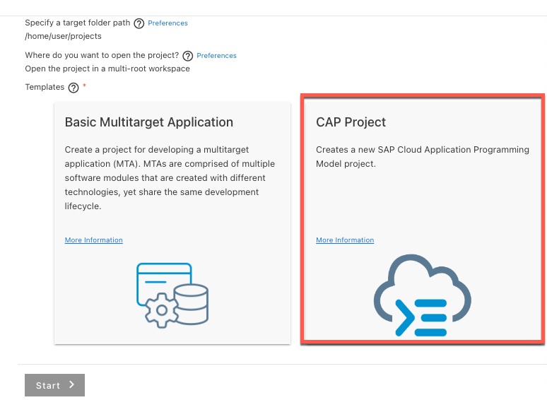
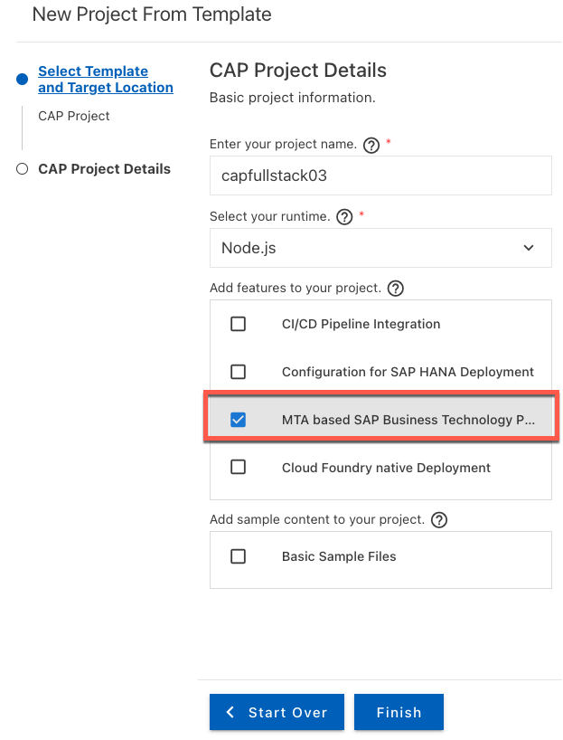
CAP Project 구성
Template를 통해 빠르게 CAP Project 생성. MTA(Multi Target Application) 타입 생성
Example source : https://github.com/SAP-samples/cloud-cap-risk-management/tree/master/templates/create-cap-application

Slide 2
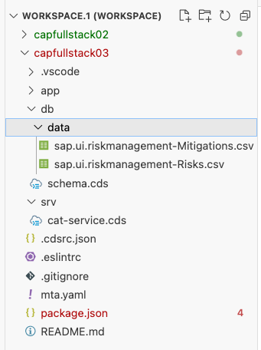
CAP Project 구성
Package.json
schema.cds & cat-service.cds 복사
➔ 아래 링크 참조
sqlite3 와 cds 부분 추가
{
"name": "capfullstack03",
"version": "1.0.0",
"description": "A simple CAP project.",
"repository": "<Add your repository here>",
"license": "UNLICENSED",
"private": true,
"dependencies": {
"@sap/cds": "^7",
"express": "^4",
"sqlite3": "^5.0.2"
},
"devDependencies": {
"@cap-js/sqlite": "^1",
"@sap/cds-dk": "^7"
},
"scripts": {
"start": "cds-serve"
},
"cds": {
"requires": {
"db": {
"kind": "sqlite",
"credentials": {
"database": ":memory:"
}
}
},
"features": {
"in_memory_db": true
}
}
}
Blog 참조 : SQLITE in-memory option for CAP
https://blogs.sap.com/2021/05/24/deploying-cap-services-with-the-in-memory-sqlite-database/
Example source : https://github.com/SAP-samples/cloud-cap-risk-management/tree/master/templates/create-cap-application

Slide 3
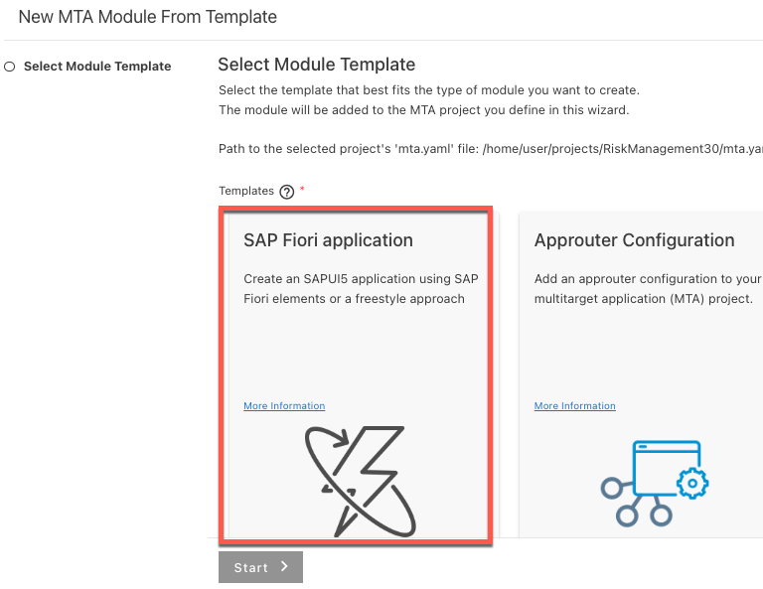
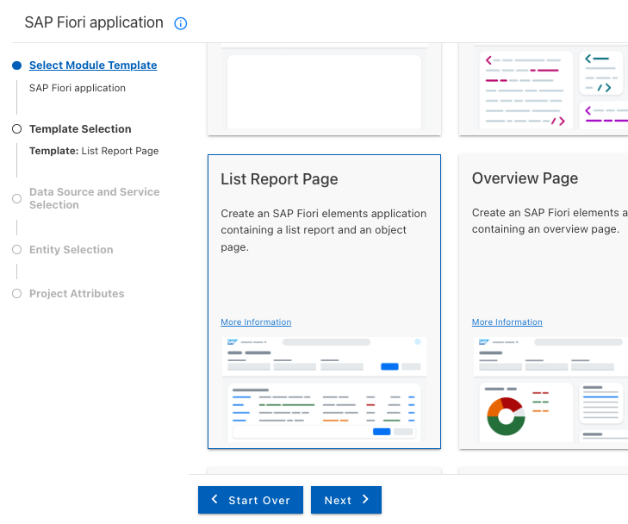
Fiori App구성
Mta.yaml >> 우클릭 >> “Create MTA Module from Template” 선택
UI 생성 – Fiori application

Slide 4
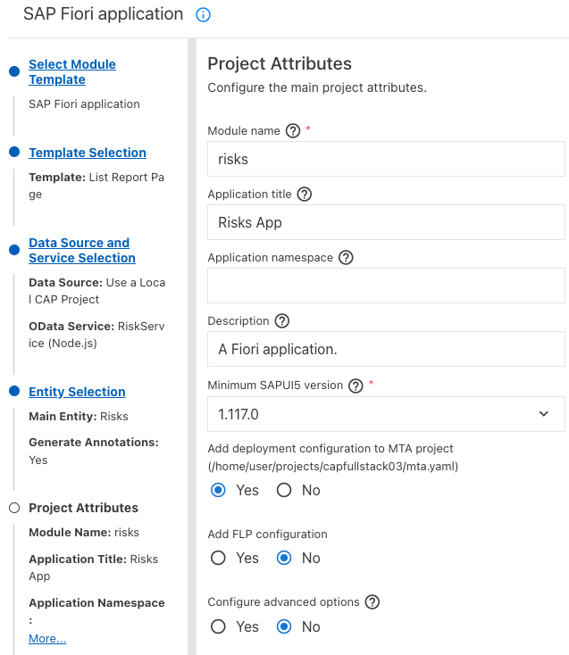
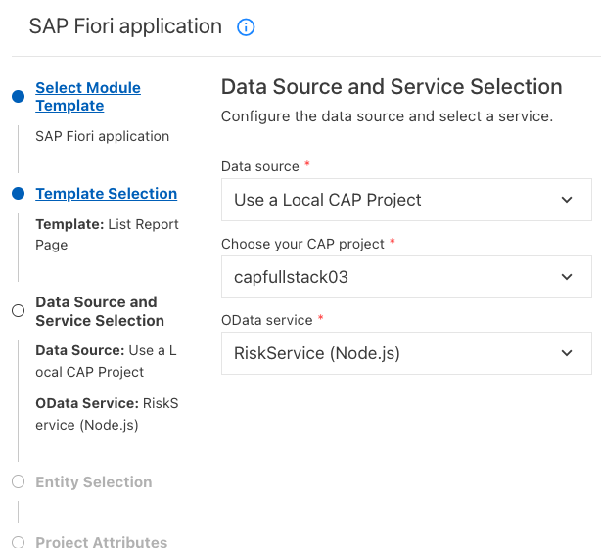
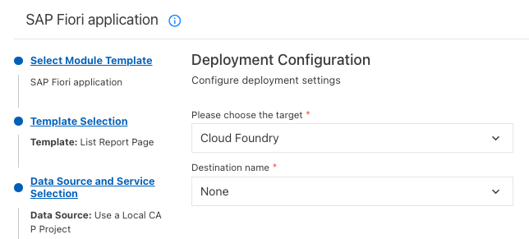
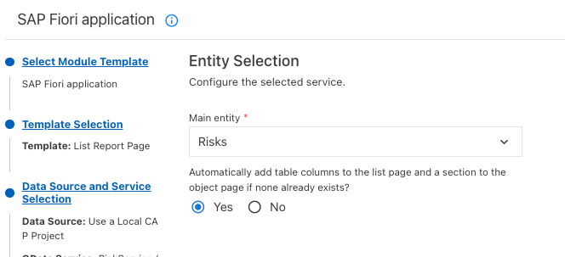
Fiori App구성
UI 생성 – Fiori application, Local CAP 선택

Slide 5
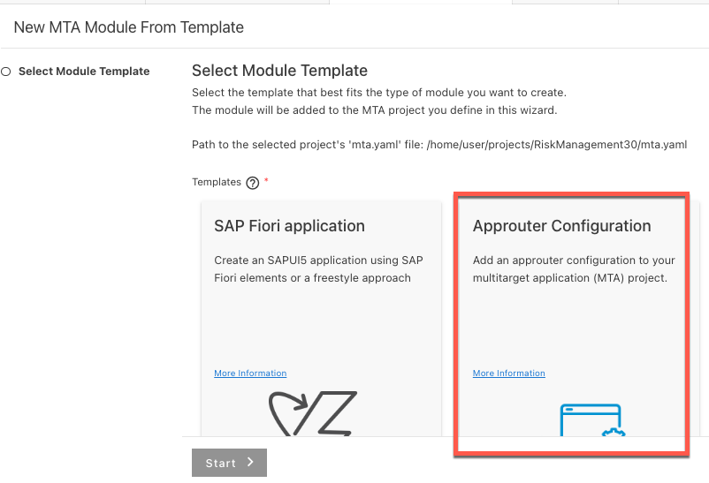
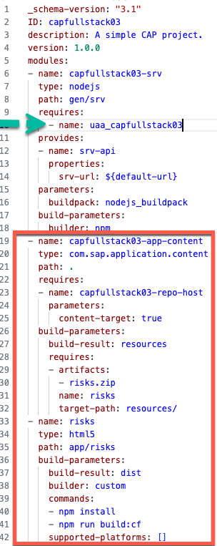
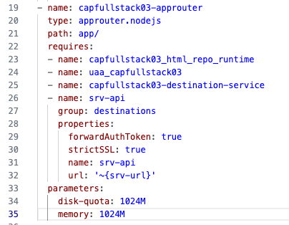
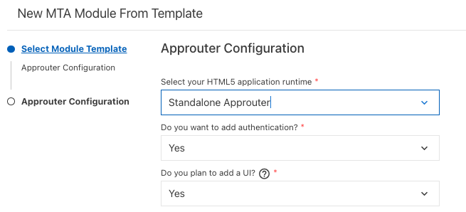
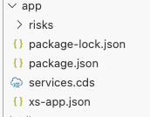
Approuter 구성
Mta.yaml >> 우클릭 >> “Create MTA Module from Template” 선택
AppRouter 구성. Mta.yaml파일 수정
Approuter 수정
추가
삭제
app/ 디렉토리 밑에 3개 파일 복사

Slide 6
AppRouter 구성
Package.json
Xs-app.json
{
"welcomeFile": "/app/risks/webapp/index.html",
"authenticationMethod": "route",
"sessionTimeout": 30,
"logout": {
"logoutEndpoint": "/do/logout",
"logoutPage": "/"
},
"routes": [
{
"source": "^/app/(.*)$",
"target": "$1",
"localDir": ".",
"authenticationType": "xsuaa"
},
{
"source": "^/(.*)$",
"target": "$1",
"destination": "srv-api",
"csrfProtection": false,
"authenticationType": "xsuaa"
}
]
}
{
"name": "approuter",
"description": "Node.js based application router service for html5-apps",
"engines": {
"node": "^16.0.0"
},
"dependencies": {
"@sap/approuter": "^14.3.0"
},
"scripts": {
"start": "node node_modules/@sap/approuter/approuter.js",
"start-local": "node node_modules/@sap/html5-repo-mock/index.js"
},
"version": "1.0.0",
"main": "index.js",
"keywords": [],
"author": "",
"license": "ISC"
}

Slide 7
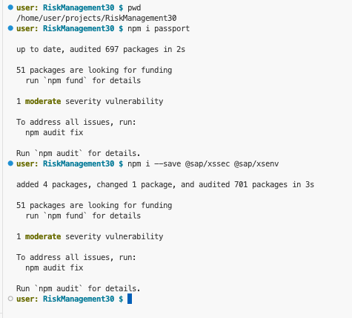
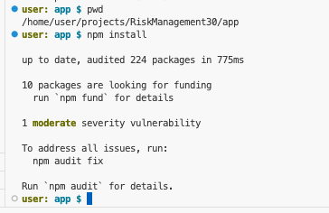
NPM install
NPM library 구성, passport, xssec, xsenv …
$>npm i sqlite3
npm WARN deprecated @npmcli/move-file@1.1.2: This functionality has been moved to @npmcli/fs
added 77 packages, and audited 650 packages in 8s
52 packages are looking for funding
run `npm fund` for details
found 0 vulnerabilities

Slide 8
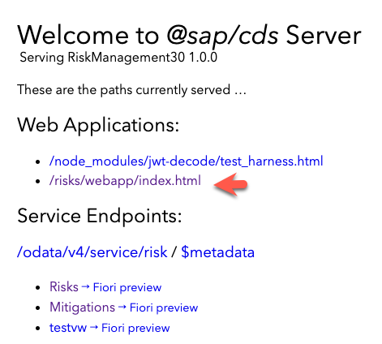
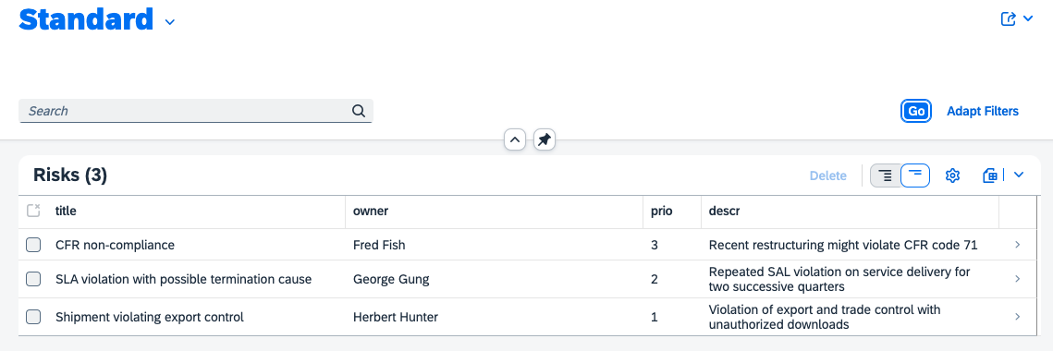
Local Testing
$>cds watch

Slide 9
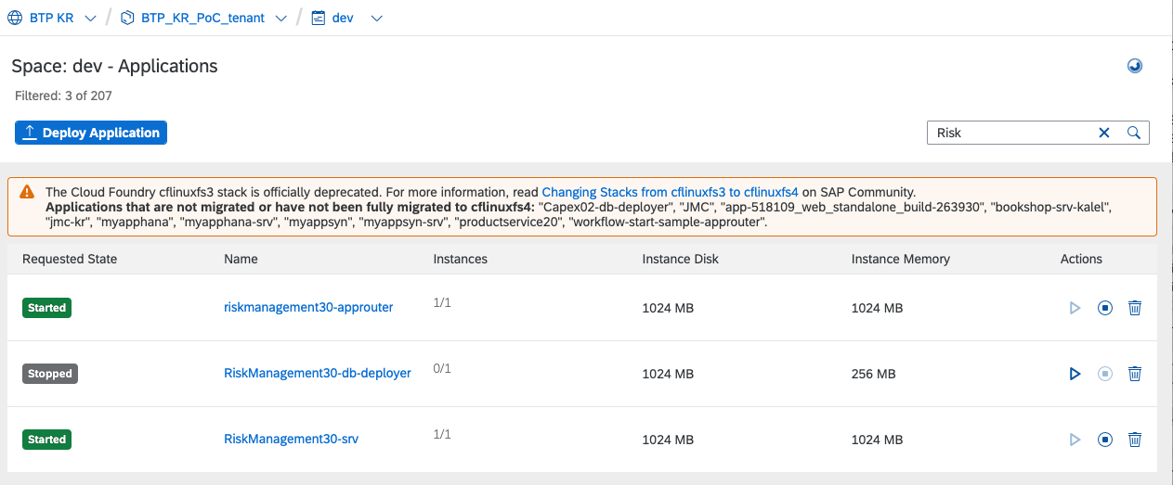
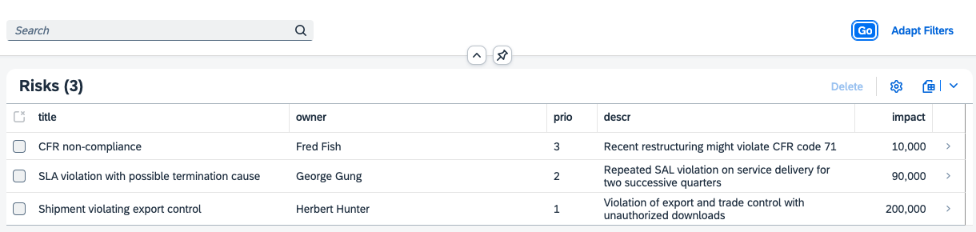
Build & Deploy & Testing
Mta.yaml파일 우클릭 → Build
Mta_archives/RiskManagement30_1.0.0.mtar 파일 확인 → 우클릭 → Deploy

