Slide 1
CAP Consume - Remote Service for Public Northwind
한 정우, SAPK

Slide 2
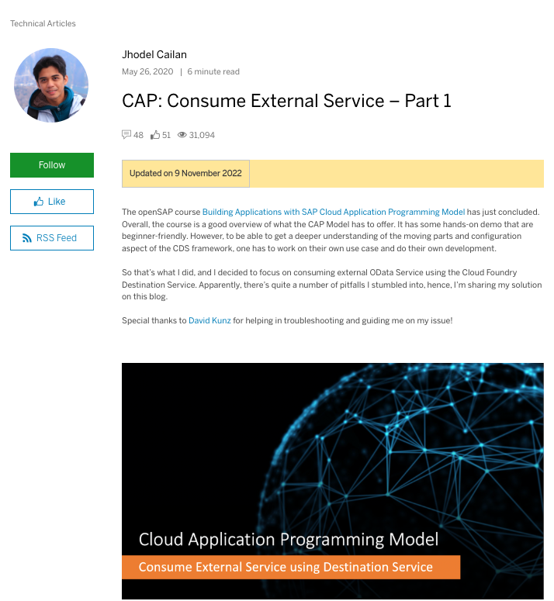
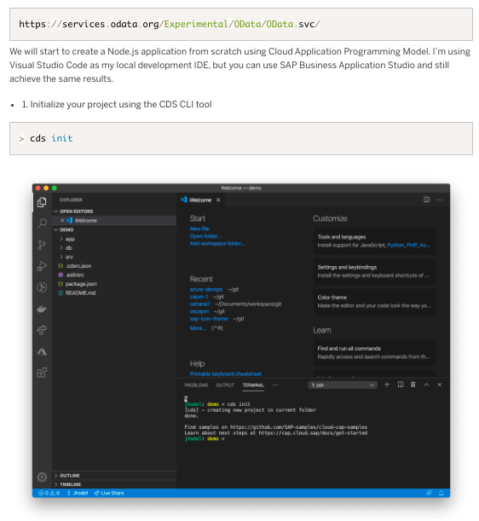
Hands-on with Speaker
https://blogs.sap.com/2020/05/26/cap-consume-external-service-part-1/

Slide 3
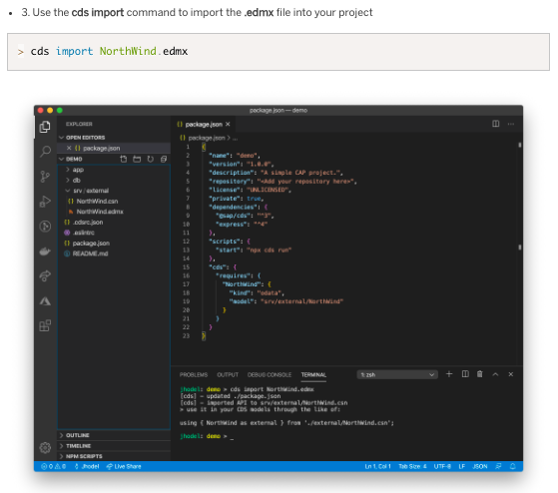
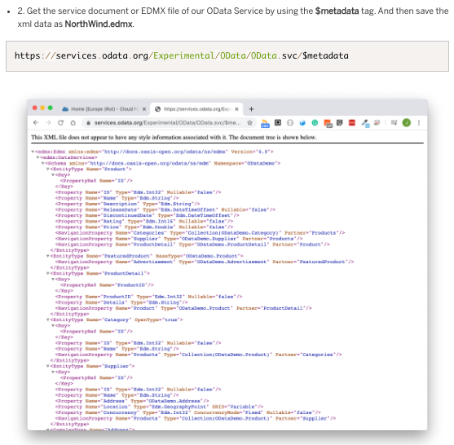

Download & Install

Slide 4
Mash-up CDS
"cds": {
"requires": {
"NorthWind": {
"kind": "odata",
"model": "srv/external/NorthWind",
"[backend]": {
"credentials": {
"url": "https://services.odata.org/Experimental/OData/OData.svc"
}
}
}
}
}
namespace ns;
entity Orders {
key ID : String(5);
owner : String(100);
products : Association to Products;
}
using {NorthWind as external} from '../srv/external/NorthWind.csn';
entity Products as projection on external.Products {
key ID, Name, Description, ReleaseDate, DiscontinuedDate, Rating, Price
};
package.json
schema2.cds
using { ns as my } from '../db/schema';
service CatalogService {
entity Orders as projection on my.Orders;
@readonly
entity Products as projection on my.Products;
}
cat-service2.cds

Slide 5
Adding custom logic – Mashup
const cds = require('@sap/cds');
module.exports = cds.service.impl(async function () {
const { Products, products } = this.entities;
const service = await cds.connect.to('NorthWind’);
this.on('READ', Products, request => {
return service.tx(request).run(request.query);
});
// Orders?$expand=products
this.on("READ", 'Orders', async (req, next) => {
if (!req.query.SELECT.columns) return next();
const expandIndex = req.query.SELECT.columns.findIndex(
({ expand, ref }) => expand && ref[0] === "products"
);
if (expandIndex < 0) return next();
// Remove expand from query
req.query.SELECT.columns.splice(expandIndex, 1);
// Make sure prodcuts_ID will be returned
if (!req.query.SELECT.columns.indexOf('*') >= 0 &&
!req.query.SELECT.columns.find(
column => column.ref && column.ref.find((ref) => ref == "products_ID"))
) {
req.query.SELECT.columns.push({ ref: ["products_ID"] });
}
const orders = await next();
const asArray = x => Array.isArray(x) ? x : [x];
// Request all associated suppliers
const productIds = asArray(orders).map(order => order.products_ID);
const products = await service.run(SELECT.from('CatalogService.Products').where({ ID: productIds }));
// Convert in a map for easier lookup
const productsMap = {};
for (const product of products)
productsMap[product.ID] = product;
// Add suppliers to result
for (const note of asArray(orders)) {
note.products = productsMap[note.products_ID];
}
return orders;
});
cat-service2.js

Slide 6
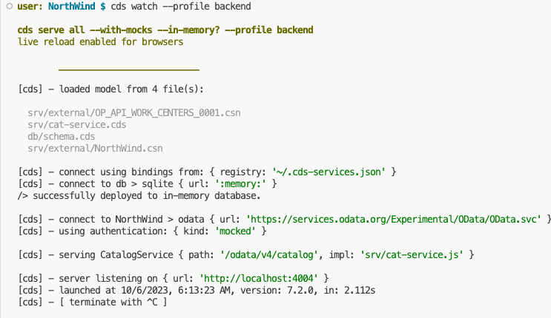
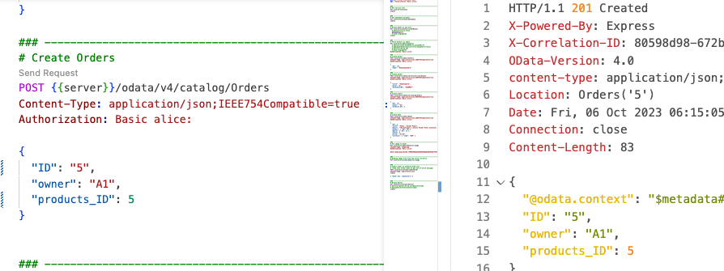
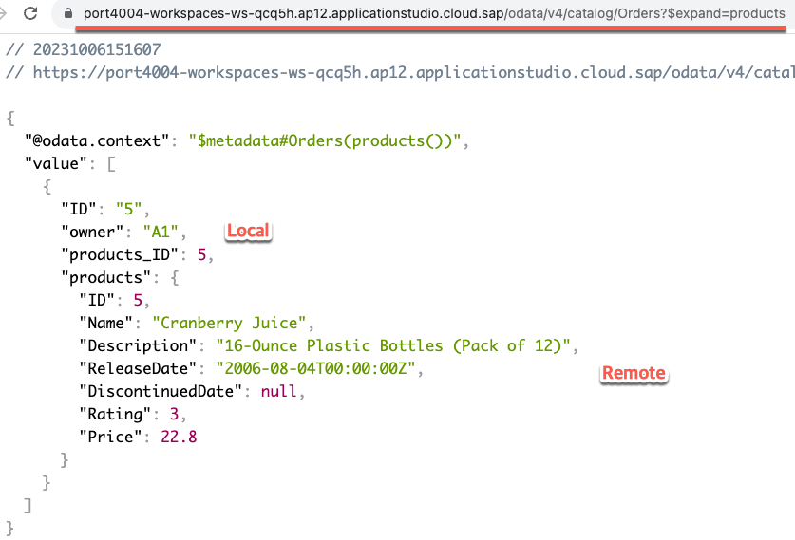
Run Mash-up CDS
POST {{server}}/odata/v4/catalog/Orders
Content-Type: application/json;IEEE754Compatible=true
Authorization: Basic alice:
{
"ID": "5",
"owner": "A1",
"products_ID": 5
}
/odata/v4/catalog/Orders?$expand=products
$>cds watch –profile backend
/odata/v4/catalog/Orders(ID='5')?$expand=products

Slide 7
CAP Consume - Remote Service for S/4HANA
한 정우, SAPK

Slide 8
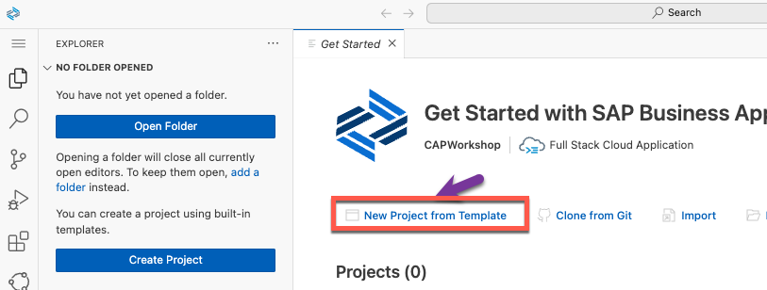
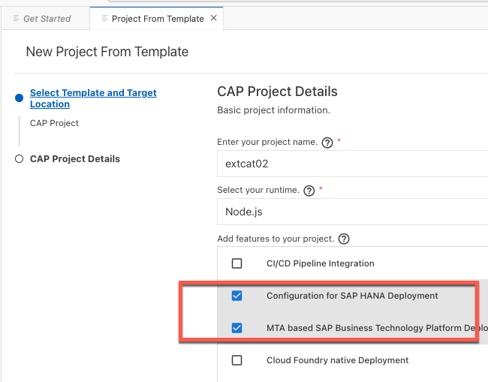
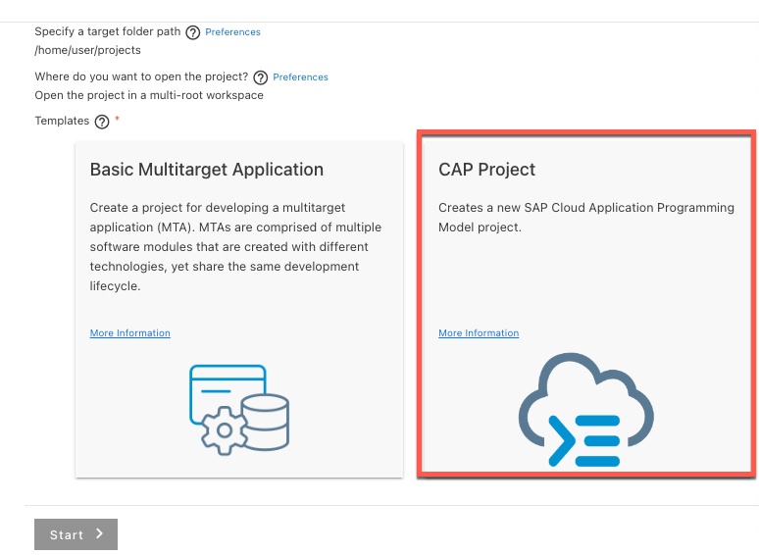
CAP Project 구성

Slide 9
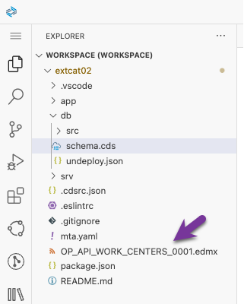
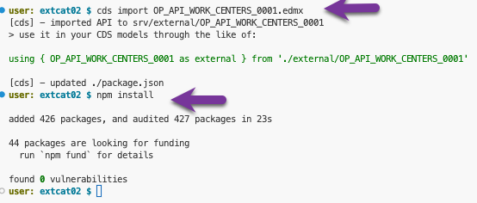
Create Remote Service
Package.json 파일 확인
"cds": {
"requires": {
"db": "hana",
"OP_API_WORK_CENTERS_0001": {
"kind": "odata-v2",
"model": "srv/external/OP_API_WORK_CENTERS_0001",
"credentials": {
"destination": "s30api2",
"path": "/sap/opu/odata/sap/API_WORK_CENTERS",
"requestTimeout": 180000000
}
}
}
}
}
Remote 시스템의 edmx 파일(OData metadata)을 복사
Cds import를 수행해, CSN 수행.

Slide 10
Firewall
S/4
On-premise
Cloud Connector
Destination
S/4
Pulic Cloud

Slide 11
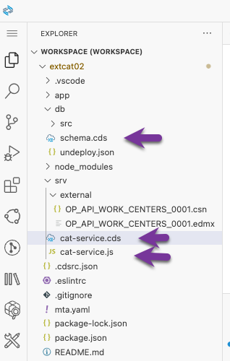
Data & Service modeling 내용 확인
cat-service.js
const cds = require('@sap/cds');
module.exports = cds.service.impl(async function() {
const { A_WorkCenters } = this.entities;
const service = await cds.connect.to('OP_API_WORK_CENTERS_0001');
this.on('READ', A_WorkCenters, request => {
return service.tx(request).run(request.query);
});
});
schema.cds
namespace sap.ui.riskmanagement;
using { managed } from '@sap/cds/common';
entity Risks : managed {
key ID : UUID @(Core.Computed : true);
title : String(100);
owner : String;
prio : String(5);
descr : String;
miti_id : UUID;
miti : Association to Mitigations
on miti.ID = miti_id;
impact : Integer;
criticality : Integer;
}
entity Mitigations : managed {
key ID : UUID @(Core.Computed : true);
description : String;
owner : String;
timeline : String;
risks : Association to many Risks on risks.miti_id= ID;
}
cat-service.cds
using { OP_API_WORK_CENTERS_0001 as WC_API } from './external/OP_API_WORK_CENTERS_0001';
using { sap.ui.riskmanagement as my } from '../db/schema';
service WCService @(requires:'any'){
entity A_WorkCenters as projection on WC_API.A_WorkCenters {
WorkCenterInternalID, WorkCenter
};
entity Risks as projection on my.Risks;
entity Mitigations as projection on my.Mitigations;
view testvw as
select A.impact, B.owner
from my.Risks as A
inner join my.Mitigations as B
on A.miti_id = B.ID
}

Slide 12
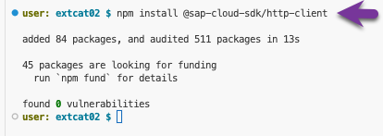
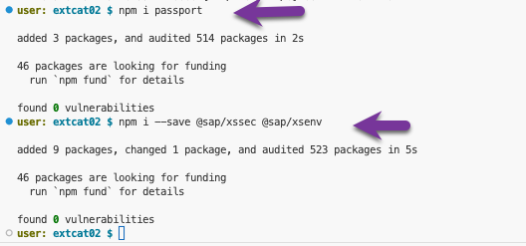
NPM library setup
NPM library 구성
구성 후, package.json 확인
….
"dependencies": {
"@sap-cloud-sdk/http-client": "^3.4.0",
"@sap/cds": "^7",
"@sap/cds-hana": "^2",
"@sap/xsenv": "^4.0.0",
"@sap/xssec": "^3.3.3",
"express": "^4",
"passport": "^0.6.0"
},
"devDependencies": {
"@cap-js/sqlite": "^1",
"@sap/cds-dk": "^7"
},
"scripts": {
"start": "cds-serve"
},
"cds": {
"requires": {
"db": "hana",
"OP_API_WORK_CENTERS_0001": {
"kind": "odata-v2",
"model": "srv/external/OP_API_WORK_CENTERS_0001",
"credentials": {
"destination": "s30api2",
"path": "/sap/opu/odata/sap/API_WORK_CENTERS",
"requestTimeout": 180000000
}
}
}
}
}

Slide 13
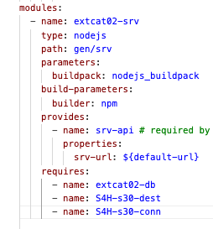
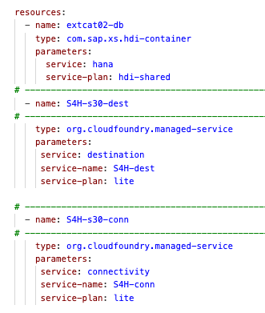
배포파일 구성(mta.yaml)
Mta.yaml
_schema-version: '3.1'
ID: extcat02
version: 1.0.0
description: "A simple CAP project."
parameters:
enable-parallel-deployments: true
build-parameters:
before-all:
- builder: custom
commands:
- npx cds build --production
modules:
- name: extcat02-srv
type: nodejs
path: gen/srv
parameters:
buildpack: nodejs_buildpack
build-parameters:
builder: npm
provides:
- name: srv-api # required by consumers of CAP services (e.g. approuter)
properties:
srv-url: ${default-url}
requires:
- name: extcat02-db
- name: S4H-s30-dest
- name: S4H-s30-conn
- name: extcat02-db-deployer
type: hdb
path: gen/db
parameters:
buildpack: nodejs_buildpack
requires:
- name: extcat02-db
resources:
- name: extcat02-db
type: com.sap.xs.hdi-container
parameters:
service: hana
service-plan: hdi-shared
# ------------------------------------------------------------
- name: S4H-s30-dest
# ------------------------------------------------------------
type: org.cloudfoundry.managed-service
parameters:
service: destination
service-name: S4H-dest
service-plan: lite
# ------------------------------------------------------------
- name: S4H-s30-conn
# ------------------------------------------------------------
type: org.cloudfoundry.managed-service
parameters:
service: connectivity
service-name: S4H-conn
service-plan: lite
destination, connectivity 인스턴스 생성을 위해, Mta.yaml파일에 내용 추가

Slide 14
CF runtime에 배포(Build & Deploy & Run)
Build : Mta.yaml파일 우클릭 후, ”Build MTA Project” 수행
Deploy: CF Login 수행. $HOME\mta_archive\sample.mtar 파일 우클릭 후, “Deploy MTA Archive” 수행
Run: 배포 후, 정상적인 OData 수행 확인.

Slide 15
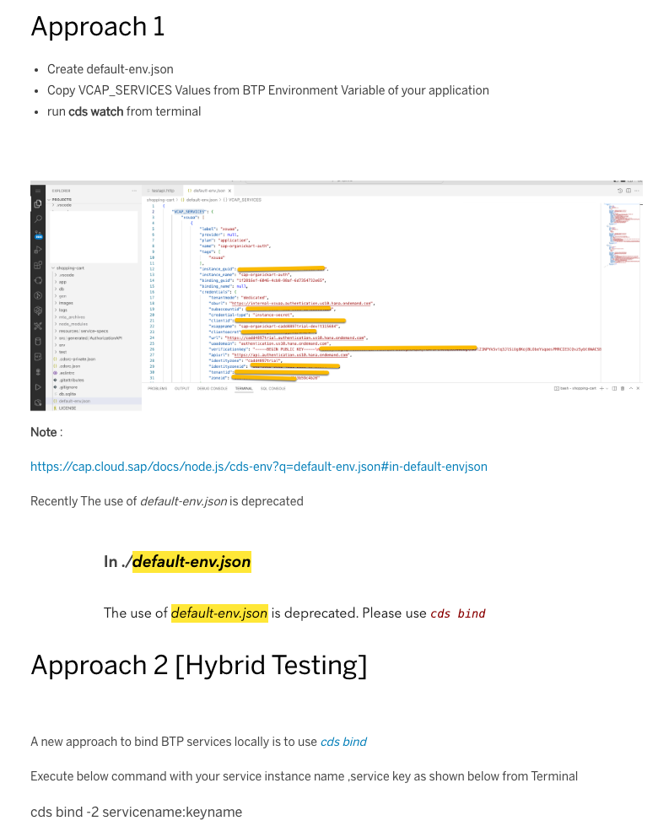
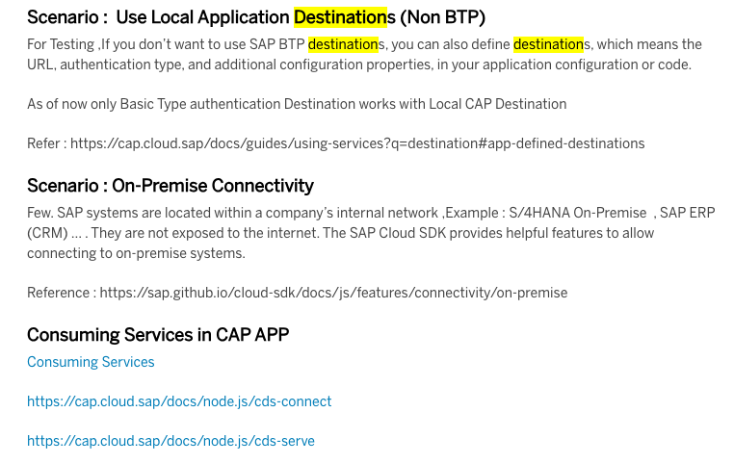
로컬에서 수행(가이드)
로컬에서 수행하기 위해서는, default-env.json파일 생성.
혹은 새로운 cds bind 수행
아래 블러그 참조:
BTP CAP : How to Connect to Remote Services Locally in CAP Application

Slide 16
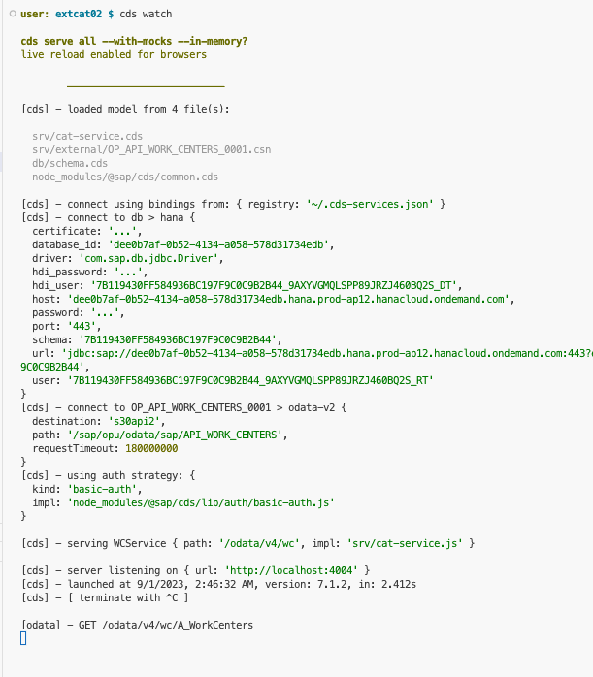
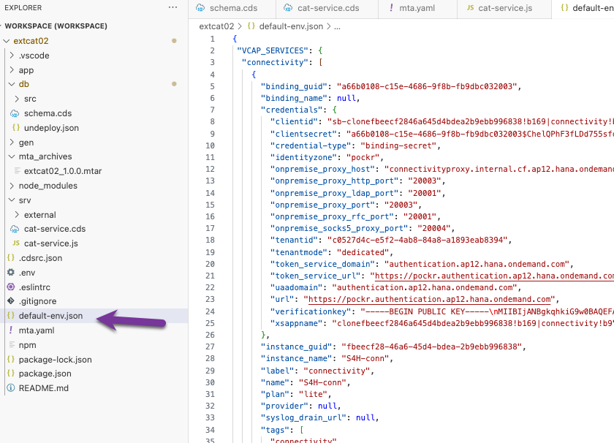
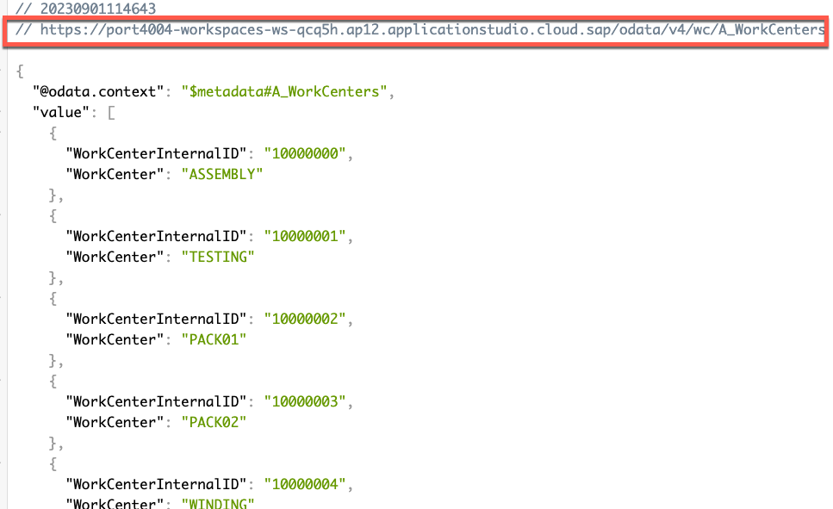
로컬에서 수행(Approach-1)
cds watch 수행.
ERP 데이타 확인(Remote 서비스 수행 결과 확인)
$>cf env service-name > default-env.json
혹은, CF Space의 환경 변수에서 복사해도 됨. ➔ 다음 장 참조

Slide 17
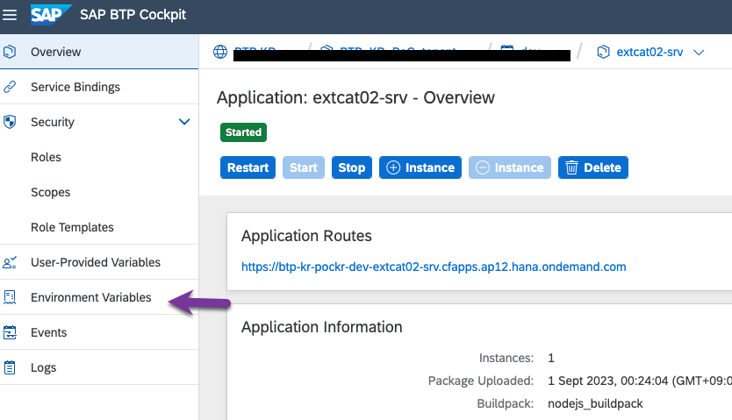
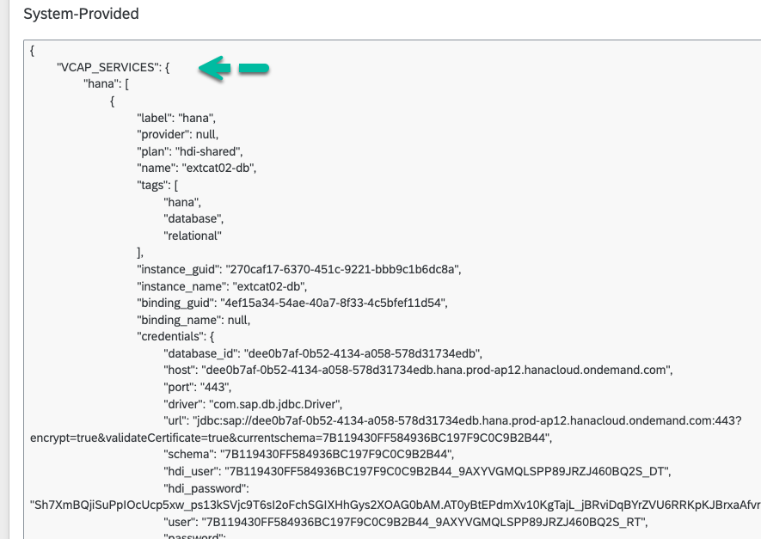
VCAP_Service 확인.
혹은, CF Space의 환경 변수에서 복사해도 됨.

Slide 18
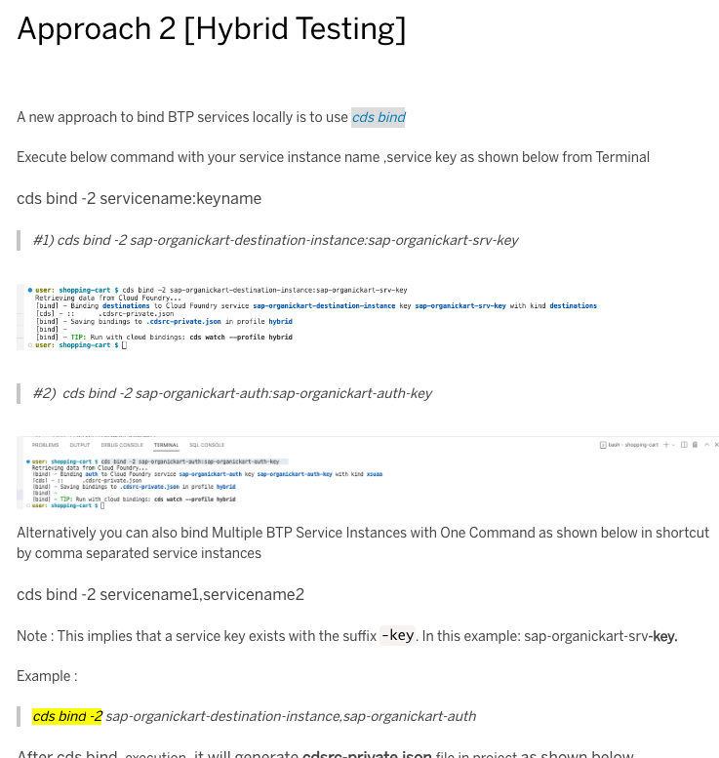
로컬에서 수행(Approach-2)
수행 로그 참조
user: extcap01 $ cf create-service-key extcap01-db extcap01-sk
Creating service key extcap01-sk for service instance extcap01-db as jungwoo.han@sap.com...
OK
user: extcap01 $ cds bind -2 extcap01-db:extcap01-sk
Retrieving data from Cloud Foundry...
Binding db to Cloud Foundry managed service extcap01-db:extcap01-sk with kind hana-cloud
Saving bindings to .cdsrc-private.json in profile hybrid
TIP: Run with cloud bindings: cds watch --profile hybrid
user: extcap01 $ cf create-service-key S4H-conn S4H-conn-sk
Creating service key S4H-conn-sk for service instance S4H-conn as jungwoo.han@sap.com...
OK
user: extcap01 $ cds bind -2 S4H-conn:S4H-conn-sk
Retrieving data from Cloud Foundry...
Binding custom-service:S4H-conn to Cloud Foundry managed service S4H-conn:S4H-conn-sk
Saving bindings to .cdsrc-private.json in profile hybrid
TIP: Run with cloud bindings: cds watch --profile hybrid
user: extcap01 $ cf create-service-key S4H-dest S4H-dest-sk
Creating service key S4H-dest-sk for service instance S4H-dest as jungwoo.han@sap.com...
OK
user: extcap01 $ cds bind -2 S4H-dest:S4H-dest-sk
Retrieving data from Cloud Foundry...
Binding destinations to Cloud Foundry ma
Saving bindings to .cdsrc-private.json in profile hybrid
TIP: Run with cloud bindings: cds watch --profile hybrid
user: extcap01 $ cds watch --profile hybrid
cds serve all --with-mocks --in-memory? --profile hybrid
live reload enabled for browsers
resolving cloud service bindings...
bound db to Cloud Foundry managed service extcap01-db:extcap01-sk
bound destinations to Cloud Foundry managed service S4H-dest:S4H-dest-sk
bound custom-service:S4H-conn to Cloud Foundry managed service S4H-conn:S4H-conn-sk

Slide 19
Error 발생시
발생 로그 : <message>Error during request to remote service: connect ETIMEDOUT 10.0.4.5:20003</message>
노츠 참조 : 3112360 - 502 error connecting to backend OData from CAP project in BAS
.env 파일에 아래와 같이 destination 정보 표기.
destinations=[{"name":"s30api2","proxyHost":"http://127.0.0.1","proxyPort":"8887","url":"http://s30api2.dest"}]
Curl 명령 수행.
$>curl http://localhost:8887/reload

