Slide 1
CAP Consume - Remote Service for S/4H Public Cloud
한 정우, SAPK

Slide 2
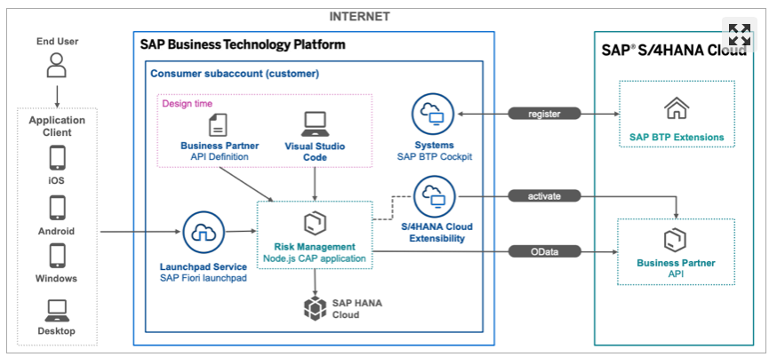
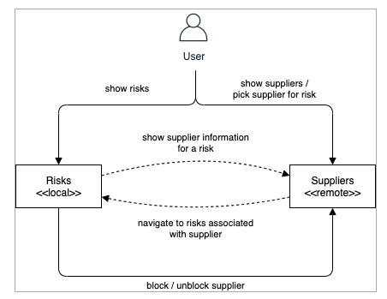
Consume Remote Services from S/4HANA Coud Using CAP
https://developers.sap.com/mission.btp-consume-external-service-cap.html

Slide 3
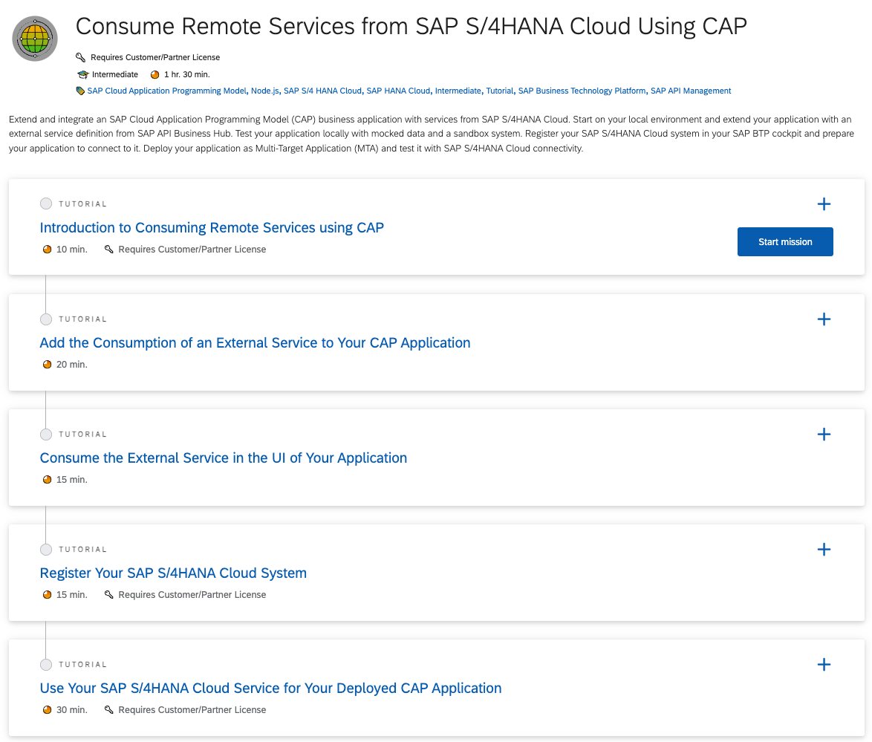
Consume Remote Services from S/4HANA Coud Using CAP
https://developers.sap.com/mission.btp-consume-external-service-cap.html
https://github.com/micol92/s4hanacloudext/blob/main/srv/cat-service.cds ➔ Data/Service 모델링 참조
CAP sample download : Prerequisite 부분 참조. (cds, csv 파일등 copy/paste)
https://github.com/micol92/s4hanacloudext/blob/main/srv/cat-service-ui.cds ➔ UI annotation 참조.
Service mash-up 구성. Service mash-up후, 아래 링크 수행가능.
/odata/v4/service/risk/Risks?$expand=supplier
BTP 에 S/4HANA Cloud 등록. BTP Global account 권한 필요.
BTP 에 S/4HANA Cloud connectivity 구성.
MTA 파일 생성 및 CF에 배포.
배포 후, BTP에서 s4-hana-cloud instance생성 확인. (Page #6 참조)
배포 후, S/4HANA Public Cloud - Communication Arrangement 에서 확인 가능. (Page #6 참조)

Slide 4
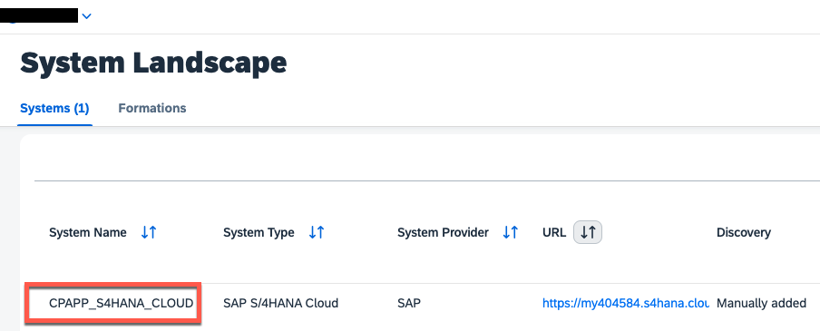
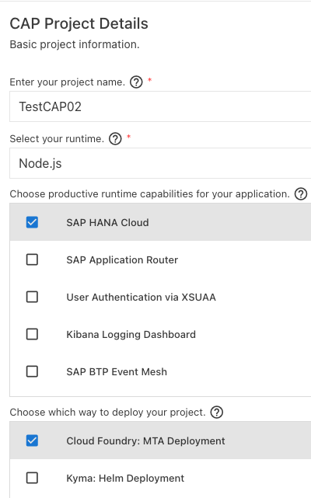
BTP side
Register Your SAP S/4HANA Cloud System
CAP project 생성 – Template이용
필수 - NPM component install
$>npm install @sap-cloud-sdk/http-client @sap-cloud-sdk/util
$>npm i passport
$>npm i @sap/xsenv @sap/xssec
System name 은 뒷부분에서 활용.

Slide 5
주요 구성 요소
데모 파일
https://github.com/micol92/s4hanacloudext
※ 아래 destination정보는 배포시 자동생성됨.
BTP Cockpit에서 만들 필요 없음.
bupa-service-config.json
mta.yaml
package.json
{
"systemName": "CPAPP_S4HANA_CLOUD",
"communicationArrangement": {
"communicationArrangementName": "CPAPP_COM_0008",
"scenarioId": "SAP_COM_0008",
"inboundAuthentication": "BasicAuthentication",
"outboundAuthentication": "BasicAuthentication",
"outboundServices": [
{
"name": "Replicate Customers from S/4 System to Client",
"isServiceActive": false
},
{
"name": "Replic
….
- name: TestCAP01-bupa
type: org.cloudfoundry.managed-service
parameters:
skip-service-updates:
plan: true
parameters: true
tags: true
service: s4-hana-cloud
service-plan: api-access
system-name: CPAPP_S4HANA_CLOUD
path: ./bupa-service-config.json
config:
systemName: CPAPP_S4HANA_CLOUD
"cds": {
"requires": {
"db": "sql",
"API_BUSINESS_PARTNER_0001": {
"kind": "odata-v2",
"model": "srv/external/API_BUSINESS_PARTNER_0001",
"[sandbox]": {
"credentials": {
"headers": {
"APIKey": "U3fwL3AfmJyu7SCDpDVxoPERL0wevZgS"
},
"url": "https://sandbox.api.sap.com/s4hanacloud/sap/opu/odata/sap/API_BUSINESS_PARTNER/"
}
},
"[production]": {
"credentials": {
"path": "/sap/opu/odata/sap/API_BUSINESS_PARTNER",
"destination": "TestCAP01-bupa"
}
}
},
"API_SALES_ORDER_SRV": {
"kind": "odata-v2",
"model": "srv/external/API_SALES_ORDER_SRV",
"csrf": true,
"csrfInBatch": true,
"[production]": {
"credentials": {
"path": "/sap/opu/odata/sap/API_SALES_ORDER_SRV",
"destination": "TestCAP01-salesorder",
"csrf": true,
"csrfInBatch": true
}
}
}
}
}
※ Web Page의 Text예제 copy/paste시 garbage값 입력가능

Slide 6
Deploy & Undeploy
$>mbt build –t ./
$>cf deploy TestCAP01_1.0.0.mtar
--> 재배포시, s4-hana-cloud 서비스 에러 발생 할 수 있음. ( Warning 메시지 )
Error determining actions to execute on service "TestCAP01-bupa": Controller operation failed: 502 Error determining actions to execute on service "TestCAP01-bupa": CF-ServiceBrokerBadResponse(10001): Service broker error: Service broker s4-service-broker failed with: Internal server error
Proceeding with automatic retry... (2 of 3 attempts left)
--(관련해서 메뉴얼 참조)
The service doesn’t support updates, to avoid errors in subsequent deployments the skip-service-updates option is activated. This means if you want to change the service settings, that you need to delete and newly create the service instance manually.
-- 다음과 같이 재배포시 에러로그가 없어짐.
Processing service "TestCAP01-bupa"...
Setting service "TestCAP01-bupa" parameters from "bupa-service-config.json"
Service parameters for service "TestCAP01-bupa" will not be updated, as the option for skipping service parameter updates is enabled.
-- 참고로 undeploy
$>cf undeploy TestCAP01 --delete-service-keys --delete-services

Slide 7
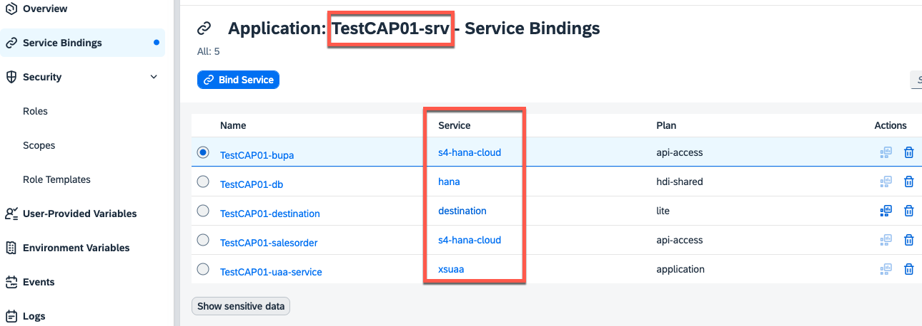
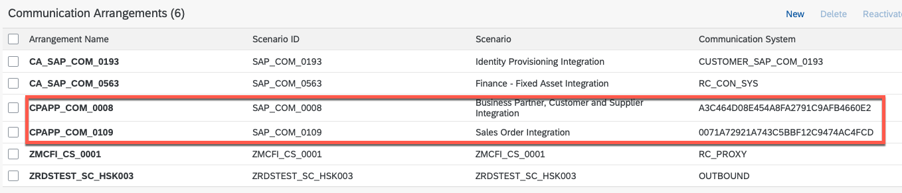
Deploy & Undeploy
Custom Application & Service Bindings
Communication Arrangement @S/4HANA Public Cloud

Slide 8
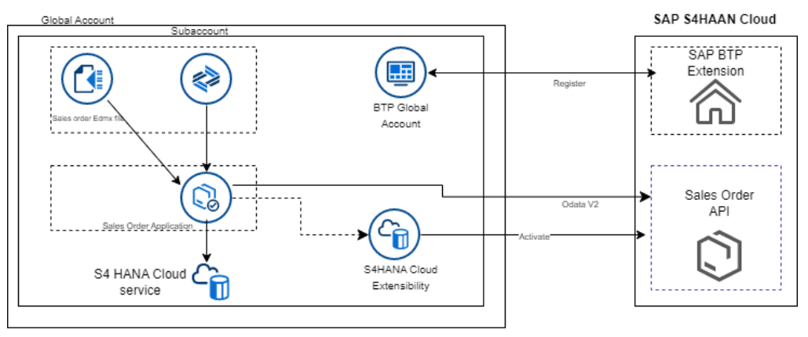
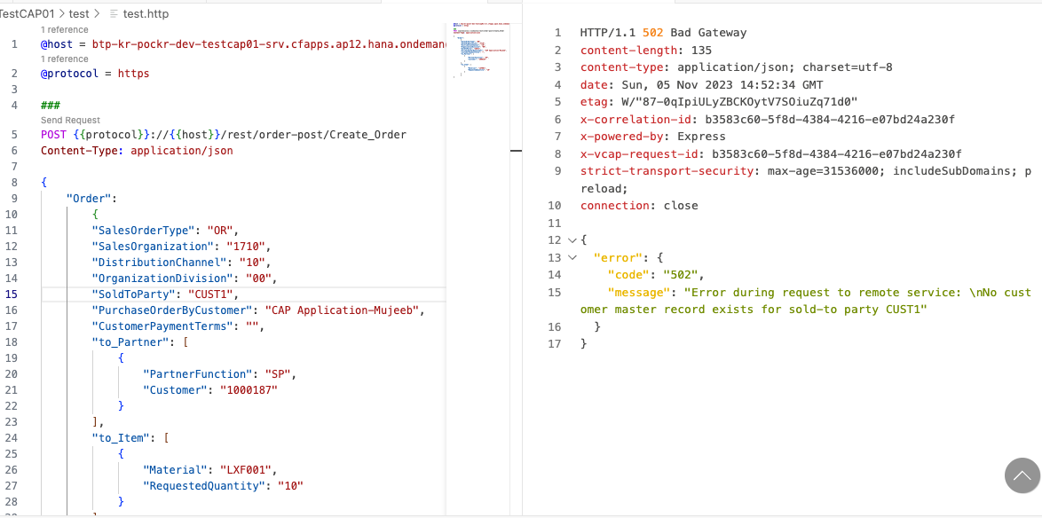
유사한 blog 참조 – Sales Order 처리
Blog는 BTP CAP에서 S/4HANA Public Cloud Sales Order 생성을 수행할 수 있는 가이드입니다.
구현된(working) 데모 소스는 링크 참조
CAP Service to Fetch + Create Sales Order in S4 HANA Public Cloud
SO 생성테스트는 오류 ➔ Master data 값의 오류로 발생.
※ Web Page의 Text예제 copy/paste시 garbage값 입력가능

Slide 9
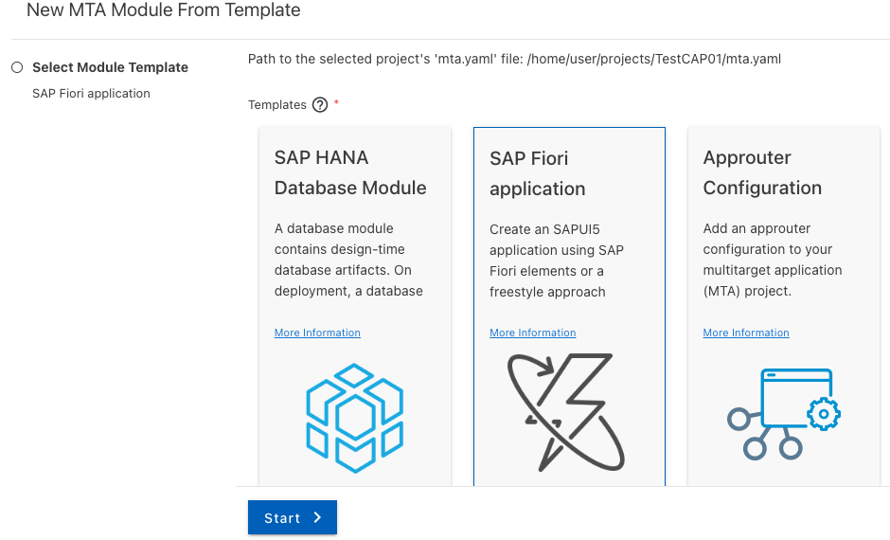
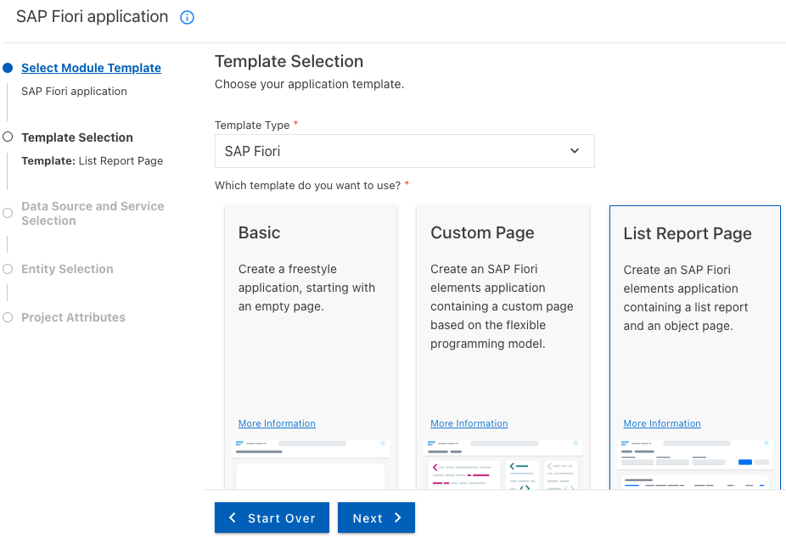
User Interface – Fiori App(w/ element)

Slide 10
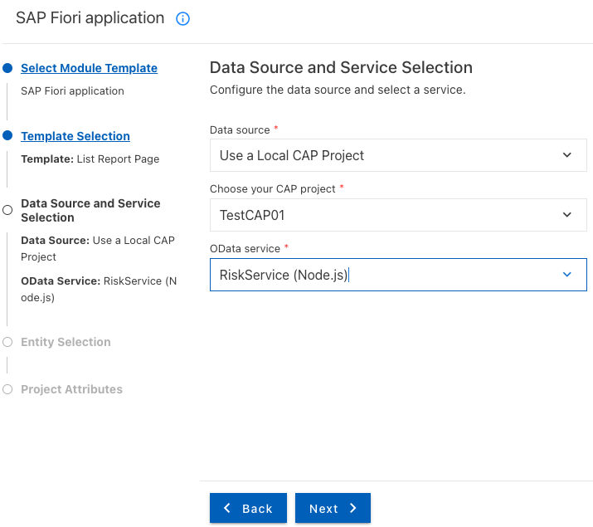
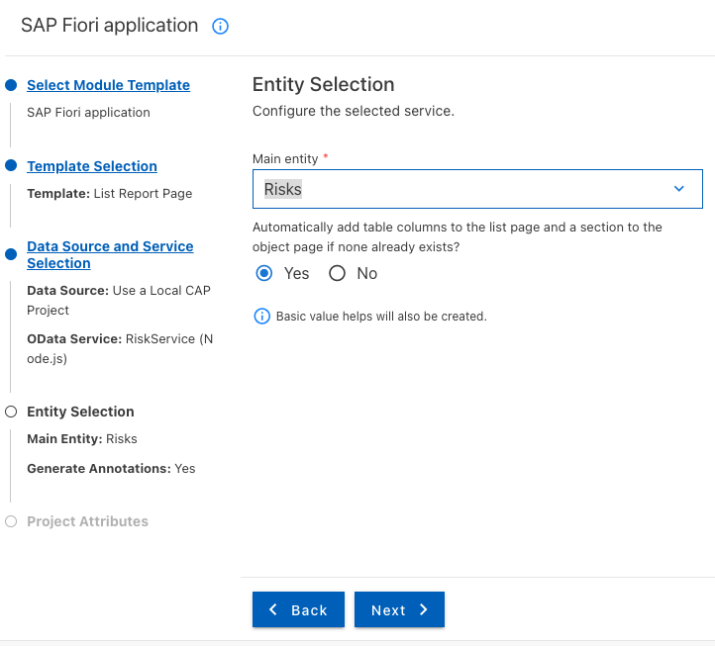
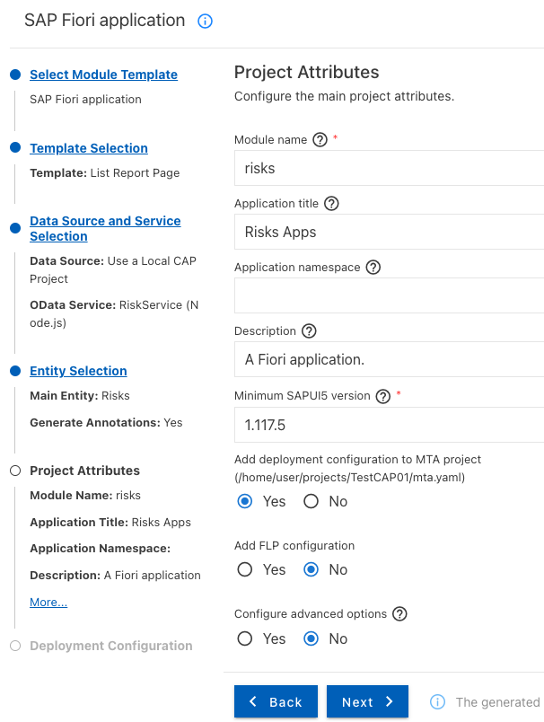
User Interface

Slide 11
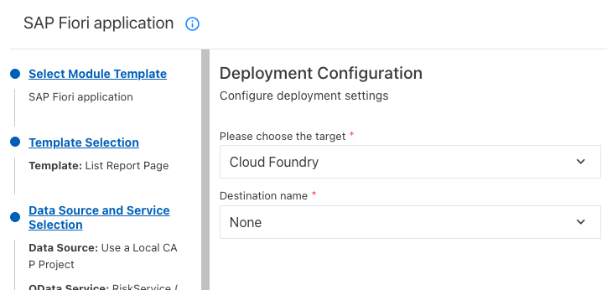
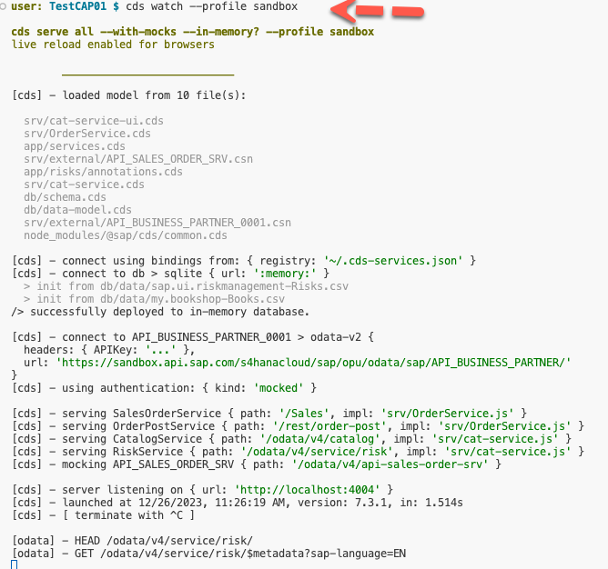
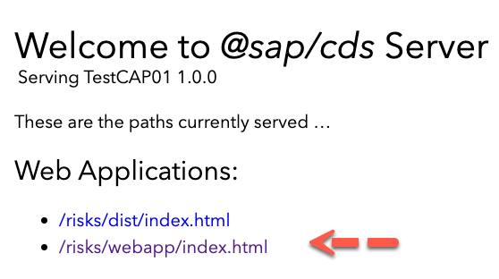
User Interface

Slide 12
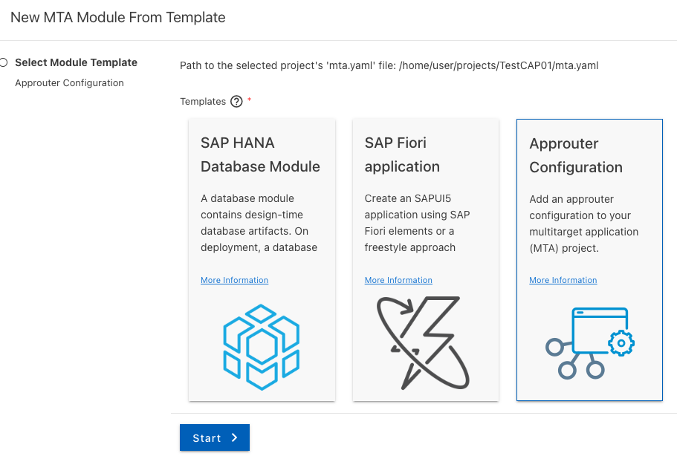
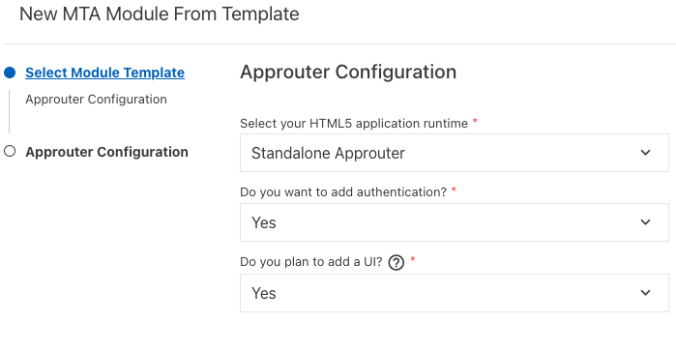
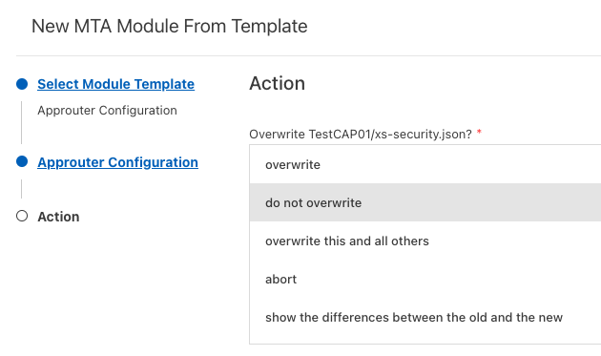
User Interface – AppRouter

Slide 13
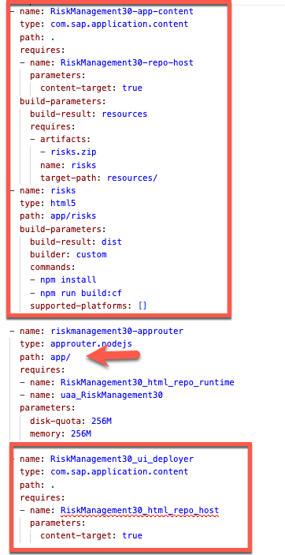
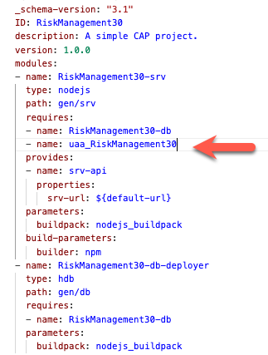
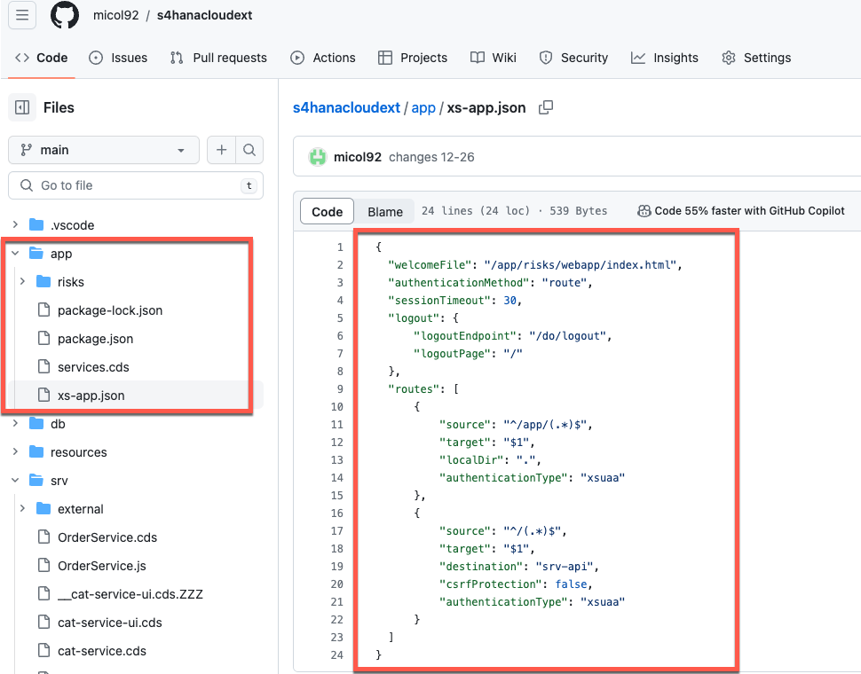
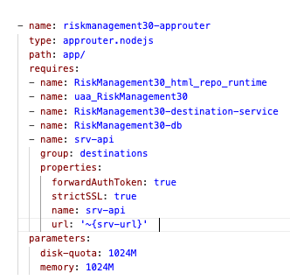
AppRouter 구성
AppRouter 구성. Mta.yaml파일 수정
AppRouter 파일 이동
https://github.com/micol92/s4hanacloudext/blob/main/mta.yaml ➔ 참조
삭제
https://github.com/micol92/s4hanacloudext/tree/main/app
삭제

Slide 14
AppRouter 구성
https://github.com/micol92/s4hanacloudext/blob/main/app/xs-app.json ➔ 참조
Package.json
Xs-app.json
{
"welcomeFile": "/app/risks/webapp/index.html",
"authenticationMethod": "route",
"sessionTimeout": 30,
"logout": {
"logoutEndpoint": "/do/logout",
"logoutPage": "/"
},
"routes": [
{
"source": "^/app/(.*)$",
"target": "$1",
"localDir": ".",
"authenticationType": "xsuaa"
},
{
"source": "^/(.*)$",
"target": "$1",
"destination": "srv-api",
"csrfProtection": false,
"authenticationType": "xsuaa"
}
]
}
{
"name": "approuter",
"description": "Node.js based application router service for html5-apps",
"engines": {
"node": "^16.0.0"
},
"dependencies": {
"@sap/approuter": "^14.3.0"
},
"scripts": {
"start": "node node_modules/@sap/approuter/approuter.js",
"start-local": "node node_modules/@sap/html5-repo-mock/index.js"
},
"version": "1.0.0",
"main": "index.js",
"keywords": [],
"author": "",
"license": "ISC"
}

Slide 15
Git command
$>git add .
$>git commit –m “added or revised code”
$>git push –u origin main
Reference Link

