Slide 1
SAP BTP 개발 프레임워크 Hands-on
SAP BTP Cloud native 개발 프레임워크인 CAP(Cloud Application Programming)와 SAP UI 표준인 Fiori App개발에 대한 이해와 주요 시나리오를 실습합니다.
사전 준비 : ① Get a Free Account on SAP BTP trial. → Click Here ② Set Up SAP Business Application Studio for Development → Click Here
■ 워크샵 아젠다 및 일정표 (09:00 ~ 16:20)
주 제 | 상세 내용 | 시간 | 기술 워크샵 사용 환경 | 참석자 준비 사항
1. SK Inc | BTP Architecture 공유 서비스별 역할등 전체 아키텍쳐 이해 | 14:00~15:00(60분) | PPT 설명 | 노트북 지참 (Chrome 브라우저 사용)
Break time |  | 14:00~15:20(20분)
2. Hands-on | BAS 이해, CAP & UI Microservice 구성 | 15:20~16:30(70분) | PPT 설명, Demo & Hands-0n
Break time |  | 16:30~16:50(20분)
3. Hands-on | CAP Best Practices 이해 Q&A | 16:50~18:00(70분) | PPT 설명, Demo & Hands-on
CAP Best Practice ➔ 링크 BTP Best Practice ➔ 링크 참조
Fiori Freestyle Example ➔ 링크 Fiori Element example ➔ 링크 참조
Notes:
- BAS 환경
-Fiori elements 샘플
-CAP (Cloud App Programming)샘플
-CDS (Core Data Service) 샘플

Slide 2
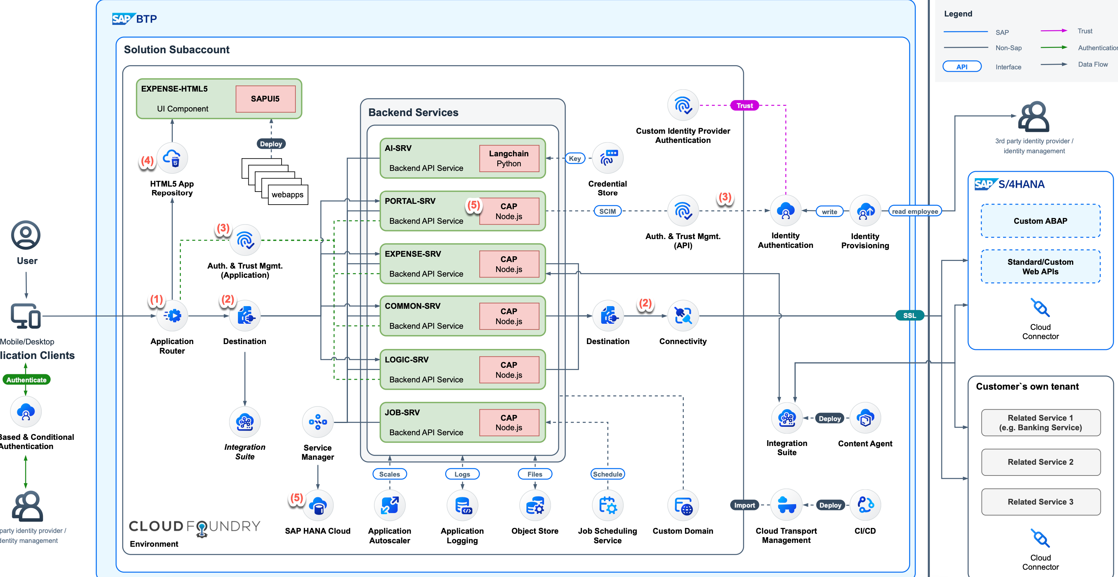
SK Inc - BTP Architecture

Slide 3




Application Router
MS-AD
SAML 2.0-Compliant Identity Provider (IdP)
Trust
IdP Federation
BTP
Trust
Service Provider
Business Application
Web Browser
Application Router
XSUAA Service Instance
XSUAA Service
route
espm
msa-srv
Other Service(s) Instance
Other Service(s)
Business User
Service Binding

Slide 4
Application Router
The application router is the single point-of-entry for an application running in the Cloud Foundry environment on SAP BTP. The application router is used to serve static content, authenticate users, rewrite URLs, and forward or proxy requests to other micro services while propagating user information.
애플리케이션 라우터는 SAP BTP의 클라우드 파운드리 환경에서 실행되는 애플리케이션의 단일 진입 지점입니다. 애플리케이션 라우터는 정적 콘텐츠를 제공하고, 사용자를 인증하고, URL을 다시 작성하고, 사용자 정보를 전파하면서 다른 마이크로 서비스에 요청을 전달하거나 프록시하는 데 사용됩니다.
AppRouter 의 주요 역할
Dispatch requests to back-end microservices (reverse proxy)
Authenticate users
Serve static content
In multitenancy scenarios, derive the tenant information from the URL and forward the information to the XS UAA service so that the authentication request is redirected to the appropriate tenant-specific Identity Provider (IdP), for example,using SAML “Bearer Assertions”.
Notes:
https://help.sap.com/docs/btp/sap-business-technology-platform/application-router-configuration

Slide 5
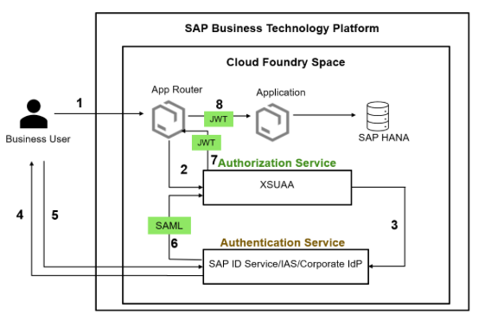
Application Router – 사용자 인증
Notes:
https://community.sap.com/t5/technology-blogs-by-sap/fundamentals-of-security-in-btp-implement-authentication-and-authorization/ba-p/13543320

Slide 6





Application Router + XSUAA Service - 사용자 권한 관리
Scope: For functional authorization checks
Attribute: For instance-based (data) authorizations (e.g. the name of a cost center)
Role template: Description of roles (for example, “employee” or “manager”) to apply to a user and any attributes that apply to the roles
Roles: Are created based on role templates at configuration time in the SAP Cloud Platform / XSA Cockpit
Role
configuration time
design time
Role Template
Scope
Attribute

Slide 7


Application Router + XSUAA Service - 사용자 권한 관리
Role
configuration time
Role Collection
design time
is assigned to
(static OR federated assignment)
Role Template
is assigned to
(static assignment)
Scope
Attribute
Business User
Role

Slide 8
Hands-on
Fundamentals of Security in BTP: Implement Authentication and Authorization in a Node.js App
Notes:
https://community.sap.com/t5/technology-blogs-by-sap/fundamentals-of-security-in-btp-implement-authentication-and-authorization/ba-p/13543320

Slide 9
Microservice Architecture & Hands-on
BTP – CF Runtime
App Router
Frontend : https://github.com/micol92/microapp02
UI5 App
Backend CAP : https://github.com/micol92/microcap02
Required resource : Same-UAA
Destination : Authentication(OAuth2UserTokenExchange)
CAP-SRV01
CAP-SRV02
Required resource : Same-UAA
Required resource : Same-UAA

Slide 10
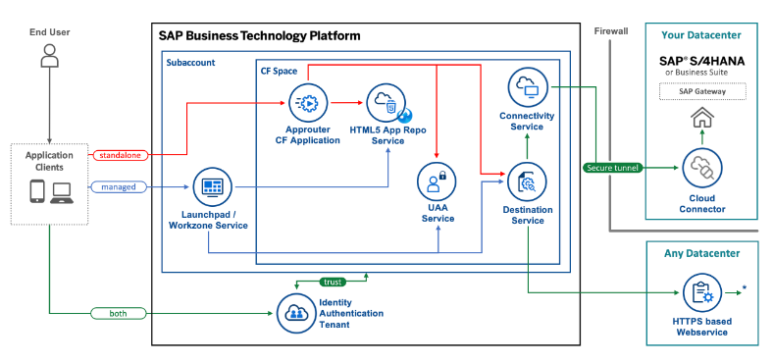
Mta.yaml 구성 모듈들에 대한 설명
Build and Deploy UI5 Freestyle Applications to SAP BTP Cloud Foundry Environment
Entity | Name | Description
modules:
approuter | ui5-standalone-approuter | cloudfoundry application which is exposed on a specific route (url)
 |  | connects to html5 app repo, destination, connectivity and uaa services
html5 deployer | html5-deployer | uploads the ui5app modules zipped ui5 app to the html5 app repo host
html5 content | ui5app | references the html5 module folder aka our ui5 application
 |  | builds and zips it
resources:
html5 app repo host | ui5-shared-repo-host | used for storing and accessing the html5 application content
html5 app repo runtime | ui5-standalone-html5repo-runtime | used for communication between approuter and html5 app repo host
destination | ui5-standalone-destination | used for defining destinations to connect to external data services
connectivity | ui5-standalone-connectivity | used for on-premise type destinations
uaa | ui5-standalone-uaa | references the xs-security file, which defines the scopes and role templates

Slide 11
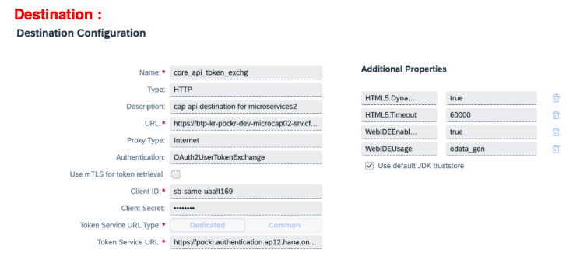
Microservice Architecture & Hands-on (Destination)

Slide 12
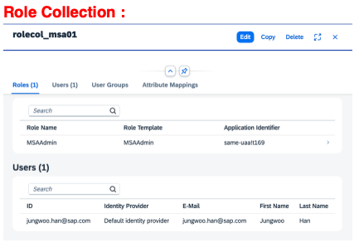
Microservice Architecture & Hands-on (Role Collection)

Slide 13
CAP Best Practice
https://help.sap.com/docs/btp/sap-business-technology-platform/best-practices-e4a7559baf9f4e4394302442745edcd9
https://cap.cloud.sap/docs/node.js/best-practices

Slide 14
Fiori Elements
Developing Apps with SAP Fiori Elements
https://sapui5.hana.ondemand.com/sdk/#/topic/03265b0408e2432c9571d6b3feb6b1fd
Guided Development
https://www.youtube.com/watch?v=my-9cnmQ0Tg

Slide 15
Fiori FreeStyle

Slide 16
SAP BTP Best Practice

