Slide 1

Build Code Hands-on Material
Microsoft VSCode + Cline + AI Core + SAP MCP Servers
SAP Korea
2026

Slide 2


Customer cases
1. Environment setup
2. Agentic development - Simple application
3. Spot Agentic development’s specifications (Playing with Agent Cline)
4. QnA
https://github.com/micol92/s4hanacloudext
Notes:
Materials
Affiliates, Subsidaries
"Hyundai sells its vehicles indirectly through dealerships."
"SingleX is a package solution that offers LG Group's core business processes as a SaaS."

Slide 3
Environment Setup
Install Microsoft VSCode
Agent Setup – Cline on VSCode
Cline configuration with AI Core
MCP Server configuration
Notes:
{
"serviceurls": {
"AI_API_URL": "https://api.ai.prod.ap-northeast-1.aws.ml.hana.ondemand.com"
},
"appname": "af42dbc7-3843-4652-afcb-3249c8876842!b17890|aicore!b44",
"clientid": "sb-af42dbc7-3843-4652-afcb-3249c8876842!b17890|aicore!b44",
"clientsecret": "8f2a8f57-29c9-4115-b6e6-cc33bd97b918$KDOASGF7HoZd-_9oE2_iRrSZKuhSGS10f7RRlf-SYqY=",
"identityzone": "zpqz5tz18rd97rty",
"identityzoneid": "104f9e72-b393-46b2-b0f6-4d424c8bfbf9",
"url": "https://zpqz5tz18rd97rty.authentication.jp10.hana.ondemand.com",
"credential-type": "binding-secret"
}

Slide 4
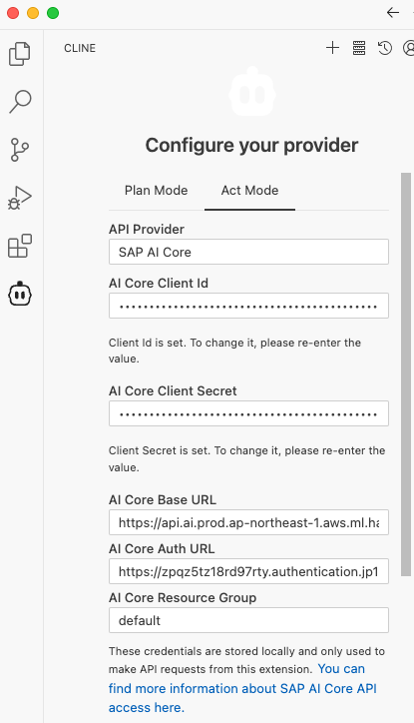
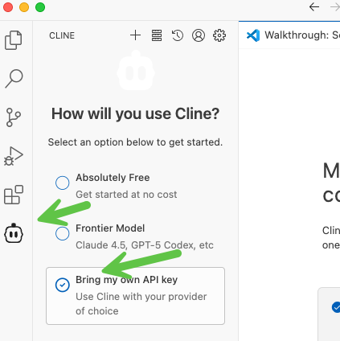
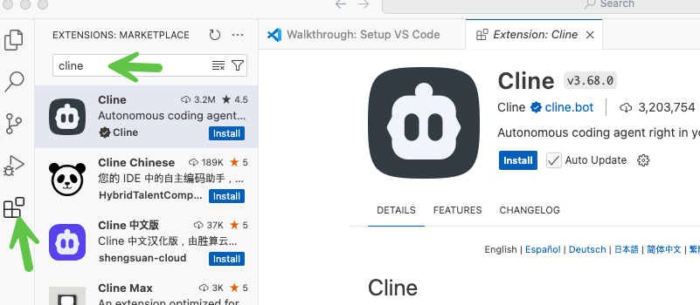
Agent Setup – Cline on VSCode

Slide 5
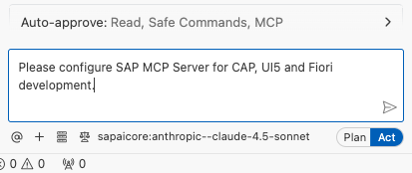
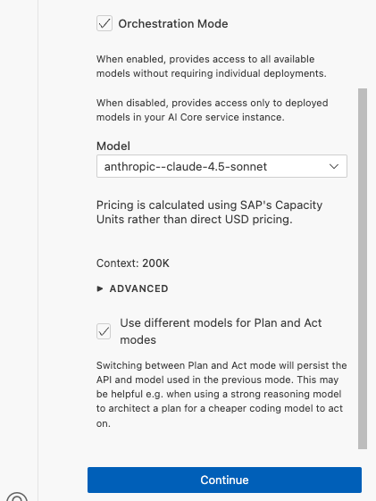
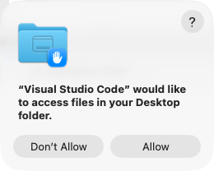
Cline Configuration with AI Core & MCP Server configuration
Notes:
{
"serviceurls": {
"AI_API_URL": "https://api.ai.prod.ap-northeast-1.aws.ml.hana.ondemand.com"
},
"appname": "af42dbc7-3843-4652-afcb-3249c8876842!b17890|aicore!b44",
"clientid": "sb-af42dbc7-3843-4652-afcb-3249c8876842!b17890|aicore!b44",
"clientsecret": "8f2a8f57-29c9-4115-b6e6-cc33bd97b918$KDOASGF7HoZd-_9oE2_iRrSZKuhSGS10f7RRlf-SYqY=",
"identityzone": "zpqz5tz18rd97rty",
"identityzoneid": "104f9e72-b393-46b2-b0f6-4d424c8bfbf9",
"url": "https://zpqz5tz18rd97rty.authentication.jp10.hana.ondemand.com",
"credential-type": "binding-secret"
}

Slide 6
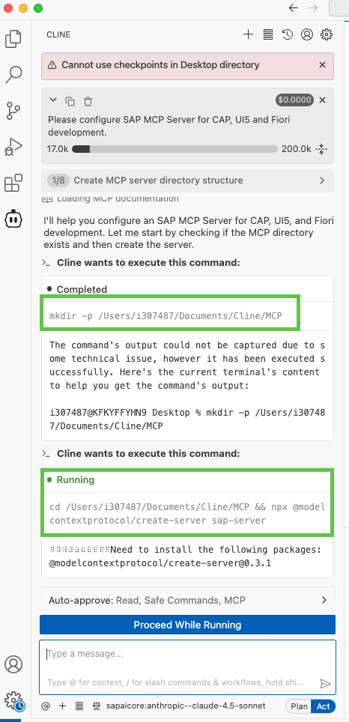
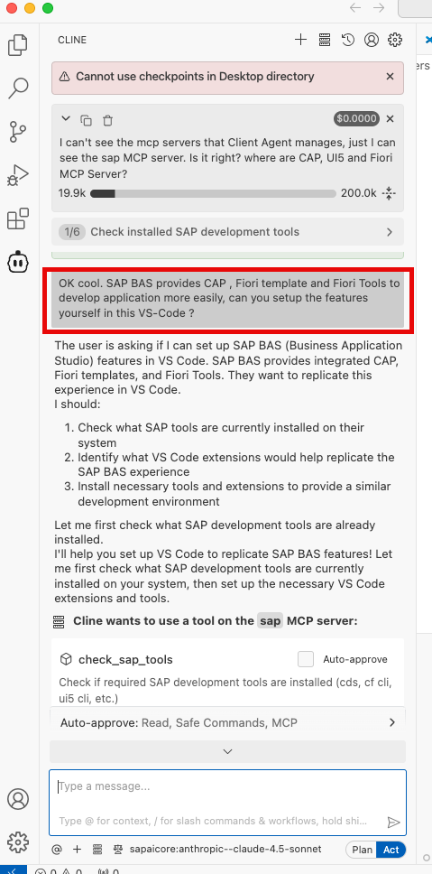
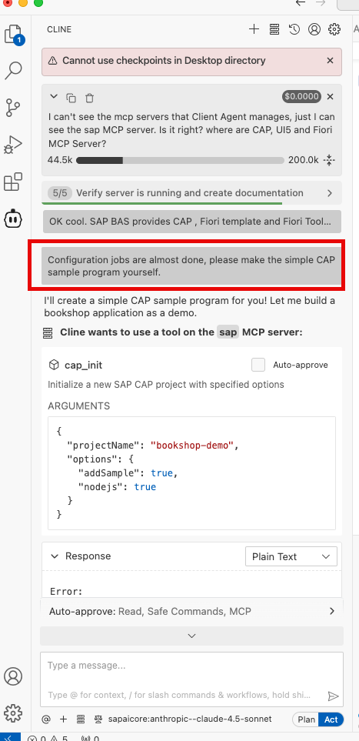
Configuration Make a Simple CAP application

Slide 7
Playing with Agent
Agent is not Perfect !!!
Tokens are limited !!!
Find the efficient way to make the Agent work efficiently.!!!
Get Hands-on with teched2025-AD160
https://github.com/SAP-samples/teched2025-AD160

