Slide 1

HOW WE RAN PROJECT AIR WITH AI FROM DAY ONE
CLAUDE CODE AS
CREATIVE COMMAND CENTER
A “Brand Brain” for the whole project, online from day one.
15
6
6
JUN 9
slides in this deck
MCP integrations
project phases
AI Day 2026
AI DAY · JUNE 9, 2026 · BROOKHAVEN HQ + GLOBAL SITES · THE WEATHER COMPANY

Slide 2



THE MISSION
Make AI feel like a festival, not a tech conference
Event: AI Day, June 9, 2026, about 830 employees across 5 global locations
Vibe: SXSW meets Coachella. Warm, bold, festival energy, not a tech conference
Five deliverables: animated logo, 24 speaker posters, PPT template, hats and wristbands, tiered swag
Creative team: a six-person crew, creative direction, design, copy, and production
Hard deadline: June 9, 2026, set by the program brief
AI DAY · JUNE 9, 2026 · BROOKHAVEN HQ + GLOBAL SITES · THE WEATHER COMPANY

Slide 3

PROJECT STRUCTURE
Six phases, one AI thread through all of them
01
02
03
Brand Foundation
Templates & Systems
Production Sprint
May 5 – 9
May 14
May 22
04
05
06
Animation & Polish
Print Handoff
Premium Swag
May 27
Jun 2
Jun 6
AI DAY · JUNE 9, 2026 · BROOKHAVEN HQ + GLOBAL SITES · THE WEATHER COMPANY

Slide 4










THE ECOSYSTEM
—
MCP PLUGINS & CONNECTIONS
Everything orbits one repo
Claude Code
the “Brand Brain” engine
Google Calendar
six meetings, one prompt
Slack
status, reveals, summaries
Google Drive
assets + 21 headshots
GitHub repo
single source of truth
Webhooks
auto status on each push
Figma
design library, read+write
AI Dashboard
the proof, shown live
AI DAY · JUNE 9, 2026 · BROOKHAVEN HQ + GLOBAL SITES · THE WEATHER COMPANY

Slide 5
FOUNDATION
—
GITHUB REPO
The repo was the project
Every document lived in GitHub: brief, phases, decisions, agendas, vendor specs
Claude read any file by raw URL: context from live source, never stale copies
Branching: main is approved, draft is in progress, review is ready for feedback
Decision logs captured every direction change, with the rationale preserved
CLAUDE.md at workspace and project level: full context in seconds at every start
AI DAY · JUNE 9, 2026 · BROOKHAVEN HQ + GLOBAL SITES · THE WEATHER COMPANY

Slide 6



INTEGRATION 1 OF 6
—
GOOGLE CALENDAR MCP
Six team meetings created in one prompt
Connected Google Calendar MCP to Claude Code: calendar write access from the terminal
All six project meetings from a single prompt: Meet links, attendees, and descriptions included
Pre-work notes, repo links, and agenda context embedded in each invite automatically
Zero copy-pasting or manual entry: invites sent with one confirmation
“The whole thing takes about 2 minutes once the repo is set up.”
docs/google-calendar-setup.md
AI DAY · JUNE 9, 2026 · BROOKHAVEN HQ + GLOBAL SITES · THE WEATHER COMPANY

Slide 7

INTEGRATION 2 OF 6
—
GOOGLE DRIVE MCP
Asset collection, hands-free
Connected Google Drive MCP with direct folder read and write from Claude
Headshot submissions for 21 ambassadors and executives, organized by poster slot
21
Claude checked folder contents and flagged missing submissions without leaving the terminal
Vendor assets, swag reference files, and brand exports all routed through Drive
headshot submissions
ambassadors + executives
AI DAY · JUNE 9, 2026 · BROOKHAVEN HQ + GLOBAL SITES · THE WEATHER COMPANY

Slide 8


INTEGRATION 3 OF 6
—
SLACK
Claude as the team’s writer
Claude drafted all Slack communications: status updates, check-ins, headshot guide rails
Poster reveal announcements formatted for internal channels, ready to send
“Ready to test” summaries after every change: what changed, how to verify, what to expect
“Created with AI” dashboard updates posted to the project channel after each milestone
Pattern: Claude drafts, Michael sends. The team always sees a human hand on the button
AI DAY · JUNE 9, 2026 · BROOKHAVEN HQ + GLOBAL SITES · THE WEATHER COMPANY

Slide 9

INTEGRATION 4 OF 6
—
FIGMA MCP
Design files, readable by AI
Connected Figma MCP with Editor access: read and write, no viewer limits
Claude inspected the component library and read color tokens and type styles directly
Color tokens
Verified logo production files: SVG, PDF, PNG @2x, WEBP @0.5x, AI source
Type styles
Audited the library against brand guidelines and flagged inconsistencies in real time
Logo variants ×4
Component library
AI DAY · JUNE 9, 2026 · BROOKHAVEN HQ + GLOBAL SITES · THE WEATHER COMPANY

Slide 10

INTEGRATION 5 OF 6
—
WEBHOOKS
Automated status on every push
Webhooks on the GitHub repo triggered Slack notifications on key events
Phase completions, logo approval, and vendor deadline updates auto-surfaced to the team
Atlas print deadline conflict (May 22 vs. May 25) flagged automatically when dates changed
No manual check-in messages needed: the system surfaced the update
Conflict detection: the webhook fired when the Atlas deadline was edited. The team saw it before anyone had to say anything.
AI DAY · JUNE 9, 2026 · BROOKHAVEN HQ + GLOBAL SITES · THE WEATHER COMPANY

Slide 11
INTEGRATION 6 OF 6
—
AI DASHBOARD
Showing our work, live
Brief commitment: “This conference is brought to you by AI. The creative should be too.”
The dashboard tracked every deliverable that used AI: the tool, its role, and the output
Tools logged: Claude Code, Adobe Firefly, ElevenLabs, Gemini, Figma AI
AI Photo Booth and AI Song documented as AI-first attendee experiences built for the event
Not just a tracker, a proof point: the dashboard is the story told on AI Day
AI DAY · JUNE 9, 2026 · BROOKHAVEN HQ + GLOBAL SITES · THE WEATHER COMPANY

Slide 12
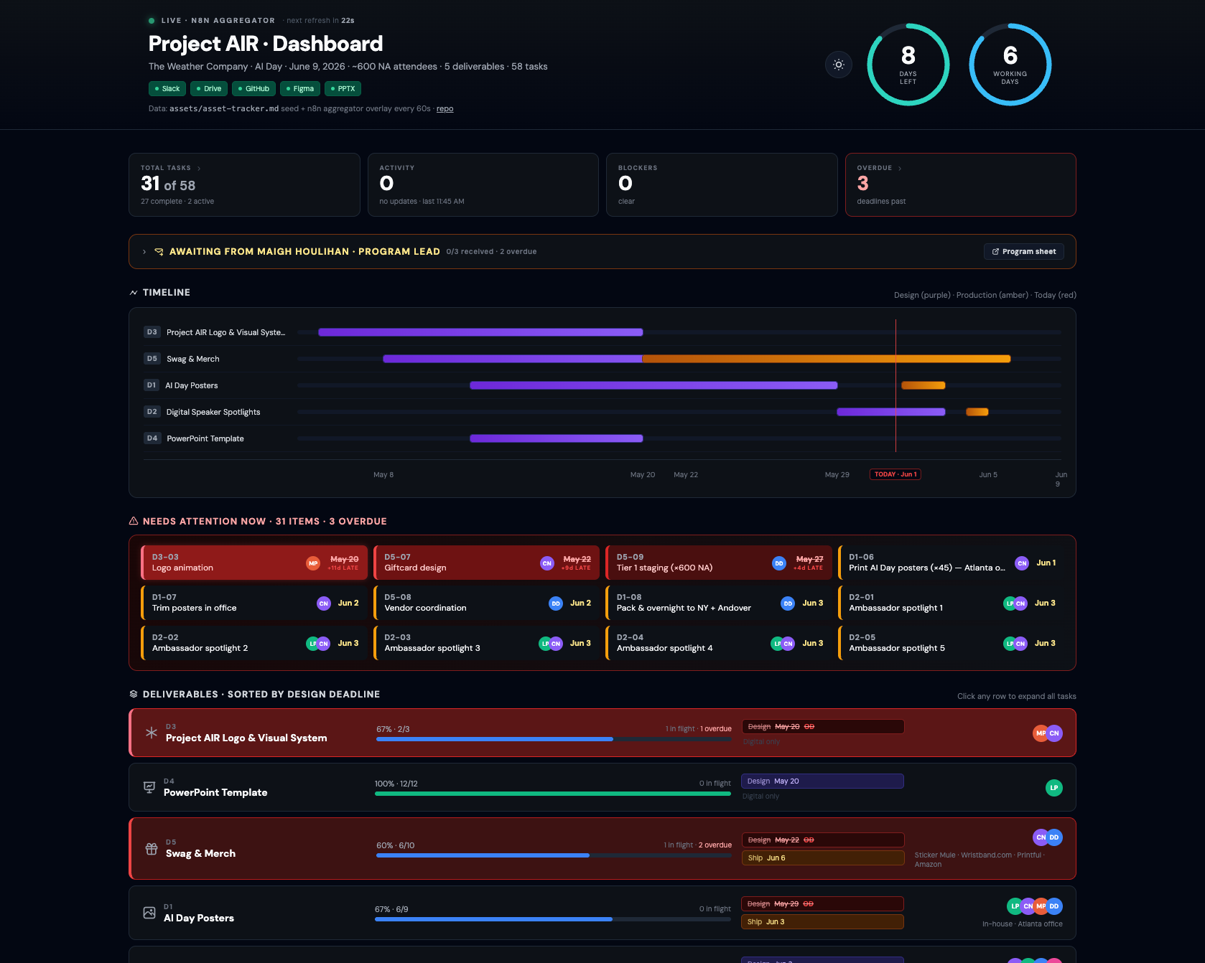
INTEGRATION 6 OF 6
—
AI DASHBOARD
Showing our work, live
AI DAY · JUNE 9, 2026 · BROOKHAVEN HQ + GLOBAL SITES · THE WEATHER COMPANY

Slide 13
AI-FIRST PROCESS
AI wasn’t a feature. It was the workflow
CREATIVE WORK
PRODUCTION WORK
Logo ideation: references and concept directions explored with AI
Meeting summaries: May 18 session notes consolidated by Gemini
Brand guidelines: written and updated live in the repo, readable any time
Poster system: slot architecture designed with Claude code-gen
Vendor comparisons: Superside vs. in-house, Atlas vs. alternatives, analyzed by Claude
Copy: 20 prompt-card ideas generated by AI pre-meeting
This presentation: generated in PptxGenJS by Claude Code
AI DAY · JUNE 9, 2026 · BROOKHAVEN HQ + GLOBAL SITES · THE WEATHER COMPANY

Slide 14
KEY CONDITIONS
—
THE FOUR Cs
The conditions that made AI-first possible
Context
Connections
Capabilities
Cadence
Everything in the repo, readable by Claude at any raw GitHub URL.
Calendar, Drive, and Figma wired in, so Claude reached tools, not just files.
A short prompt kicked off multi-step jobs that shipped real artifacts.
Webhooks and the dashboard kept delivering with no one watching.
Underneath it all: trust and iteration. The team redirected, Claude revised. A collaborator, not a vending machine.
AI DAY · JUNE 9, 2026 · BROOKHAVEN HQ + GLOBAL SITES · THE WEATHER COMPANY

Slide 15
RETROSPECTIVE
Lessons from a creative sprint with AI
KEEP
ADD NEXT TIME
CLAUDE.md session-start context at workspace and project level
Slack MCP connected from day one, not mid-project
Repo-as-source-of-truth with raw GitHub URLs for instant access
Webhook setup in the first week, not after phase 2
MCP connections to Calendar and Drive set up before the project starts
Dashboard structure defined before production begins
Decision logs for every major turn: context that accumulates
Figma MCP set up before the component library is built
AI DAY · JUNE 9, 2026 · BROOKHAVEN HQ + GLOBAL SITES · THE WEATHER COMPANY

Slide 16
THE ECOSYSTEM
—
MCP PLUGINS & CONNECTIONS
Everything orbits one repo
Claude Code
the “Brand Brain” engine
Google Calendar
six meetings, one prompt
Slack
status, reveals, summaries
Google Drive
assets + 21 headshots
GitHub repo
single source of truth
Webhooks
auto status on each push
Figma
design library, read+write
AI Dashboard
the proof, shown live
AI DAY · JUNE 9, 2026 · BROOKHAVEN HQ + GLOBAL SITES · THE WEATHER COMPANY

Slide 17
“
This conference is brought to you by AI.
The creative should be too.
We didn’t just talk about AI adoption. We ran the project with it.
PROJECT AIR · AI IN REACH · THE WEATHER COMPANY
Workflow: docs/claude-workflow.md

