Slide 1

Organizational Context
Building Components
PS - Problem Statement
The MicroCanvas® Framework
By Informatik LLC
Write the draft of your one line problem statement
A well defined problem statement identifies the negative aspects of an existing situation, while defining a boundary (time, finance, geography) around that specific situation or challenge. Example:
The quality of easily accessible water is declining 10% every year globally.
By Informatik LLC
Q2 2019 https://doulab.net
The MicroCanvas Framework by Doulab is licensed under a Creative Commons Attribution-NoDerivatives 4.0 International License. Based on a work at https://themicrocanvas.com. Based on work by Luis Santiago and the MicroCanvas Community. For a copy of this license, http://creativecommons.org/licenses/by-sa/4.0/ or send a letter to Creative Commons, PO Box 1866, Mountain View, CA 94042, USA. Rev 1.1 2018-05-15

Slide 2
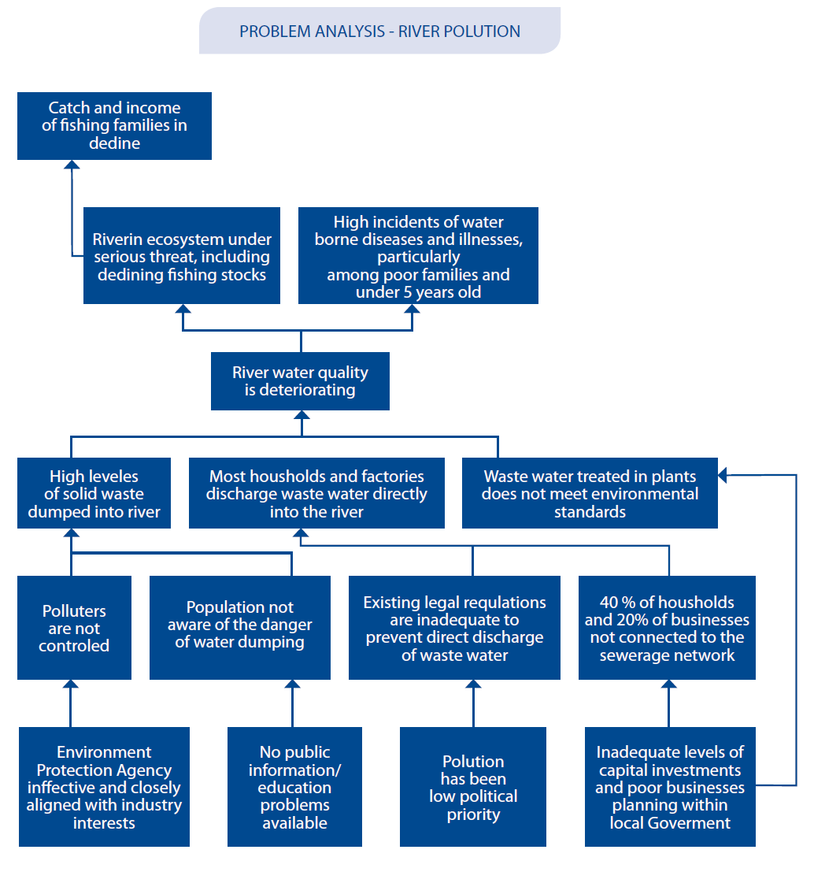
Organizational Context
Building Components
PS - Problem Statement
The MicroCanvas® Framework
| STEP 1 – Problem Analysis by creating a problem tree
By Informatik LLC
The problem analysis identifies the negative aspects of an existing situation and establishes the “cause and effect” relationships between the identified problems.
Creating a problem tree should ideally be undertaken as a participatory group event.
It is suggested to use individual pieces of paper or cards on which to write individual problem statements, which can then be sorted into cause and effect relationships on a visual display.
Effects
MAIN PROBLEM
Causes
STEP 1.1 – Identify major existing problems, based upon available information. Openly brainstorm problems which stakeholders consider to be a priority. Write down each problem on a separated visual support (paper/cards/strategyzer)
STEP 1.2 – Select an individual starter, a focal problem for analysis
STEP 1.3 – Look for related problems to the starter problem: identify substantial and direct causes/effects of the focal problem
STEP 1.4 – Look for related problems to the starter problem: identify substantial and direct causes/effects of the focal problem
STEP 1.4 – Begin to construct the problem tree by establishing a hierarchy of cause and effects relationship between the problems: Problems which are directly causing the starter problem are put below / Problems which are direct effects of the starter problem are put above
STEP 1.5 – All other problems are then sorted in the same way – the guiding question being ‘What causes that?’ If there are two or more causes combining to produce an effect, place them at the same level in the diagram.
STEP 1.6 – Connect the problems with cause-effect arrows – clearly showing key links.
STEP 1.7 – Review the diagram, verify its validity and completeness and make necessary adjustment: Ask yourself/the group – ‘are there important problems that have not been mentioned yet?’ If so, include them at an appropriate place in the diagram.
The MicroCanvas Framework by Doulab is licensed under a Creative Commons Attribution-NoDerivatives 4.0 International License. Based on a work at https://themicrocanvas.com. Based on work by Luis Santiago and the MicroCanvas Community. For a copy of this license, http://creativecommons.org/licenses/by-sa/4.0/ or send a letter to Creative Commons, PO Box 1866, Mountain View, CA 94042, USA. Rev 1.1 2018-05-15

