Slide 1
E-Savings Web System
User Manual

Slide 2

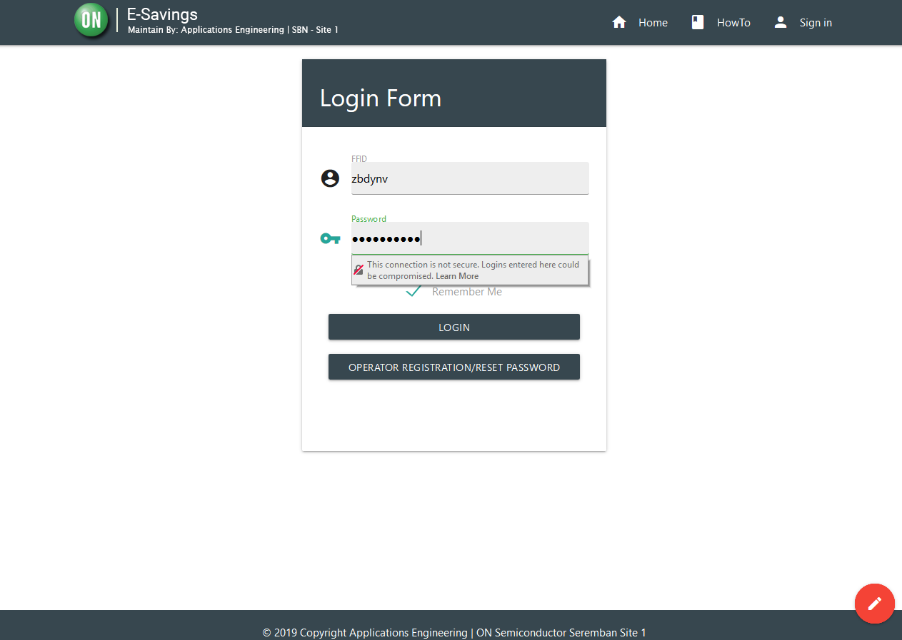
Procedures (Submission of Proposal)
Open your browser and navigate http://myse01ws014.ad.onsemi.com:8090/Home/Index
To login, you may use your AD user Account credentials. For those who doesn’t have ONdex Account, Please do manual registration via clicking . For more details please click link.

Slide 3


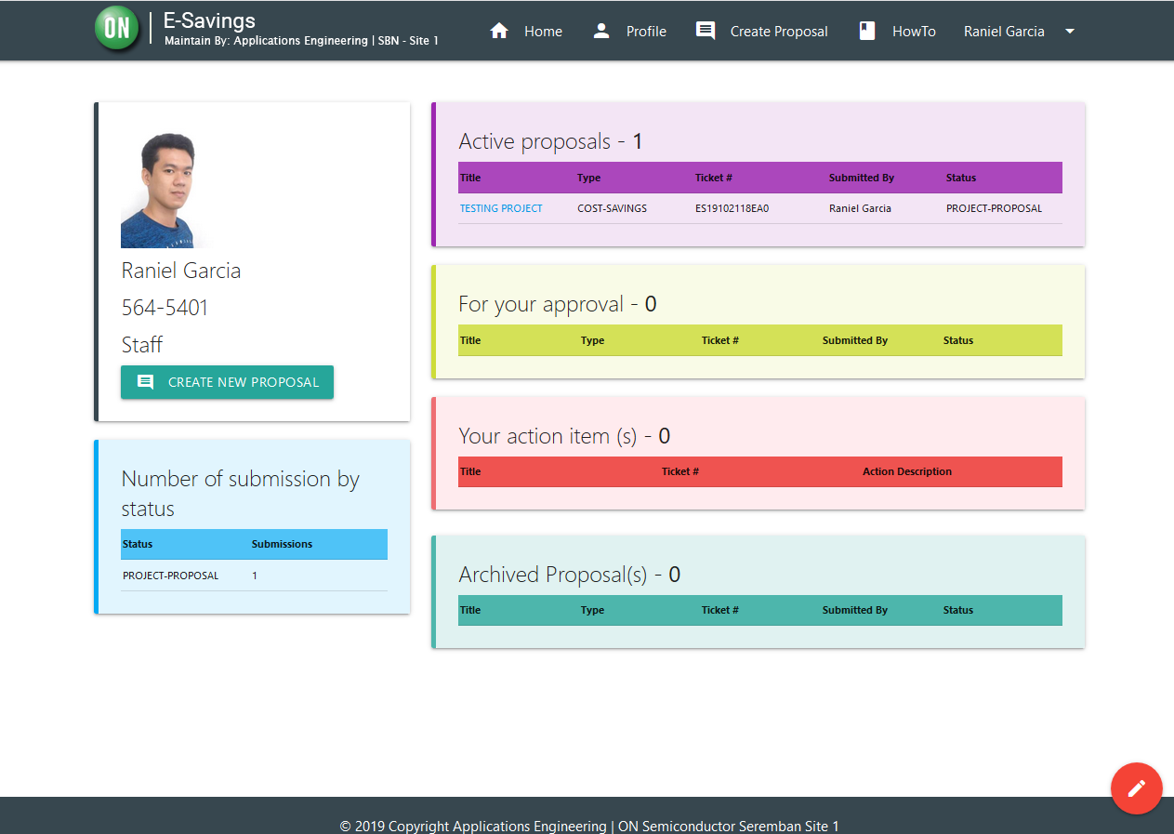
Procedures (Submission of Proposal)
3. In the MyProfile Page click the or to start creating Proposal.

Slide 4
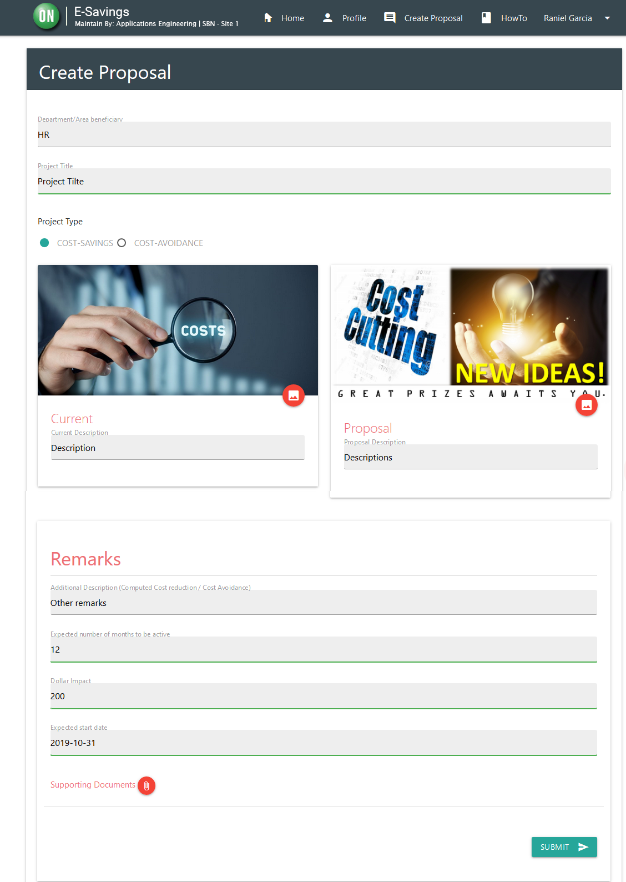

Procedures (Submission of Proposal)
4. Fill out information display on the web form. Picture attachment is optional, if it is not applicable on the proposal to be submitted.
For IDL employees, the Expected number of months to be active, Dollar impact and expected start date fields is required, but the approver can always modify this fields when needed
After filling the out the information, click the . An email notification will be sent regarding to your submitted proposal entry.

Slide 5
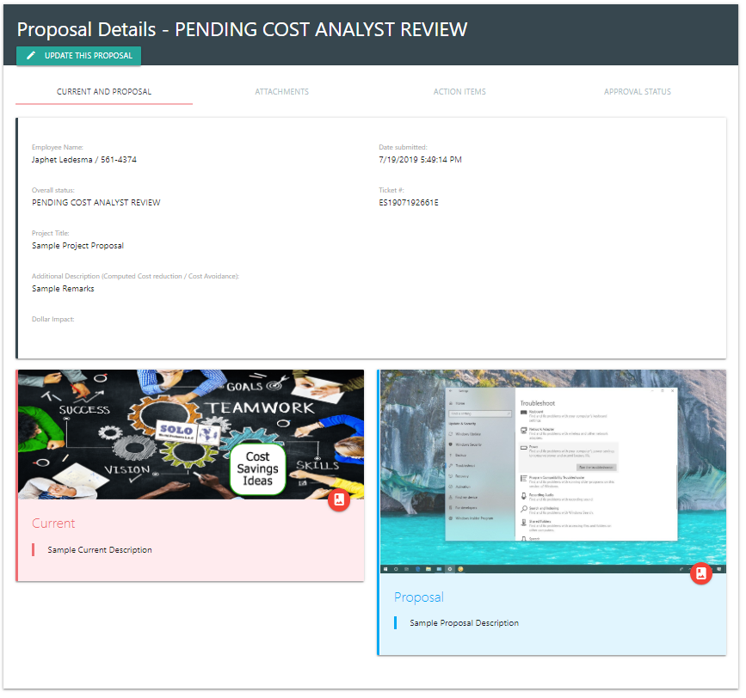
Procedure
Upon submission of proposal entry, the item will now pending on the Cost Analyst approver. This module contains the information regarding the proposal submitted by the user.

Slide 6
Procedures (Approval of Proposal Entries)
Open your browser and navigate http://myse01ws014.ad.onsemi.com:8090/Home/Index
To login, you may use your AD user Account credentials. For those who doesn’t have ONdex Account, Please do manual registration via clicking . For more details please click link.

Slide 7

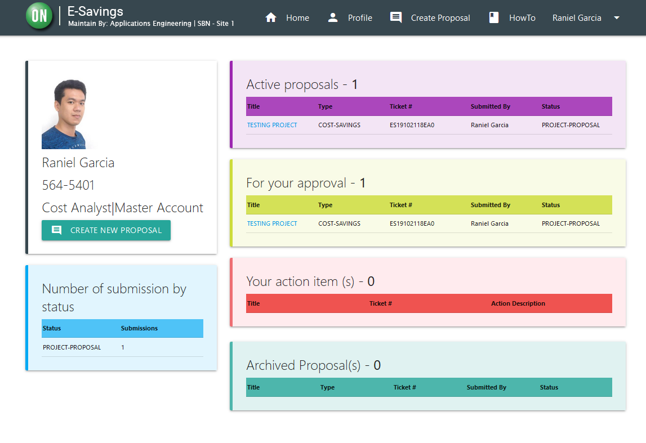

Procedure (Approval of Proposal)
3. In the MyProfile Page, On the panel, click the item entry that will under approval.
Clicking that will go to the Proposal Details Page
The system also send an email notification to the approver when new proposal submitted under his/her area

Slide 8
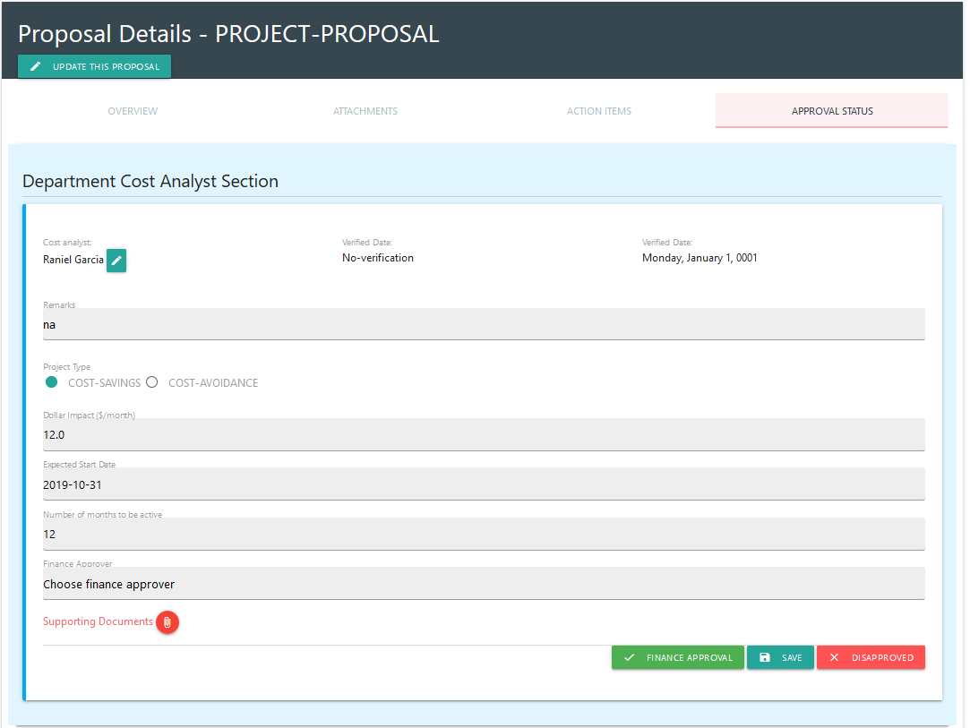



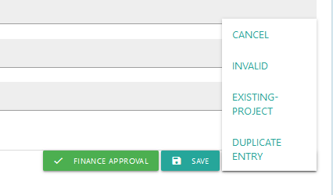


Procedures (Approval of Proposal Entries – Cost Analyst)
4. On the APPROVAL STATUS tab found in Proposal details, under the
panel, input the remarks, and update dollar impact, expected start date, number of months to be active if necessary
Click button when you are not yet done on verification of other required data or computation.
Click and choose whether the proposal is INVALID,
EXISTING PROJECT,
DUPLICATE ENTRY or
CANCEL.
Click if approved, but before that, you need to choose Finance approver on
An email notification will be send after the approval.

Slide 9
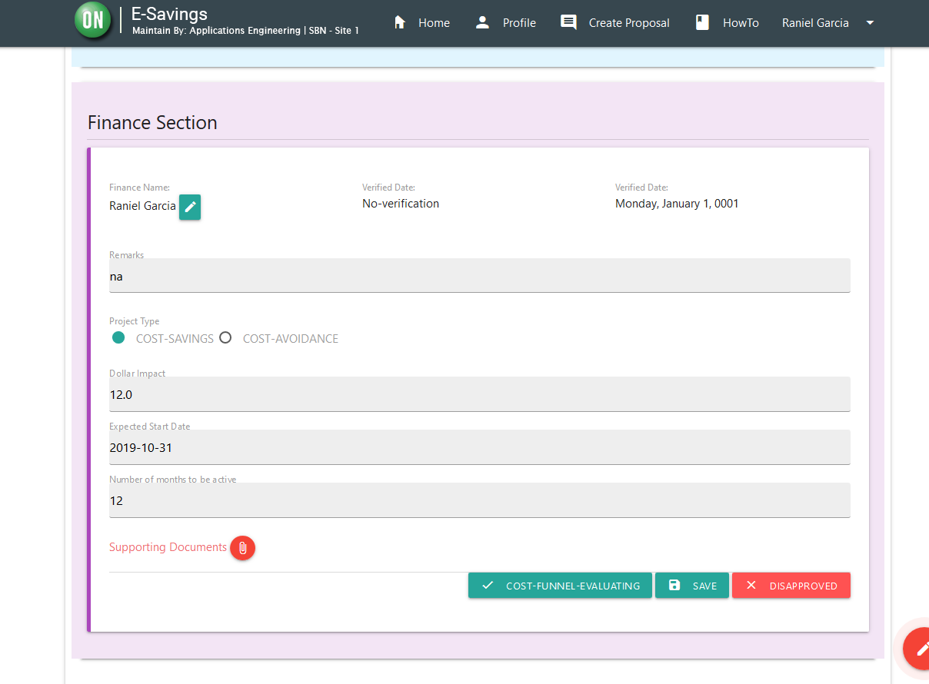


Procedures (Approval of Proposal Entries – Finance)
5. On the APPROVAL STATUS tab found in Proposal details, under the
panel, input remarks, and update dollar impact, expected start date, number of months to be active if necessary.
Click button when you are not yet done on verification of other required data or computation.
Click and choose whether the proposal is INVALID,
EXISTING PROJECT,
DUPLICATE ENTRY or
CANCEL.
Click if approved, the proposal will be move to COST-FUNNEL-EVALUATION status
An email notification will be send after the approval.

Slide 10
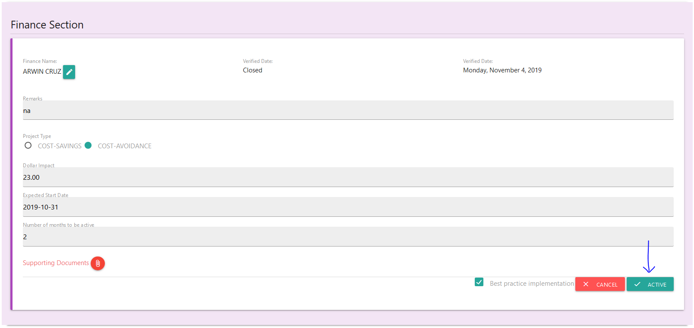
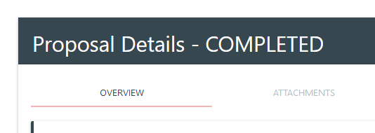
Procedure (Proposal status to ACTIVE and ACTIVE to COMPLETED)
After Finance approval, the status of the proposal is COST-FUNNEL-EVALUATING, this means that the proposal is now waiting for implementation. When the proposal is ready, the finance or the admin user can now move the proposal to ACTIVE status.
To move to ACTIVE status, click the button Active.
The system will now monitor this proposal until
It’s completion, it will use the number of months
to be active, when the system detect that the
project is no longer active, it will automatically
change the status to COMPLETED. It will also
send an email notification on this process.

Slide 11
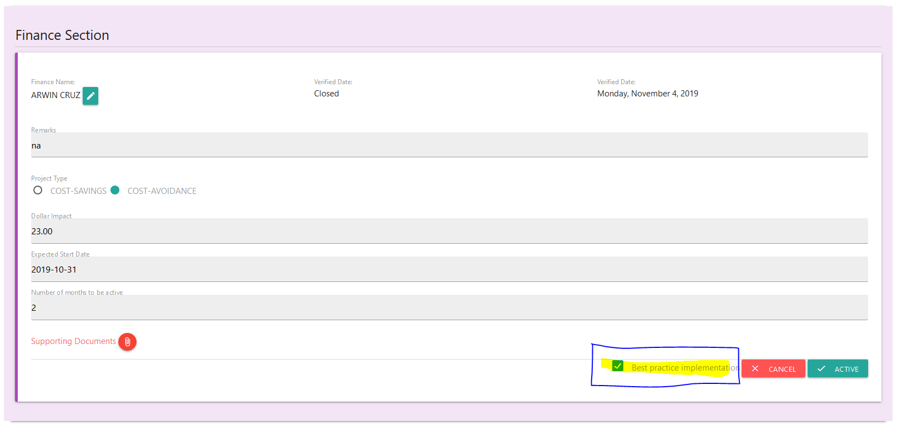
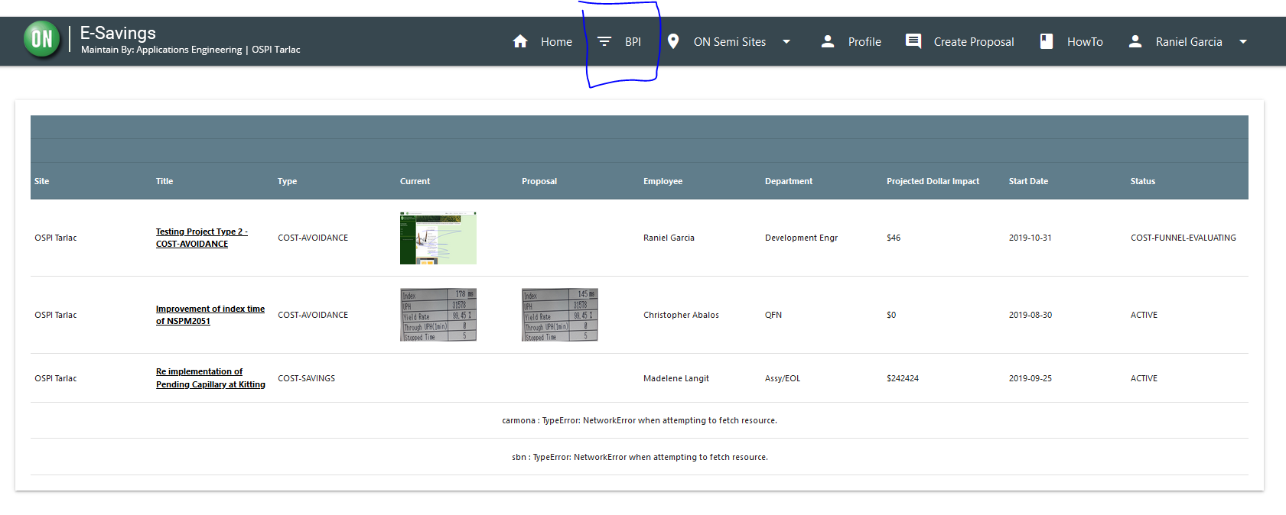
Procedure – marking proposal as Best Practice Implementation
To mark the proposal as BPI, you just need to check the Best practice implementation checkbox as shown below, and it will automatically include in BPI list,

Slide 12
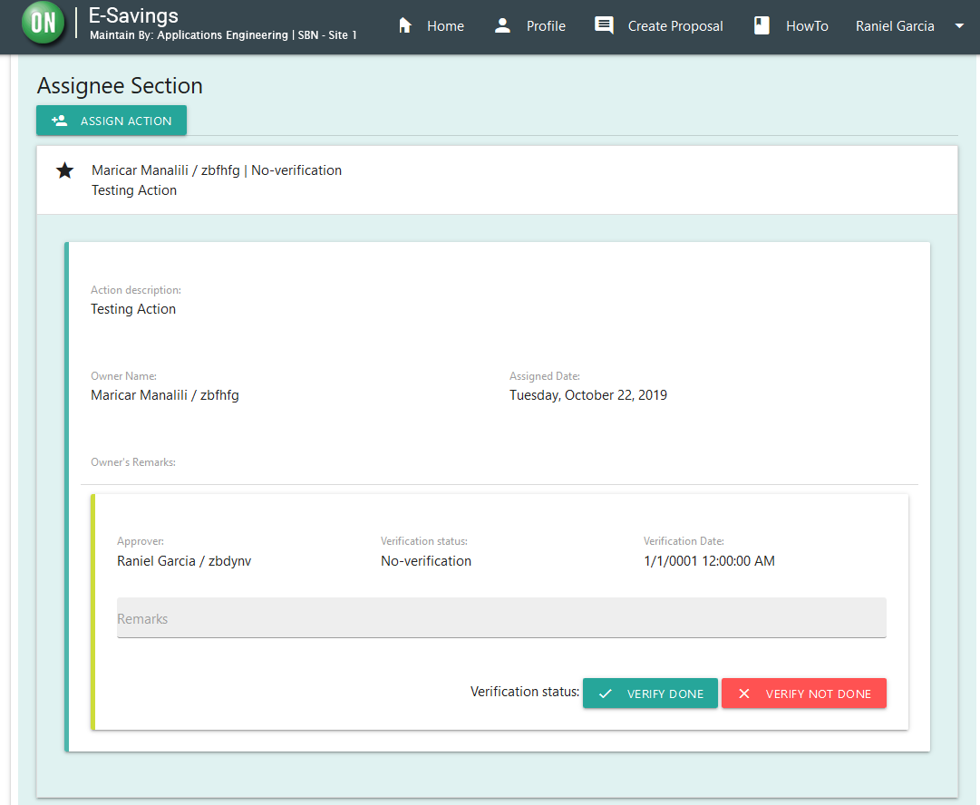

Procedures (Assign action item)
In order to assign, on the ACTION ITEMS tab found in Proposal details, on the Assignee Section, click the . This will display a form where to input the action items and the action owner. The system also send an email notification to the action owner.

Slide 13
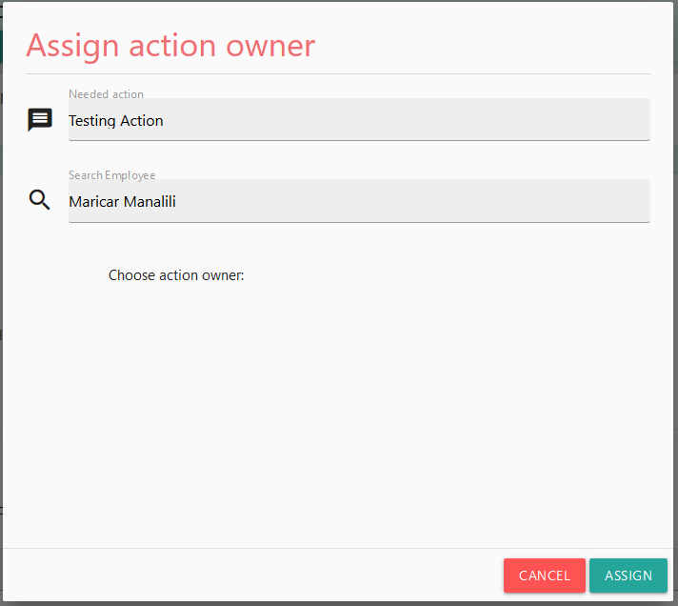

Procedures (Approval of Entries)
Encode the action and the action owner name then enter and choose the owner. One action owner per action item. Then click . An email notification will send for the action item.

Slide 14
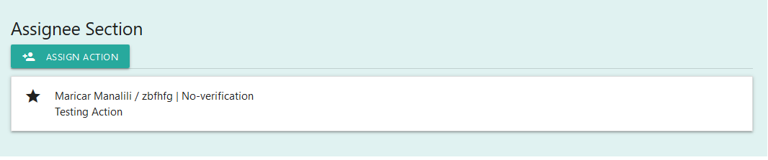
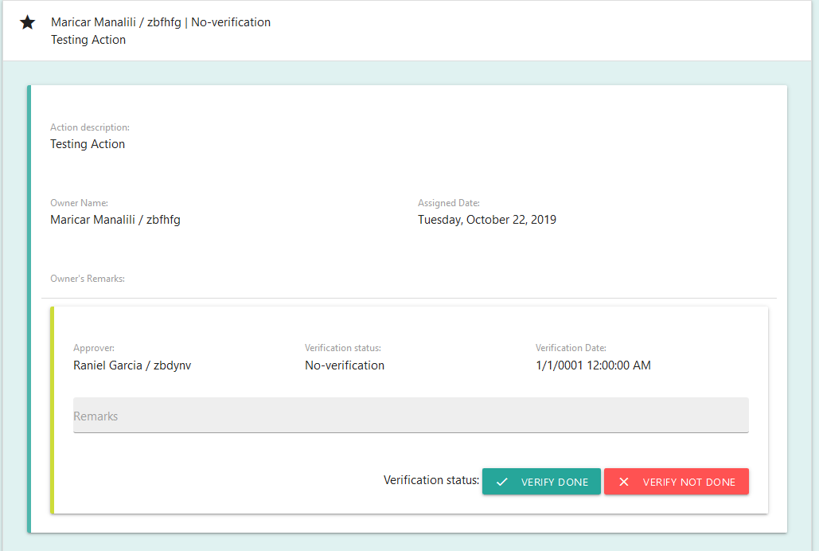
Procedures (Approval of Proposal Entries)
To Approve the action items on ACTION ITEMS tab, under the assignee section, click the actionee (name beside the star icon ) to display approval menu.

Slide 15
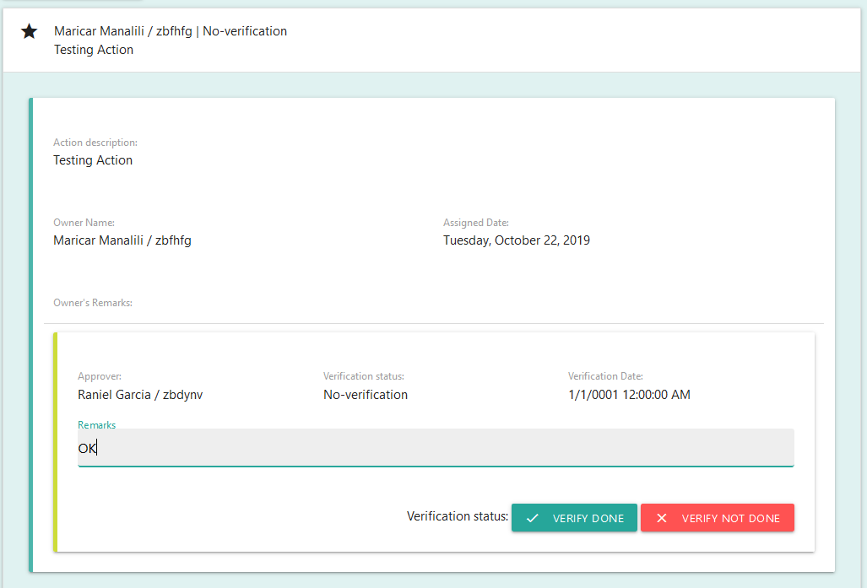


Procedures (Approval of Proposal Entries)
On the Action Item Approval, input remarks. Click the
if approve, click
if disapprove.
The action item will still be open when
disapproved.

