Slide 1

Combinatorial Optimization Algorithm in Java
Nicholas Andrew Marien
Project Euler problem 345
Min/Max Matrix Sums
The Hungarian Method
Java

Slide 2
Toy Problem

Slide 4
437 + 526 + 576 + 1108 + 974 = 3621

Slide 5
438 + 608 + 423 + 900 + 974 = 3343

Slide 6
438 + 608 + 413 + 900 + 891 = 3250

Slide 10
Step 1

Slide 11
Step 1

Slide 12
Step 1

Slide 13
Step 1

Slide 14
Step 1

Slide 15
Step 1

Slide 16
Step 1

Slide 17
Step 1

Slide 18
End of Toy Problem. What about a real problem where an optimal solution by inspection is nearly impossible.

Slide 19
Project Euler problem 345

Slide 20
Min/Max Matrix Sums

Slide 21
Toy Problem p2

Slide 24
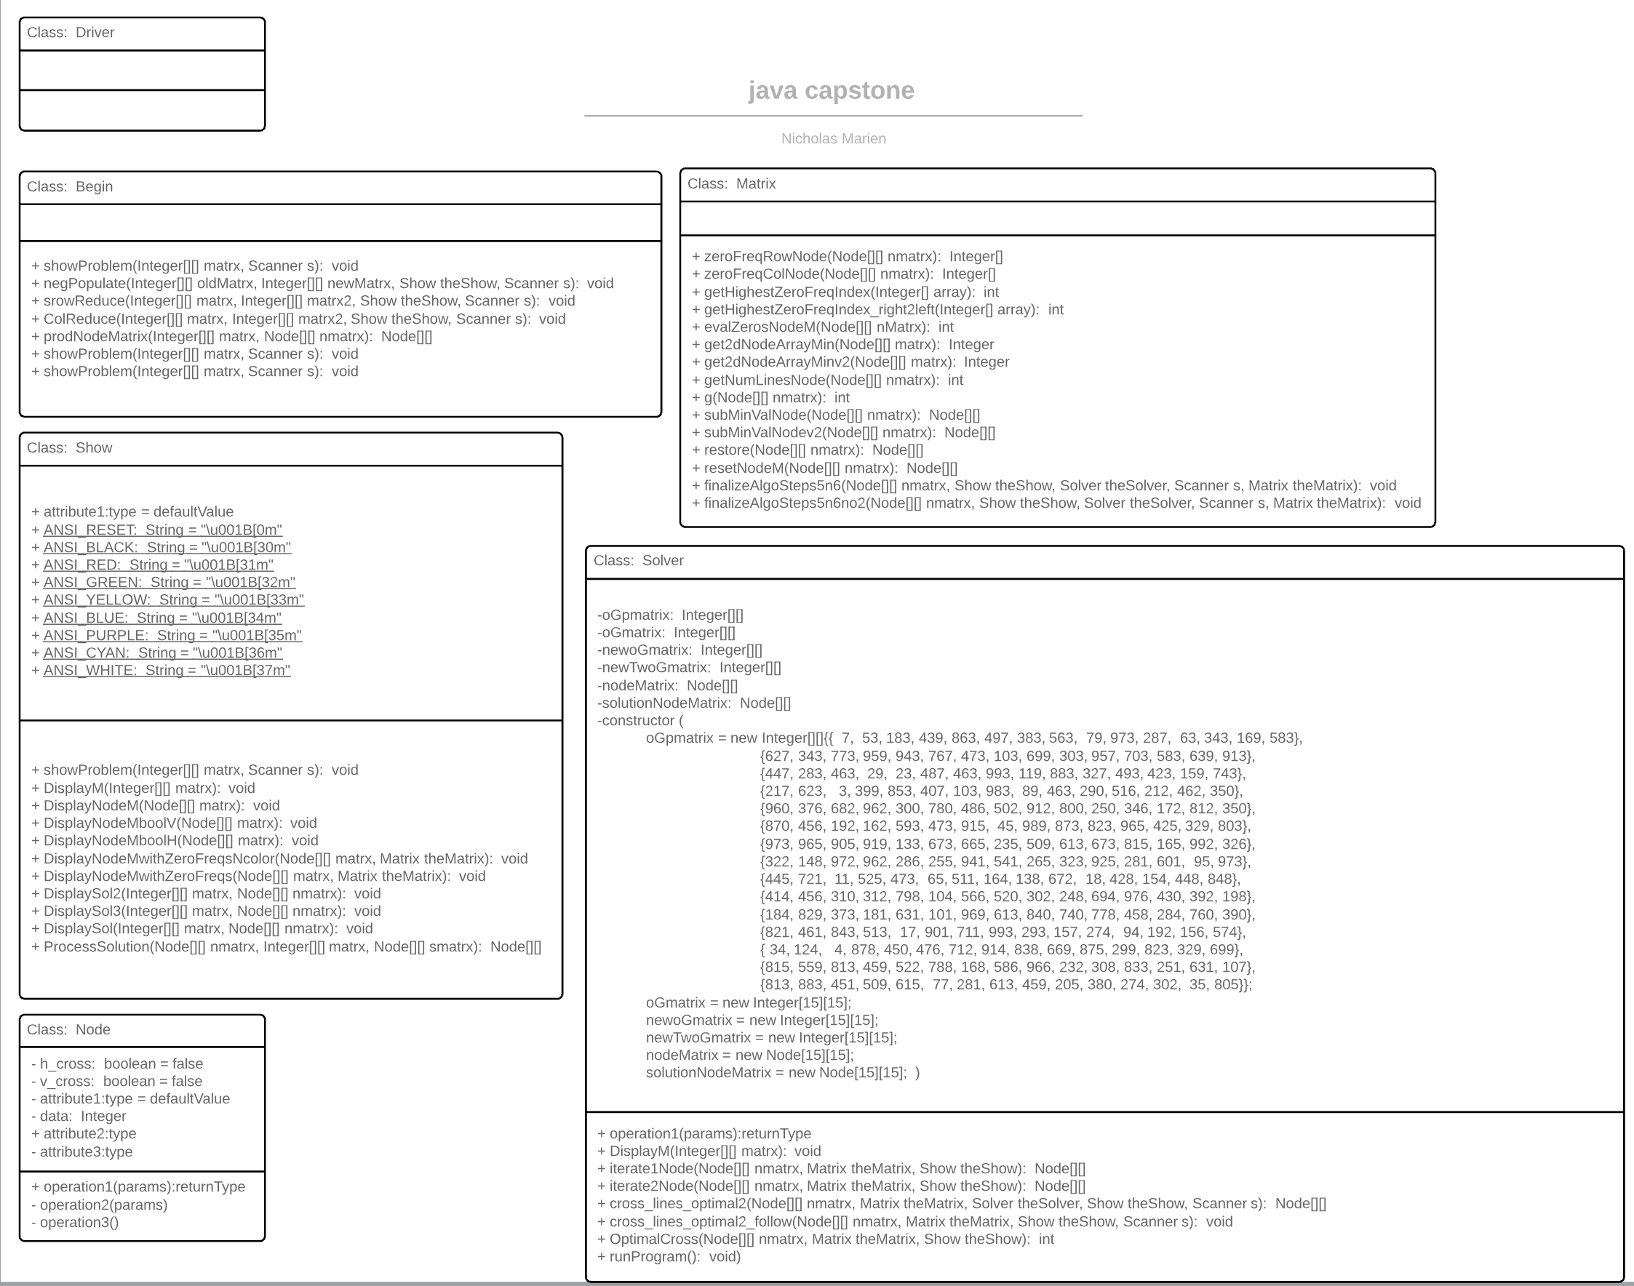

Slide 25
The Hungarian Method
Harvard PDF: citation needed. No paraphrasing. This document is laid out and worded beautifully.

Slide 26
The Assignment Problem:
Suppose we have n
resources to which we want to assign to
n tasks on a one-to-one basis.
Suppose also that we know the cost of assigning
a given resource to a given task. We wish to find an
optimal assignment–one which minimizes total cost.

Slide 27
The Hungarian Method: The following algorithm applies the above theorem to a given n × n cost matrix to find an optimal assignment.
Step 1. Subtract the smallest entry in each row from all the entries of its row.
Step 2. Subtract the smallest entry in each column from all the entries of its column.
Step 3. Draw lines through appropriate rows and columns so that all the
zero entries of the cost matrix are covered and the minimum number of
such lines is used.

Slide 28
Step 4.
Test for Optimality: (i) If the minimum number of covering lines
is n, an optimal assignment of zeros is possible and we are finished. (ii) If
the minimum number of covering lines is less than n, an optimal
assignment of zeros is not yet possible. In that case, proceed to Step 5.
Step 5.
Determine the smallest entry not covered by any line. Subtract
this entry from each uncovered row, and then add it to each covered
column. Return to Step 3.

Slide 29
Cost Analysis
Indicate the financial advantages for the customer
Compare quality and price with those of the competition

Slide 30
Strengths and Advantages
Summarize the special features and advantages of the product being introduced

Slide 31
Next Steps of Action
Explain the steps that now need to be taken

Slide 32
Combinatorial Optimization Algorithm in Java
Long-term Goal
Customer Wishes
Fulfilling
Customer Needs
Cost Analysis
Strengths and Advantages
Next Steps of Action

