Slide 1
Methods
To model the relationship between biomarker (?) levels on microplastics (4—int1, sul1, Pa, Sm) and the categorical factors of plastic type, time, and water type, we implemented a generalized linear model (GLM) in R (version 4.2.1) using the glm() function with a Gaussian family and identity link function, specifying the model formula as biomarker response ~ plastic_type + time + water_type. Biomarker responses were normal transformed by finding the optimal lambda for a Box-Cox transformation. The choice of the Gaussian family and identity link assumes that the response variable is normally distributed and linearly related to the additive effects of the categorical predictors. We examined the model summary to assess the significance of each factor's coefficients, which represent the expected change in biomarker expression for each factor level compared to the reference level. We repeated these models for water concentrations, dropping the plastic type covariate. To select the most parsimonious model, we employed bidirectional stepwise regression using the step() function from the stats package, specifying direction = "both". The Akaike Information Criterion (AIC) was used as the model selection metric to balance goodness of fit with model complexity, with a lower AIC indicating a better model fit. The stepwise procedure iteratively added or removed predictors to minimize the AIC until no further improvements could be made, yielding a final model containing only the most informative variables and interactions for explaining the response.
I have removed the fb level and inserted 0 concentrations for week 0 for each of the response variables for microplastics (to have the same dimensions as water data).

Slide 2
Results
For visual inspection, there are plots (histograms, boxplots by week, and qqplots) of the untransformed data, box cox with optimal lambda, natural log, and log10.
MM said that log10 was most typically used so I stuck with that, the other transformations did not help much.
To make the glm output easier to process, I present only the log10 results, full results in 1 slide and then the stepwise glm in the next slide.

Slide 3
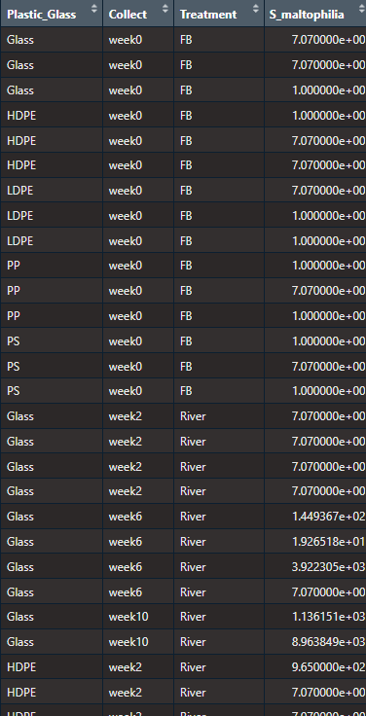
Microplastic data

Slide 4
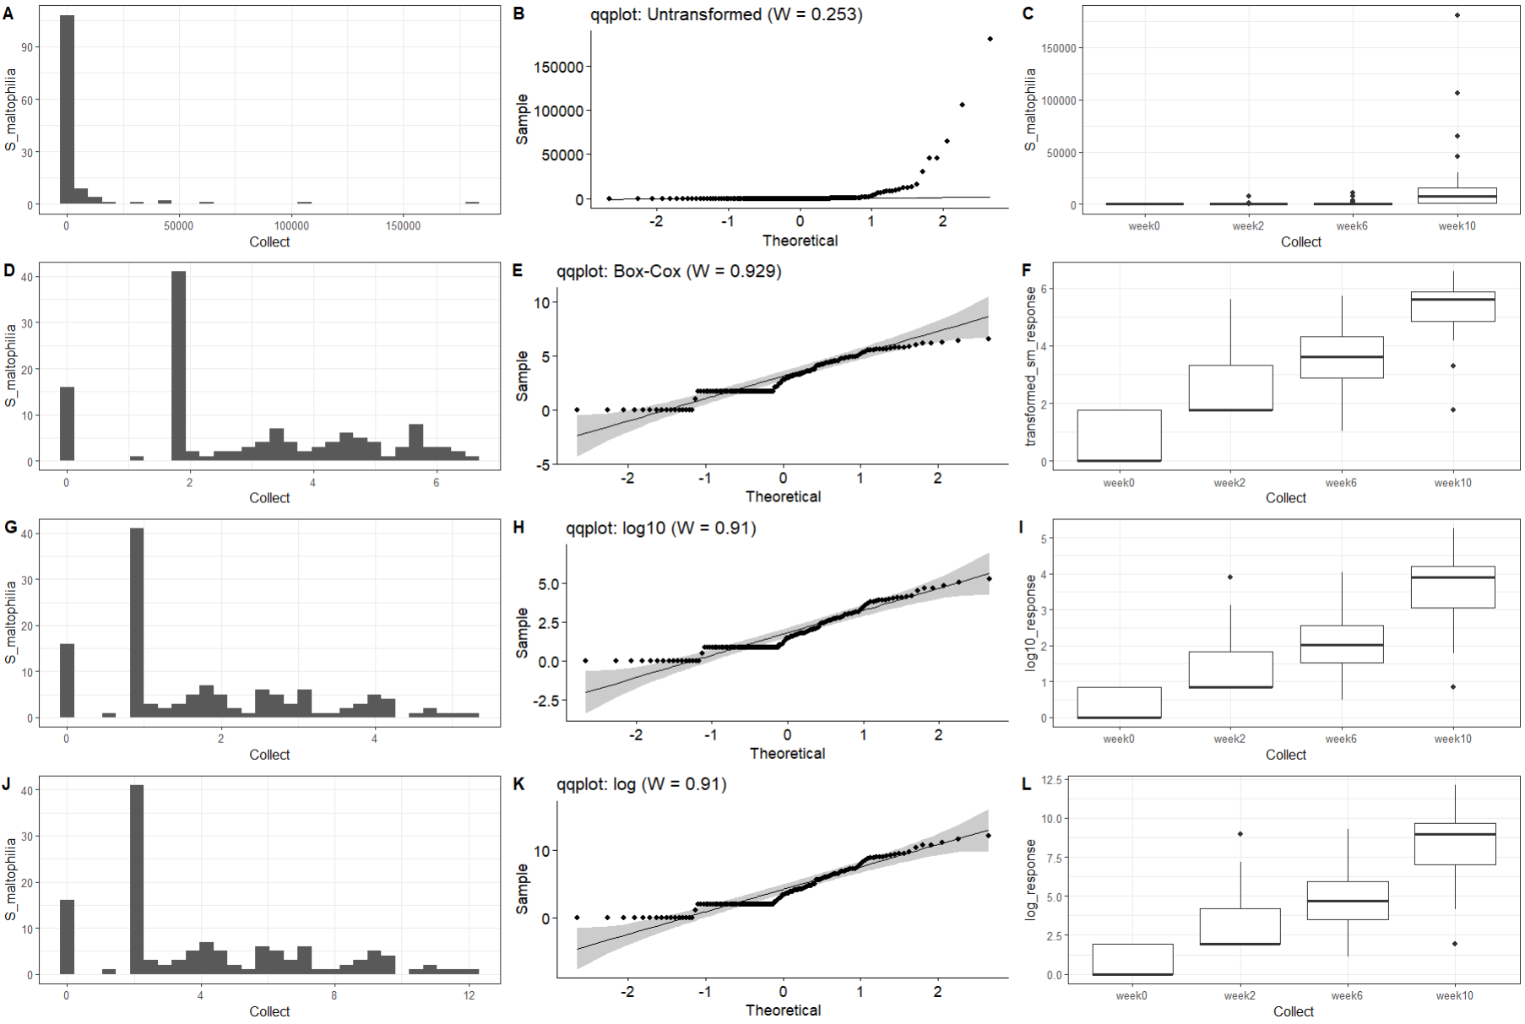
Microplastics: S_maltophilia data transformation
-Shapiro-Wilks normality statistic (W), range from 0 to 1, with 1 being perfectly normal
-All transformations fail normality at p<0.05
-The box-cox transformation does a bit better inducing normality
-ln and log10 essentially equivalent, not too far behind

Slide 5
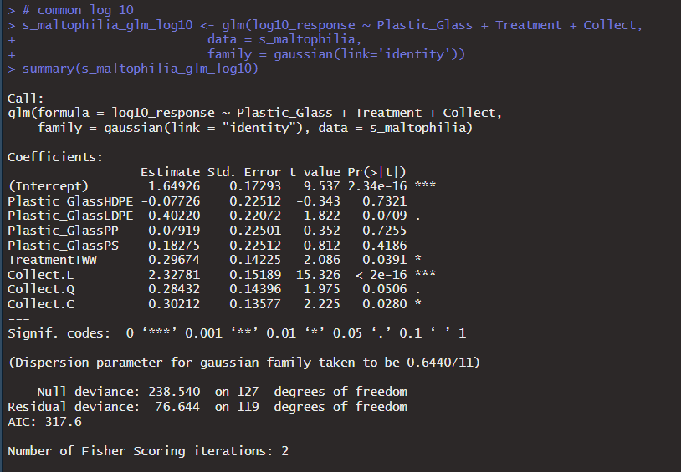
S maltophilia mp glm full model

Slide 6
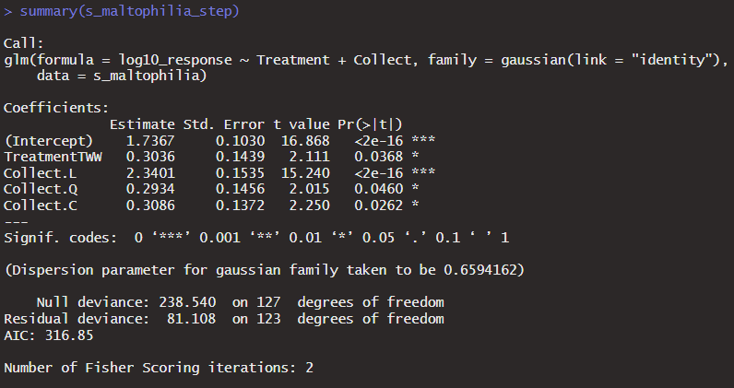
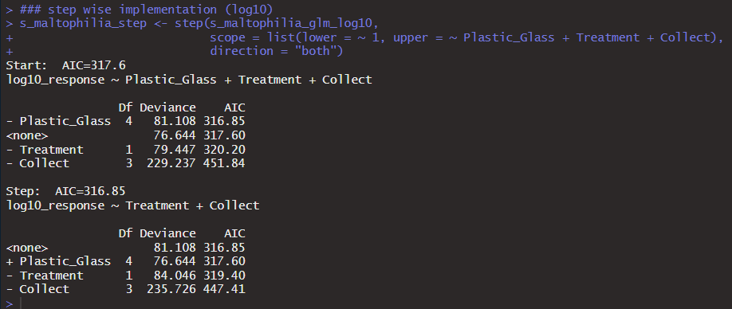
S maltophilia mp glm step -time and water treatment variable kept

Slide 7
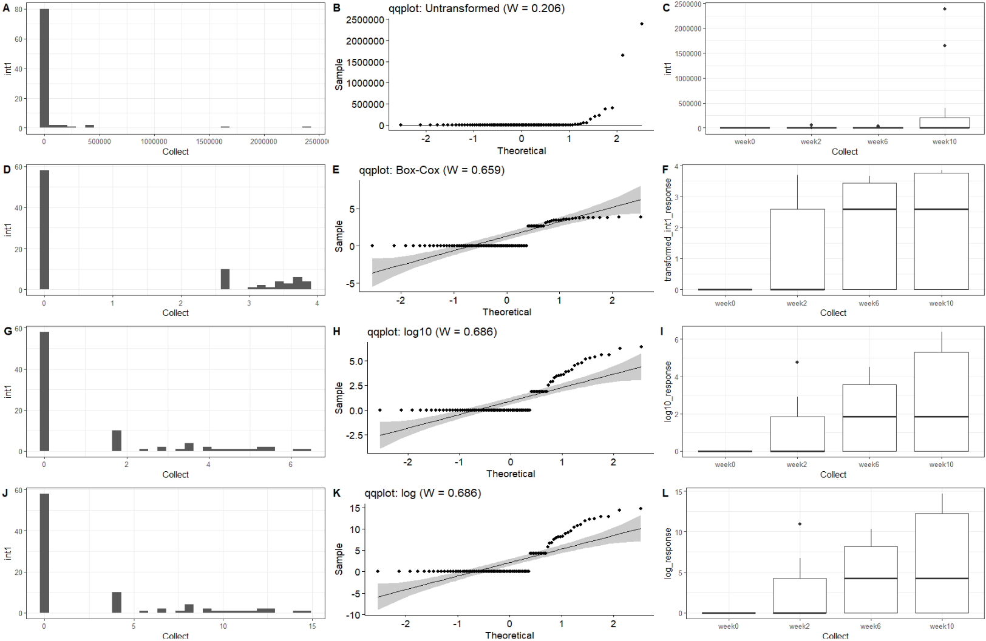
intI1 data transformation

Slide 8
Int1 mp glm full model

Slide 9
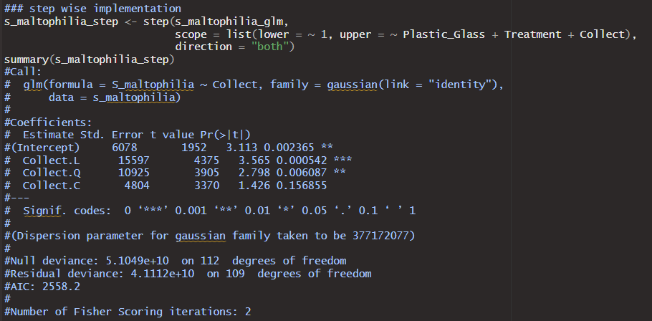
Int1 mp step - only time kept, linear or quadratic

Slide 10
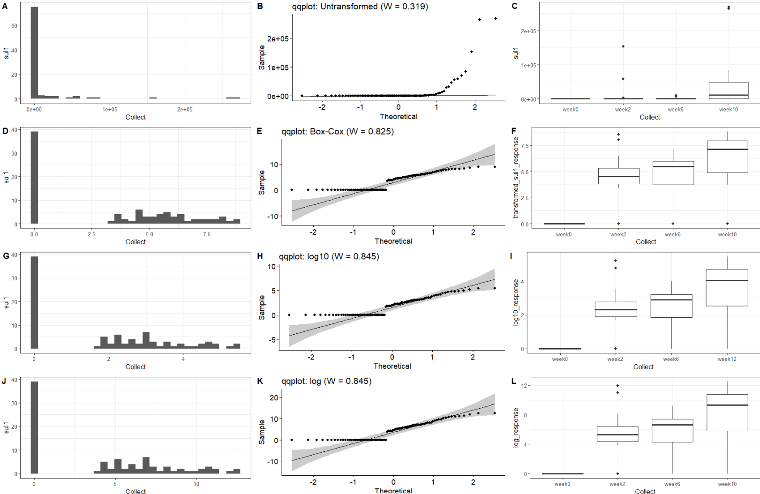
Sul1 data transformation

Slide 11
Sul1 mp glm full model

Slide 12
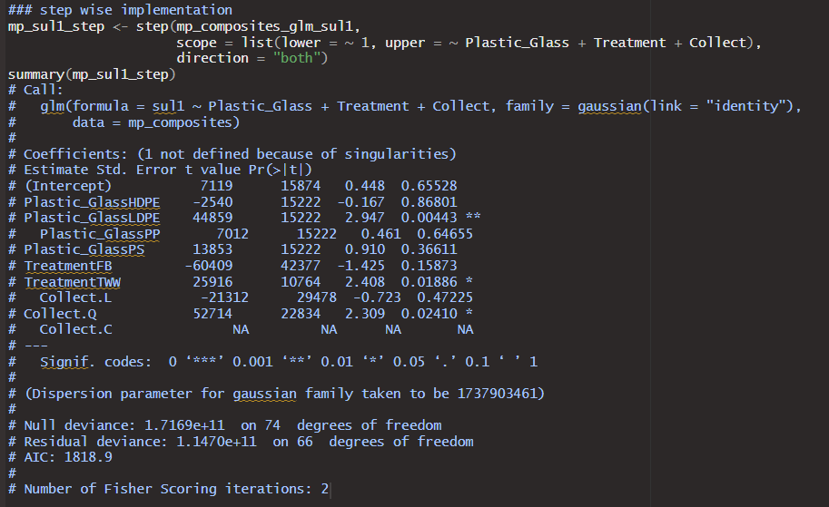
Sul1 mp step -everything kept -time quadratic

Slide 13
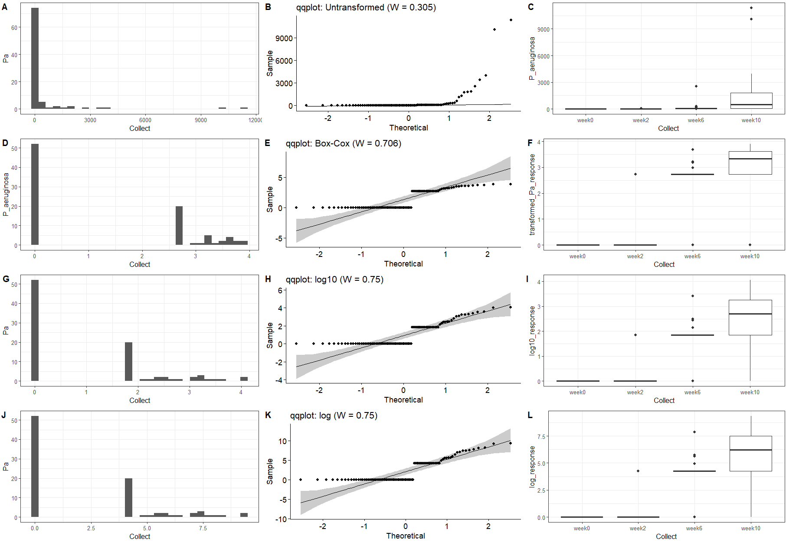
P. a data transformation

Slide 14
P aeruginosa mp glm full model

Slide 15
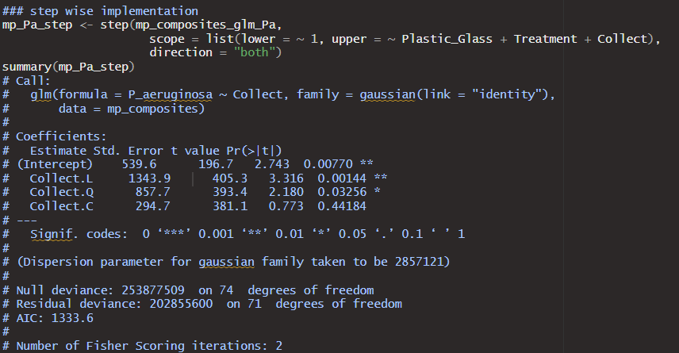
P. aeruginosa mp step - time kept and now significant for both linear and quadratic

Slide 16
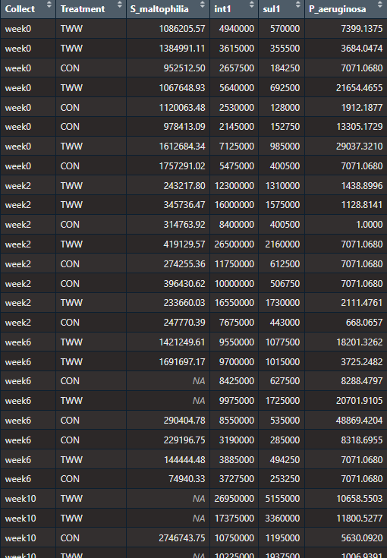
Water Data

Slide 17
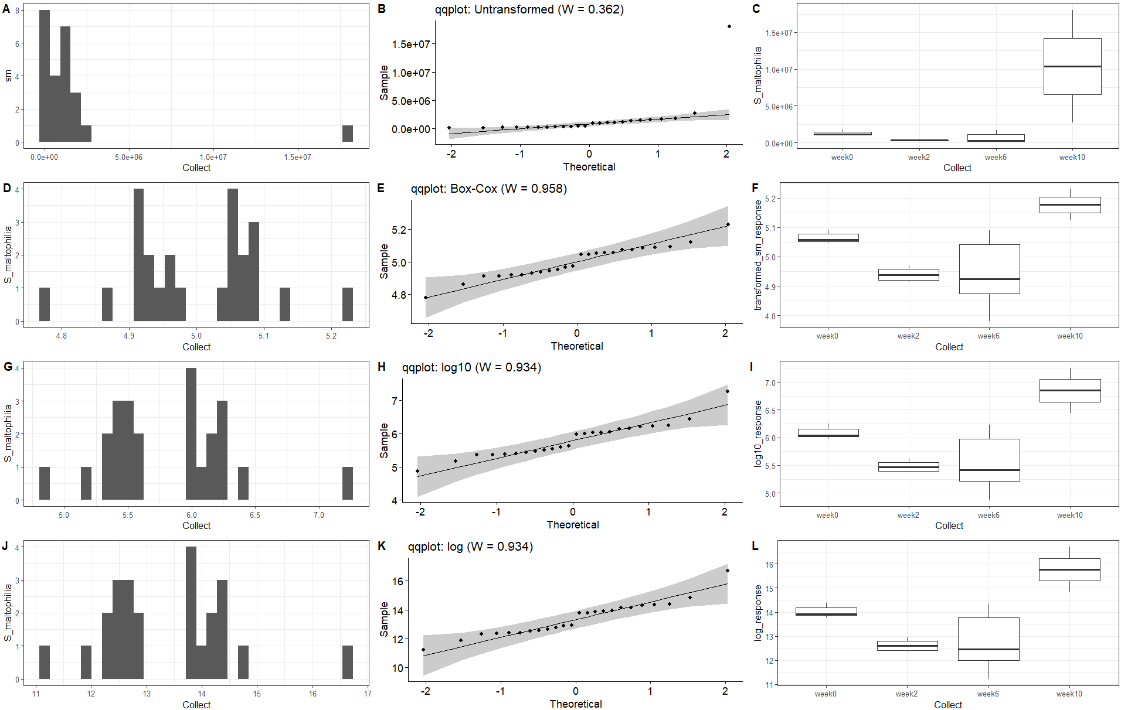
S_maltophilia water data transformation

Slide 18
S maltophilia water glm full model

Slide 19
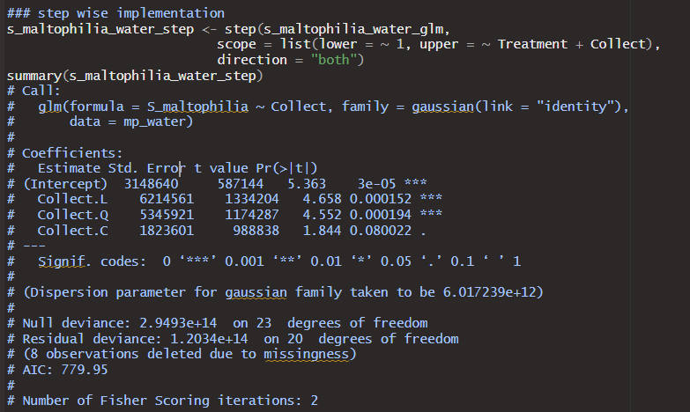
S maltophilia water step --time trend remains for step() implementation

Slide 20
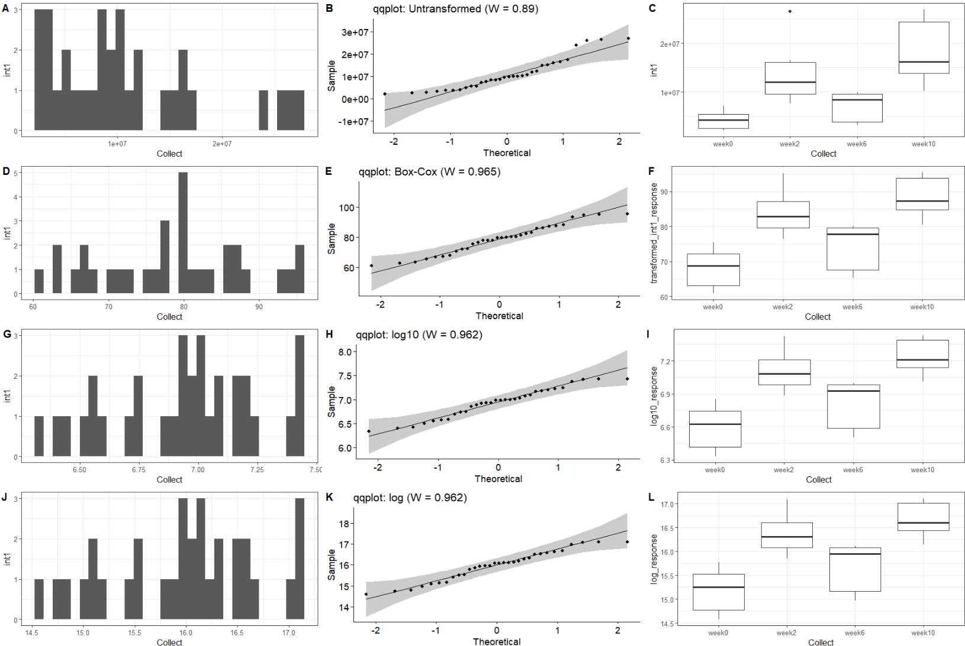
intI1 water data transformation

Slide 21
Int1 water glm full model

Slide 22
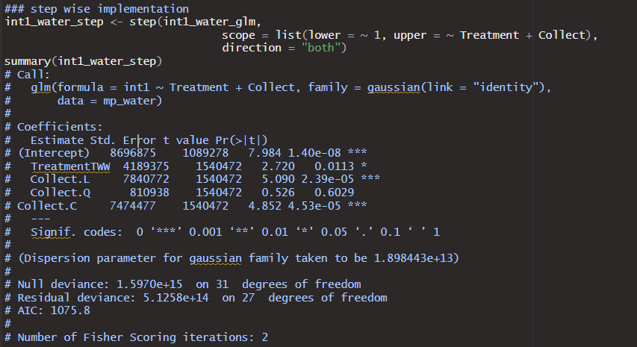
Int1 water step --linear time trend and TWW difference remain in step model (as expected here)

Slide 23
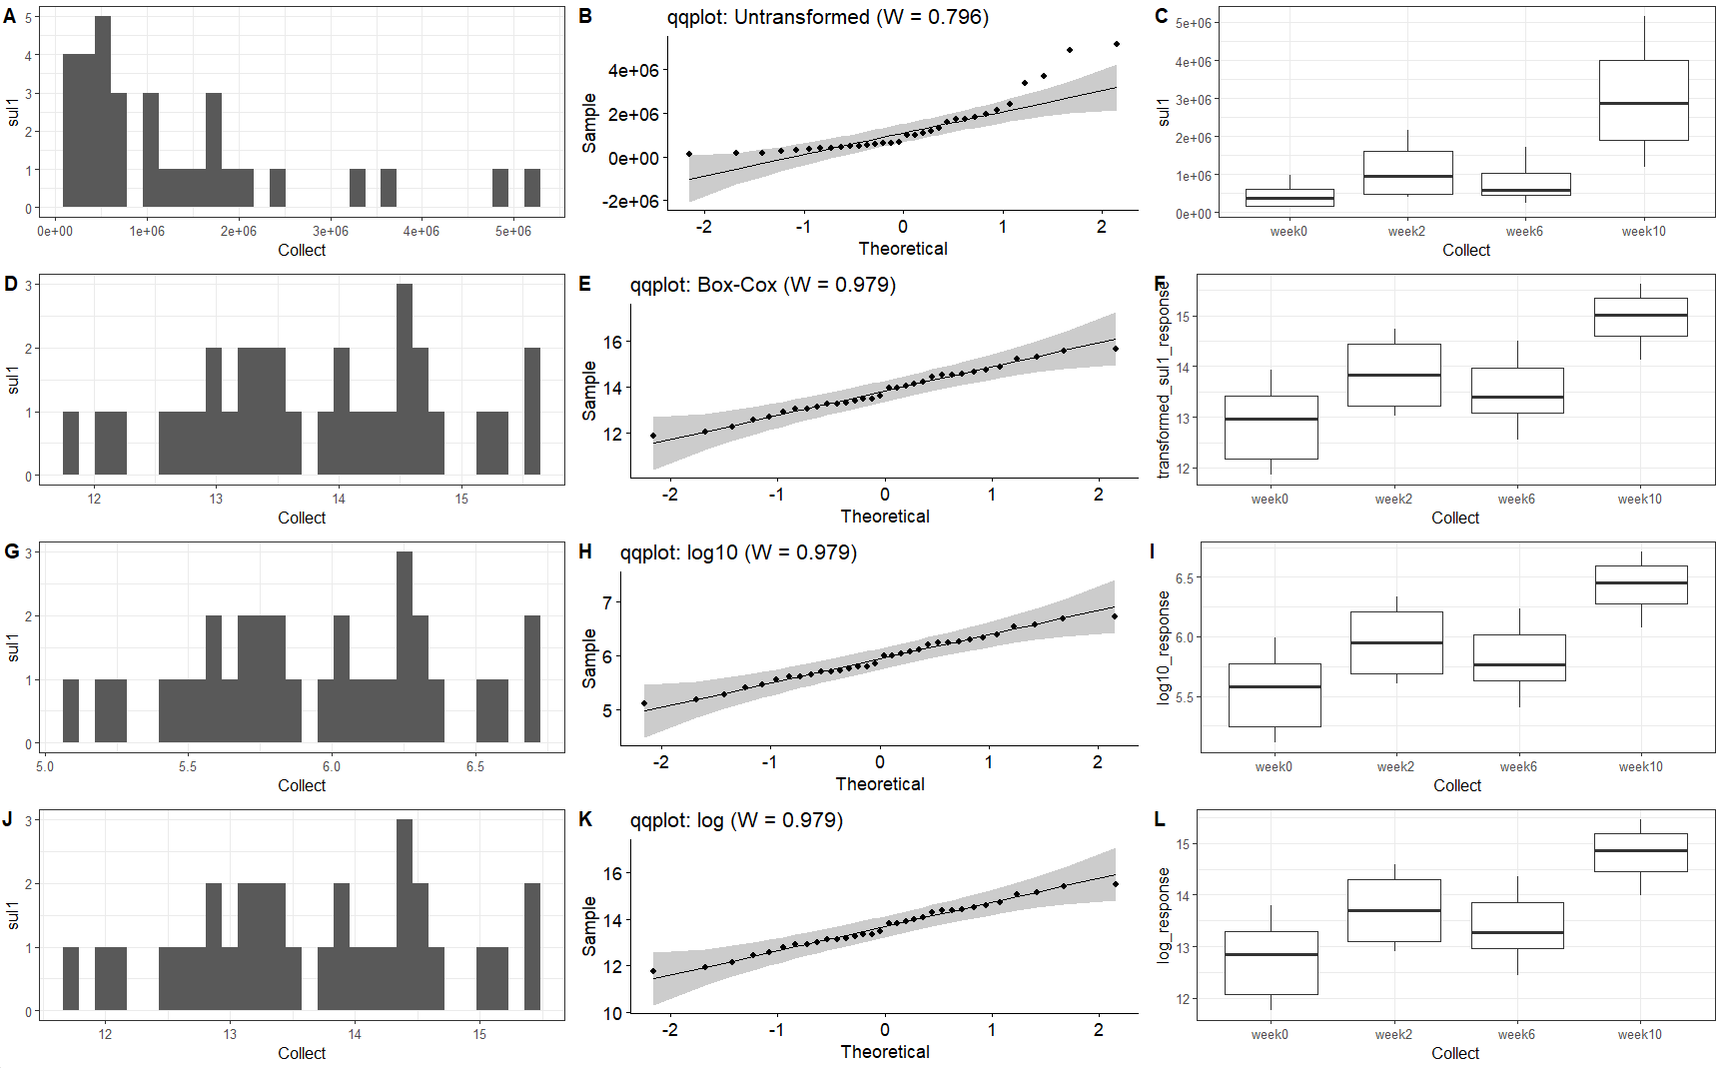
sul1 data transformation

Slide 24
Sul1 water glm full model

Slide 25
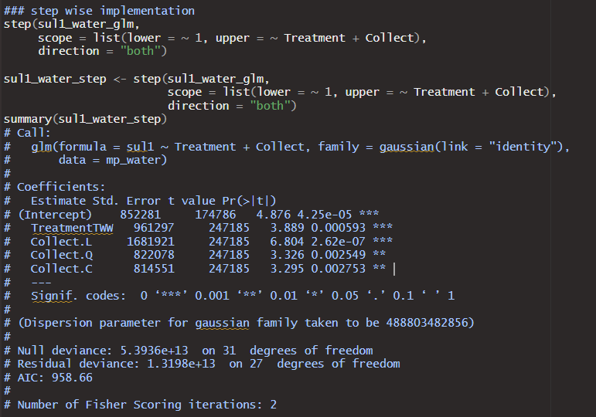
Sul1 water full glm --time trend and TWW difference remain

Slide 26
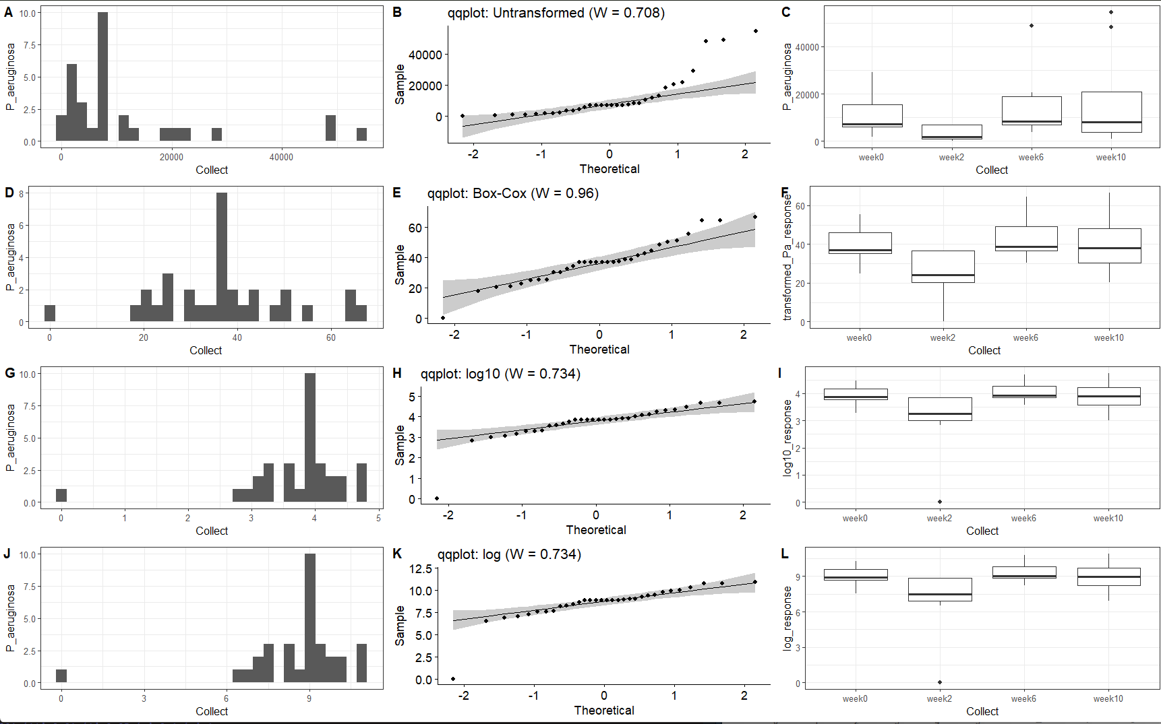
P_aeruginosa data transformation

Slide 27
P aeruginosa water glm full model

Slide 28
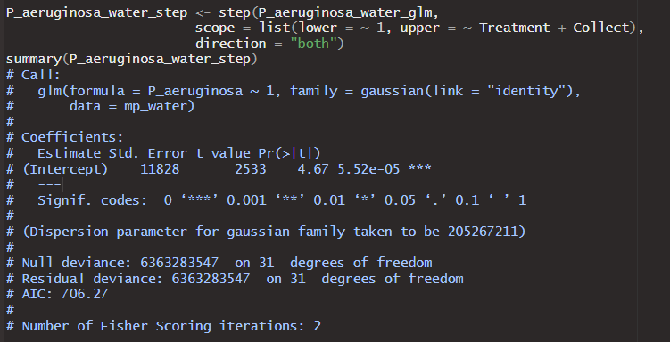
P. aeruginosa water step -still nothing significant

Slide 29
Overall Results
Microplastics--Not sure how much detail you need.
Time is significant for all the responses (p value in full model is significant and/or kept in the stepwise regression).
LDPE often differentiates itself from other plastics (significant in 3 of the 4, still the lowest p value in the 4th), but plastic type gets dropped in the stepwise for all but sul1. (Might be different with less plastic levels in the factor)
Water type different for sul1 only, but I have not deleted the fb data at this point.
Water—
S. multophilia there is a time trend but no difference between the water treatments.
Int1 and sul1 both show time trends and water differences.
P. aeruginosa no time trend or difference between the water treatments
Presumably time trends in the water may possibly be a bit of a confounding variable for interpreting the accumulation on microplastics over time.

