Slide 1
Methods
To model the relationship between biomarker (?) levels on microplastics (4—int1, sul1, Pa, Sm) and the categorical factors of plastic type, time, and water type, we implemented a generalized linear model (GLM) in R (version 4.2.1) using the glm() function with a Gaussian family and identity link function, specifying the model formula as biomarker response ~ plastic_type + time + water_type. Biomarker responses were normal transformed by finding the optimal lambda for a Box-Cox transformation. The choice of the Gaussian family and identity link assumes that the response variable is normally distributed and linearly related to the additive effects of the categorical predictors. We examined the model summary to assess the significance of each factor's coefficients, which represent the expected change in biomarker expression for each factor level compared to the reference level. We repeated these models for water concentrations, dropping the plastic type covariate. To select the most parsimonious model, we employed bidirectional stepwise regression using the step() function from the stats package, specifying direction = "both". The Akaike Information Criterion (AIC) was used as the model selection metric to balance goodness of fit with model complexity, with a lower AIC indicating a better model fit. The stepwise procedure iteratively added or removed predictors to minimize the AIC until no further improvements could be made, yielding a final model containing only the most informative variables and interactions for explaining the response.
I have removed the fb level and inserted 0 concentrations for week 0 for each of the response variables for microplastics (to have the same dimensions as water data).

Slide 2
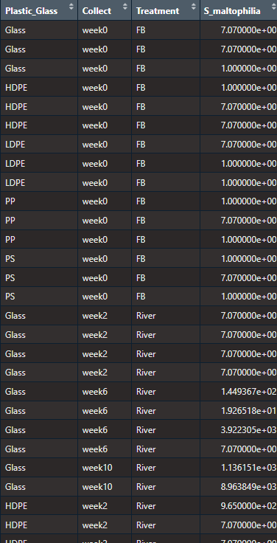
Microplastic data

Slide 3
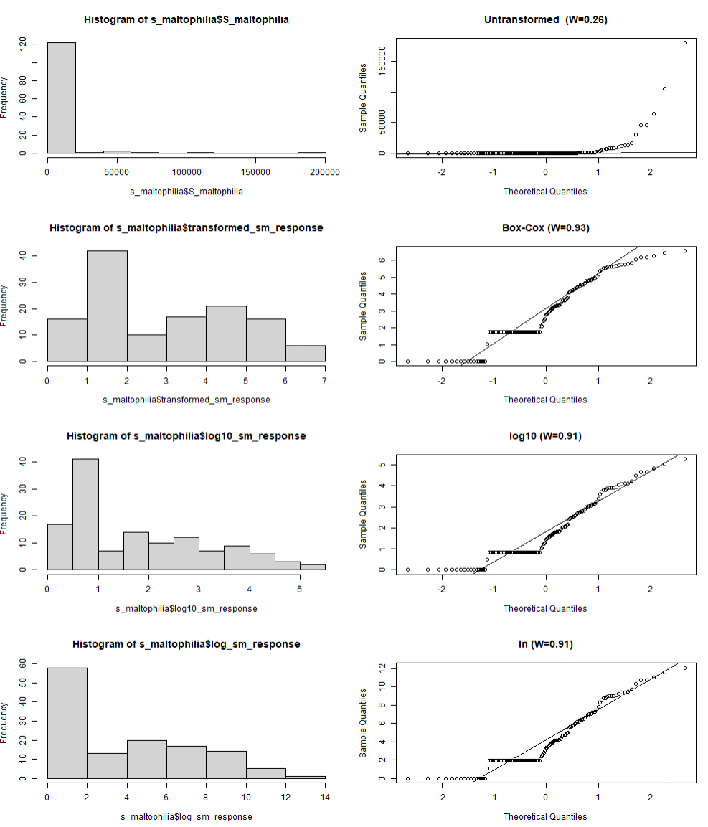
Microplastics: S_maltophilia data transformation
-Shapiro-Wilks normality statistic (W), range from 0 to 1, with 1 being perfectly normal
-All transformations fail normality at p<0.05
-The box-cox transformation does a bit better inducing normality
-ln and log10 essentially equivalent, not too far behind

Slide 4
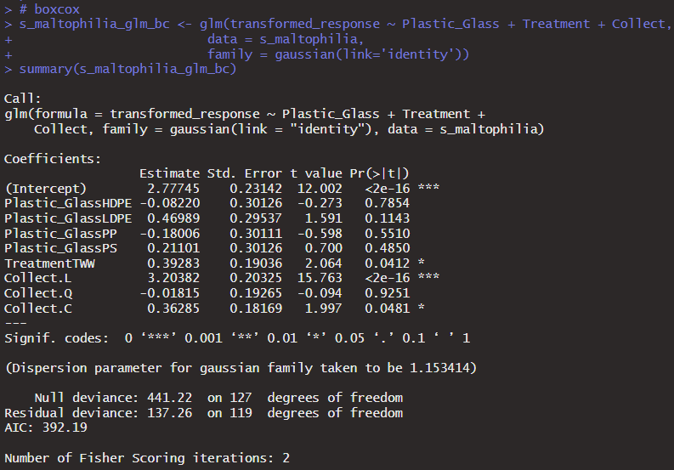
S maltophilia mp full glm (Box Cox) -time linear -water treatment effect

Slide 5
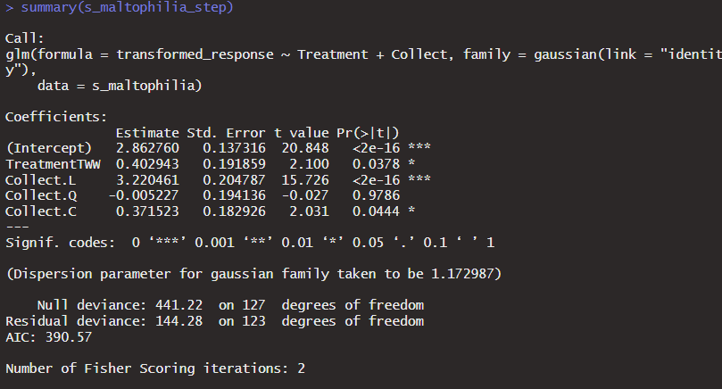
S maltophilia mp glm step -time and water treatment variable kept

Slide 6
intI1 data transformation

Slide 7
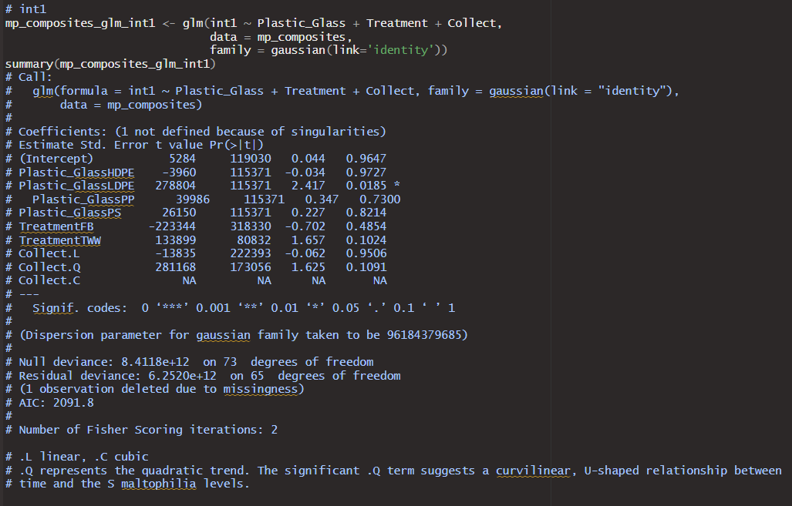
Int1 mp full glm -ldpe -evidence for time quadratic (p=0.1)

Slide 8
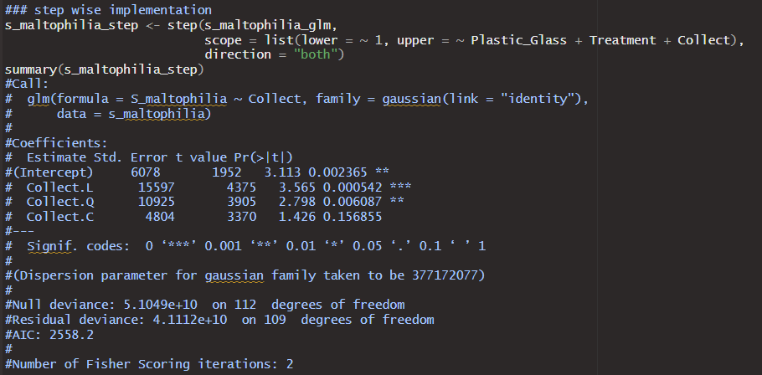
Int1 mp step - only time kept, linear or quadratic

Slide 9
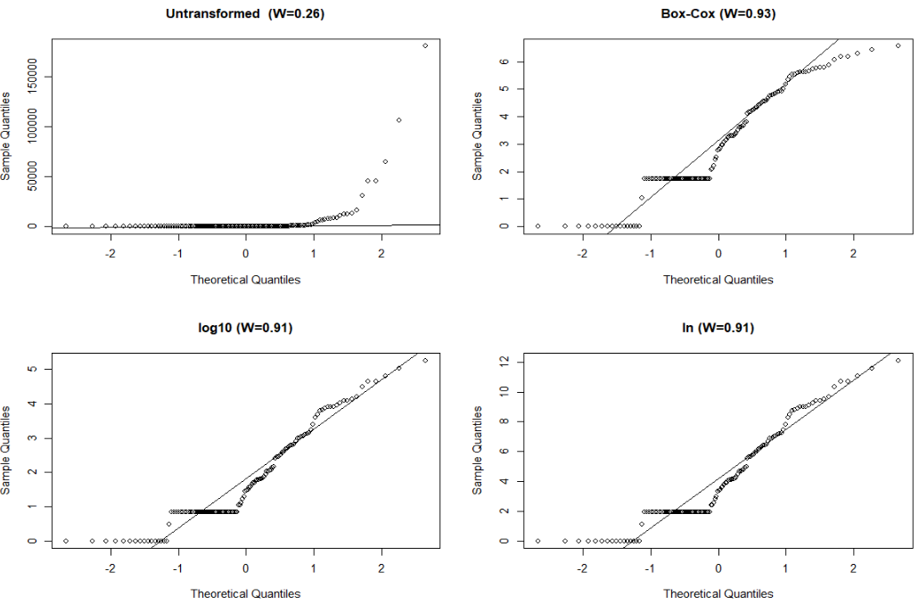
S_maltophilia data transformation

Slide 10
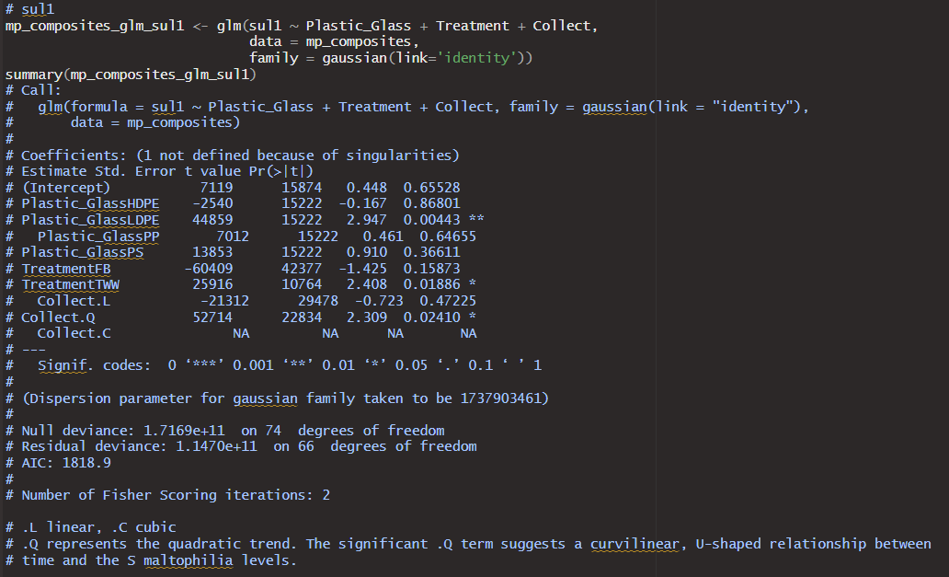
Sul1 mp full glm -ldpe -tww -time quadratic

Slide 11
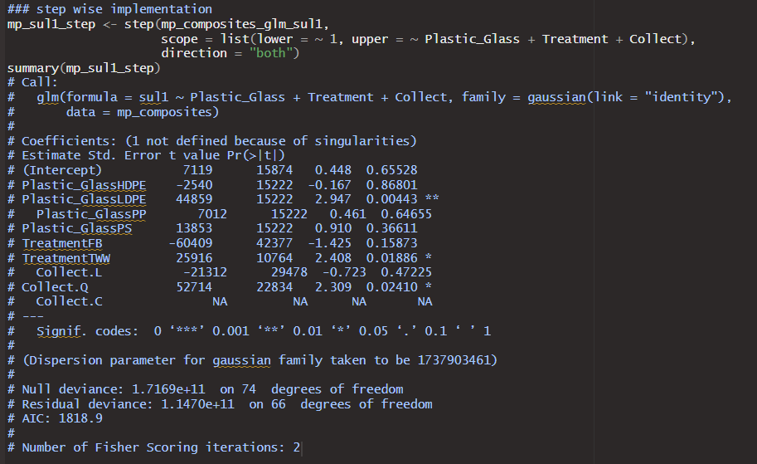
Sul1 mp step -everything kept -time quadratic

Slide 12
S_maltophilia data transformation

Slide 13
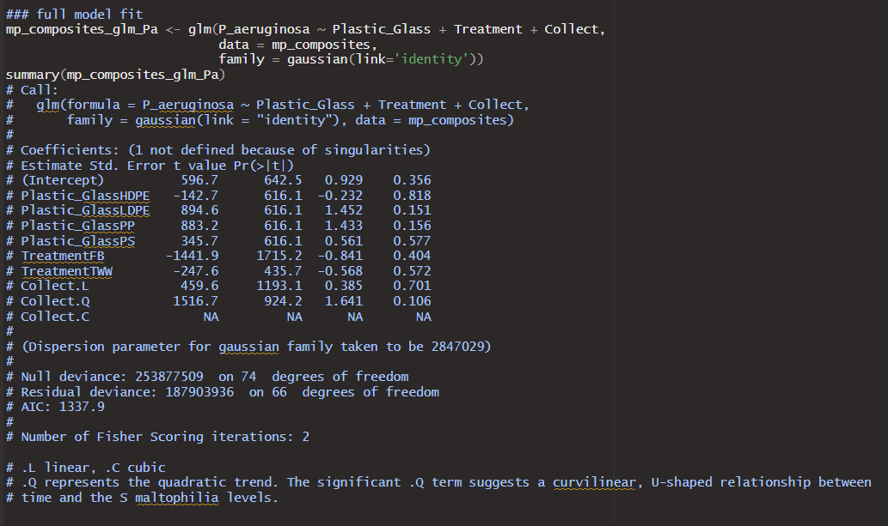
P. aeruginosa mp full glm -time quadratic with p=0.1

Slide 14
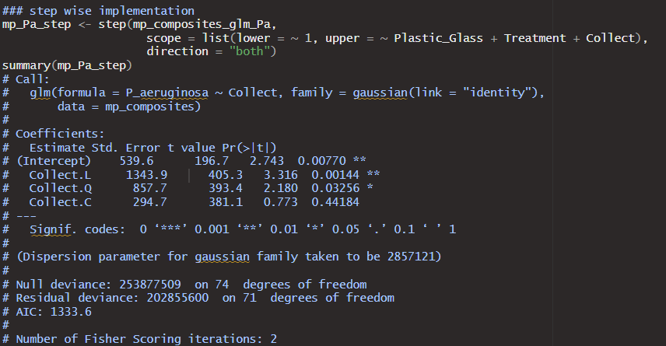
P. aeruginosa mp step - time kept and now significant for both linear and quadratic

Slide 15
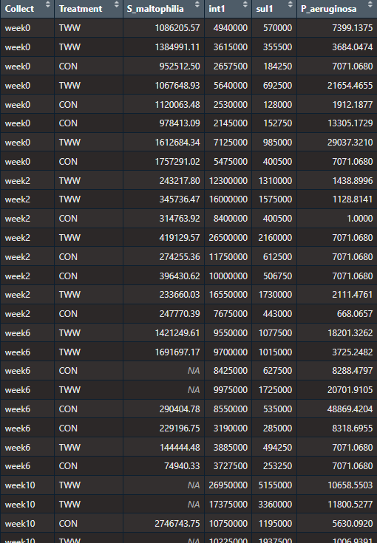
Water Data

Slide 16
S_maltophilia data transformation

Slide 17
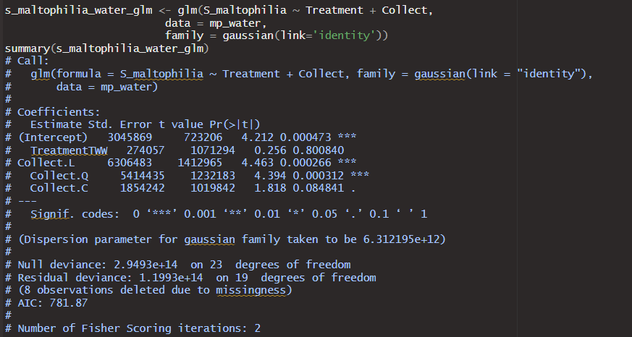
S maltophilia water full glm --there does seem to be a linear/quadratic trend over time here

Slide 18
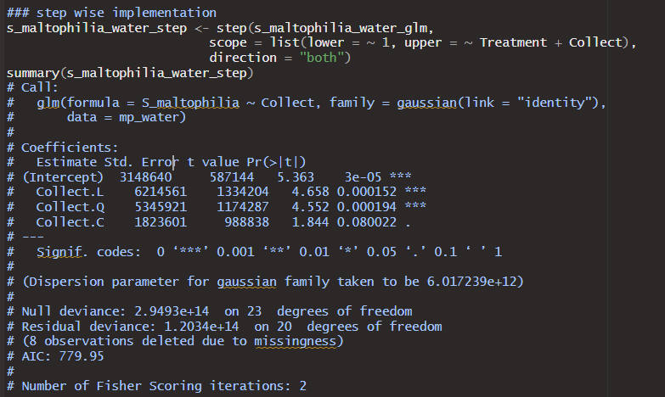
S maltophilia water step --time trend remains for step() implementation

Slide 19
S_maltophilia data transformation

Slide 20
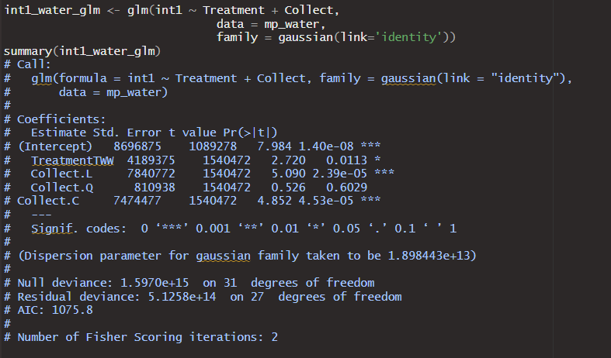
Int1 water full glm --TWW significant vs river water --linear time trend also present

Slide 21
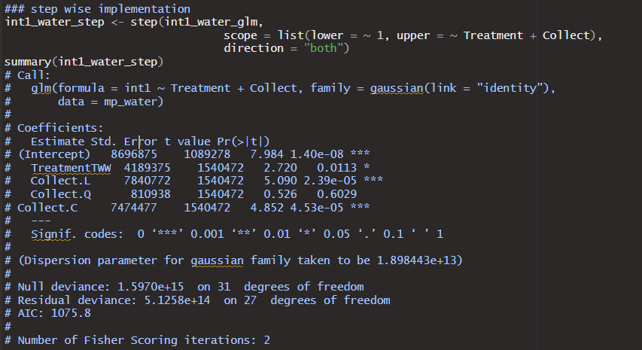
Int1 water step --linear time trend and TWW difference remain in step model (as expected here)

Slide 22
S_maltophilia data transformation

Slide 23
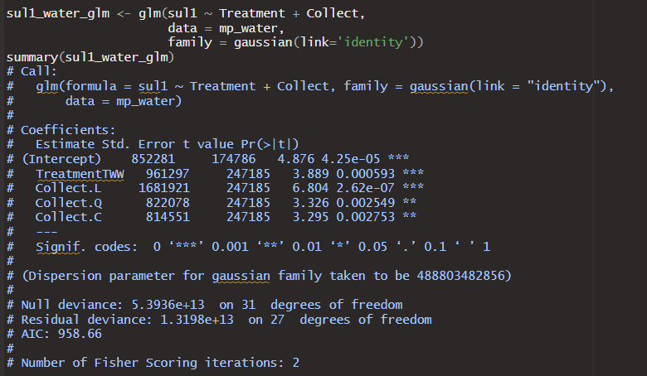
Sul1 water full glm --time trend present TWW difference versus RW(Con)

Slide 24
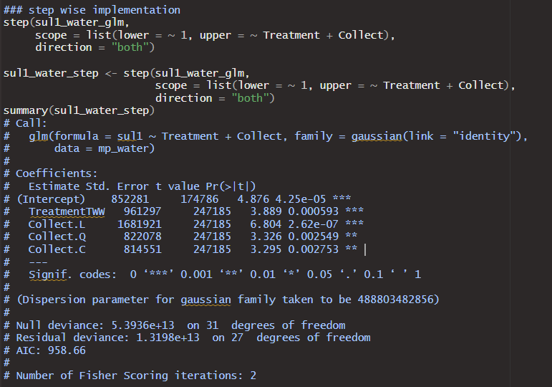
Sul1 water full glm --time trend and TWW difference remain

Slide 25
S_maltophilia data transformation

Slide 26
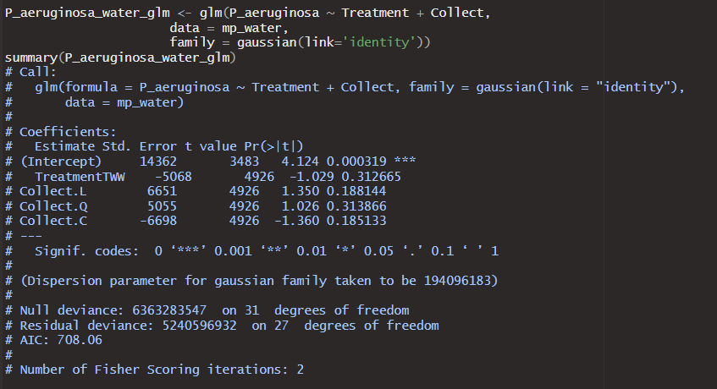
P. aeruginosa water full glm -nothing significant

Slide 27
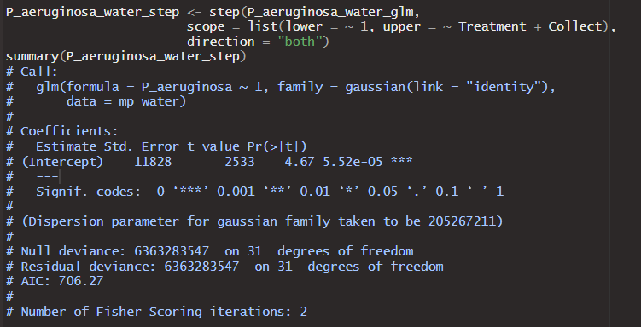
P. aeruginosa water step -still nothing significant

Slide 28
Overall Results
Microplastics--Not sure how much detail you need.
Time is significant for all the responses (p value in full model is significant and/or kept in the stepwise regression).
LDPE often differentiates itself from other plastics (significant in 3 of the 4, still the lowest p value in the 4th), but plastic type gets dropped in the stepwise for all but sul1. (Might be different with less plastic levels in the factor)
Water type different for sul1 only, but I have not deleted the fb data at this point.
Water—
S. multophilia there is a time trend but no difference between the water treatments.
Int1 and sul1 both show time trends and water differences.
P. aeruginosa no time trend or difference between the water treatments
Presumably time trends in the water may possibly be a bit of a confounding variable for interpreting the accumulation on microplastics over time.

