Slide 1
Methods
To model the relationship between biomarker (?) levels on microplastics (4—int1, sul1, Pa, Sm) and the categorical factors of plastic type, time, and water type, we implemented a generalized linear model (GLM) in R (version 4.2.1) using the glm() function with a Gaussian family and identity link function, specifying the model formula as biomarker response ~ plastic_type + time + water_type. Biomarker responses were normalized with a log10 transformation. The choice of the Gaussian family and identity link assumes that the response variable is normally distributed and linearly related to the additive effects of the categorical predictors. We examined the model summary to assess the significance of each factor's coefficients, which represent the expected change in biomarker expression for each factor level compared to the reference level. We repeated these models for water concentrations, dropping the plastic type covariate. To select the most parsimonious model, we employed bidirectional stepwise regression using the step() function from the stats package, specifying direction = "both". The Akaike Information Criterion (AIC) was used as the model selection metric to balance goodness of fit with model complexity, with a lower AIC indicating a better model fit. The stepwise procedure iteratively added or removed predictors to minimize the AIC until no further improvements could be made, yielding a final model containing only the most informative variables and interactions for explaining the response.
As discussed earlier. I have removed the fb level and inserted 0 concentrations for week 0 for each of the response variables for microplastics (to have the same dimensions as water data).

Slide 2
Results
For visual inspection, there are plots (histograms, boxplots by week, and qqplots) of the untransformed data, box cox with optimal lambda, natural log, and log10.
MM said that log10 was most typically used so I stuck with that for the glm, the normality differences between log10, natural log, and optimal Box-Cox are minor for this data.
Therefore, to make the glm output easier to process, I present only the glm of the log10 transformed data, full results in 1 slide and then the stepwise glm in the next slide.

Slide 3
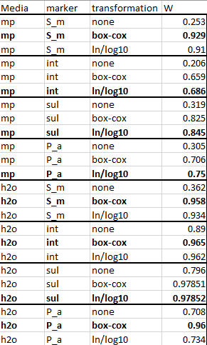
Transformations
Normality was assessed with a Shapiro-Wilks test for untransformed data, for the optimal lambda of a box-cox transformation, natural log, and log10 transformations. The statistic is a Shapiro-Wilks W test, where W=1 is perfect normality and values approaching 1 are better than lower W scores. The transformations made the data more normal (and therefore better fits for the glm) compared to the untransformed data for all 8 data subsets.
Note: The normality scores for the natural log and log10 are equivalent here (though not for a goodness of fit test which we don’t need for the glm). Technically a log transformation is a subset of the Box-Cox transformation algorithm, though the Box-Cox does not always perform better.
Here, the log transformations had a slightly better fit 4 times and the log transformations did better the other 4 times. Therefore, I decided to just stick with the log10 transformation for the glm implementation since that is more typical for this field and there is little difference overall.

Slide 4
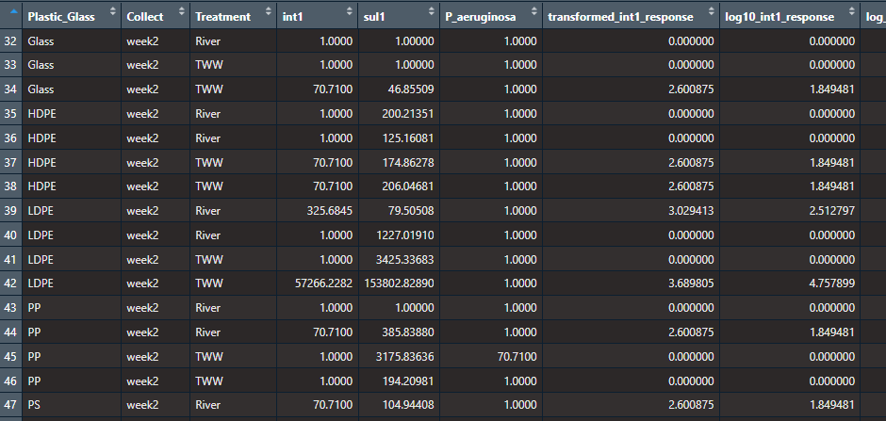
Microplastic data

Slide 5
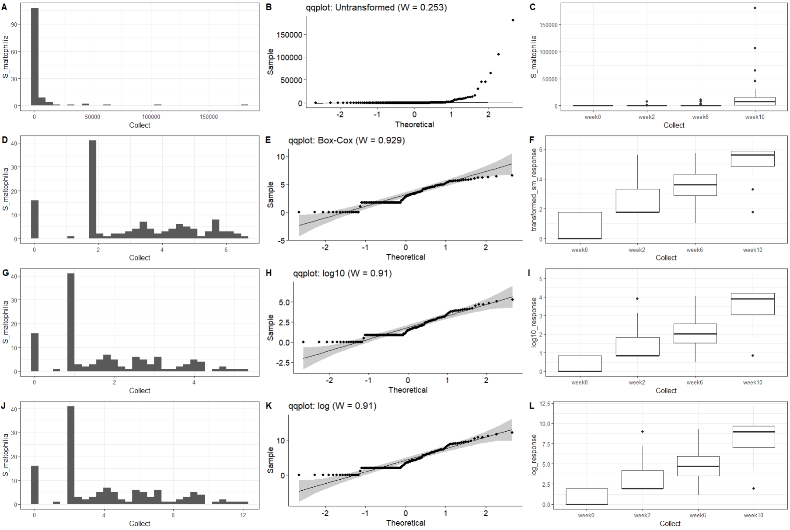
Microplastics: S_maltophilia data transformation
-Shapiro-Wilks normality statistic (W), range from 0 to 1, with 1 being perfectly normal
-All transformations fail normality at p<0.05
-The box-cox transformation does a bit better inducing normality
-ln and log10 essentially equivalent, not too far behind

Slide 6
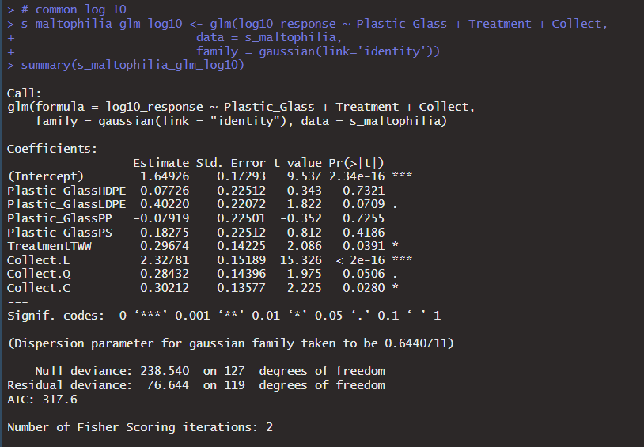
S maltophilia mp glm full model
Mixed on plastic type, only ldpe close to significance
Treatment significant
Linear with time most significant

Slide 7
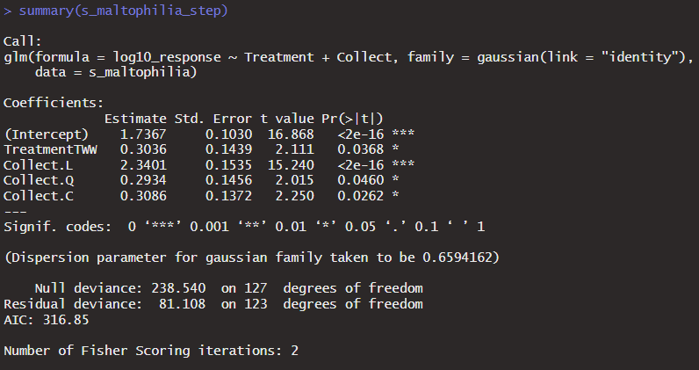
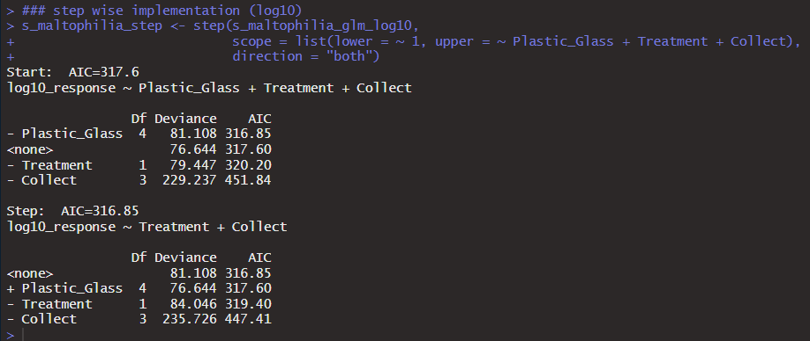
S maltophilia mp glm step -time and water treatment variable kept -plastic type is dropped by the step wise but AIC difference is less than 1 so close to being included

Slide 8
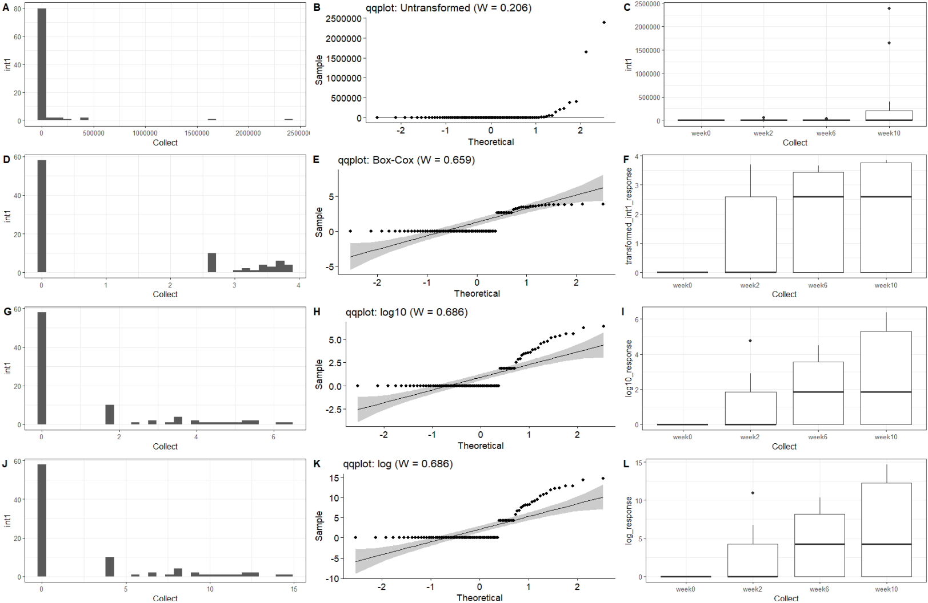
intI1 data transformation
-Shapiro-Wilks normality statistic (W), range from 0 to 1, with 1 being perfectly normal
-All transformations fail normality at p<0.05
-The log transformations do a bit better inducing normality, but neither do a great job

Slide 9
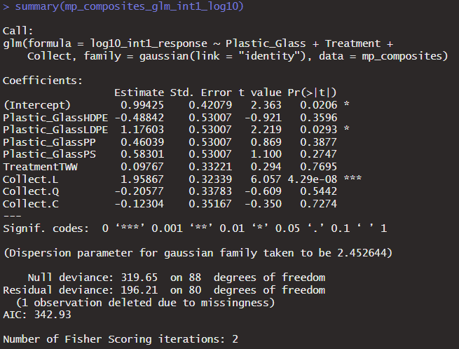
Int1 mp glm full model
Mixed on plastic type again, ldpe is significant
Treatment a small (and insignificant) positive bump for amended water
Linear with time most significant (again)

Slide 10
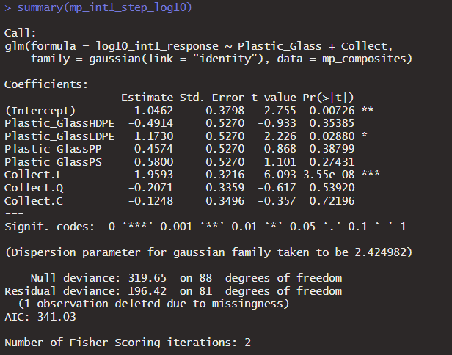
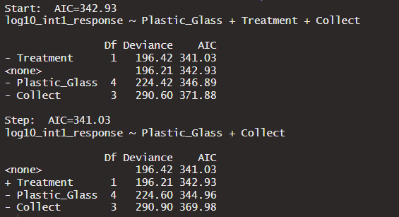
Int1 mp step - time kept, linear - plastic type is significant - treatment type is dropped

Slide 11
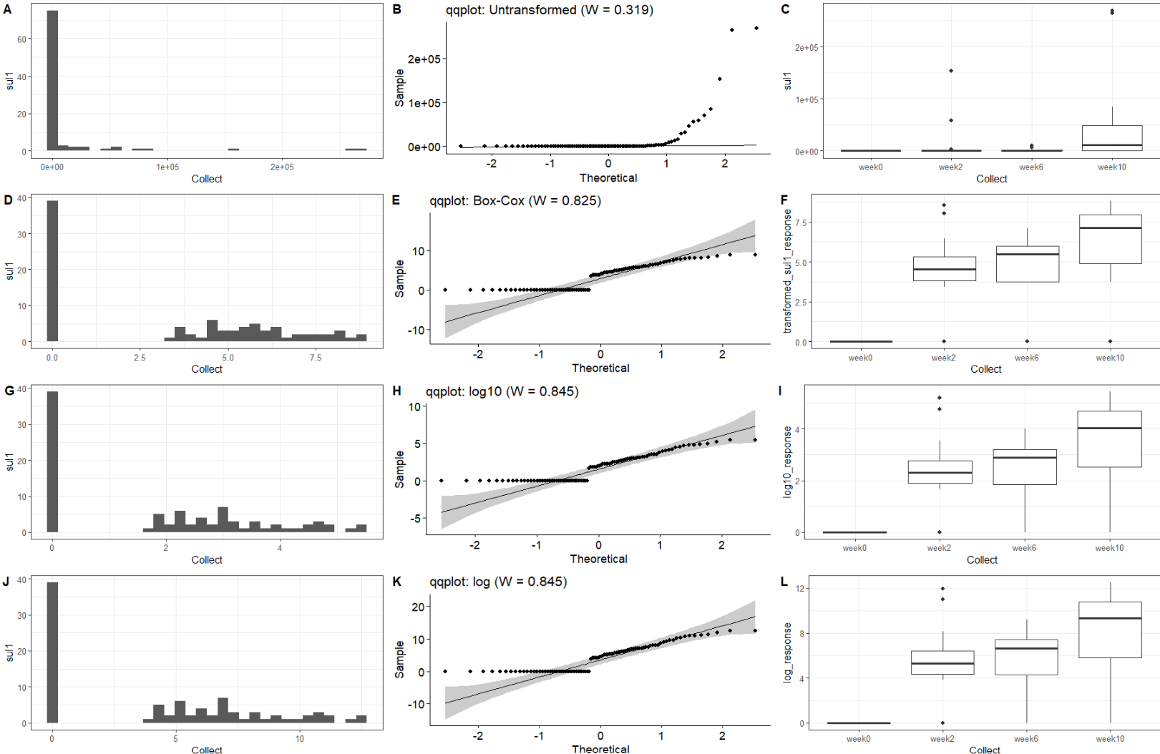
Sul1 data transformation
-Shapiro-Wilks normality statistic (W), range from 0 to 1, with 1 being perfectly normal
-All transformations fail normality at p<0.05
-The log transformations do a bit better inducing normality, but neither do a great job.

Slide 12
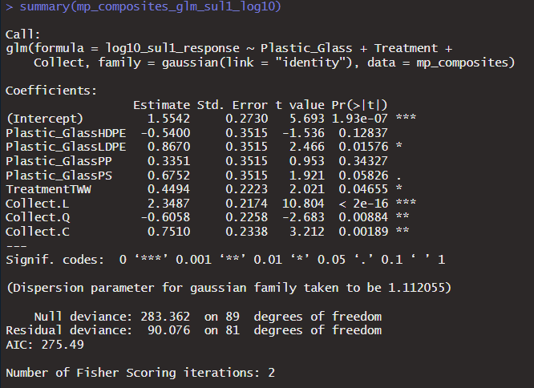
Sul1 mp glm full model
Everything significant here, time (all the methods work but linear most significant again)
Positive effect of amended water significant
HDPE negative coefficient (n.s.), other coefficients positive with LDPE significant

Slide 13
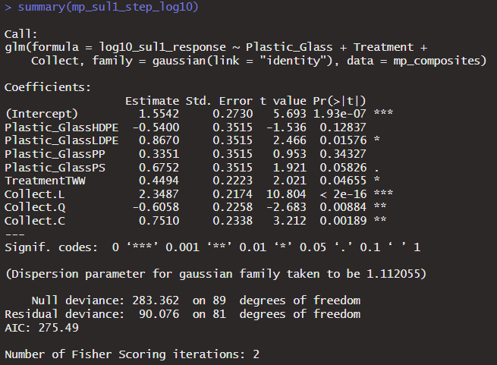
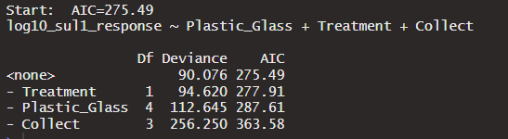
Sul1 mp step -everything kept -time linear but other choices also work

Slide 14
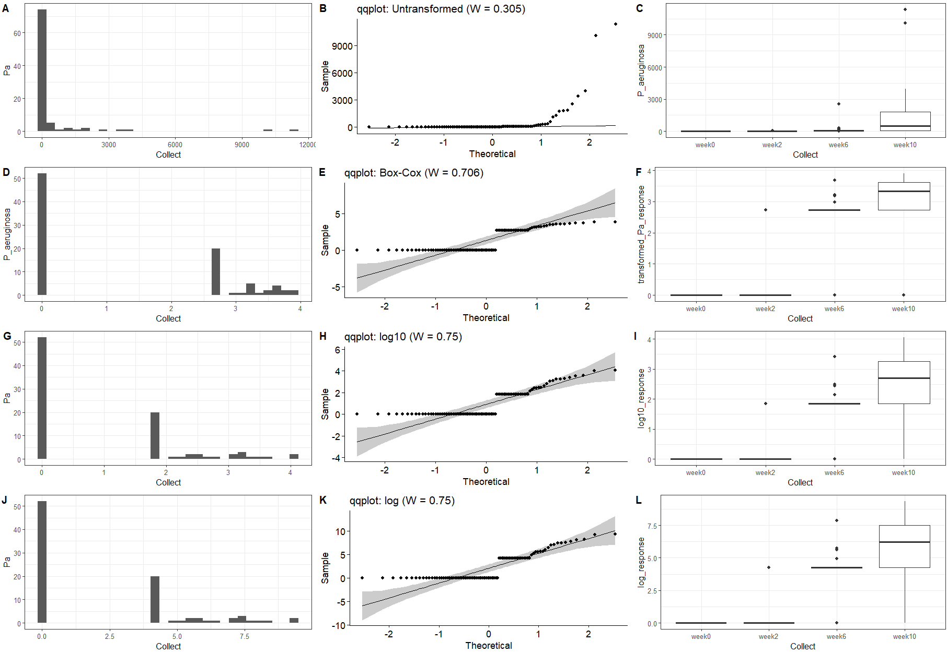
P. a data transformation
-Shapiro-Wilks normality statistic (W), range from 0 to 1, with 1 being perfectly normal
-All transformations fail normality at p<0.05
-The log transformations do a bit better inducing normality, but neither do a great job.

Slide 15
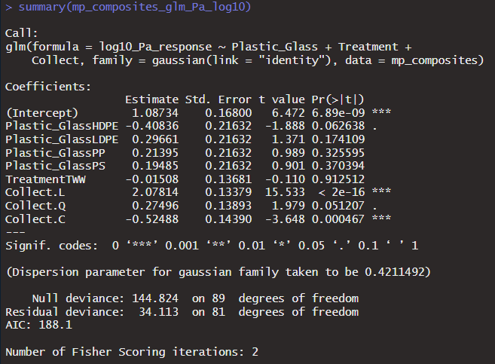
P aeruginosa mp glm full model
Everything significant here again, time (all the methods work but linear once again most significant)
Negative (n.s.) effect of amended water
HDPE negative coefficient again (some support, p=0.06), other coefficients positive but none significant

Slide 16
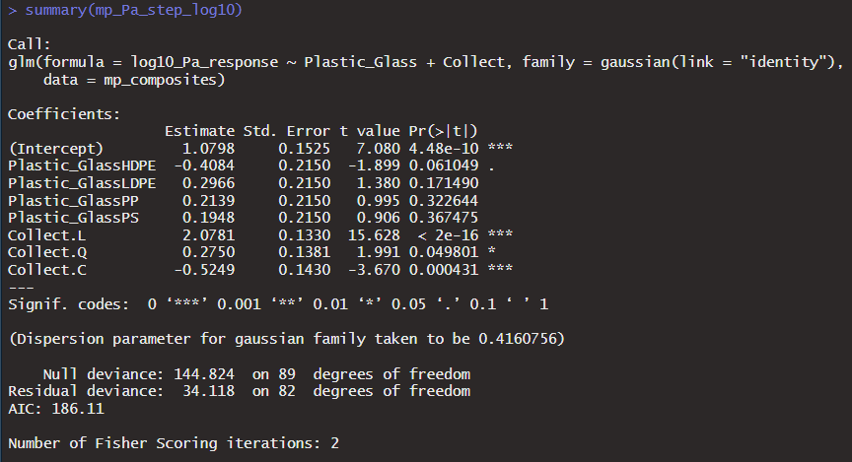
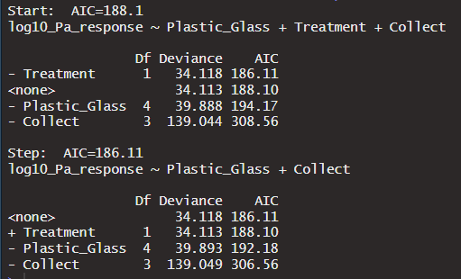
P. aeruginosa mp step - time kept and significant - water type dropped again

Slide 17
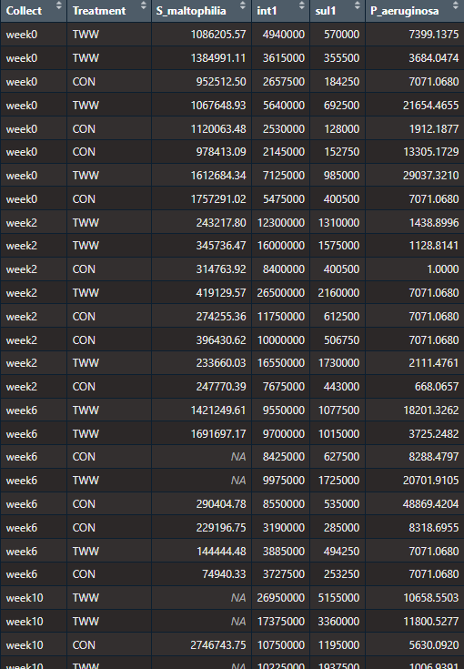
Water Data

Slide 18
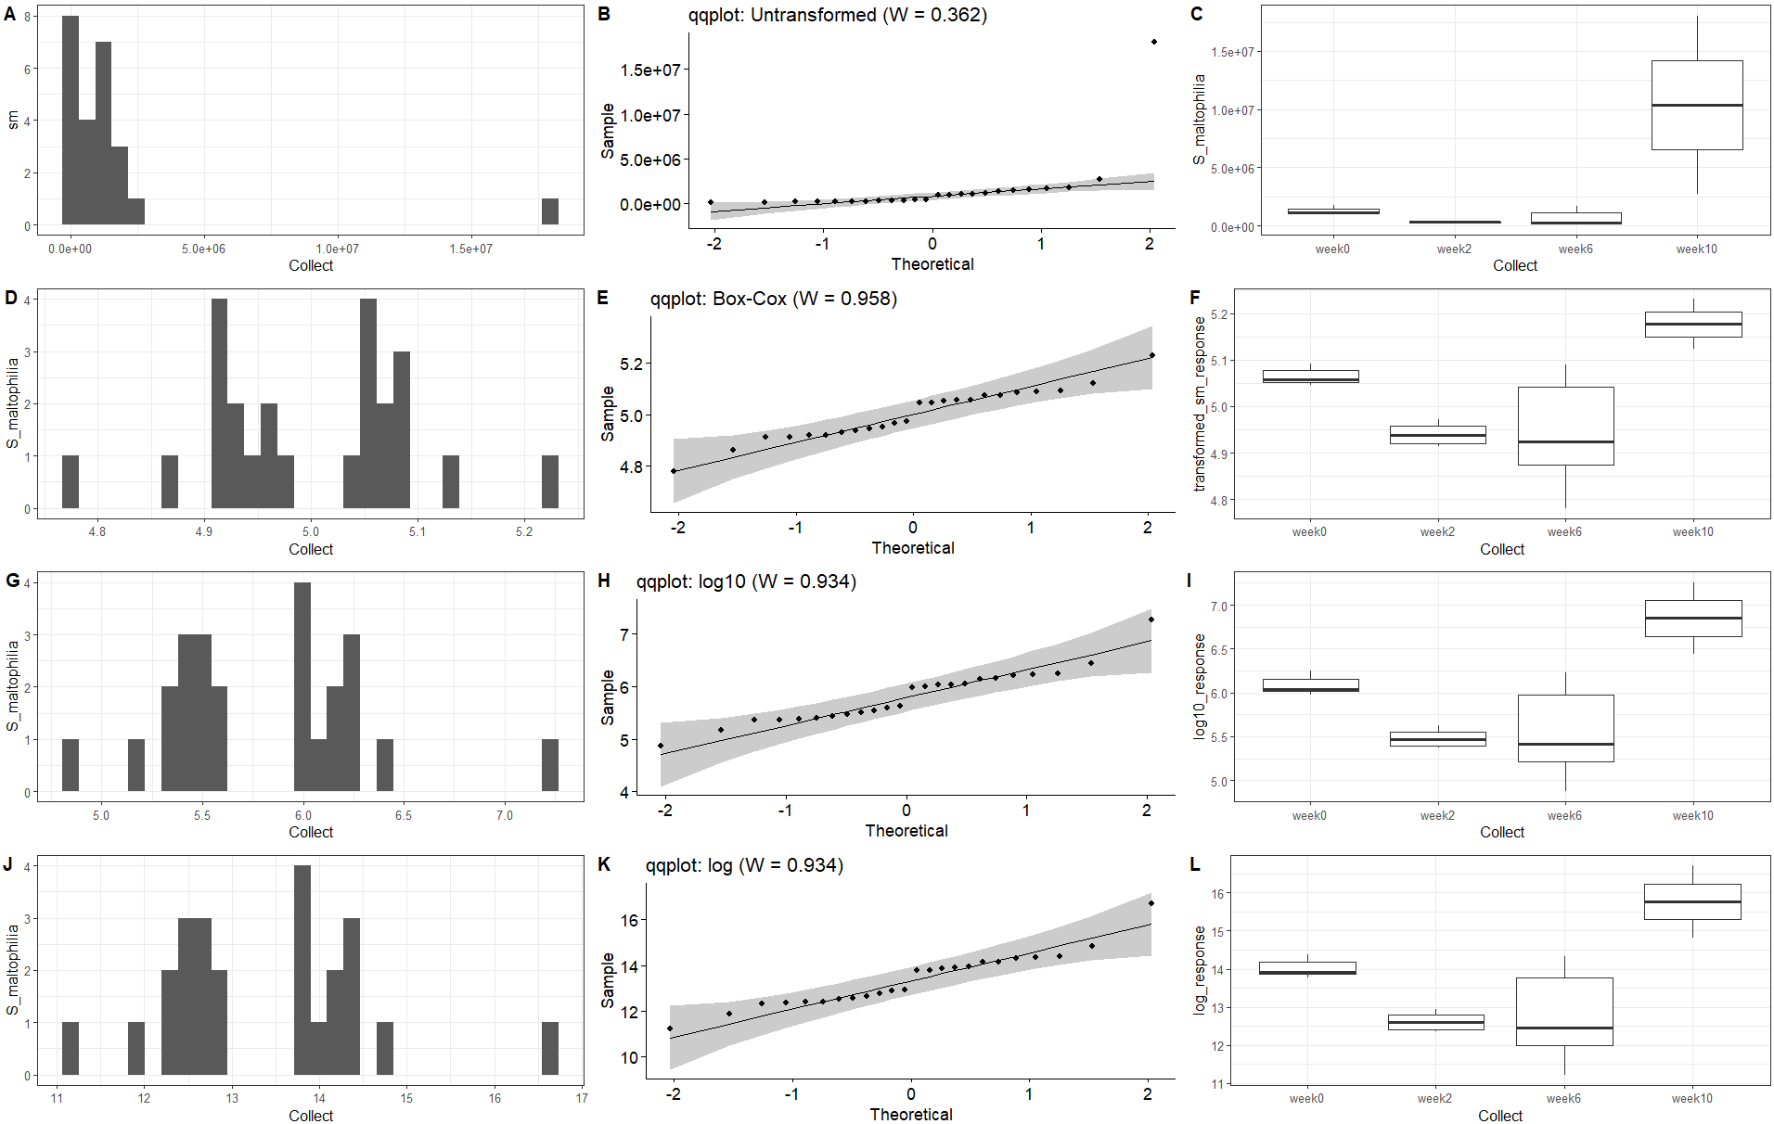
S_maltophilia water data transformation
-Shapiro-Wilks normality statistic (W), range from 0 to 1, with 1 being perfectly normal
-These transformations pass normality.
-The Box_Cox does a good job of inducing normality here, the log transformations not far behind.

Slide 19
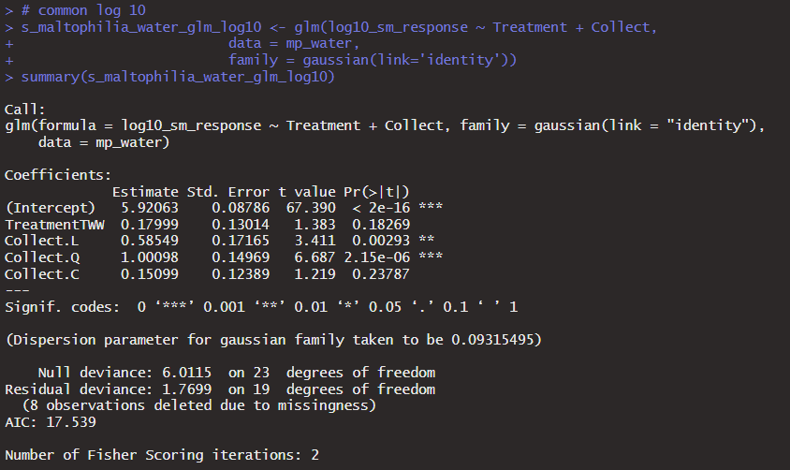
S maltophilia water glm full model
Treatment type insignificant in the full model
Time, linear or quadratic

Slide 20
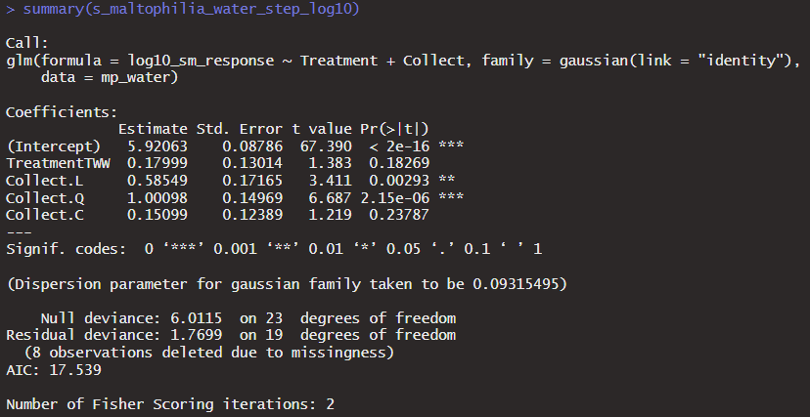
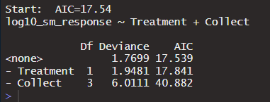
S maltophilia water stepwise --time trend kept, little more support for quadratic versus linear - water type not significant in full model but kept in stepwise

Slide 21
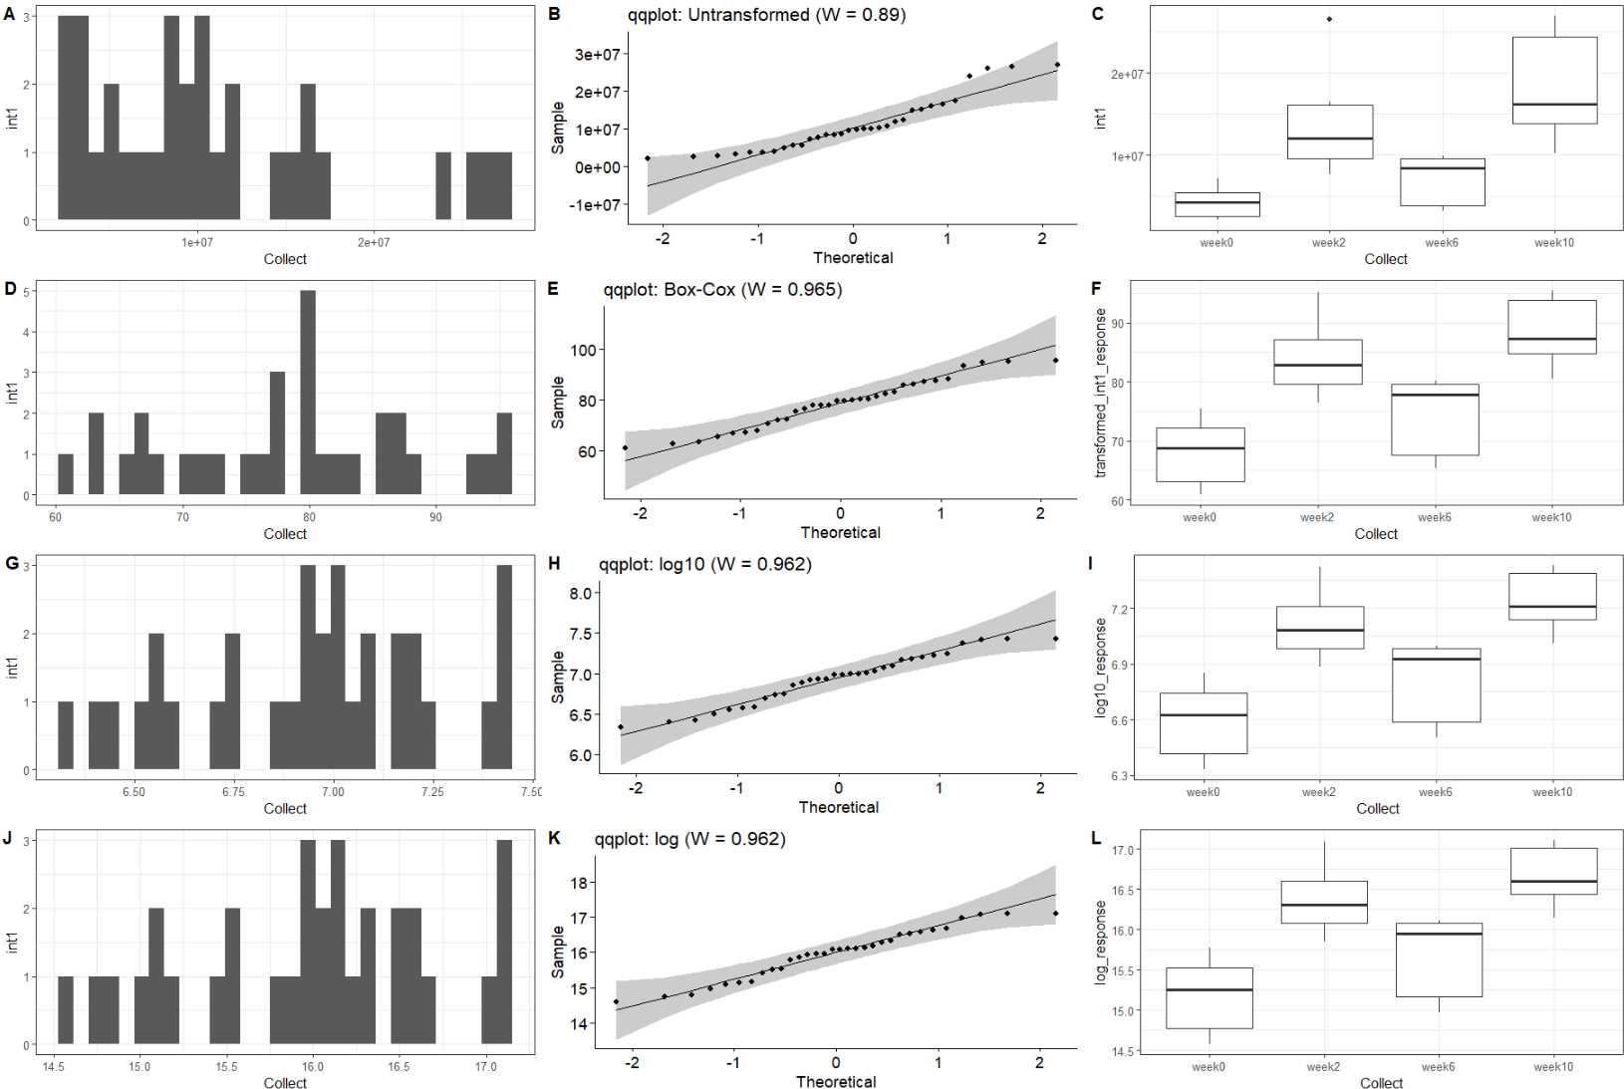
intI1 water data transformation
-Shapiro-Wilks normality statistic (W), range from 0 to 1, with 1 being perfectly normal
-These transformations are good and induce normality.
-They all do a good job.

Slide 22
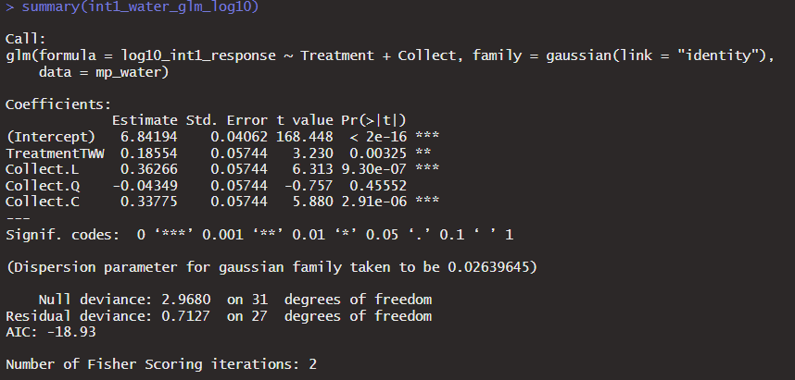
Int1 water glm full model
Treatment type significant in the full model, positive bump for amended water
Time, linear or cubic

Slide 23
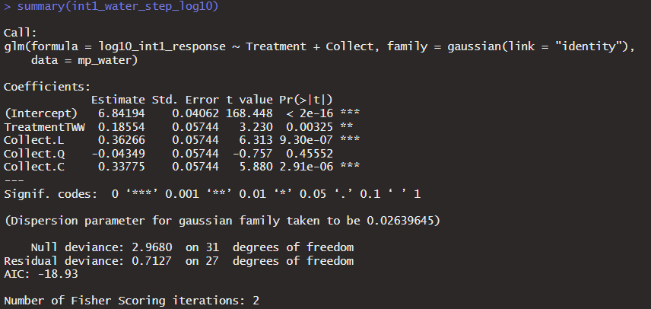
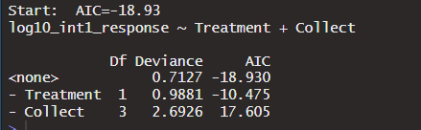
Int1 water step --linear time trend (and cubic) and positive TWW difference remain in step model

Slide 24
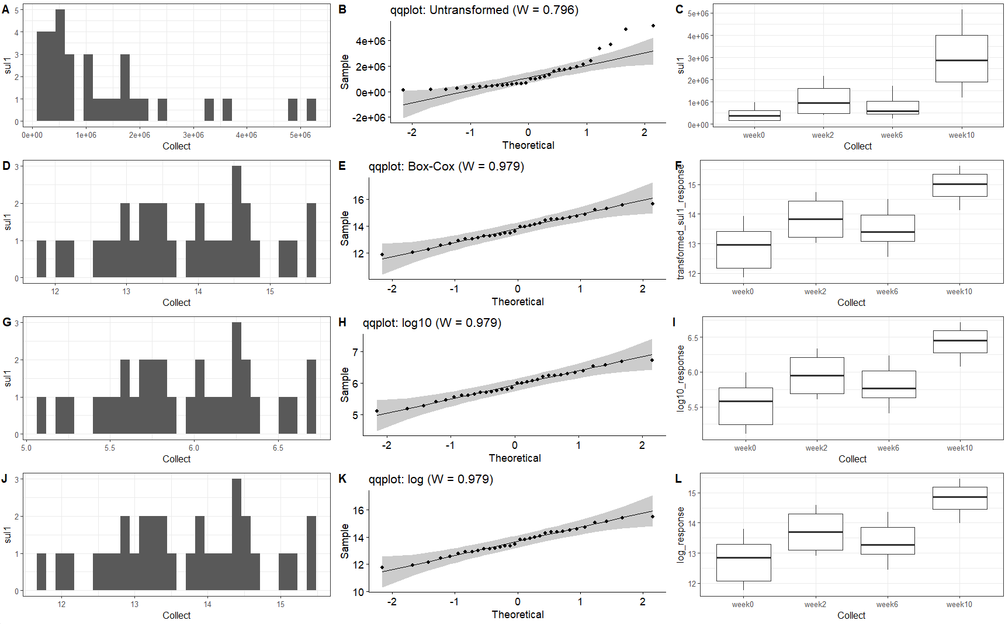
sul1 data transformation
-Shapiro-Wilks normality statistic (W), range from 0 to 1, with 1 being perfectly normal
-These transformations are good and induce normality.
-They transfomrations are essentially tied to 3 significant digits

Slide 25
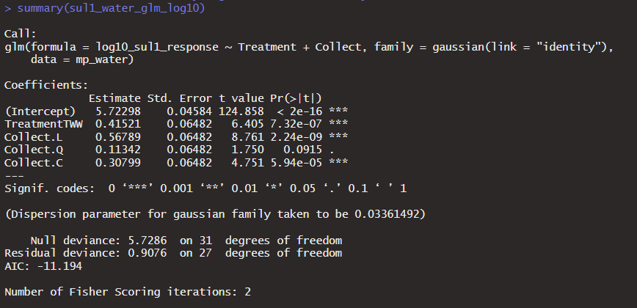
Sul1 water glm full model
Treatment type significant in the full model, positive bump for amended water
Time, linear or cubic again

Slide 26
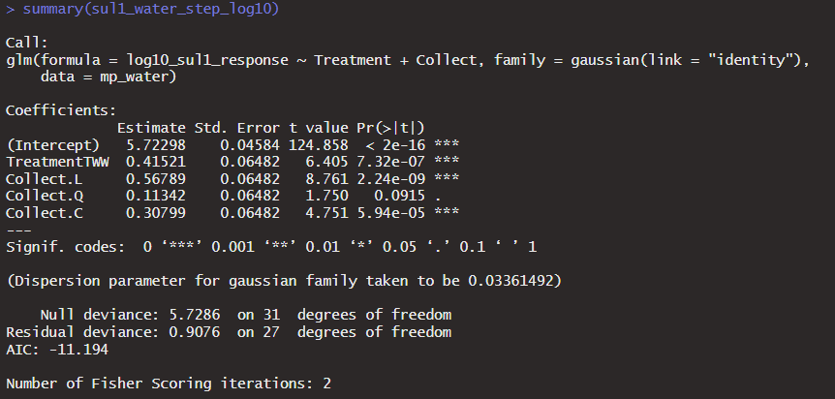
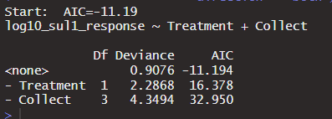
Sul1 water step glm --time trend and TWW difference remain, step wise does not drop anything

Slide 27
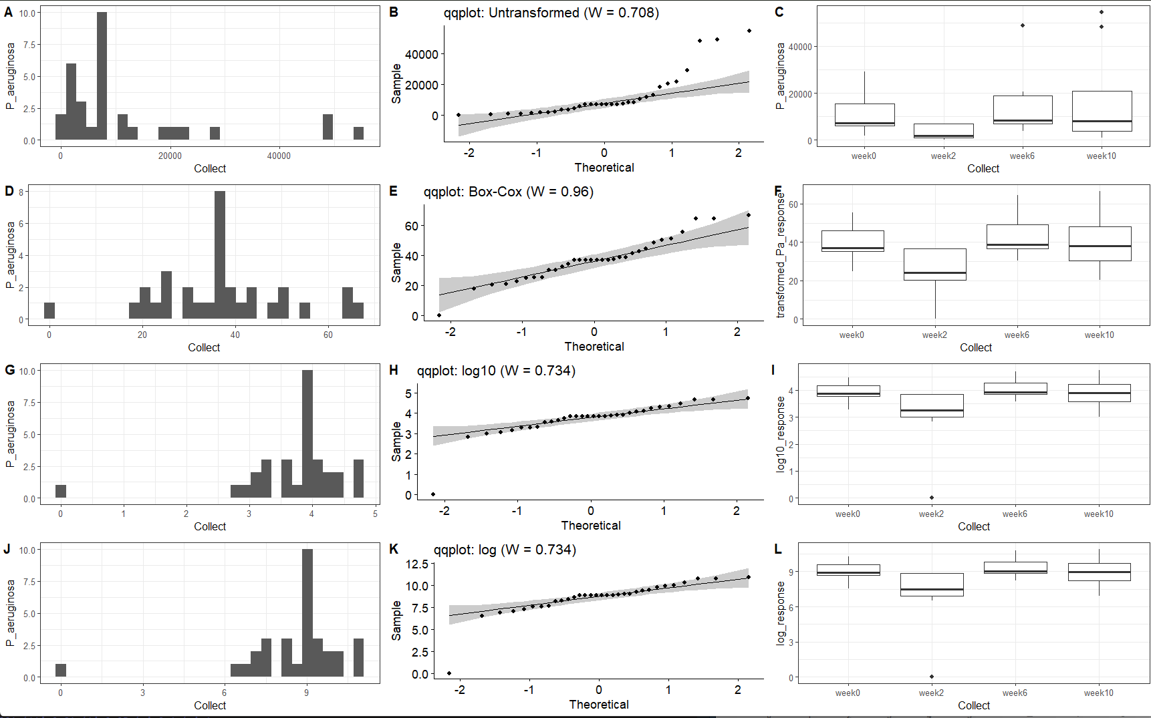
P_aeruginosa data transformation
-Shapiro-Wilks normality statistic (W), range from 0 to 1, with 1 being perfectly normal
-Box cox does a much better job here.

Slide 28
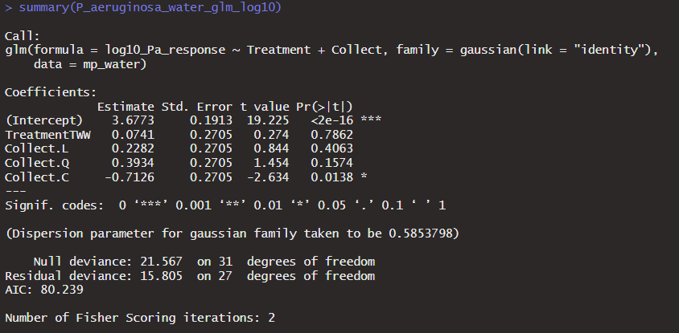
P aeruginosa water glm full model
Not much works here, response is pretty normally distributed
- treatment type has positive coefficient for amended water but not significant
- time cubic is significant but not linear or quadratic

Slide 29
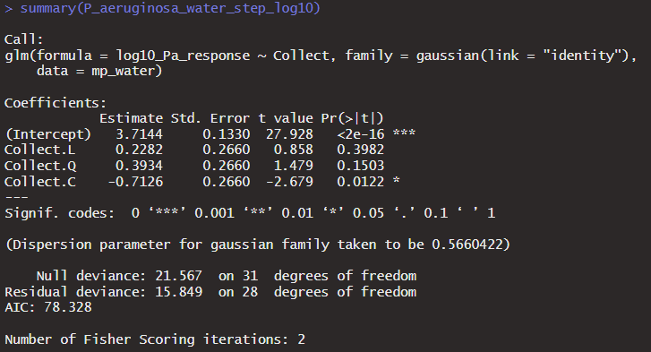
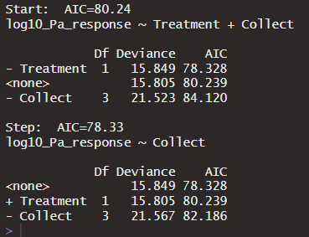
P. aeruginosa water step -water treatment dropped in stepwise

Slide 30
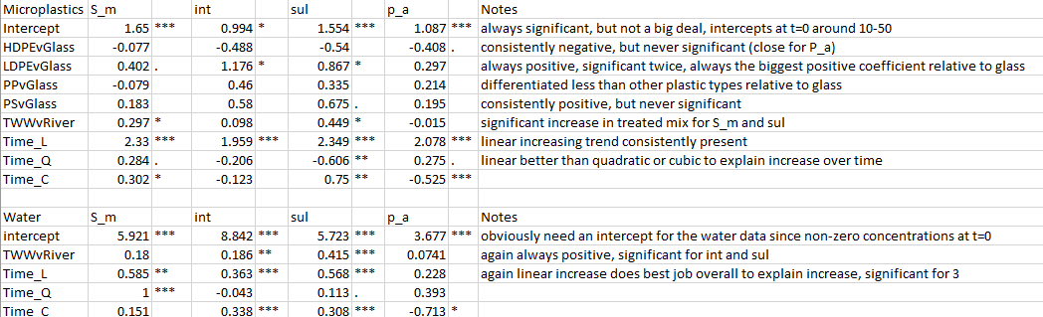
Full glm coefficients (log10)

Slide 31
Overall Results
Microplastics--Not sure how much detail you need.
Time is significant for all the responses (p value in full model is significant and/or kept in the stepwise regression), linear response generally does best but there is some support for quadratic and cubic.
LDPE often differentiates itself from other plastics (significant in 3 of the 4, still the lowest p value in the 4th)
Water type matters for multophilia and sul1, actually a small negative (not significant) for P. a.
Water—
S. multophilia there is a time trend but no difference between the water treatments.
Int1 and sul1 both show time trends and positive water differences.
P. aeruginosa no linear time trend (cubic pops up though) or difference between the water treatments
Presumably positive time trends in the water (unexpected?) may possibly be a bit of a confounding variable for interpreting the accumulation on microplastics over time.

