Slide 1
Methods
To model the relationship between biomarker (?) levels on microplastics (4—int1, sul1, Pa, Sm) and the categorical factors of plastic type, time, and water type, we implemented a generalized linear model (GLM) in R (version 4.2.1) using the glm() function with a Gaussian family and identity link function, specifying the model formula as biomarker response ~ plastic_type + time + water_type. The choice of the Gaussian family and identity link assumes that the response variable is normally distributed and linearly related to the additive effects of the categorical predictors. We examined the model summary to assess the significance of each factor's coefficients, which represent the expected change in biomarker expression for each factor level compared to the reference level. We repeated these models for water concentrations, dropping the plastic type covariate. To select the most parsimonious model, we employed bidirectional stepwise regression using the step() function from the stats package, specifying direction = "both". The Akaike Information Criterion (AIC) was used as the model selection metric to balance goodness of fit with model complexity, with a lower AIC indicating a better model fit. The stepwise procedure iteratively added or removed predictors to minimize the AIC until no further improvements could be made, yielding a final model containing only the most informative variables and interactions for explaining the response.
I have a question on how we want to handle time step 0 for microplastics. I have not removed the fb level and not sure if we want to insert 0 concentrations for week 0 for each of the response variables for microplastics (to have the same dimensions as water data).

Slide 2
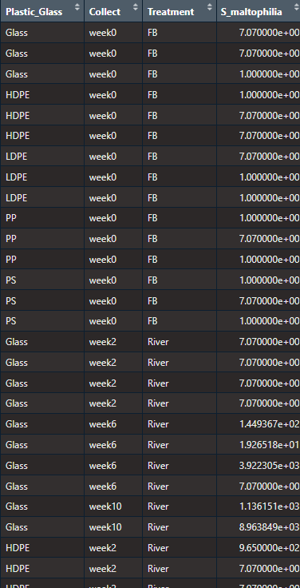
Microplastic data

Slide 3
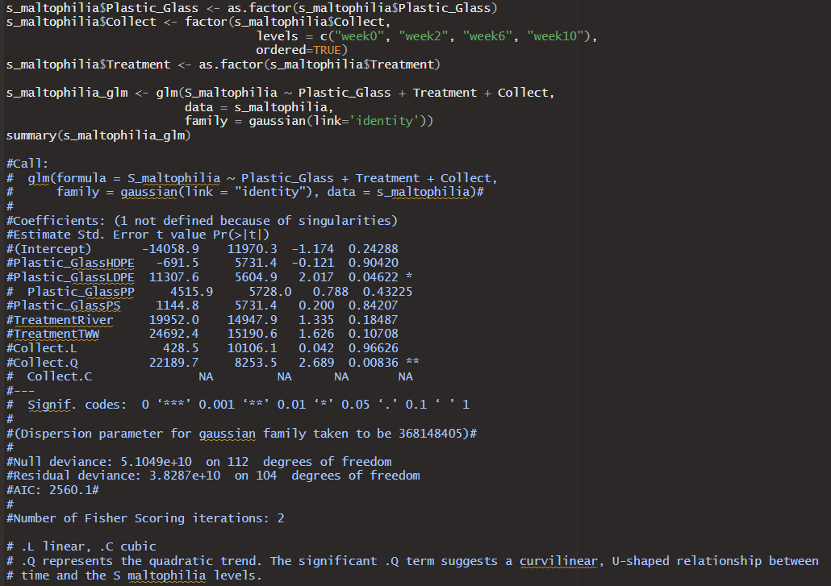
S maltophilia mp full glm -time quadratic -ldpe

Slide 4
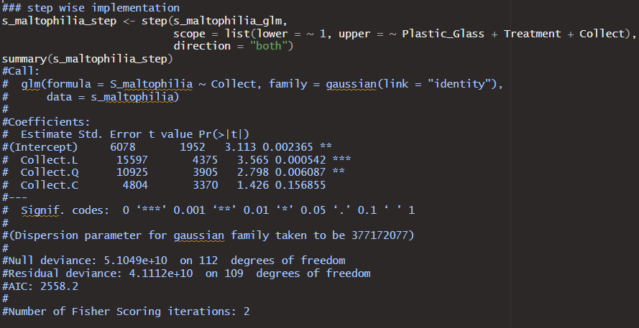
S maltophilia mp glm step -time only variable kept

Slide 5
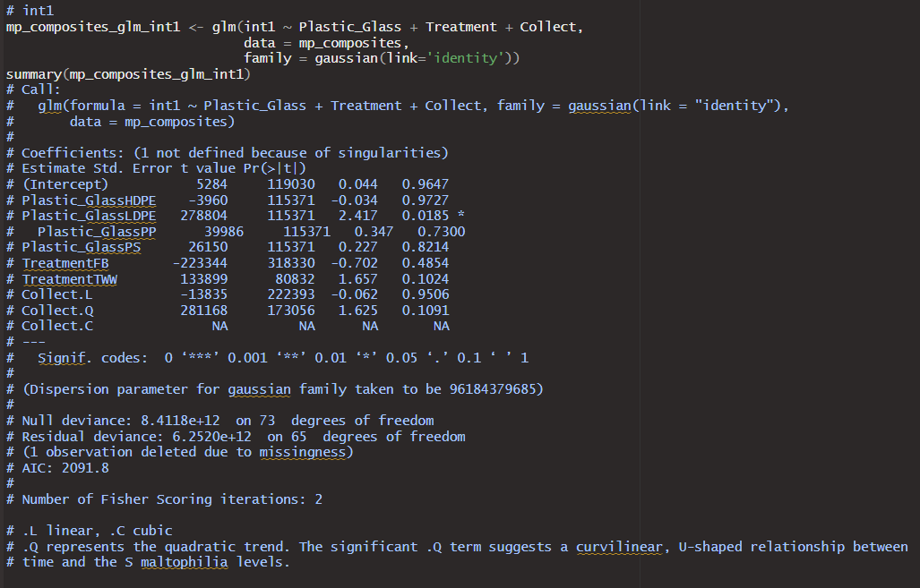
Int1 mp full glm -ldpe -evidence for time quadratic (p=0.1)

Slide 6
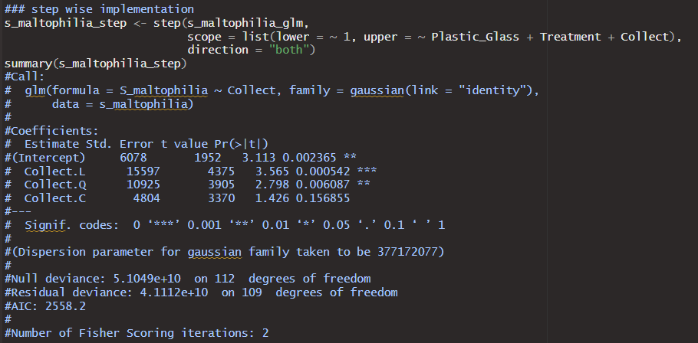
Int1 mp step - only time kept, linear or quadratic

Slide 7
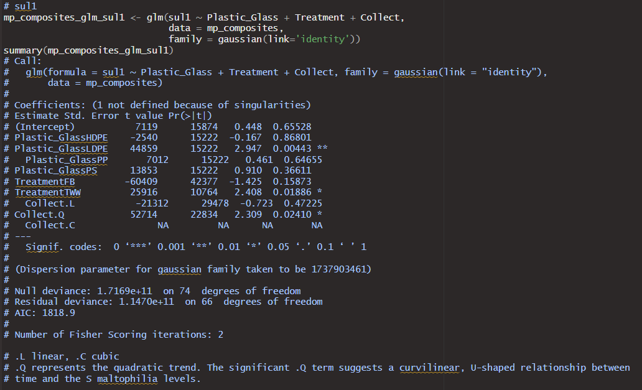
Sul1 mp full glm -ldpe -tww -time quadratic

Slide 8
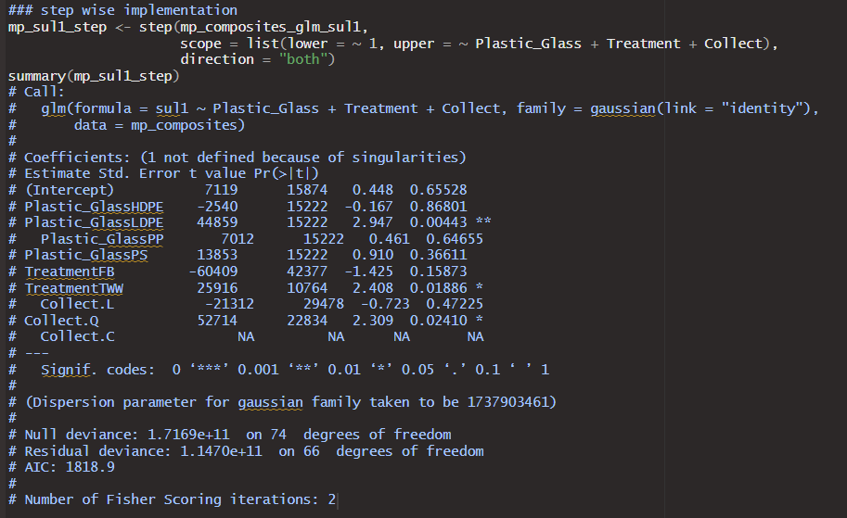
Sul1 mp step -everything kept -time quadratic

Slide 9
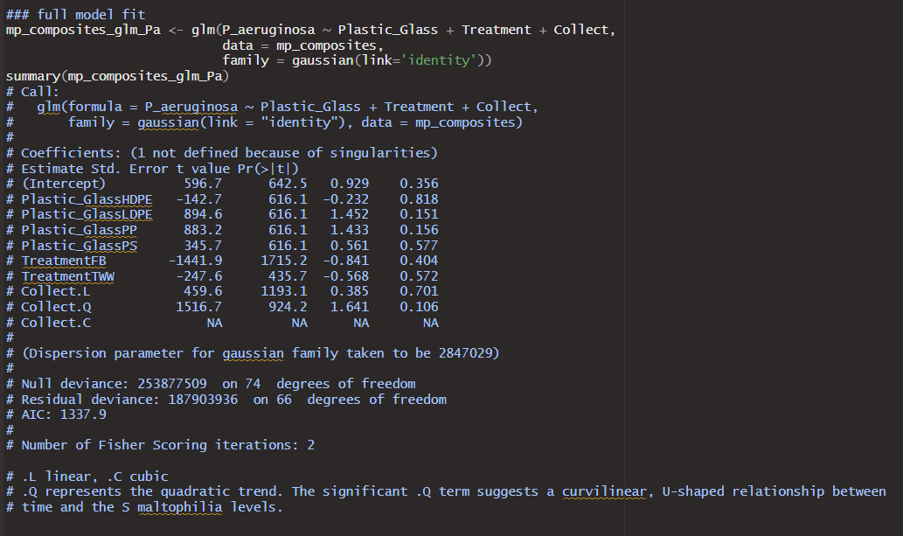
P. aeruginosa mp full glm -time quadratic with p=0.1

Slide 10
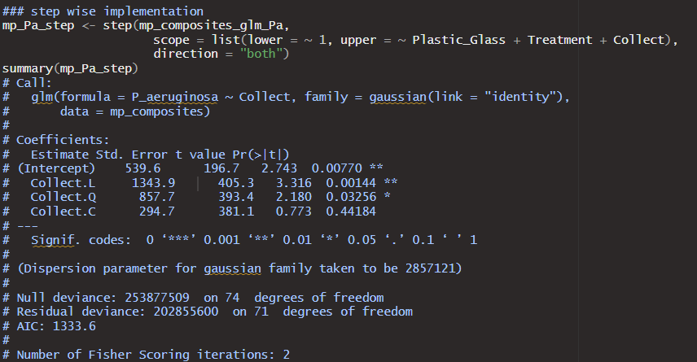
P. aeruginosa mp step - time kept and now significant for both linear and quadratic

Slide 11
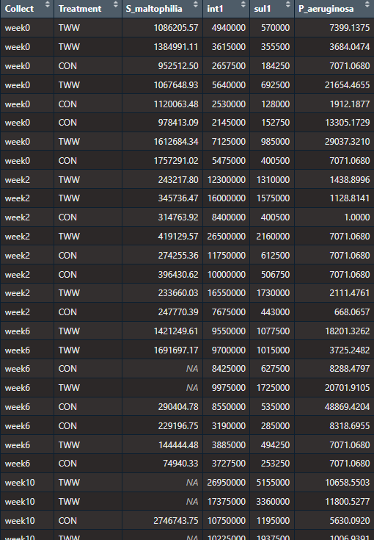
Data

Slide 12
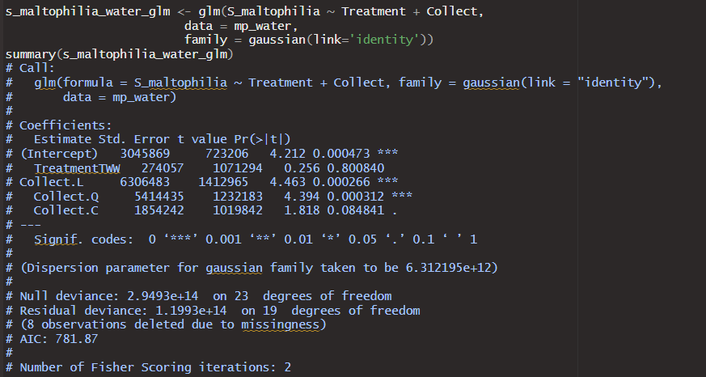
S maltophilia water full glm --there does seem to be a linear/quadratic trend over time here

Slide 13
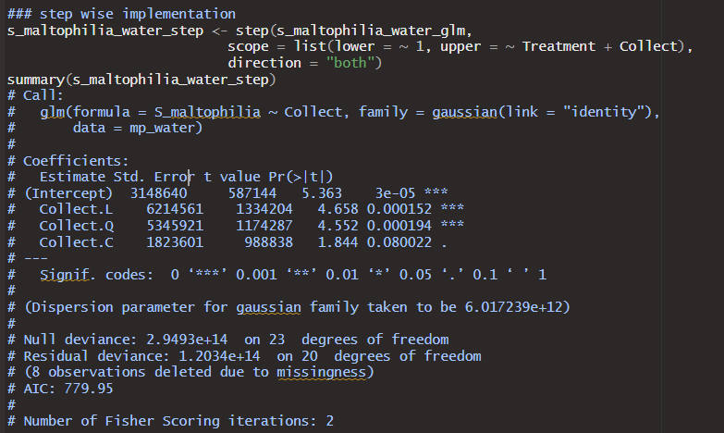
S maltophilia water step --time trend remains for step() implementation

Slide 14
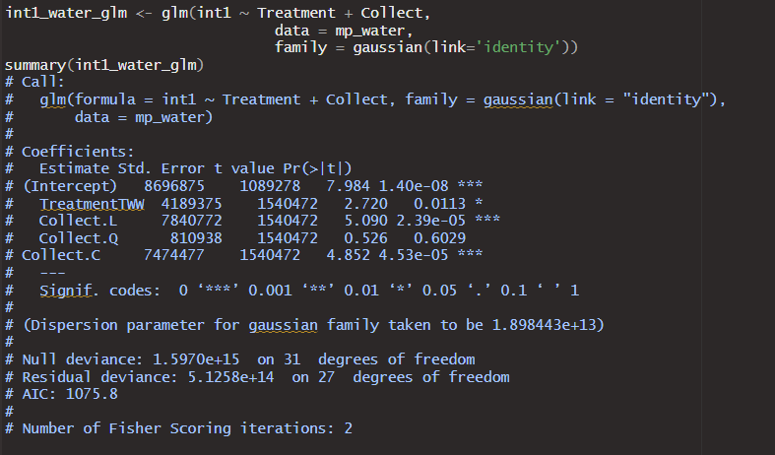
Int1 water full glm --TWW significant vs river water --linear time trend also present

Slide 15
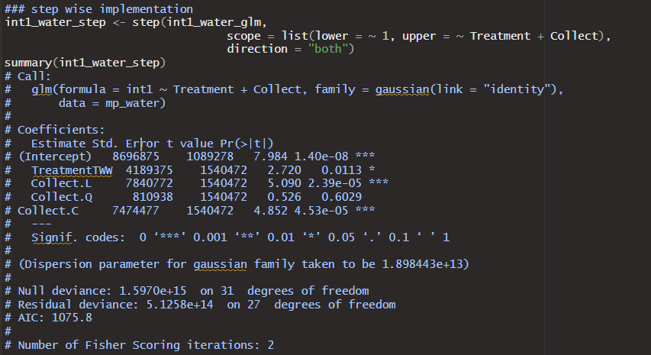
Int1 water step --linear time trend and TWW difference remain in step model (as expected here)

Slide 16
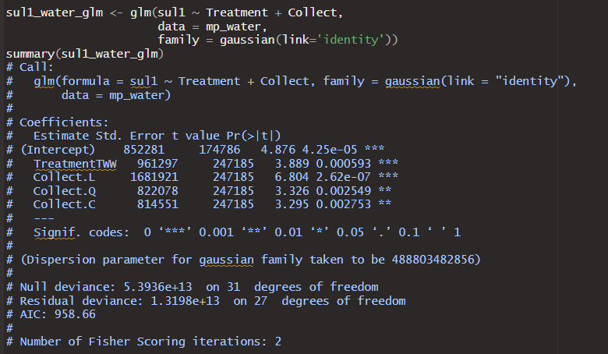
Sul1 water full glm --time trend present TWW difference versus RW(Con)

Slide 17
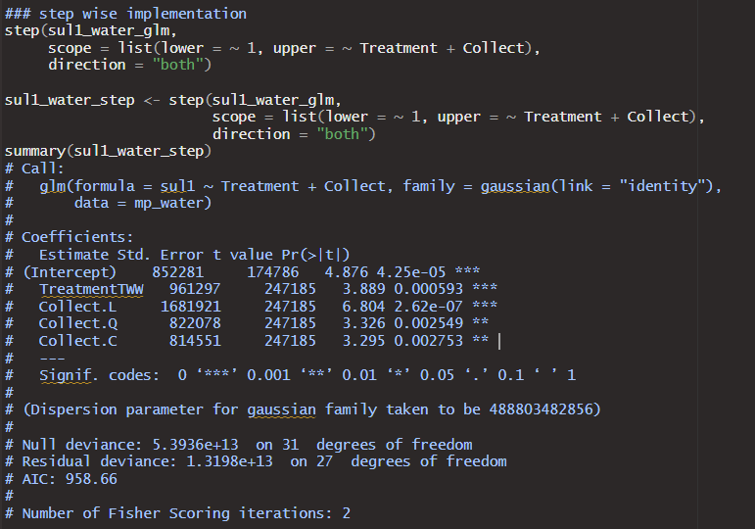
Sul1 water full glm --time trend and TWW difference remain

Slide 18
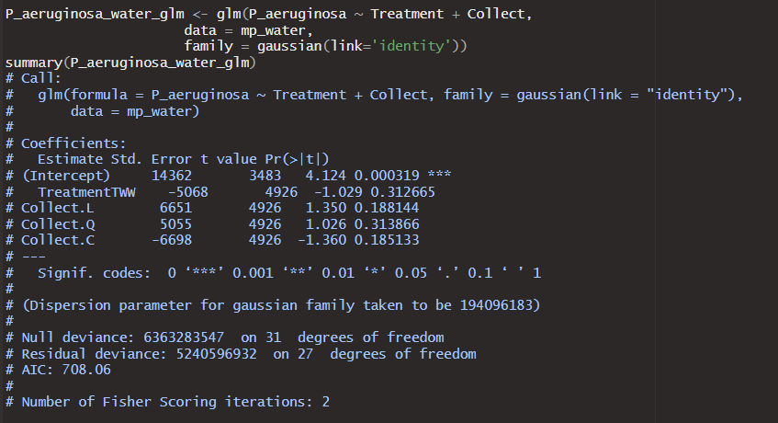
P. aeruginosa water full glm -nothing significant

Slide 19
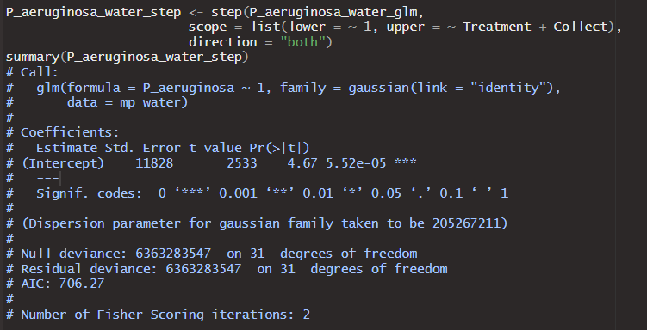
P. aeruginosa water step -still nothing significant

Slide 20
Overall Results
Microplastics--Not sure how much detail you need.
Time is significant for all the reponses (p value in full model is significant and/or kept in the stepwise regression).
LDPE often differentiates itself from other plastics (significant in 3 of the 4, still the lowest p value in the 4th), but plastic type gets dropped in the stepwise for all but sul1. (Might be different with less plastic levels in the factor)
Water type different for sul1 only, but I have not deleted the fb data at this point.
Water—
S. multophilia there is a time trend but no difference between the water treatments.
Int1 and sul1 both show time trends and water differences.
P. aeruginosa no time trend or difference between the water treatments
Presumably time trends in the water may possibly be a bit of a confounding variable for interpreting the accumulation on microplastics over time.

