Slide 1

Path-inder
Matchmaking for bacterial genomes
https://github.com/microbio-hackathon-2024/pathinder-client https://microbioinfo-hackathon.loculus.org/
Notes:
Pathfinder?

Slide 2
The problem
I have a genome sequence of a pathogen, but I want to know who else has encountered it.
Current Issues:
Centralized databases require users to submit full datasets (e.g., sequence reads or assemblies), which can be a barrier to sharing data quickly.
OR download everything from ENA/SRA and search myself.
Proposed Solution: Can we create a system where researchers can post minimal information—just enough to identify potential matches—allowing others to access relevant sequences and collaborate?

Slide 3
What is Path-inder (pathogen-tinder)
A software to match researchers with similar pathogen genome
Database uses an instance of Loculus, that has been altered to store the hash vector: https://microbioinfo-hackathon.loculus.org/group/1
Client
Database
Input an assembled genome
Extract sequences for a fixed set of marker genes
Convert to a vector of short strings using a hashing function (md5)
Compare strings with others in the database to find similar genomes
Stores basic metadata and hashes
Users can submit new records online or programmatically
Notes:
How it works - CLIENT
Input an assembled genome
Extract sequences for a fixed set of marker genes
Convert to a vector of short strings using a hashing function (md5)
Compare strings with others in the database to find similar genomes
Database uses an instance of Loculus, that has been altered to store the had vector: https://microbioinfo-hackathon.loculus.org/group/1

Slide 4
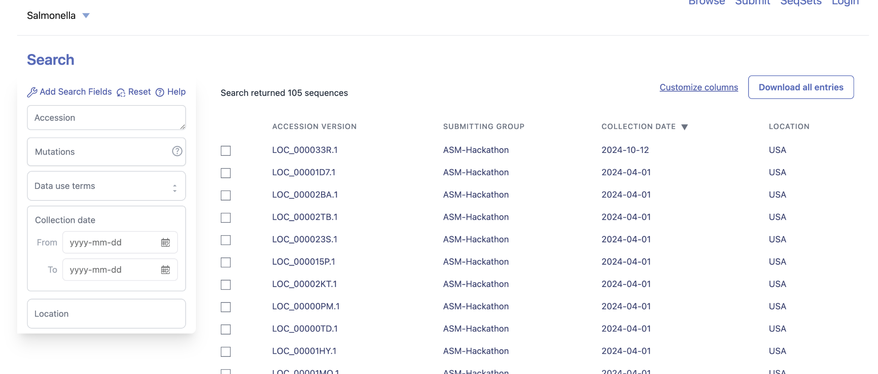
Loculus interface

Slide 5
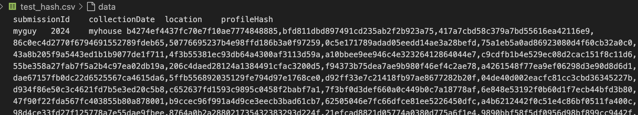
Outputs of the client side scripts
Output of hashing

Slide 6
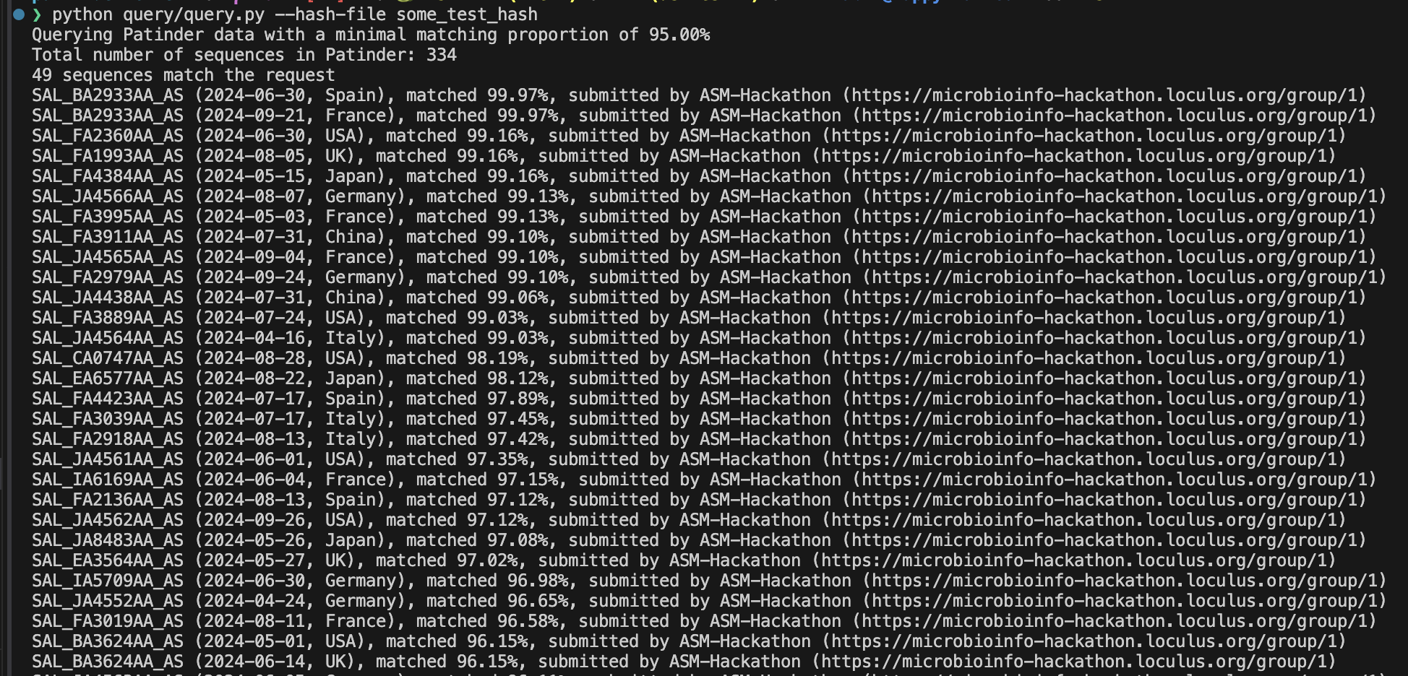
Outputs of the client side scripts
Output of query

Slide 7
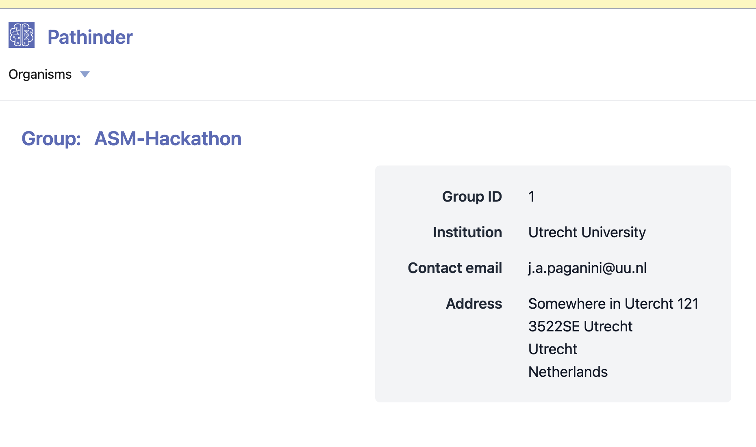
Where does that link go?

Slide 8
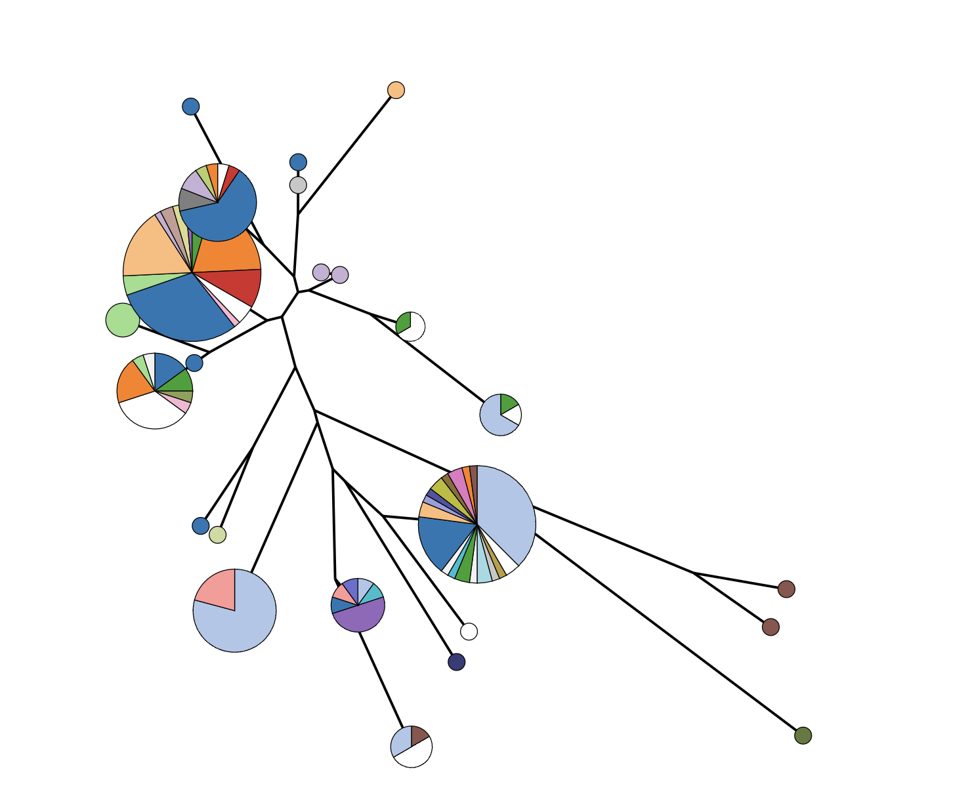
A simple sanity check
Fed in some genomes from https://www.cell.com/current-biology/fulltext/S0960-9822(18)30694-8
After that they come from the neighboring cluster
The query is its own top hit
Top 18 hits are from the same cluster

Slide 9
Progress
We have an allele caller (hacked from enterobase) to extract sequences for marker gene set
We have a script to hash the allele sequences
We have a script to query the loculus database with those hashes
We have a script to upload new records to the database
Next steps:
Decent testing + benchmarking
Write some glue to stitch the scripts together
???
Profit

Slide 10

Acknowledgements
The Team
Nabil-Fareed Alikhan
Chaoran Chen
Julian Paganini
Advice
Tim Dallman
Torsten Seemann
Lee Katz
https://github.com/microbio-hackathon-2024/pathinder-client
Supported by
Petit Foundation for Emerging Technologies

