Slide 1
Thursday: Differential abundance
Lecture
Differential abundance analysis methods
Practical
Differential abundance in practice
Lecture
Overview of microbiota data science methods & concepts

Slide 2
Other key concepts
- alpha diversity
- beta diversity & community similarity
- differential abundance
- core & prevalence
- community types

Slide 3
Normalizing library size?
If sample A has been sampled deeper than sample B, then the counts can also be expected to be higher.
Compositional data: Divide by the total number of reads per sample (compositional abundance)
Problem: Abundant taxa distort the ratios.

Slide 4
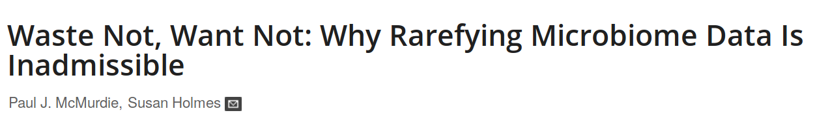
Rarefaction
If sample A has been sampled deeper than sample B, we the counts can be expected to be higher.
Solution: Rarify to even sampling depth
Limitation: Abundant taxa may distort the ratios.

Slide 5
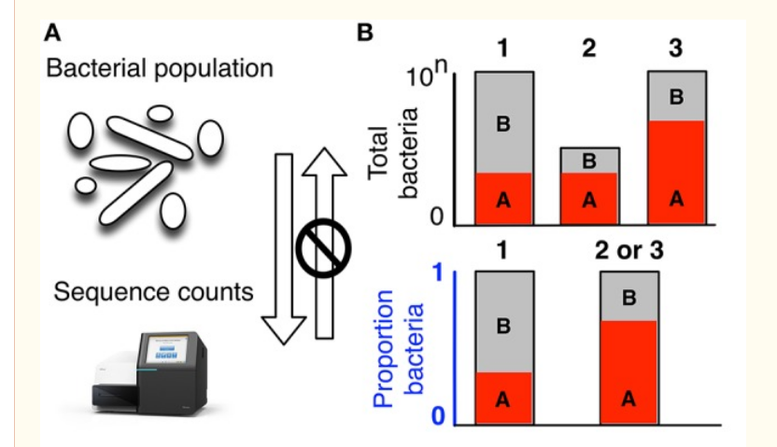
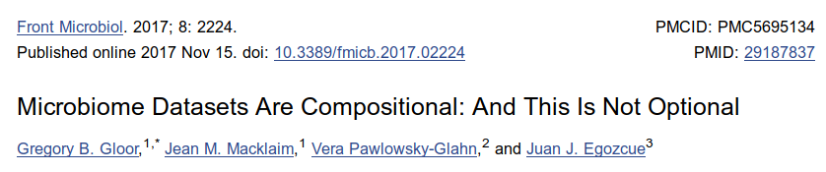

Slide 6
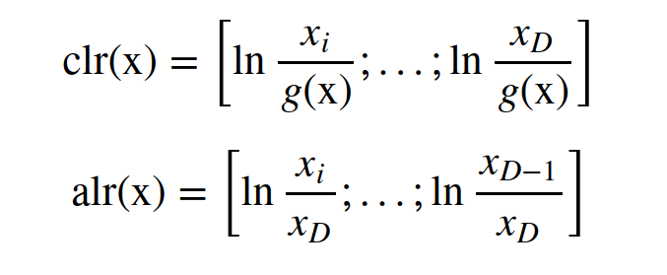

Slide 7
Transformations
transform(x, “compositional”)
transform(x, “clr”)
transform(x, “log10p”)
transform(x, “hellinger”)
transform(x, “identity”)

Slide 8
Friday: Presentations & closing
Course participant presentations on microbiome data analytics

Slide 9
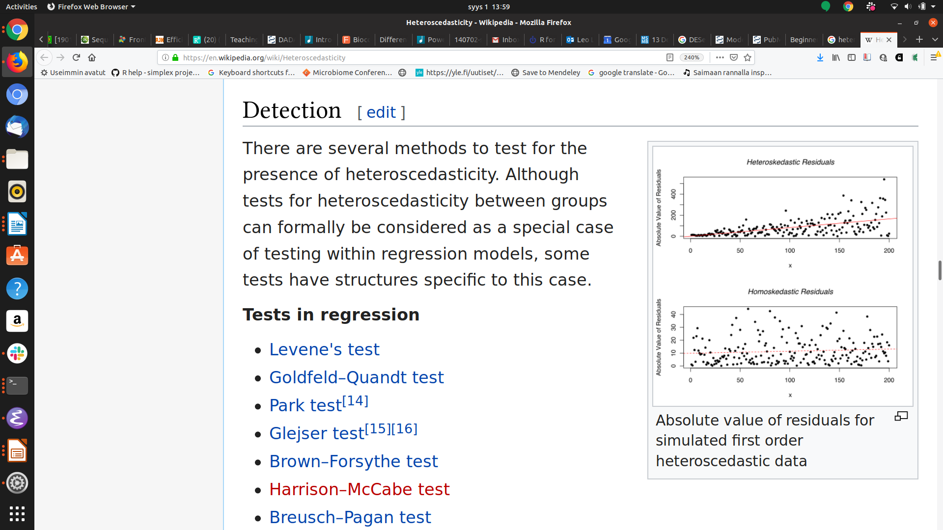
Normalizing heteroschedasticity (overdispersion)?
Problem: Variance depends on the mean in heteroschedastic systems.
Solution:
- Use parametric stochastic model to infer what happens at the tails
- Borrow information and share power across taxa to estimate the variances (large p, small n)
- “Shrink” the values towards mean
→ DESeq2, EdgeR, Limma..

Slide 10
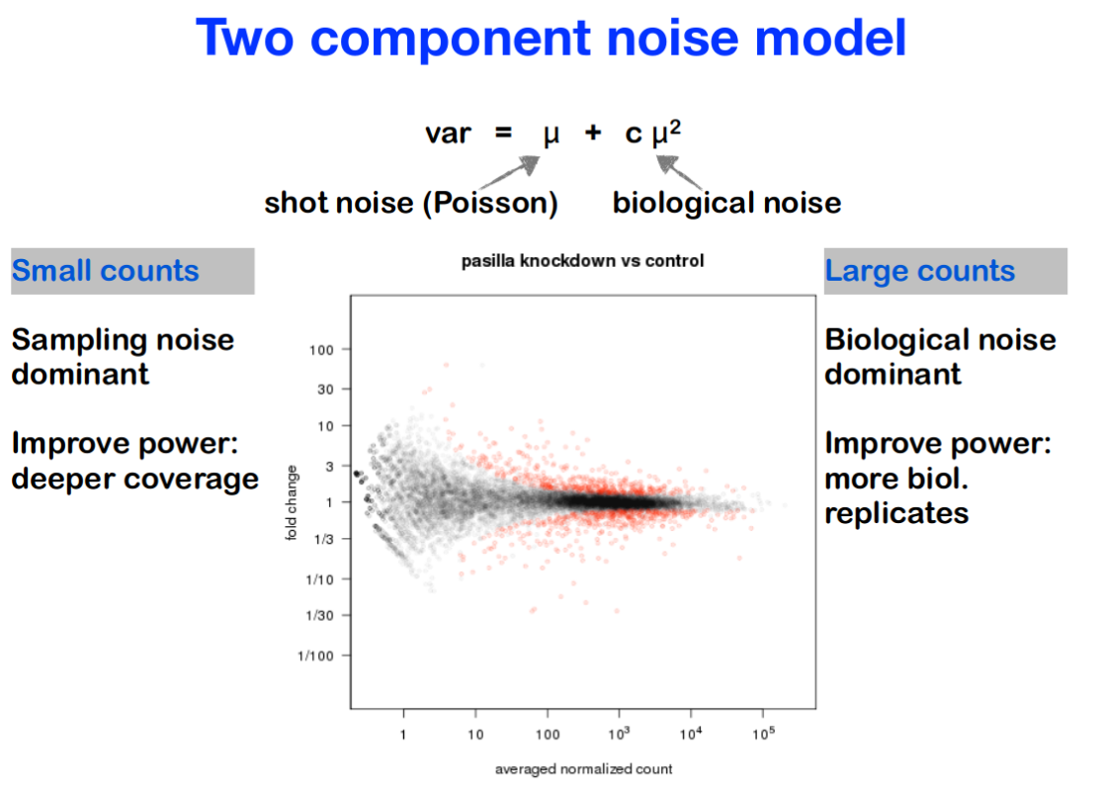

Slide 11
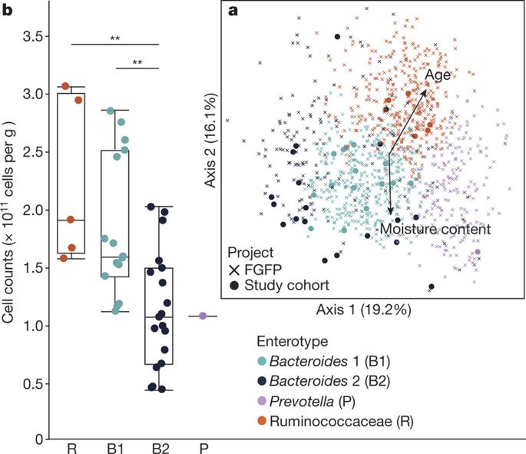
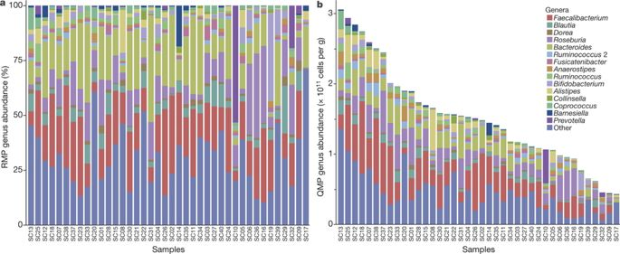
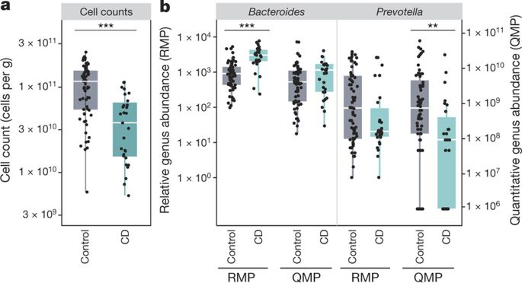
Relative versus absolute abundance: quantitative microbiome profiling
RMP vs. QMP:
drastic effect on conclusions!
Vandeputte et al. Nature 551:507-511, 2017
<number> / 56

Slide 12
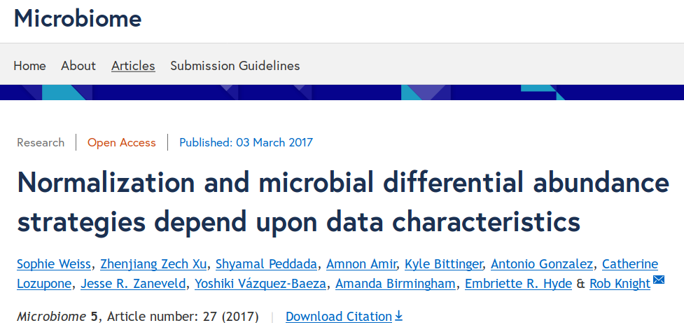
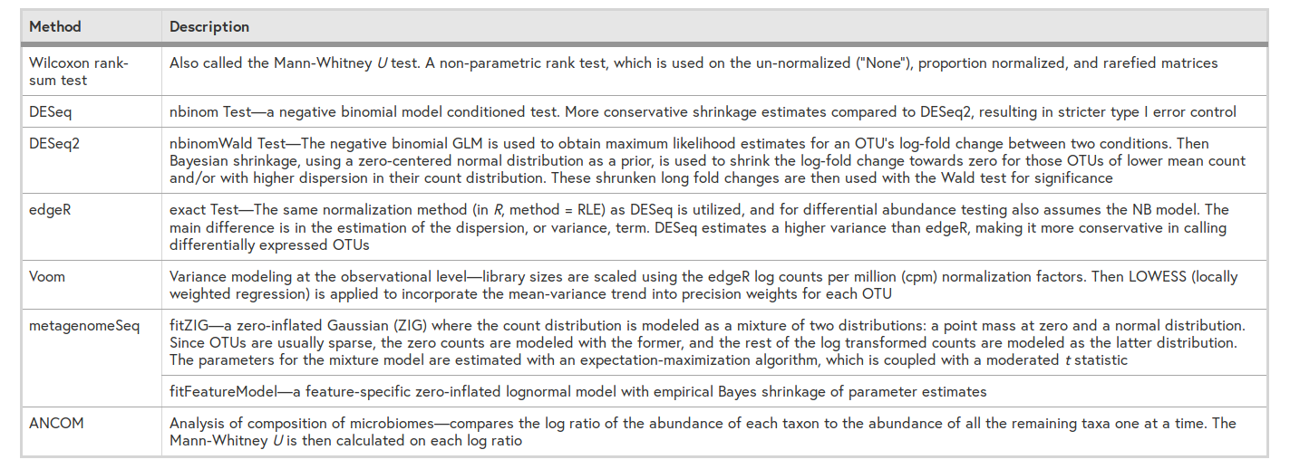

Slide 13
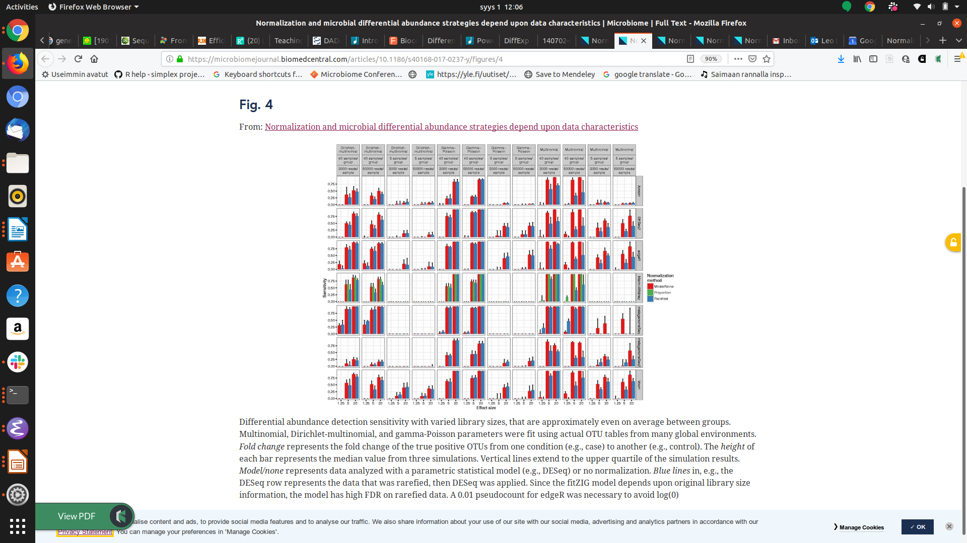
Differential abundance detection sensitivity

Slide 14
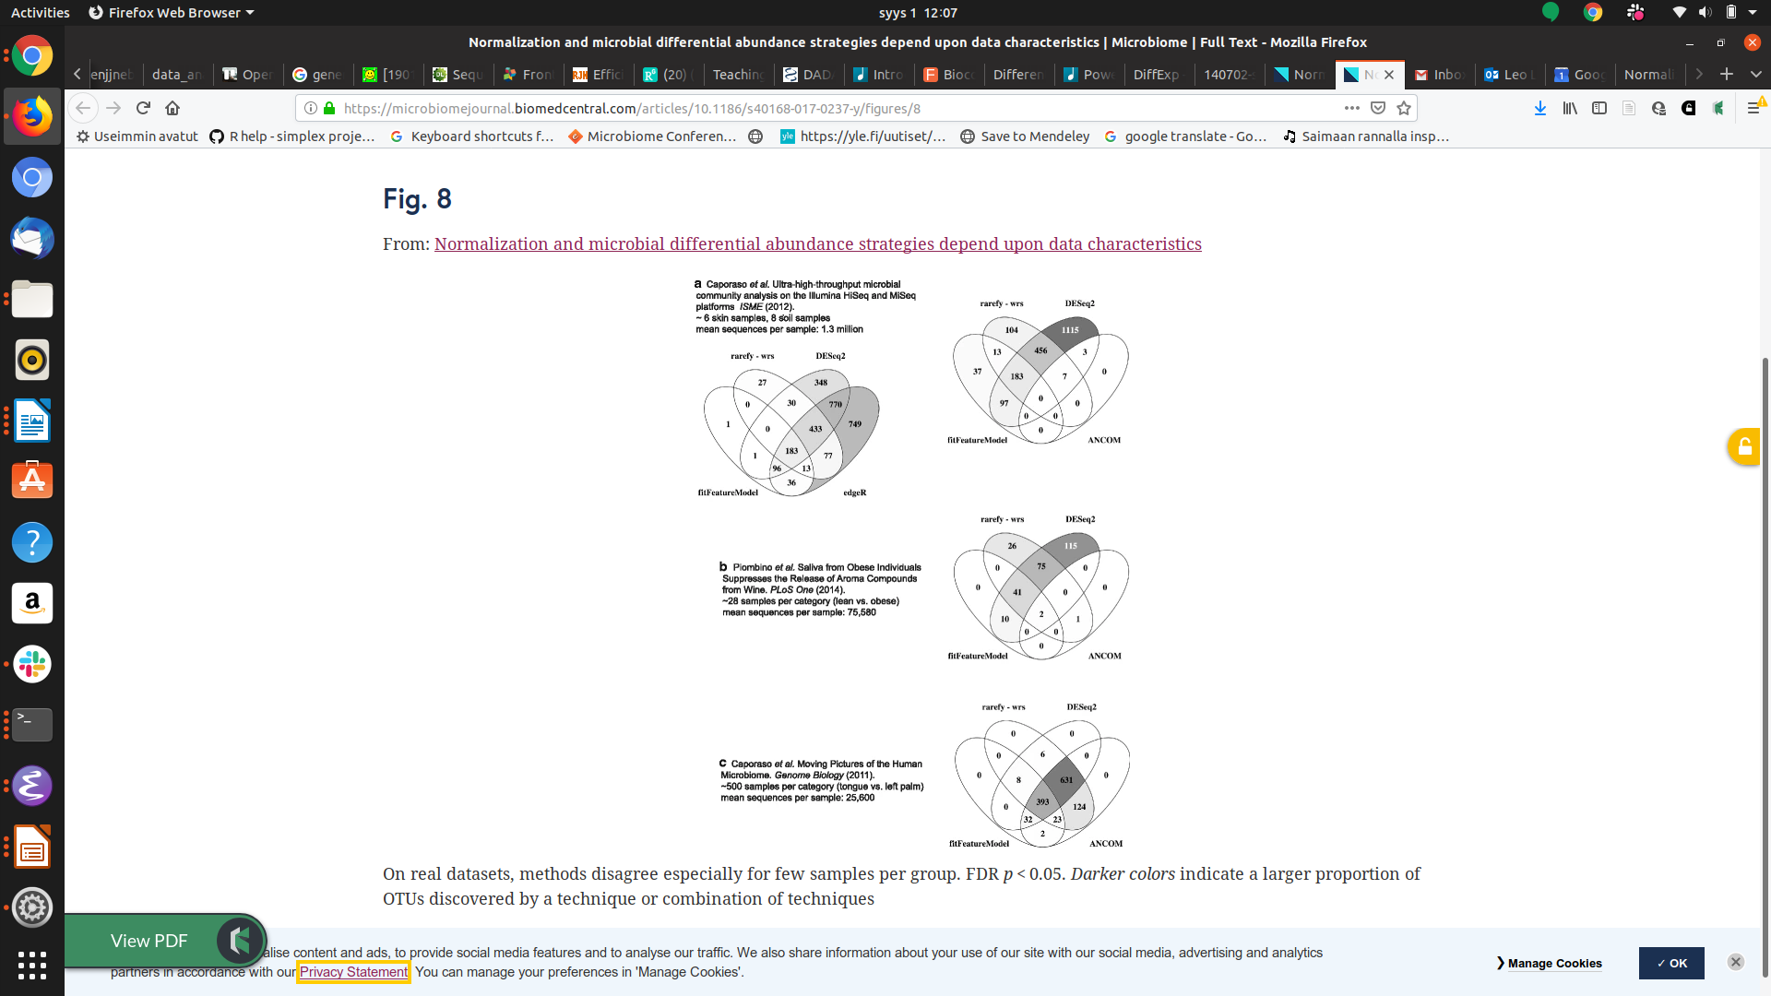
Different methods do not always agree

Slide 15
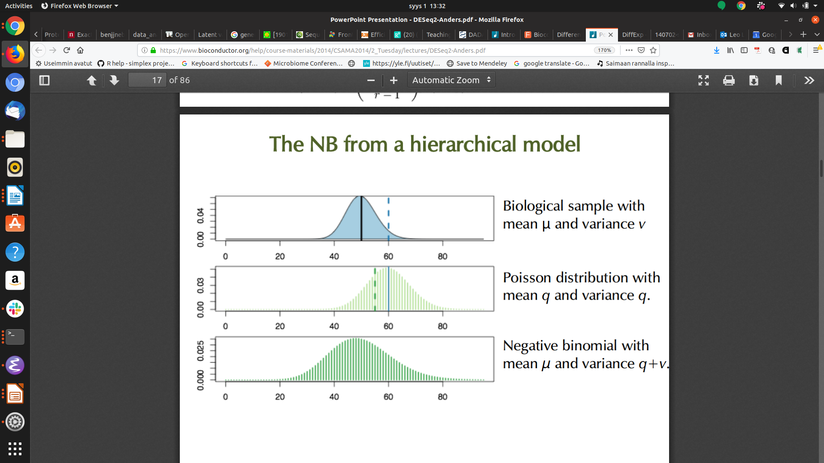
Latent variable models: Gamma-Poisson

Slide 16
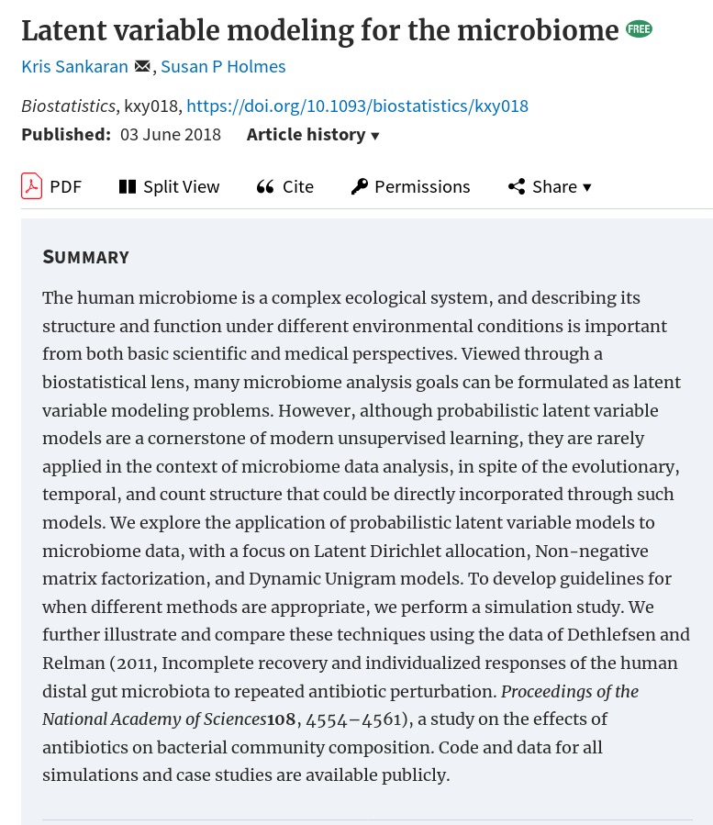
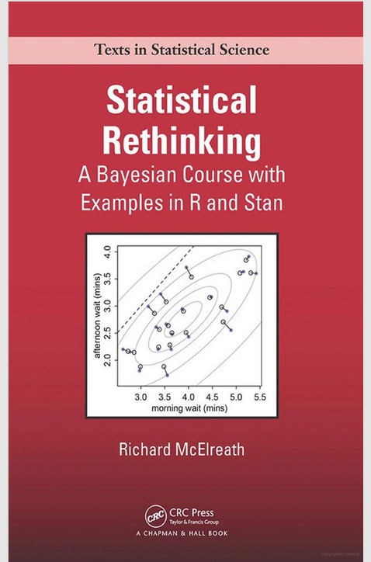

Slide 17
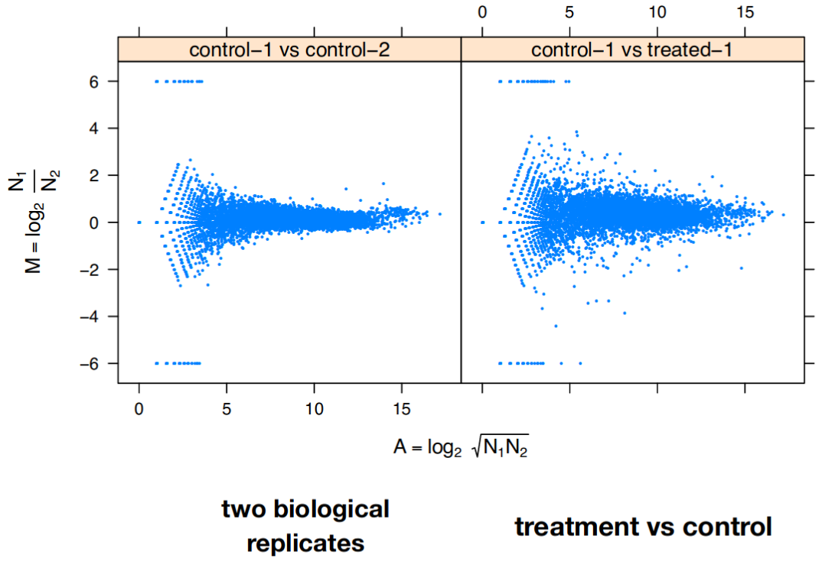

Slide 18
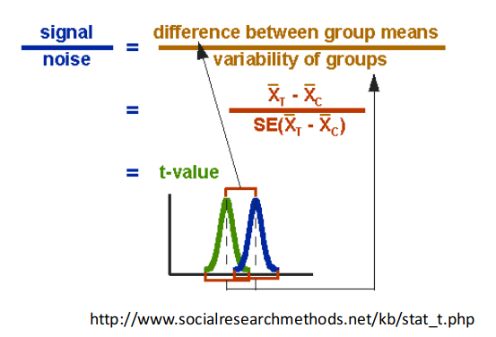
Standard t-test for two-group comparison?
Problems:
Few replicates
Non-gaussian, discrete, positive, skewed..
Multiple testing

Slide 19
Normalizing heteroschedasticity (overdispersion)?
Problem: Variance depends on the mean in heteroschedastic systems.
Solution:
- Use parametric stochastic model to infer what happens at the tails
- Borrow information and share power across taxa to estimate the variances (large p, small n)
- “Shrink” the values towards mean
→ DESeq2, EdgeR, Limma..

Slide 20
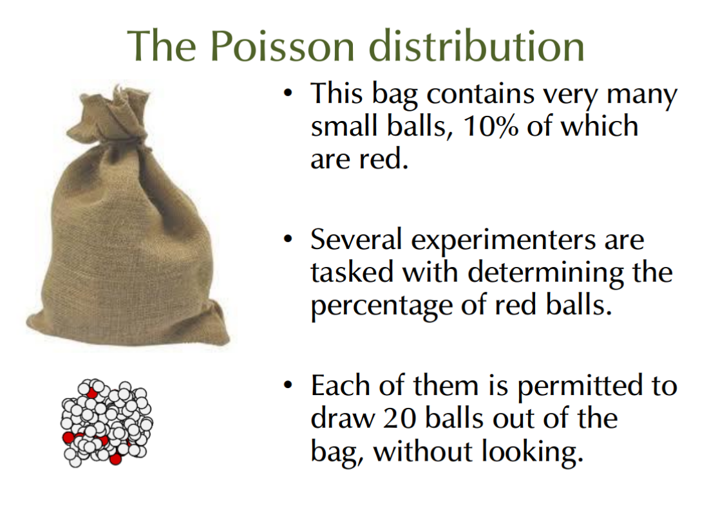

Slide 21
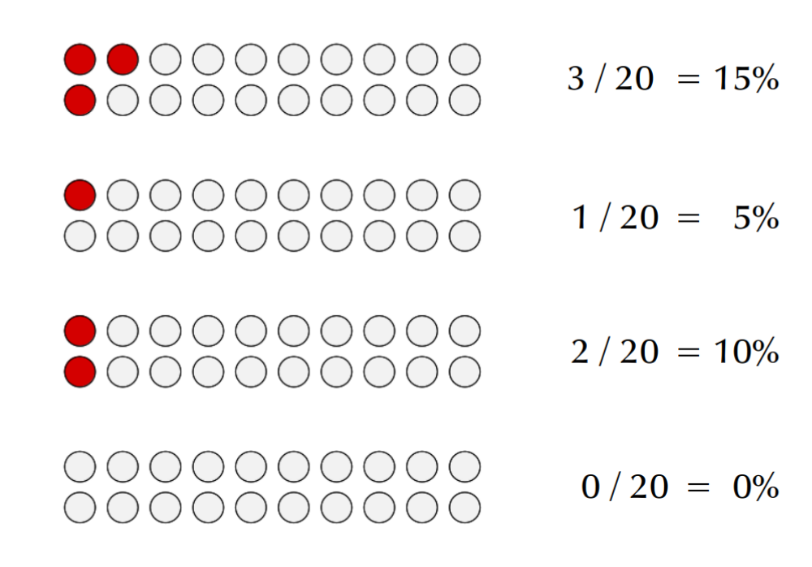

Slide 22
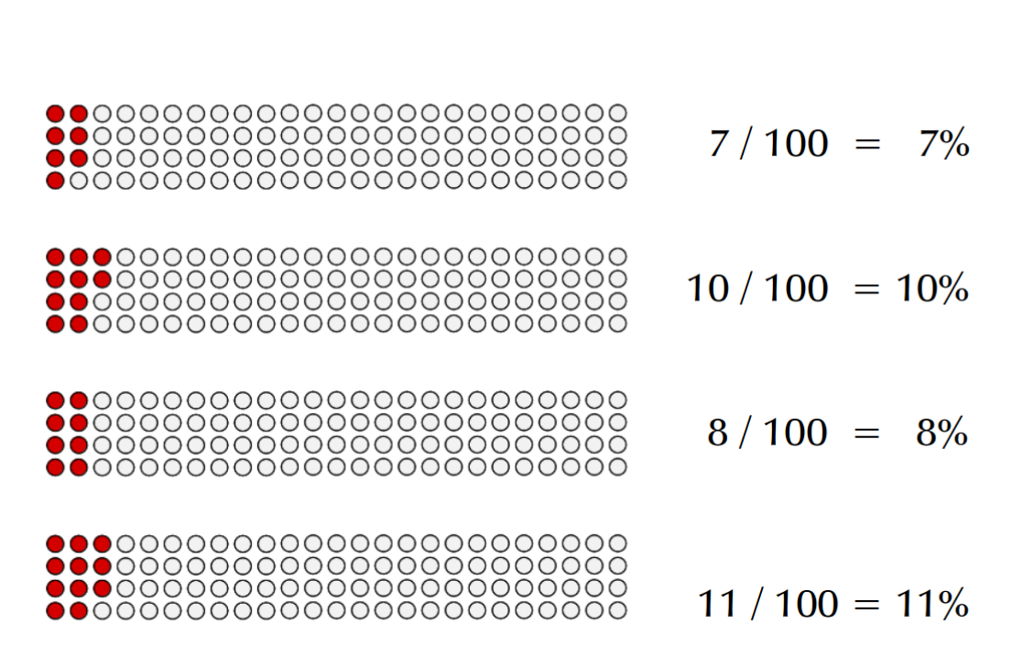

Slide 23
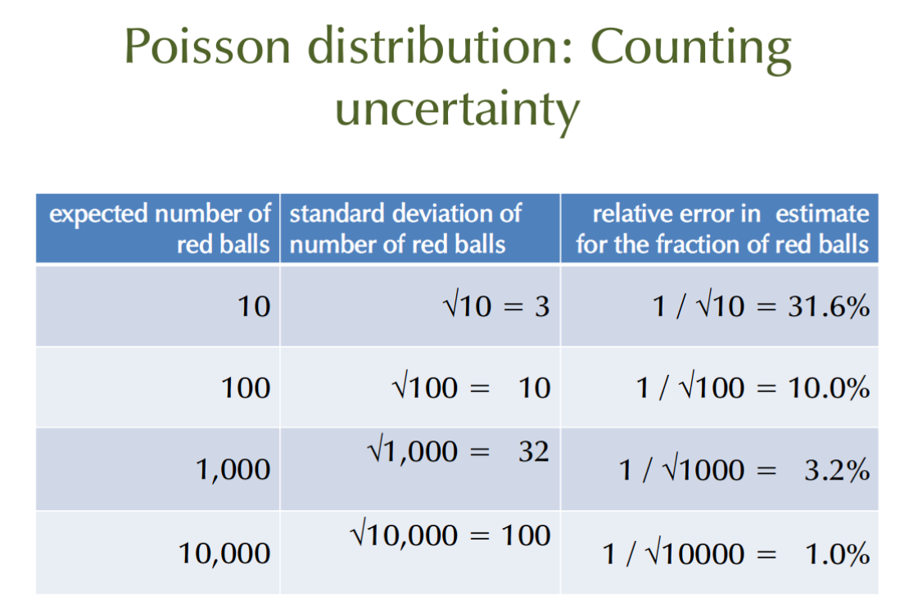

Slide 24
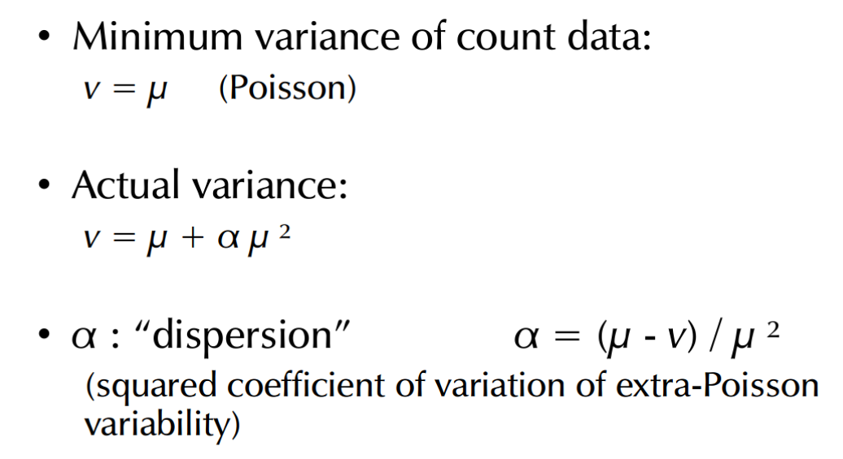
Dispersion and
overdispersion

Slide 26
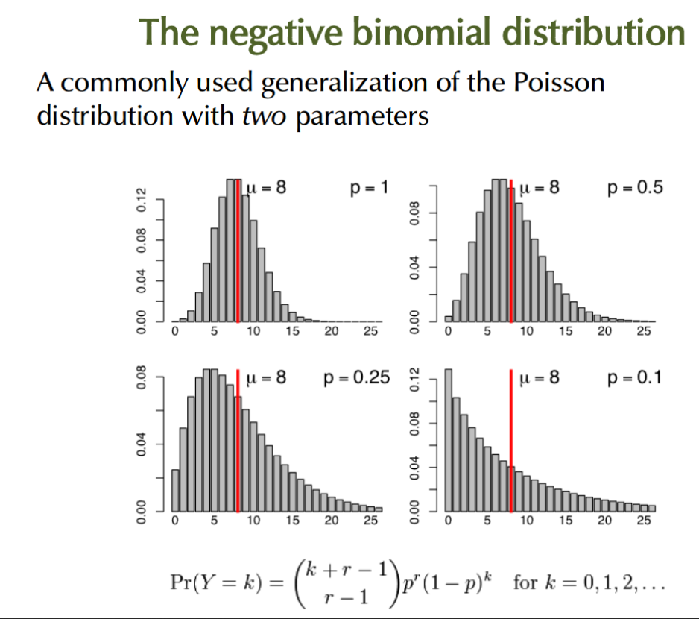

Slide 27
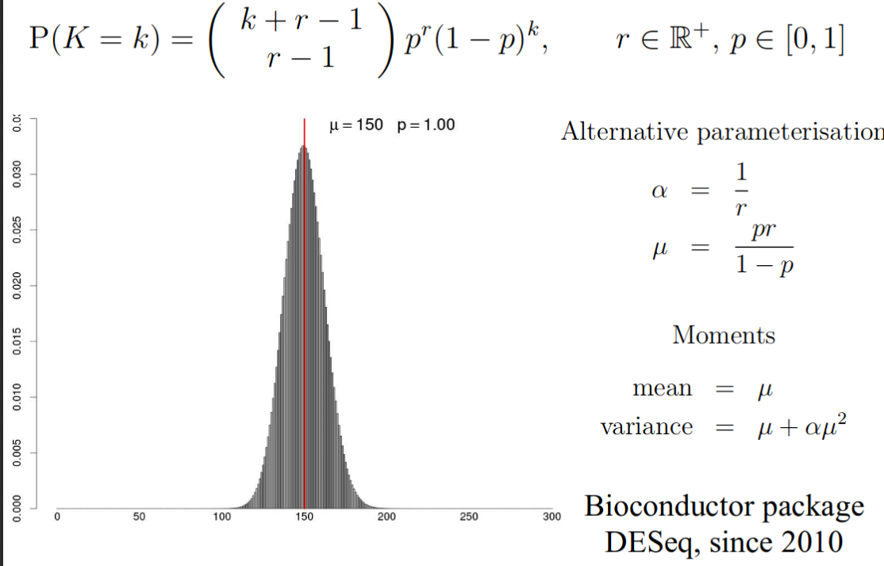
Gamma-Poisson (negative binomial)

Slide 28
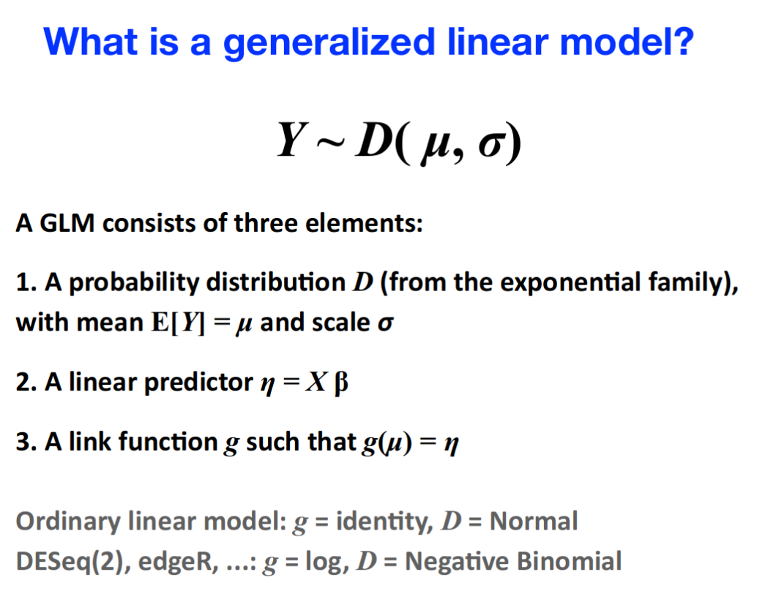
Or: μ = g⁻¹(η) = g⁻¹(Xβ)

Slide 29
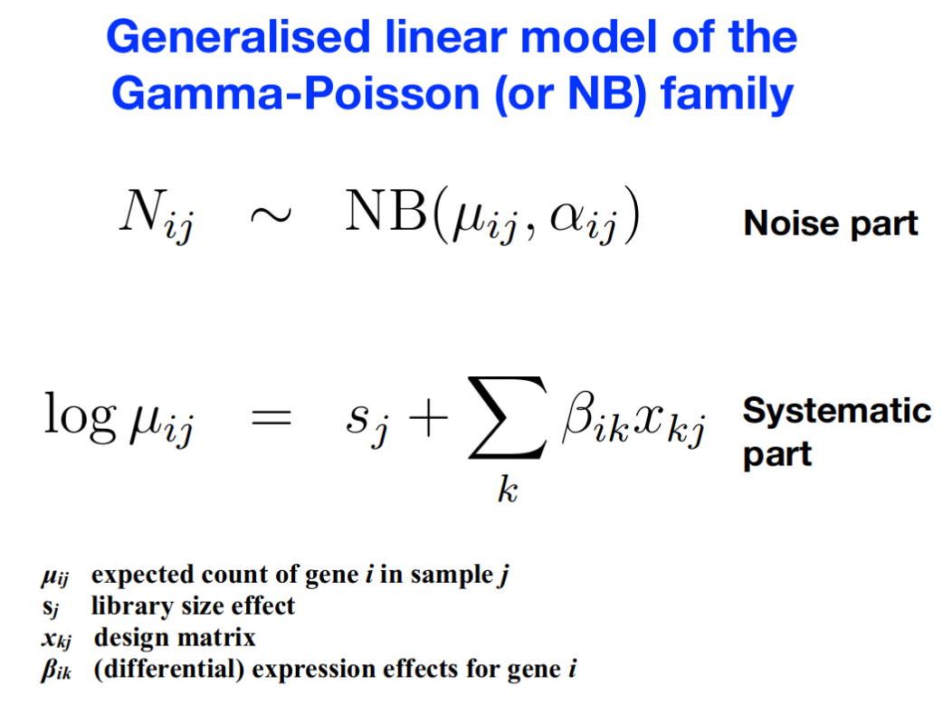

Slide 30
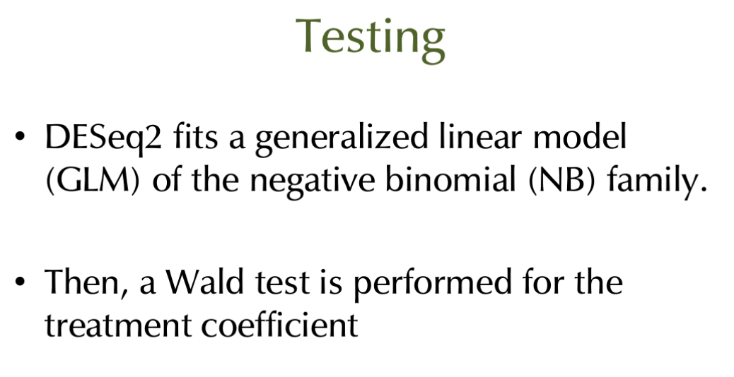

Slide 31
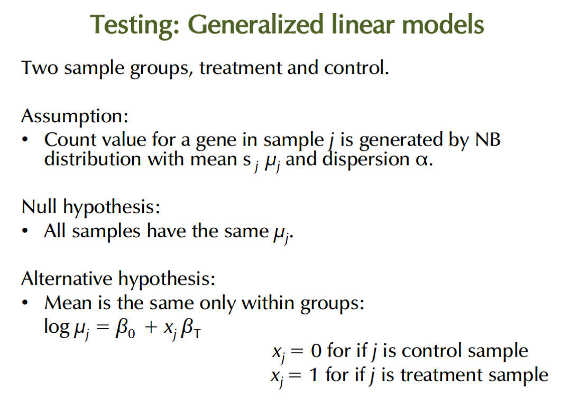

Slide 32
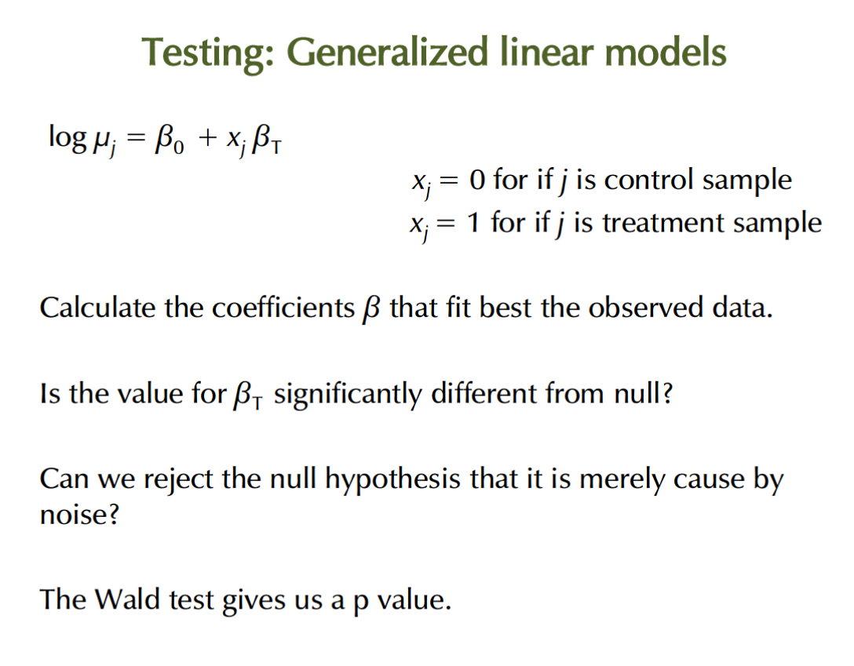

Slide 33
Normalizing heteroschedasticity (overdispersion)?
Problem: Variance depends on the mean in heteroschedastic systems.
Solution:
- Use parametric stochastic model to infer what happens at the tails
- Borrow information and share power across taxa to estimate the variances (large p, small n)
- “Shrink” the values towards mean
→ DESeq2, EdgeR, Limma..

Slide 35
Exercise
Pick the example data in phyloseq format
Follow the examples on DESeq2

Slide 36
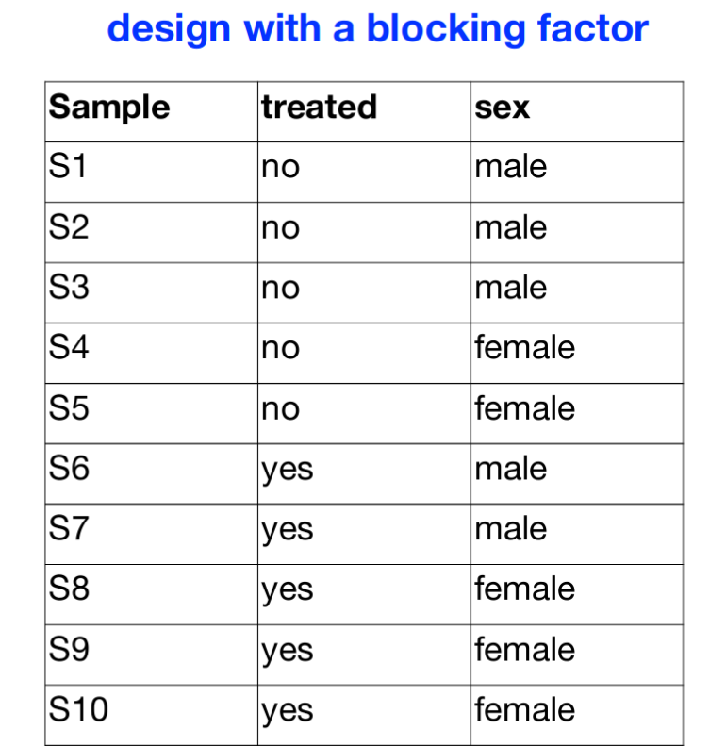
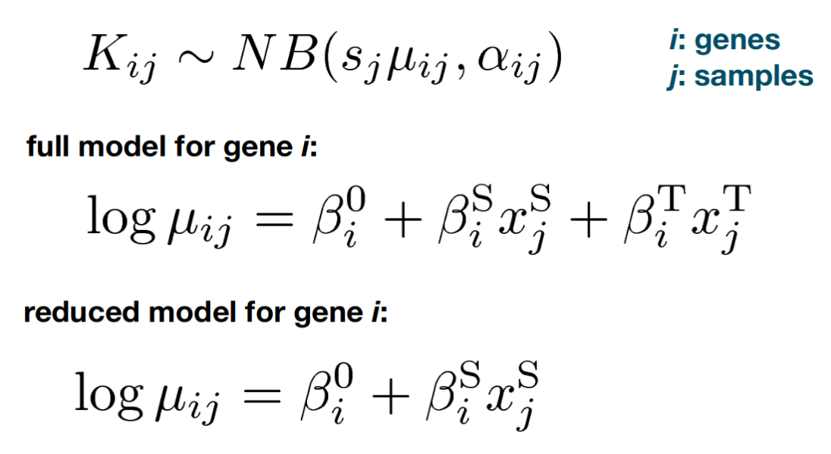

Slide 37
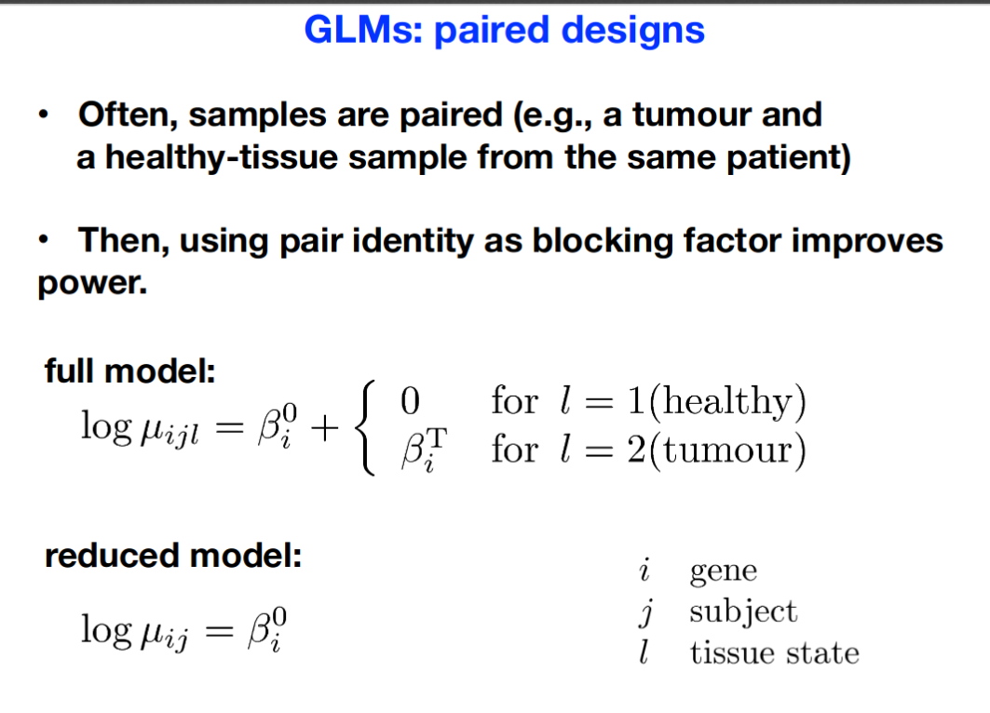

Slide 38
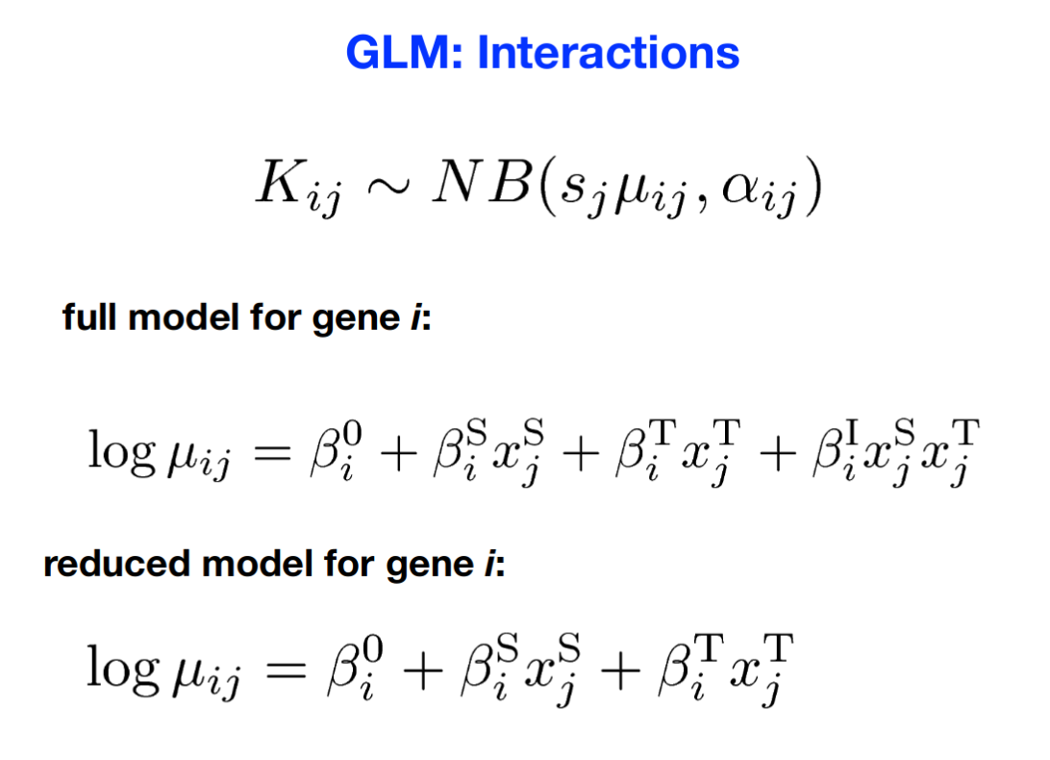

Slide 39
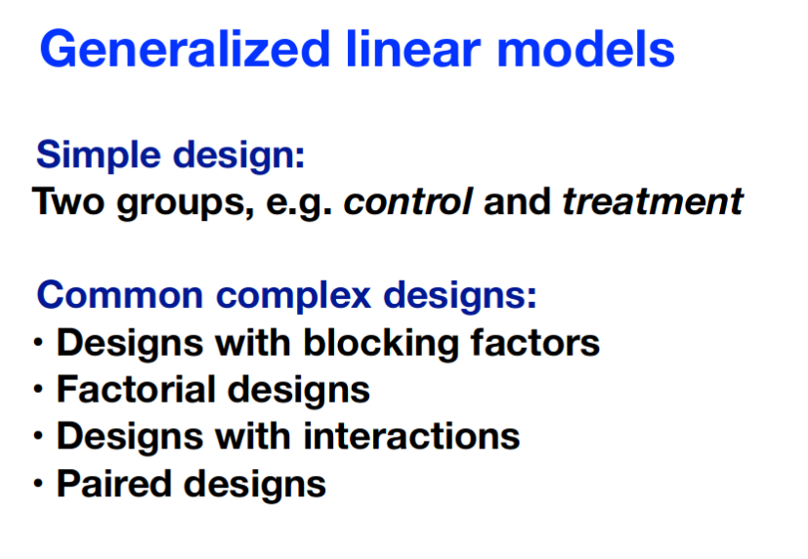

Slide 40


Slide 41
Part II: Statistical testing and special properties of microbiome data

Slide 42
Standard t-test for two-group comparison?
Problems:
Few replicates
Non-gaussian, discrete, positive, skewed..
Multiple testing

Slide 43
Normalizing heteroschedasticity (overdispersion)?
Problem: Variance depends on the mean in heteroschedastic systems.
Solution:
- Use parametric stochastic model to infer what happens at the tails
- Borrow information and share power across taxa to estimate the variances (large p, small n)
- “Shrink” the values towards mean
→ DESeq2, EdgeR, Limma..

Slide 44
Dispersion and
overdispersion

Slide 47
Gamma-Poisson (negative binomial)

Slide 49
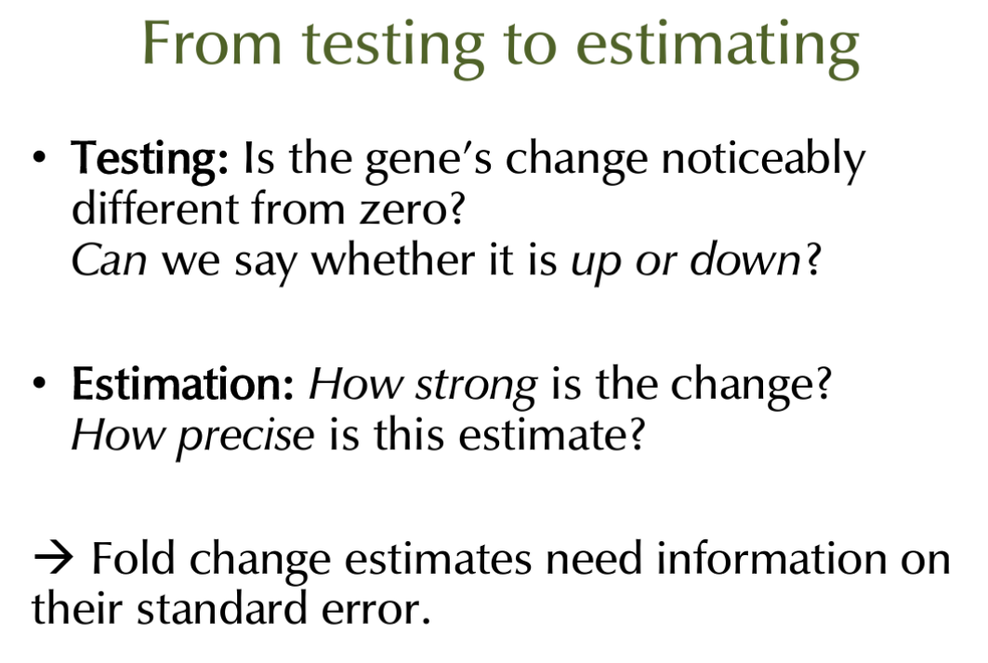

Slide 50
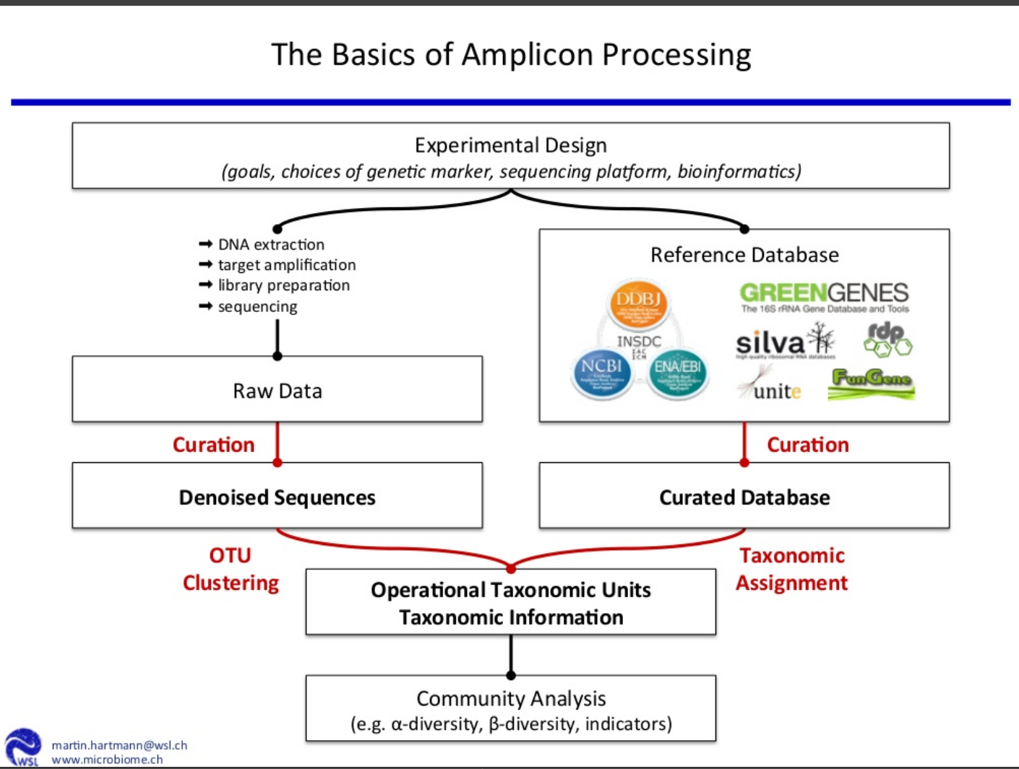

Slide 51
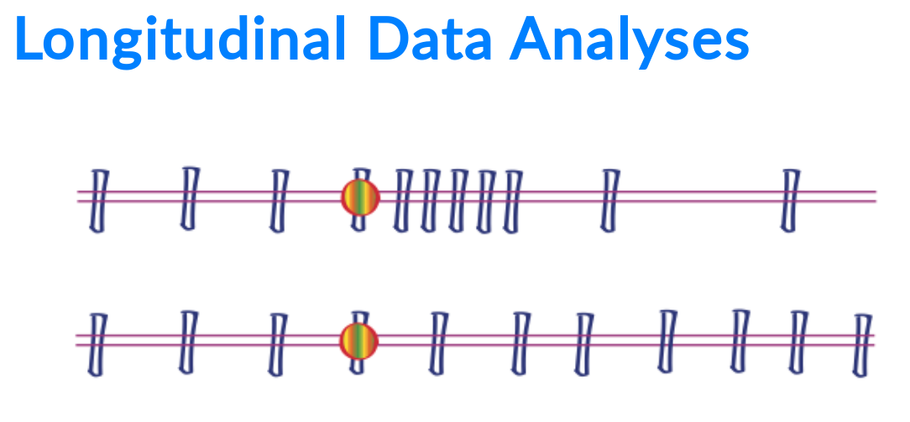
Source: Susan Holmes | http://web.stanford.edu/class/bios221/Short-Phyloseq-Resources.html

Slide 52
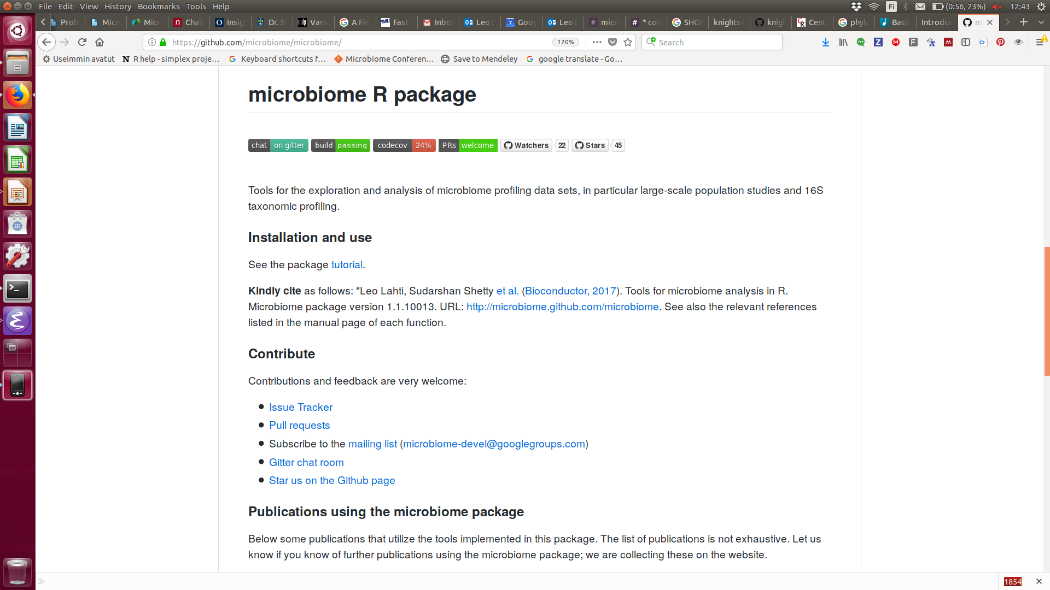

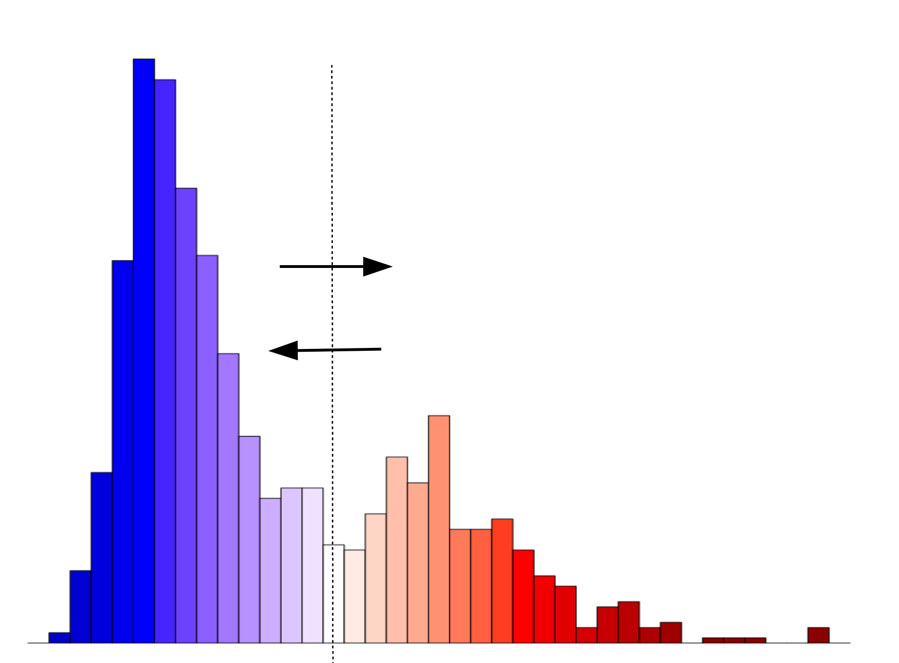
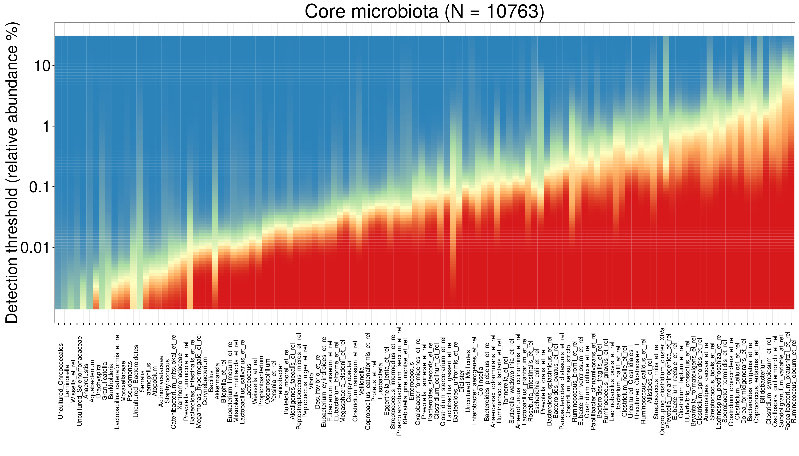
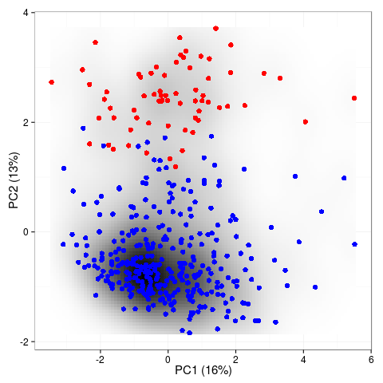
Alpha & beta
diversity
alpha(x)
diversity(x)
evenness(x)
dominance(x)
rarity(x)
readcount(x)
Core & prevalence
prevalence(x)
core(x)
core_members(x)
Stability & resilience
Transformations
transform(x, “compositional”)
transform(x, “clr”)
transform(x, “log10p”)
transform(x, “hellinger”)
transform(x, “identity”)
Community
- Online tutorials
- Mailing list
- Gitter chat
- Example data
- Workshops
Quality control
- continous integration
- unit tests
<number> / 56

Slide 53
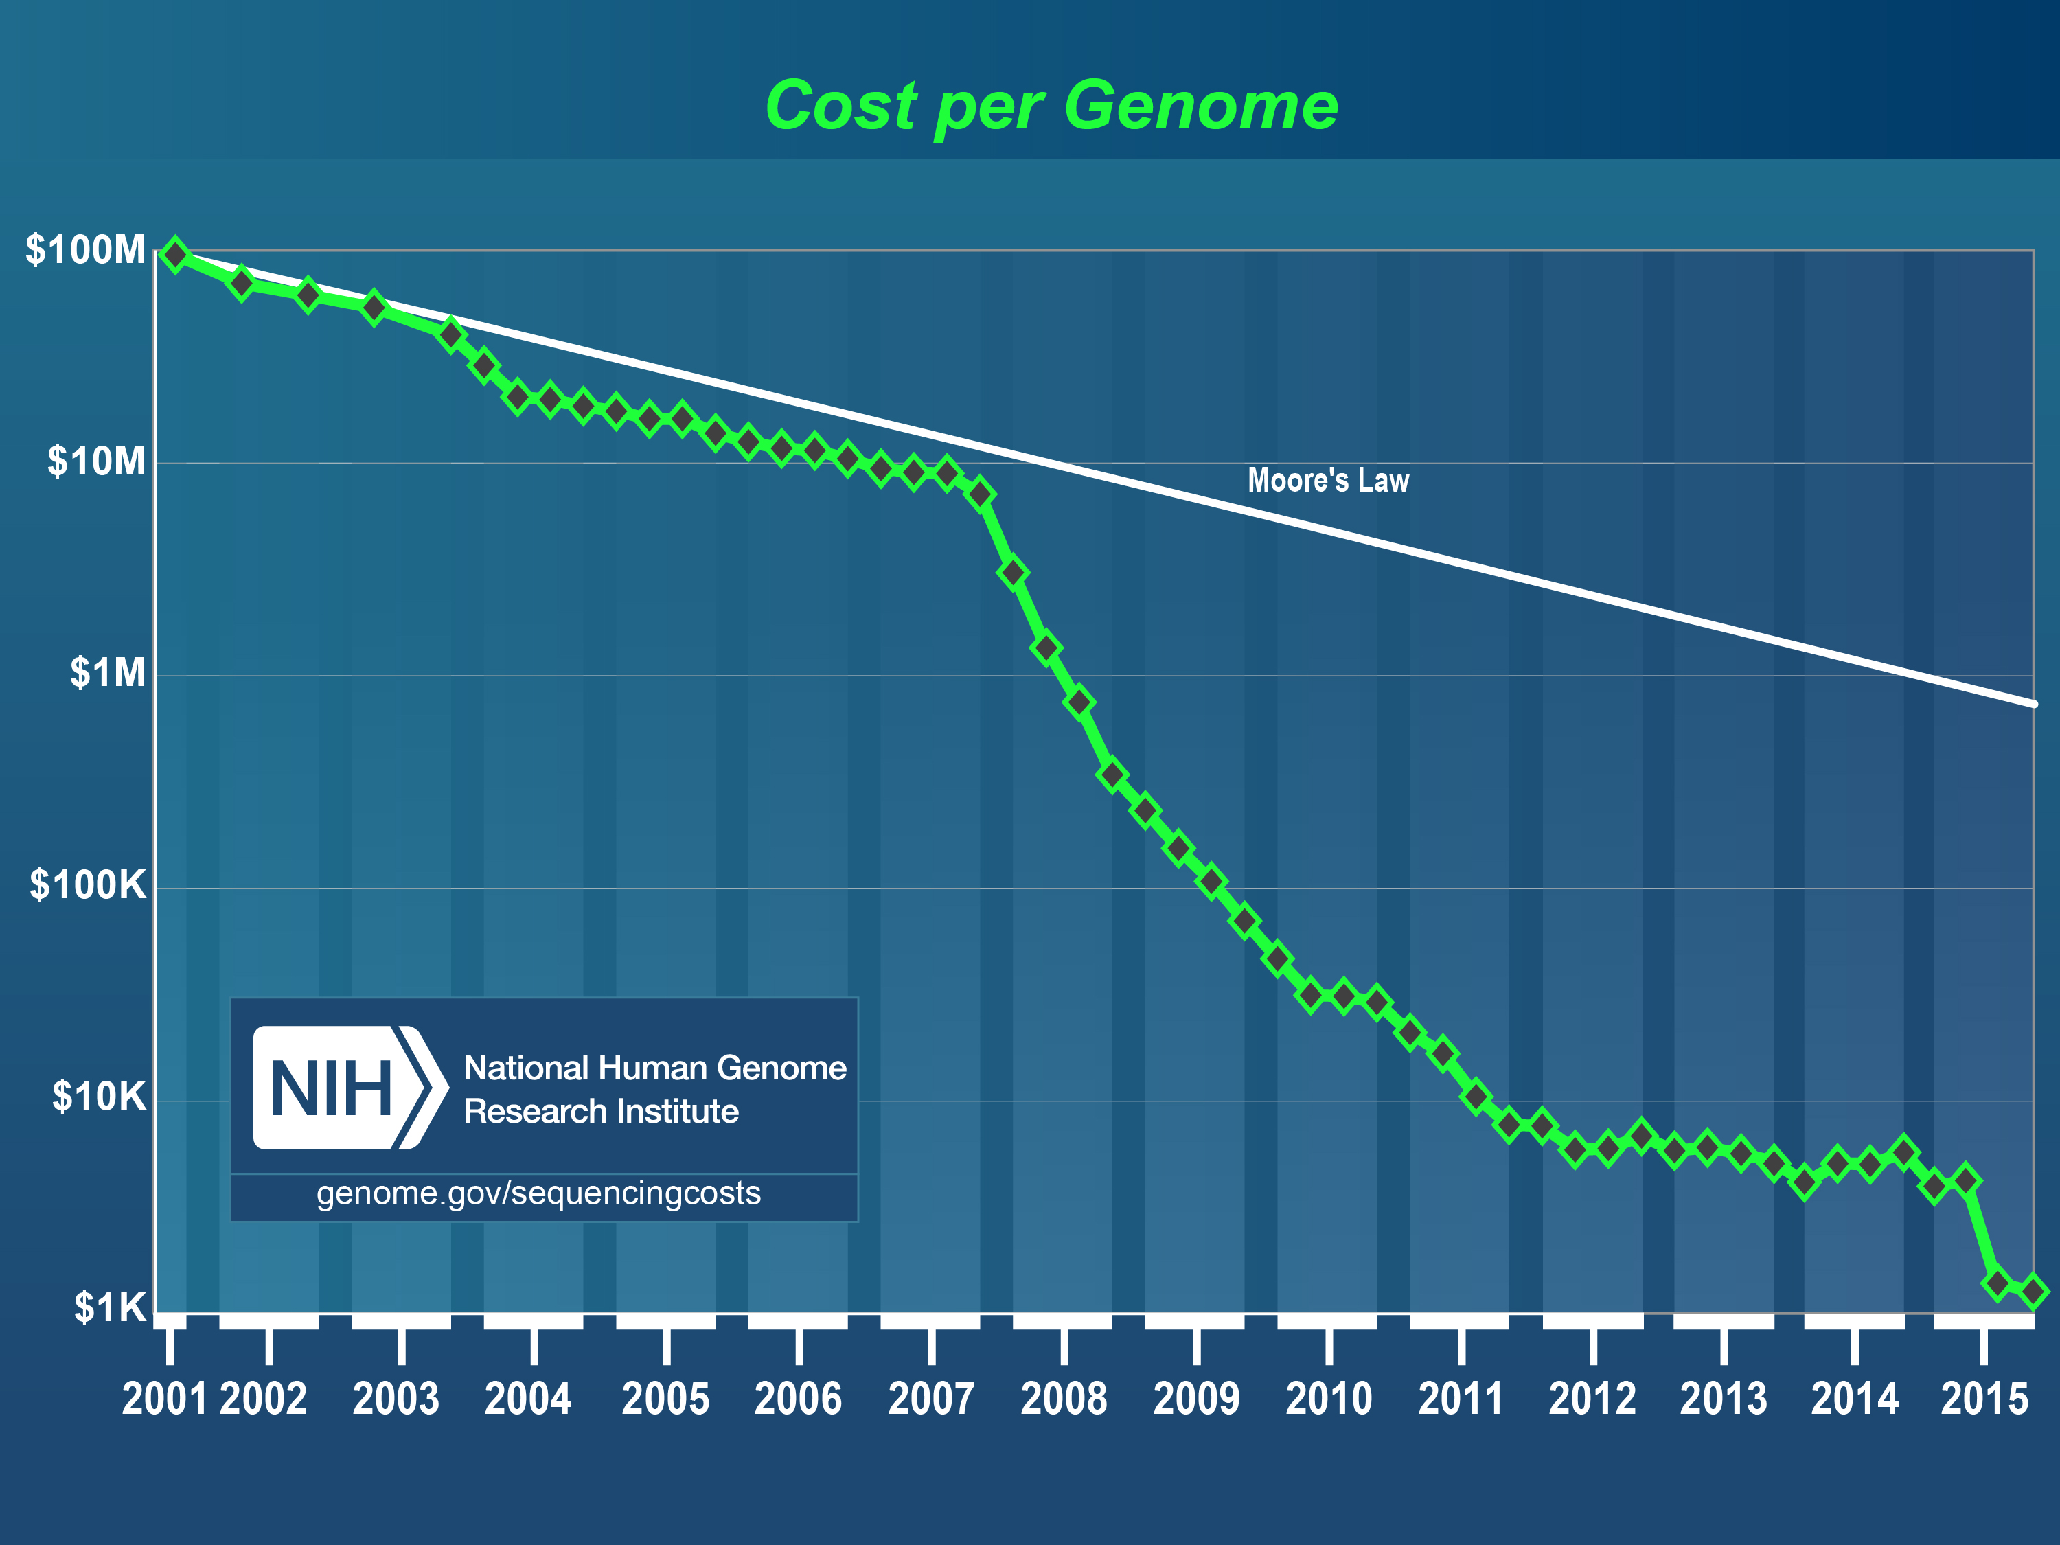

Slide 54
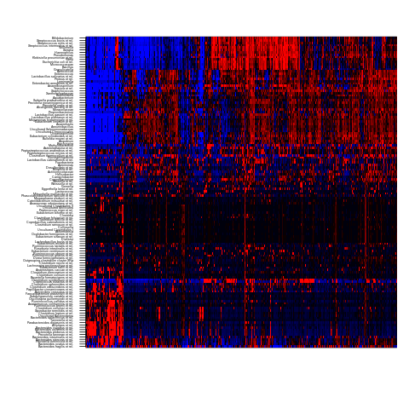
Core microbiota only few species are prevalent (shared) in population at a high abundance
Microbial taxa
Subjects
Data: HITChip Atlas

Slide 56


