Slide 1
Tuesday: Key concepts & alpha diversity
Demo
Microbiome data exploration
Lecture
Key concepts in microbiome data science
Practical
Alpha diversity: estimation, analysis, and visualization

Slide 2
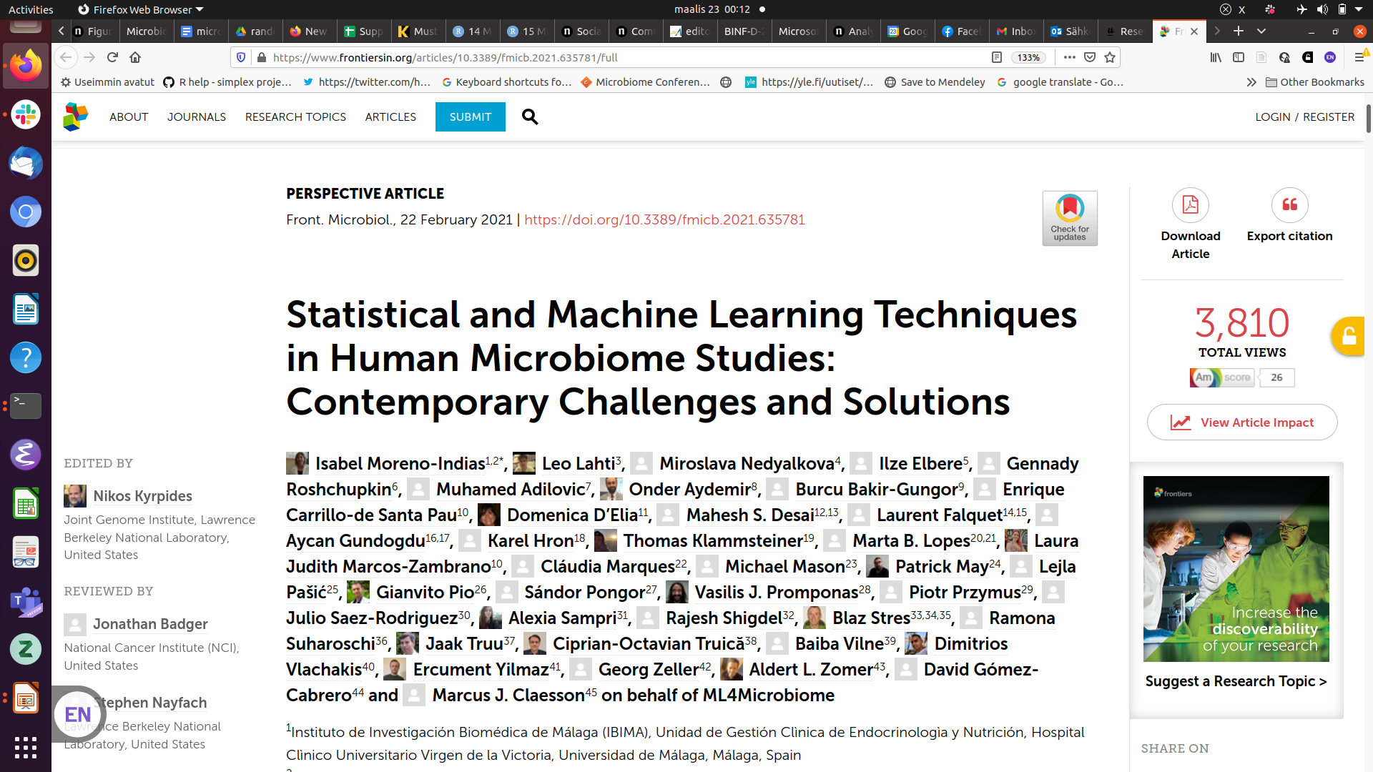
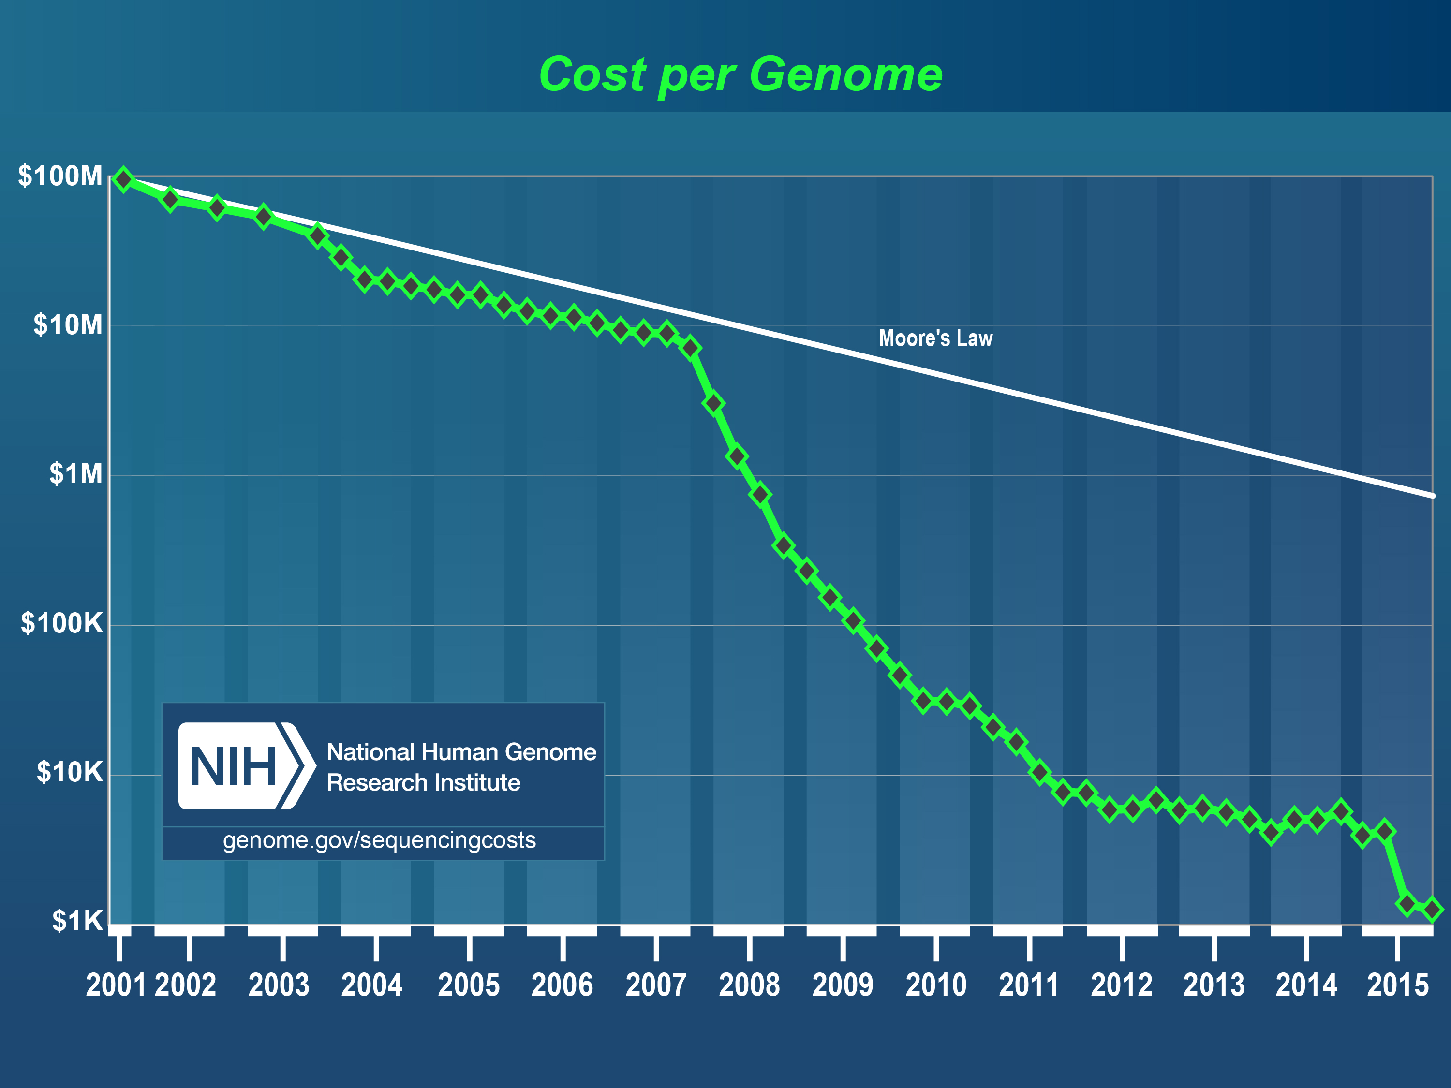

Slide 3
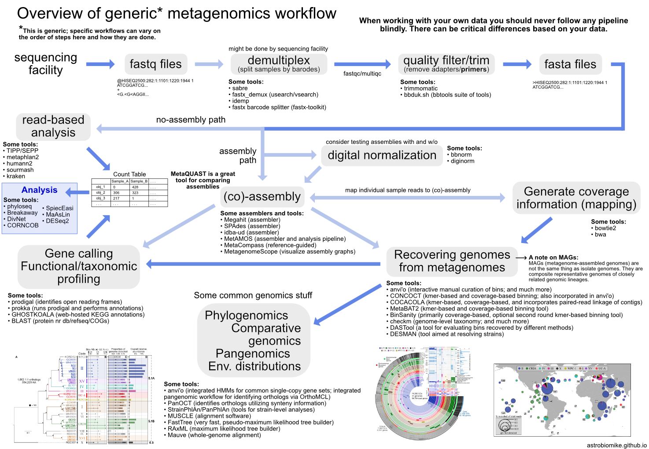
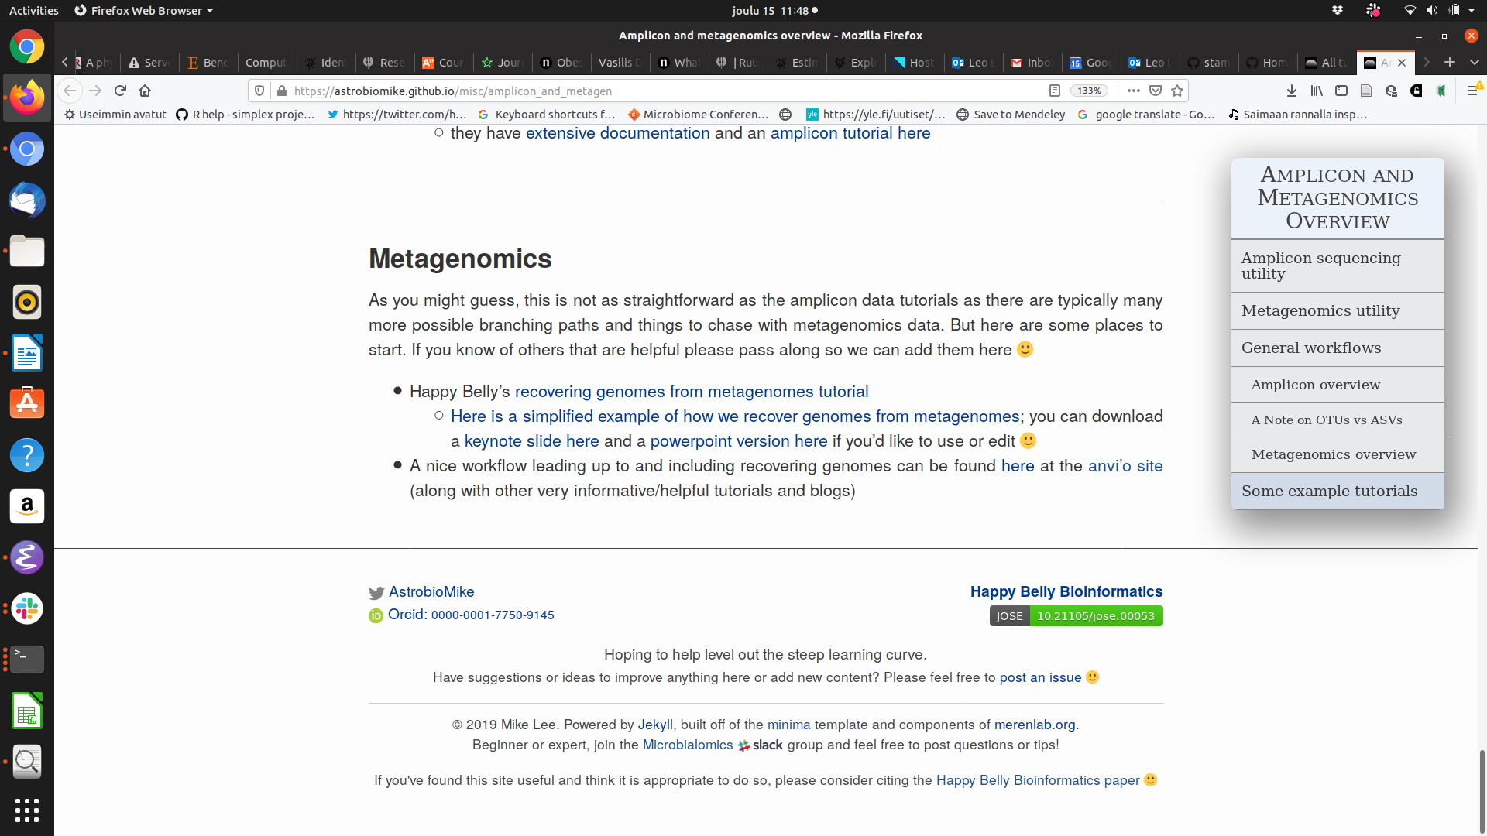
Lee, (2019). Happy Belly Bioinformatics: an open-source resource dedicated to helping biologists utilize bioinformatics. Journal of Open Source Education, 4(41), 53, https://doi.org/10.21105/jose.00053

Slide 4
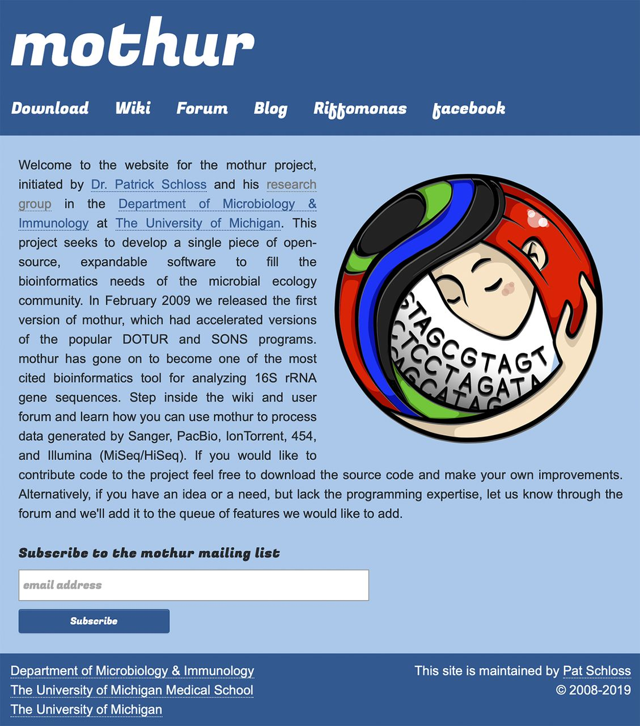
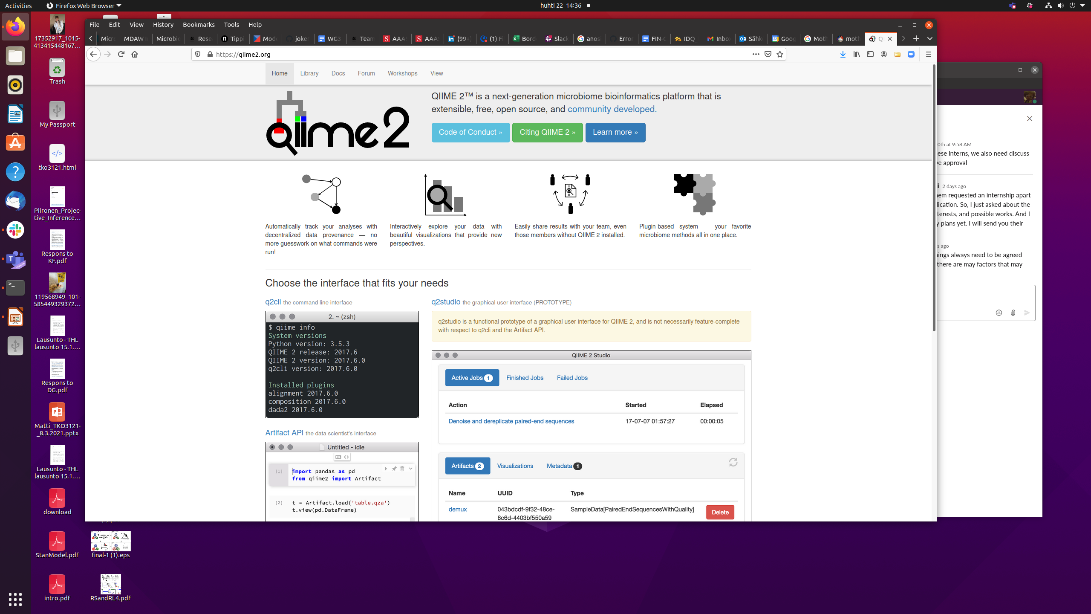

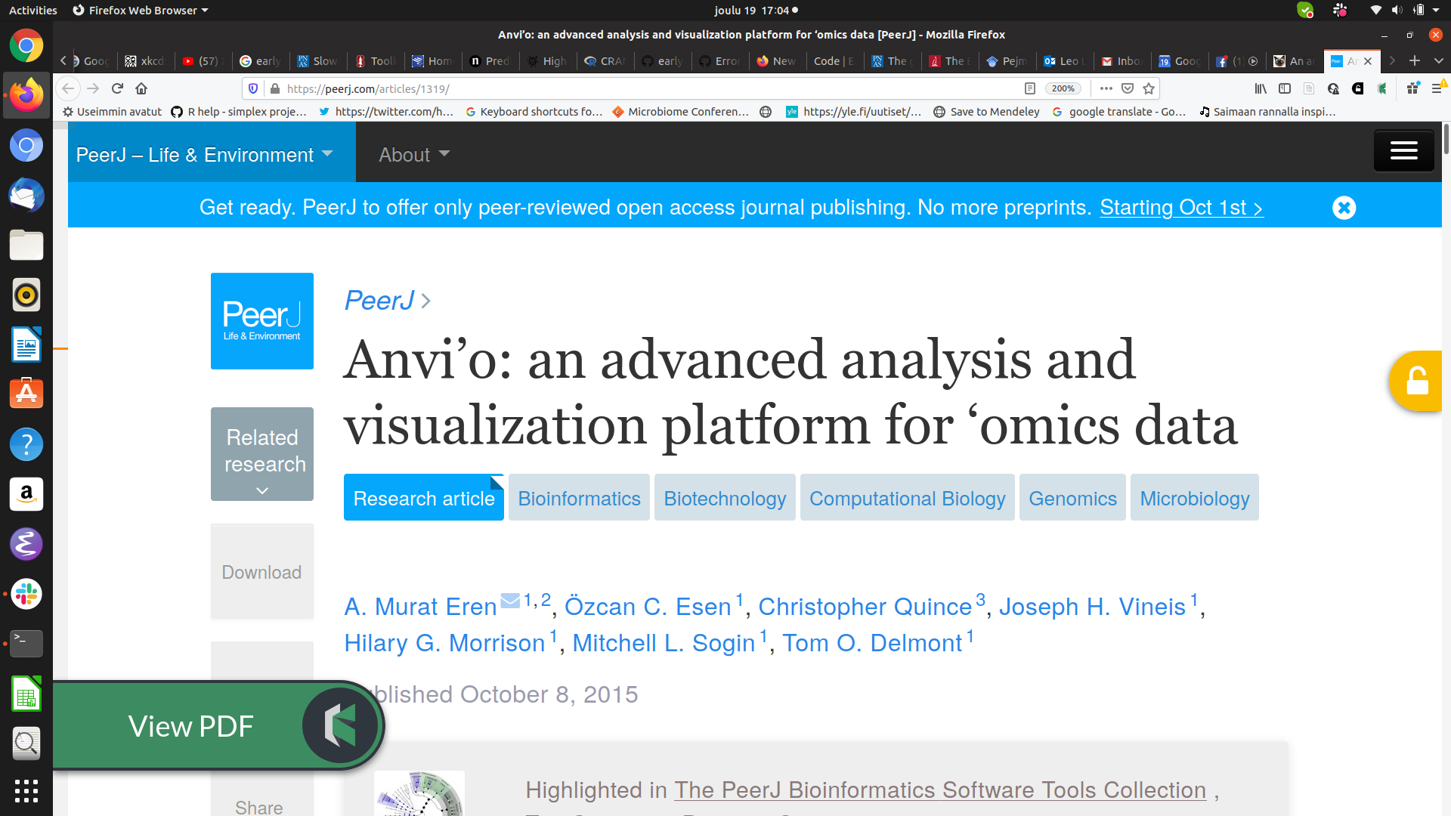
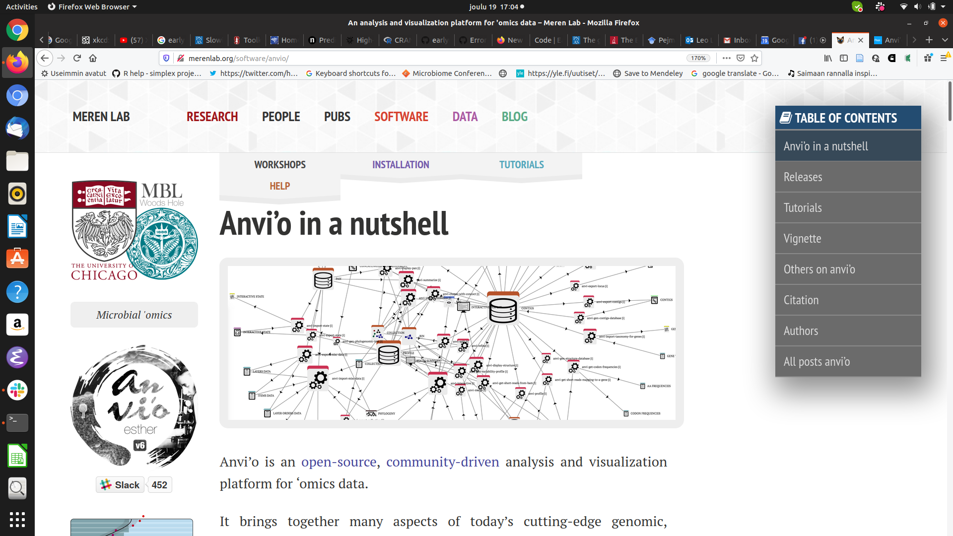
open data science ecosystems

Slide 5
Data
Algorithms
Results
<number>/25

Slide 6
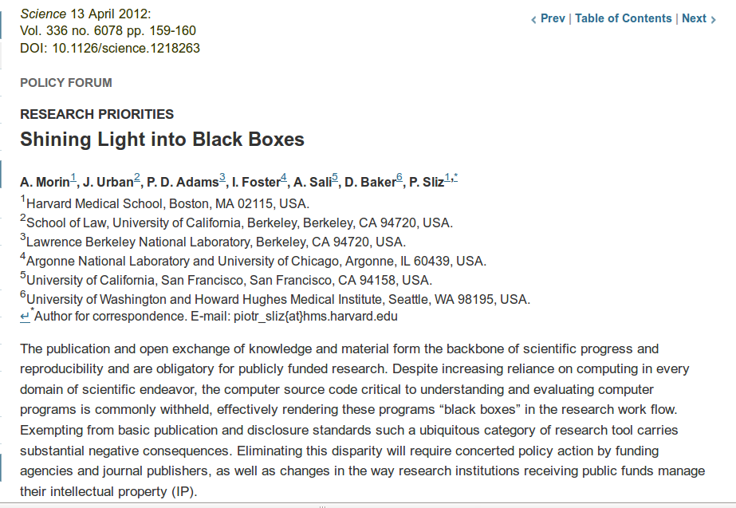
?
Data
Methods
Results
<number>/25

Slide 7

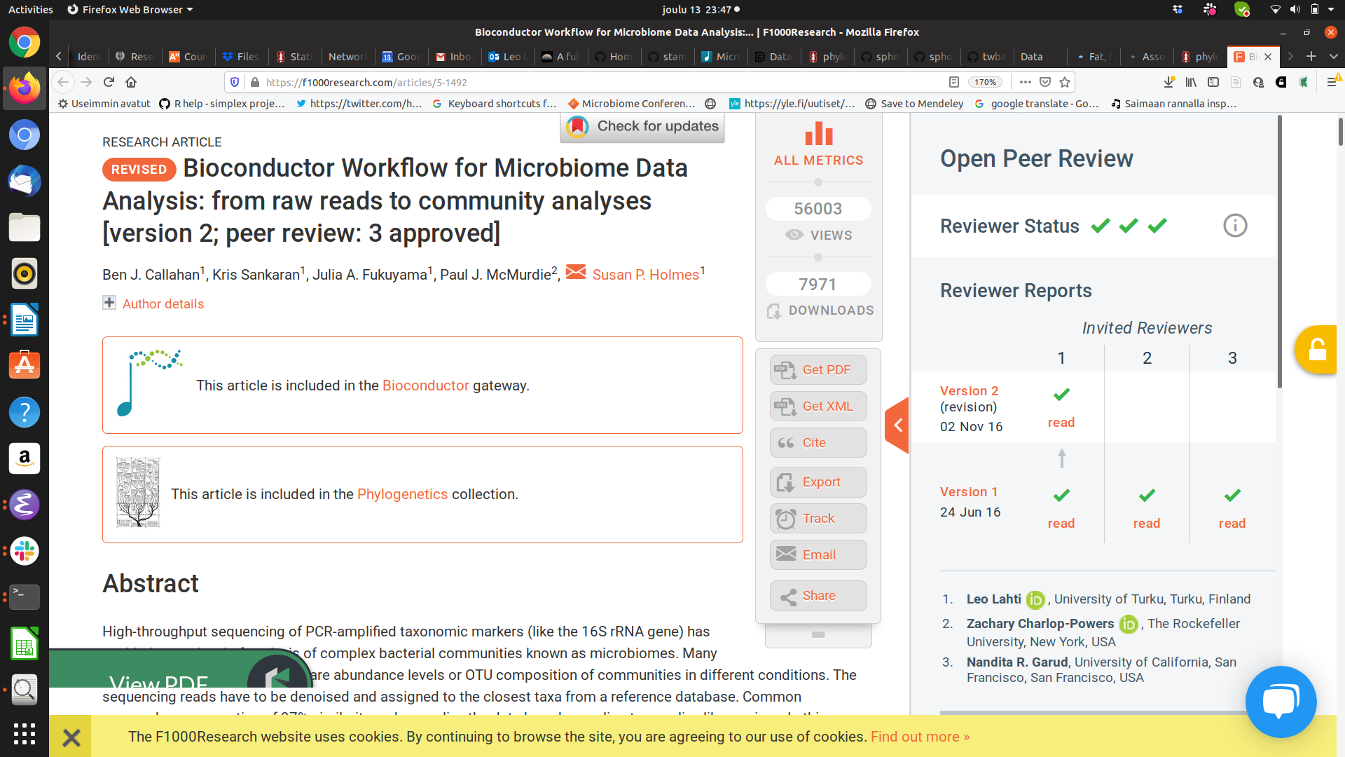
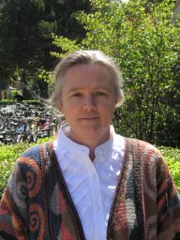
Data science workflow
R for Data Science / H. Wickham
<number> / 25

Slide 8
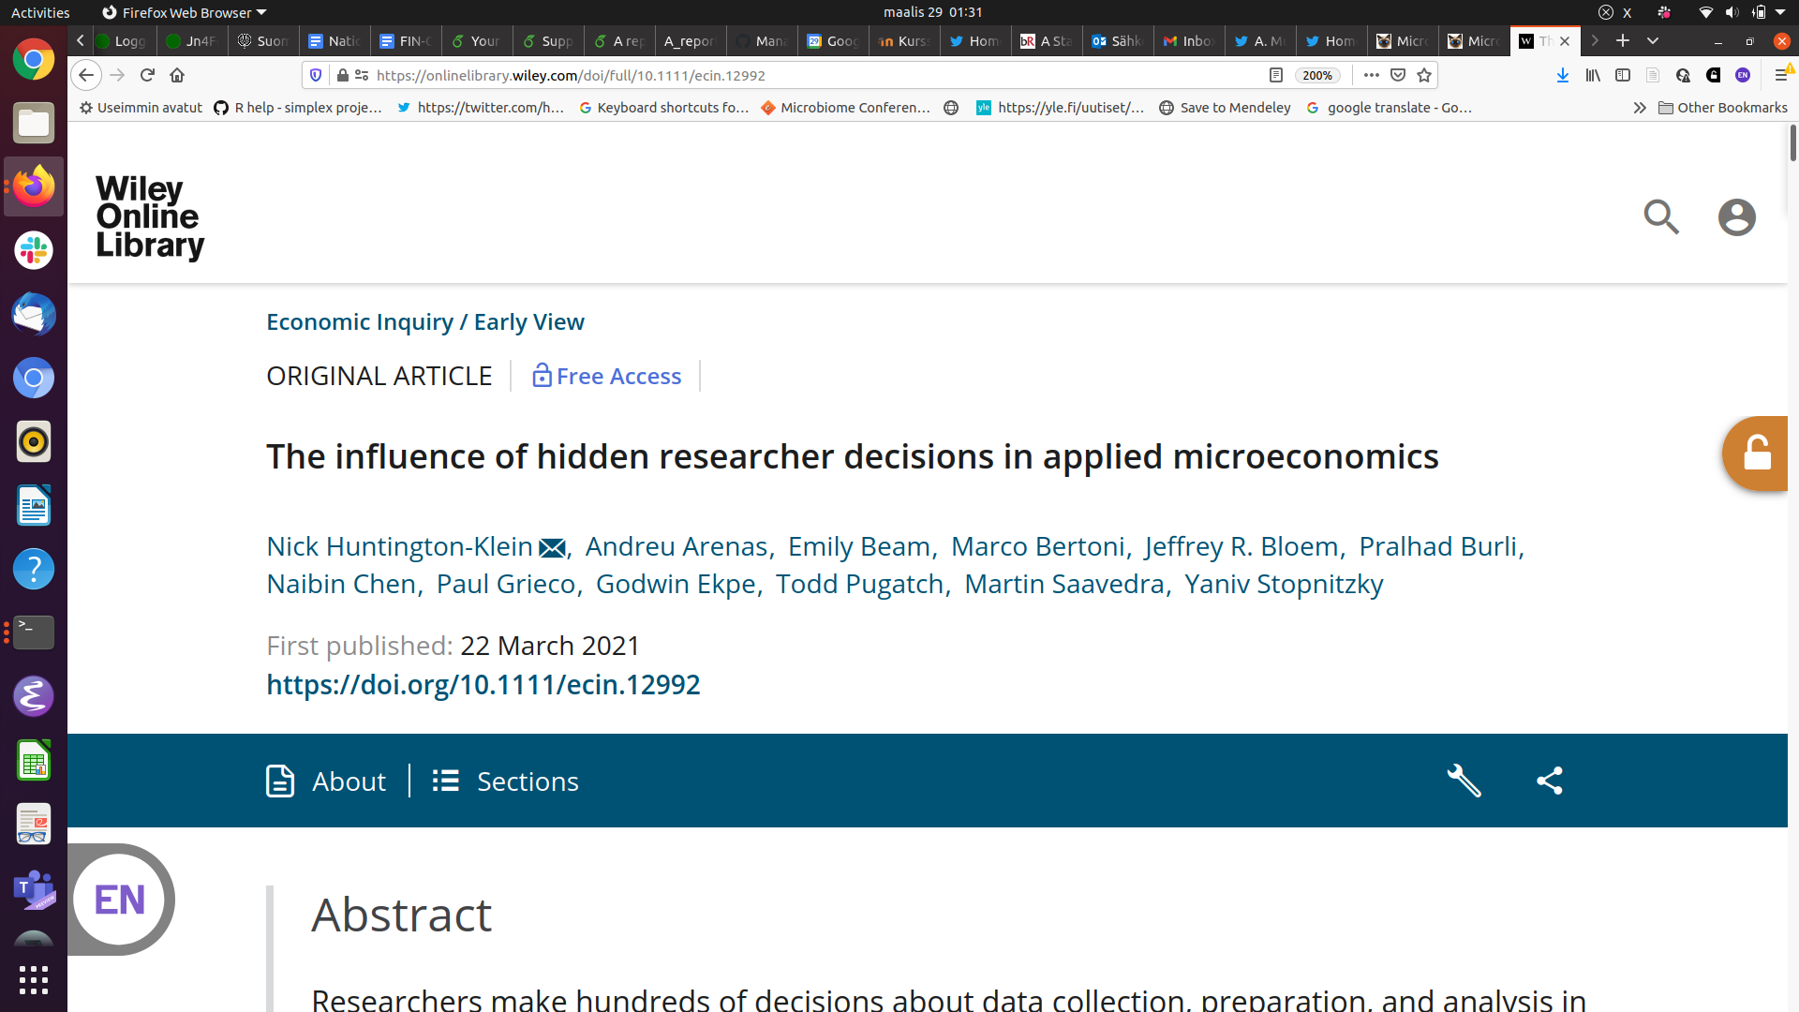
Researchers make hundreds of decisions about data collection, preparation, and analysis in their research. We use a many‐analysts approach to measure the extent and impact of these decisions. Two published causal empirical results are replicated by seven replicators each. We find large differences in data preparation and analysis decisions, many of which would not likely be reported in a publication. No two replicators reported the same sample size. Statistical significance varied across replications, and for one of the studies the effect's sign varied as well. The standard deviation of estimates across replications was 3–4 times the mean reported standard error.
<number> / 25

Slide 9
“I have begun to think that no one ought to publish biometric results, without lodging a well arranged and well bound manuscript copy of all his data, in some place whereit should be accessible, under reasonable restrictions, to those who desire to verify his work.”
Francis Galton (1901), Biometrika 1:1, pp. 7-10.
<number> / 25

Slide 10
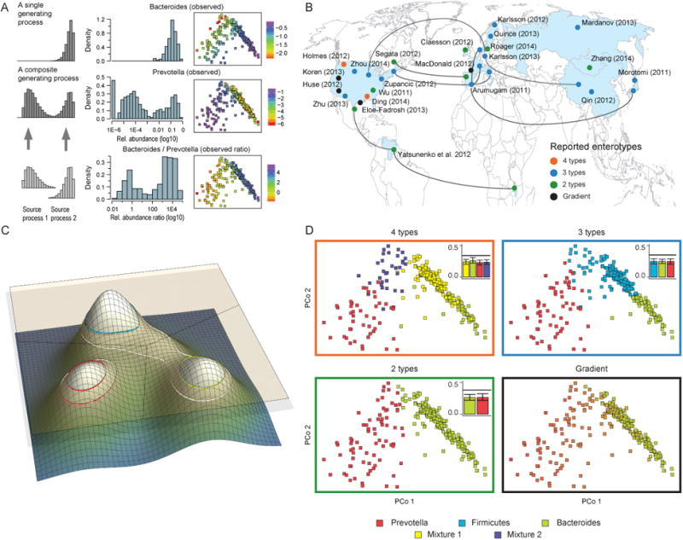
How to choose a correct model?
→ a community typing example
Taxonomic level
- Phylum
- Family
- Order
- Genus
- Species
- Strain..
2 x 6⁶ = 93312
Filtering
- None
- Prevalent
- Core
- Excl. outliers
- High variance
- Custom
Enterotypes in the landscape of gut microbial community composition. Costea et al. Nature 2018.
Normalization
- None
- TSS
- CSS
- ILR/ALR/CLR
- phILR
- Hellinger
(Dis)similarity
- Eulidean
- Aitchison
- Bray-Curtis
- Jaccard
- weighted Unifrac
- unweighted Unifrac
Clustering method
- Hierarchical / Ward
- Hierarchical / Complete
- Gaussian mixture
- DMM
- PAMR
- K-means
Regulation
- Calinski-Harabasz
- Dirichlet Process
- Silhouette Index
- AIC
- BIC
- DIC
Walk-through example in R/Bioc by Holmes & McMurdie http://statweb.stanford.edu/~susan/papers/EnterotypeRR.html

Slide 11
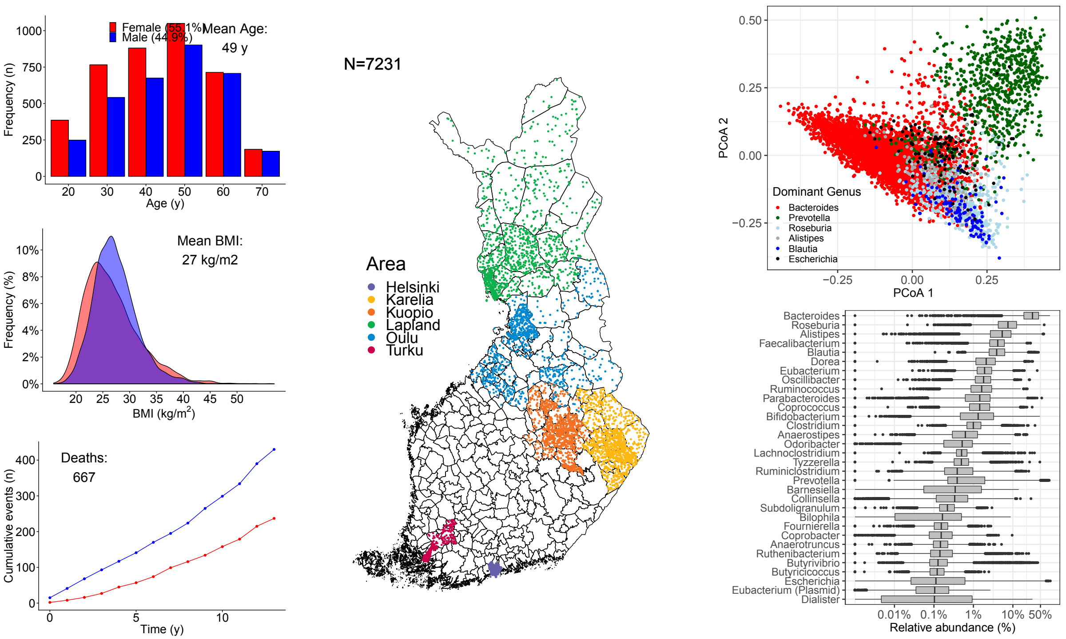
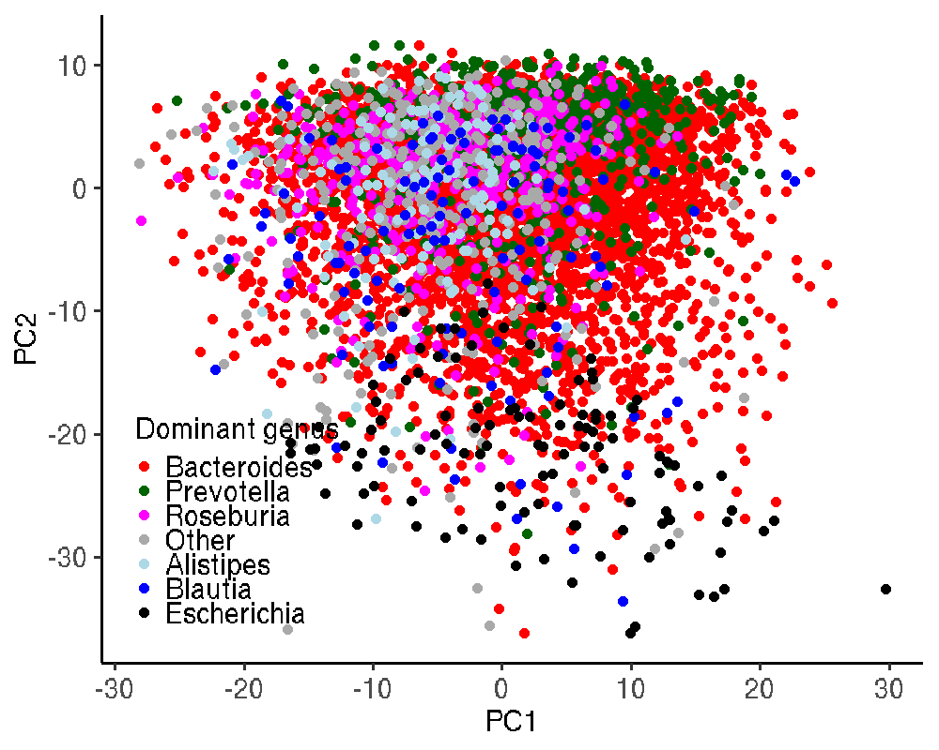
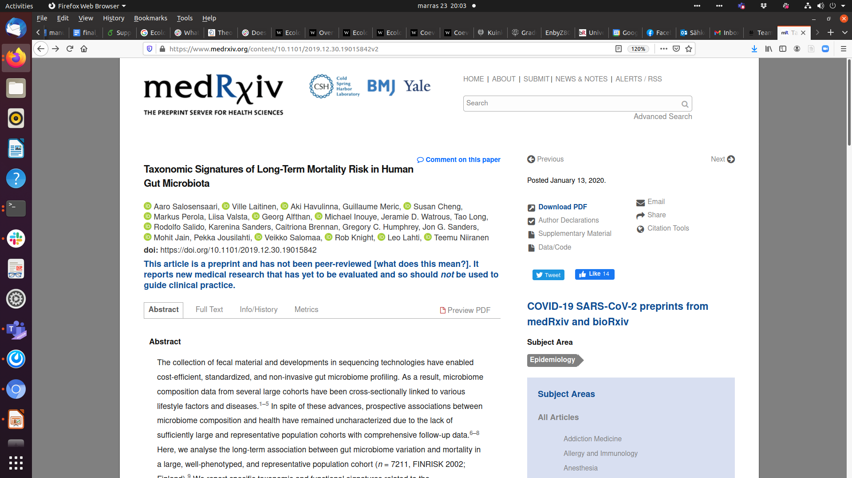
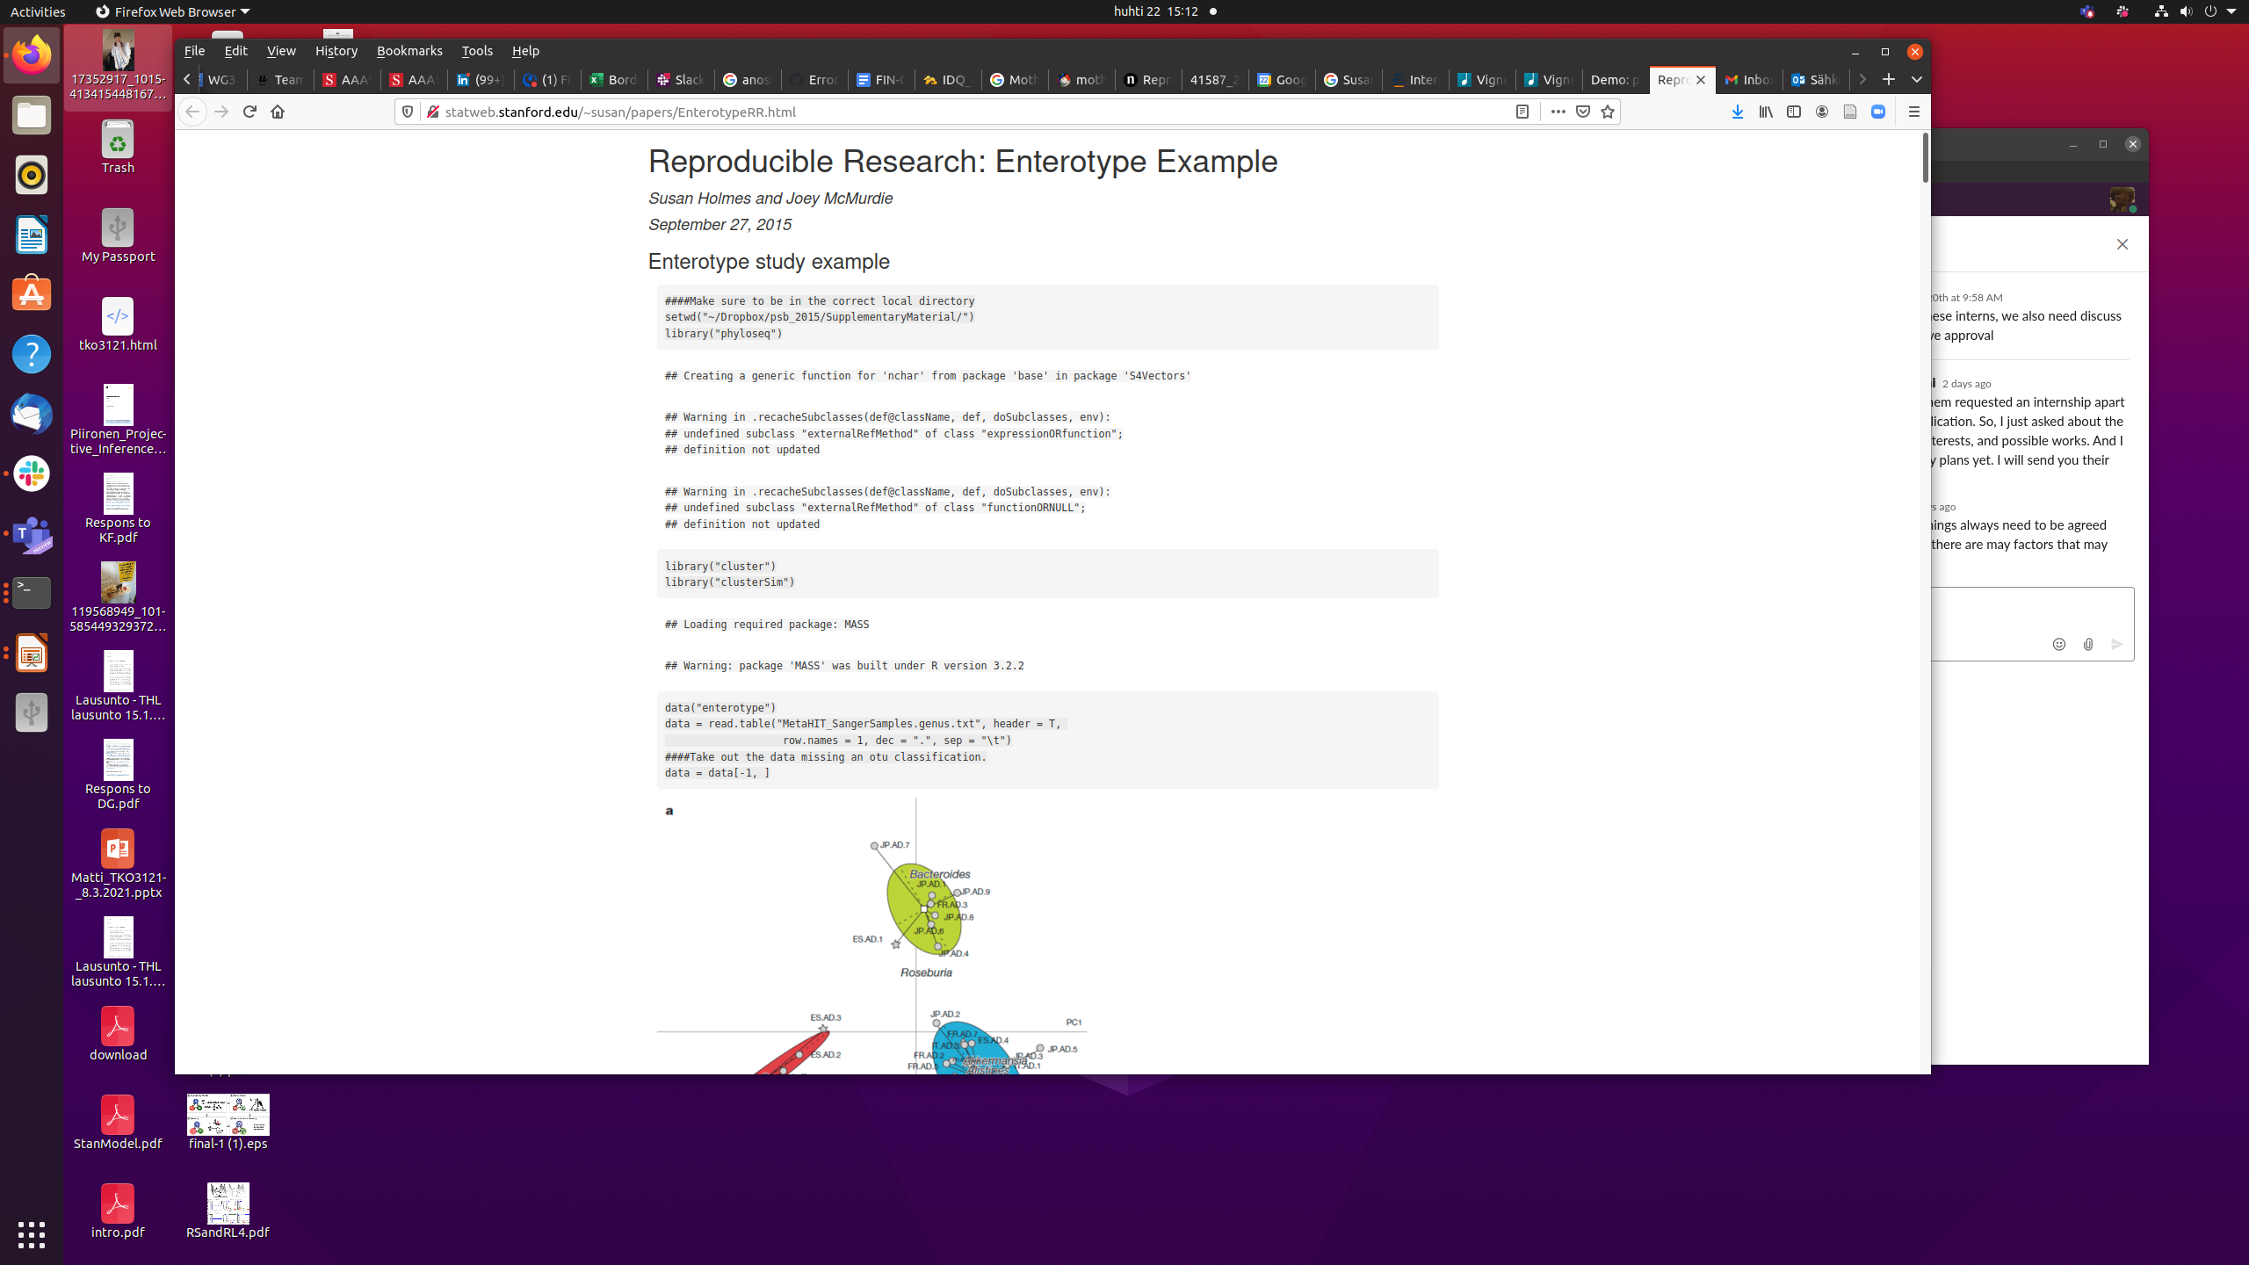
PCoA + Bray-Curtis
PCA + Aitchison
http://statweb.stanford.edu/~susan/papers/EnterotypeRR.html

Slide 12
Reproducible workflows improve transparency and robustness
R for Data Science / H. Wickham
Taxonomic level?
- Phylum
- Family
- Order
- Genus
- Species
- Strain..
Normalization
- None
- TSS
- CSS
- ILR/ALR/CLR
- phILR
- Hellinger
(Dis)similarity?
- Eulidean
- Aitchison
- Bray-Curtis
- Jaccard
- weighted Unifrac
- unweighted Unifrac
Regulation
- Calinski-Harabasz
- Dirichlet Process
- Silhouette Index
- AIC
- BIC
- DIC
Clustering
- Hierarchical / Ward
- Hierarchical / Complete
- Gaussian mixture
- DMM
- PAMR
- K-means

Slide 13
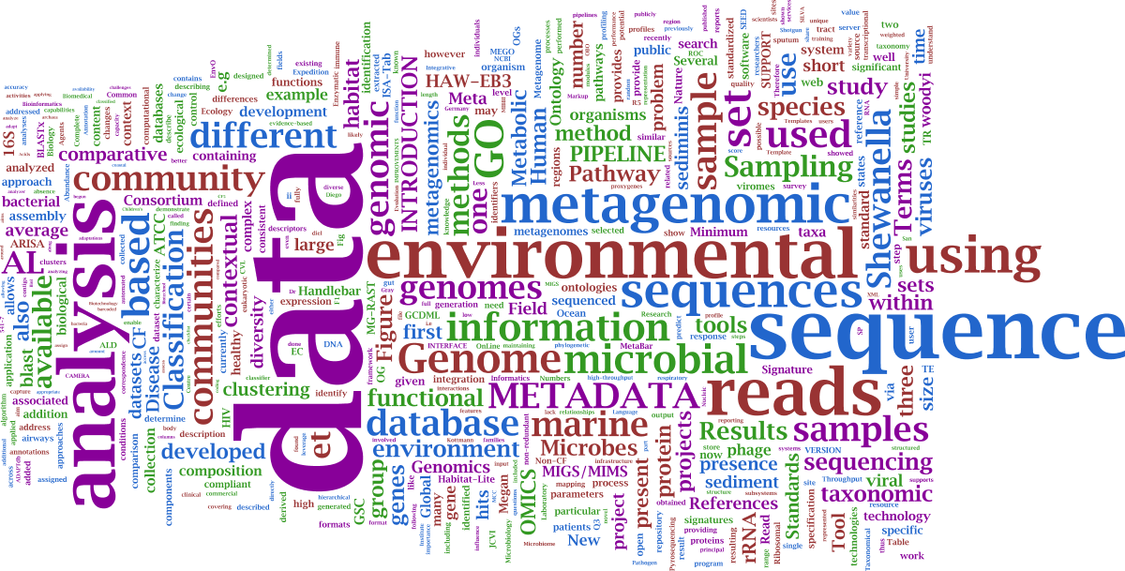

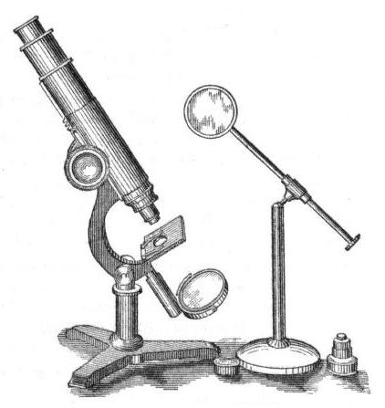
Hypothesis testing vs. hypothesis discovery?
?
Hypothesis
Method
Data
Tools

Slide 14
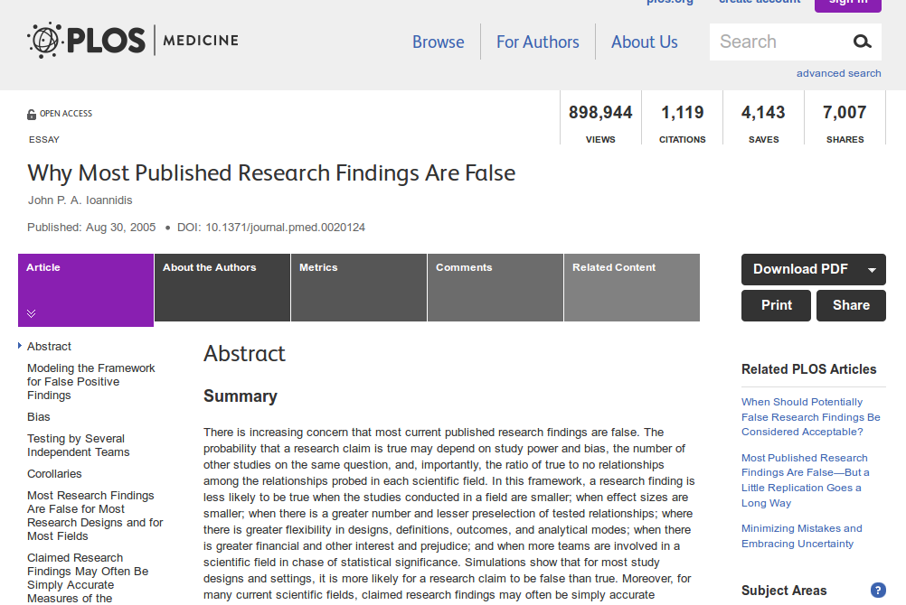
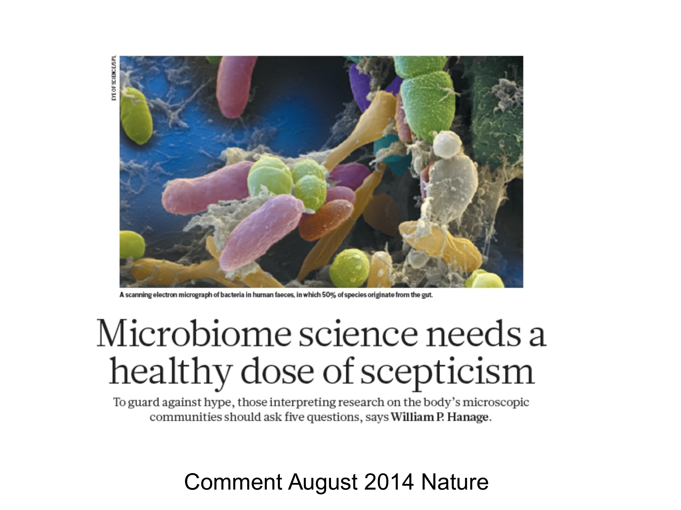
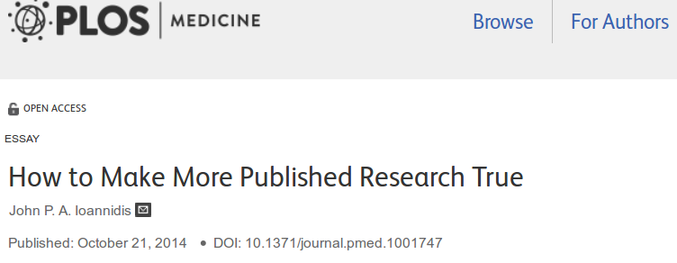
<number>/25

Slide 15
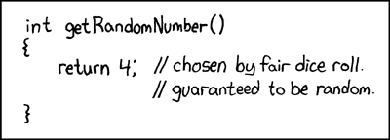
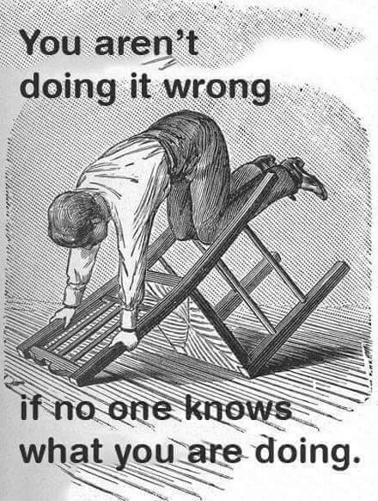
http://web.stanford.edu/class/cs109l/unrestricted/images/
<number> / 25

Slide 16

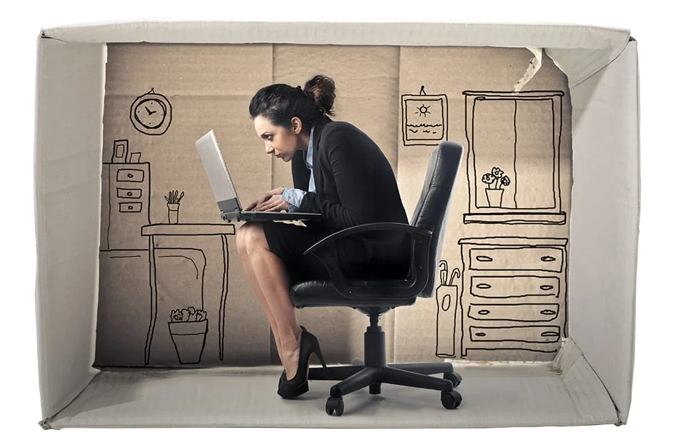
Data silo

Slide 17
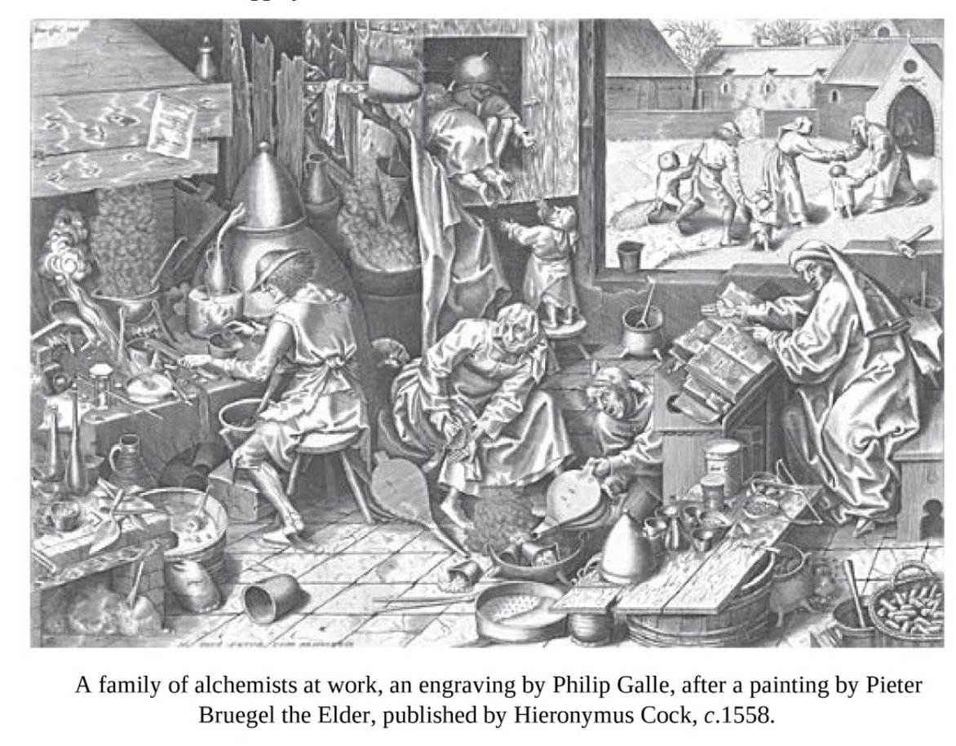
The demise of alchemy provides further evidence, if further evidence were needed, that what marks out modern science is not the conduct of experiments (alchemists conducted plenty of experiments), but the formation of a critical community capable of assessing discoveries and replicating results. Alchemy, as a clandestine enterprise, could never develop a community of the right sort. Popper was right to think that science can flourish only in an open society.
The Invention of Science: A New History of the Scientific Revolution, by David Wootton
<number> / 25

Slide 19
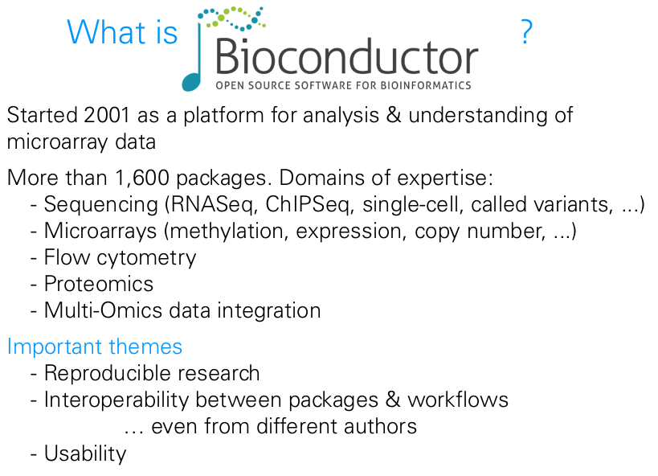
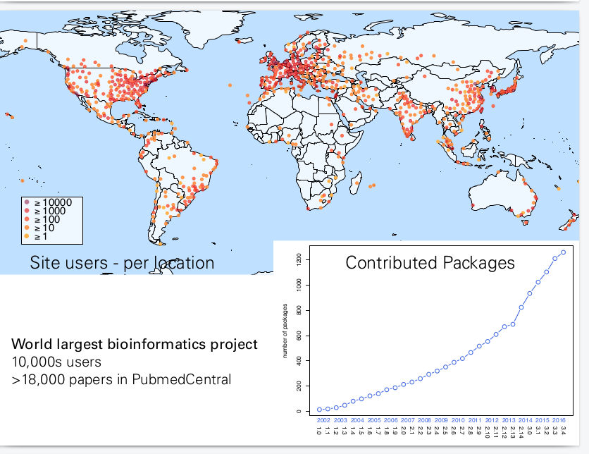
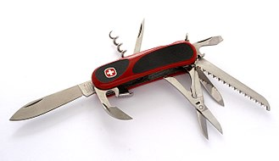
<number> / 25

Slide 20
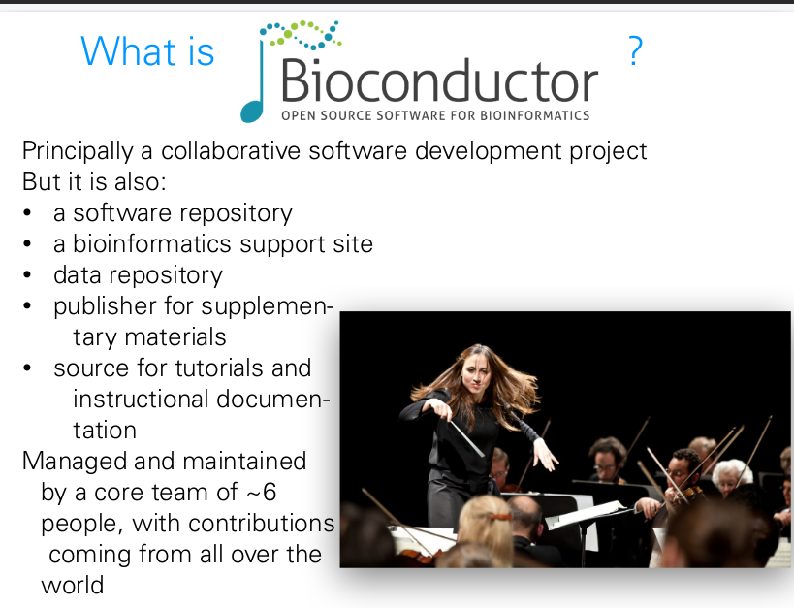

Slide 21
Pre- vs. post-publication review
Submission
Open, iterative
post-publication
review (experts,
public)
Initial
screen
(pre-publication review)
Immediate
publication
(citable versions)
“Final”
publication
<number>/25

Slide 22
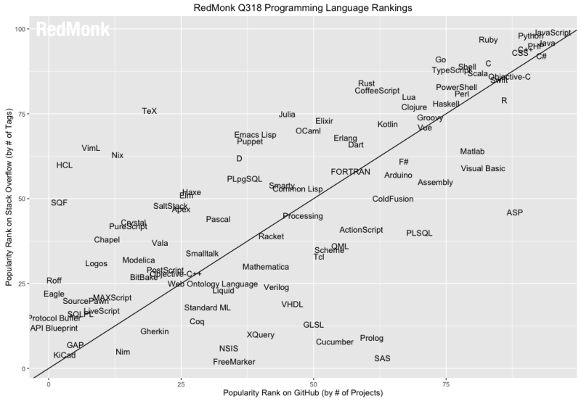
Varying cultures of open collaboration

Slide 23
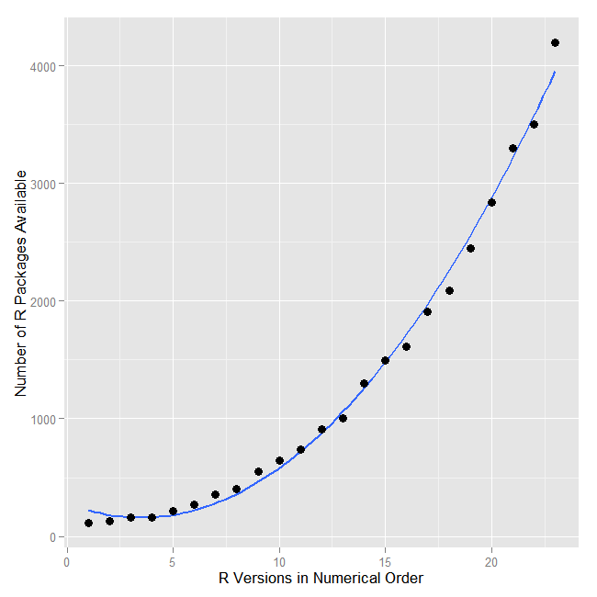





Number of open analysis tools has grown exponentially
Value of data can increase through sharing & use
<number>/25

Slide 24
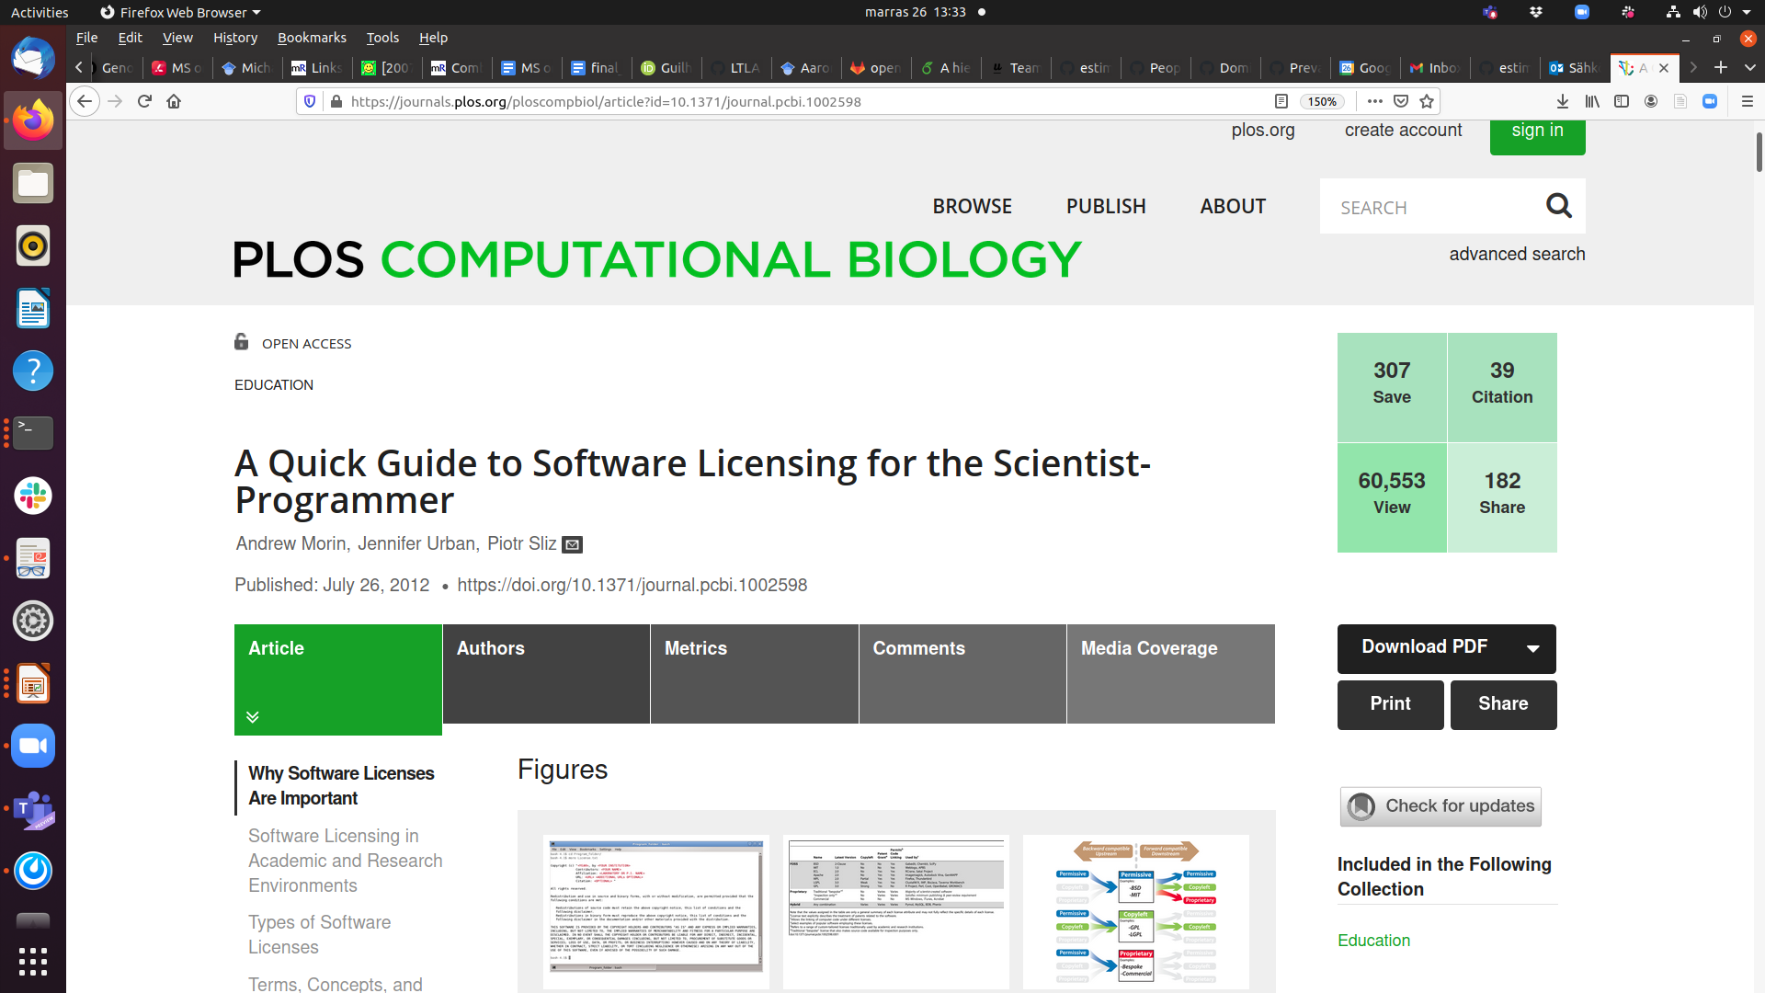
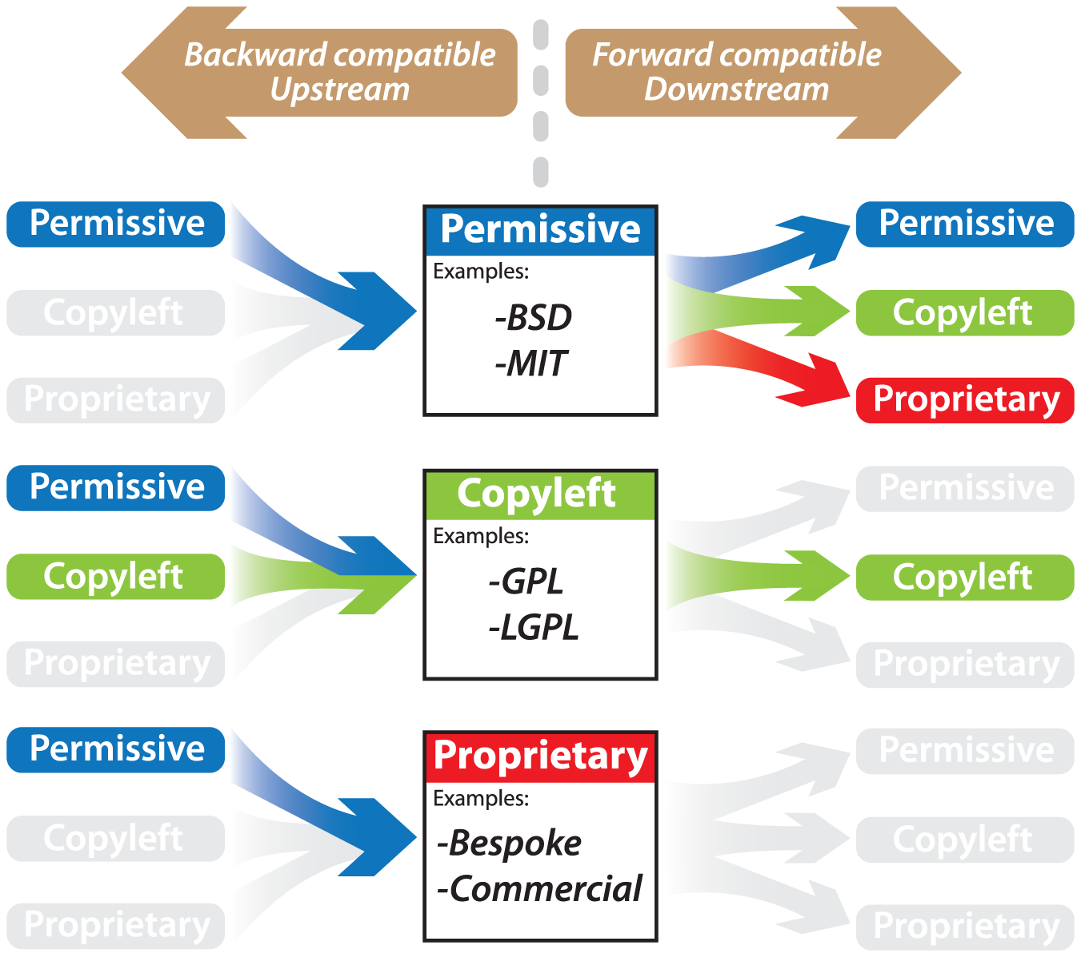
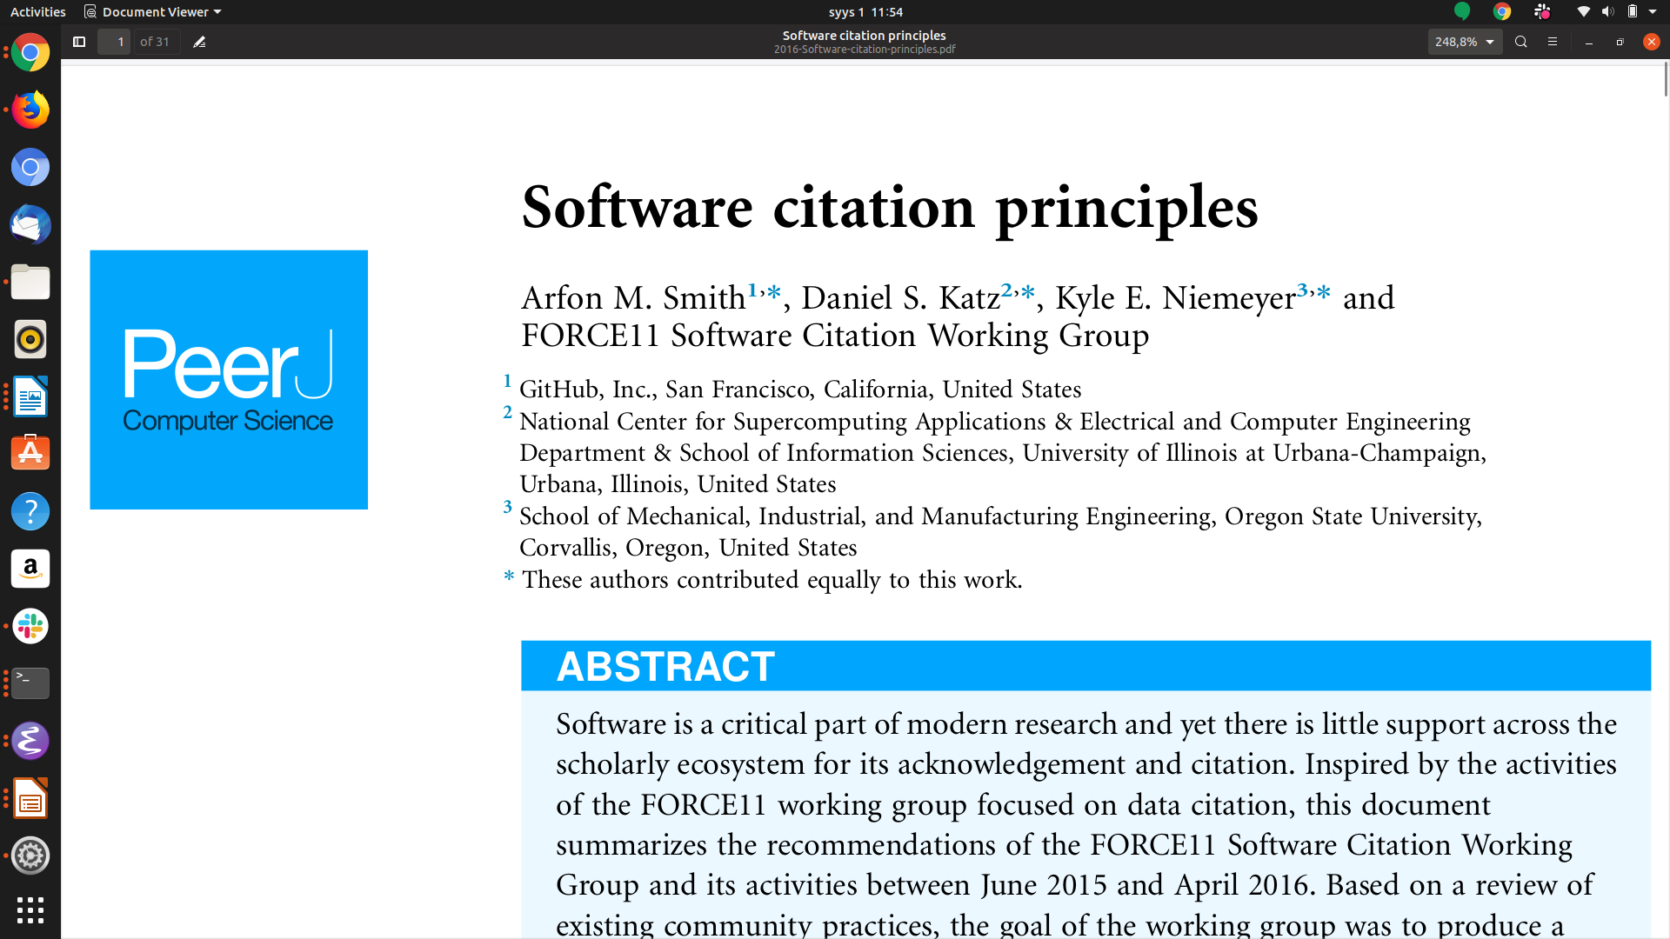
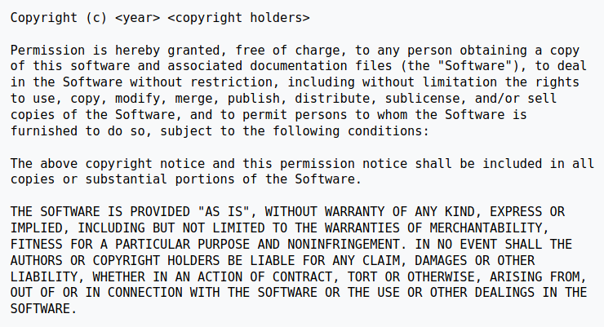
MIT License

Slide 25
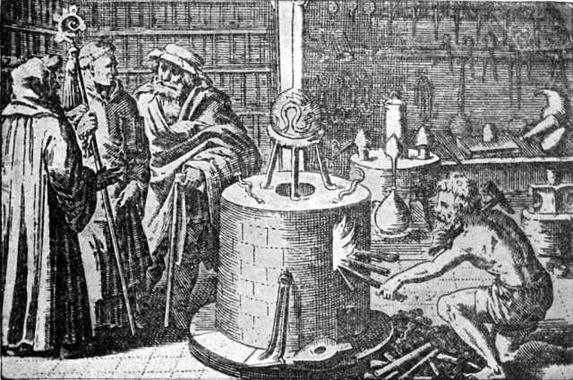
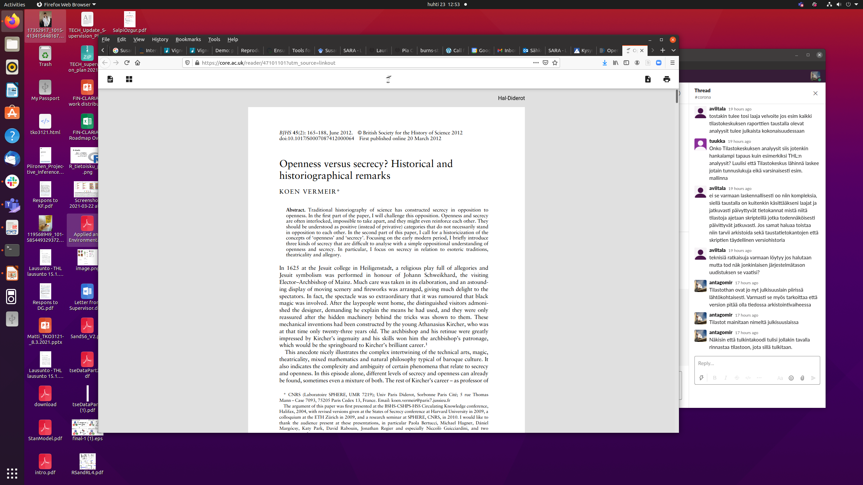
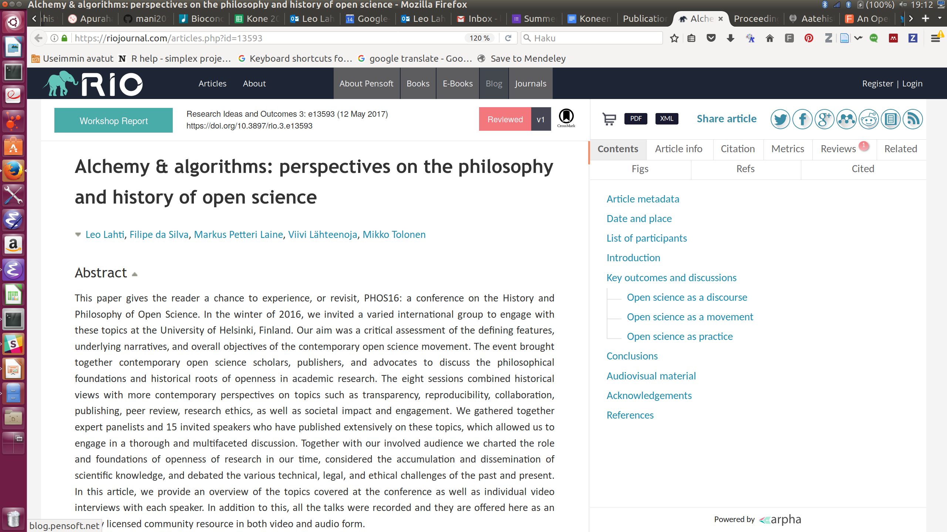
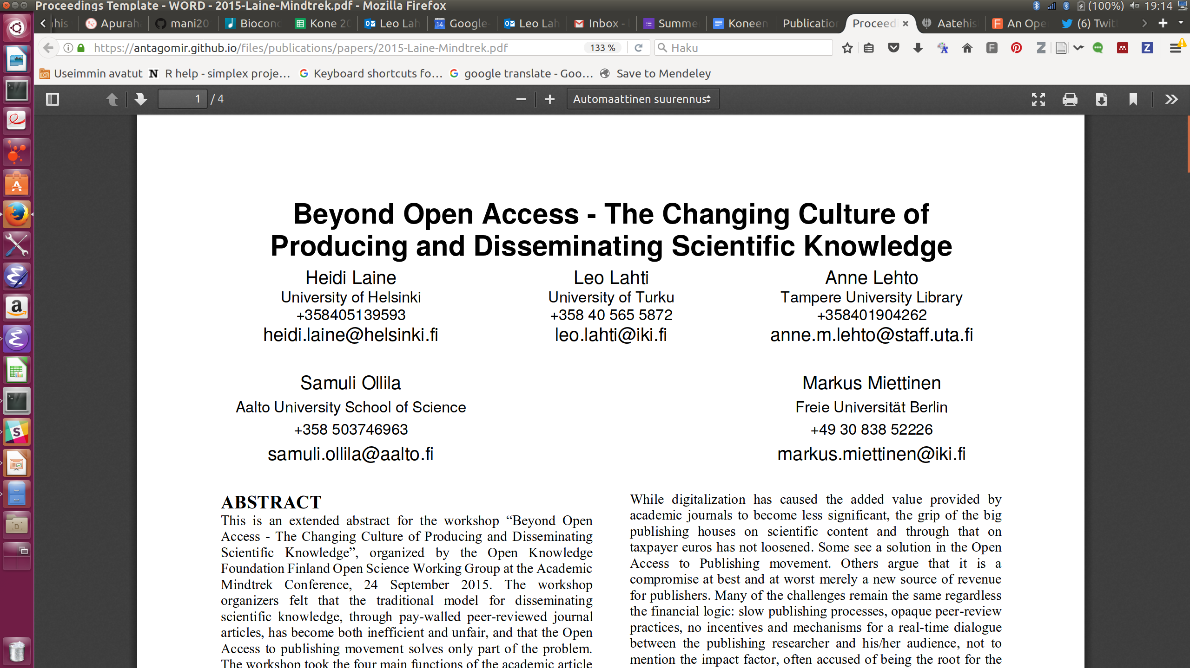
Open reporting and communication were part of academic culture since the early days
Source: Wikimedia Commons / Public domain
Research Ideas and Outcomes 3:e13593, 2017
<number>/25
Proceedings of the 19th International Academic Mindtrek Conference 2015. ACM New York, NY, USA. ISBN: 978-1-4503-3948-3

