Slide 1
Lecture: Key concepts
- special properties of microbiome data
- data science workflows
- alpha diversity
- beta diversity
- differential abundance

Slide 2

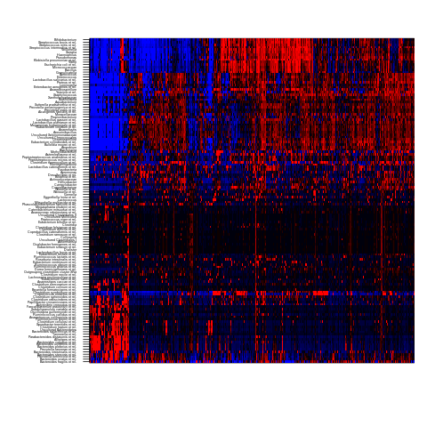
Human Intestinal Tract (HIT)Chip Atlas:
100+ genera ~ 10,000+ samples
Individuals
Taxa
Gut microbiota: 1000 western adults (Lahti et al. Nature Comm. 2014)
Standardized – cost efficient – accurate at 0.1% relative abundance
Rajilic-Stojanovic et al. Env. Microbiol. 2009
<number> / 34

Slide 3
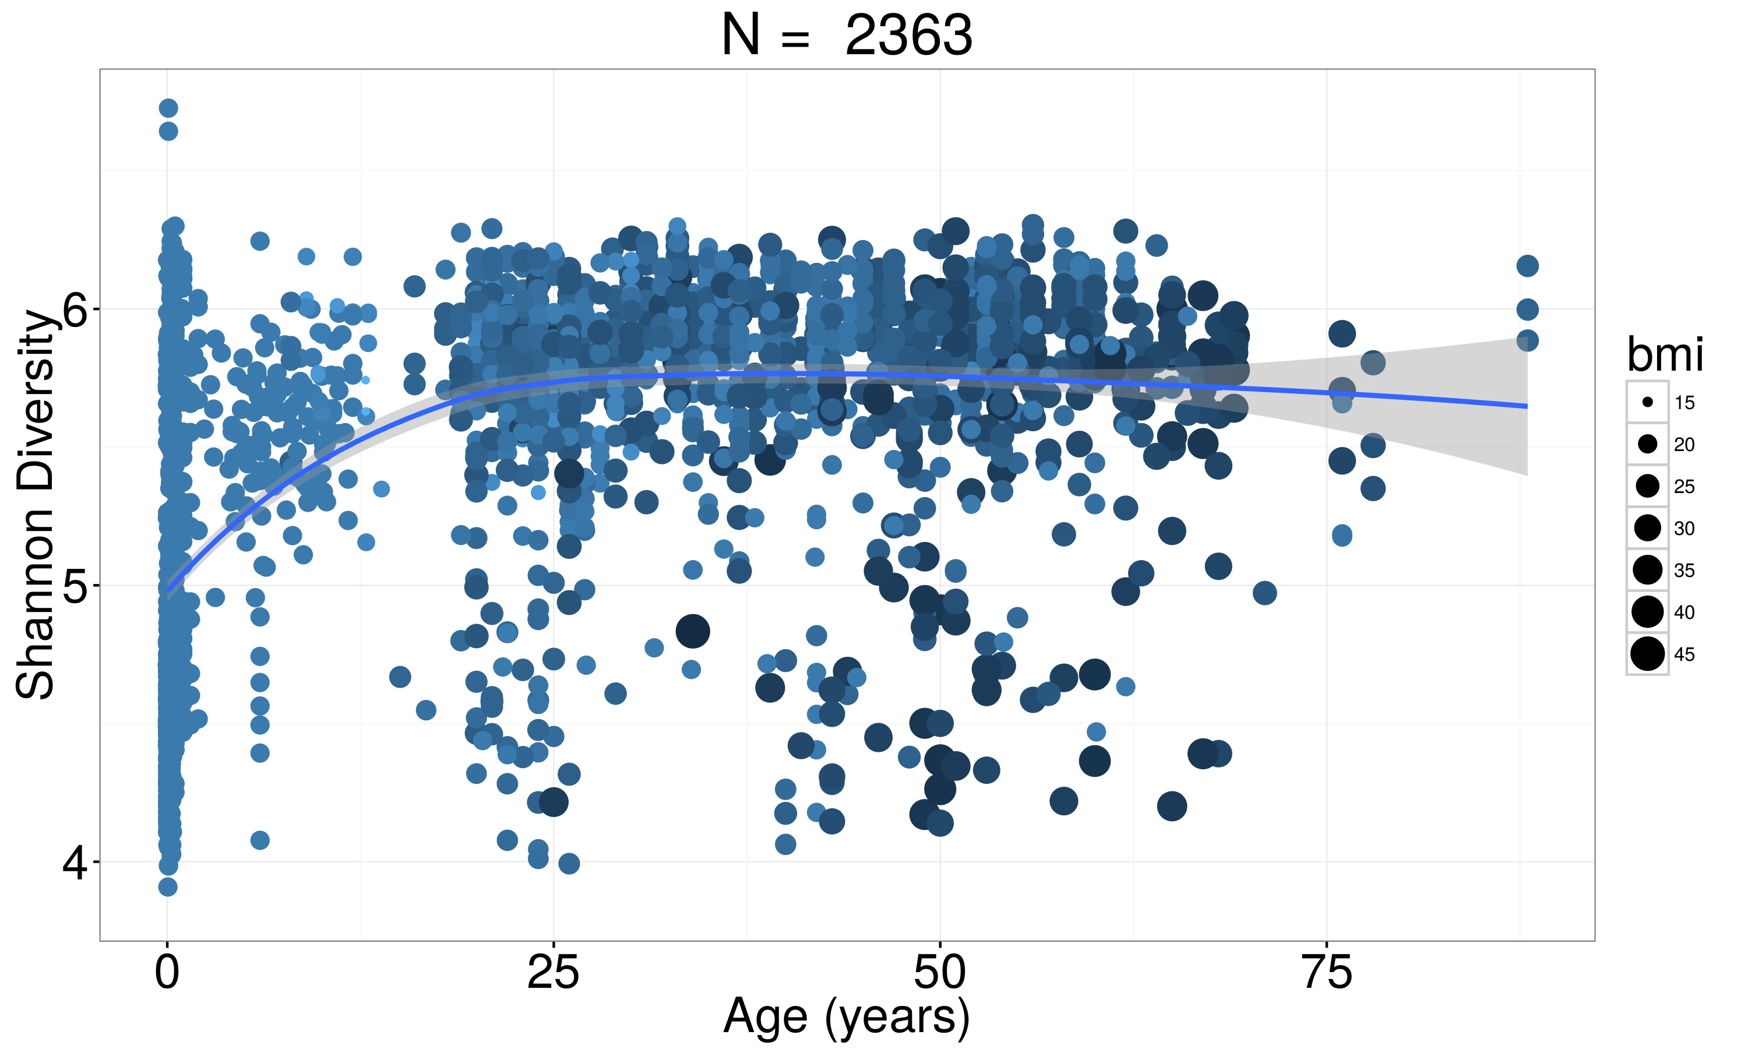
Aging, microbiome diversity & tipping elements:
healthy & normal obese subjects
Low diversity samples

Slide 4
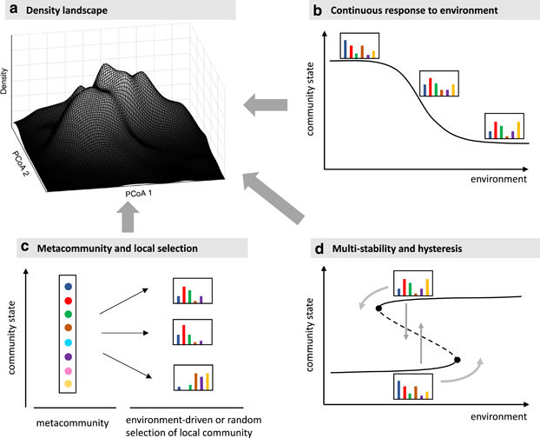
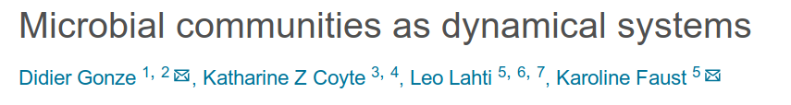
Key sources of microbial ecosystem variation
External perturbations
(push & pulse)
Internal dynamics and multi-stability
Immigration
Stochasticity
Memory
<number> / 34

Slide 5
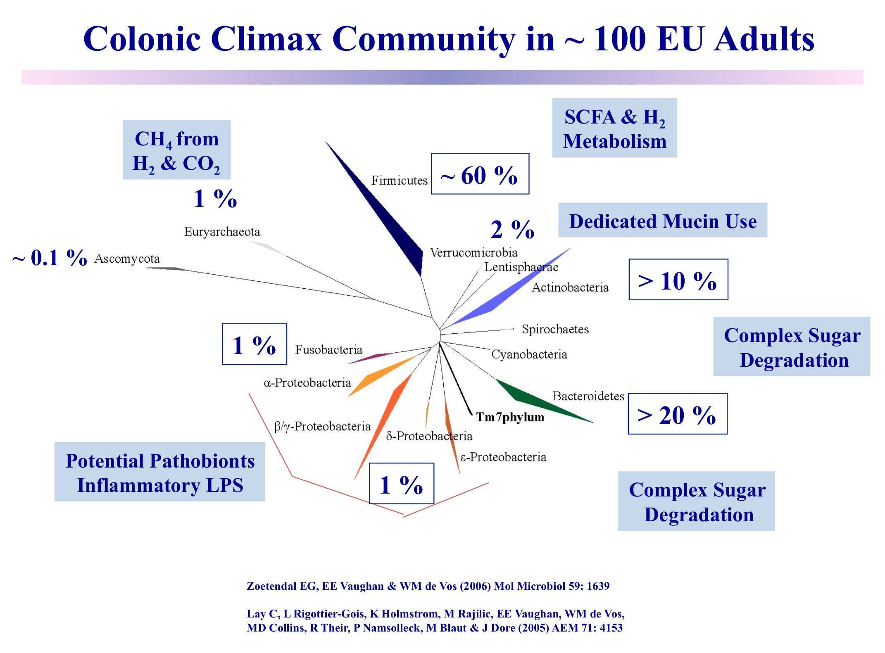
Special properties of microbiome data
Sparse
Compositional
Non-Gaussian
Overdispersed
Discrete
Complex
Stochastic
Multi-level

Slide 6
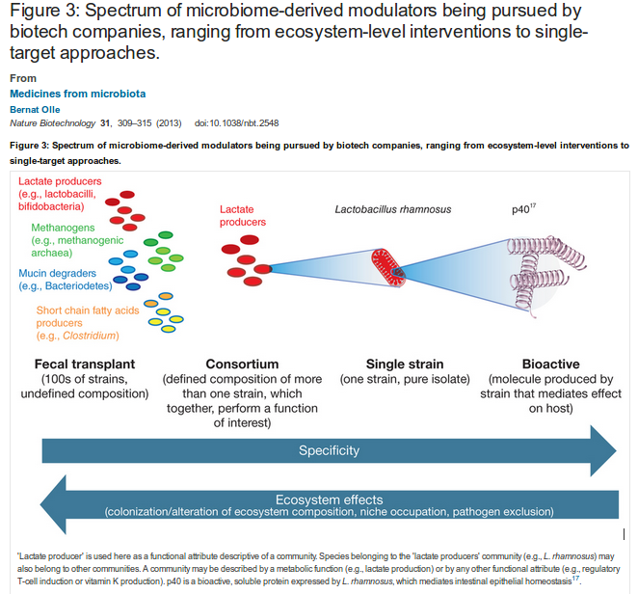
State diagnosis & manipulation: from specific targets to the overall ecosystem
Diet
Life style
Antibiotics
Probiotics
Prebiotics
Fecal transplants

Slide 7
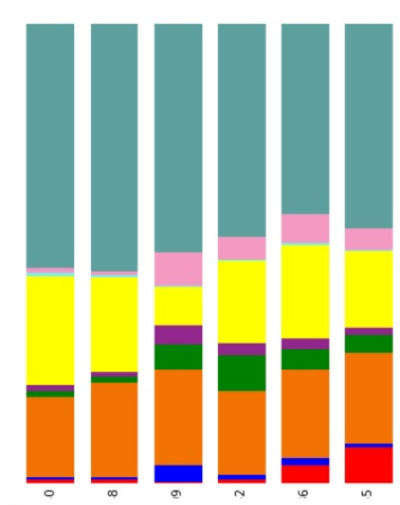
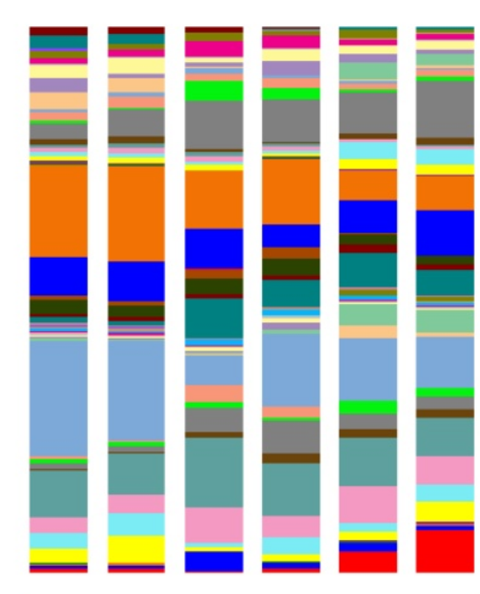
Phylum level
Feature selection?
Genus level
<number> / 34

Slide 8
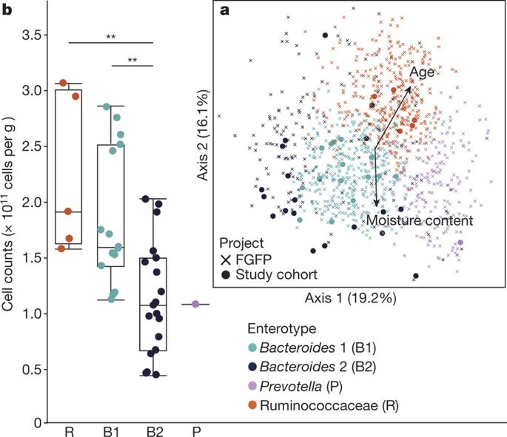
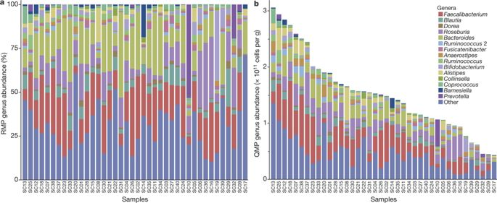
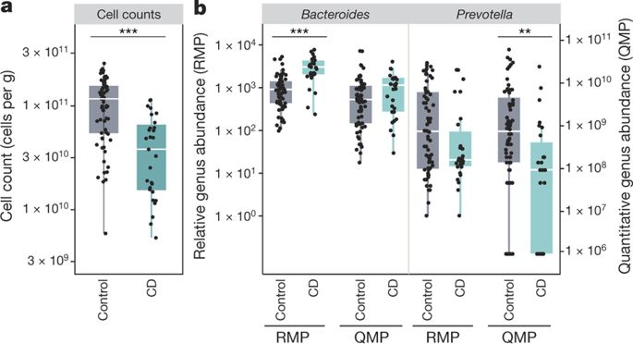
Relative versus absolute abundance: quantitative microbiome profiling
RMP vs. QMP:
drastic effect on conclusions!
Vandeputte et al. Nature 551:507-511, 2017
<number> / 34

Slide 9

Demo: Data exploration
Task: see the online material
R for Data Science / H. Wickham

Slide 10
Reproducible reporting and best practices

Slide 11
Typical study designs
Case-control studies
Interventions
Cross-sectional population cohorts
Prospective follow-ups
Longitudinal time series
Multi-omics

Slide 12
Standard workflow in microbiome data science
Retrieve data
Preprocess
Explore
Analyse
Model
Report

Slide 13
OTU
Abundances
OTUs
Samples

Slide 14
Side information on samples
Metadata
(age, bmi, sex..)
OTU
Abundances
OTUs
Samples

Slide 15
Side information on samples
Metadata
(age, bmi, sex..)
Side information on
taxonomic units
Ref
Seq
Phylo
tree
Tax
table
OTU
Abundances
OTUs
Samples

Slide 16
From individuals to populations, follow-ups, and multimodal data
Individual
Population
Longitudinal cohort
S x 1
S X N
S x N x T
Sequence
Variants /
OTUs
S x N x T x K
“Multi-modal” longitudinal cohort
OTU
Metagenome
Metabolome
<number> / 34

Slide 17
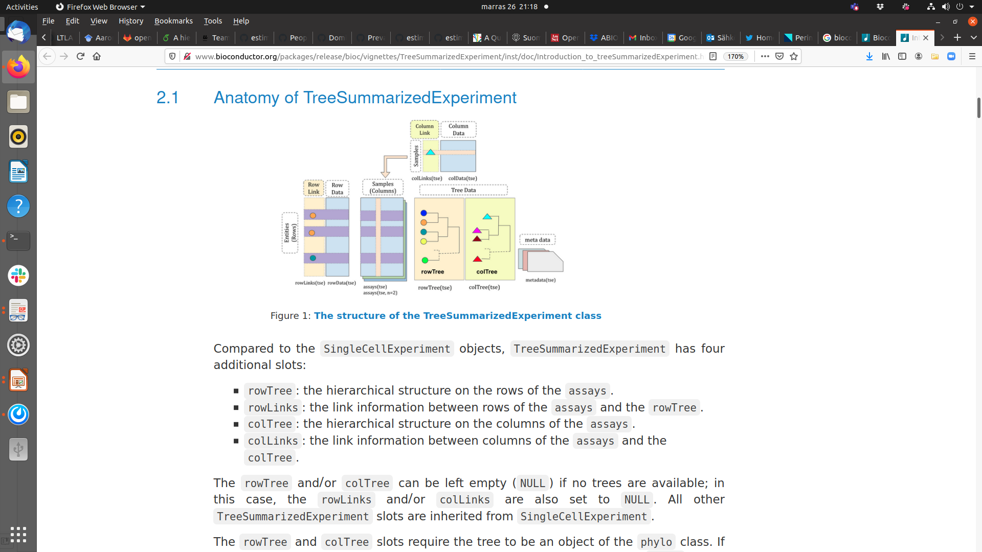
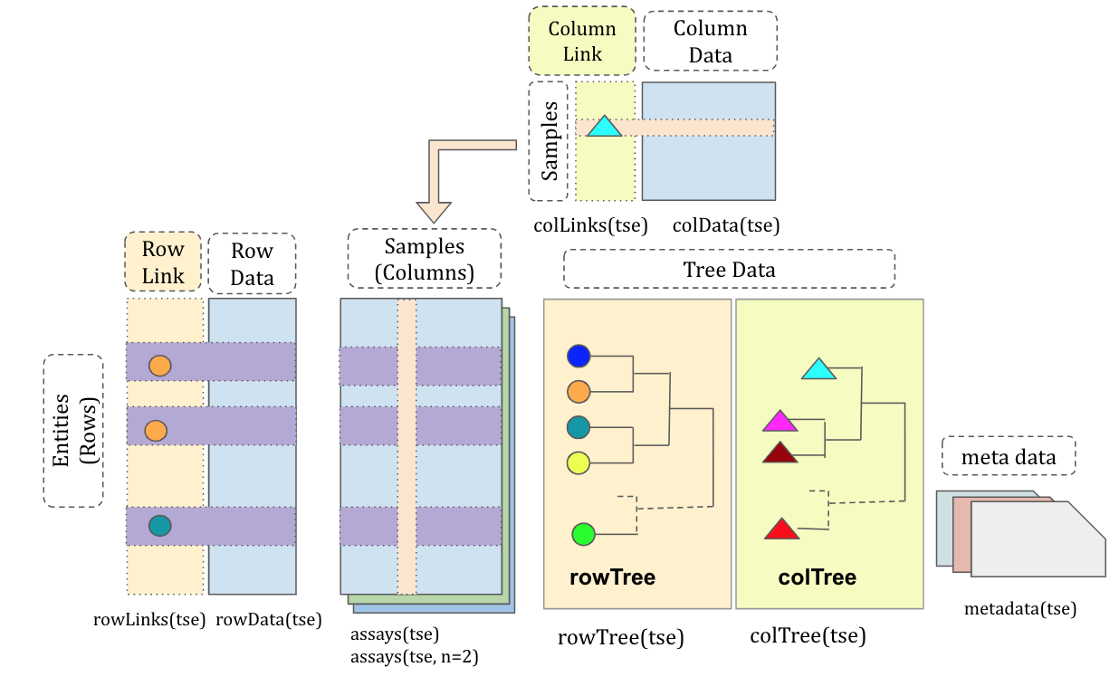

Slide 18

Example workflow
Check the poster
F1000 / EuroBioC!

Slide 19
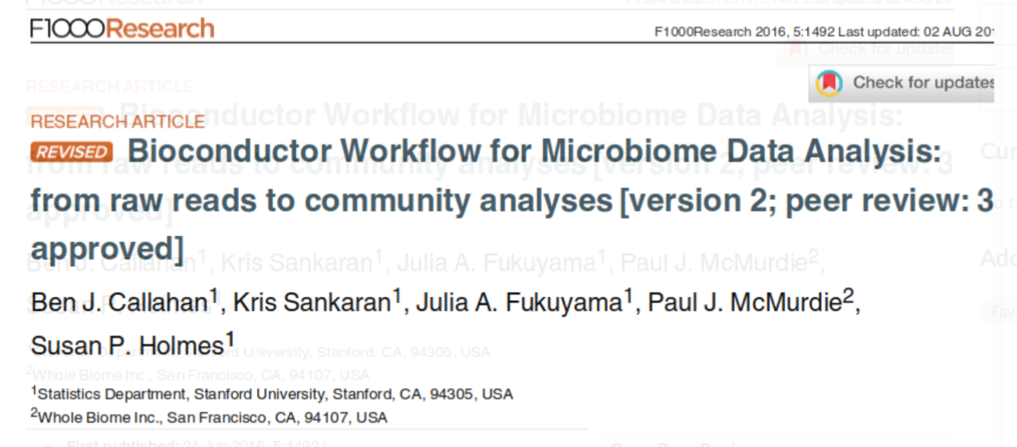

Slide 20
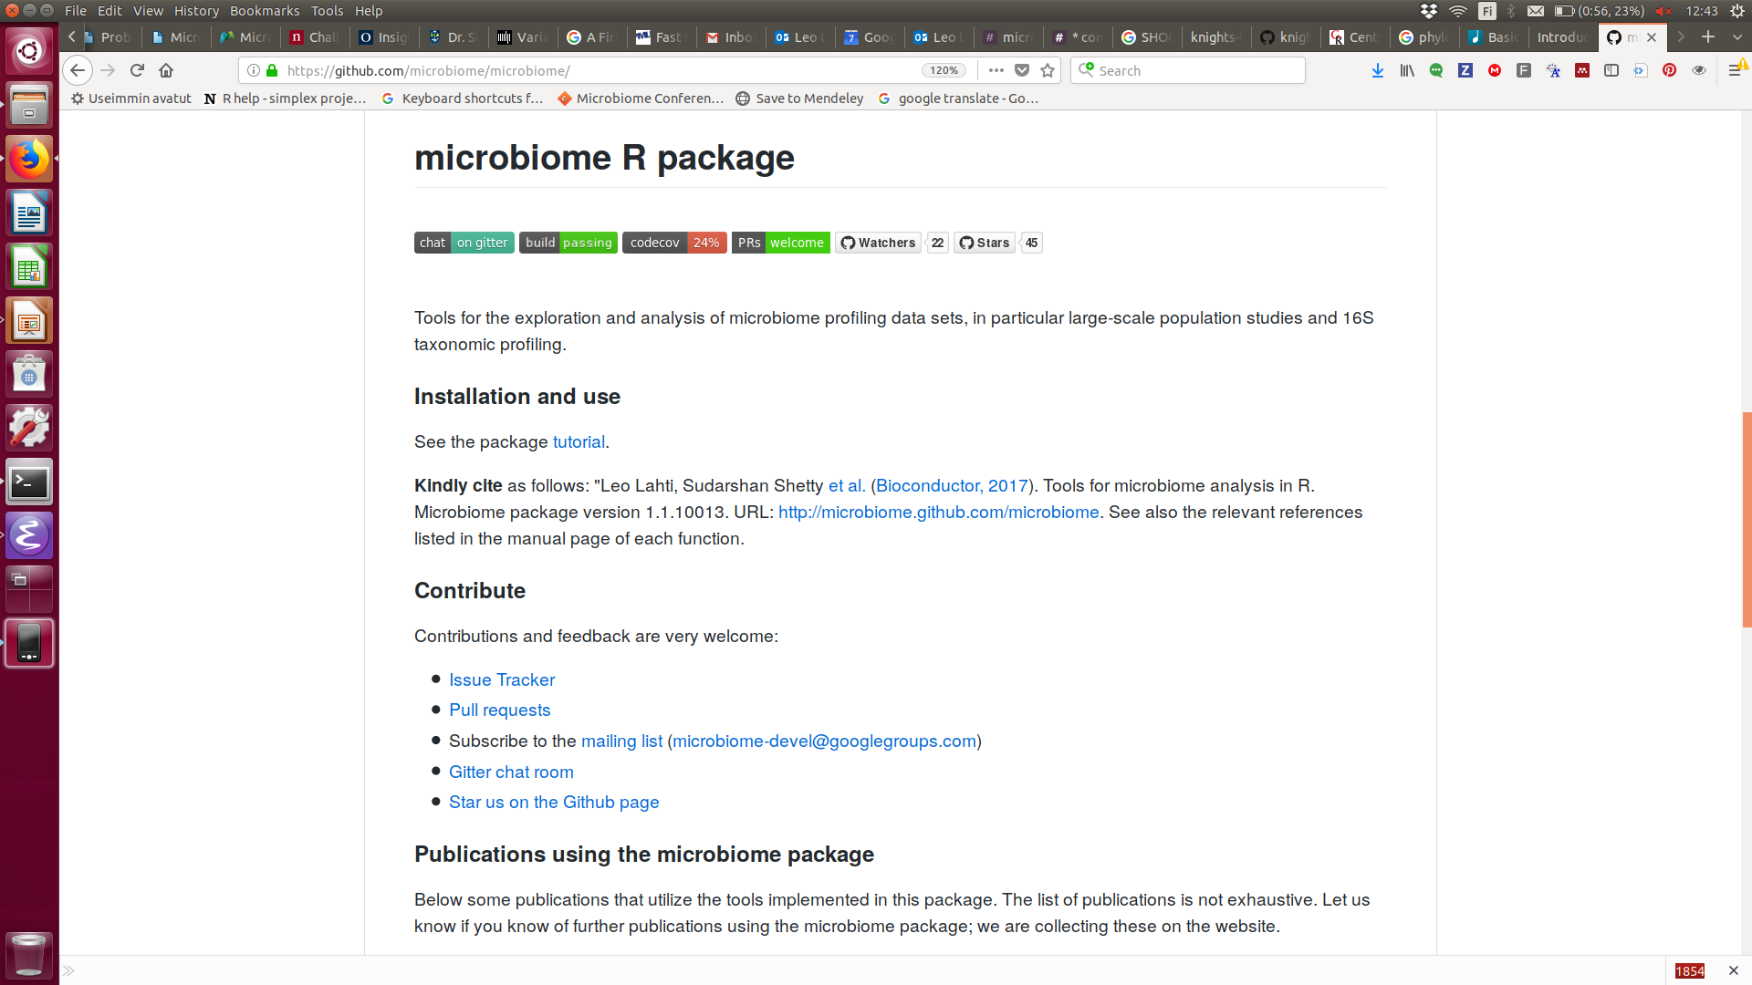

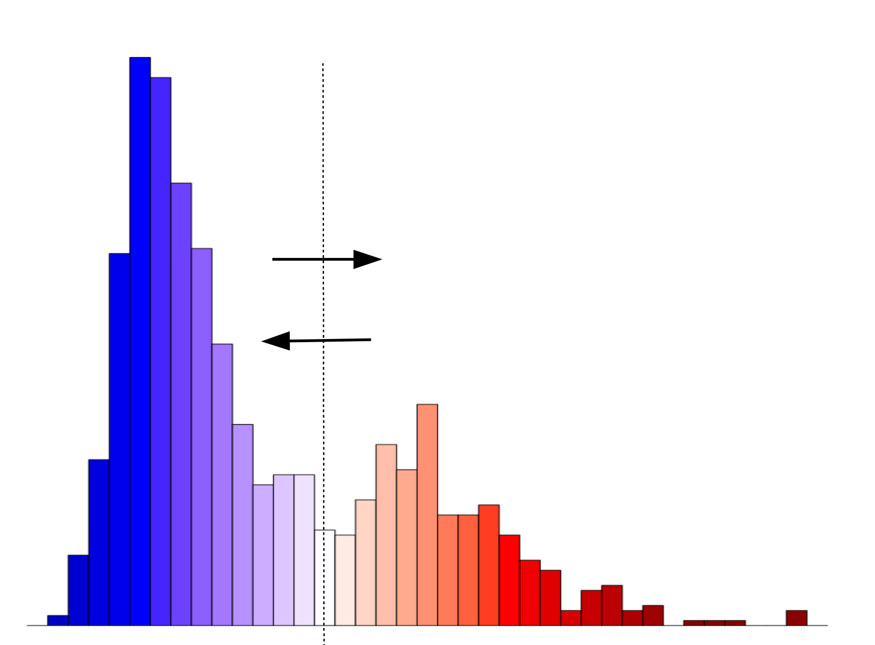
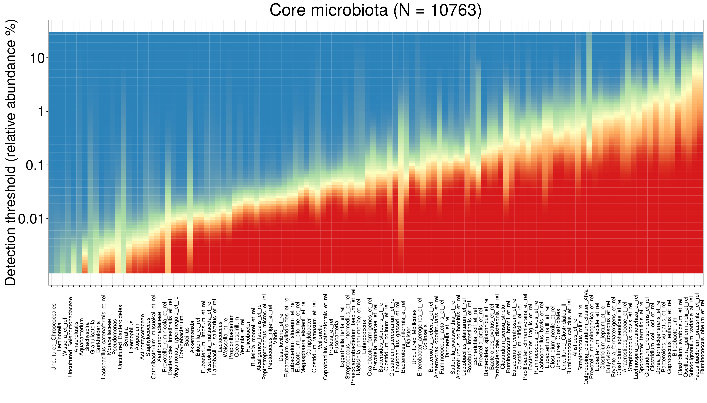
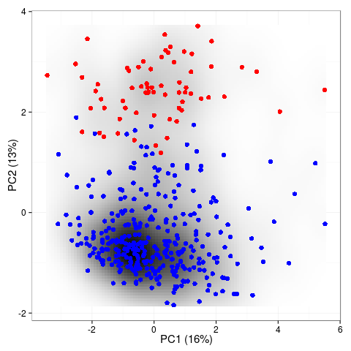
Alpha & beta
diversity
alpha(x)
diversity(x)
evenness(x)
dominance(x)
rarity(x)
readcount(x)
Core & prevalence
prevalence(x)
core(x)
core_members(x)
Stability & resilience
Transformations
transform(x, “compositional”)
transform(x, “clr”)
transform(x, “log10p”)
transform(x, “hellinger”)
transform(x, “identity”)
Community
- Online tutorials
- Mailing list
- Gitter chat
- Example data
- Workshops
Quality control
- continous integration
- unit tests
http://microbiome.github.io
<number> / 34

Slide 21
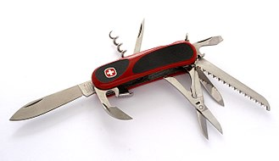
Figure: Wikipedia

Slide 22
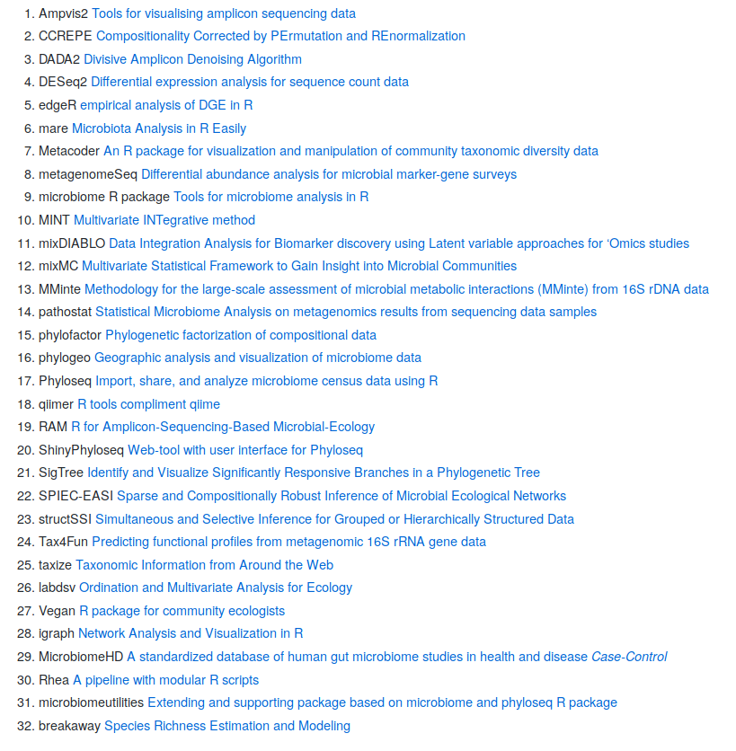
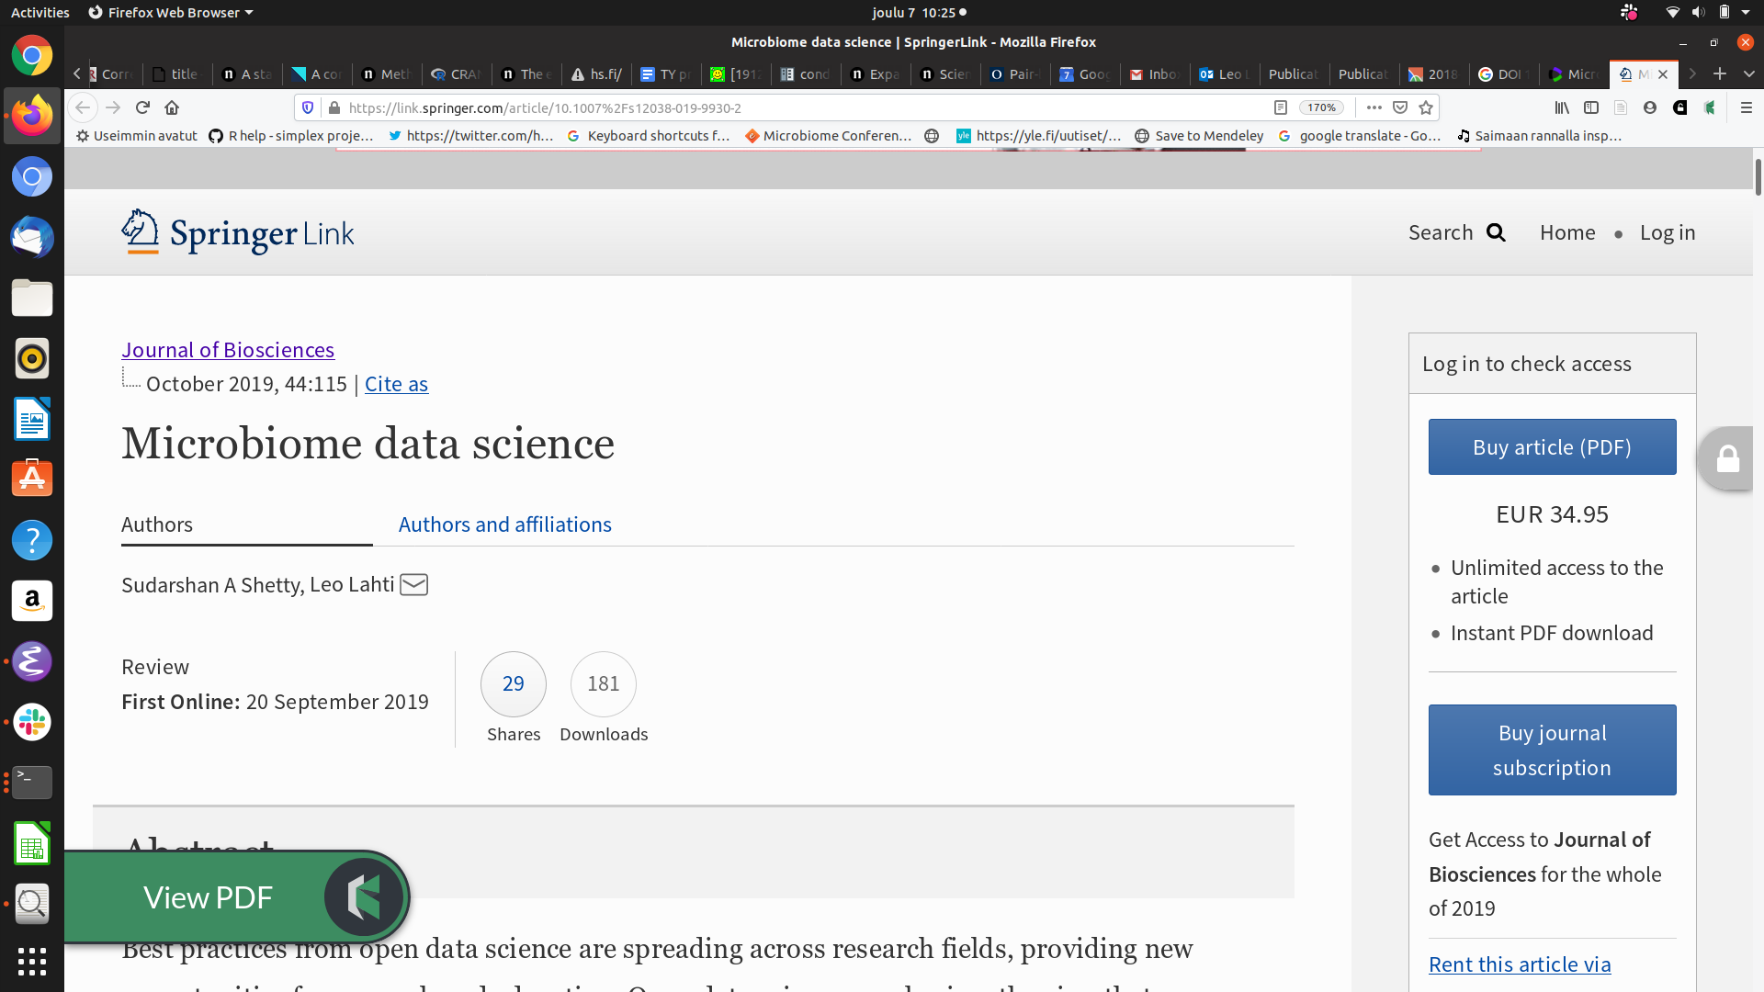

A survey for 16S
Github.com/microsud/
Tools-Microbiome-Analysis
<number> / 34

Slide 23
Tuesday: Key concepts & alpha diversity
Demo
Microbiome data exploration
Lecture
Key concepts in microbiome data science
Practical
Alpha diversity: estimation, analysis, and visualization

Slide 24
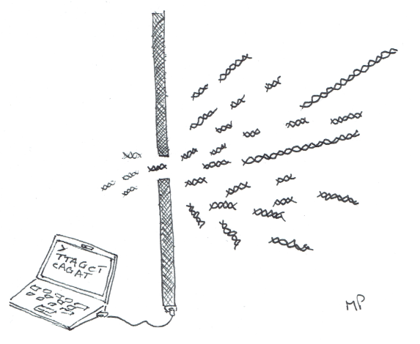
Finite sampling
<number> / 34
https://github.com/mblstamps/stamps2019/blob/master/STAMPS2019_overview_Pop.pdf

Slide 25
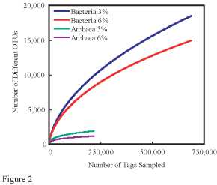

Slide 26
Wednesday: Beta diversity
Demonstration
Community similarity
Practical
Beta diversity: estimation, analysis, and visualization

Slide 27
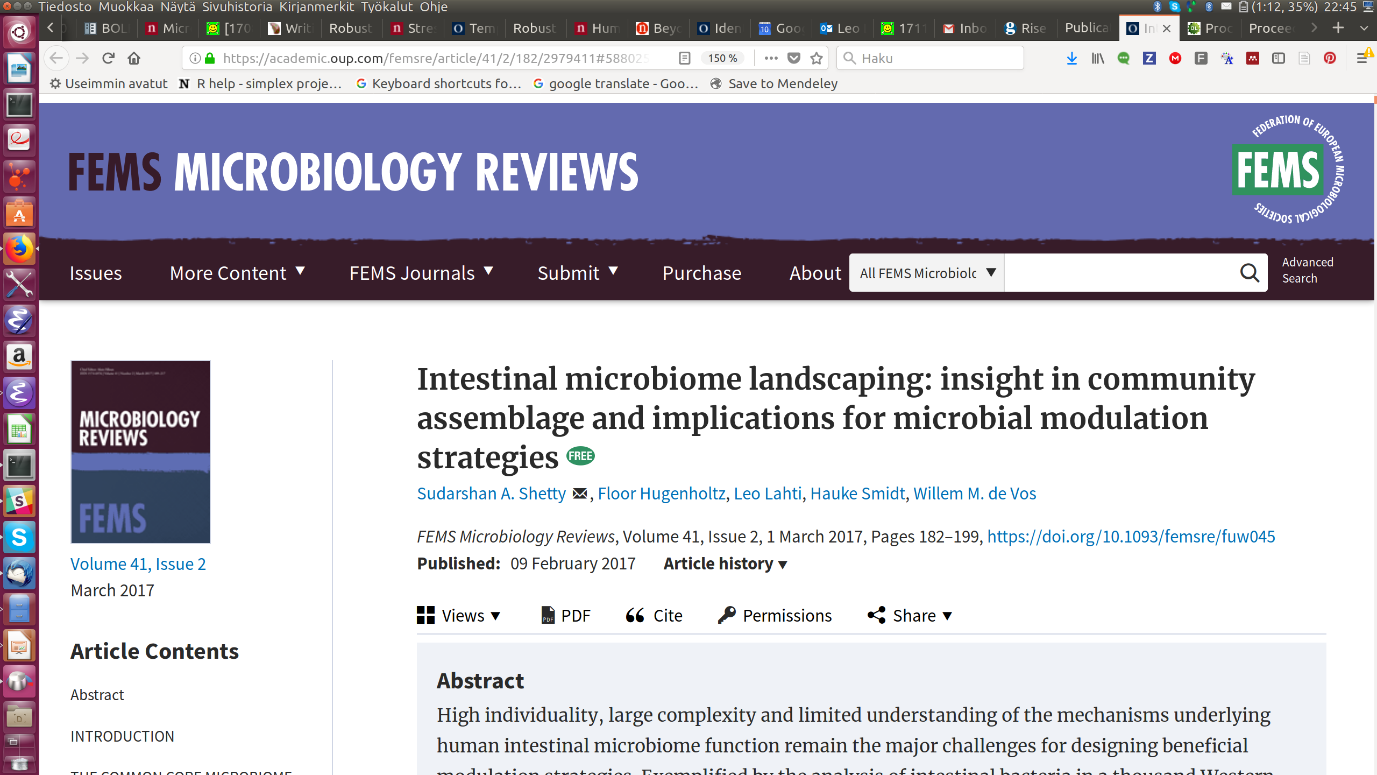
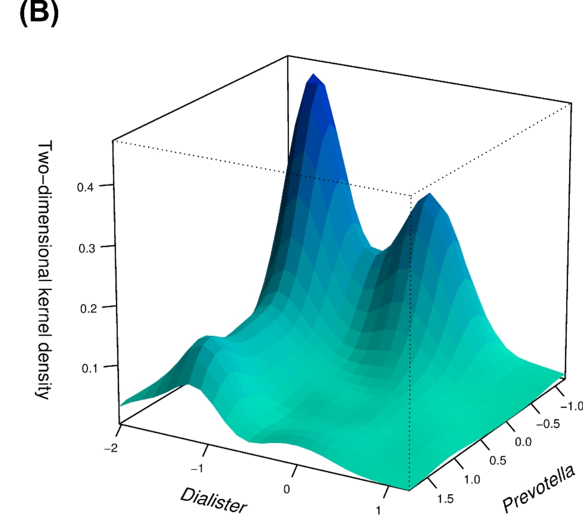
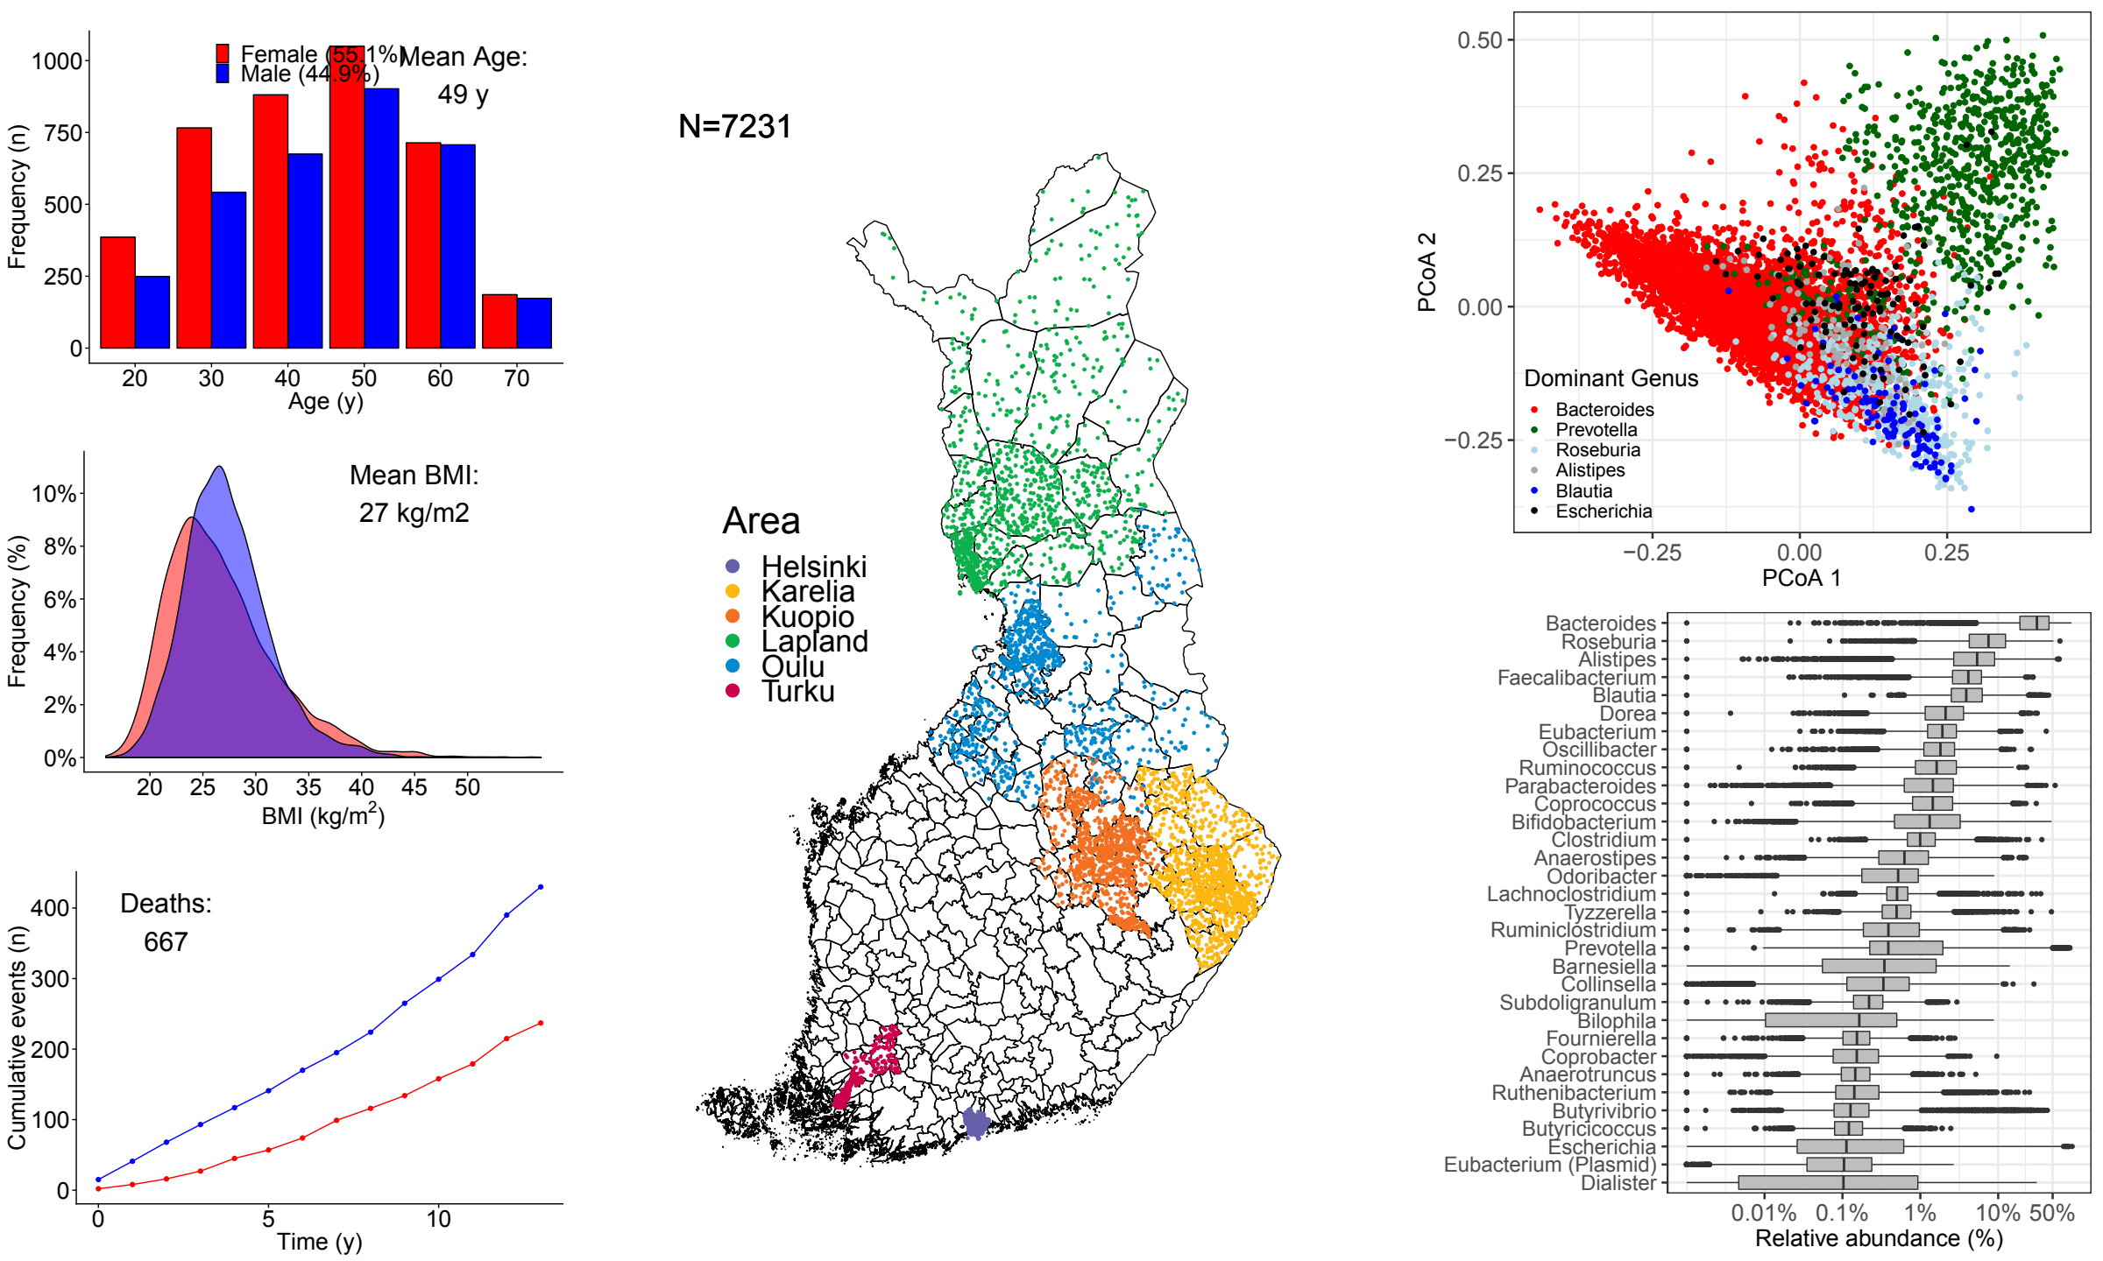
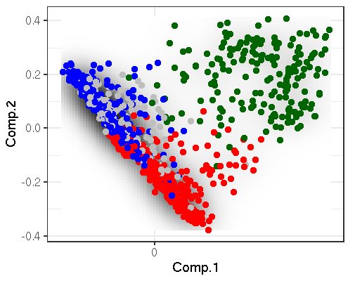
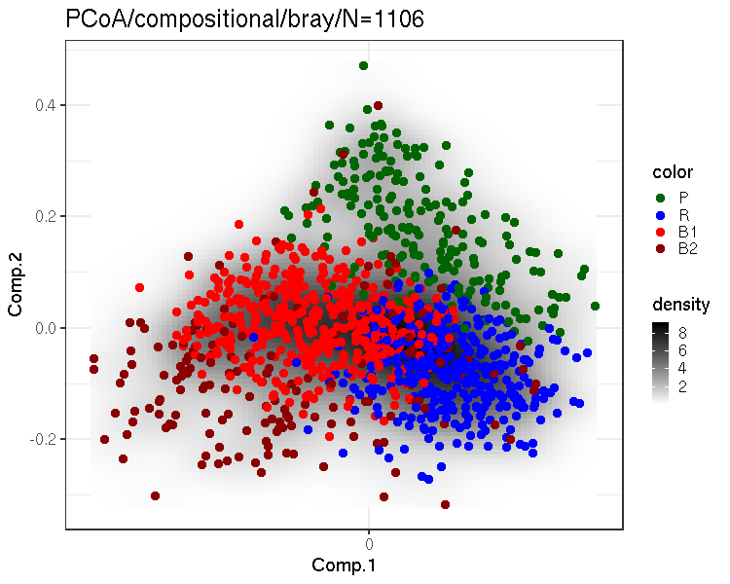
FINRISK (N = 7219)
HITChip
(N = 1006)
FINRISK
(N = 7211)
FGFP
(N = 1106)
<number> / 34

Slide 28
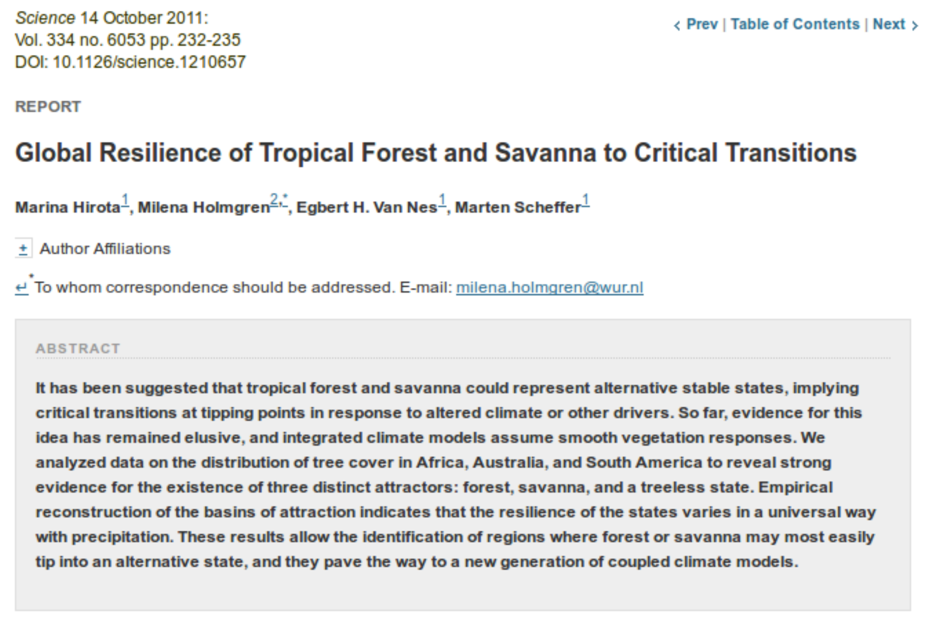
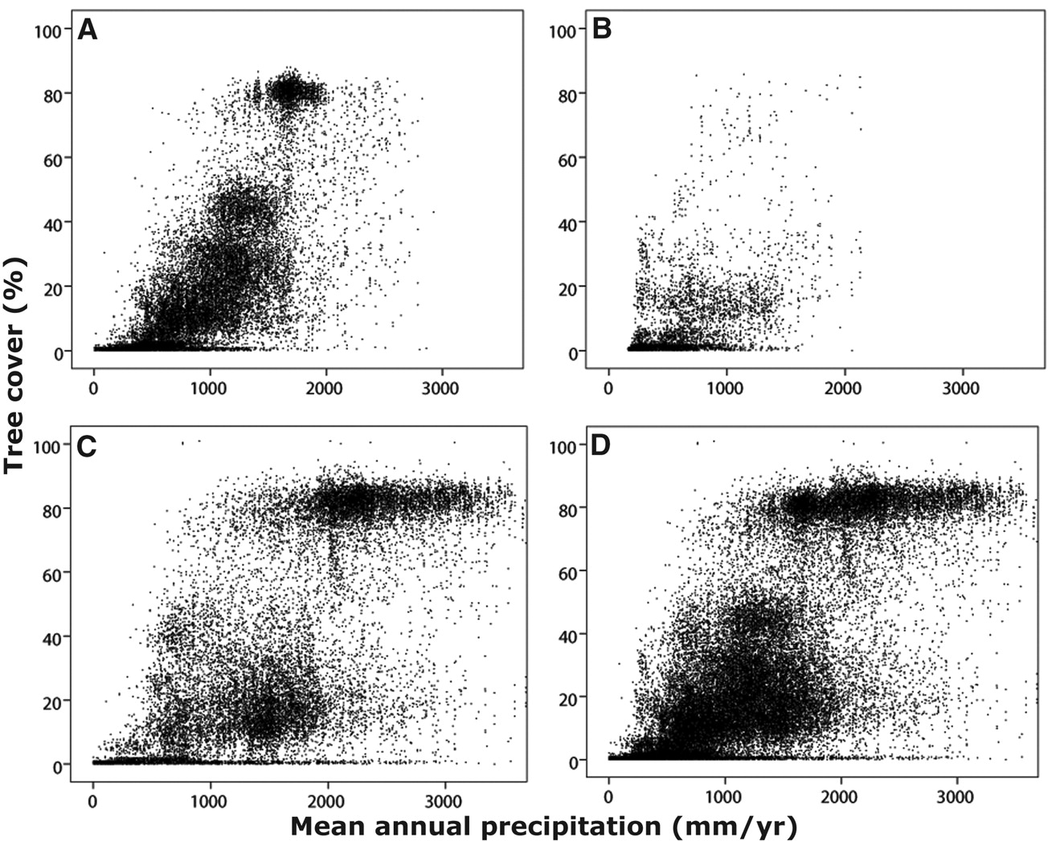
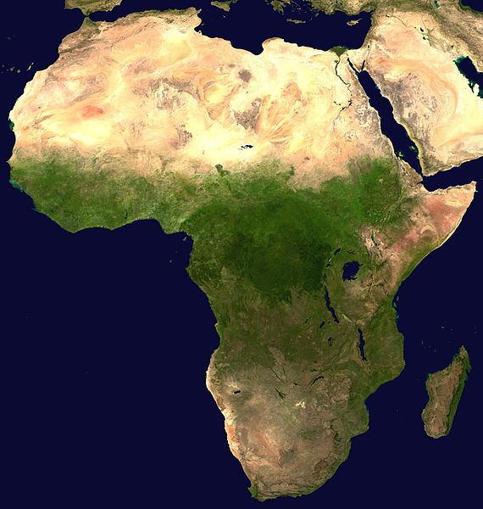

<number> / 34

Slide 29
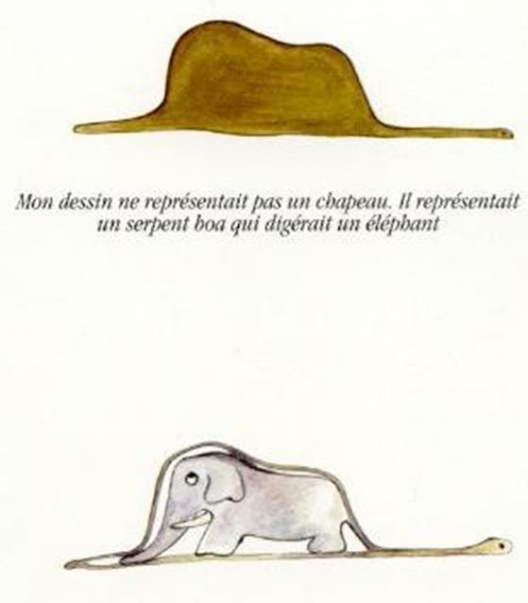
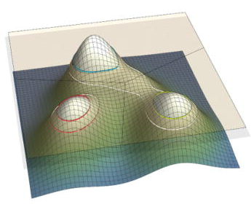

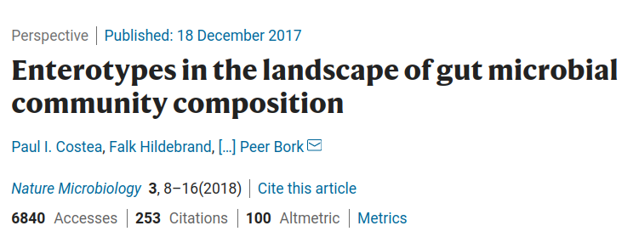
<number> / 34

Slide 30
Thursday: Differential abundance
Lecture
Differential abundance analysis methods
Practical
Differential abundance in practice
Lecture
Overview of microbiota data science methods & concepts

Slide 31
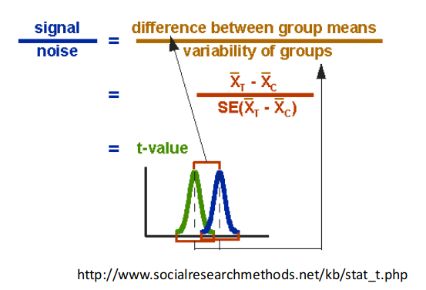
Standard t-test for two-group comparison?
Problems:
Few replicates
Non-gaussian, discrete, positive, skewed..
Multiple testing

Slide 32
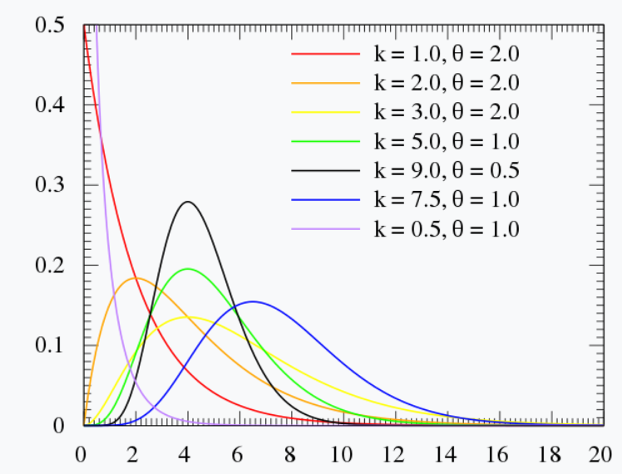
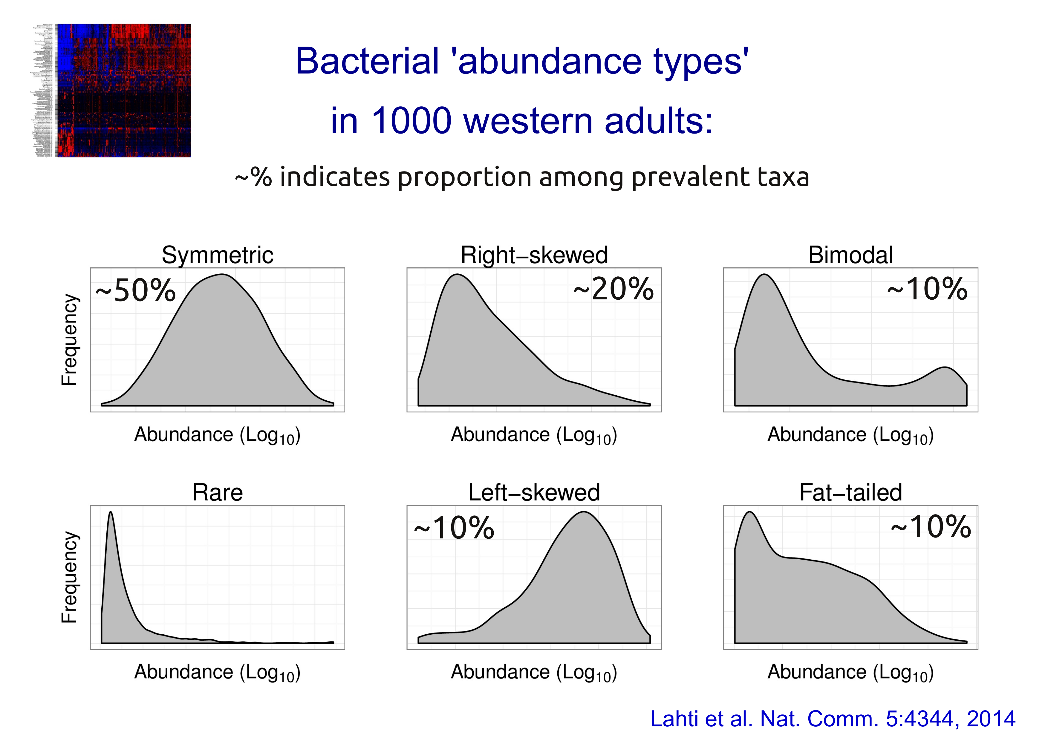
Gamma distribution gives a flexible model for biological abundance variation
<number> / 34

Slide 33
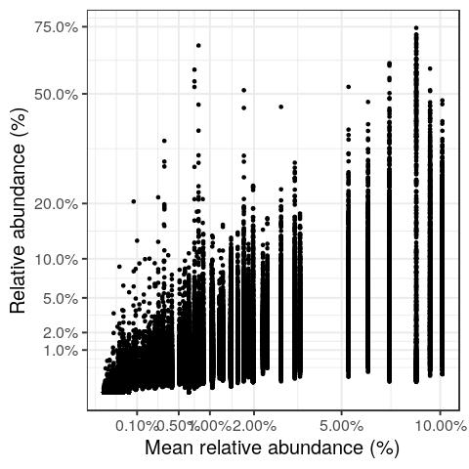
Taylor’s law (in HITChip Atlas)
Prevotella
Faecalibacterium
Bacteroides
Oscillospira
Heteroschedasticity:
Variance increases with the mean
Overdispersion:
Variance increases faster than proposed by the model
Data: HITChip Atlas
<number> / 34

Slide 34
Lecture: Key concepts
- special properties of microbiome data
- data science workflows
- alpha diversity
- beta diversity
- differential abundance

