Slide 1
Tuesday: Key concepts & alpha diversity
Demo
Microbiome data exploration
Lecture
Key concepts in microbiome data science
Practical
Alpha diversity: estimation, analysis, and visualization

Slide 2
Part I: Key concepts
- alpha diversity
- beta diversity & community similarity
- core & prevalence
- normalization & transformations
- landscape & abundance types & ordination

Slide 3
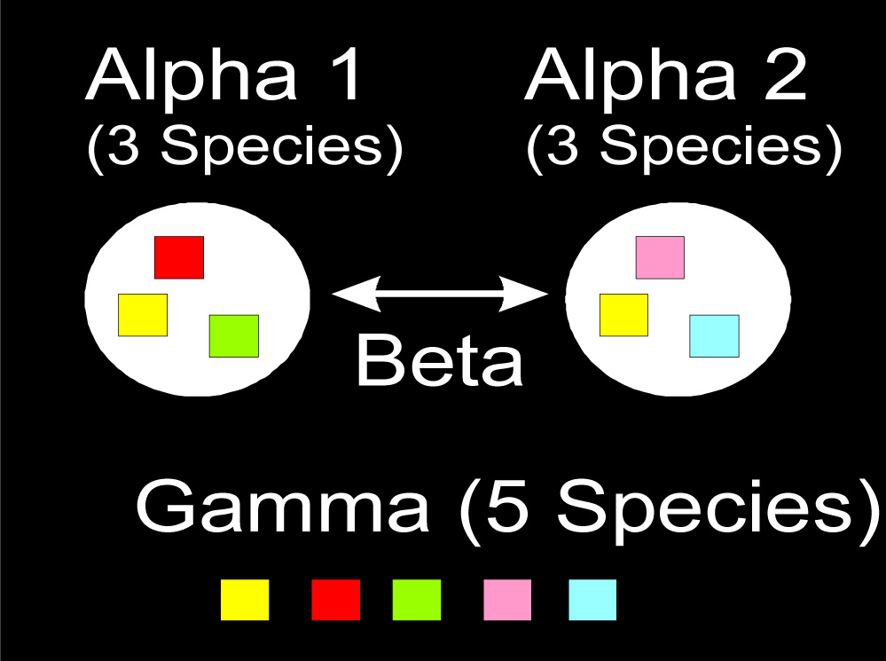
Alpha, Beta and Gamma diversity

Slide 4
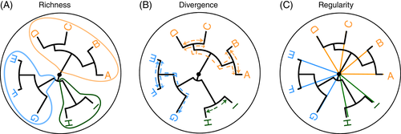


Slide 5
Richness:
- Number of types
- Estimates of true richness based on
finite sample sizes (Howard Sanders
1968); see e.g. Chao1
Evenness:
distribution of sizes (even or uneven?)
Diversity:
richness & evenness
Dominance

Slide 6
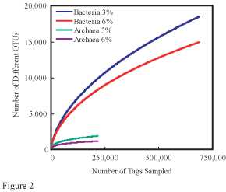

Slide 7
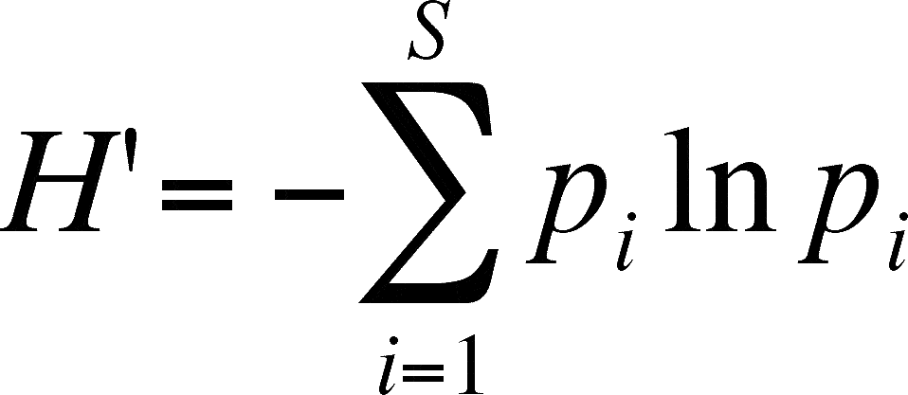
Shannon diversity
True richness
exp(H)

Slide 8
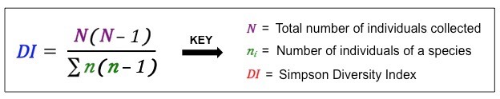
Inverse Simpson
How likely it is to pick two members of the same species at random?

Slide 9

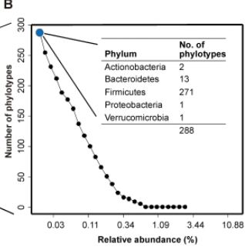
(Alpha) Diversity
True diversity, or the effective number of types, refers to the number of equally abundant types needed for the average proportional abundance of the types to equal that observed in the dataset of interest.
Jalanka-Tuovinen et al. PloS One 2011
R: richness (number of distinct types)
p_{i}: proportion of type I
Order of diversity:
q = 0 : Species Richness
q = 1 : Shannon diversity
q = 2 : (Inverse) Simpson diversity
q ≠ 1 : Renyi entropy

Slide 10
Evenness (Equitability)
H / ln(S)
H: Shannon diversity
S: Species richness

Slide 11
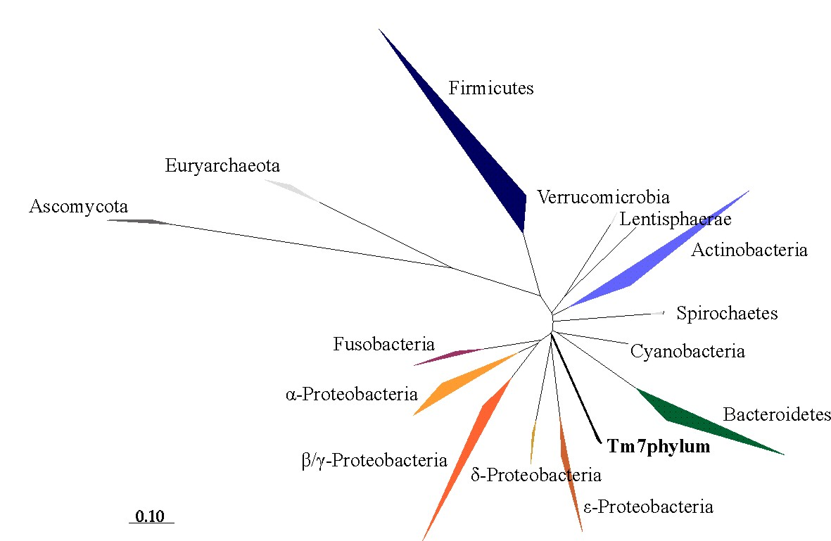
Alpha & beta
diversity
alpha(x)
diversity(x)
evenness(x)
dominance(x)
rarity(x)
readcount(x)

Slide 12
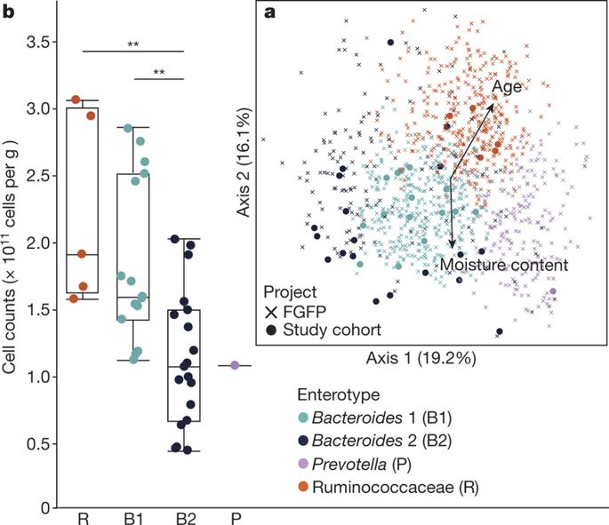
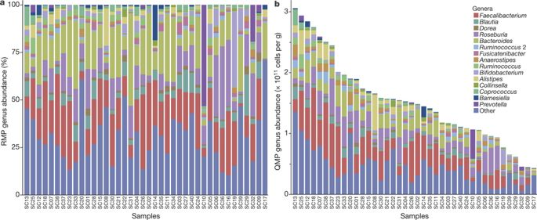
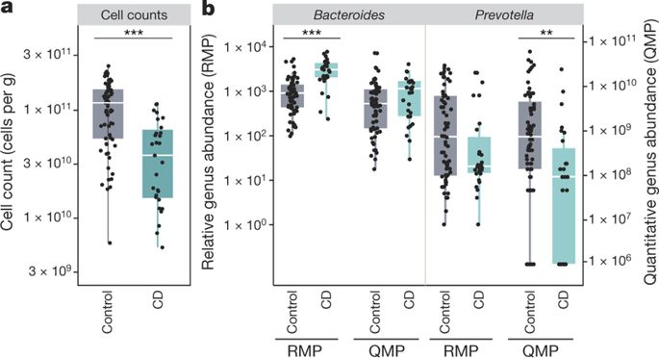
Relative versus absolute abundance: quantitative microbiome profiling
RMP vs. QMP:
drastic effect on conclusions!
Vandeputte et al. Nature 551:507-511, 2017
<number> / 37

Slide 13
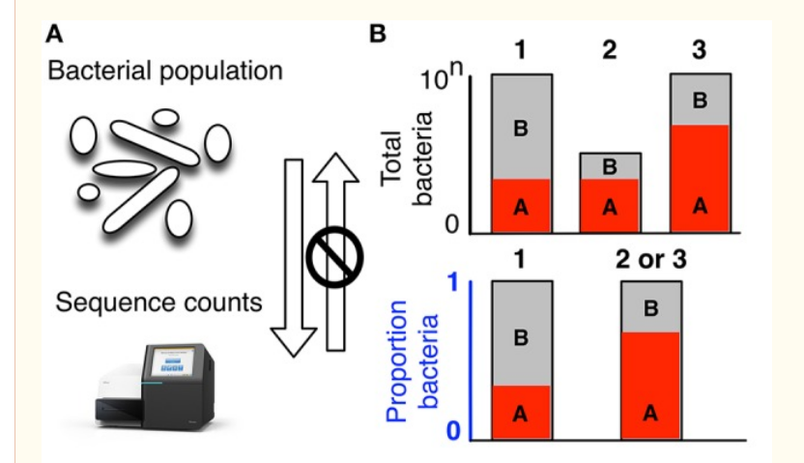
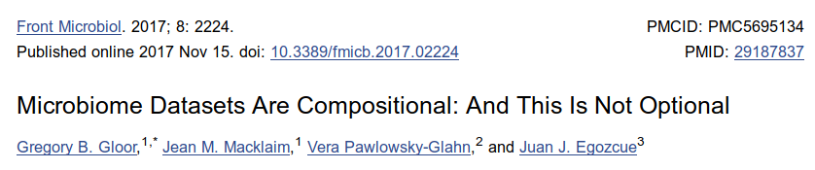

Slide 14
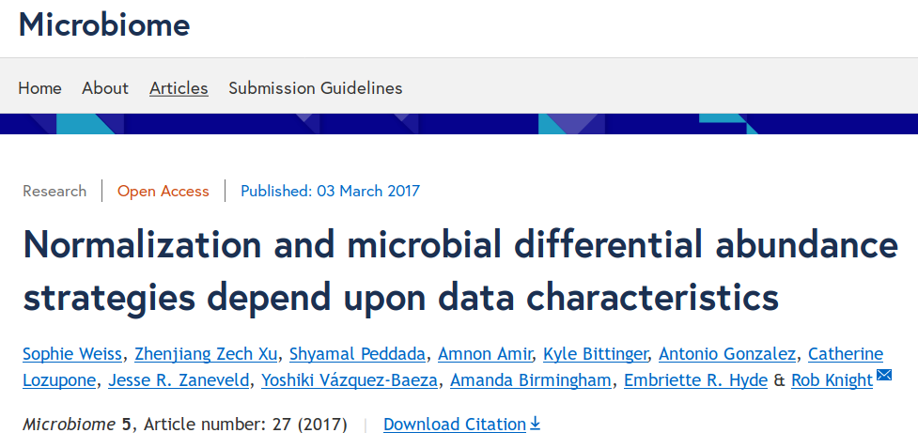
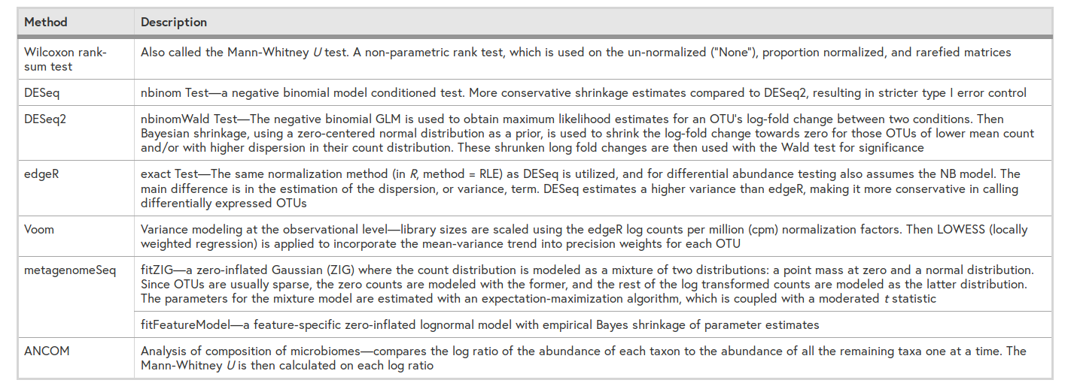

Slide 15
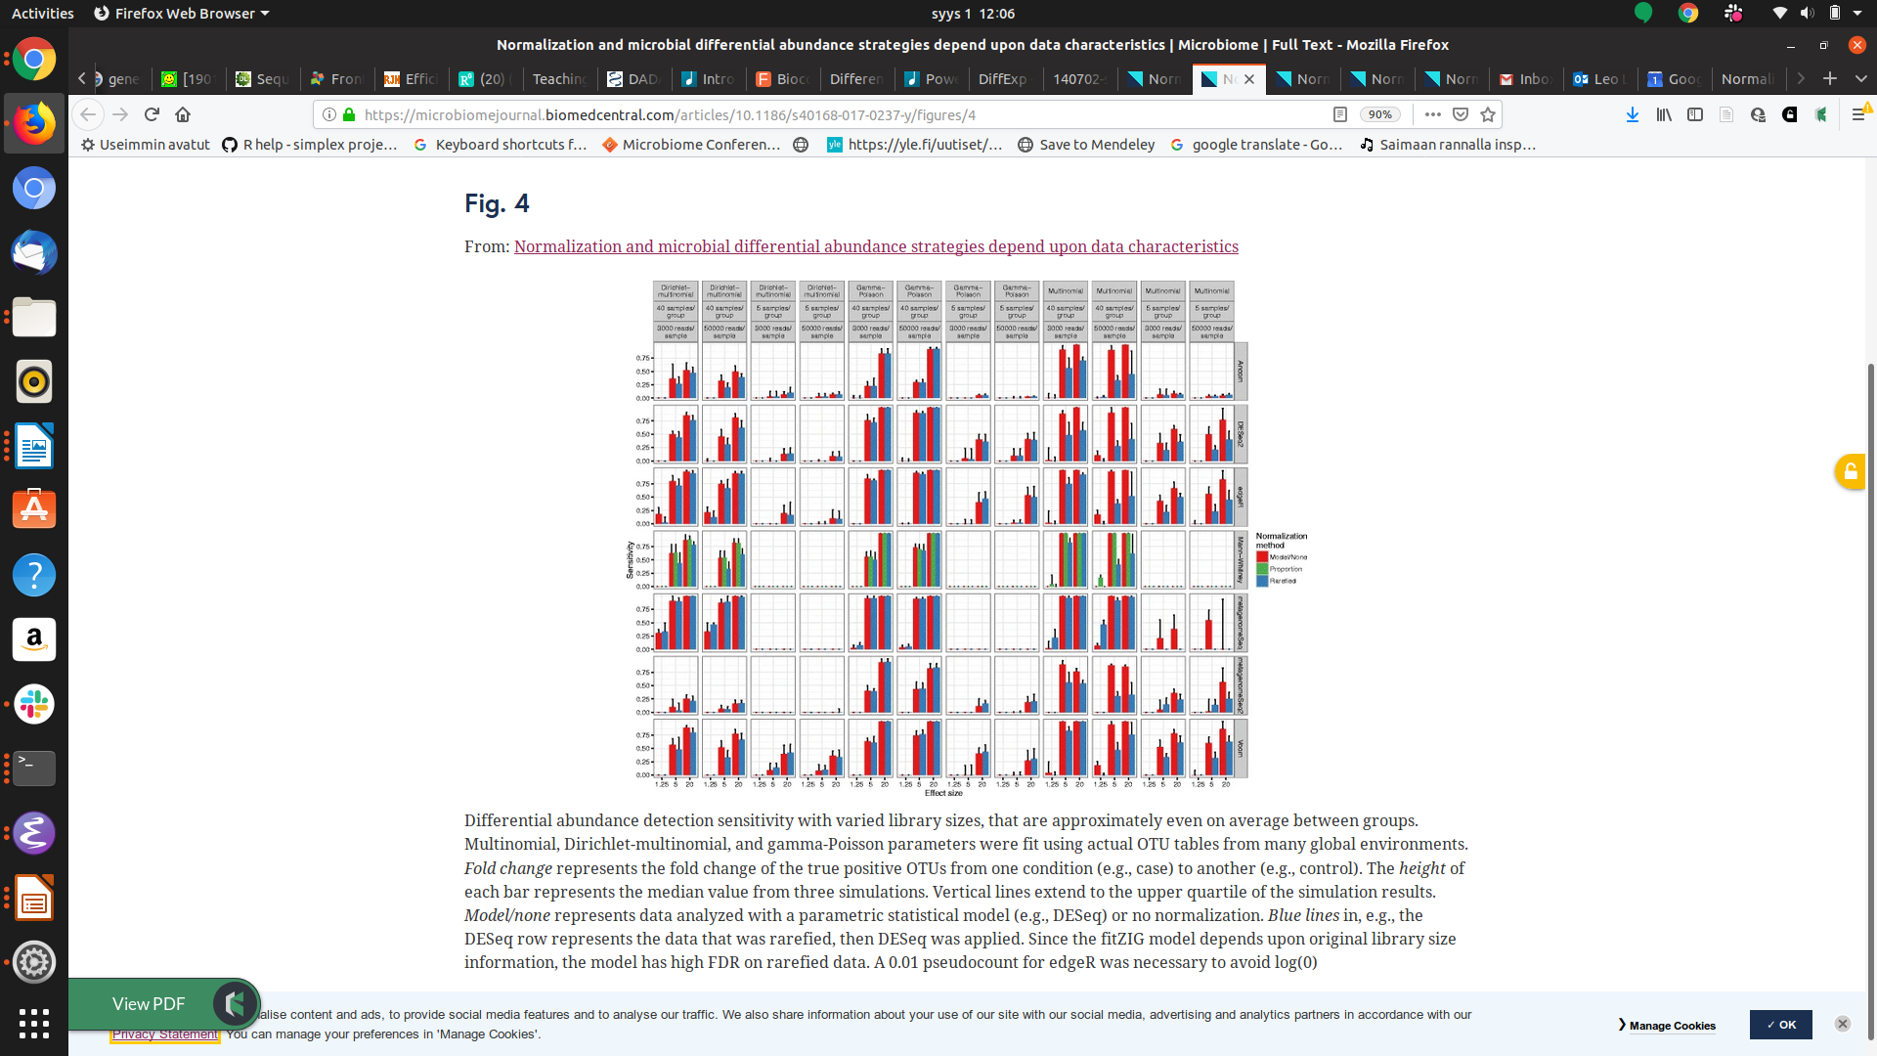
Differential abundance detection sensitivity

Slide 16
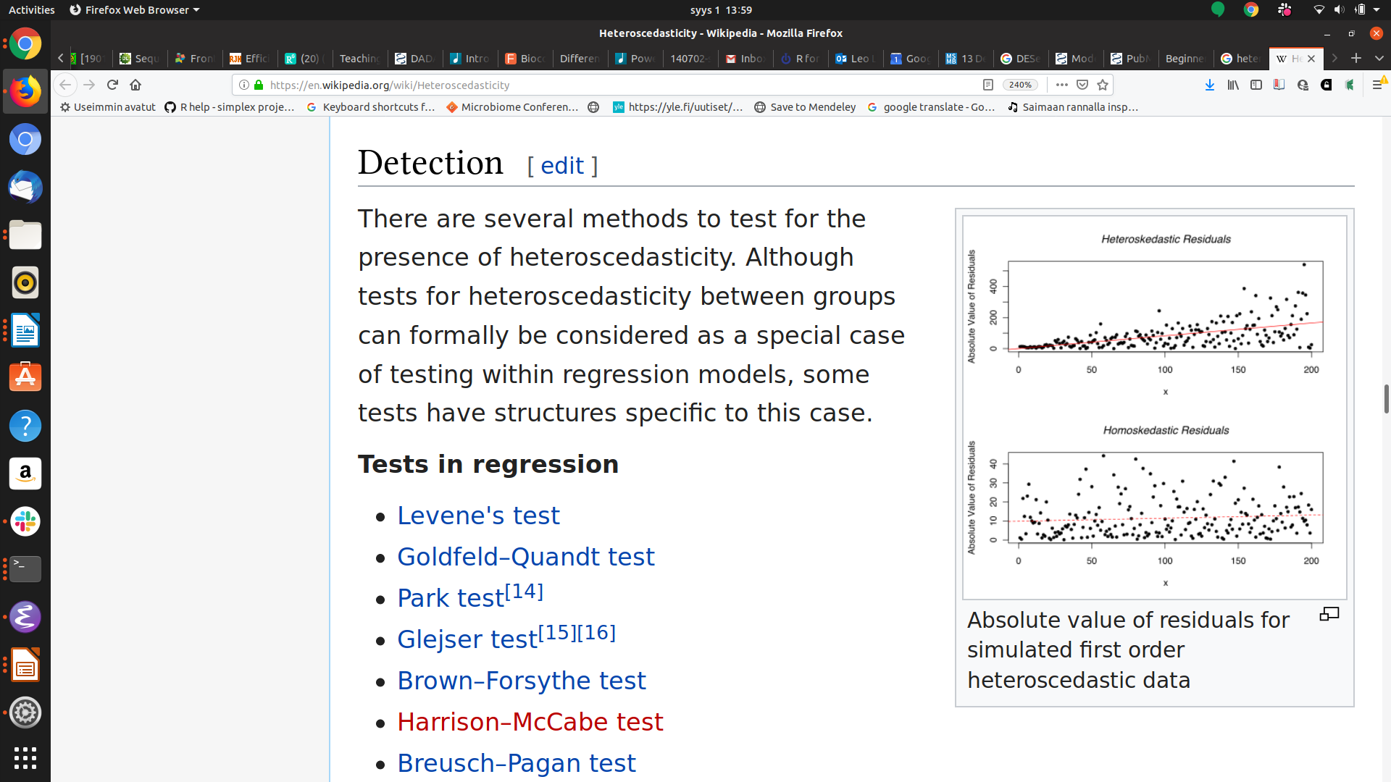
Normalizing heteroschedasticity (overdispersion)?
Problem: Variance depends on the mean in heteroschedastic systems.
Solution:
- Use parametric stochastic model to infer what happens at the tails
- Borrow information and share power across taxa to estimate the variances (large p, small n)
- “Shrink” the values towards mean
→ DESeq2, EdgeR, Limma..

Slide 17
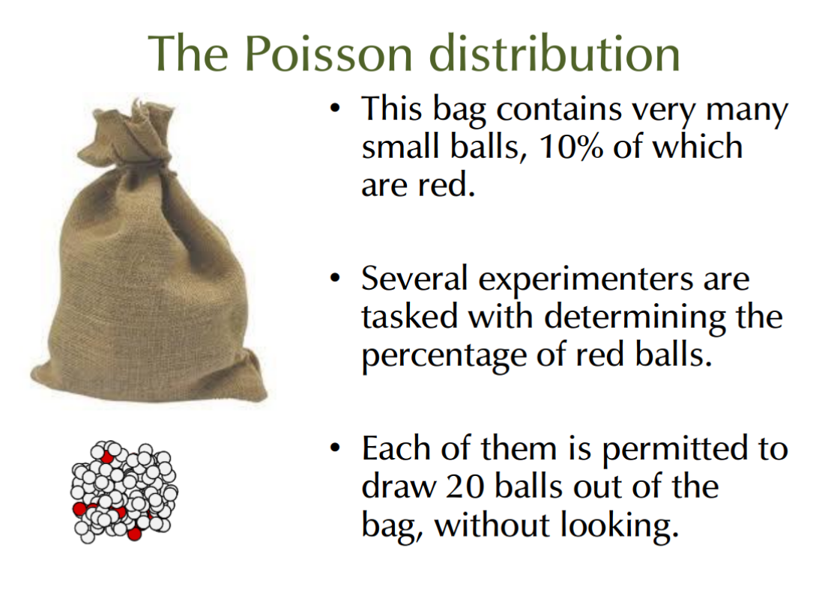

Slide 18
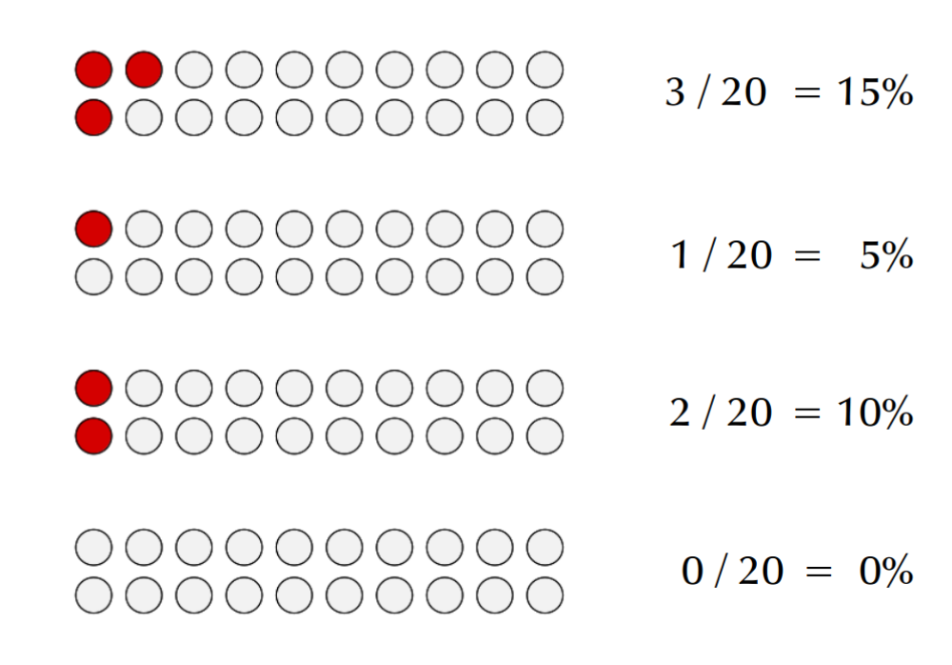

Slide 19
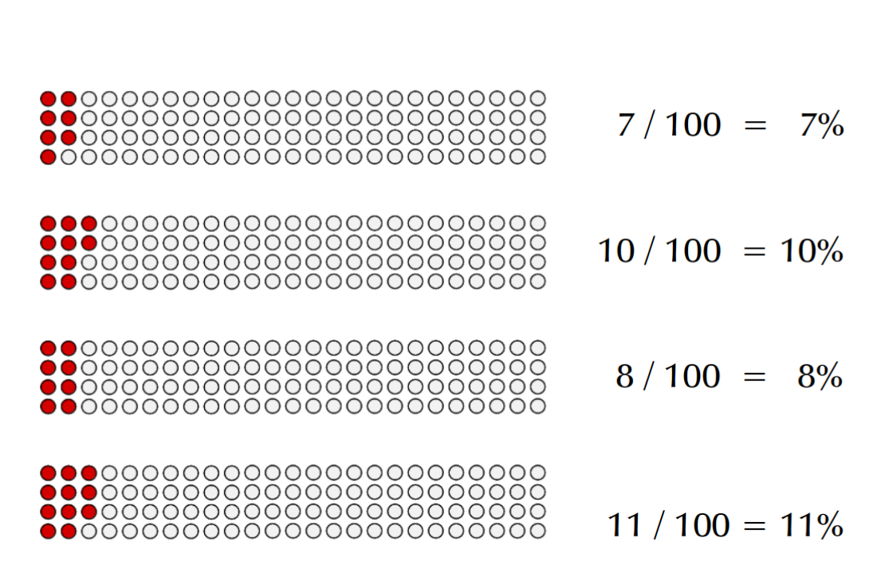

Slide 20
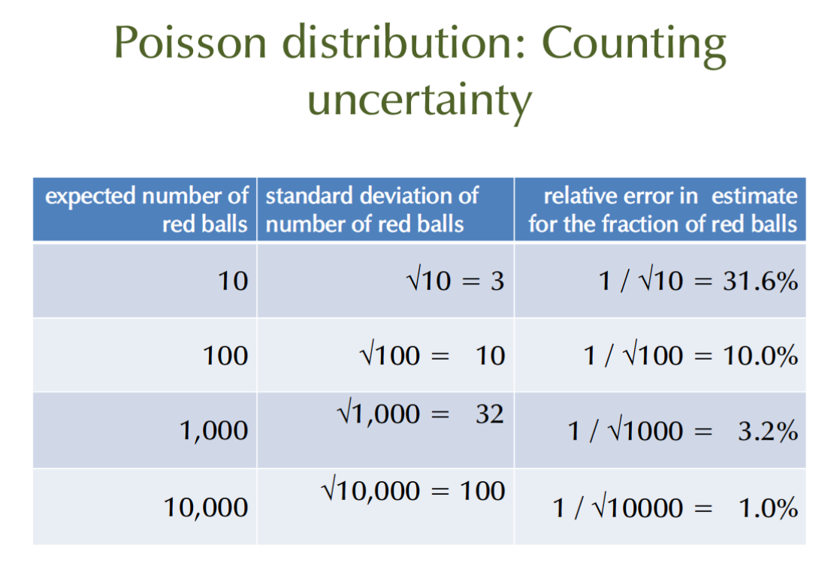

Slide 21
Normalizing library size?
If sample A has been sampled deeper than sample B, we the counts can be expected to be higher.
Compositional data: Divide by the total number of reads per sample (compositional abundance)
Problem: Abundant taxa may distort the ratios.

Slide 22
Relative versus absolute abundance: quantitative microbiome profiling
RMP vs. QMP:
drastic effect on conclusions!
Vandeputte et al. Nature 551:507-511, 2017
<number> / 37

Slide 24
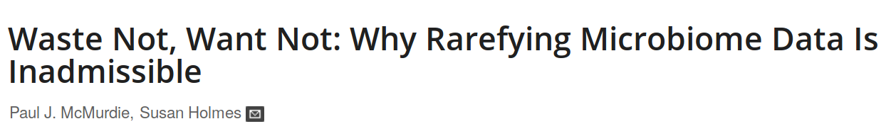
Rarefaction
If sample A has been sampled deeper than sample B, we the counts can be expected to be higher.
Solution: Rarify to even sampling depth
Limitation: Abundant taxa may distort the ratios.

Slide 25
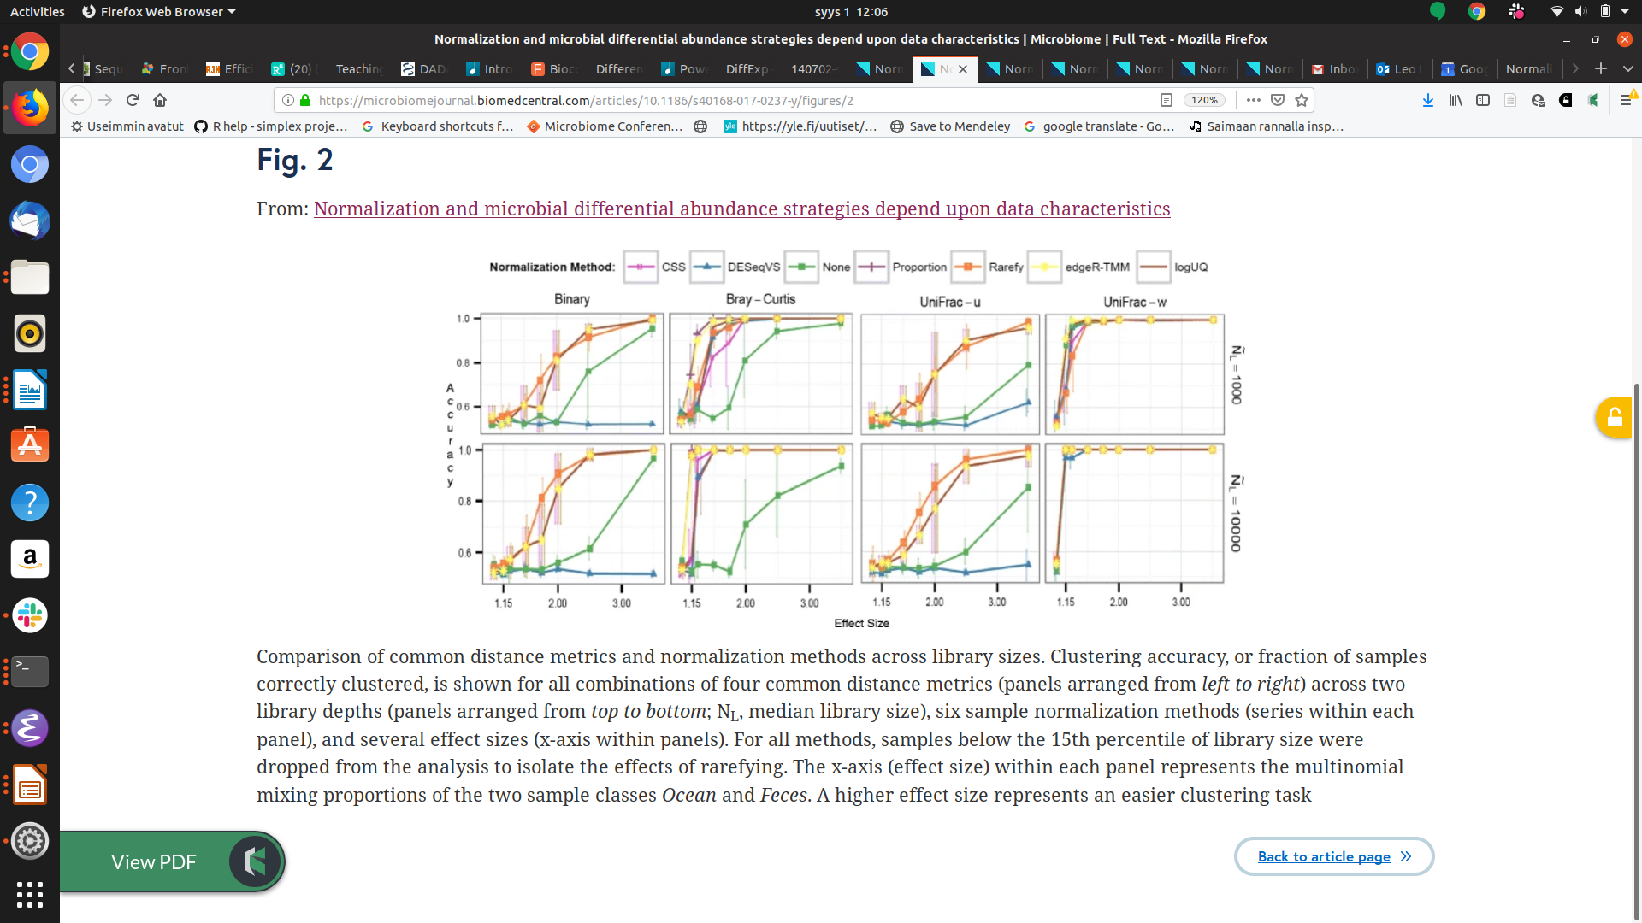
Dissimilarity measure and normalization affect clustering accuracy

Slide 26
Normalizing library size?
Sequencing generates varying number of reads per sample.
If sample A has been sampled deeper than sample B, we the counts can be expected to be higher.

Slide 27
Normalizing library size?
If sample A has been sampled deeper than sample B, we the counts can be expected to be higher.
Compositional data: Divide by the total number of reads per sample (compositional abundance)
Problem: Abundant taxa may distort the ratios.

Slide 28
Rarefaction
If sample A has been sampled deeper than sample B, we the counts can be expected to be higher.
Solution: Rarify to even sampling depth
Limitation: Abundant taxa may distort the ratios.

Slide 29
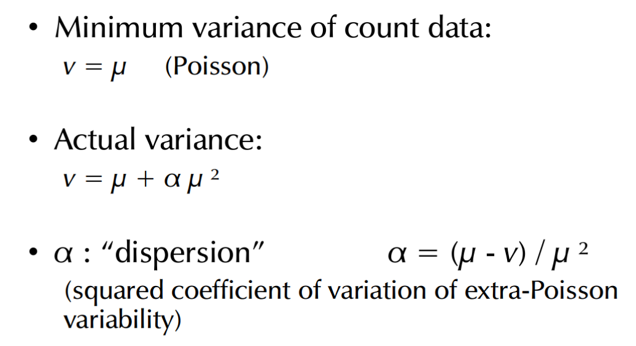
Dispersion and
overdispersion

Slide 30
Normalizing library size?
If sample A has been sampled deeper than sample B, then the counts can also be expected to be higher.
Compositional data: Divide by the total number of reads per sample (compositional abundance)
Problem: Abundant taxa distort the ratios.

Slide 32
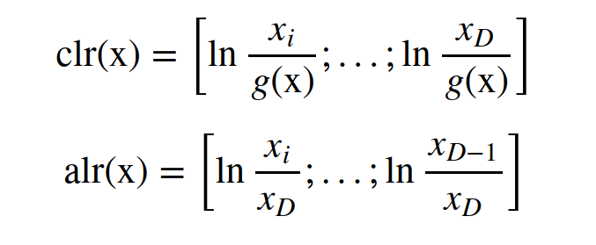

Slide 33
Transformations
transform(x, “compositional”)
transform(x, “clr”)
transform(x, “log10p”)
transform(x, “hellinger”)
transform(x, “identity”)

Slide 34
Rarefaction
If sample A has been sampled deeper than sample B, we the counts can be expected to be higher.
Solution: Rarify to even sampling depth
Limitation: Abundant taxa may distort the ratios.

Slide 35
Other key concepts
- alpha diversity
- beta diversity & community similarity
- differential abundance
- core & prevalence

Slide 36
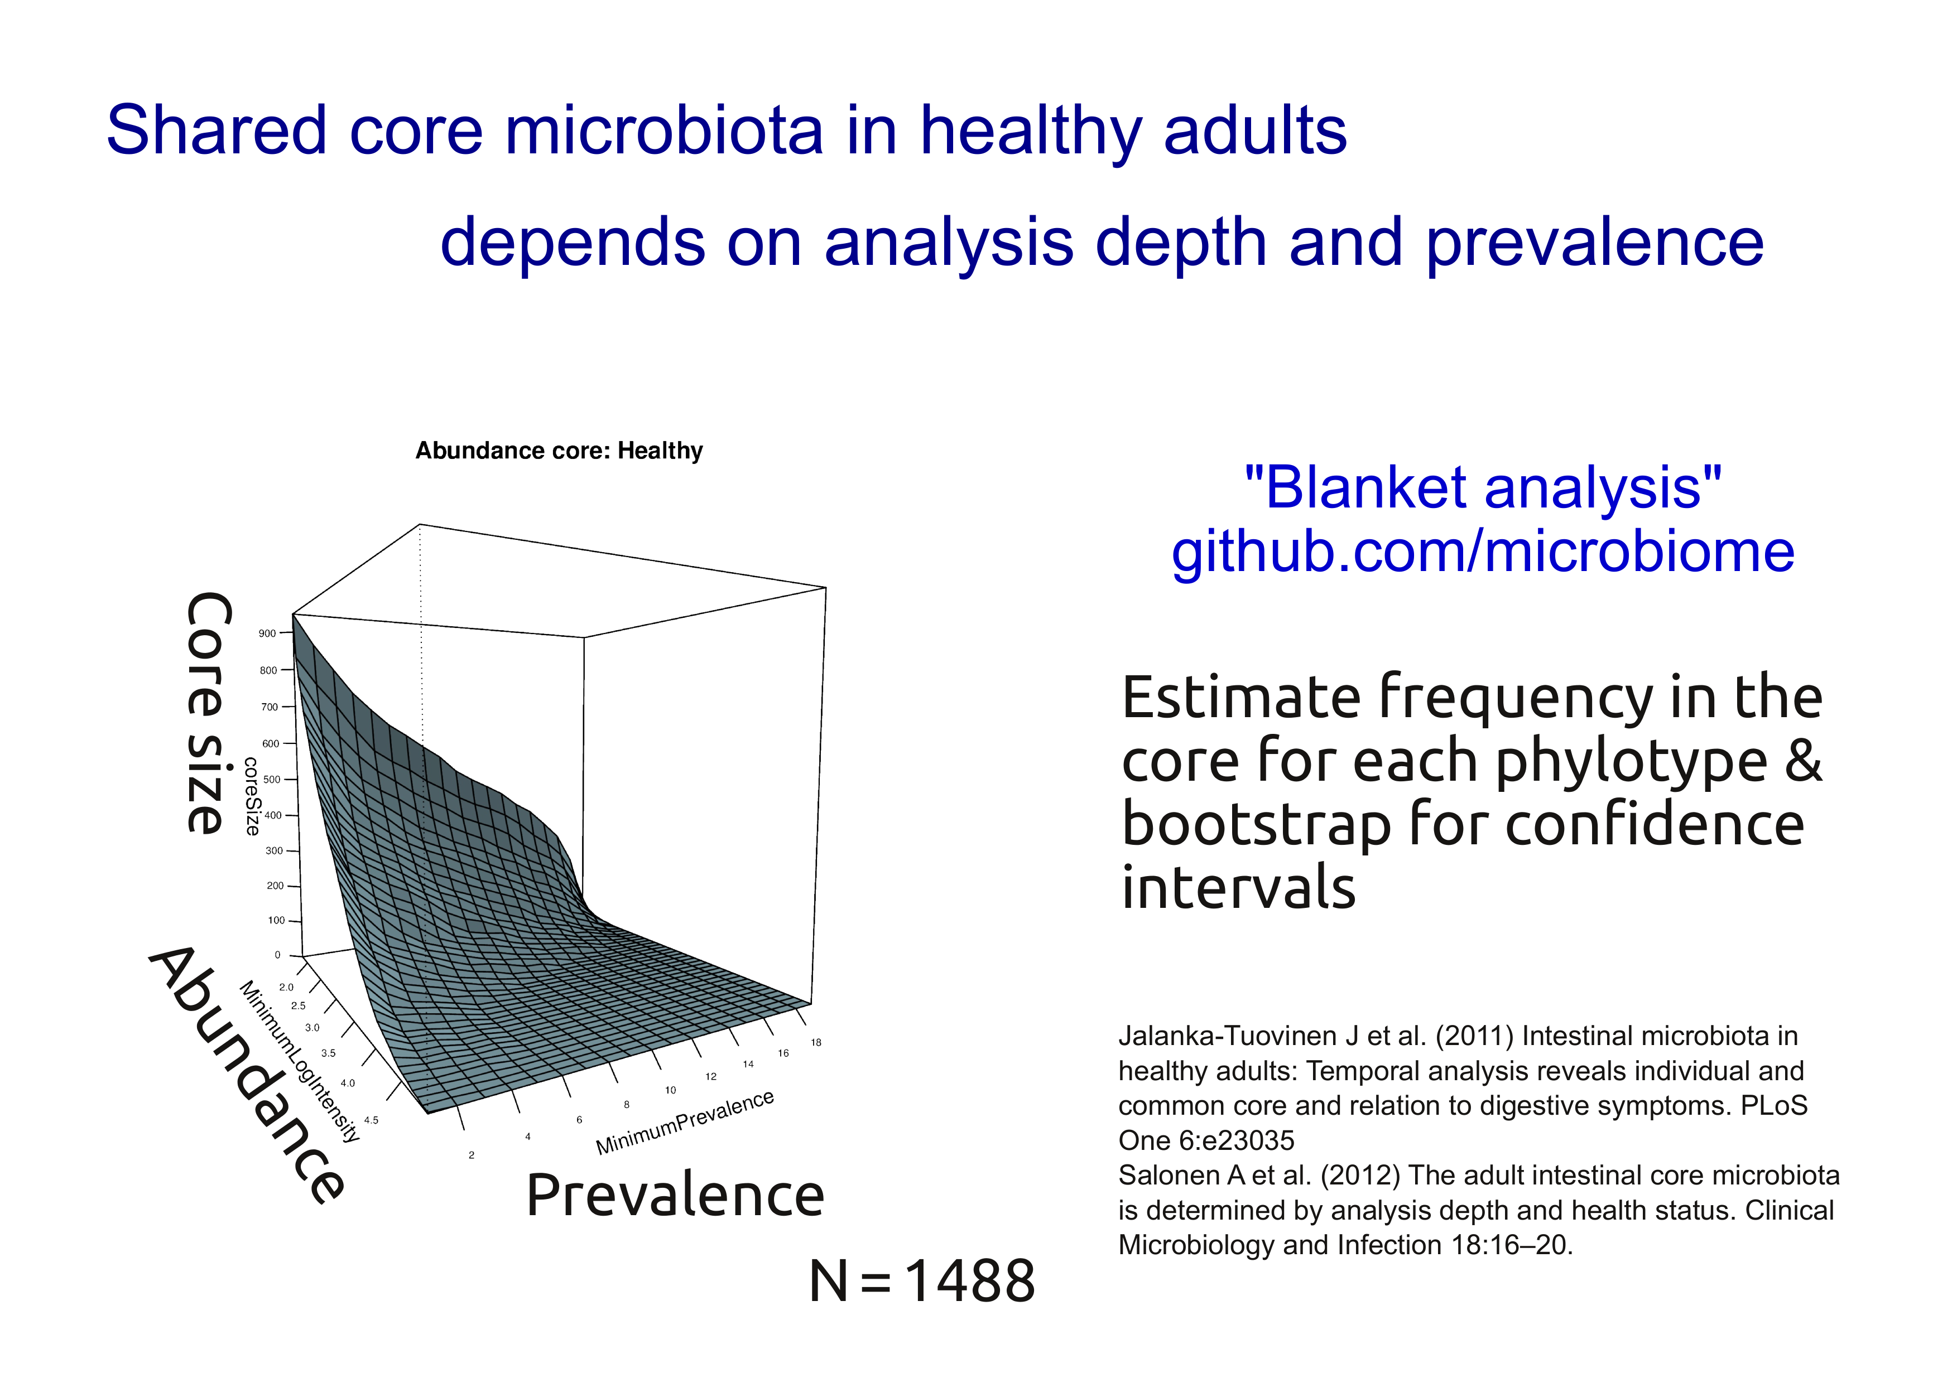

Slide 37
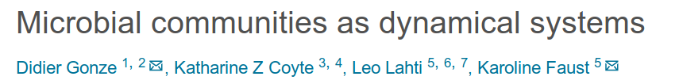
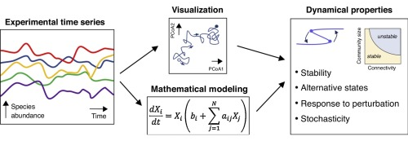
<number> / 37

