Slide 1
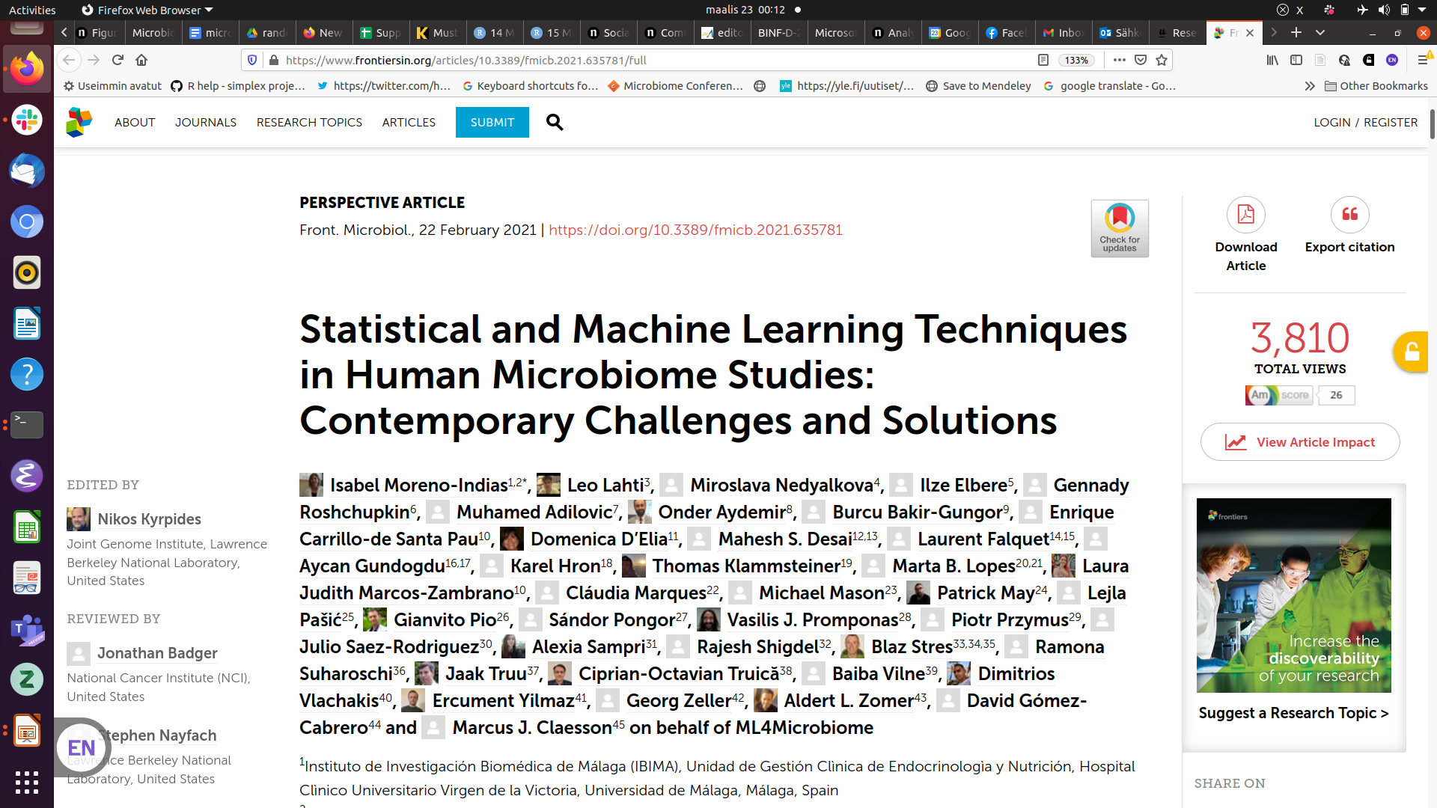
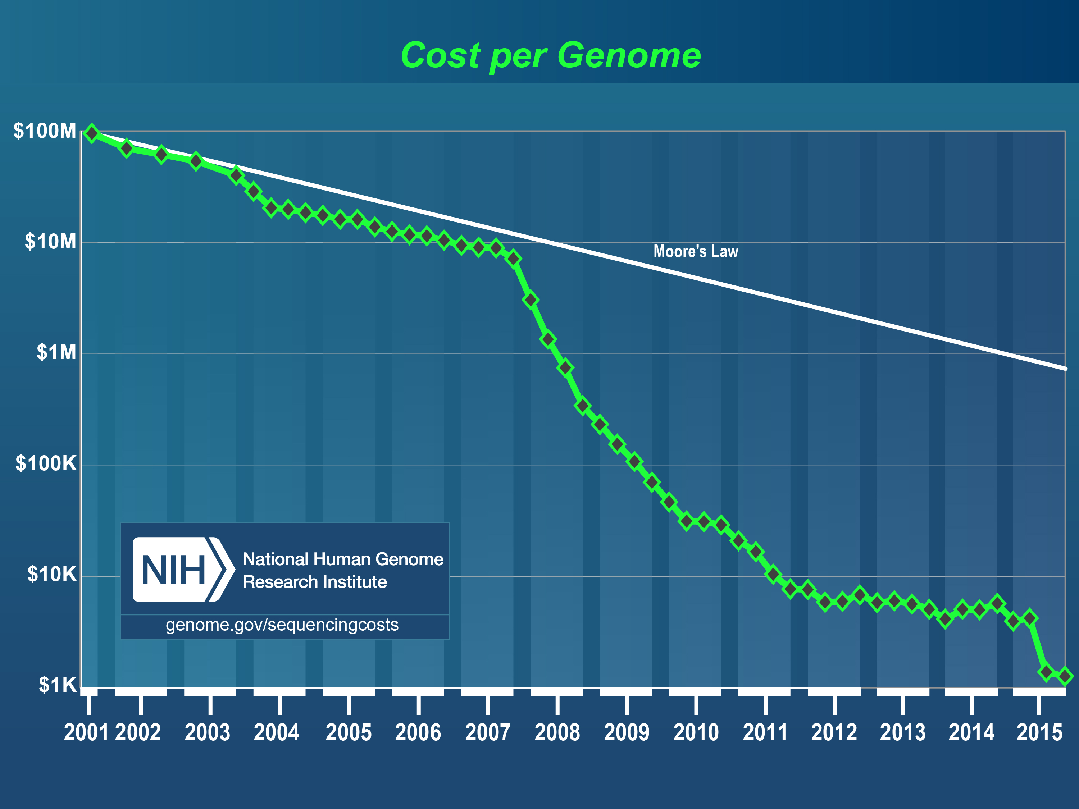

Slide 2

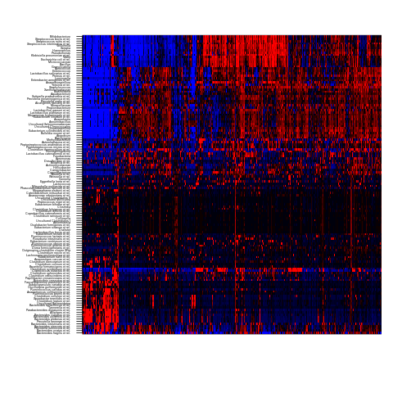
Human Intestinal Tract (HIT)Chip Atlas:
100+ genera ~ 10,000+ samples
Individuals
Taxa
Gut microbiota: 1000 western adults (Lahti et al. Nature Comm. 2014)
Standardized – cost efficient – accurate at 0.1% relative abundance
Rajilic-Stojanovic et al. Env. Microbiol. 2009
<number> / 36

Slide 3
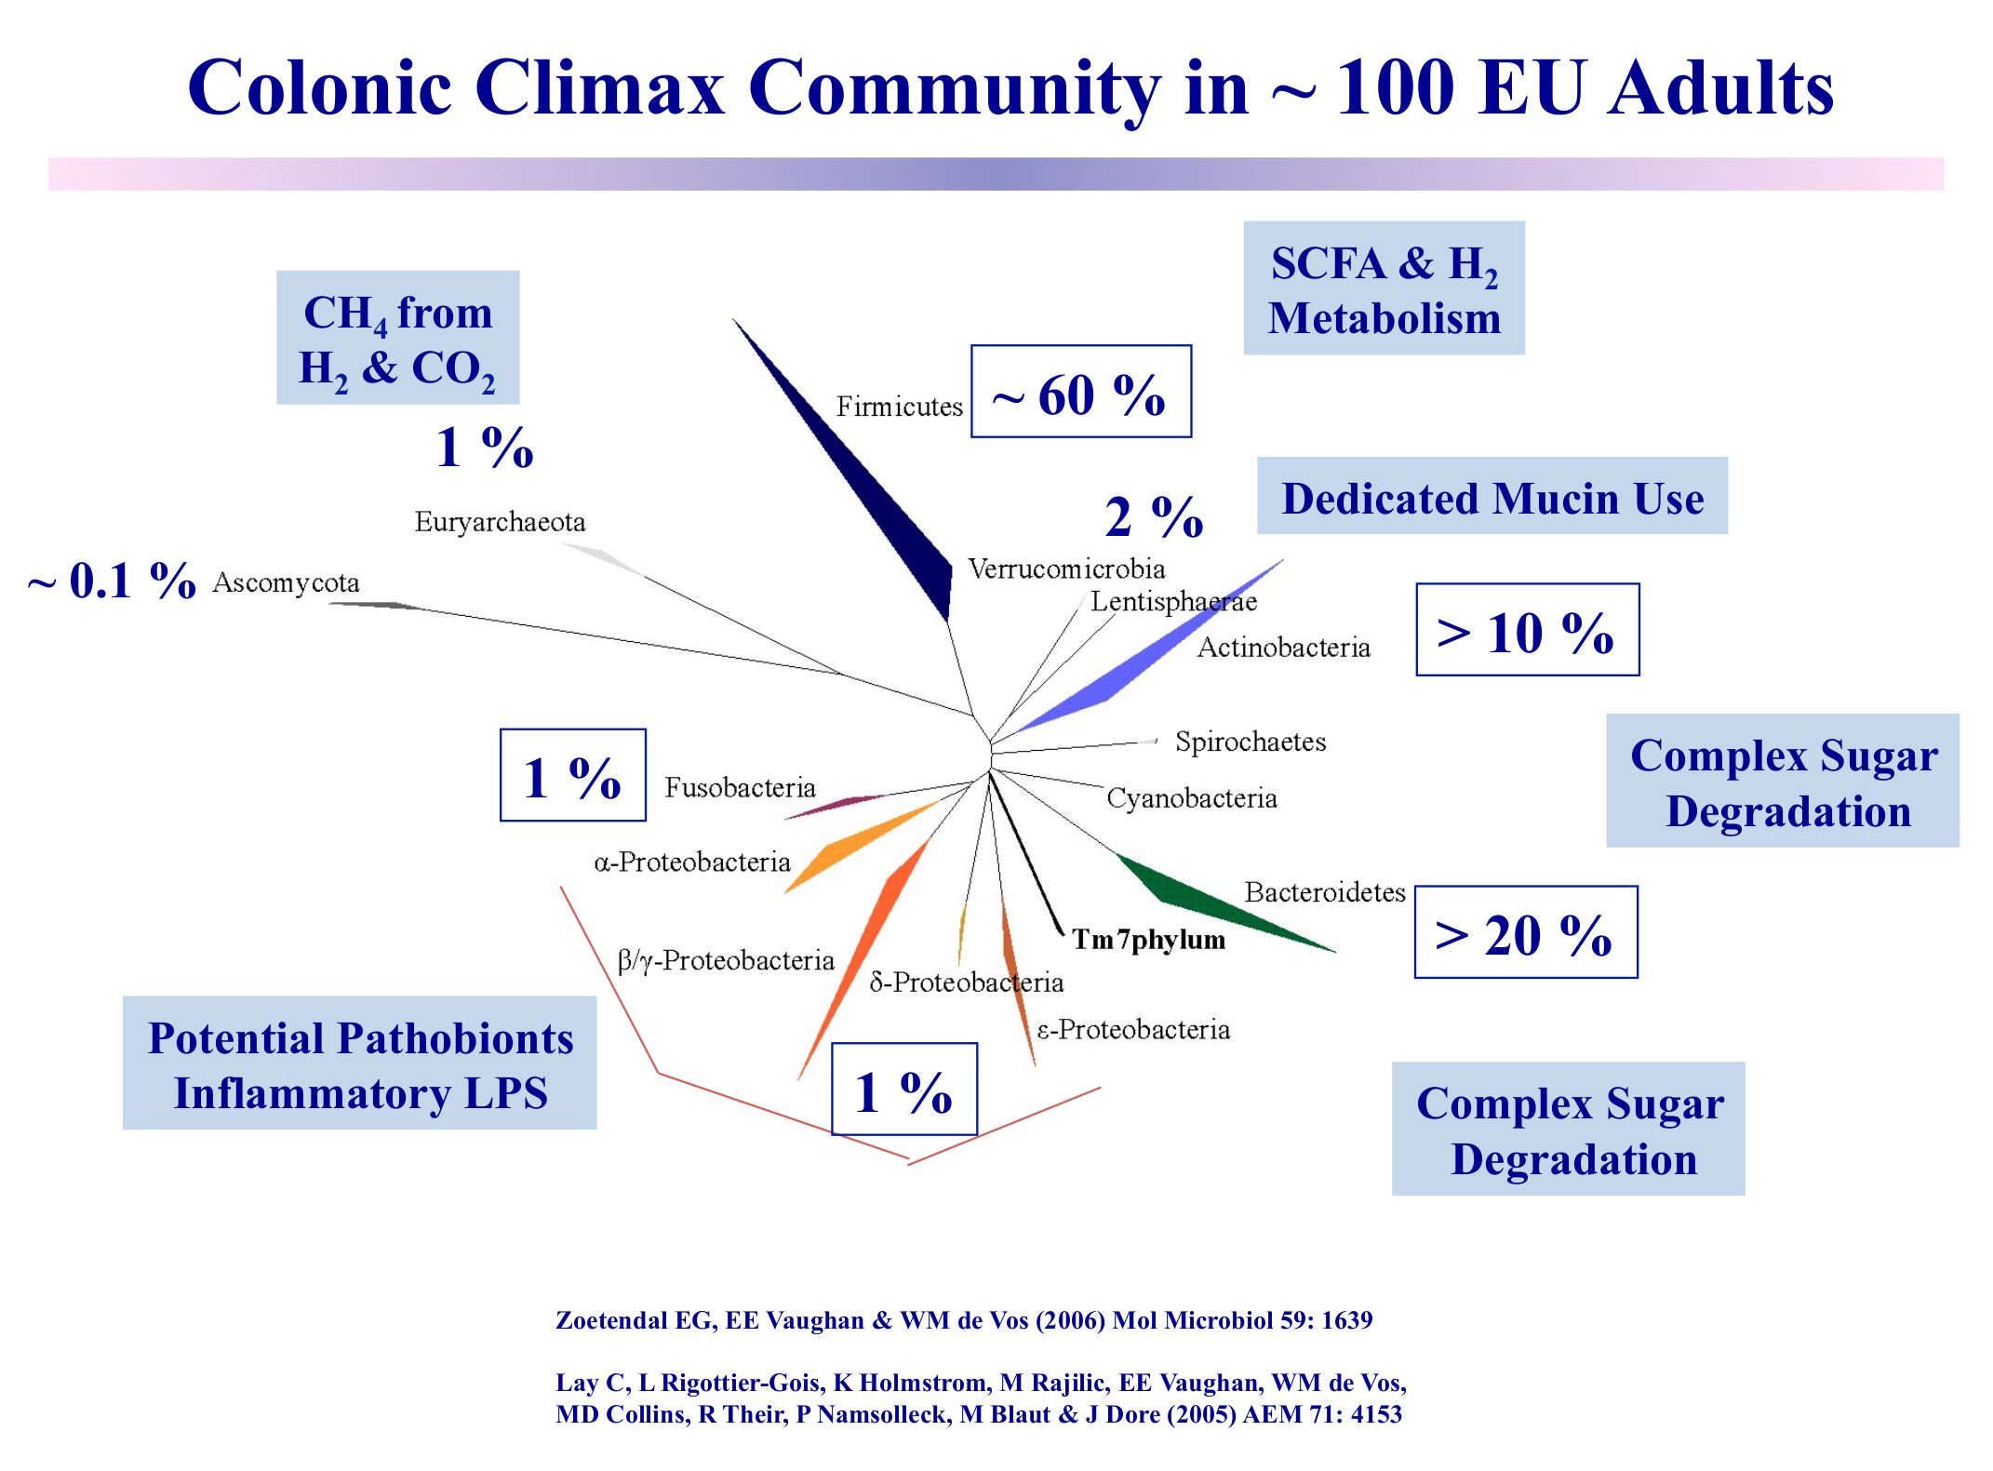
Special properties of microbiome data
Sparse
Compositional
Non-Gaussian
Overdispersed
Discrete
Complex
Stochastic
Multi-level

Slide 4
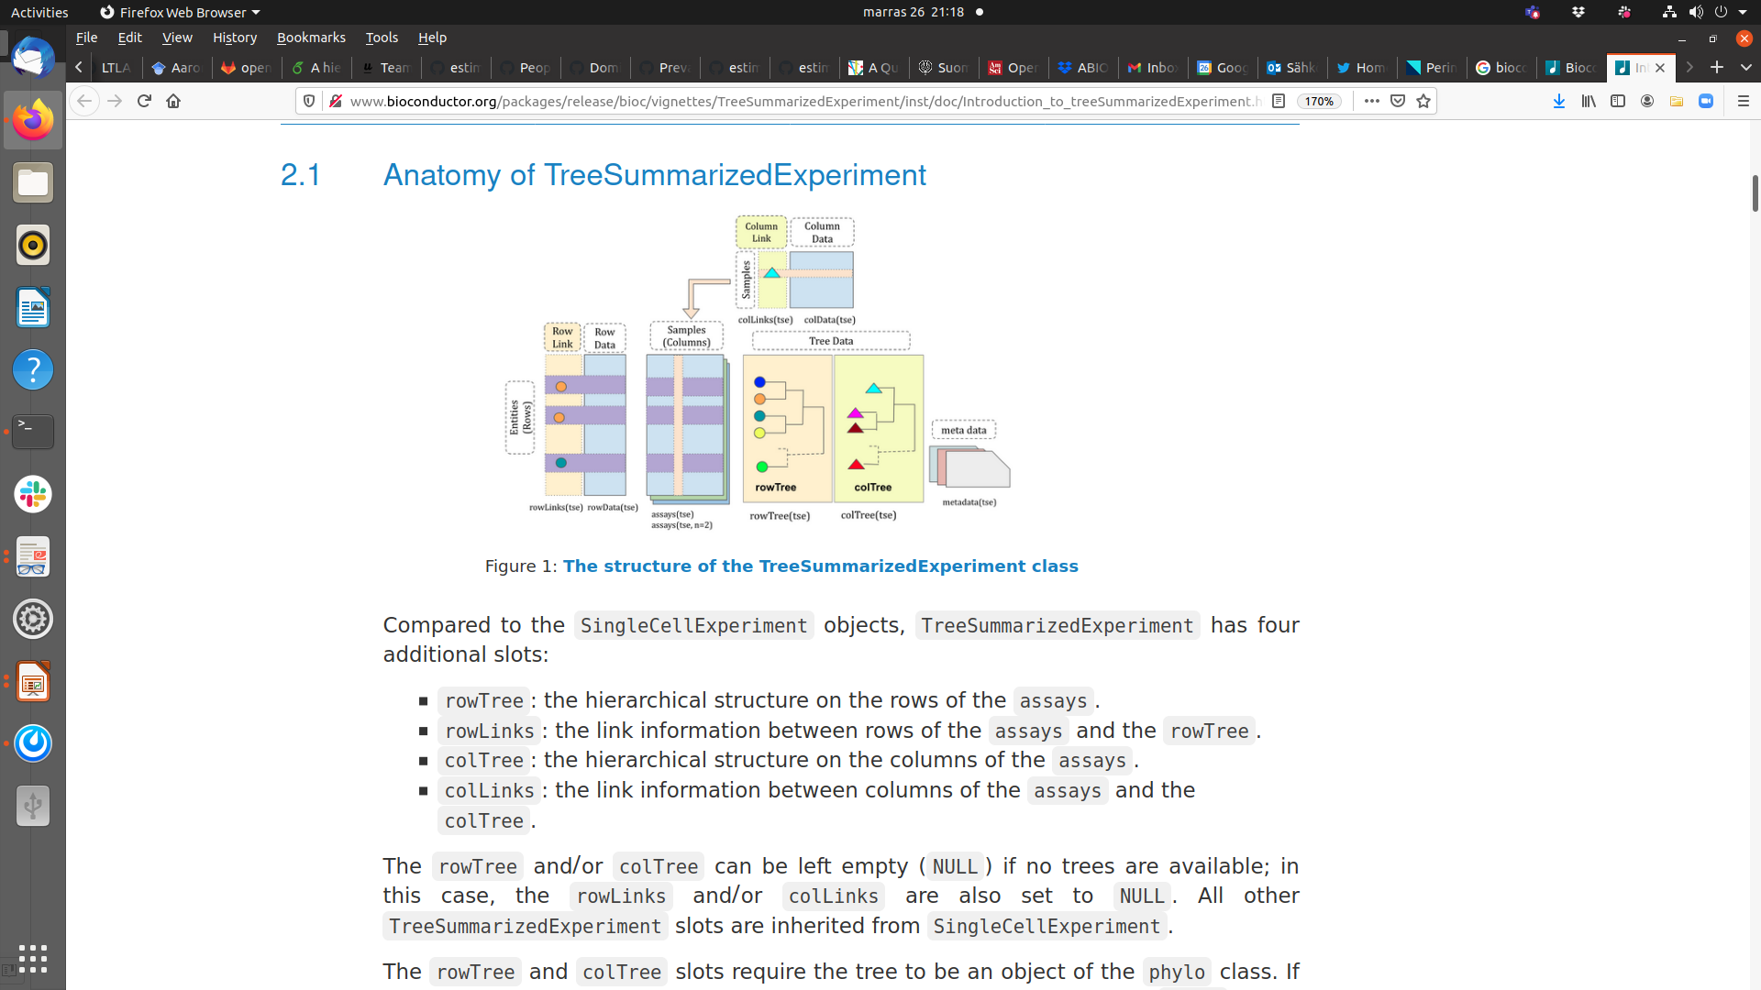
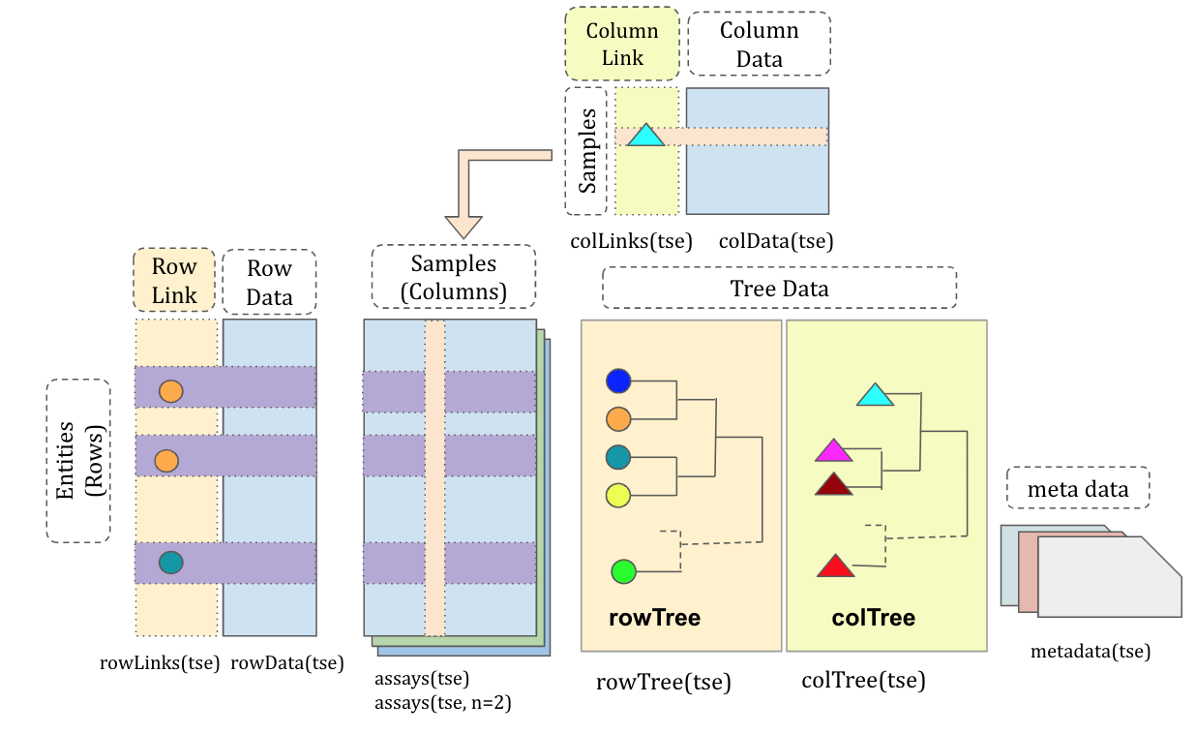

Slide 5

Example workflow
Check the poster
F1000 / EuroBioC!

Slide 6
Typical study designs
Case-control studies
Interventions
Cross-sectional population cohorts
Prospective follow-ups
Longitudinal time series
Multi-omics

Slide 7
Lecture: Key concepts
- special properties of microbiome data
- data science workflows
- alpha diversity
- beta diversity
- differential abundance

Slide 8
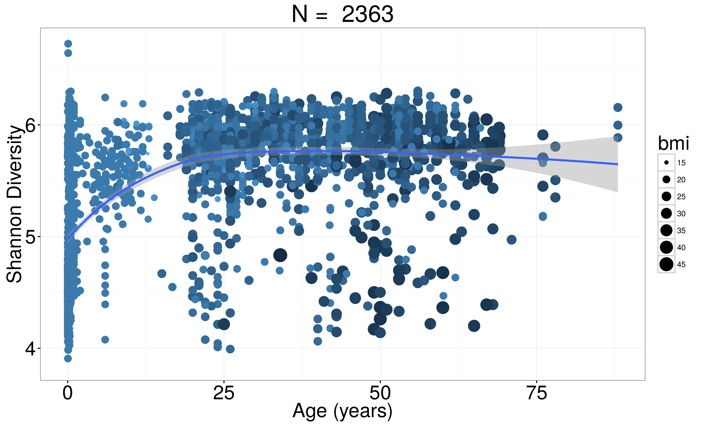
Alpha diversity & aging
healthy & normal obese subjects
Low diversity samples

Slide 9
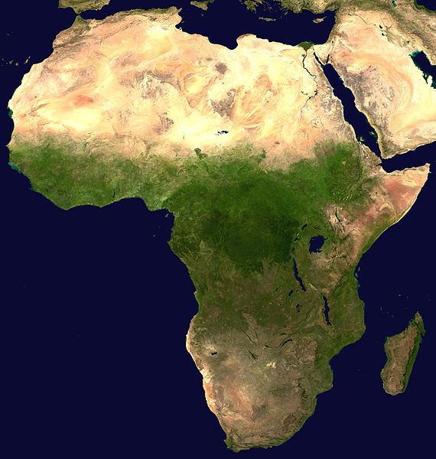
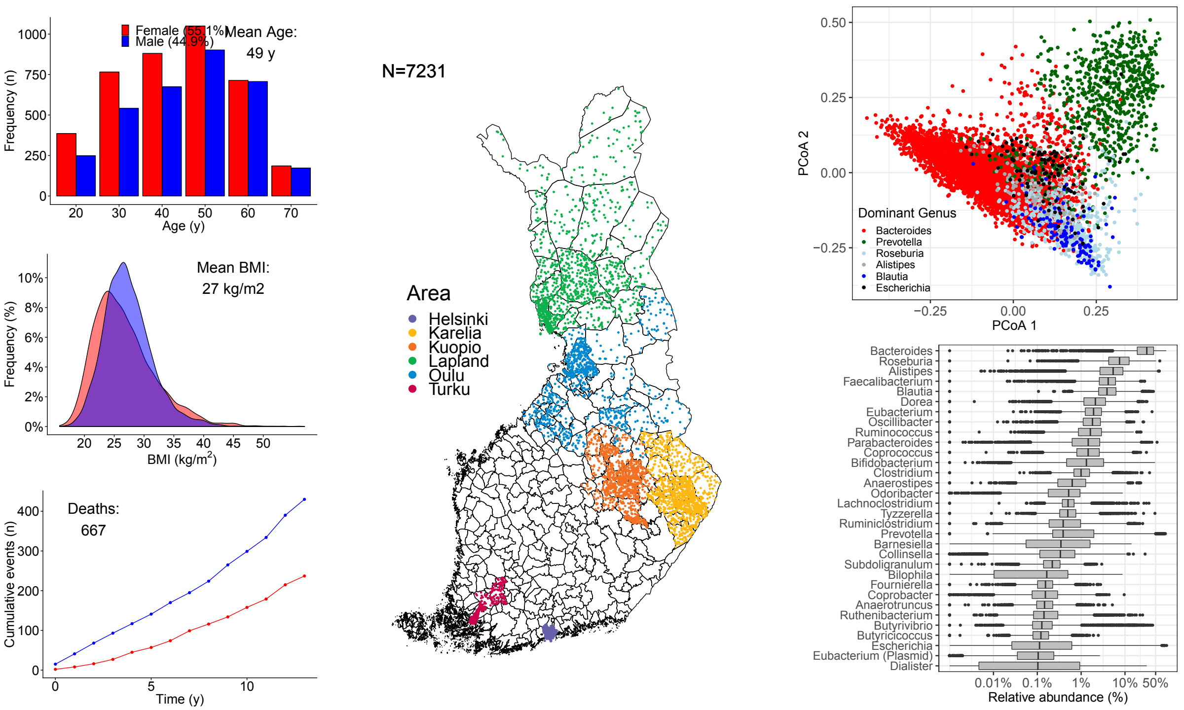
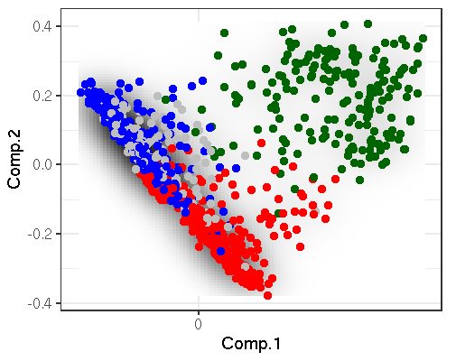
Beta diversity & population landscape
FINRISK (N = 7219)
HITChip
(N = 1006)
FINRISK
(N = 7211)
<number> / 36

Slide 10
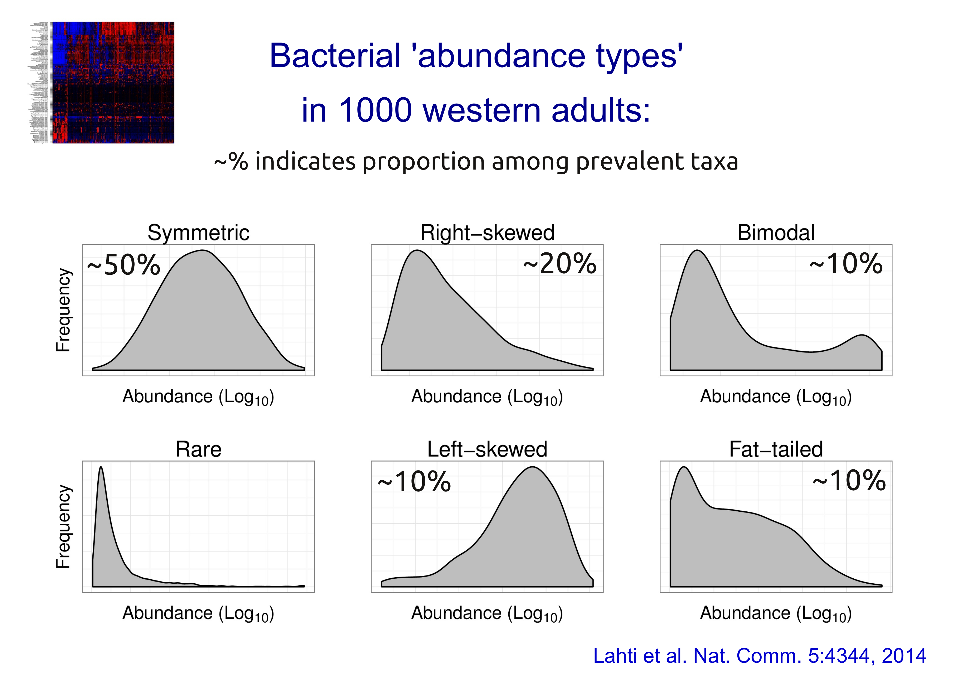
Differential abundance
Standard t-test for two-group comparison?
Problems:
Few replicates
Non-gaussian, discrete, positive, skewed..
Multiple testing

Slide 11
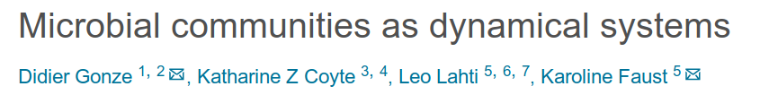
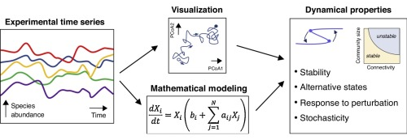
<number> / 36

Slide 12
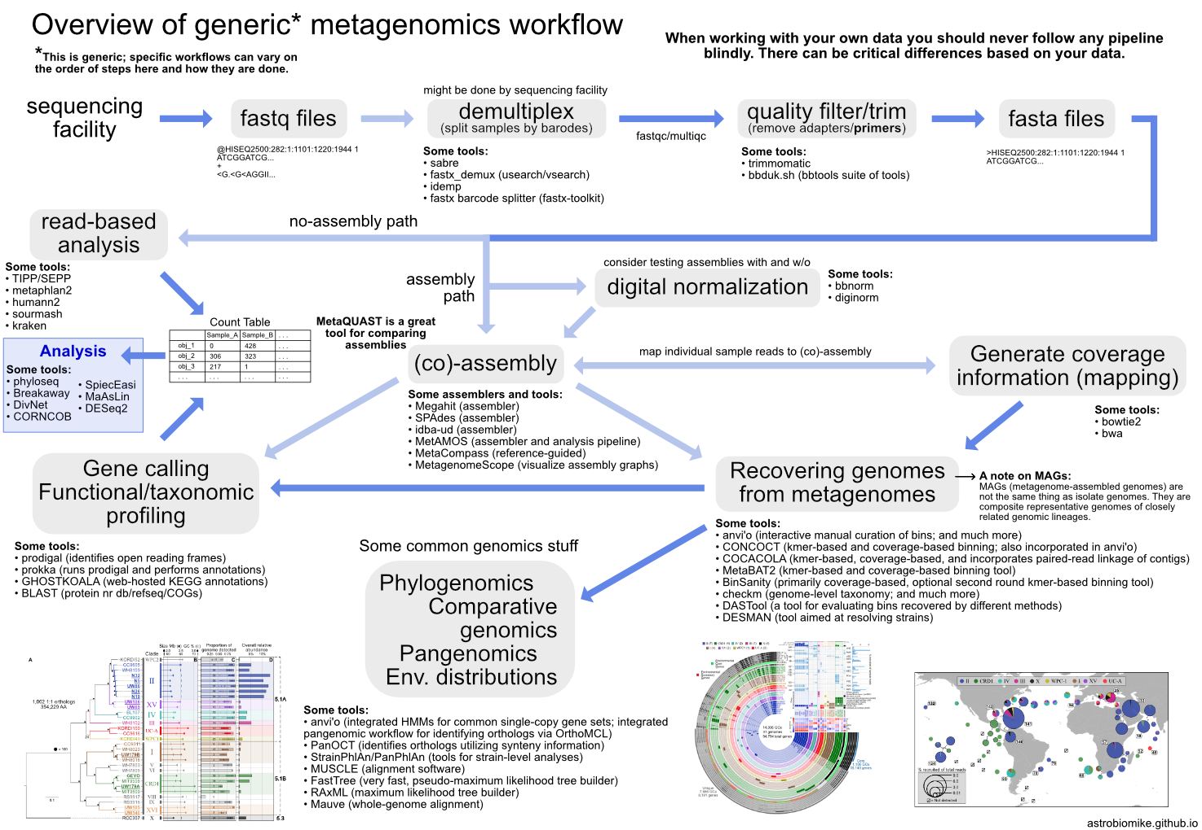
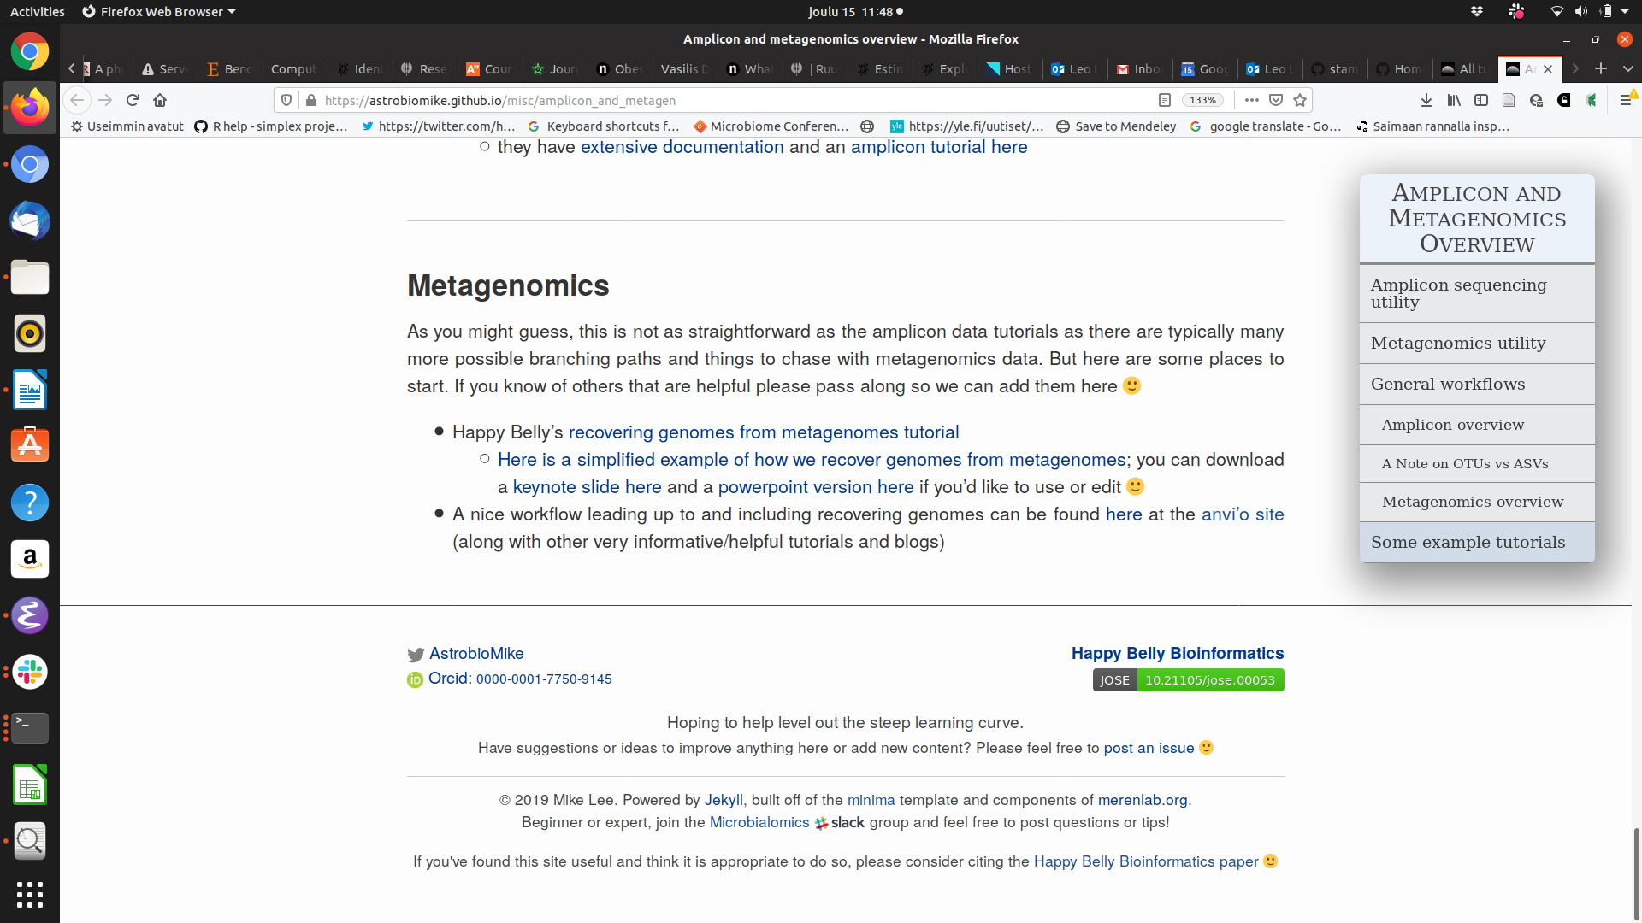
Lee, (2019). Happy Belly Bioinformatics: an open-source resource dedicated to helping biologists utilize bioinformatics. Journal of Open Source Education, 4(41), 53, https://doi.org/10.21105/jose.00053

Slide 13
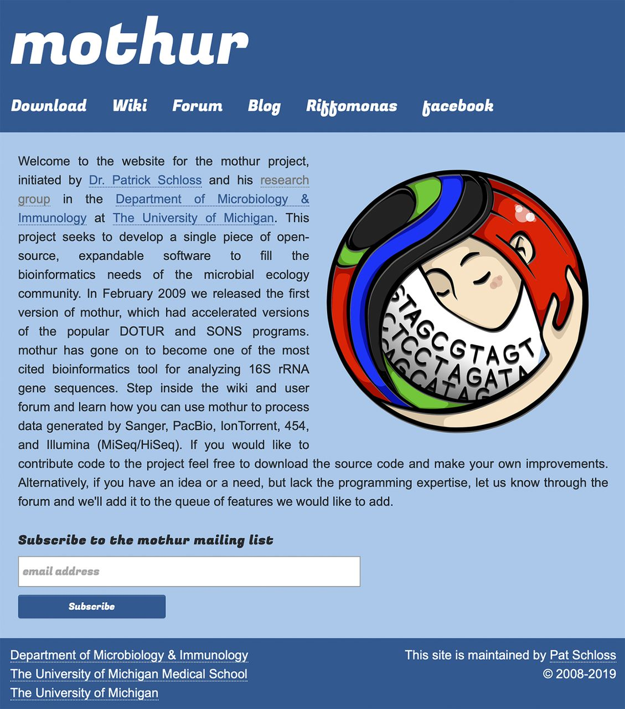
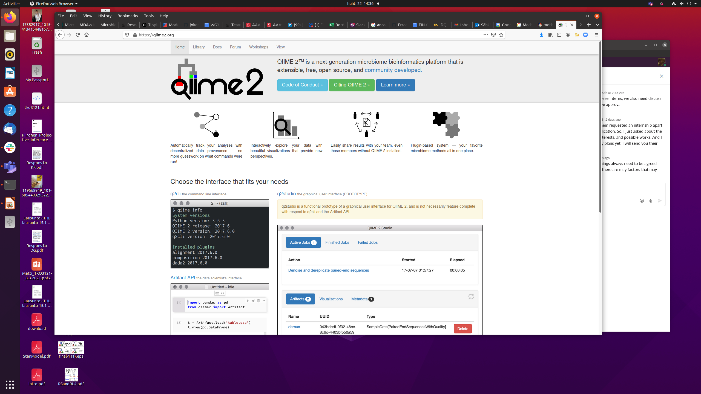

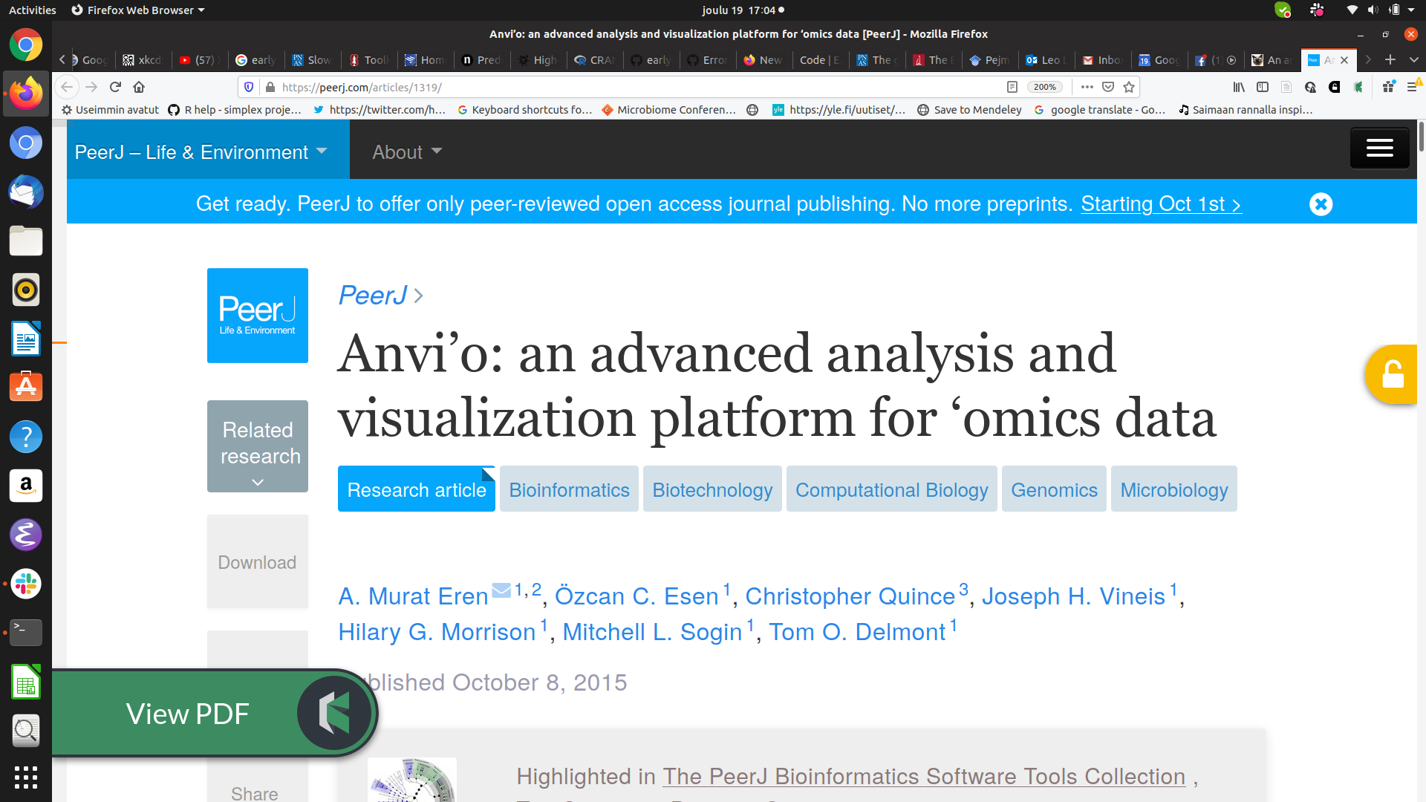
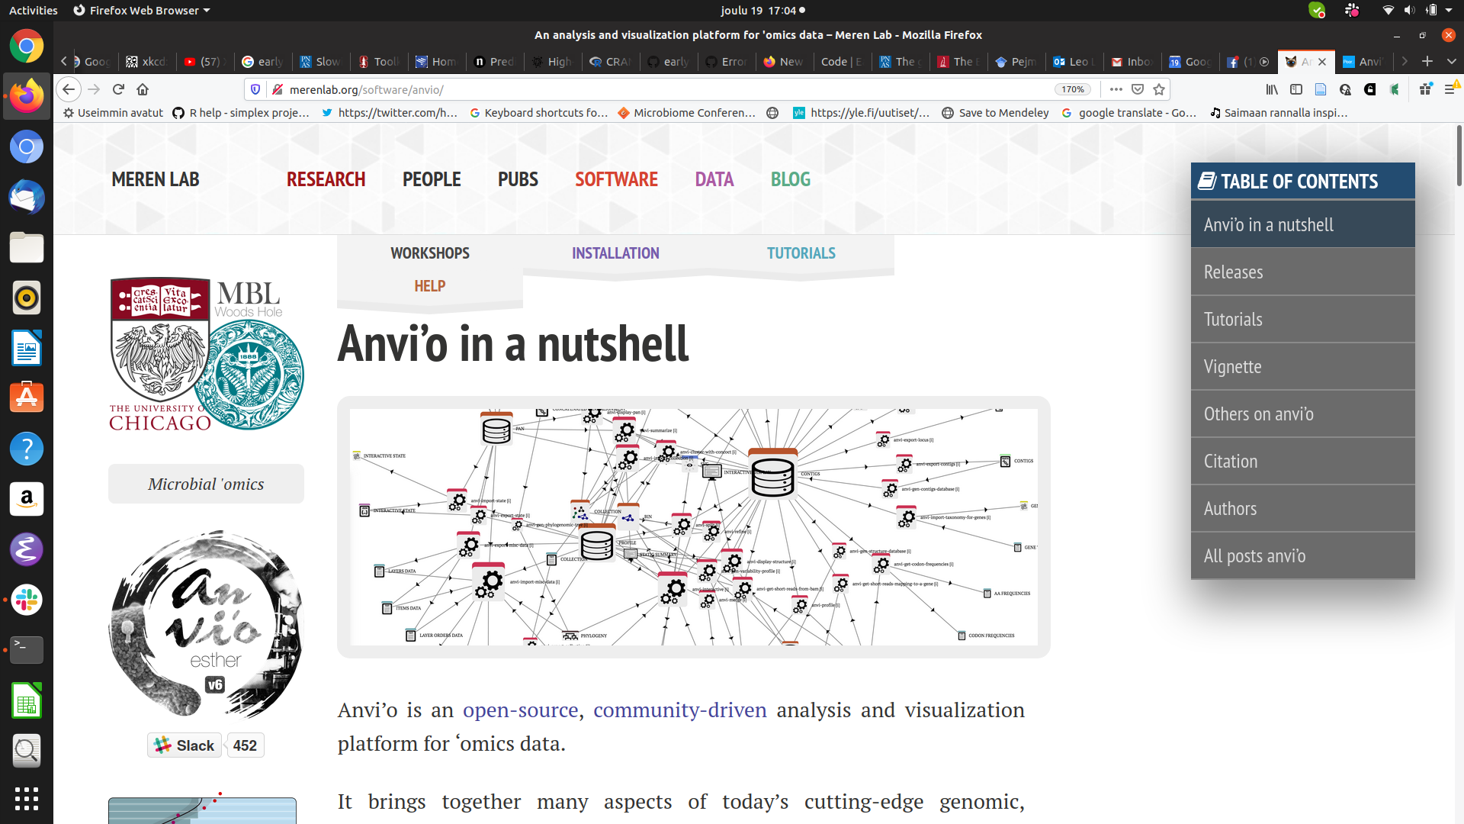
open data science ecosystems

Slide 14

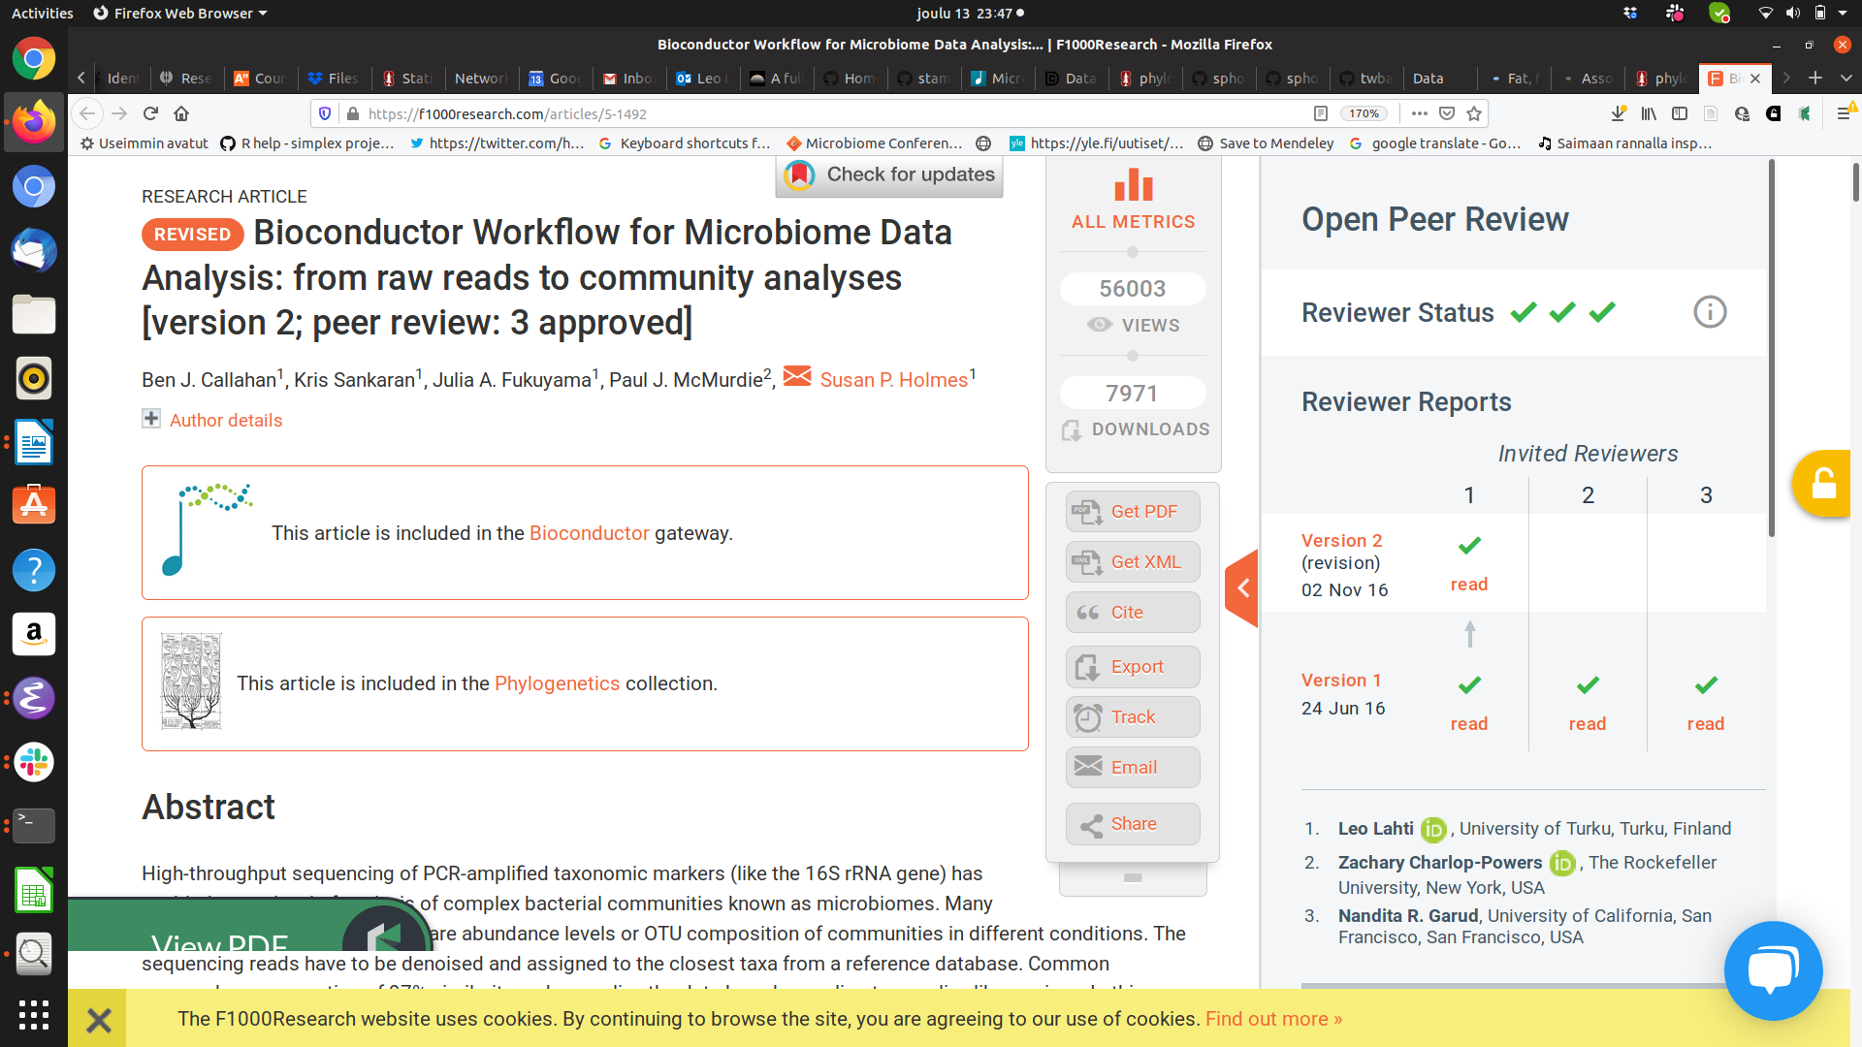

Data science workflow
R for Data Science / H. Wickham
<number> / 36

Slide 15
Data
Algorithms
Results
<number>/36

Slide 16
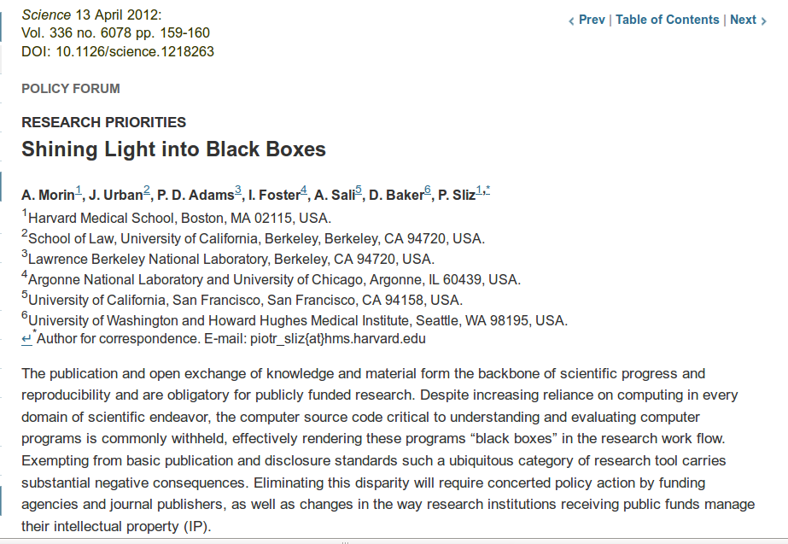
?
Data
Methods
Results
<number>/36

Slide 17
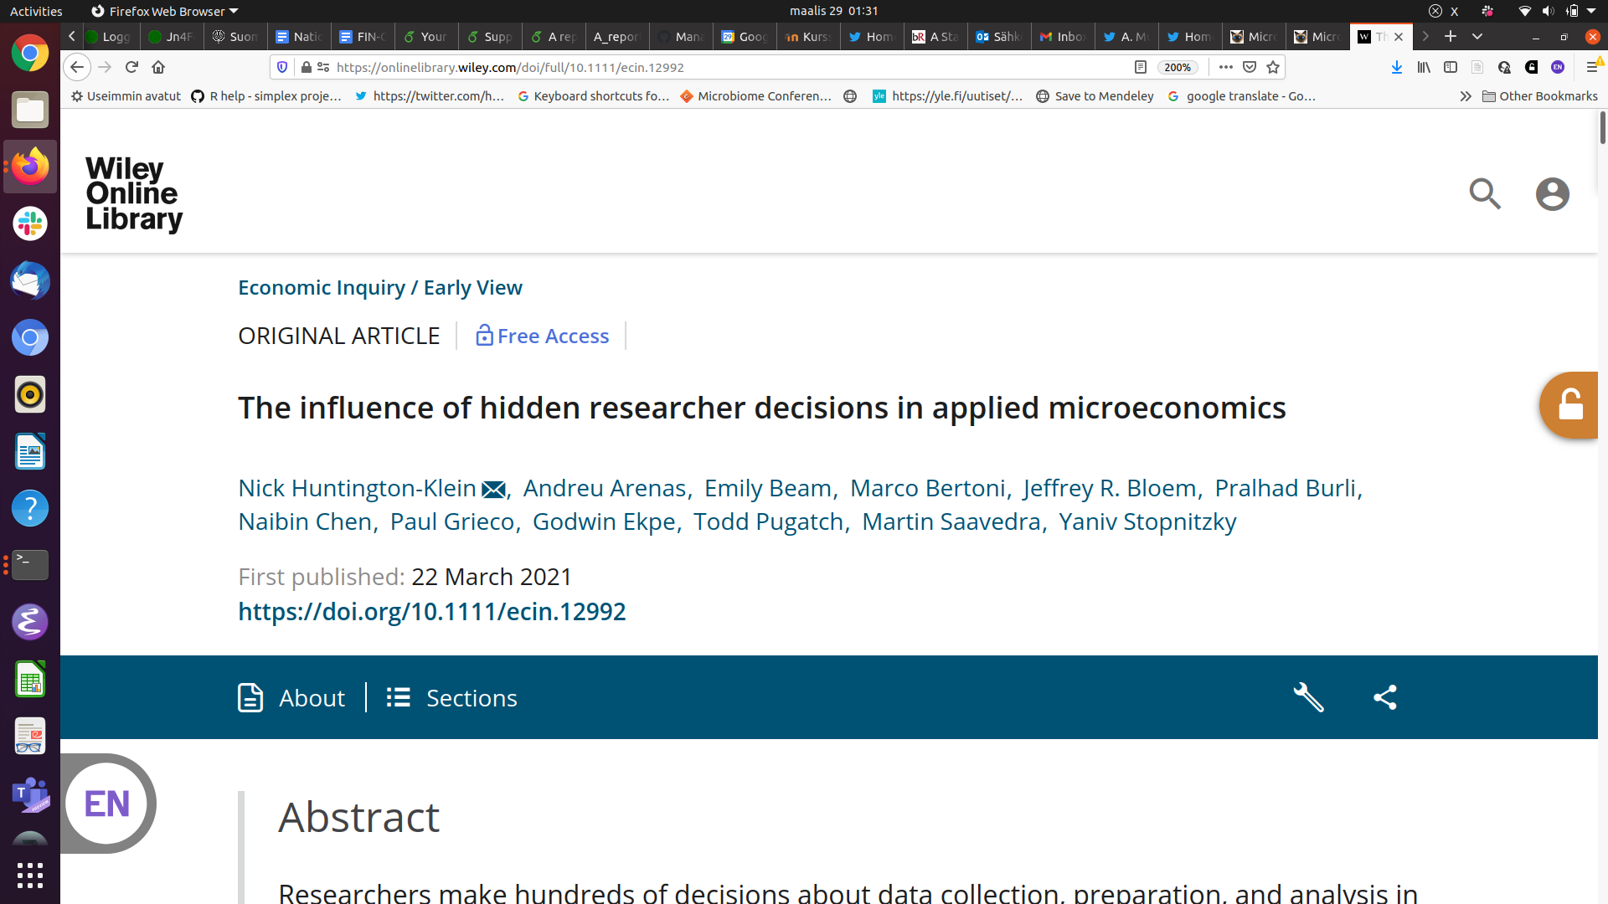
Researchers make hundreds of decisions about data collection, preparation, and analysis in their research. We use a many‐analysts approach to measure the extent and impact of these decisions. Two published causal empirical results are replicated by seven replicators each. We find large differences in data preparation and analysis decisions, many of which would not likely be reported in a publication. No two replicators reported the same sample size. Statistical significance varied across replications, and for one of the studies the effect's sign varied as well. The standard deviation of estimates across replications was 3–4 times the mean reported standard error.
<number> / 36

Slide 18
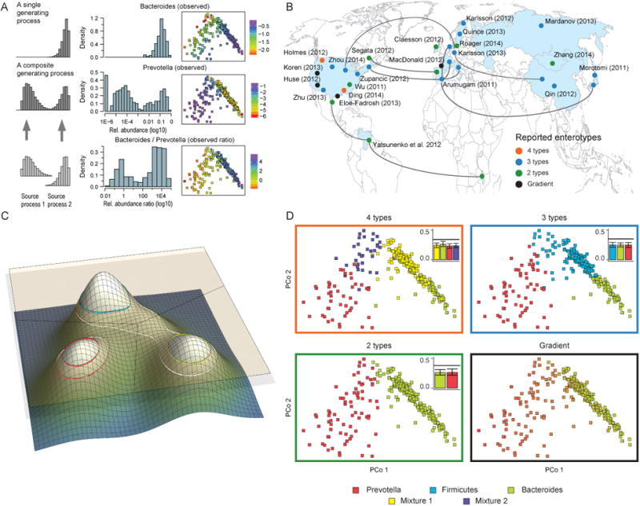
How to choose a correct model?
→ a community typing example
Taxonomic level
- Phylum
- Family
- Order
- Genus
- Species
- Strain..
2 x 6⁶ = 93312
Filtering
- None
- Prevalent
- Core
- Excl. outliers
- High variance
- Custom
Enterotypes in the landscape of gut microbial community composition. Costea et al. Nature 2018.
Normalization
- None
- TSS
- CSS
- ILR/ALR/CLR
- phILR
- Hellinger
(Dis)similarity
- Eulidean
- Aitchison
- Bray-Curtis
- Jaccard
- weighted Unifrac
- unweighted Unifrac
Clustering method
- Hierarchical / Ward
- Hierarchical / Complete
- Gaussian mixture
- DMM
- PAMR
- K-means
Regulation
- Calinski-Harabasz
- Dirichlet Process
- Silhouette Index
- AIC
- BIC
- DIC
Walk-through example in R/Bioc by Holmes & McMurdie http://statweb.stanford.edu/~susan/papers/EnterotypeRR.html

Slide 19
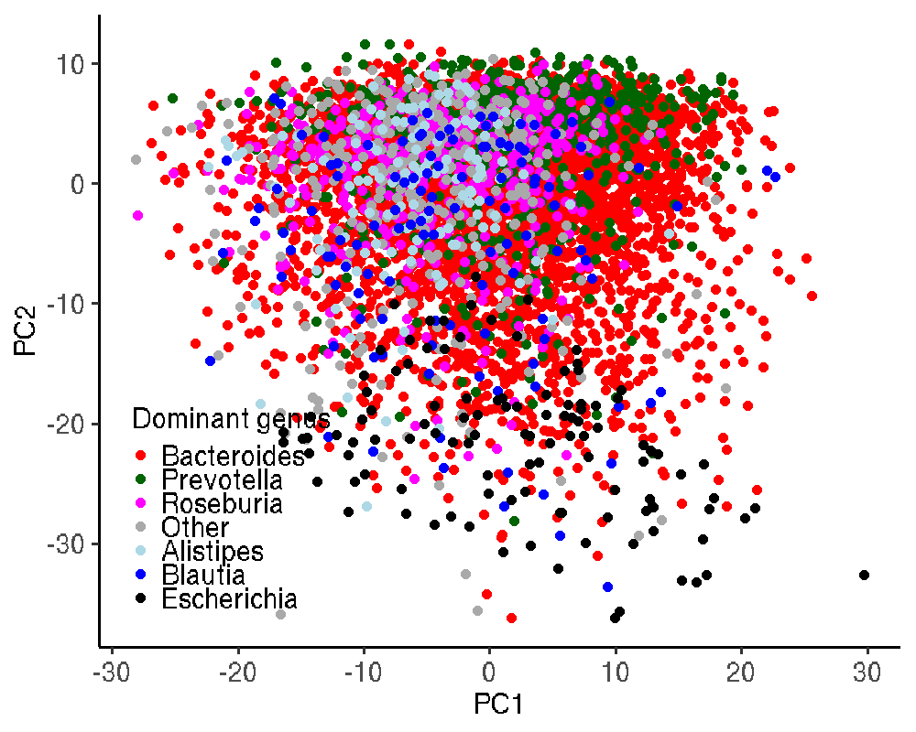
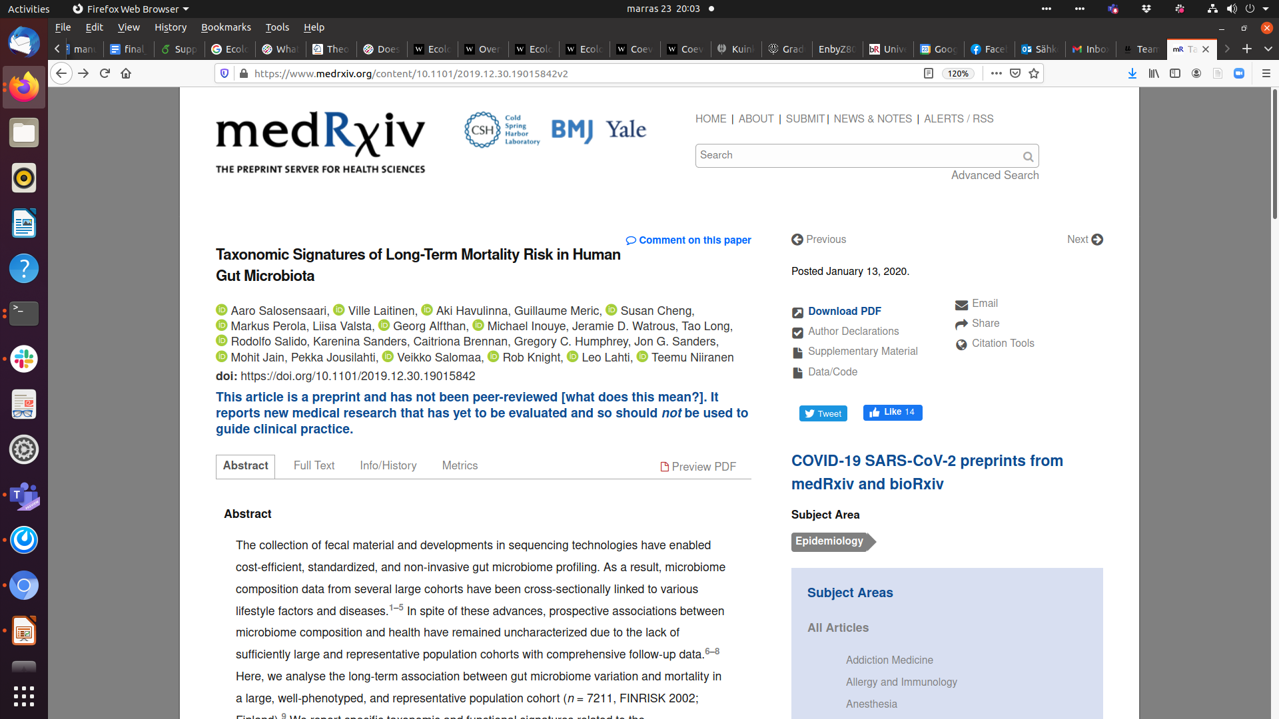
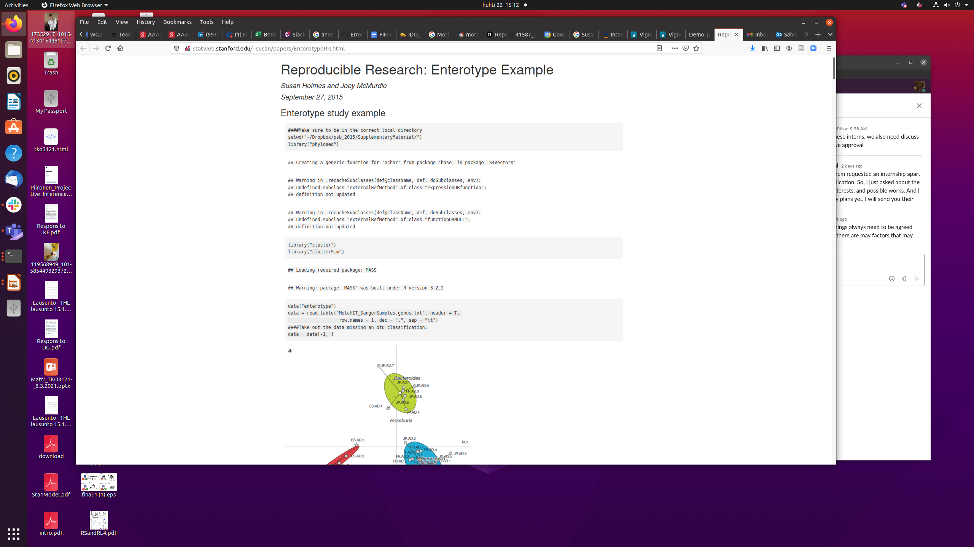
PCoA + Bray-Curtis
PCA + Aitchison
http://statweb.stanford.edu/~susan/papers/EnterotypeRR.html

Slide 20
“I have begun to think that no one ought to publish biometric results, without lodging a well arranged and well bound manuscript copy of all his data, in some place whereit should be accessible, under reasonable restrictions, to those who desire to verify his work.”
Francis Galton (1901), Biometrika 1:1, pp. 7-10.
<number> / 36

Slide 21
Reproducible workflows improve transparency and robustness
R for Data Science / H. Wickham
Taxonomic level?
- Phylum
- Family
- Order
- Genus
- Species
- Strain..
Normalization
- None
- TSS
- CSS
- ILR/ALR/CLR
- phILR
- Hellinger
(Dis)similarity?
- Eulidean
- Aitchison
- Bray-Curtis
- Jaccard
- weighted Unifrac
- unweighted Unifrac
Regulation
- Calinski-Harabasz
- Dirichlet Process
- Silhouette Index
- AIC
- BIC
- DIC
Clustering
- Hierarchical / Ward
- Hierarchical / Complete
- Gaussian mixture
- DMM
- PAMR
- K-means

Slide 22
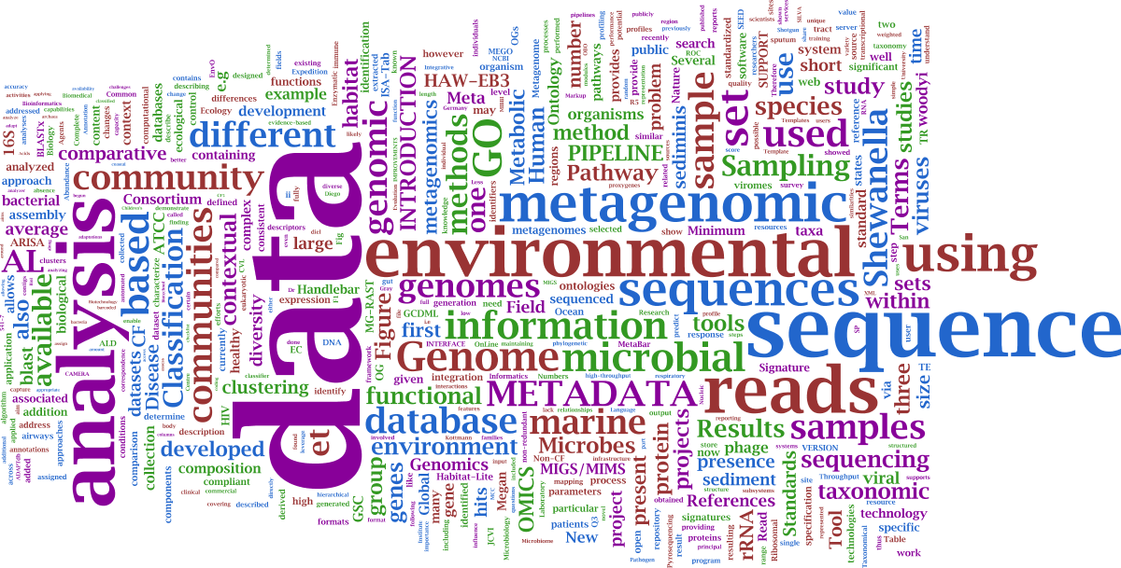

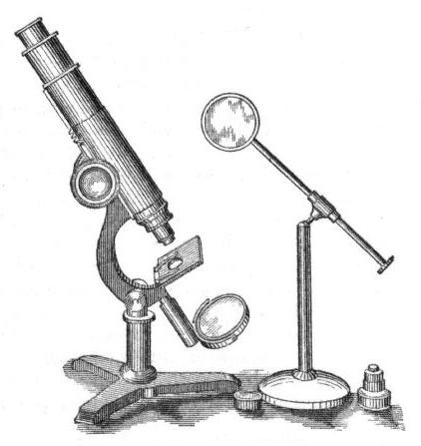
Hypothesis testing vs. hypothesis discovery?
?
Hypothesis
Method
Data
Tools

Slide 23
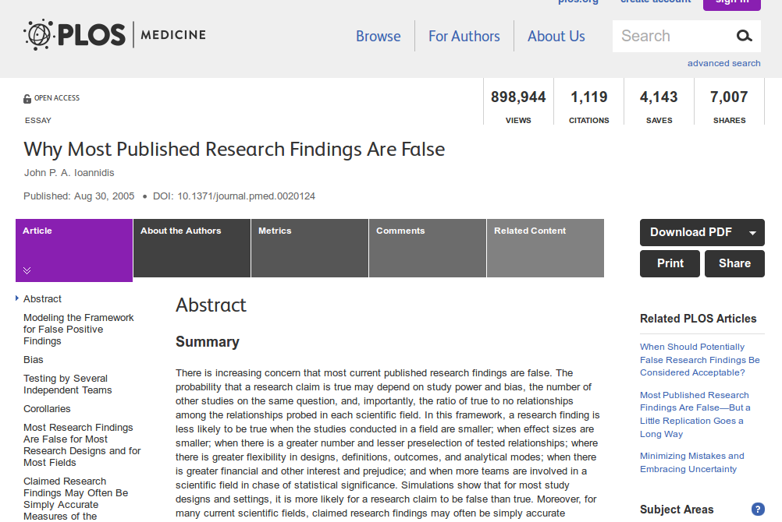
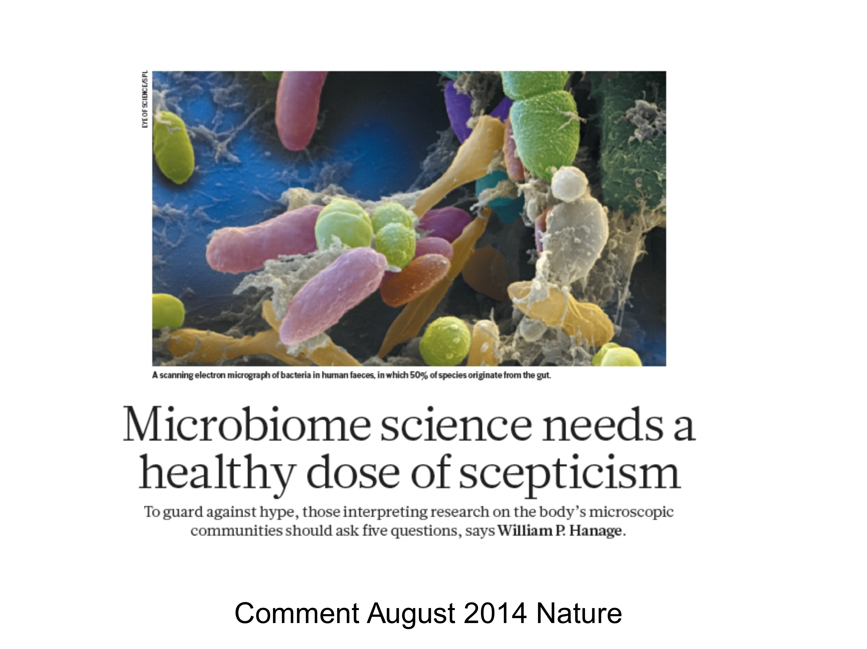
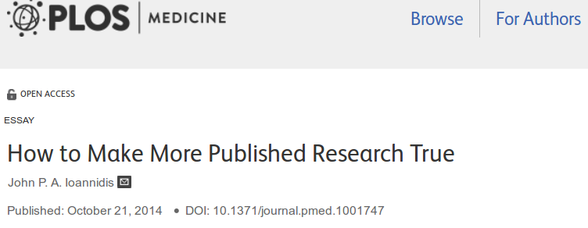
<number>/36

Slide 24
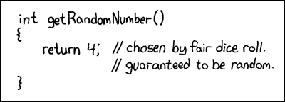
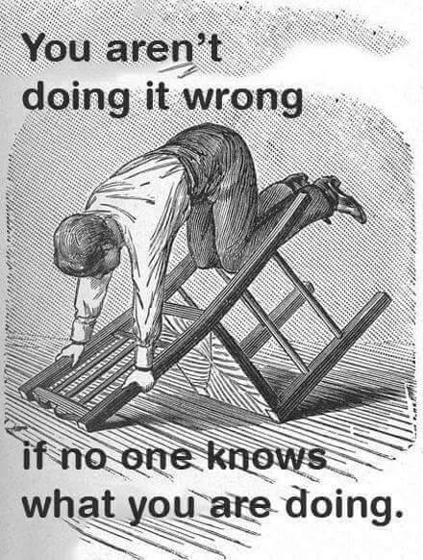
http://web.stanford.edu/class/cs109l/unrestricted/images/
<number> / 36

Slide 25
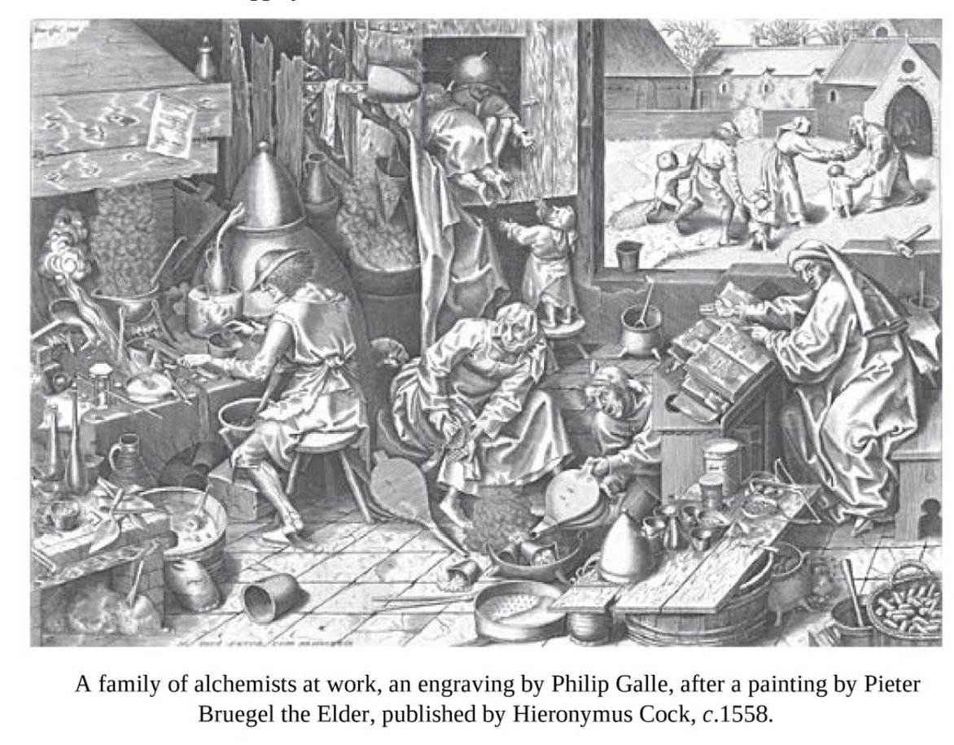
The demise of alchemy provides further evidence, if further evidence were needed, that what marks out modern science is not the conduct of experiments (alchemists conducted plenty of experiments), but the formation of a critical community capable of assessing discoveries and replicating results. Alchemy, as a clandestine enterprise, could never develop a community of the right sort. Popper was right to think that science can flourish only in an open society.
The Invention of Science: A New History of the Scientific Revolution, by David Wootton
<number> / 36

Slide 26

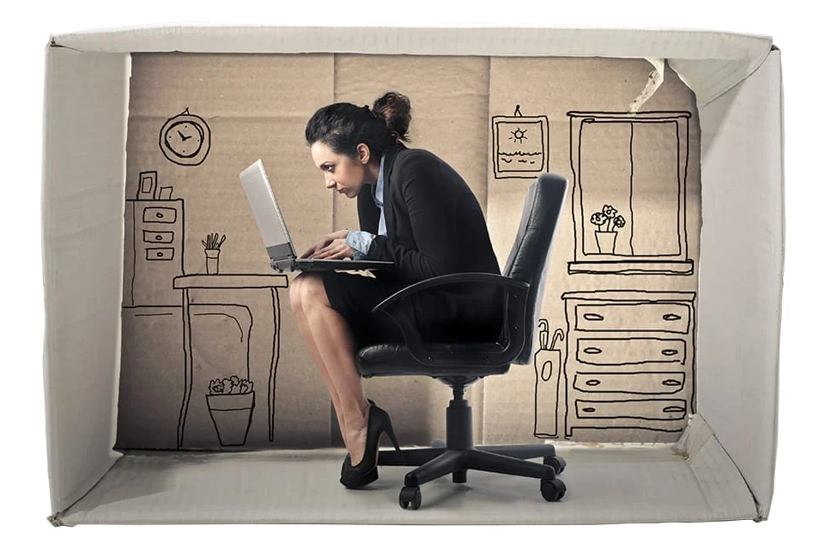
Data silo

Slide 28
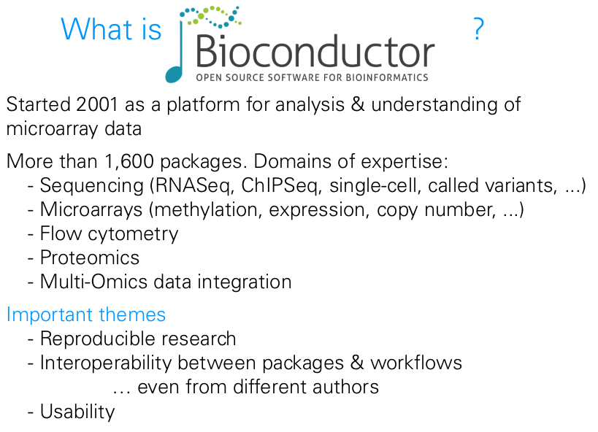
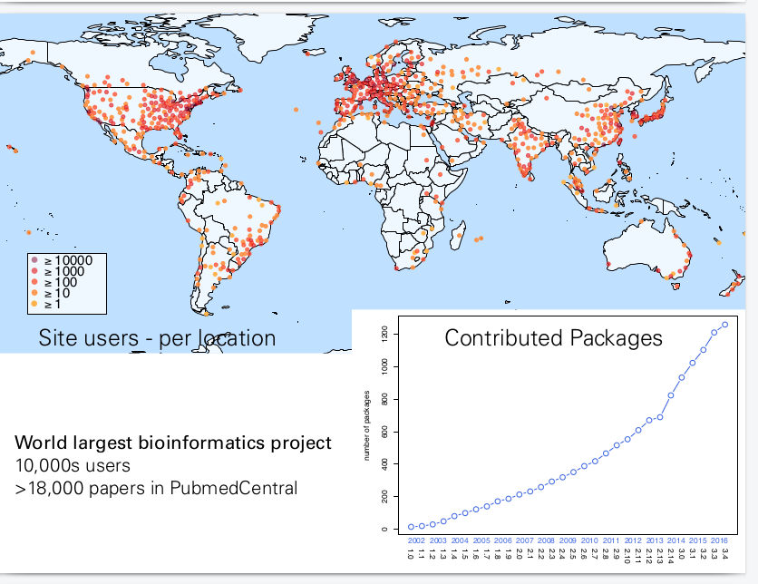
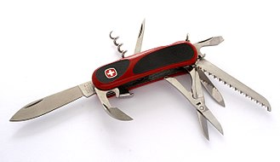
<number> / 36

Slide 29
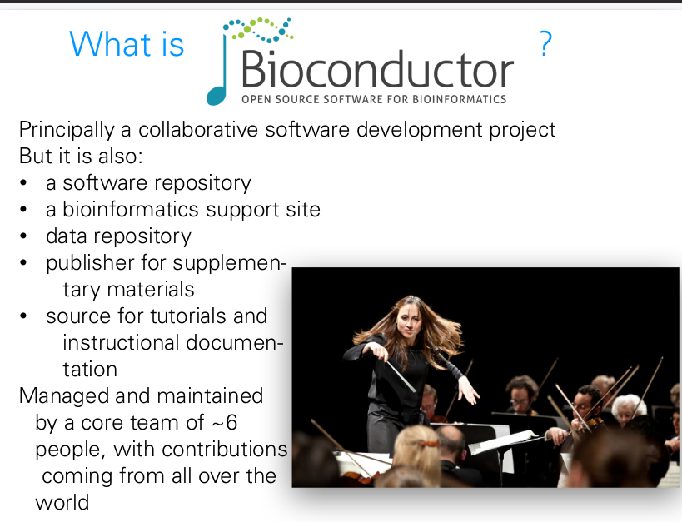

Slide 30
Pre- vs. post-publication review
Submission
Open, iterative
post-publication
review (experts,
public)
Initial
screen
(pre-publication review)
Immediate
publication
(citable versions)
“Final”
publication
<number>/36

Slide 31
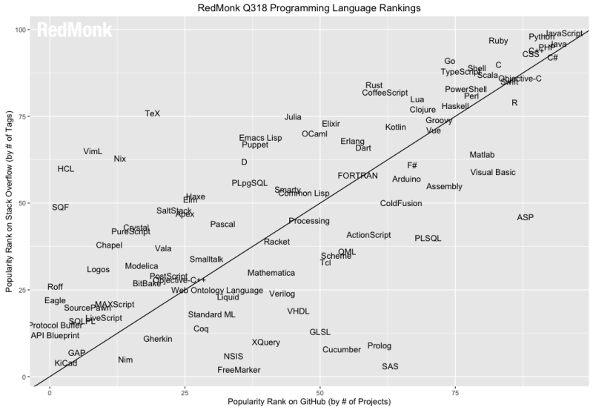
Varying cultures of open collaboration

Slide 32
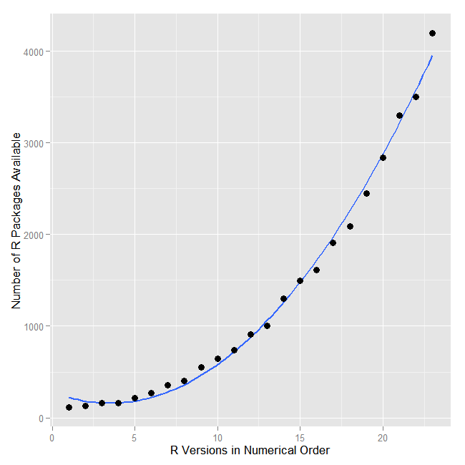





Number of open analysis tools has grown exponentially
Value of data can increase through sharing & use
<number>/36

Slide 33
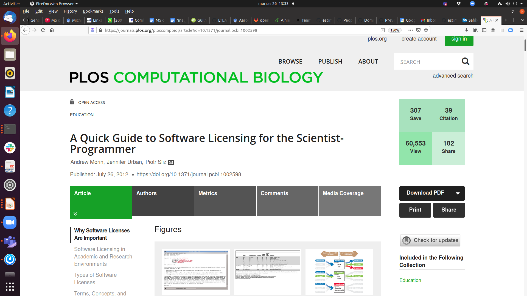
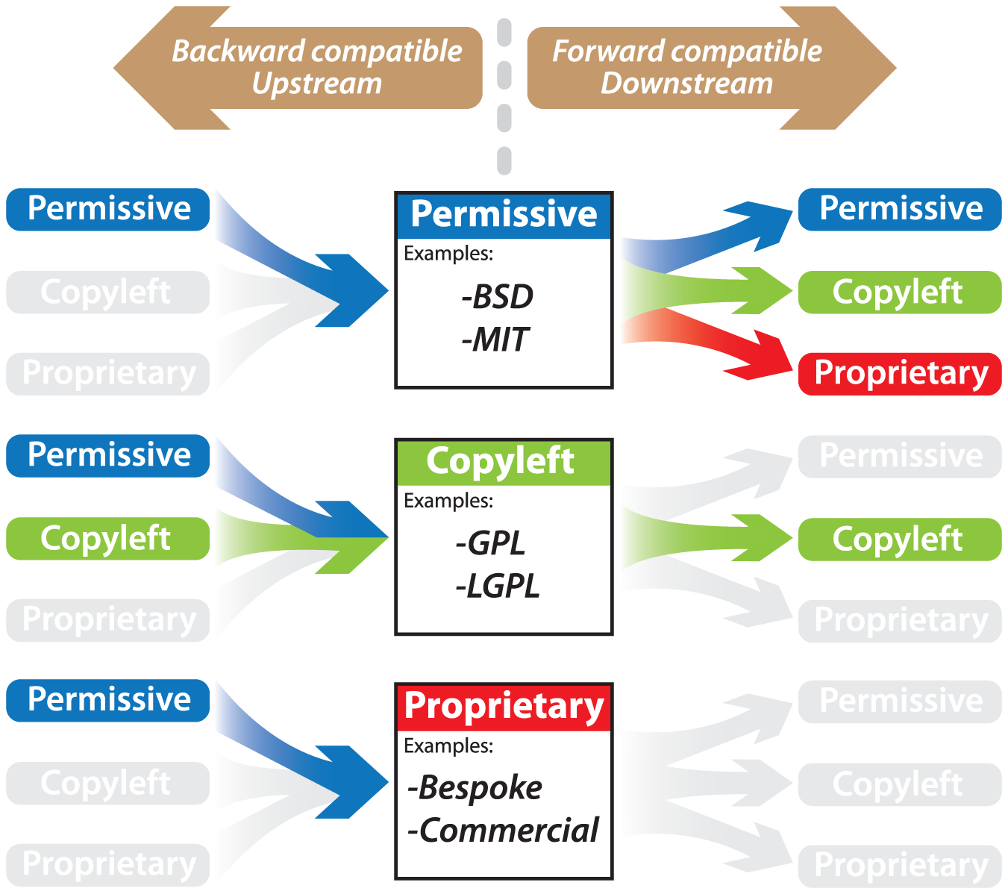
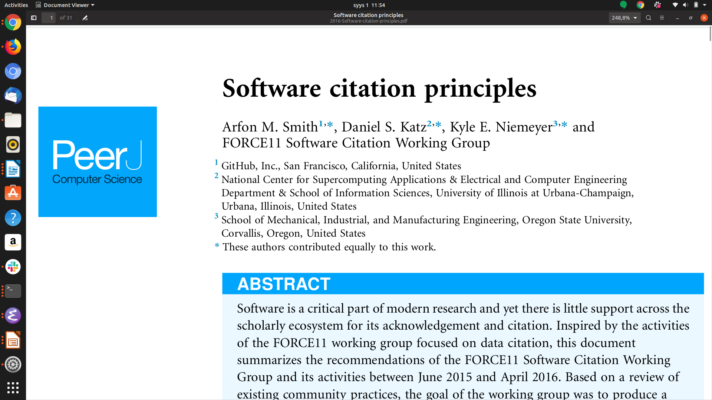
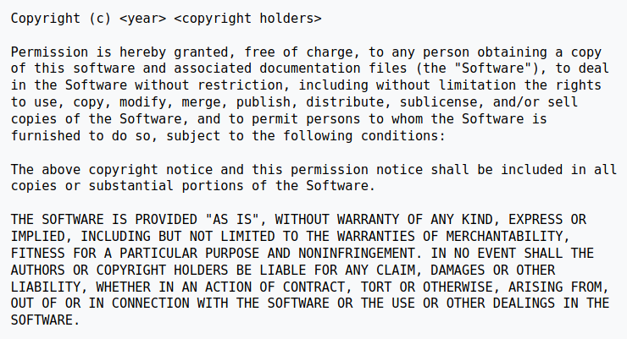
MIT License

Slide 34
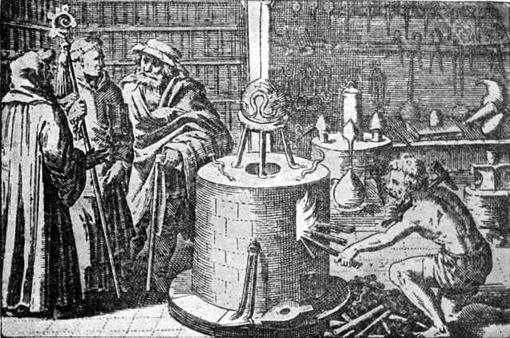
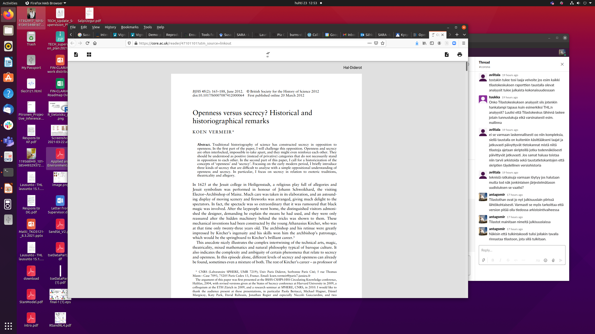
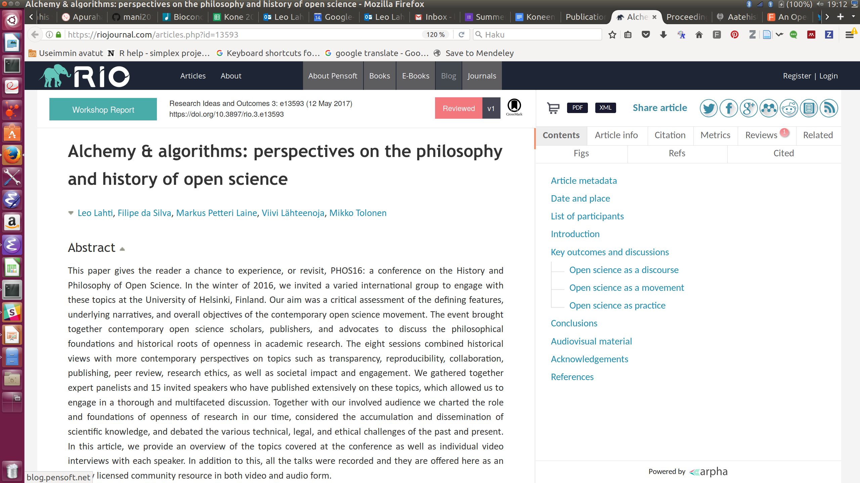
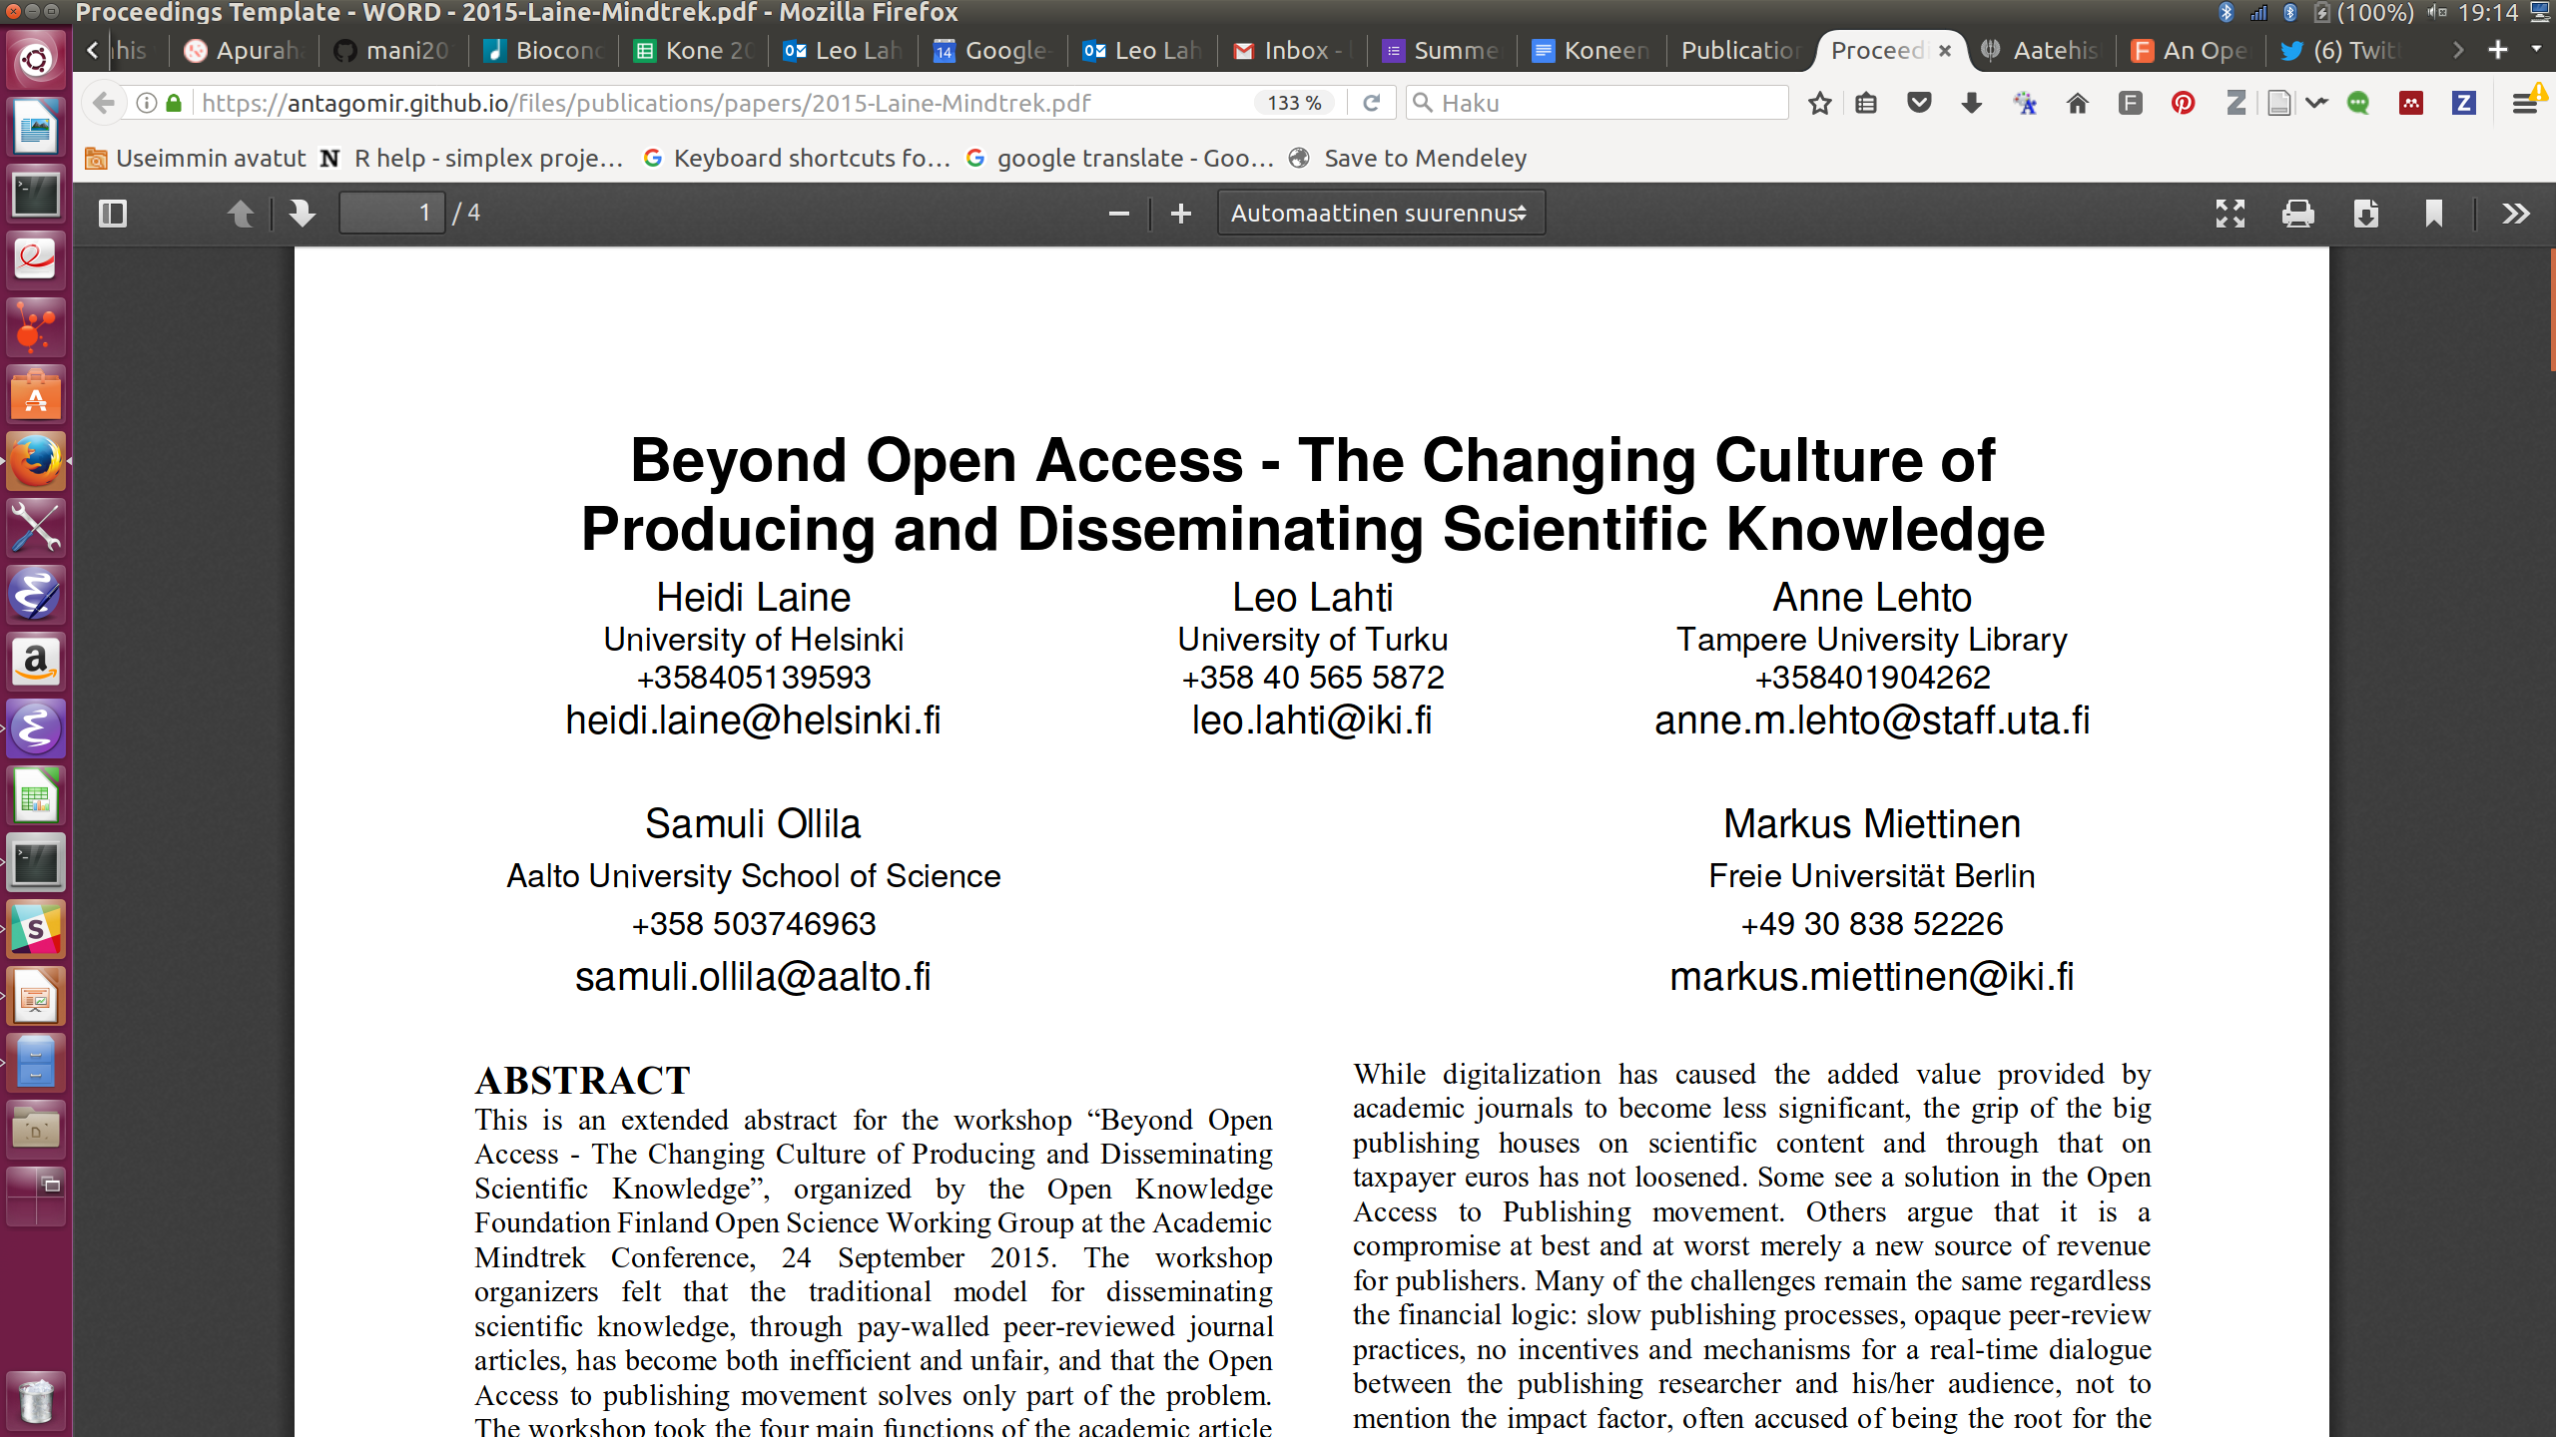
Open reporting and communication were part of academic culture since the early days
Source: Wikimedia Commons / Public domain
Research Ideas and Outcomes 3:e13593, 2017
<number>/36
Proceedings of the 19th International Academic Mindtrek Conference 2015. ACM New York, NY, USA. ISBN: 978-1-4503-3948-3

Slide 35
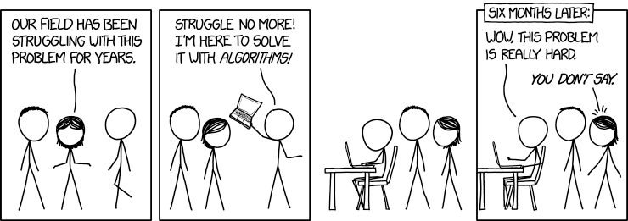

Slide 36
Task
Create a clear reproducible report of the example data, including the following aspects:
- Data import
- Data exploration & summaries
- Alpha diversity
- Beta diversity
- Differential abundance analysis
- Conclusions

