Slide 1
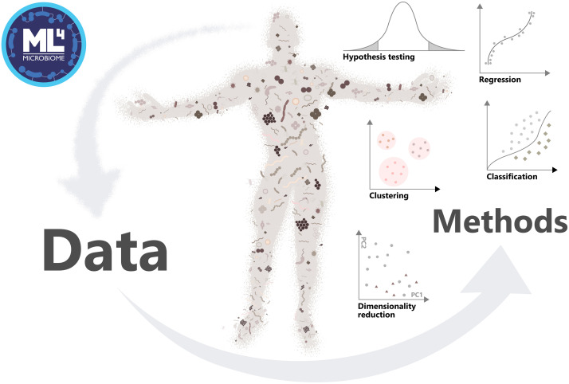

Microbiome data science
Figure source: Moreno-Indias et al. (2021) Statistical and Machine Learning Techniques in Human Microbiome Studies: Contemporary Challenges and Solutions. URL: https://doi.org/10.3389/fmicb.2021.635781. Frontiers in Microbiology 12:11.
Associate Prof. Leo Lahti | datascience.utu.fi
Department of Computing, University of Turku, Finland
@antagomir

Slide 2
Acknowledgments
Course organizers
- Mirjam Bloemendaal
Course assistants
- Henrik Eckermann
- Tuomas Borman
- Chouaib Benchraka
Miaverse collective
- Sudarshan Shetty
- Felix Ernst

Slide 3
Learning goals
Key concepts in microbiome bioinformatics
Common data science tools & best practices

Slide 4
Overview of the week
Key data analytical concepts
Intro to microbiome data science
Alpha diversity
Beta diversity
Differential abundance analysis (Henrik)
Conclusion
Course work presentations

Slide 5
Monday: from raw sequences to ecological data analysis
Lectures (by Tom)
Microbiota analysis: association studies vs. causality; microbiota sequencing methods (16S, shotgun, metagenomics)
DNA isolation and 16S rRNA gene sequencing: from raw sequences to OTU table in a biom file
Getting started
Prerequisities
Data generation and import
Open science methods
Practical
Importing microbiome data to R for interactive data analysis
Initializing reproducible report with Rmarkdown

Slide 6
Getting started
- Checklist
- R, R studio, R packages installation ok?
- additional reading
- online chat (Gitter & Slack)
- course assigment

Slide 7
Course assignment – case study options
Option 1 ADHD-associated changes in gut microbiota and brain in a mouse model
Option 2 Western diet intervention study in serotonin transporter modified mouse model
Mice received three weeks of Western (high fat, high sugar) or Control diet in three Genotype groups, a wild-type group and 2 groups with either partial or complete knock-out of the serotonin transporter (SERT), leading to an excess of serotonin in the gut, brain and blood circulation. Mice were measured before and after the intervention. In total there are three factors in this design, Time (pre-,post-intervention), Diet (Control, Western diet) and Genotype group (WT, HET, KO). There are about 6-8 mice per group.
Option 3 Open data set of your own choice, see e.g. Bioconductor ExperimentHub
microbiomeDataSets
curatedMetagenomicData

Slide 8
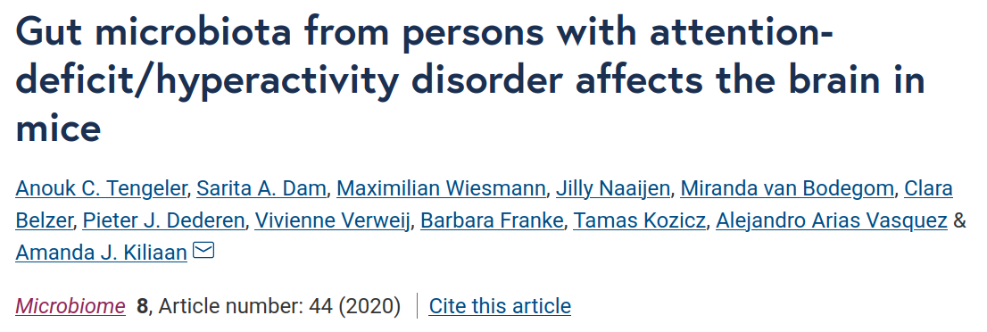
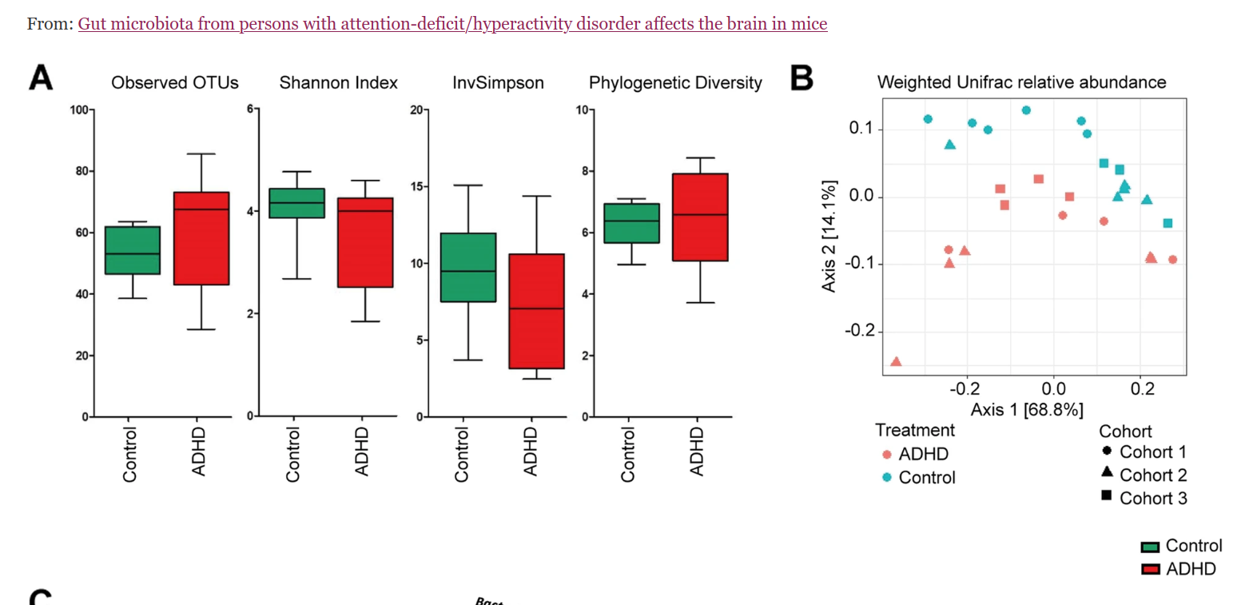

Slide 9
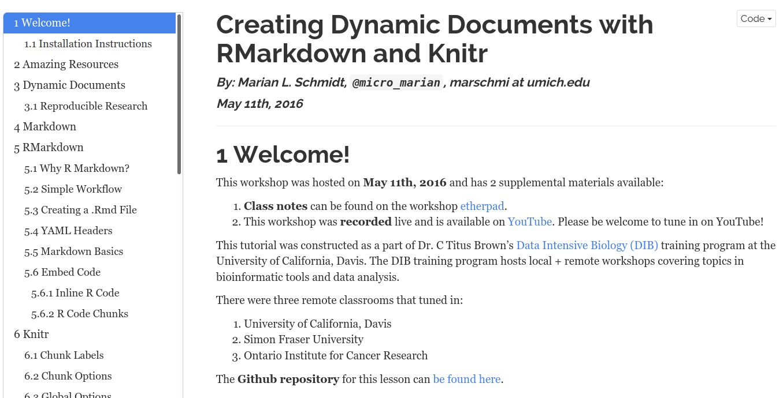
Initializing reproducible report
Task: create Rmarkdown document that imports the data

Slide 10
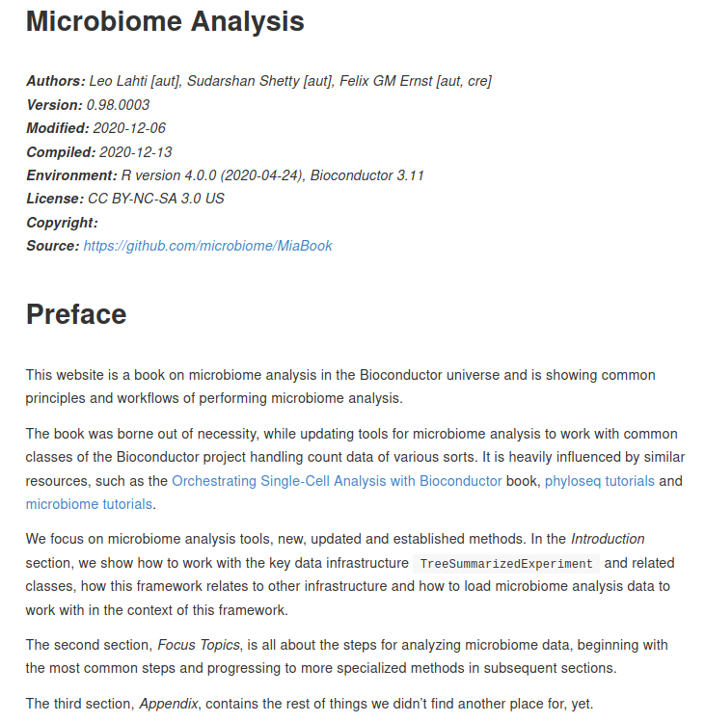
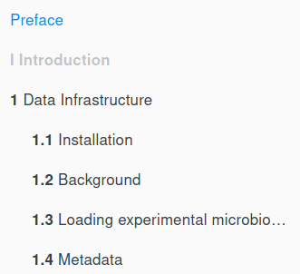
Orchestrating Microbiome Analysis with R and Bioconductor – online book: in progress
microbiome.github.io

Slide 11
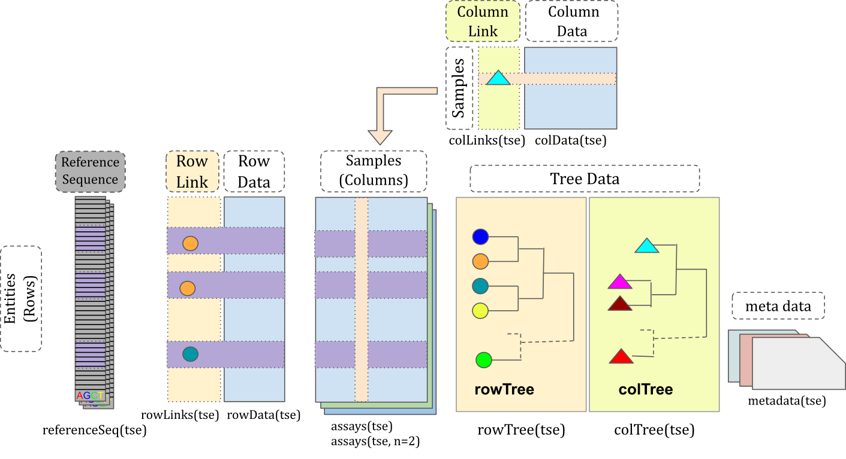
Importing microbiome data to R
Task: import biom data files for your chosen case study into a specific data container (structure) in R, TreeSummarizedExperiment (TSE) Huang et al. (2020). This provides the basis for downstream data analysis.

Slide 12
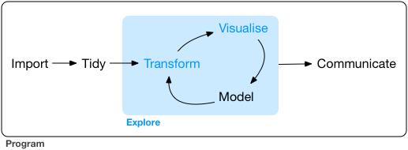
Data exploration
Task: see the online material
R for Data Science / H. Wickham

