Slide 1
Wrap-up & conclusions

Slide 2
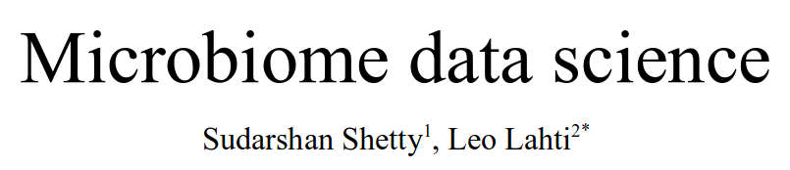
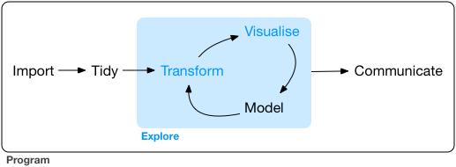
R for Data Science / H. Wickham
<number> / 9

Slide 3
Summary and reflection of the leaning objects

Slide 4
Other tools & environments (QIIME2, Anvi’o, ...)

Slide 5
Feedback?

Slide 6
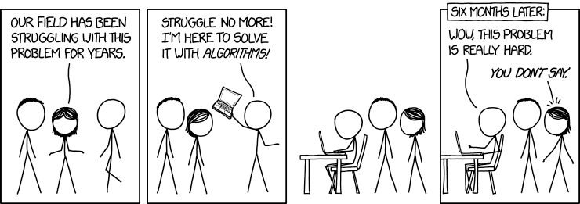
Microbiome data science
Microbiome Data Analysis workshop 2021

Slide 7
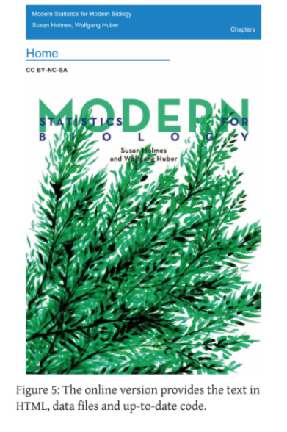
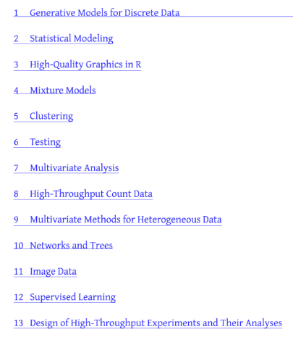

Slide 8
