Slide 1
Tabular data analysis
Leo Lahti

Slide 2
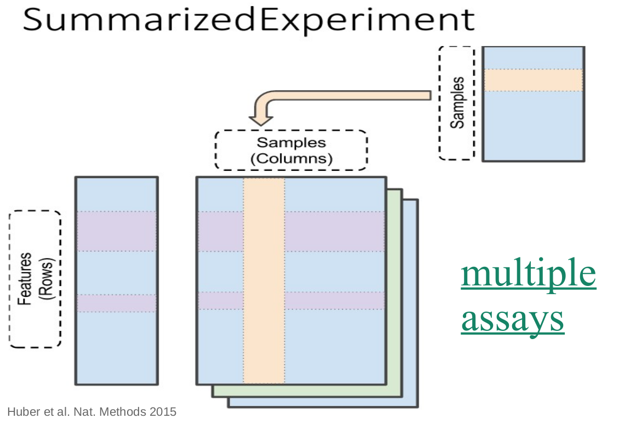
Recap of Day 1
Data: SummarizedExperiment: rowData, colData, assays
Methods: subsetting, transformations

Slide 3
Day 1: Basic data wrangling
reproducible data science workflow
data import
data containers
data manipulation (subsetting, transformations)
Today’s learning goals
Expanding multi-assay analyses: TreeSummarizedExperiment
augmenting the data (add diversities)
data agglomeration & alternative experiments
tree information: rowTree, colTree
Today’s program
Morning: data wrangling
Afternoon: data visualizations

Slide 4
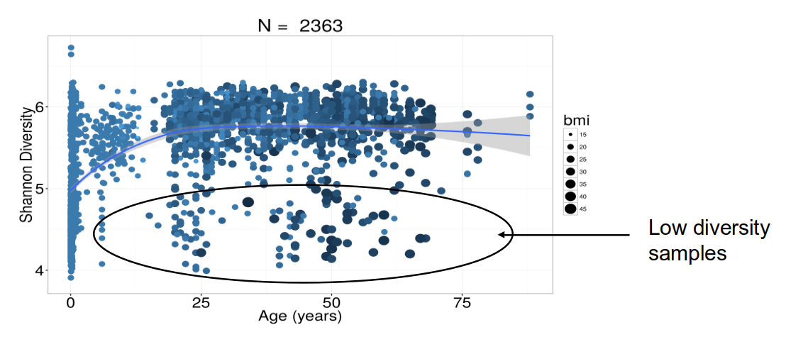
Data enrichment
Visualizing colData
Task: visualize the abundance of a specific microbial Species against the measurement Site
Alpha diversity task
Use the available tools to assess and visualize alpha diversity, and augment colData
Exercises 17.5.1-17.5.2
Add Shannon diversity in colData
Visualize diversity differences between sample groups
Alpha diversity & aging
Healthy & normal obese subjects.

Slide 5
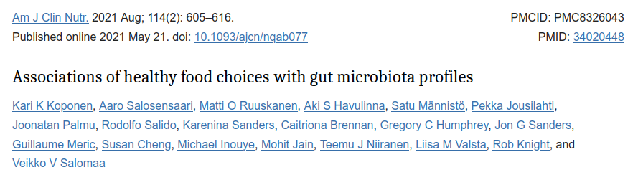
Alpha diversity and diet

Slide 6
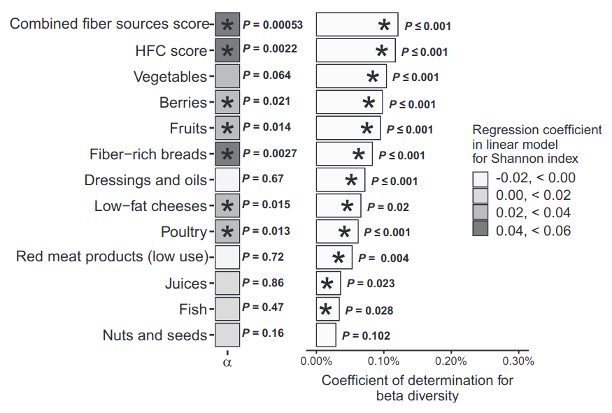

Slide 7
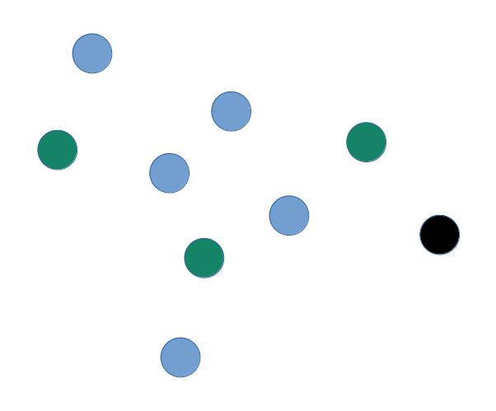
Alpha diversity
How many types?
Distribution of types?
Dominance of types?

Slide 8
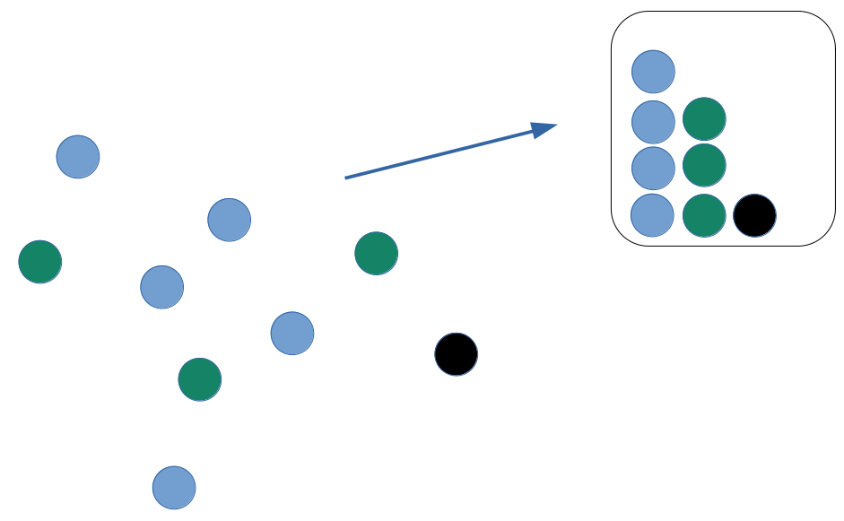
Alpha diversity
How many types?
Distribution of types?
Dominance of types?

Slide 9
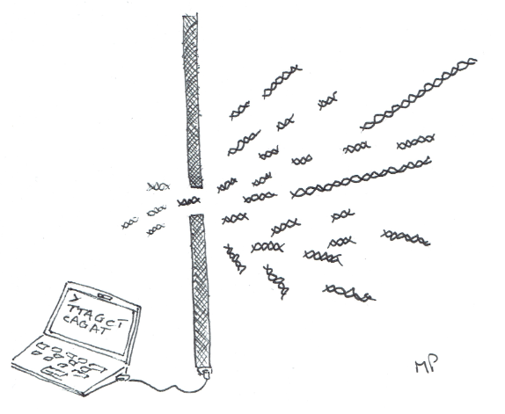
Alpha diversity indices
Richness
number of types
Eetimates of true richness based on finite sample sizes (Howard Sanders 1968); see e.g. Chao1
Evenness
distribution of sizes (even or uneven?)
Diversity
Combining richness & evenness
Dominance
Finite sampling
https://github.com/mblstamps/stamps2019/blob/master/STAMPS2019_overview_Pop.pdf

Slide 10
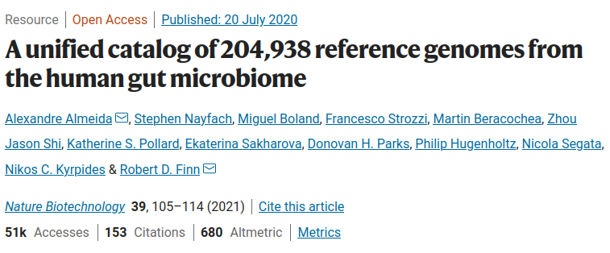

Slide 11
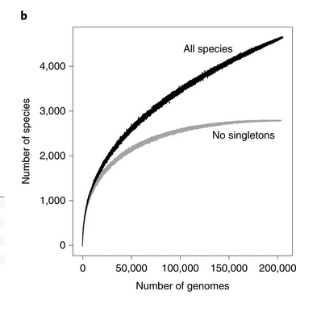
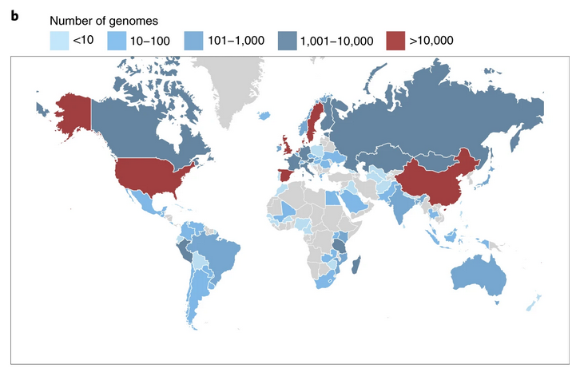

Slide 12
High-quality reference genomes are required for functional characterization and taxonomic assignment of the human gut microbiota.
Unified Human Gastrointestinal Genome (UHGG):
4,644 gut prokaryotes (>70% lack cultured representatives)
204,938 nonredundant genomes
Encode >170 million protein sequences, collated into Unified Human Gastrointestinal Protein (UHGP) catalog.
UHGP more than doubles the number of gut proteins in comparison to those present in the Integrated Gene Catalog.
40% of the UHGP lack functional annotations
Intraspecies genomic variation analyses revealed a large reservoir of accessory genes and single-nucleotide variants, many of which are specific to individual human populations.
The UHGG and UHGP collections enable studies linking genotypes to phenotypes in the human gut microbiome.
Estimating species content

Slide 13
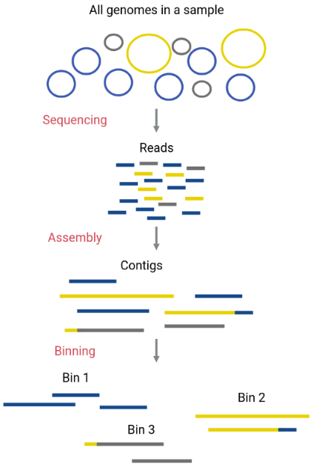
Copyright © Claudia Zirion, Diego Garfias, Vanessa Arellano, Aaron Jaime, Abel Lovaco, Daniel Díaz, Abraham Avelar, Nelly Sélem https://carpentries-incubator.github.io/metagenomics-workshop/)

Slide 15
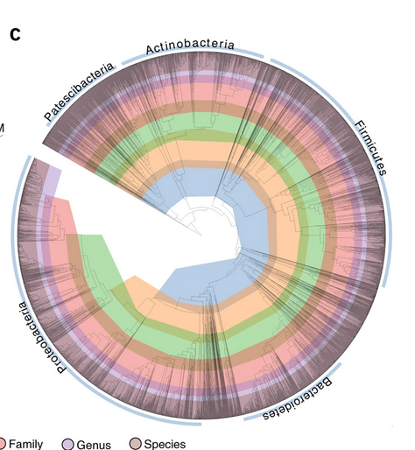
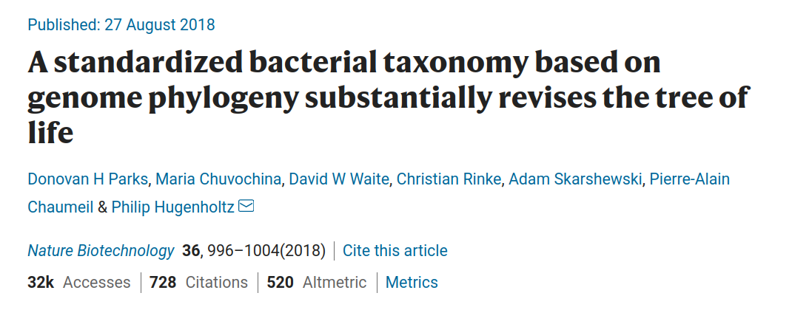

Slide 16
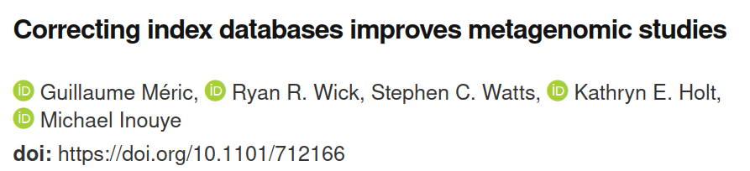

Slide 17
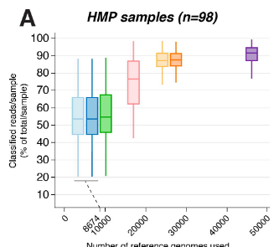
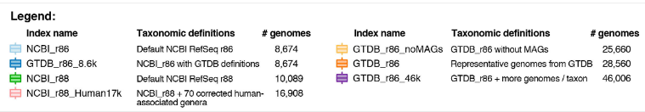

Slide 18
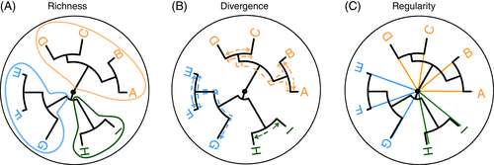
Common alpha diversity indices
Phylogenetically neutral diversities:
Richness (observed, Chao1, ACE)
Evenness (Pielou’s evenness)
Diversity (inverse Simpson, Shannon)
Phylogeny-aware diversities:
Faith diversity index
Phylogenetic diversity indices

Slide 19
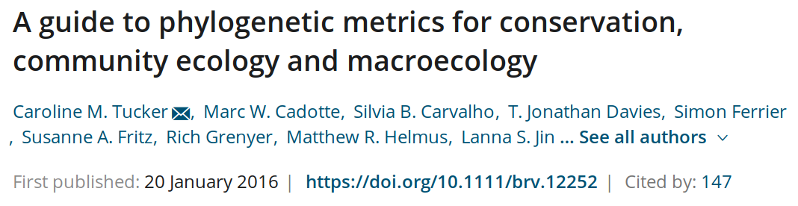

Slide 20
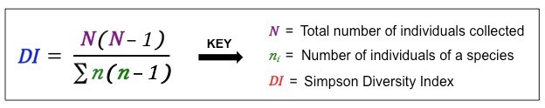
Inverse Simpson

Slide 21
How likely it is to pick two members of the same species at random?

Slide 22
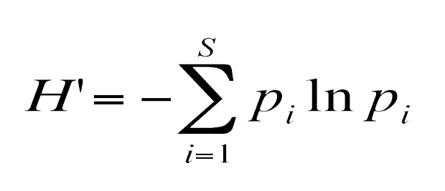
Inverse Simpson
Beware the variants:
Simpson ($λ$)
reciprocal Simpson ($1−λ$)
inverse Simpson ($\frac{1}{λ}$)
Shannon diversity
Shannon Index:

Slide 23
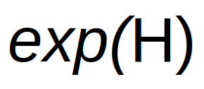
True Richness:

Slide 24
True diversity, or the effective number of types, refers to the number of equally abundant types needed for the average proportional abundance of the types to equal what is observed in the dataset of interest.
Evenness
H / ln(S)
H: Shannon diversity
S: Species richness
Hill’s Diversity as a unifying concept
Hill’s alpha diversities
R: richness (number of distinct types)
pi: proportion of type I
Order of diversity:
q = 0 : Species Richness
q = 1 : Shannon diversity
q = 2 : (Inverse) Simpson diversity
q ≠ 1 : Renyi entropy
Hill’s Diversity as a unifying concept

Slide 25
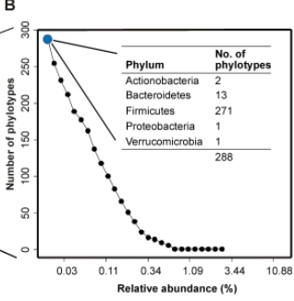
Hill’s alpha diversities
Richness
inverse Simpson
Shannon

Slide 26
Data wrangling
Option | Rows (features) | Cols (samples) | Recommendation
assays | match | match | Data transformations
altExp | free | match | Alternative experiments
MultiAssay | free | free (mapping) | Multi-omic experiments
Basic data operations
Transform
Subset
Merge
Aggregate
Split
Subsetting
Load example data set:
library(mia) data(GlobalPatterns) tse <- GlobalPatterns
Check dimension:
dim(tse)
[1] 19216 26
Check dimension for a subset:
dim(tse[1:10, 1:3])
[1] 10 3
Transformations
Presence/absence
Compositional (percentages)
$Log_{10}$
CLR and other Aitchison transformations
Phylogenetic transformations (e.g. philr)
Custom transformations
Transformations
Task: Alternative assays
visualize transformed data; histograms, boxplots
compare different transformations (scatterplot?)
Agglomeration
taxonomic units
TreeSE objects
Agglomeration
Agglomerate microbiota data to higher taxonomic levels:
chapter 6.3
agglomerateByRank
compare diversity or prevalent features between levels
Alternative experiments
Alternative assays vs. alternative experiments?
Store agglomerated data: altExp
Do all levels at once: splitByRanks
Splits
Splitting by:
taxonomic units
sample or feature groups
Taxonomic ranks & altExp
The alternative experiments (altExp) mechanism allows us to include multiple abundance tables at different taxonomic levels.

Slide 27
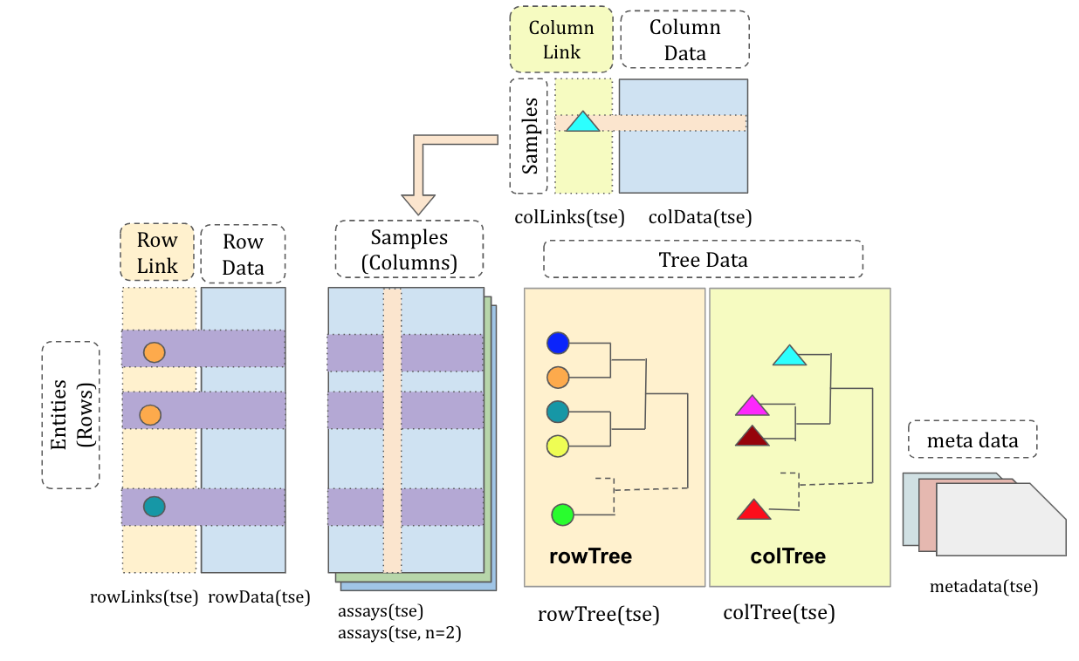
Alternative experiments and assays?
Pick clr assay from Genus-level data table?
Compare Shannon diversity from Genus and Species levels?
TreeSummarizedExperiment
Huang et al. F1000, 2021

Slide 28
Visualization
Ordination
Visualize example data with PCoA using Bray-Curtis dissimilarity
Visualize example data with PCA using Aitchison distance (CLR + Euclid)
Heatmaps
Visualize abundance variation for selected taxa on a heatmap
Trees
Visualize phylogenetic tree using the examples

