Slide 1
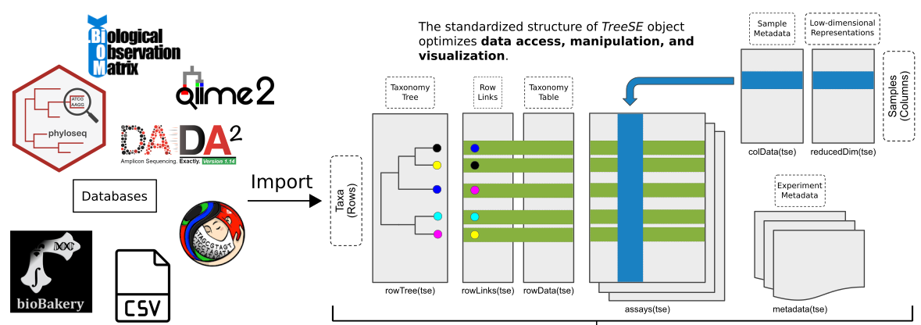
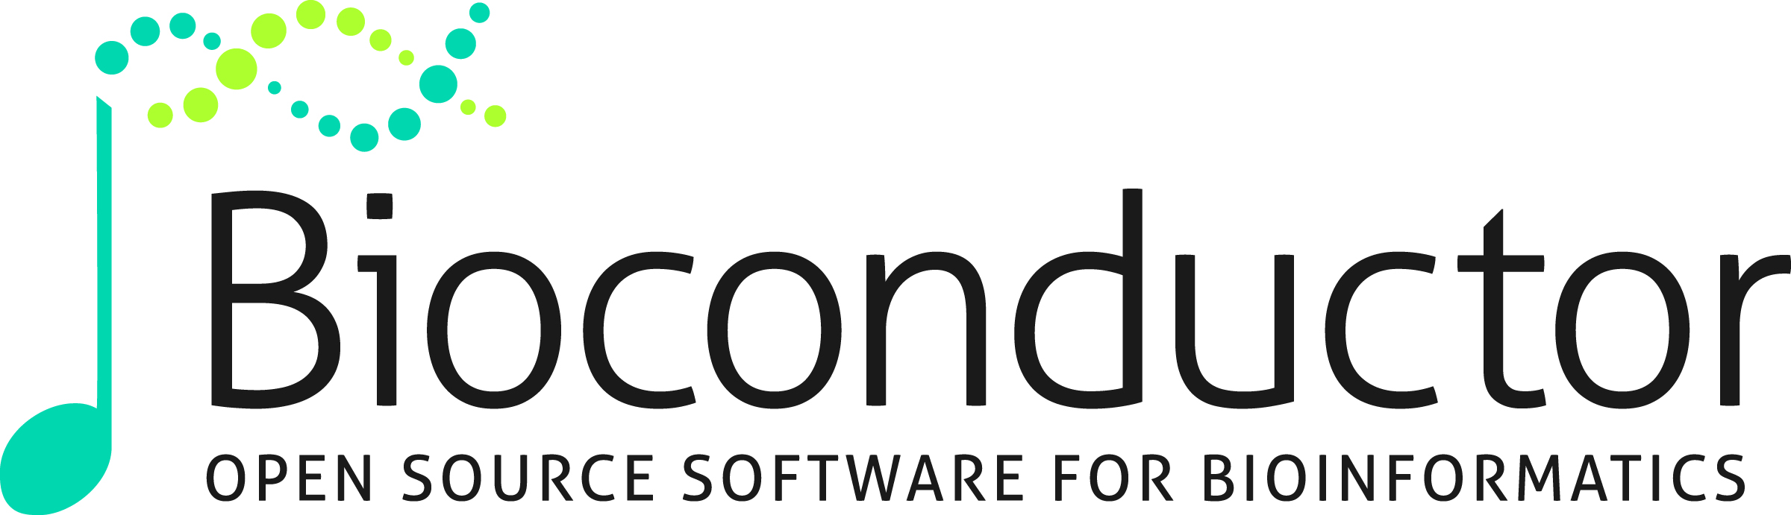
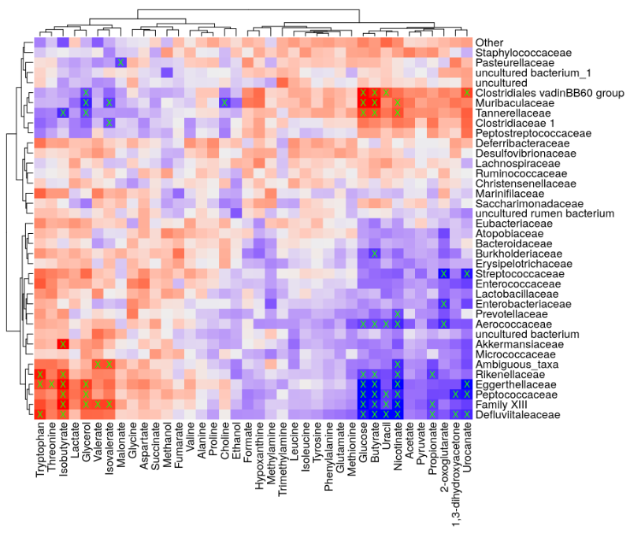
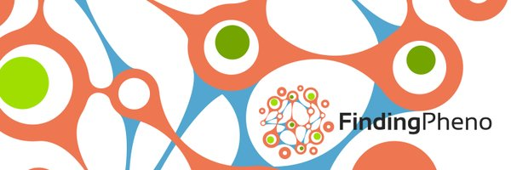
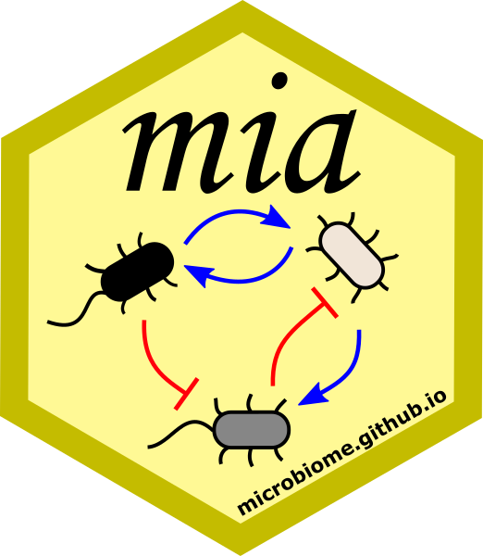
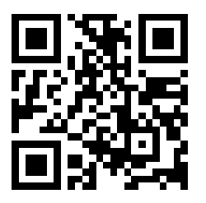

Statistical programming framework for multi-modal microbiome data integration
Leo Lahti, Tuomas Borman & mia collective
Coordinated by: Department of Computing, University of Turku, Finland
The need to integrate multiple assays and data modalities (e.g. omics) keeps increasing but systematic frameworks for jointly analysing heterogeneous data modalities remain limited.
Bioconductor has a long track record in distributing quality-controlled solutions for statistical programming in many fields of omics and bridging the gap between them.
A dedicated data science framework, miaverse, has recently emerged to streamline hierarchical, multi-modal data analyses in microbiome research.
Community-driven development is supported by optimized multi-assay data containers and open data resources from e.g. curatedMetagenomicData, MGnify & ExperimentHub.
Open online resources showcase integrative & optimized microbiome data science workflows based on the new framework.
microbiome.github.io/OMA
This project has received funding from the European Union’s Horizon 2020 research and innovation programme under grant agreement No 952914

