Slide 1
Four Switch Buck Boost Development Board
Franz Thalheimer/MCU16 Apps
Sept. 2020

Slide 2
High Level dsPIC33CK Firmware

Slide 3
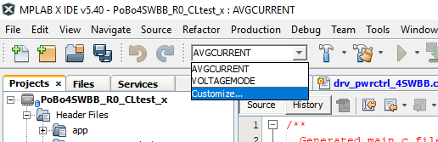
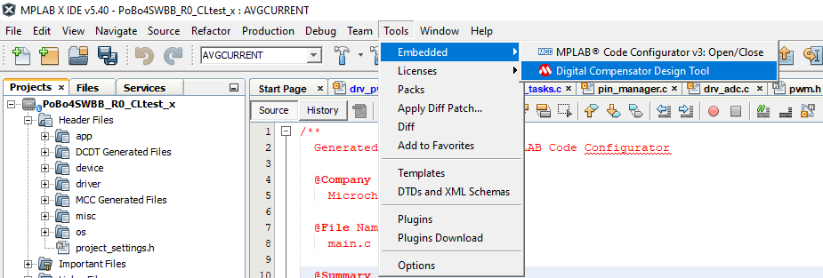
dsPIC33CK Software Project
The demo project has 2 compile options for different conrol mode.
AVGCURRENTMODE runs the power stage with two control loops. An inner loop average current controler (2p2z) and an outer loop voltage controller (2p2z).
VOLTAGEMODE runs an voltage controller only (3p3z).
The control loops are designed with the Digital Compensator Design Tool and the settings can be found in the project Under Tool/Embedded/Digital Comensator Design Tool. That tool is available as an MPLABX plugin.

Slide 4
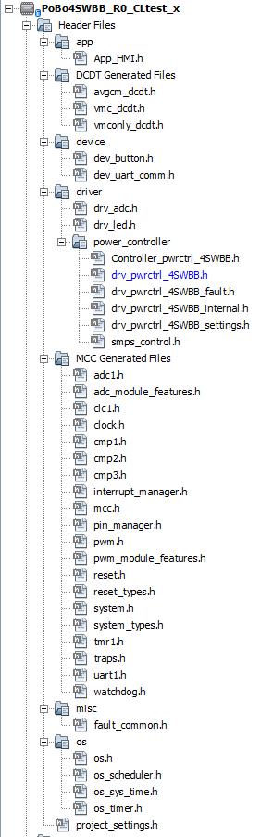
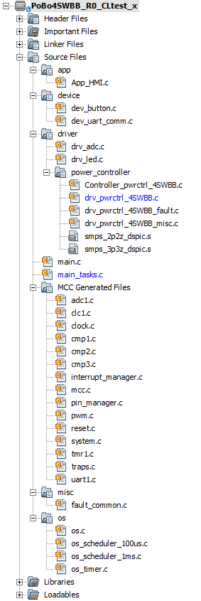
dsPIC33CK Software Project
handles button inputs and controls the LEDs
device driver for button handling
device driver for send and receive data via UART interface
ADC measurements handle as Interrupt Service Routine
driver for various LED functions
driver to initialize the controllers for the 2 control modes
power controller including State Machine, Control Loop handling and initialization of PWM and controller
fault Handler including initialization and check the fault options
power controller additional functions for the State Machine
controller library assembly files
main file with initializations
scheduler tasks
peripheral initializations based on MCC with MCC additional API‘s
fault handler common functions
scheduler initializations
scheduler 100us ticker based on T1 ISR with derivated ms tickers
not used because timer is initialized by MCC

Slide 5
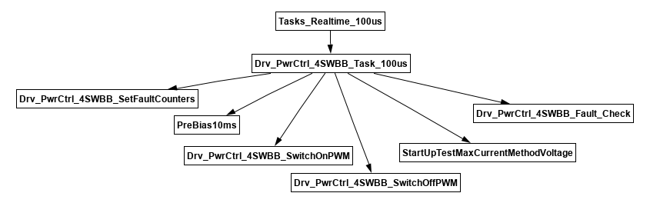
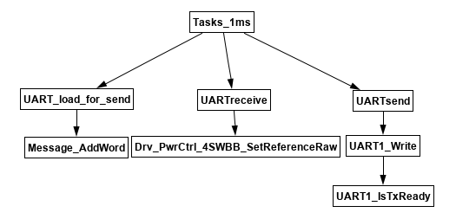
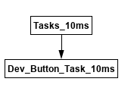
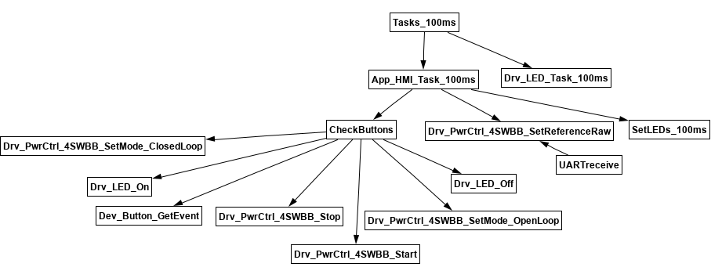
Scheduler Tasks

Slide 6
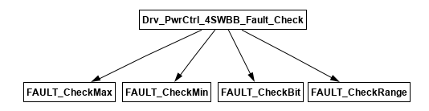
Fault Handler

Slide 7
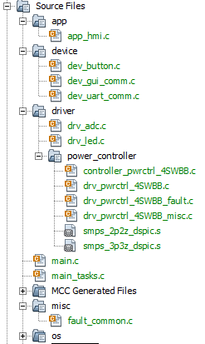
Source File(s) structure

Slide 8
Human Machine Interface
LD100 slow blinking Wait for SW2 short pressed to initialize and startup Powersupply
LD100 permanent On Powersupply is up and running
LD101 permanent Off Powersupply is running in Closed Loop mode
LD101 slow blinking Powersupply is running in Open Loop mode
LD101 permanent On Fault happened
Before power up the 4 switch buck boost power board please be sure a Digital Power Plug In Module (DP-PIM) is added. Either you preprogramm the DP-PIM or run in debug mode with any kind of Microchip In Circuit Debugger.
After power up the first check is the red LED LD2 on DP-PIM. If dsPIC33 software is running LD2 is blinking slow.
On the power board green LED LD100 and red LED LD101 are slow blinking.
Slow blinking green LED indicates waiting on short pressing SW2 to start initialization and start run of the Powersupply.
If SW2 is pressed and Powersupply is running then green LED is permament on.
Pressing SW2 again switches off Powersupply and green LED is blinking slow. With that SW2 short press switches ON/OFF the Powersupply
A slow blinking red LED indicates the Powersupply is running in Open Loop.
If Powersupply is in run mode and pressing SW2 long, then the control mode is changed from Open Loop to Closed Loop. Pressing SW2 long again changes control mode.

Slide 9
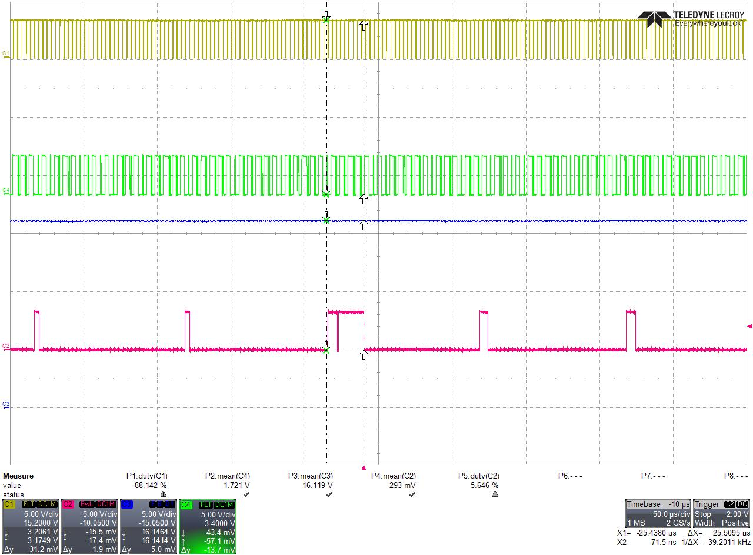
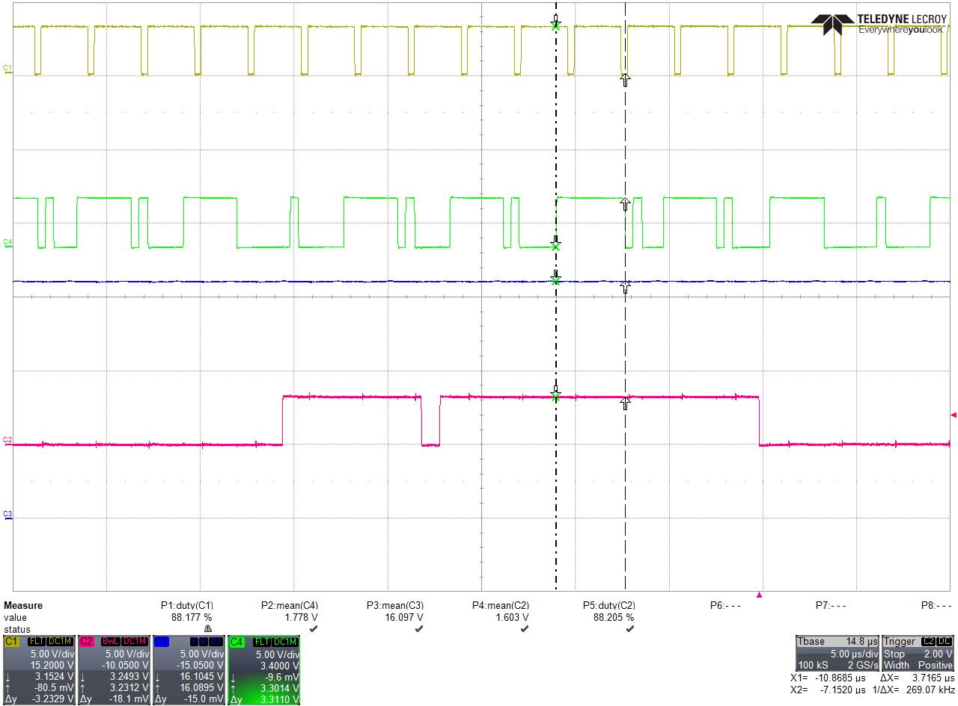
Timing / Workload
PWM_BUCK_H
ANCAN0-ISR
+VOUT
Scheduler tasks (100us+1ms+10ms+100ms)
94us inactive
Scheduler Tasks Workload:
25.5us active, 94us inactive → 25.5/(25.5 + 94) = 21%
But that is interrupted by high priority ISR
ADCAN0 ISR Workload:
3.7us+0.5us active, 0.4us+1.1us inactive → 4.2/(4.2 + 1.5) = 74%
Worst case with both loops and in Boost mode

Slide 10
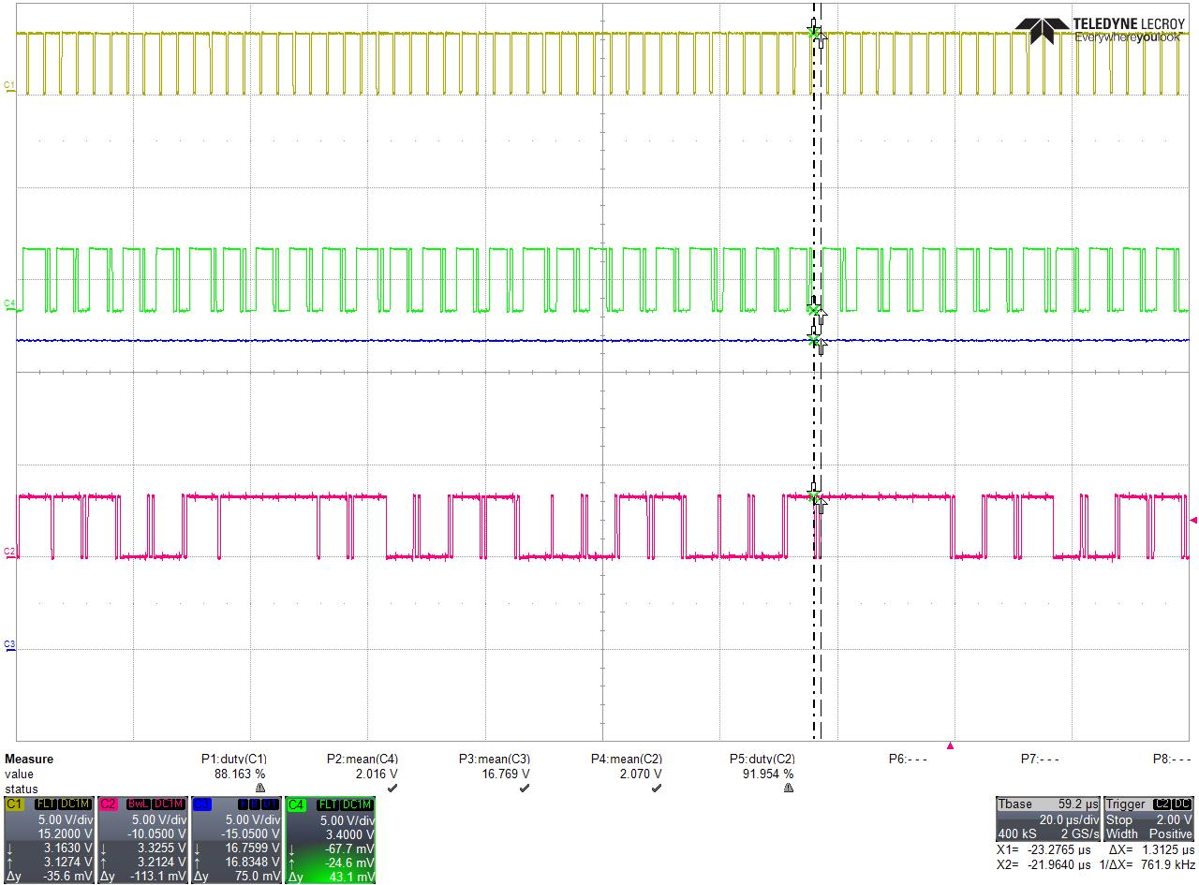
Timing / Workload
Background Tasks free Workload:
1.31us * 28 / 200us = 18.3% free → whole workload is 81.7%
Worst case in Boost mode
PWM_BUCK_H
ANCAN0-ISR
+VOUT
Background Task (toggle)

Slide 11
Additional Documents
Iin/Vin Feedforward
Startup I AVG Current Mode
Startup II AVG Current Mode
Startup III AVG Current Mode
Board Test
Control Loop Measurment
Plant Vout
Plant Iin
Misc.

Slide 12
Iin/Vin Feedforward
Vin | Iin at 25W | Iin / digit | Vin/digit | m | m*3 | b
8 | 3.125 | 2377.852 | 1241.212 | -0.65278 | -1.95833 | 3188.091
10 | 2.5 | 2013.246 | 1551.515 |  |  | 3026.044
12 | 2.083333 | 1770.175 | 1861.818 |  |  | 2985.533
14 | 1.785714 | 1596.553 | 2172.121 |  |  | 3014.471
16 | 1.5625 | 1466.337 | 2482.424 |  |  | 3086.814
18 | 1.388889 | 1365.058 | 2792.727 |  |  | 3188.094
 | y=mx+b
 | Iin=-0.66*Vin+3200
 | 3*Iin=9600-2*Vin

Slide 13
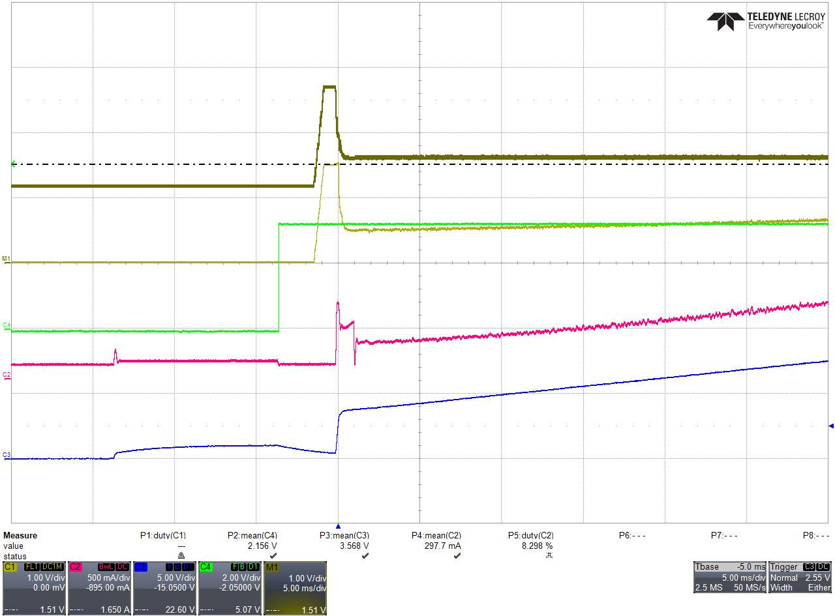
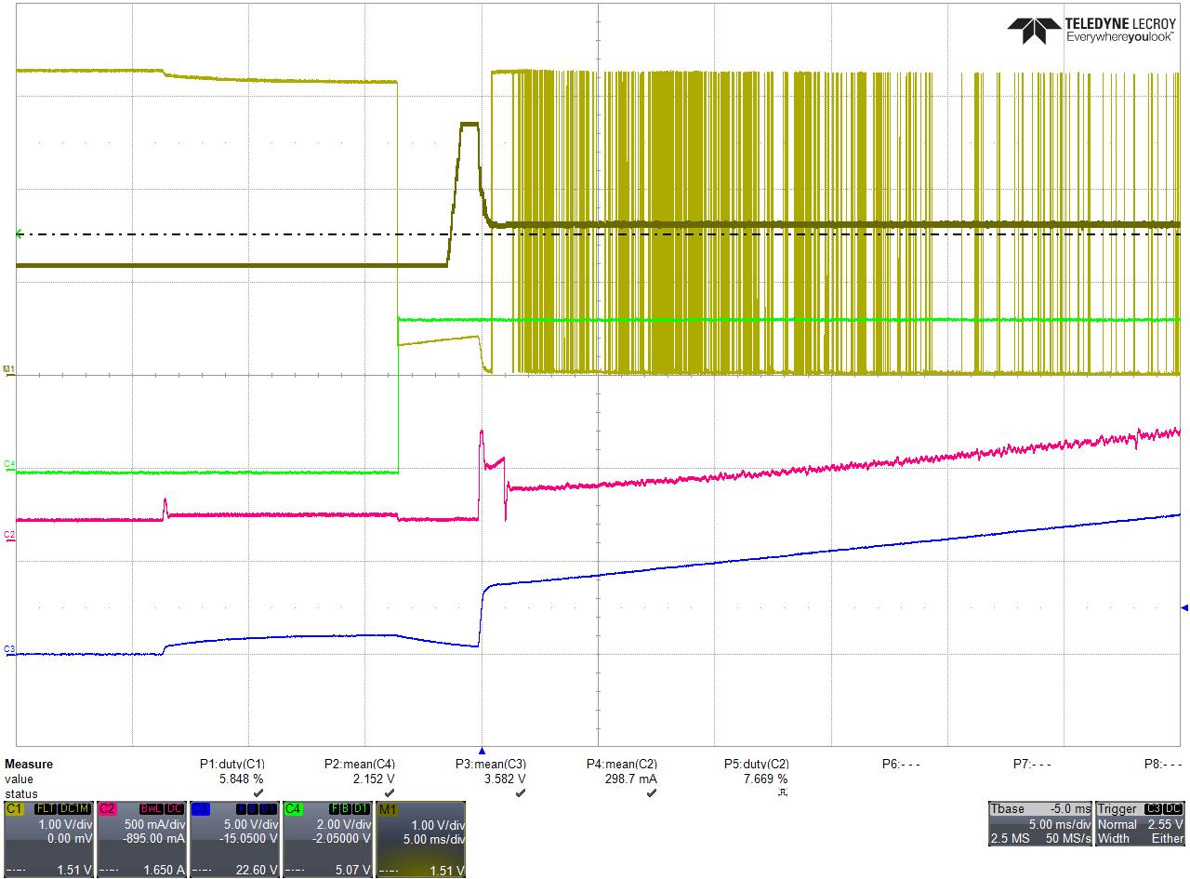
Startup I in Closed Loop
Vref-Vout
Iref-Iin (+2048)
Iref-Iin (+2048)
IACref
Softstart Start
Iin (Current Probe)
+VOUT
Ph 1
Ph 2
Ph 1: after switch on there is a pre-biasing for 10ms.
Ph2: DCmin is now set to 0. That is the reason why Vout goes down because we have Iref = 0 which leads to DC=0.
Controller Init with clear history at state Power_On_Delay before Prebias.

Slide 14
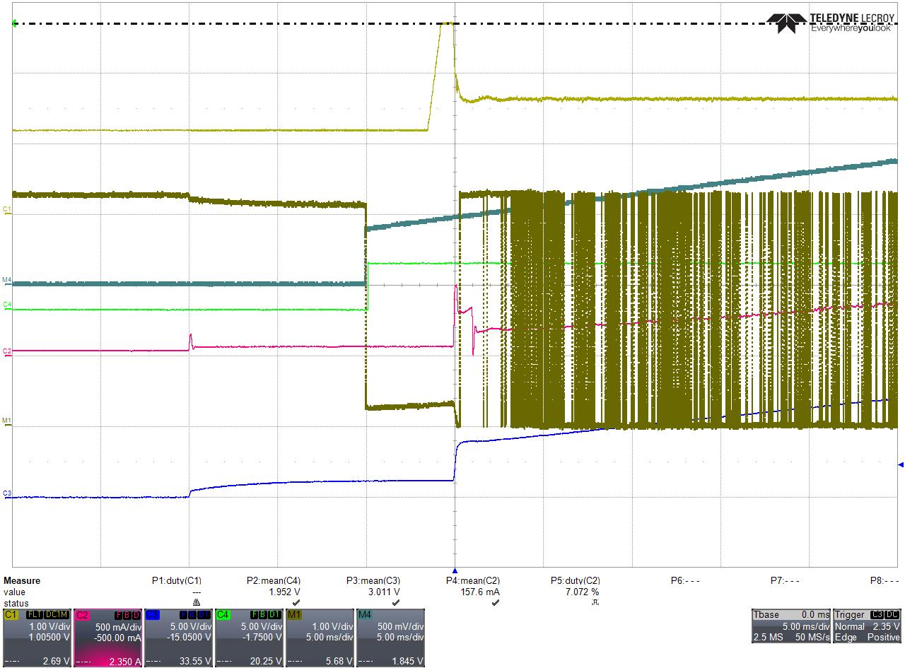
Startup II in Closed Loop
Ph 1: PreBias
after switch on there is a pre-biasung for 10ms.
buck switches run synchronous. boost switches run asynchronous (hifh side off, body diode).
Voutref is set to 0V → PWM‘s run with min. DC (200ns).
Controll loops are running, no open loop phase.
Ph2: begin of SoftStart
Voutref is set to 3.3V. Iinref is set depending on Vin and 25W.
with 12V Vin Iinref is calculated to 2.3A.
voltage controller starts working and needs some time to get an output value. this is the delay until an Iref for the current controller is > 0.
Ph3:
Iref for current controller starts rising from 0.
current controller need some time until DC goes high and Vout starts rising.
Controller Init with clear history at state Power_On_Delay before Prebias.
That leads to the delay in Ph2 + Ph3.
Controller Init with clear history after Prebias, begin of SoftStart looks different and removes delay from Ph2/3.
Vref - Vout
Ph 3
Ph 1
Ph 2

Slide 15
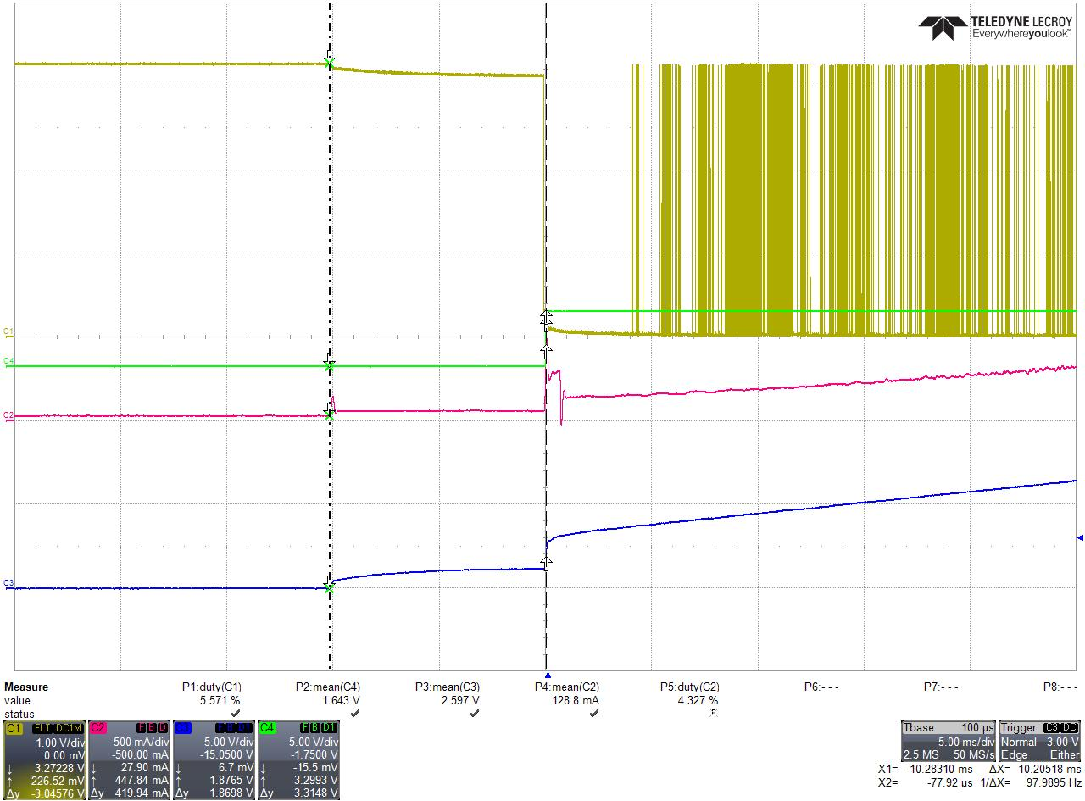
Startup III in Closed Loop
Ph 1: PreBias
after switch on there is a pre-biasung for 10ms.
buck switches run synchronous. boost switches run asynchronous (hifh side off, body diode).
Voutref is set to 0V → PWM‘s run with min. DC (200ns).
Controll loops are running, no open loop phase.
Controller Init with clear history after Prebias, begin of SoftStart. (compare to previous pages).
DCmin for Buck is set to 0 after Prebias.
Vref-Vout goes to 0 and does not stay at a postive value for Ph2/3 at previous plots.
Vref-Vout

Slide 16


Startup Ramp
set the ramp speed to xx ms; called once at initialization;
calculate the ramp value based on actual start value and end value;
called and calculated before every PCS_SOFT_START;
$$rampspeed_value=\frac{\left(VoutRef−VoutStart\right)≪4}{rampspeed_ms∗10}$$
(multiply by 16 for resolution)
(multiply by 10 because of 100us task)
called in PCS_SOFTSTART as softstart ramp;
if power controller is running and a change in Vout reference happens then the rampspeed_value is fixed set to RUNNING_RAMP_SPEED;

Slide 17
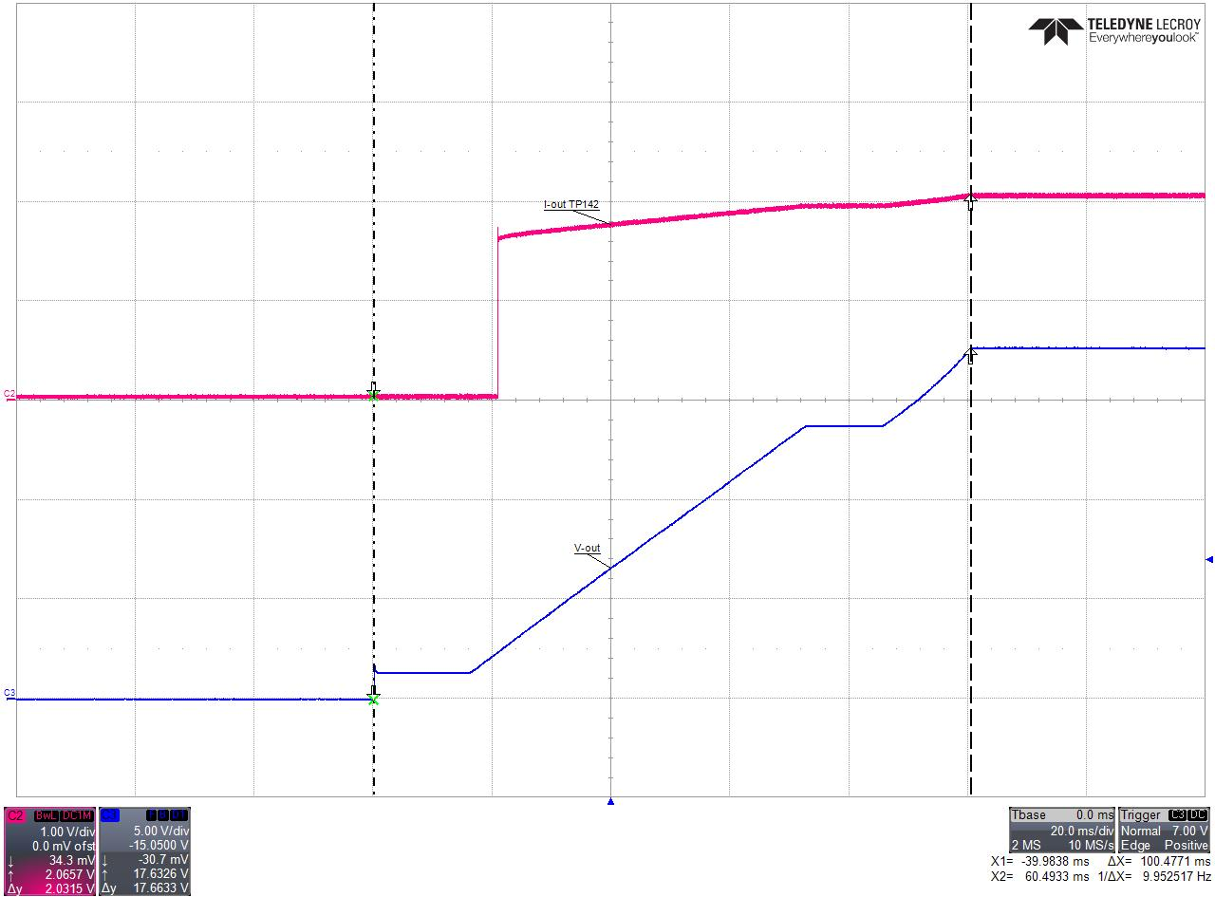
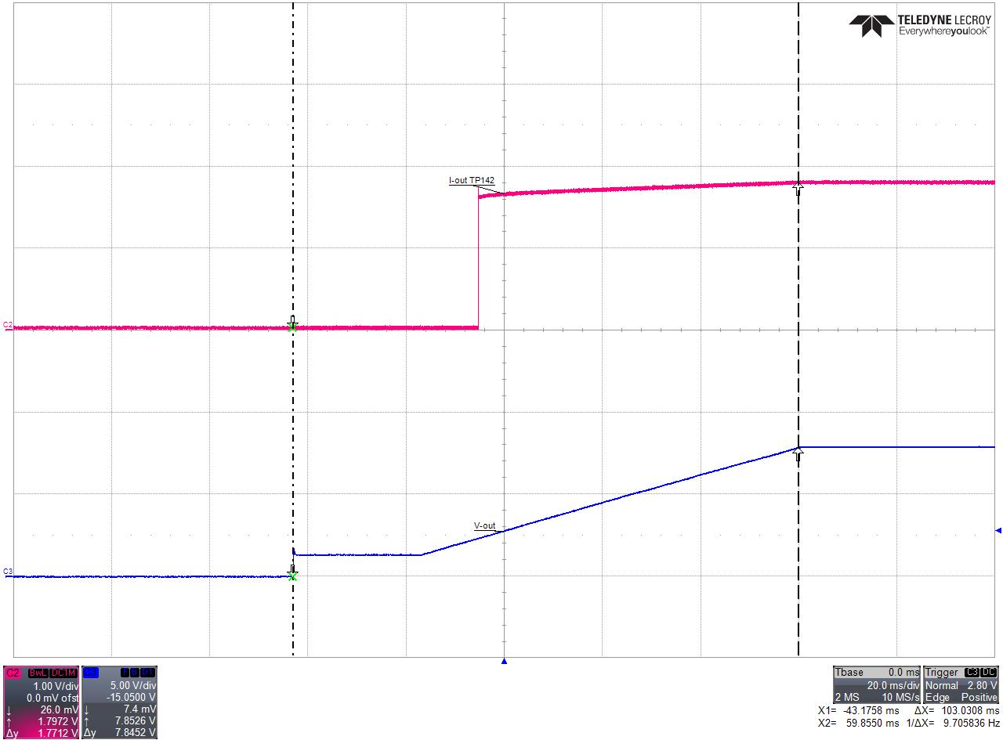
Startup Ramp in Open Loop (100ms)
Start from 0V to 18V
Start from 0V to 8V

Slide 18
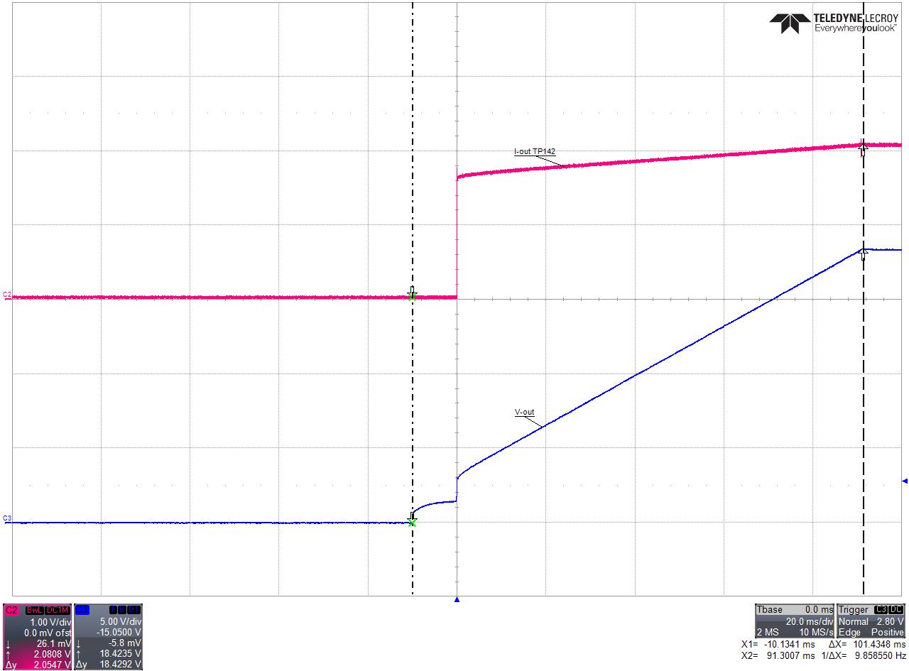
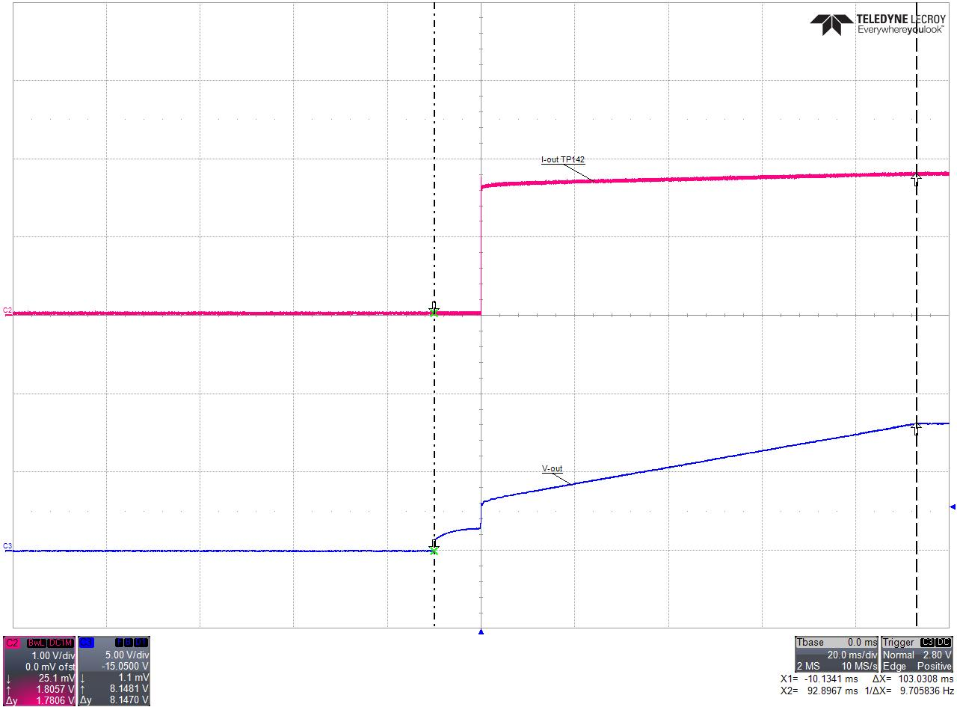
Startup Ramp in Closed Loop (100ms)
Start from 0V to 18V
Start from 0V to 8V

Slide 19
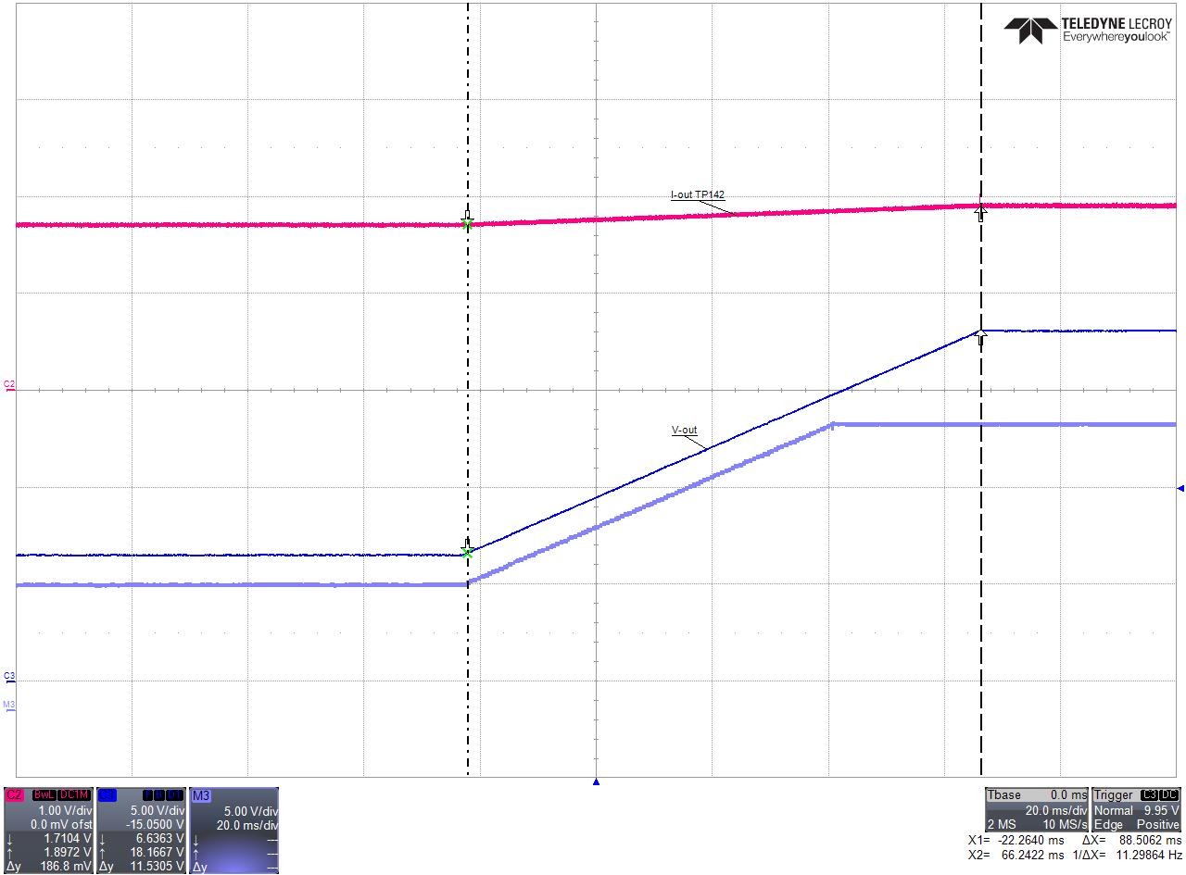
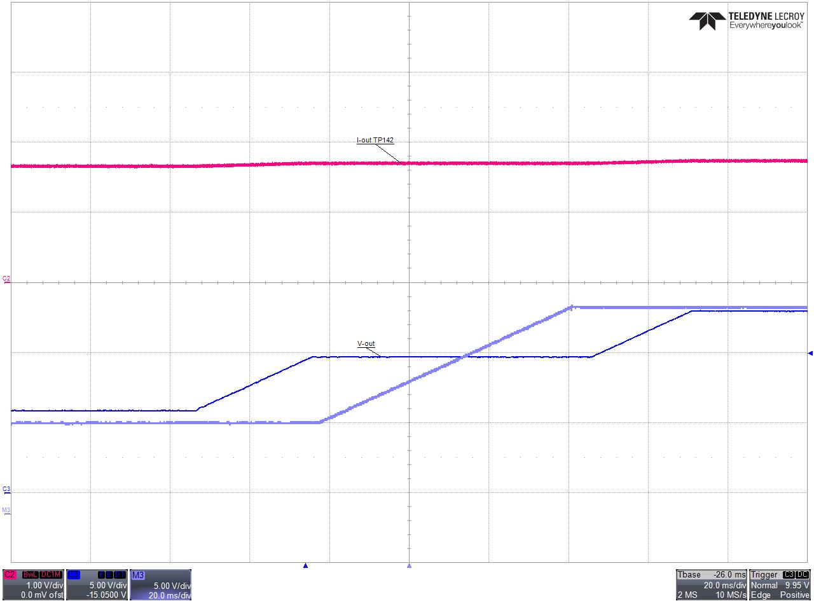
Softstart Ramp at Vref change in Open Loop
Change Vref from 6V to 18V and 6V to 15V by changing the referenc value with GUI.
Set Vref by GUI is done immediately.
Slope is the same, means same dV/dT
Change Vref referenc value with potentiometer.
Set Vref by poti can be delayed in between because poti value is updated only every 100ms.
But slope is the same dV/dT.

Slide 20
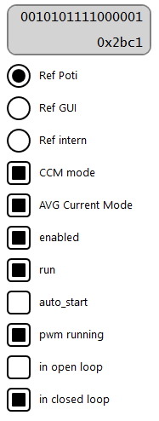


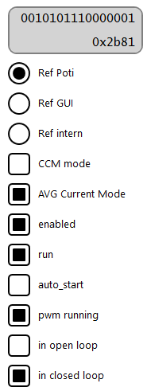
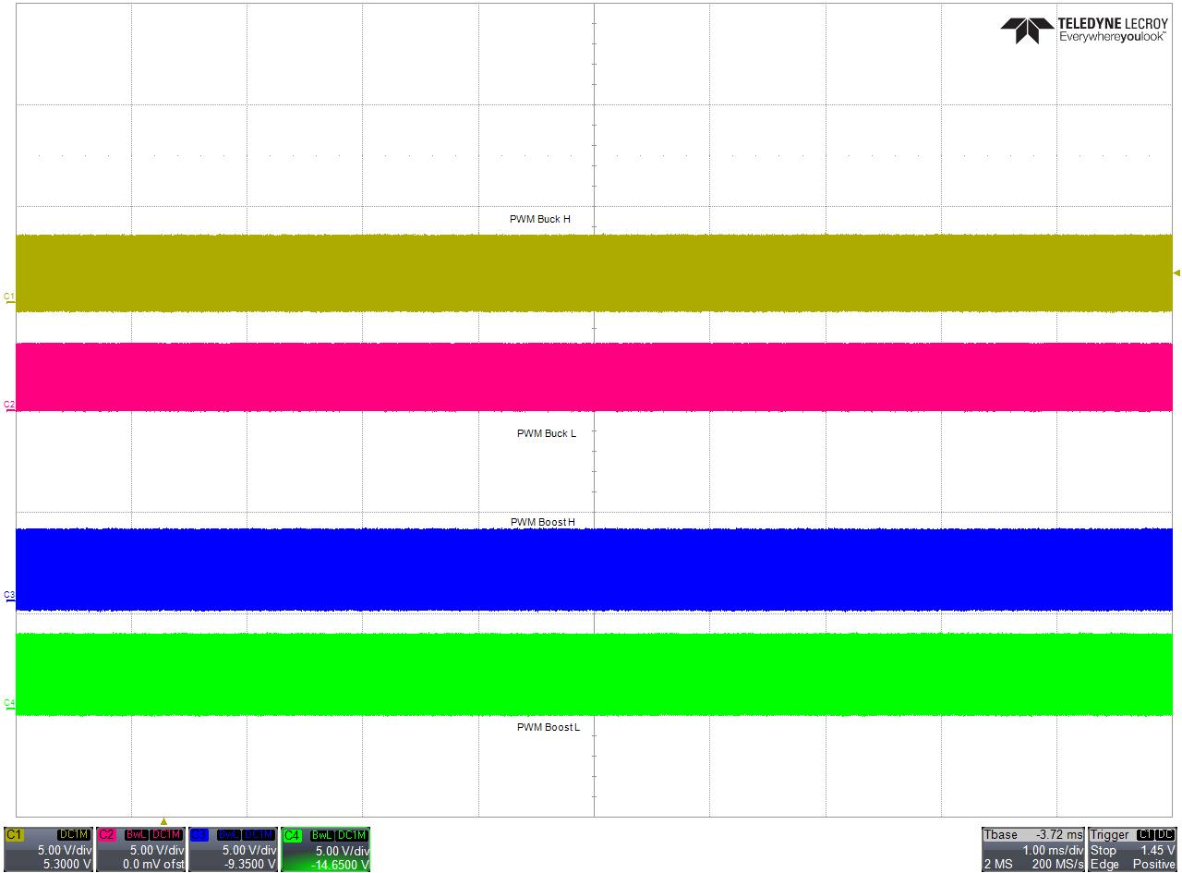
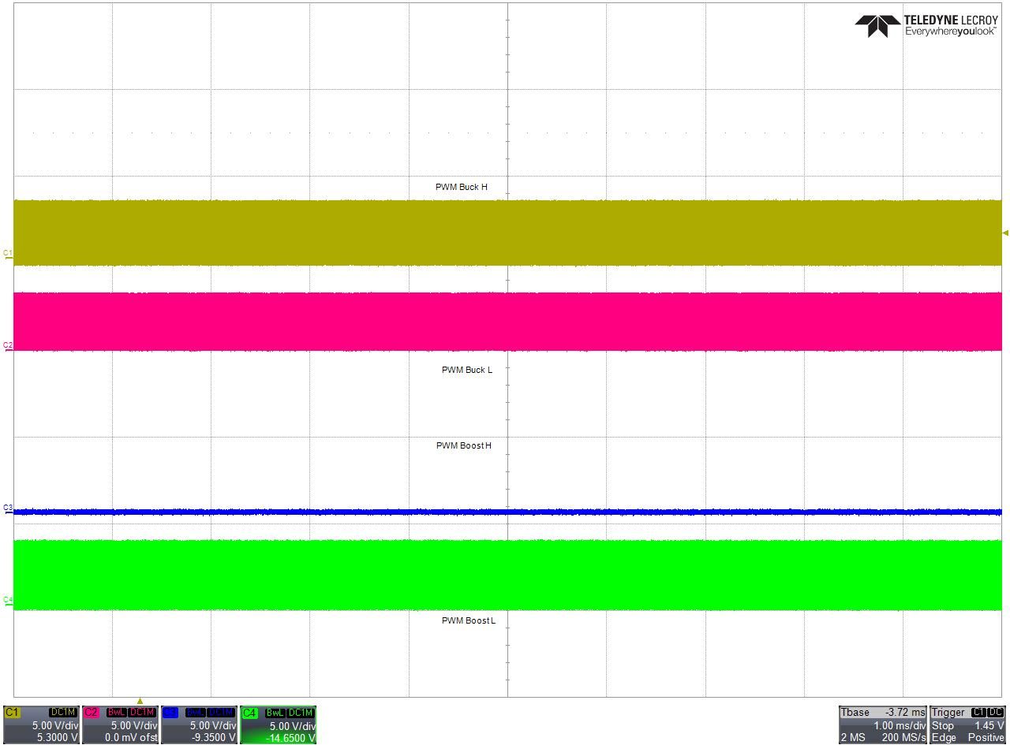
CCM <-> DCM
#define IOUT_CCM_FLOAT (float)((((0.4*0.5)+1.65)*4096)/3.3) //0.5A
#define IOUT_CCM (uint16_t) IOUT_CCM_FLOAT
#define IOUT_DCM_FLOAT (float)((((0.4*0.4)+1.65)*4096)/3.3) //0.4A
#define IOUT_DCM (uint16_t) IOUT_DCM_FLOAT

Slide 21
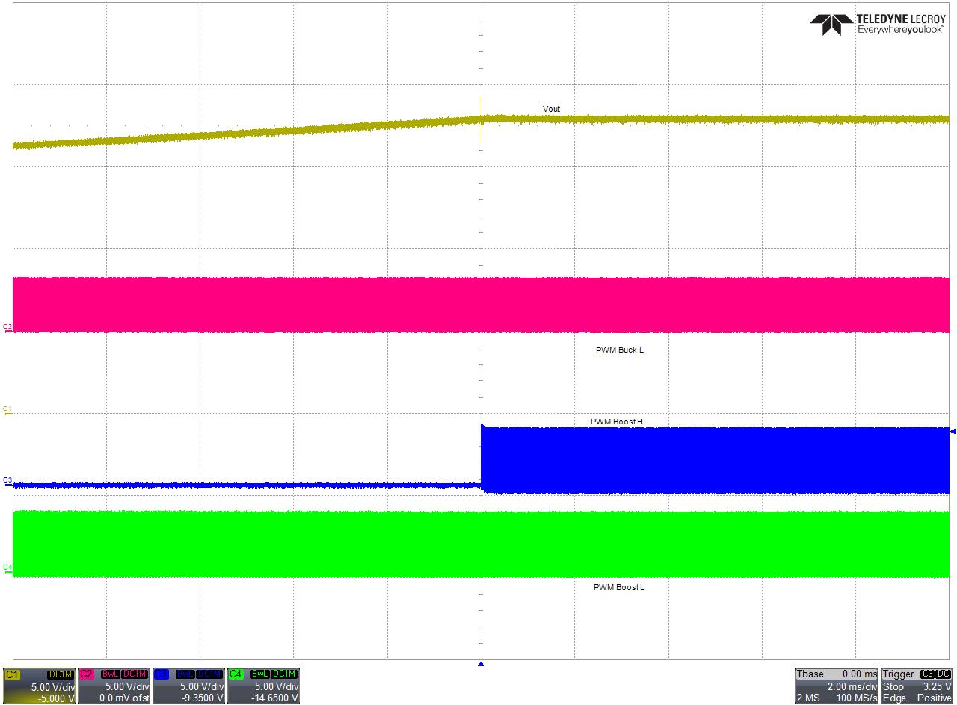
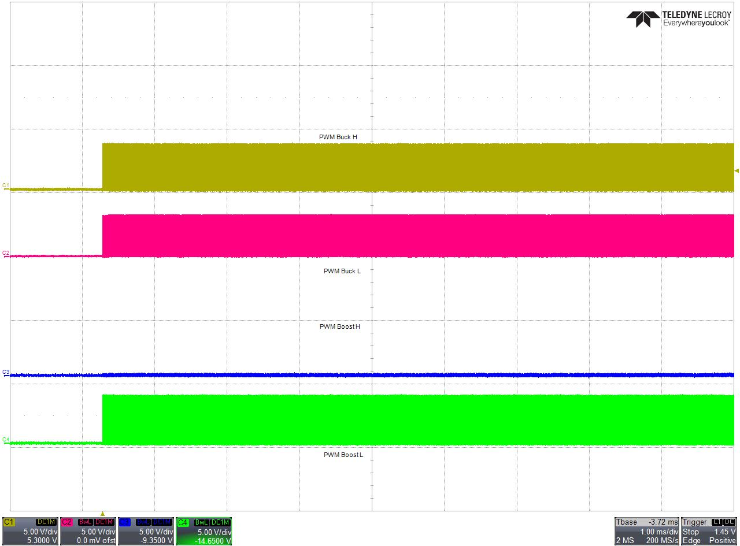
Startup Switching Scheme
Startup is done in DCM Mode, Boost syncronous switch is off.
After Startup ramp CCM<->DCM is checked and in CCM synch. Boost switch is turned on.

Slide 22
Board Test
LD100 slow blinking Wait for SW2 short pressed to initialize and startup Powersupply
LD100 permanent On Powersupply is up and running
LD101 slow blinking Powersupply is running in Open Loop mode
LD101 permanent On Fault happened
LD100 permanent Off
Both LEDs Off Board Test OK
LD101 permanent Off
Vin = 12V, Rload = 10Ω, Measure Vout with Multimeter should be in the range of 15V
Testsoftware checks internal for:
Vin: 1790 (11.5V) --- 1940 (12.5V)
Vout: 2240 (14.5V) --- 2400 (15.5V)
Iin: 1650 (1.9A) --- 1750 (2.1A)
Iout: 2700(1.3A) --- 2800 (1.5A)
Vaux_ 3100(5V) --- 3720 (6V)

Slide 23
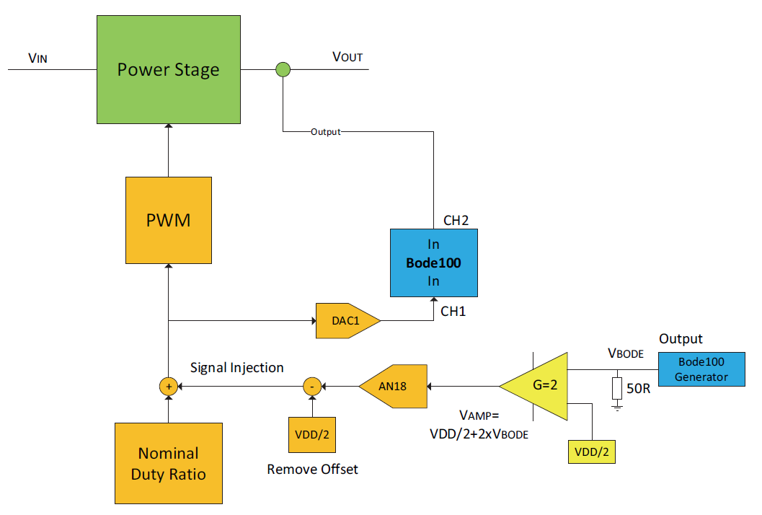
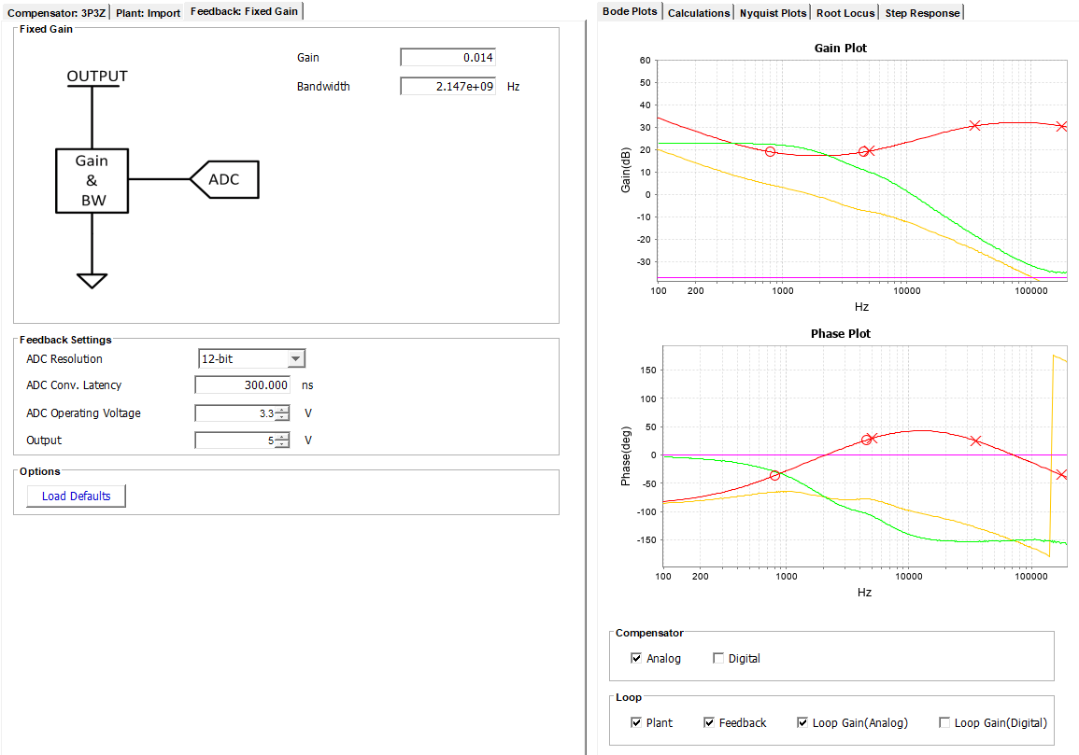






Plant Measurement Vout
Buck Test: Vin=13.8V, Vout=11V, Load=10Ω.
Mindi: in Mindi the Plant measurments is done in analog domain with a ramp of 1V.
Plant Measurment: to match the right Gains on Ch1 and Ch2 the DAC output must be normalized to 100% duty cycle.
(see block diagram)
$$\frac{Ramp}{DACmax}=\frac{1V}{3.3V}×4095=1241 digit$$
$$Gain=\frac{100\%DC}{Ramp}=\frac{11428}{1241}=9.2$$
To get the right Plant measurment the DAC value must divided by the Gain of 9 before feeding into Ch1 of Bode 100.
$$Plant Gain=20×log\frac{Vin}{Ramp}=20×\log\left(\frac{13.8}{1}\right)=23dB$$
If we design digital compensator with DCDT (or any other tool) we must consider the K-Gain coming from our feedback system. Without that Gain our Loop Gain curve is plotted that Gain higher than the real result.
To consider the Gain use the Feedback Gain set to
$\frac{1}{73.7}=$0.014
$$K Gain=Kfb×KADC×KPWM$$
$$K Gain=8×\frac{3.3}{4095}×11428 =73.7 ≡37dB$$
see next page

Slide 24
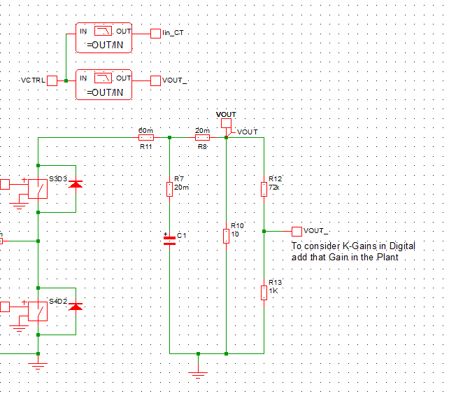
Plant Measurement Vout
The digital K-Gain could be involved direct in the Plant measurement in MINDI. The Plant Gain is reduced by the K-Gain (here 73/37dB)
Then in DCDT it is more obvious to set the Gain to 1.

Slide 25


Plant Measurement Vout
K-Gain for the outer voltage loop in average current mode. 32768 is the resolution of our 1Q15 calculation.
$$K Gain=8×\frac{3.3}{4095}×32768 =211 ≡138dB$$
K-Gain for the inner average current loop.
$$K Gain=X×\frac{3.3}{4095}×11428 =211 ≡138dB$$

Slide 26
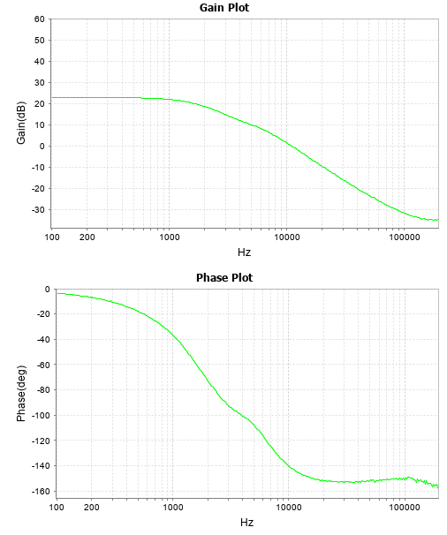
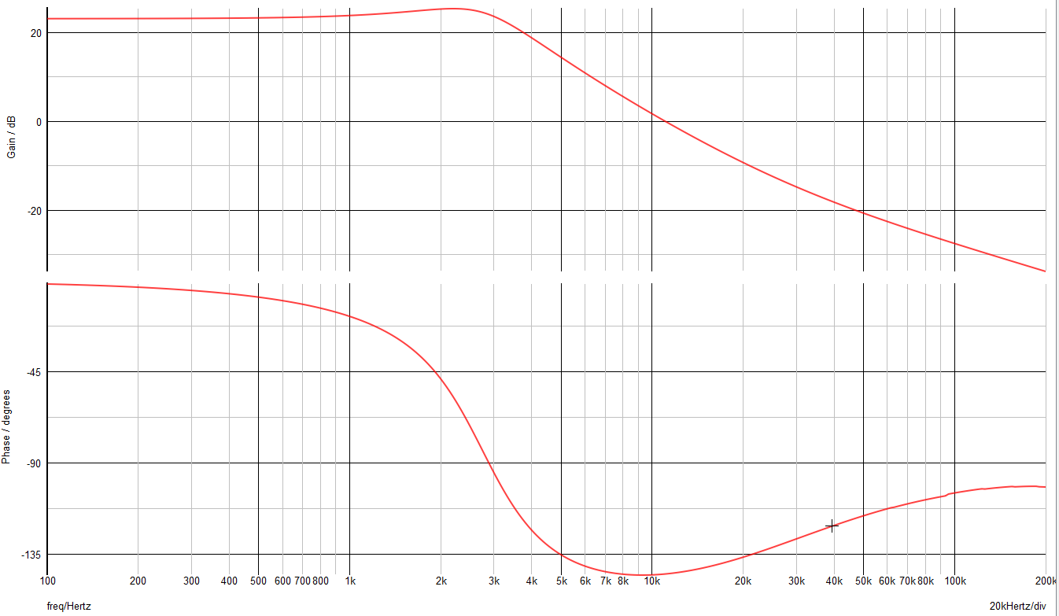
Plant Measurement Vout
DCDT import form Bode100 measurement
MINDI simulation

Slide 27
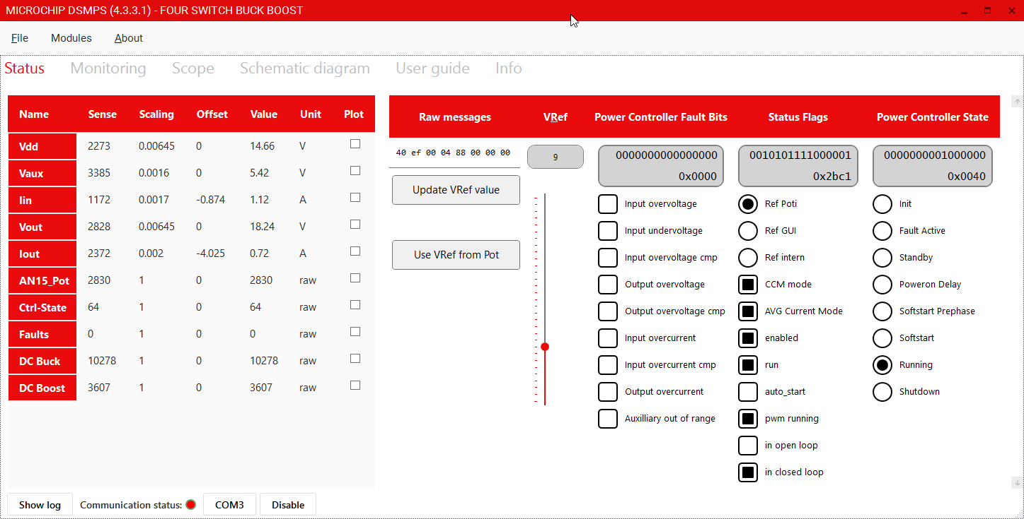
Graphical Interface

Slide 28
Q&A

Slide 29
Thank You!

