Slide 1
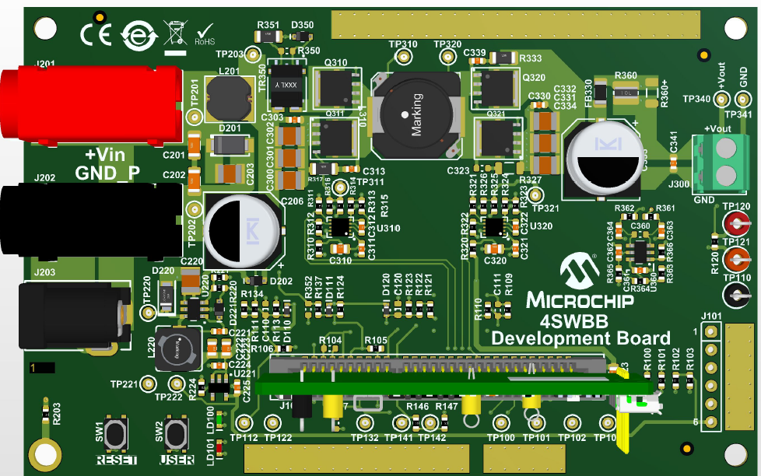
Four Switch Buck Boost Development Board
MCU16 Apps
April 2021

Slide 2
4SWBB with VMC, AVCMC, BidiM
1) Startup fwrd/rev (Closed Loop/Open Loop)
- Vin/Vout/Load variants
- Softstart
2) Load Steps fwrd/rev (Closed Loop)
- Zero load to max load at different Vin/Vout
- min load to max load at nominal Vin and nominal Vout
3) PWM Setup fwrd/rev
- Base Modes Setup
- Synchronisation between Primary and Secondary SR
4) ADC Setup fwrd/rev
- ADC core handling for all analog signals
5) Firmware Workload
- ISR timing
- OS timing including auxilliary tasks
6) API inline funktions for PWM handling
- in drv_pwrctrl_ILLC_internal.h
7) Test Setup fwrd/rev
- Blank Board
- Potentiometer as Reference Input
- Power Board Visualizer
8) Plant Measurement
- Voltage Mode Plant Measurement Setup
9) Loop Measurements
- 2P2Z Controller (alternative 3P3Z)
- Modifications on Control Library
10) Fault Handling fwrd/rev
- Vin Over/Under Voltage (hiccup mode)
- Vout Over Voltage (Vout clamped in firmware to min 8V and max 12V)
- Output Overcurrent based on ADC (hiccup mode)
- Output Overcurrent based on CMP
- Auxilliary Power Out Of Range
11) Operating Modes fwrd/rev
- frwd OL
- frwd VMC
- fwrd AVCMC (with outer VMC)
- frwd AVCMC or VMC for battery charging
- rev VMC
- rev AVCMC (with outer VMC)
- switch fwrd → rev
- switch rev → fwrd

Slide 3
1) Startup fwrd
Closed/Open Loop

Slide 4
Startup CL VMC, AVCMC and BiDi AVCMC/VMC Setup
DC
Electronic
Load
50W
Resistive
Load
100Ω
12V
Vin
4 switch buck-boost
Vout
forward

Slide 5
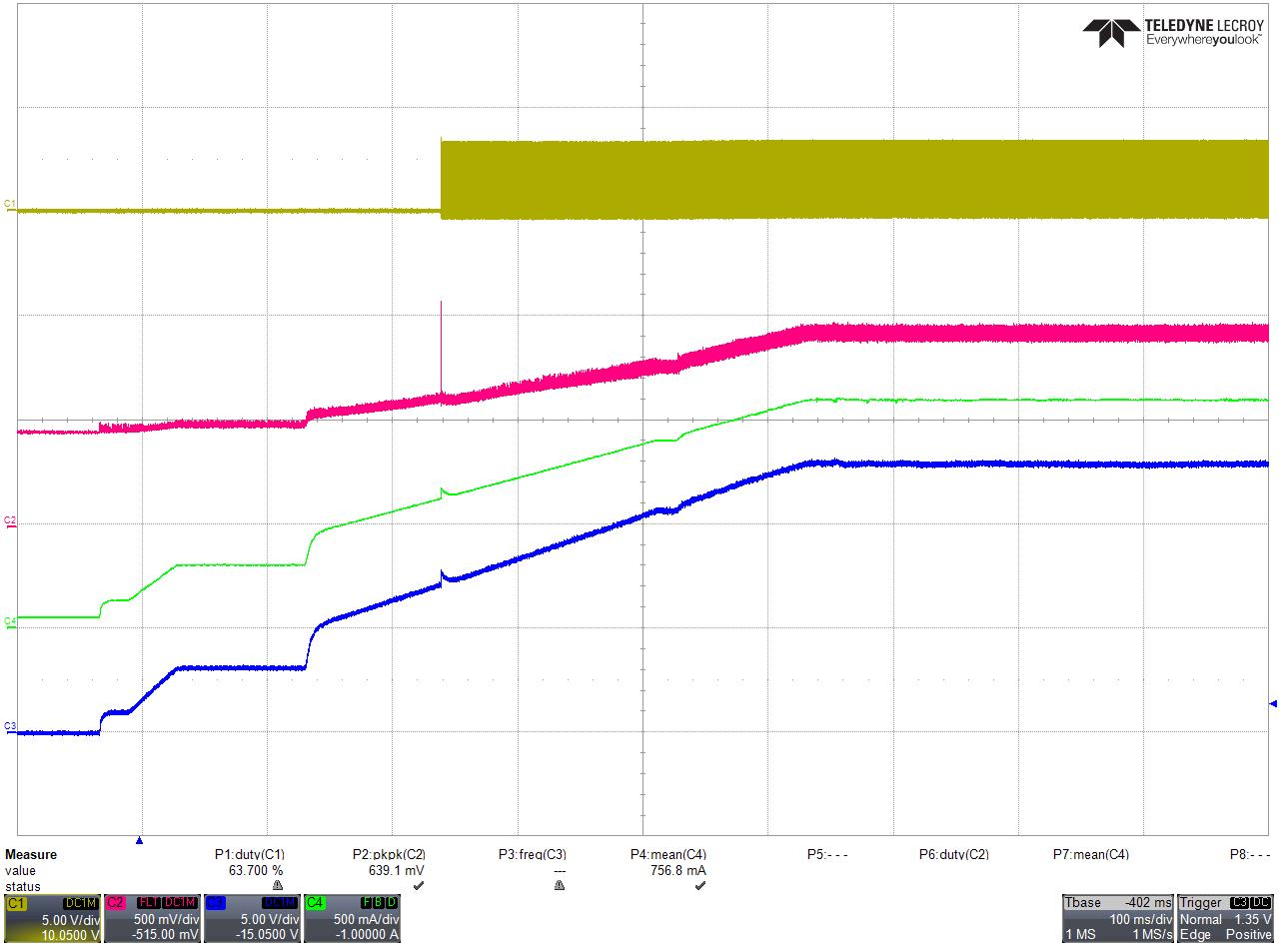
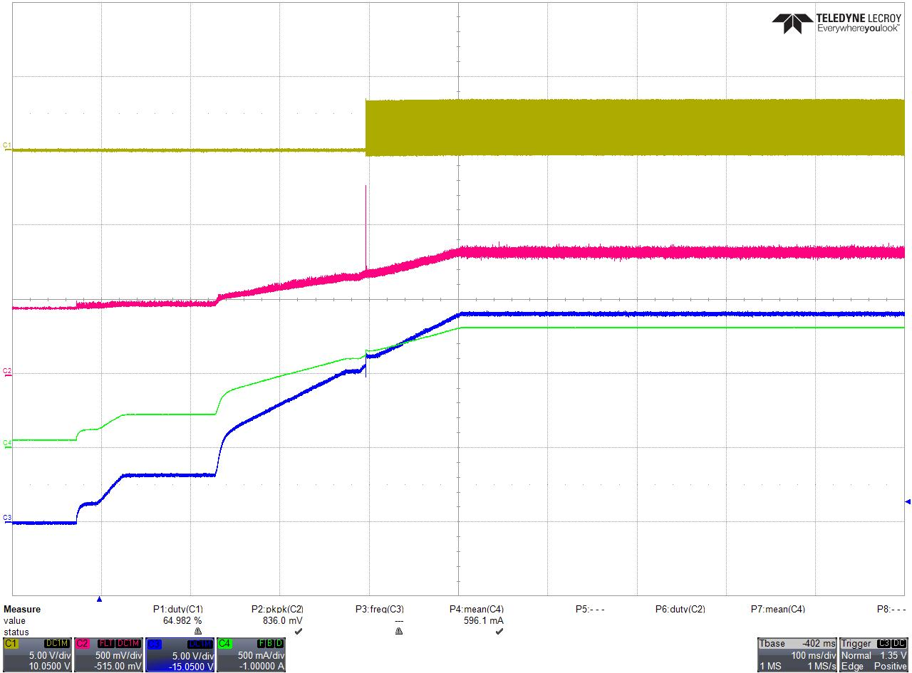
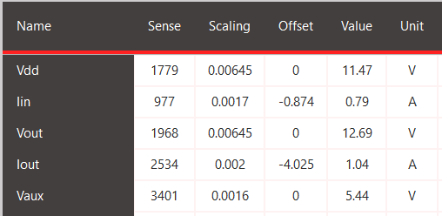
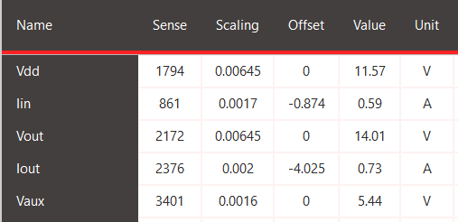
Startup CL BiDi AVCMC/VMC
DCM/CCM Boost Synch Switch
PWM2_H
Iin (TP132)
Vout
Iout (Current Probe)
Run in constant current mode.
Constant current set to 1A and Vout does not reach voltage mode set point = 14V.
Startup in constant current mode and then switch to voltage mode.
Constant current set to 1A and Vout reaches voltage mode set point = 14V before current get 1A.
Firmware always starts constant current ramp.
Runs in ACMC OR VMC depending on current and voltage.

Slide 6
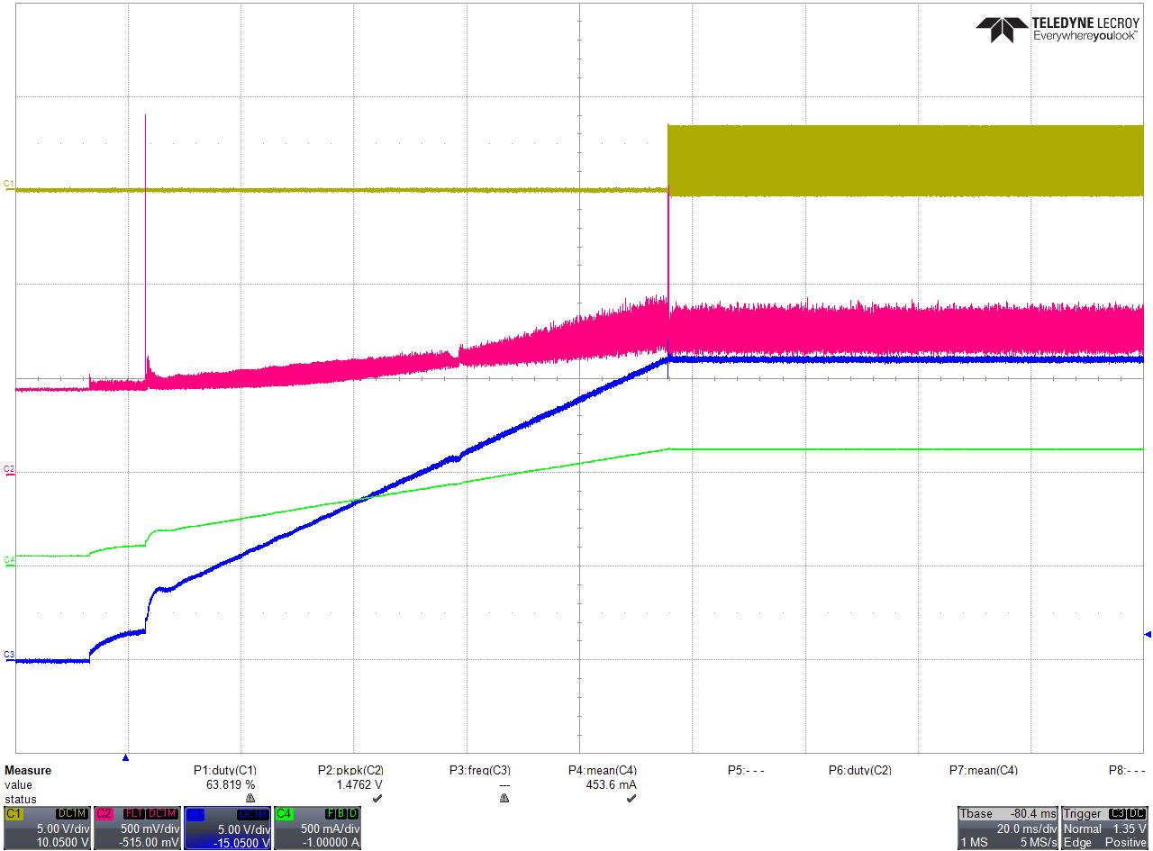
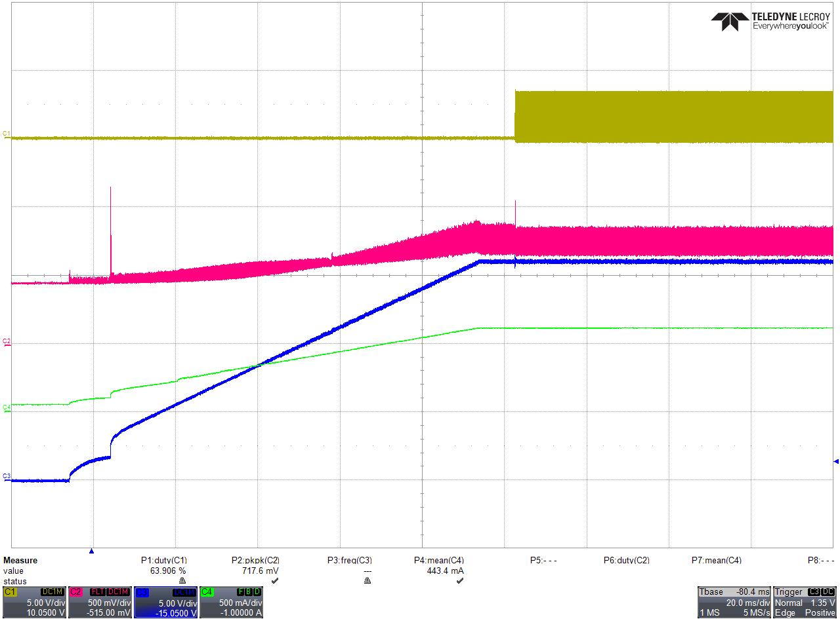
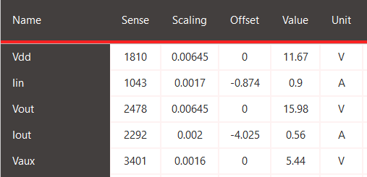
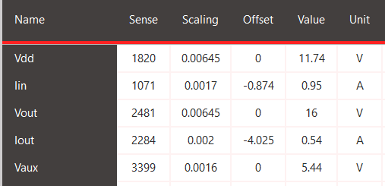
Startup CL VMC and AVCMC
VMC
AVCMC
PWM2_H
Iin (TP132)
Vout
Iout (Current Probe)

Slide 7
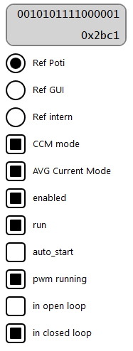

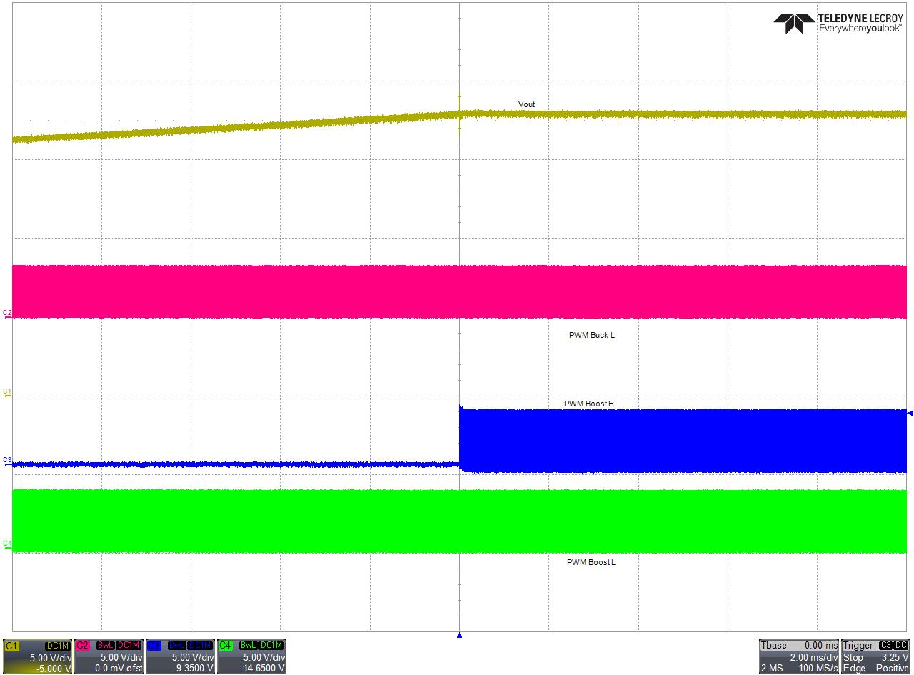
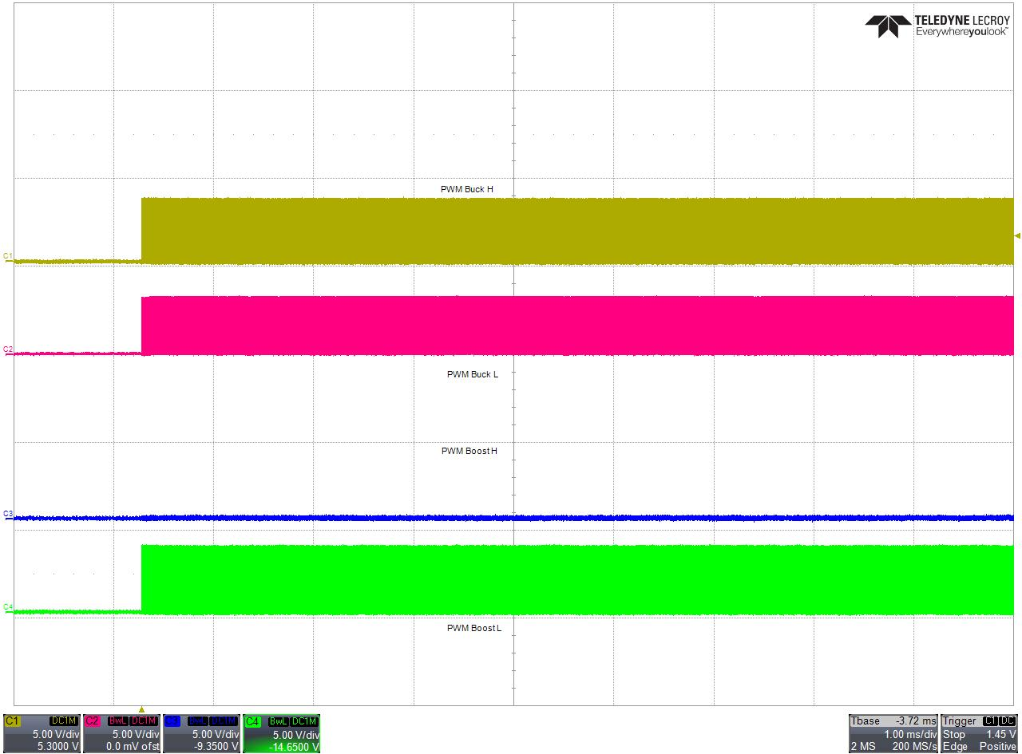
Startup Switching Scheme
Startup is done in DCM Mode, Boost syncronous switch is off.
After Startup ramp CCM<->DCM is checked and in CCM synch. Boost switch is turned on.

Slide 8
1) Startup rev
Closed Loop

Slide 9
1) Startup fwrd <--> rev
Closed Loop

Slide 10
Startup after switch between fwrd and rev
reverse
Caps Board
DC
Electronic
Load
50W
Resistive
Load
100Ω
Super
caps
12V
Vin
4 switch buck-boost
Vout
Vprebias
6V
forward

Slide 11
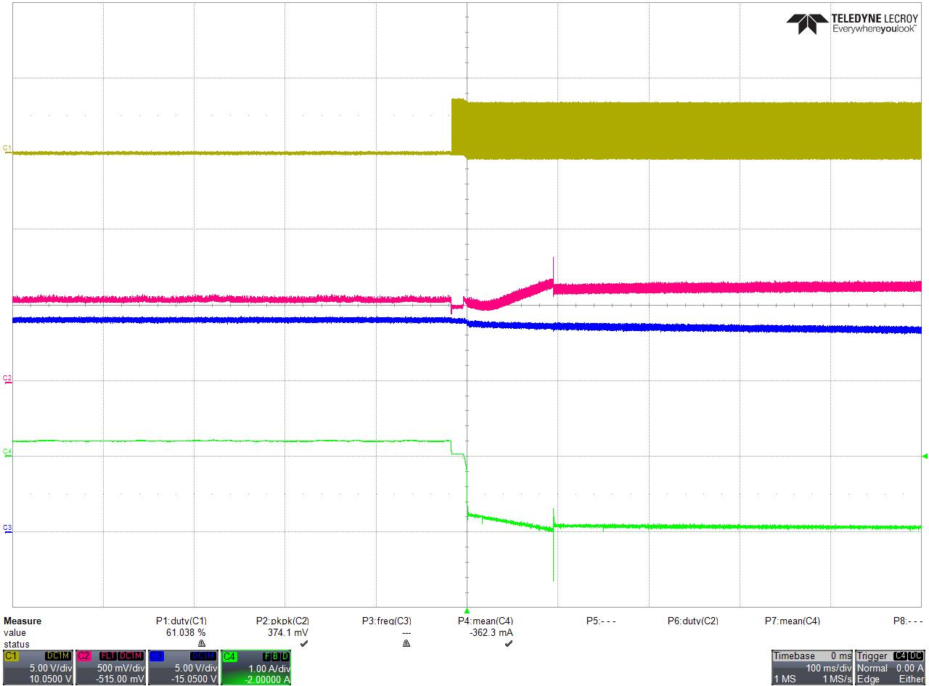
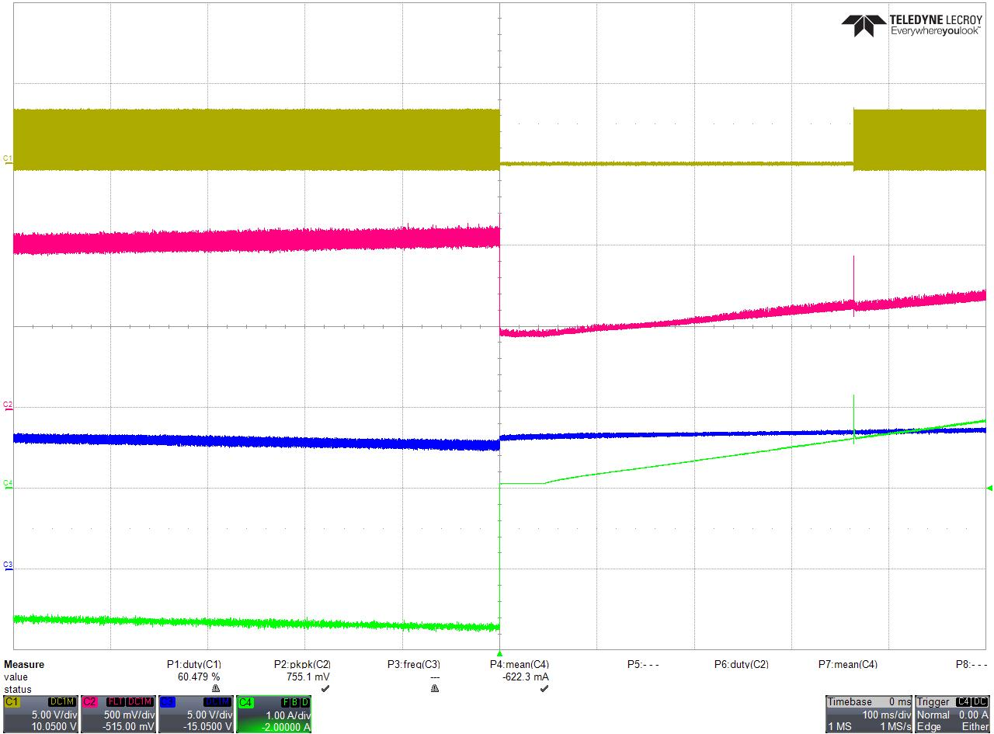
Startup after switch between fwrd and rev
fwrd → rev
rev → fwrd
PWM2_H
Iin (TP132)
Vout
Iout (Current Probe)

Slide 12
2) Load Steps fwrd
Closed Loop

Slide 13
2) Load Steps rev
Closed Loop

Slide 14
3) PWM Setup fwrd
xxx

Slide 16
3) PWM Setup rev
xxx

Slide 17
4) ADC Setup fwrd
ADC Cores

Slide 18
4) ADC Setup rev
ADC Cores

Slide 19
5) Firmware Workloads
ISR Timing

Slide 20
6) API inline funktions
PWM Handling

Slide 21
7) Test Setup fwrd
Tool Chain

Slide 22
Bench Setup BiDi fwrd
reverse
Caps Board
DC
Electronic
Load
50W
Resistive
Load
100Ω
Super
caps
12V
Vin
4 switch buck-boost
Vout
Vprebias
6V
forward
DC
Electronic
Load
50W
Resistive
Load
100Ω
12V
Vin
4 switch buck-boost
Vout
forward

Slide 23
7) Test Setup rev
Tool Chain

Slide 24

Bench Setup BiDi rev
+
-
External Switch
4SWBB PoBo
1N5819
Vaux
(ext)
forward
DC Bus
reverse
Vdc
(AN15)
Vdd
Vout
Test Setup:
Use a mechanical switch as the “External Switch”. In reverse mode measure Vdc as reference for Vdd. Set a bit if Vdd is equal Vdc. Then you can switch on the External Switch by hand.

Slide 25
Bench Setup BiDi rev
+
-
4SWBB PoBo
Delta < 0,5V
BMS decides to switch off
Or
DC Bus is low
forward
DC Bus
13V
reverse
Vdc
(AN15)
Vdd
Vout
Test Setup:
Use a mechanical switch as the “External Switch”. In reverse mode measure Vdc as reference for Vdd. Set a bit if Vdd is equal Vdc. Then you can switch on the External Switch by hand.
BMS for every single cell, I2C for communication BMS to 4SWBB
Comm to outer system higher level system via CAN

Slide 26
DC
Electronic
Load
50W
Resistive
Load
100Ω
12V
MRGN-900
Vdd
4 switch buck-boost
Vout
12V
PS-300D
forward
reverse

Slide 28
8) Plant Measurement
with the DP-PIM additional on-board circuitry

Slide 29
9) Loop Measurments
Closed Loop Frequency Measurements

Slide 30
10) Fault Handling fwrd
MCU16 SMPS Fault Handler

Slide 31
10) Fault Handling rev
MCU16 SMPS Fault Handler

Slide 32
12) Operating Modes
- frwd OL
- frwd VMC
- fwrd AVCMC (with outer VMC)
- frwd AVCMC or VMC for battery charging
- rev VMC
- rev AVCMC (with outer VMC)
- switch fwrd → rev
- switch rev → fwrd

Slide 33
MISC
div.

Slide 34

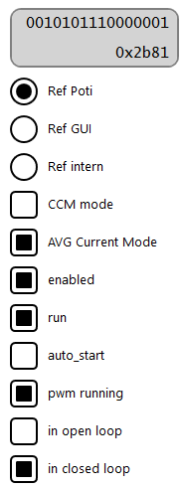

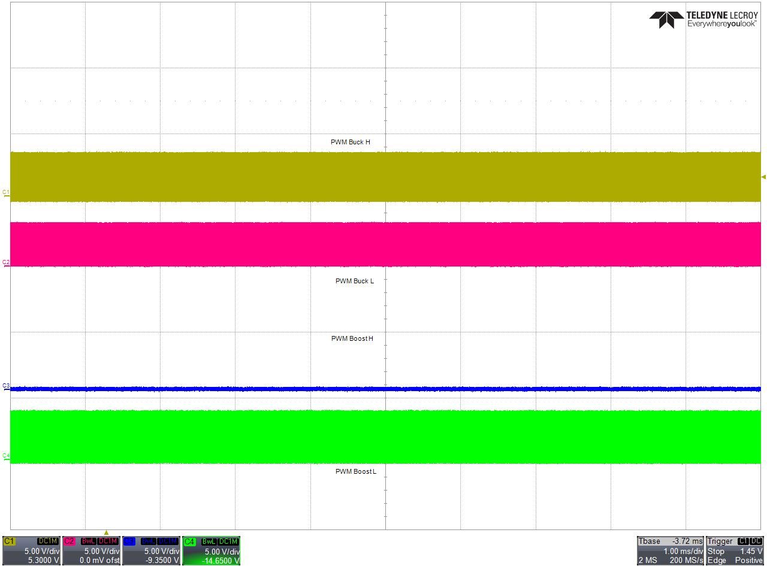
CCM <-> DCM
#define IOUT_CCM_FLOAT (float)((((0.4*0.5)+1.65)*4096)/3.3) //0.5A
#define IOUT_CCM (uint16_t) IOUT_CCM_FLOAT
#define IOUT_DCM_FLOAT (float)((((0.4*0.4)+1.65)*4096)/3.3) //0.4A
#define IOUT_DCM (uint16_t) IOUT_DCM_FLOAT

Slide 35
FIGURE 1-7: FIRMWARE BLOCK DIAGRAM
app_hmi
(buttins, leds)
app_gui
(external gui)
drv_gui_comm
uart1
drv_pwrctrl_ILLC
SR PWM output
PHA
drv_adc
ISR: 133kHz – 166kHz
SR_state_machine
Load Current Balancing
800kHz – 1MHz
SR PWM output
PHB
Potentiometer
Ext-Ref
state_machine
Int-Ref
control_loop
PWM output
PHA
Task_Realtime 100us
800kHz – 1MHz
PWM output
PHB
main_tasks
fault_check
drv_pwrctrl_ILLC_fault
OS_Scheduler
MCC Peripheral Init
fault_common

Slide 36
TABLE 1-9: FIRMWARE BLOCKS
Component | Description
OS_Scheduler | Core of the Cooperative Operation System, calls realtime and non-realtime functions.
MCC Peripheral Init | Contains initialization and APIs for the peripherals
fault_common | Contains common functions to do fault checks. In this project they are used from the fault_check handler of the ILLC.
main_tasks | Contains all functions that are called by the scheduler. Main point where other important functions are being called.
drv_pwrctrl_ILLC_fault | Contains all fault check functions to check if voltages and currents are in the right range. This fault check function is called from the ILLC state machine.
drv_pwrctrl_ILLC | main component of the ILLC. Contains the state machine and the control loop.
Potentiometer | The potentiometer position is being used as a reference voltage for the ILLC.
drv_adc | Handles the analog/digital conversion synchrone to the PWM and calls the control loop of the ILLC.
app_gui, drv_gui_comm, uart1 | Contains the UART communication with the GUI to visualize the status of the ILLC.
SR_state_machine | Control of Synchron Rectifier Switches. Adaptive settings of switch on delay compared to primary switching.
Load Current Balancing | The Duty Cycle of Syncron Rectifier Switches are individual controlled for each interleaved phase to get same load current in every interleaved phase.

Slide 37
PoBo Visualizer
Iin/A
Iout/A
Output Voltage
5V...20VDC
20Wmax
Input Voltage
L310
2Amax
VDD/V
8Vdc...18Vdc
VOUT/V
Current
Half Bridge
Half Bridge
Current
Filter
Filter
Sense
BUCK
BOOST
Sense
Duty Cycle/%
Duty Cycle/%
AUX PS/V

