Slide 1
Firmware Structure
main.c file
System_Initialize
Power Control Initialize
Fault Initialize
main_tasks.c
Power Control Execute
Pwrctrl State Machine
MCC extension user configuration
Callback Initialization
OS_Scheduler
Tasks_100us
PBV Task Uart Communication Handling
Operating System Initialize
Power Board Visualizer Initialize
LED Initialize
Fan Initialize
Temperature Initialize
Tasks_1ms
PBV Task
CAN Communication Handling
Tasks_10ms
Tasks_100ms
LED Execute Fan Execute Temperature Execute
Tasks_1s
Scheduler Run Forever
Watchdog Clear
PBV Task Uncritical PBV data
ISR::
ADC measurement
Fault Checks Control Loop Execution PWM distribution

Slide 2
INITIALIZE
Initialize complete
FAULT DETECTION
No fault detected
Fault detected
STANDBY
Power Supply enabled
Fault detected
SOFT START
Voltage limit = Vtarget
Current limit = Itarget
Power limit =Ptarget
I/V/P target
changed
Fault detected
ONLINE (UP AND RUNNING)
Power Supply disabled

Slide 3
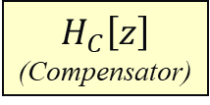
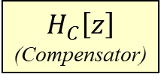
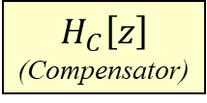
dsPIC33 device
dev_pwrctrl_isr.c
app_PBV
CCP
CAN
PBV comm
interface
ILimit
S
C
A
L
E
R
Voltage Feedback Loop (10KHz control interleaved with PLoop)
dev_fan.c
CCP
Fan
error
$$H_{C}\left[z\right]$$
(Compensator)
output
VLimit
+
-
dev_temp.c
input
Anti-Windup
Temperature
Sense
ADC
Power Feedback Loop (10KHz control interleaved with VLoop)
error
$$H_{C}\left[z\right]$$
(Compensator)
output
PLimit
+
-
input
Anti-Windup
REF
dev_pwrctrl_pwm.c
Current Feedback Loop (100KHz execution)
PWM Distribution
G_{P}(s)
(Plant)
PWM
V_{OUT}
t
Anti-Windup
error
$$H_{C}\left[z\right]$$
(Compensator)
dev_current_sensor.c
+
-
output
input
Current Sense
Voltage Divider
ADC
ADC
dev_pwrctrl_sm.c
State Machine
Hardware Fault
TIMER
CMP
GPIO
Soft-Start
V_{IN}
DAC
dev_led.c
Voltage Divider
Fault Protection
dev_fault.c
ADC

Slide 4
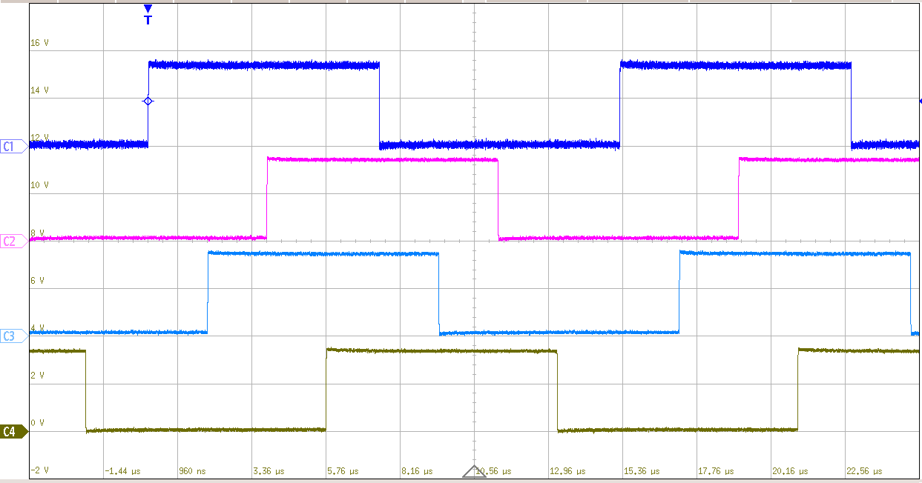
PWM1H
soc
PG2TRIGC
PWM3H
soc
PWM2H
PG1TRIGC
soc
PWM4H
PG3TRIGC

