Slide 1
DAB

Slide 2
Cascaded PWM
Pros
Single PWM update request bit for all PWMs
Cons
Phase defined needs to follow the order of the cascade PWMs (if cascade is PWM 1-2-3-4, the phase of the leading PWM will the reference of the client PWM)
Calculation of Phases done in runtime needs to be considered

Slide 3
Lorant’s implementation
Pros
Direct write to TRIGx value for the phase
Freedom to change the PWM phase whatever you define in it
Cons
User need to manually initialize the PWM Event for the primary secondary phase (PWM1, 2)
Two update bits needs to be set (need to make sure that all PWMs are updated in the same cycle, otherwise it will be one instruction late for the other)

Slide 4
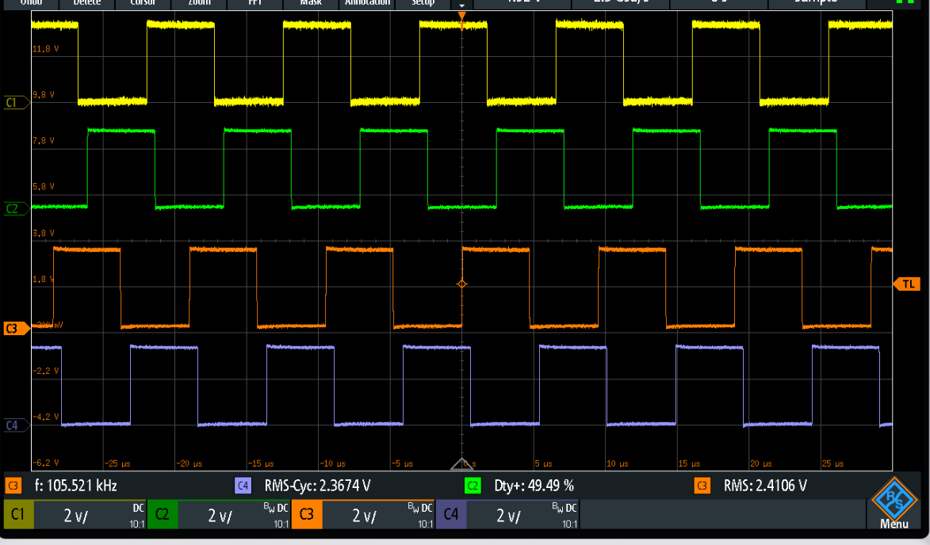
Lorant’s implementation
SOC Self-Trigger
PCI Sync – PWMEVTx event
Client SOC – PWM1 TRIGC
Client SOC – PWM2 TRIGC
3
1
2
4

