Slide 1
Dual Active Bridge

Slide 2
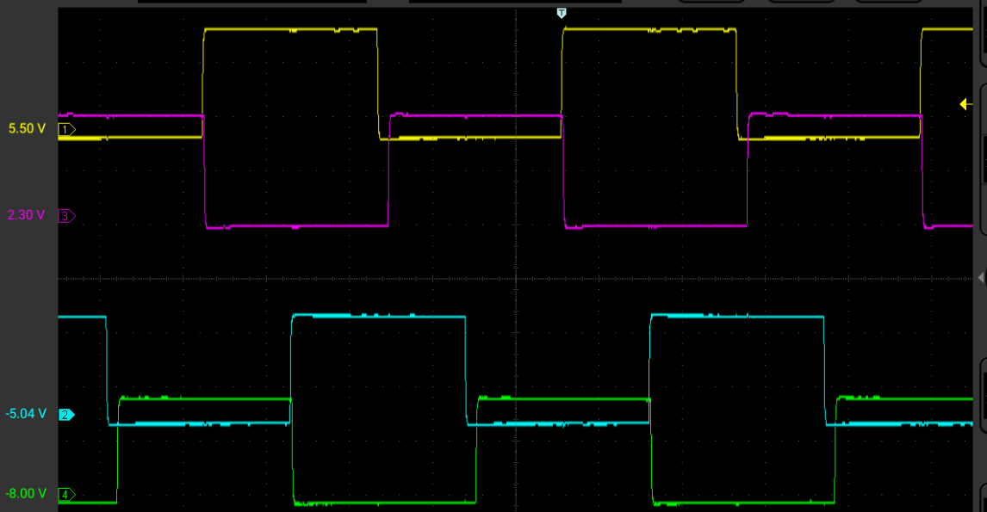
PWM Configuration – Cascaded PWM 1-2-3-4
PRItoSEC Phase 90 – (Bridge Phase / 2)
PWM1
PWM3
Bridge Phase 180 – 360 degrees
PWM2
PWM4

Slide 3
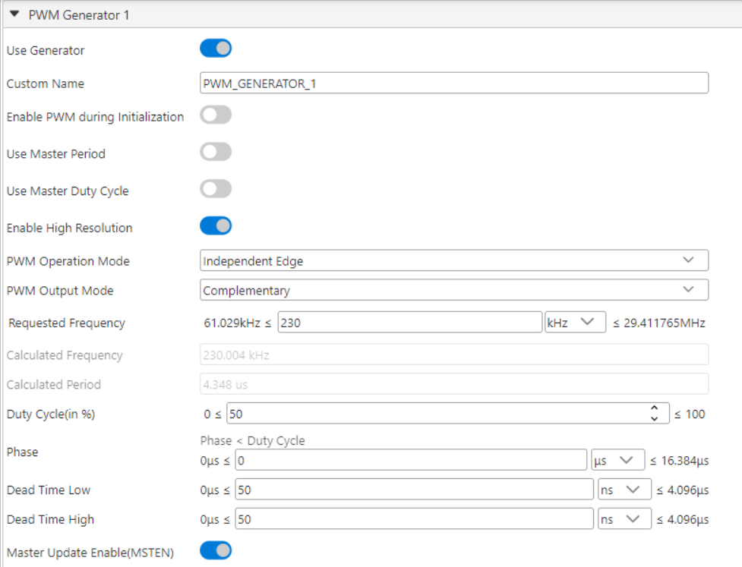
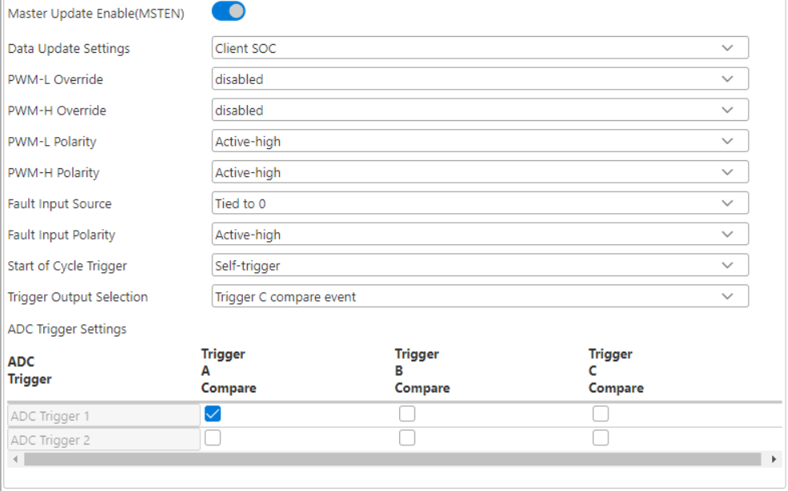
MCC PWM1

Slide 4
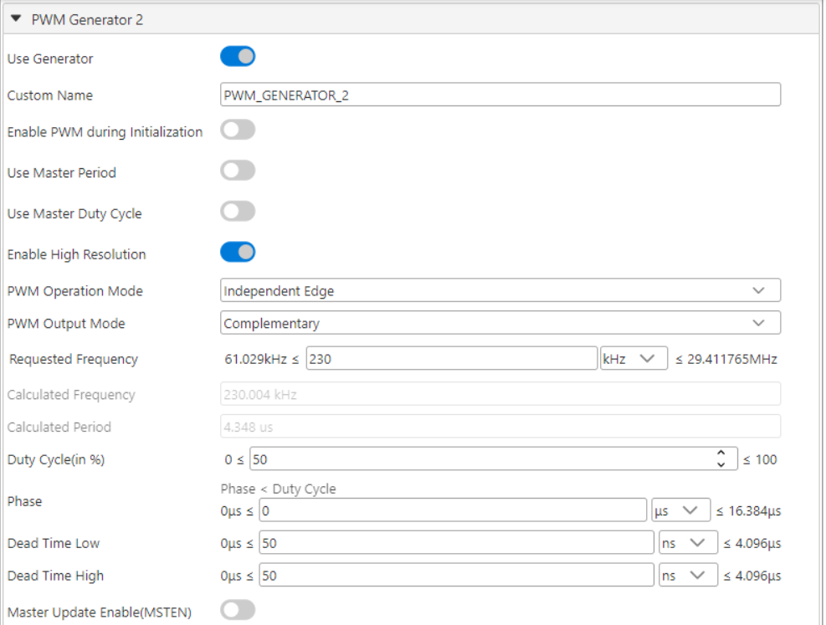
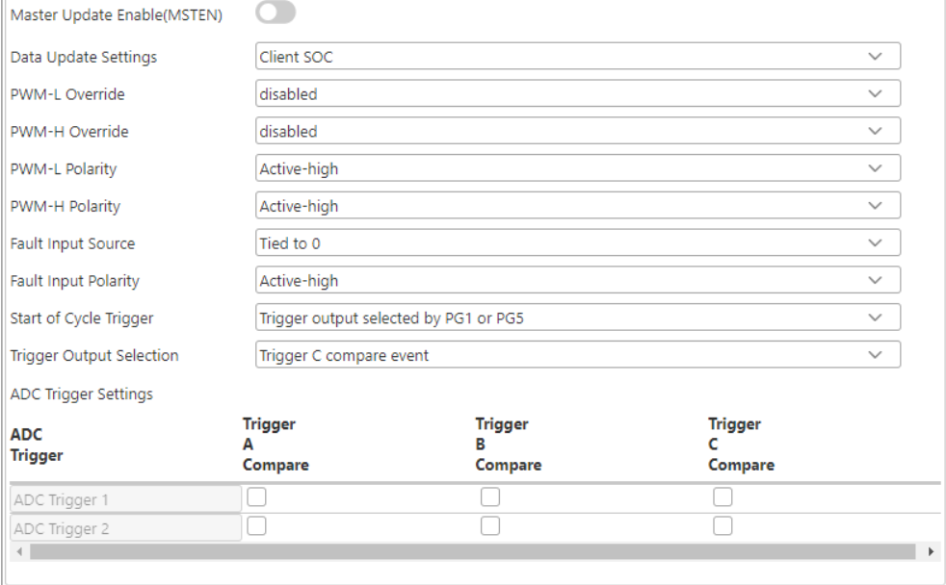
MCC PWM2

Slide 5
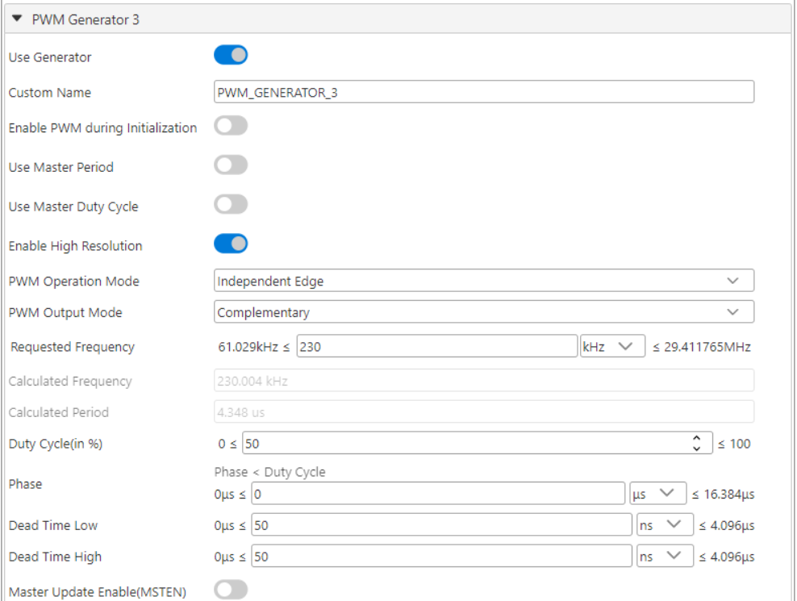

MCC PWM3

Slide 6
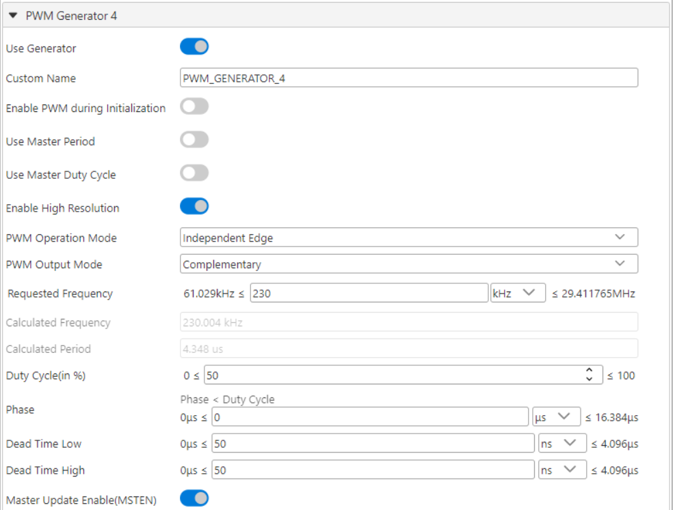
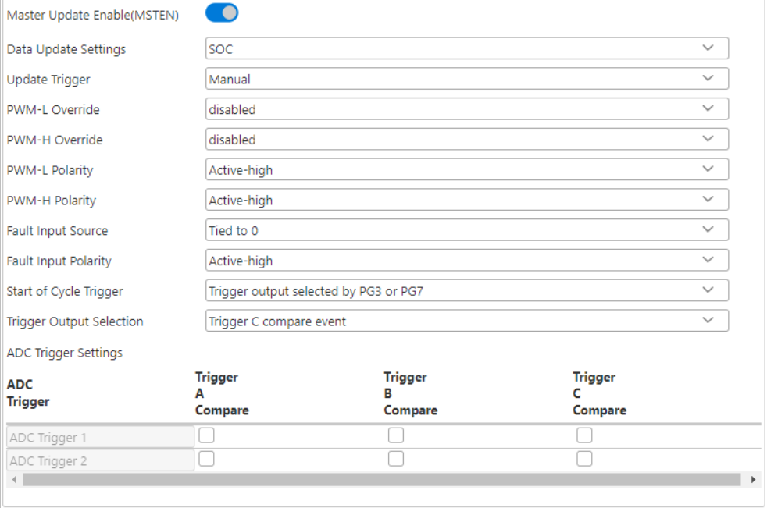
MCC PWM4

Slide 7
FB_Vdd-PWM_P fault implementation
SCCP2 input capture
CLC2
DMA2

Slide 8
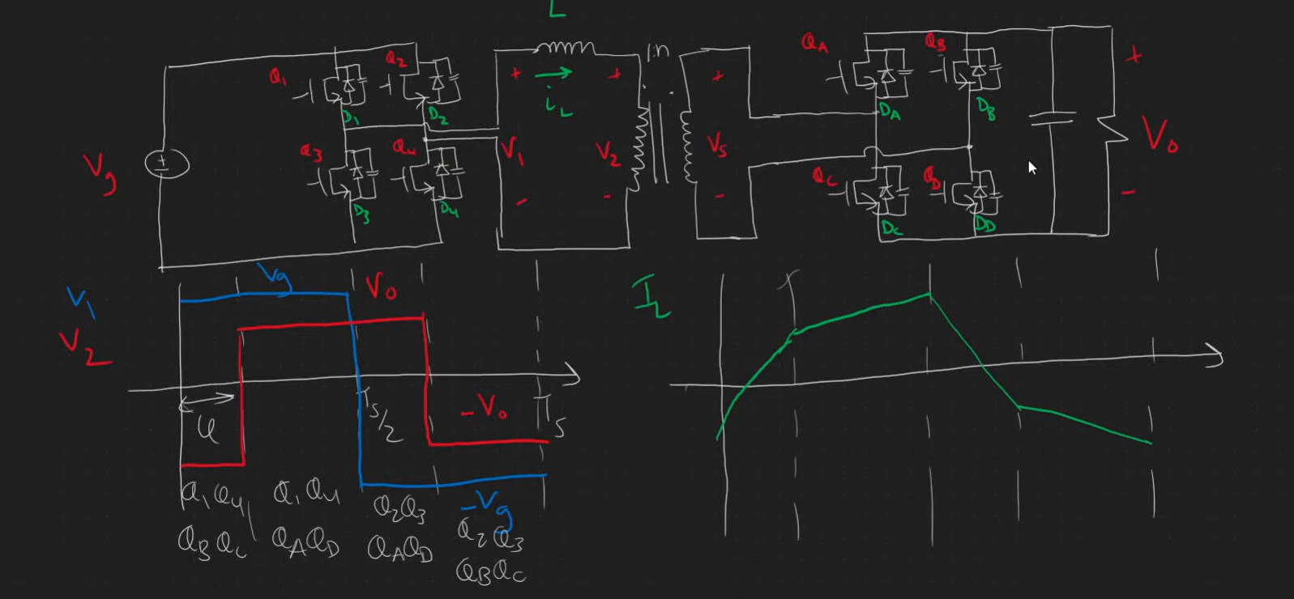
DAB operation

Slide 9
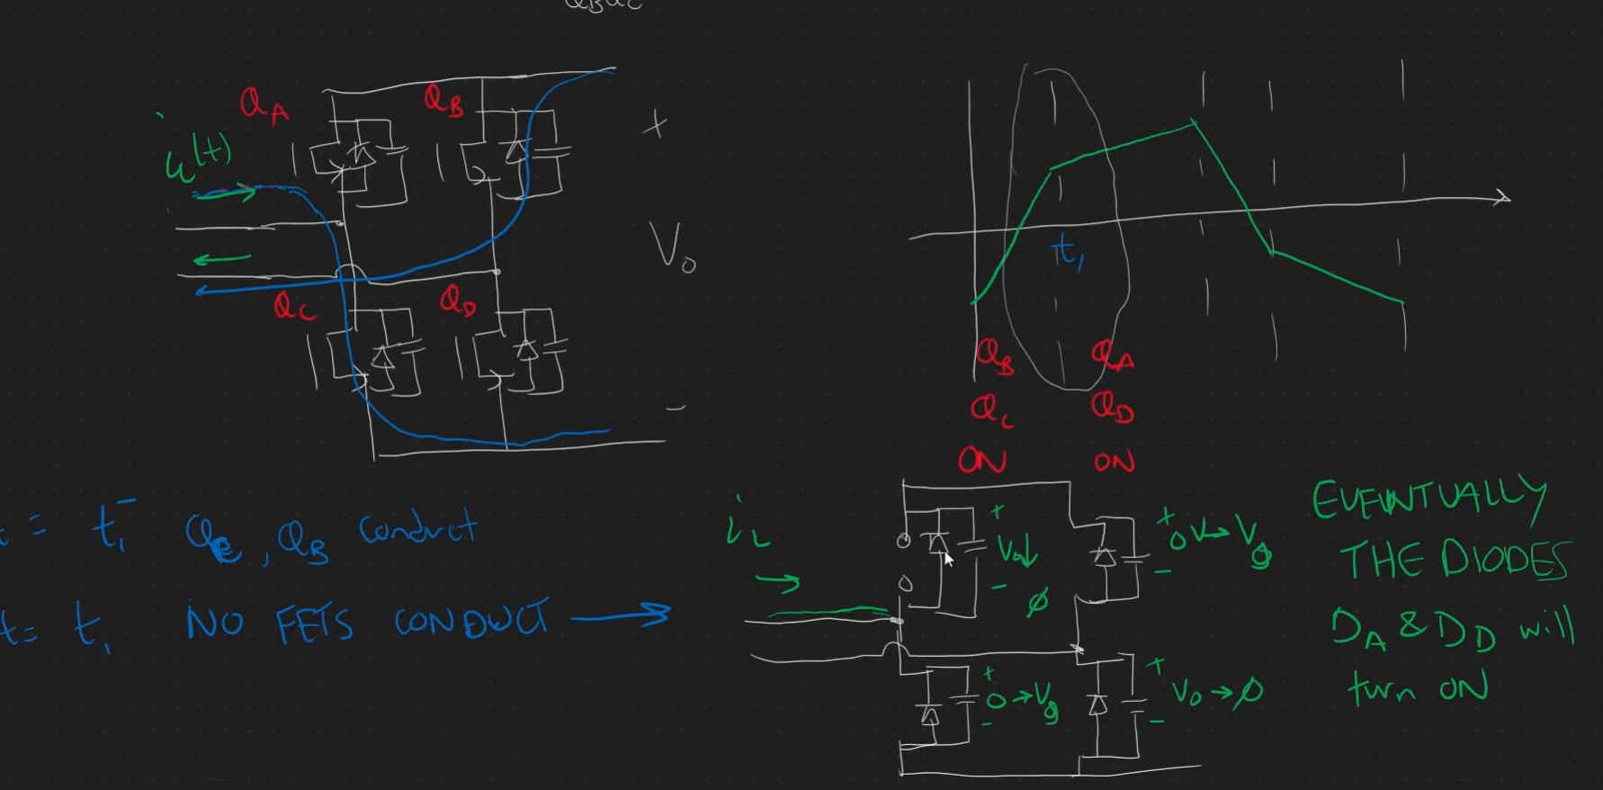
Inductor current naturally forces commutation of Diode

Slide 10
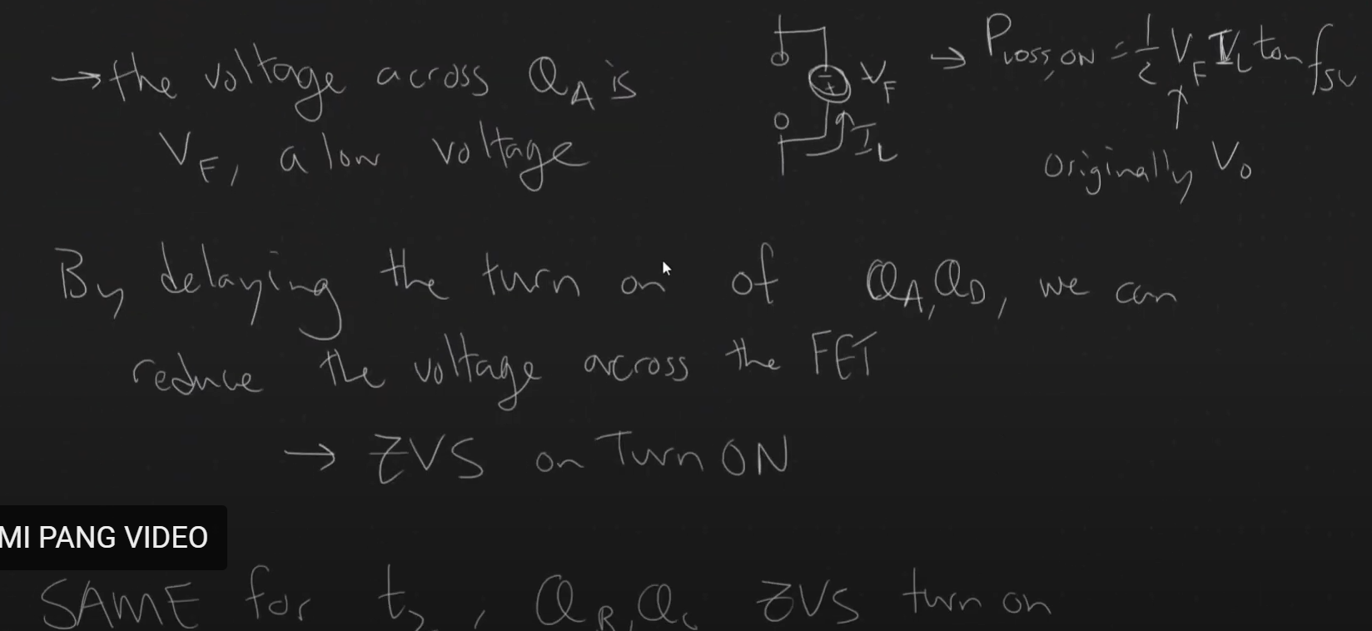

Slide 11
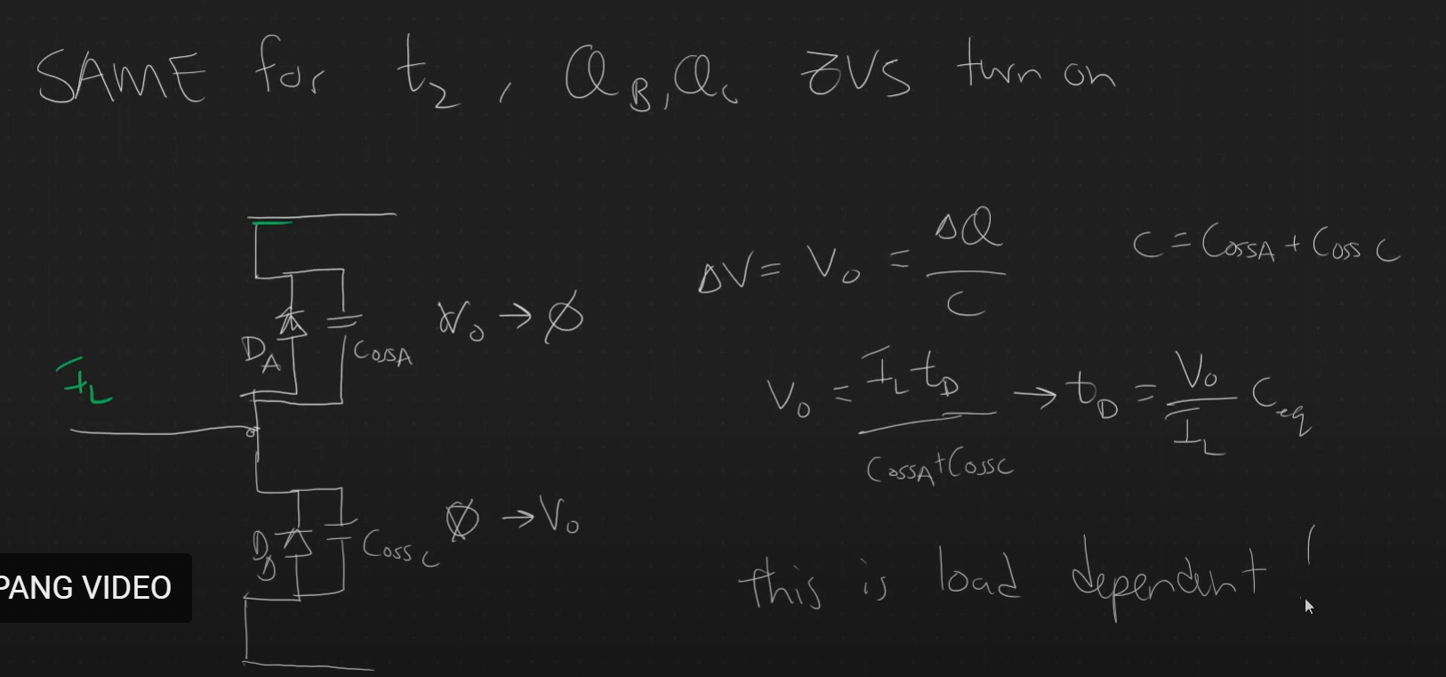
Deadtime equation for ZVS

Slide 12
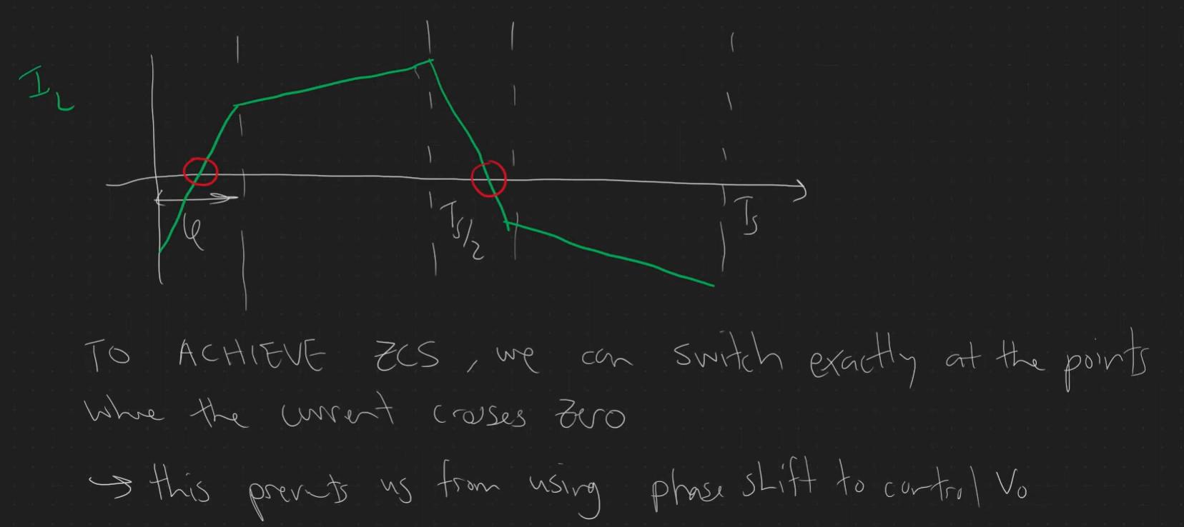
ZCS

Slide 13
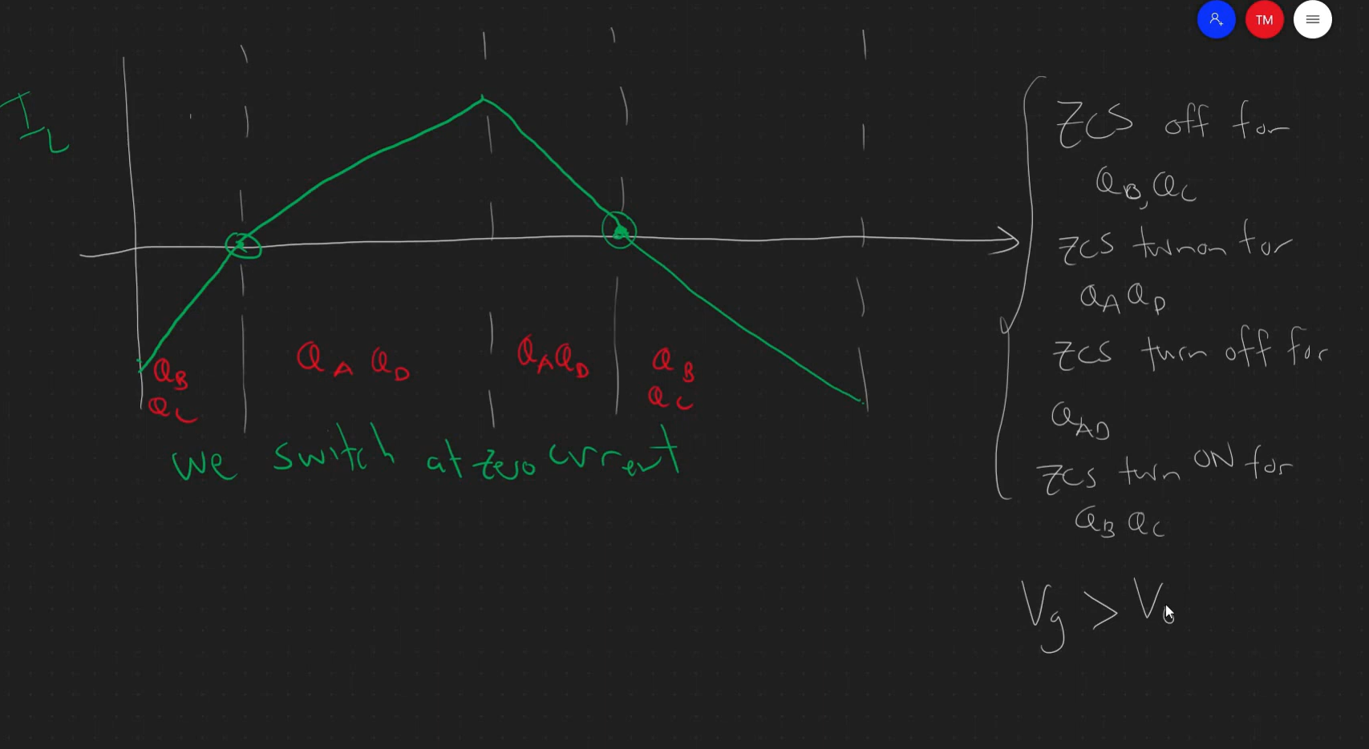
A new modulation to achieve soft switching ZCS

Slide 14
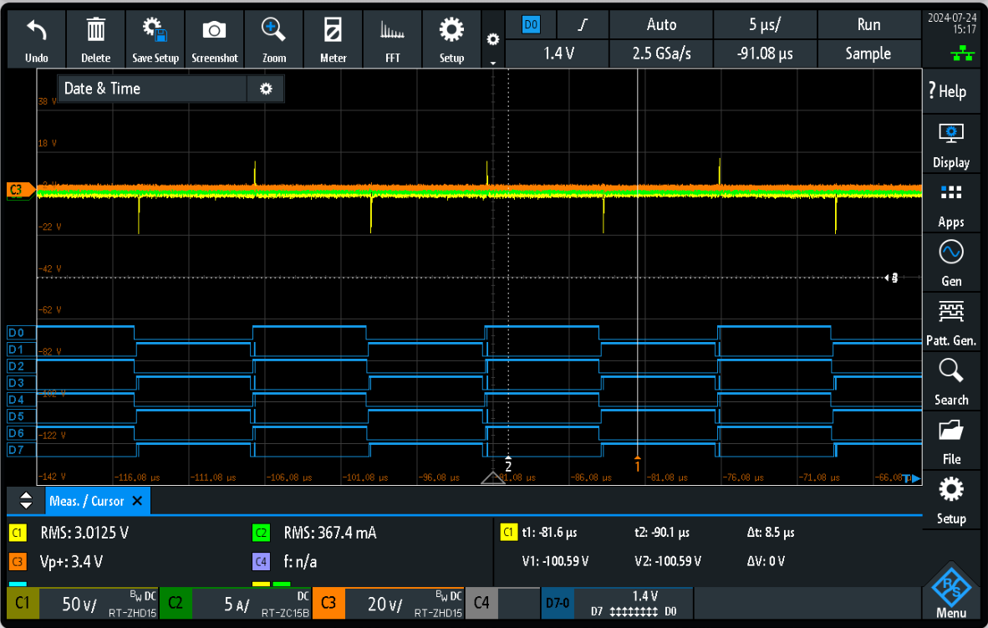
Actual testing to the DAB board in Garching (Open Loop measurement) – no Power flow
Control Phase: 0 degrees
Primary side PWM
PWM1: D0 D1
PWM3: D2 D3
Secondary side PWM
PWM2: D4 D5
PWM4: D6 D7

Slide 15
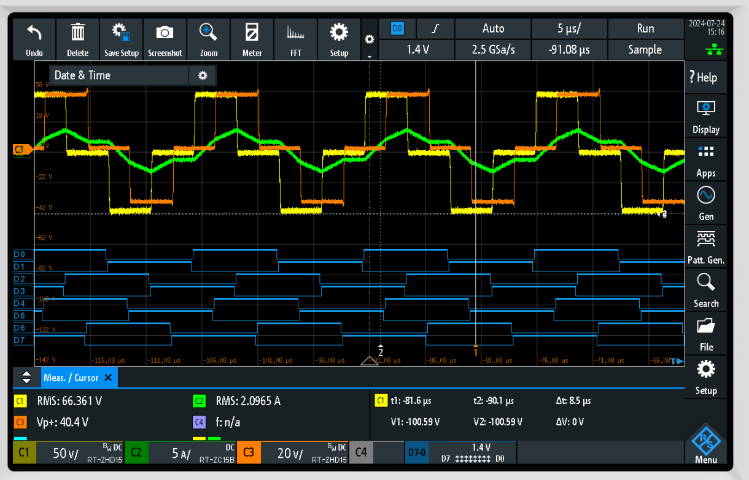
Actual testing to the DAB board in Garching (Open Loop measurement) – with Power flow
Control Phase: 90 degrees
Primary side PWM
PWM1: D0 D1
PWM3: D2 D3
Secondary side PWM
PWM2: D4 D5
PWM4: D6 D7
C1 – yellow (primary Bridge voltage)
C2 - green (transformer current)
C3 - orange (secondary Bridge voltage)

Slide 16
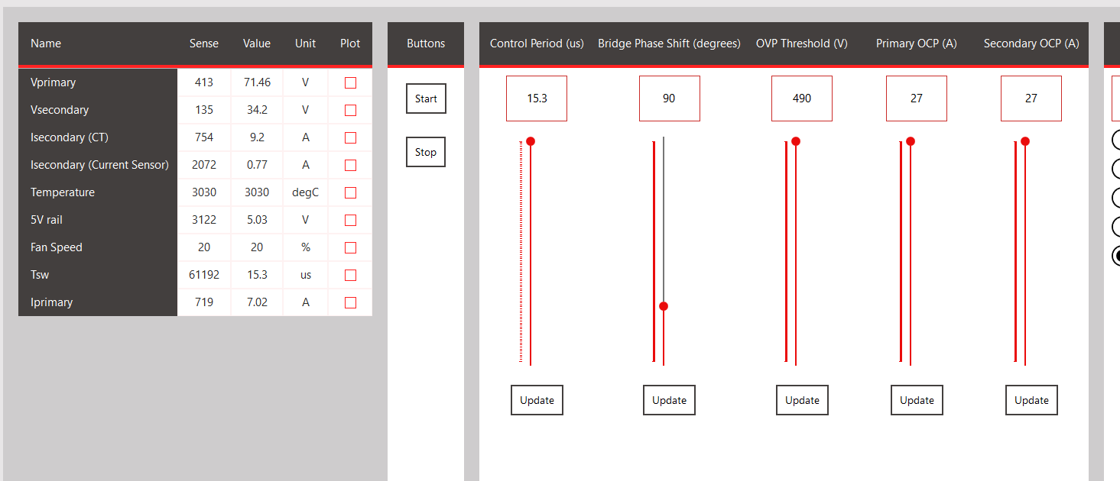
Actual testing to the DAB board in Garching (Open Loop measurement) – with Power flow

