Slide 1
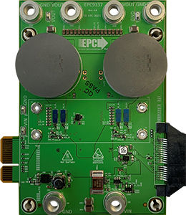
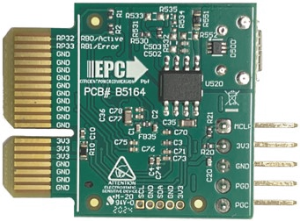
125 A
125 A @ 12 V DC
VOUT = 12 V DC (buck mode)
VIN = 9…18 V DC (boost mode)
EPC9528
Controller Card
EPC9528
Controller Card
- supported soon -
17…64 V DC
(buck mode)
VOUT = 48 V DC (boost mode)
32 A @ 48 V DC
29 A

Slide 2
VOUT = 12 V DC (buck mode)
VOUT = 12 V DC (buck mode)
250 A
EPC9528
Controller Card
17…64 V DC
(buck mode)
66 A @ 48V
17…64 V DC
(buck mode)

Slide 3
VIN = 9…18 V DC (boost mode)
VOUT = 12 V DC (buck mode)
125 A @ 12 V DC
EPC9528
Controller Card
EPC9528
Controller Card
- supported soon -
VOUT = 48 V DC (boost mode)
17…64 V DC
(buck mode)
29 A
32 A @ 48 V DC
48V/3A Auxiliary Power Supply
For Loss Compensation

