Slide 1
dsPIC33EDV64MC205 Development Board Operating Instruction

Slide 2
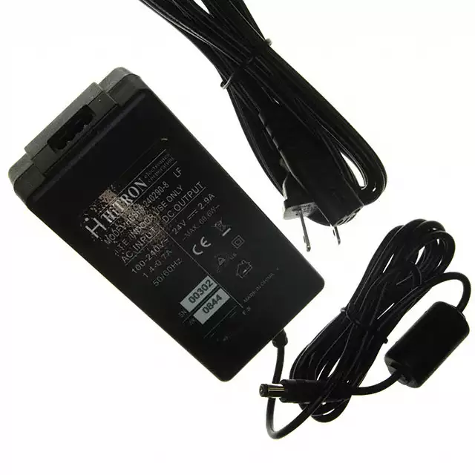
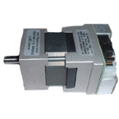
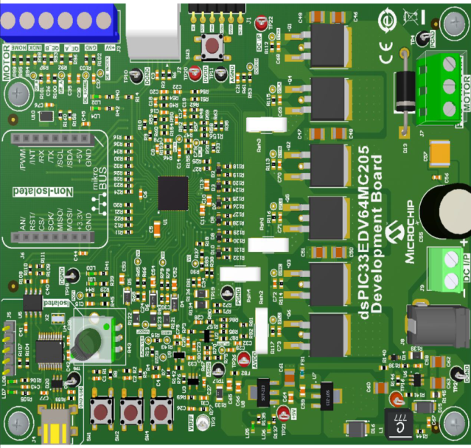
Demonstration Requirements
dsPIC33EDV64MC205 Development Board
24V Power Supply (AC002013) (available at www.microchipdirect.com)
24V Hurst Motor (AC300020) (available at www.microchipdirect.com)

Slide 3

dsPIC33EDV64MC205 Development Board
Programming/
Debug Interface
Connector (J2)
MCLR Reset
(SW3)
Debug LED(LD2)
Motor Connector
(J7)
Debug LED(LD1)
Input Power
Supply connectors
(J9 and J8)
Speed Reference
Potentiometer
(POT1)
Pushbutton(SW2)
Pushbutton(SW1)
USB-UART Debug
Interface (J4)

Slide 4
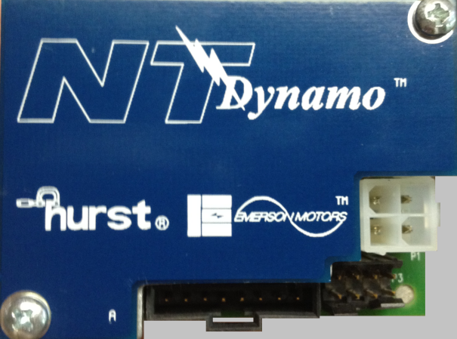
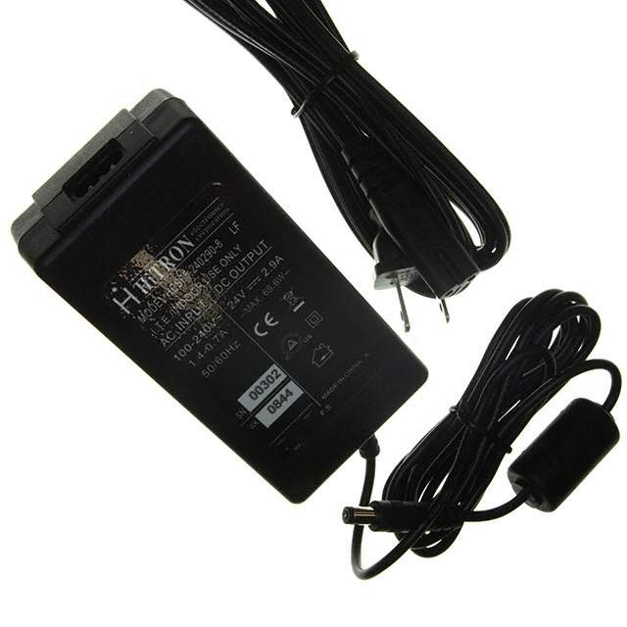
Connection Diagram- Power Supply and Motors
Leave Green wire disconnected
Plug-in the output of the 24V adapter to connector J8 on the dsPIC33EDV64MC205 Development Board.
MOTOR

Slide 5
Operating Instructions
 | Press button SW1 button the dsPIC33EDV64MC205 Development Board. The motor should start spinning smoothly in one direction. Led ‘LD1’ is turned off indicating button SW1 is pressed and the motor is spinning.
 | Vary the speed of the motor using the potentiometer1,labeled POT 1 on dsPIC33EDV64MC205 Development Board. In the Normal mode ,potentiometer can be used to set speed in the range 500-2000 Rpm. In the extended speed mode, potentiometer can be used to set speed in the range 500-3500 rpm.
 | Press button SW2 on the dspIC33EDV64MC205 Development Board, to enter extended speed range. In this mode, output power delivered by motor is limited in the speed ranging from 2000 Rpm to 3500 rpm.
 | Press button SW1 while motor is spinning to stop the motor. Led LD1is turned ON to indicate motor has stopped.

Slide 6
Thank You

