Slide 1
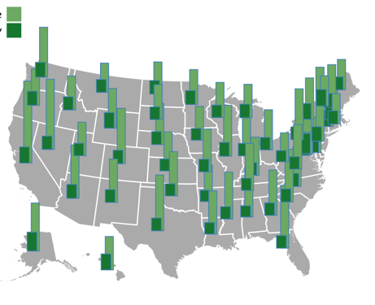
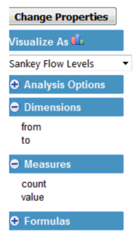
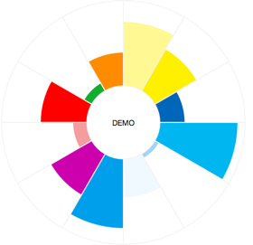
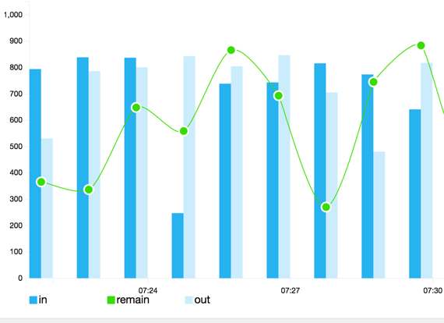
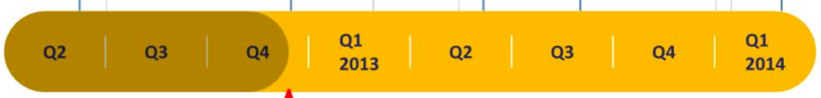
Dimensions Filter: (multiple choices)
User (session & scenarios(aggregate) & request type)
Service & Instance (service category, instance count)
Runtime Metrics (QoS, exceptions)
Statistics Chart: (multiple choices)
User
Service & instance
Runtime Metrics
Instance|service
landscape|flow|compare

Slide 2
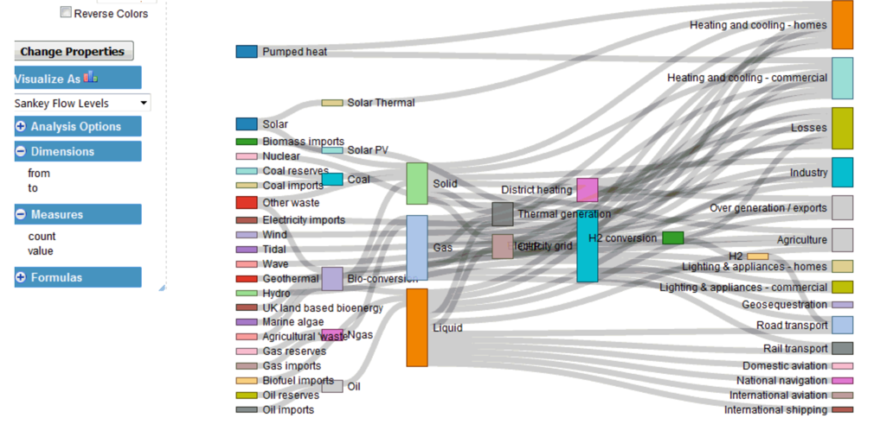
Dimensions Filter: (multiple choices)
User (session & scenarios(aggregate) & request type)
Service & Instance (service category, instance count)
Runtime Metrics (QoS, exceptions)
Statistics Chart: (multiple choices)
User
Service & instance
Runtime Metrics
Instance|service
landscape|flow|compare

Slide 3
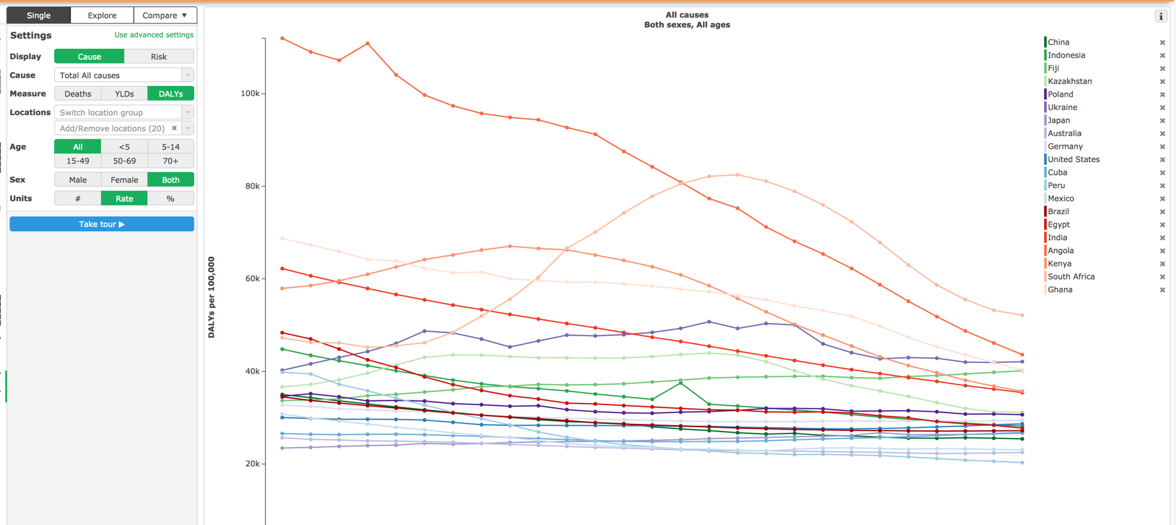
Instance|service
landscape|flow|compare

