Slide 1
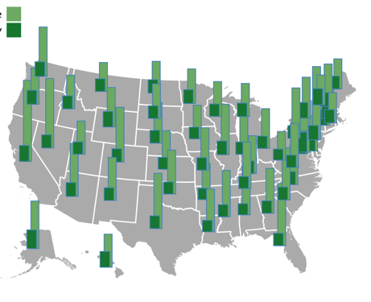
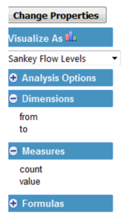
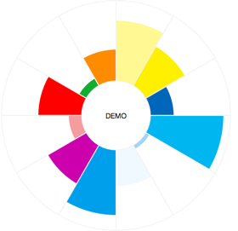
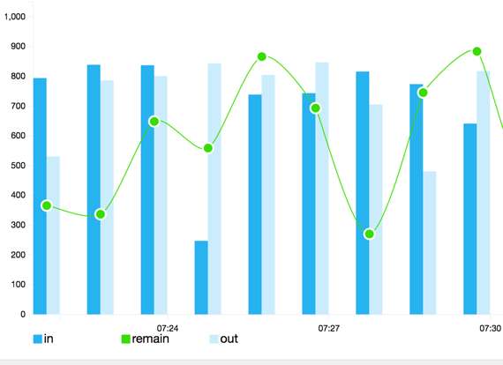
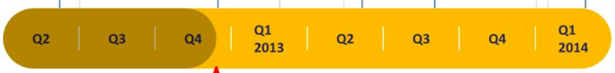
Dimensions Filter: (multiple choice)
User (session & Scenarios & request type)
Service & Instance
Runtime Metrics (QoS)
Statistics Chart: (multiple choice)
User
Service & instance
Runtime Metrics (QoS)
Instance|service|compare

Slide 2
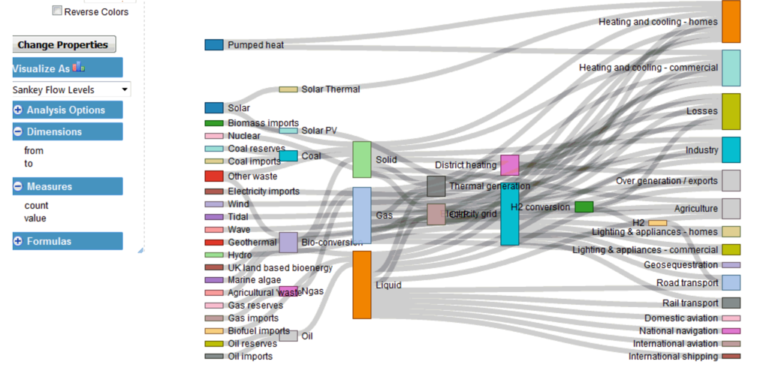
Dimensions Filter: (multiple choice)
User (session & Scenarios & request type)
Service & Instance
Runtime Metrics (QoS)
Statistics Chart: (multiple choice)
User
Service & instance
Runtime Metrics (QoS)
Instance|service|compare

Slide 3
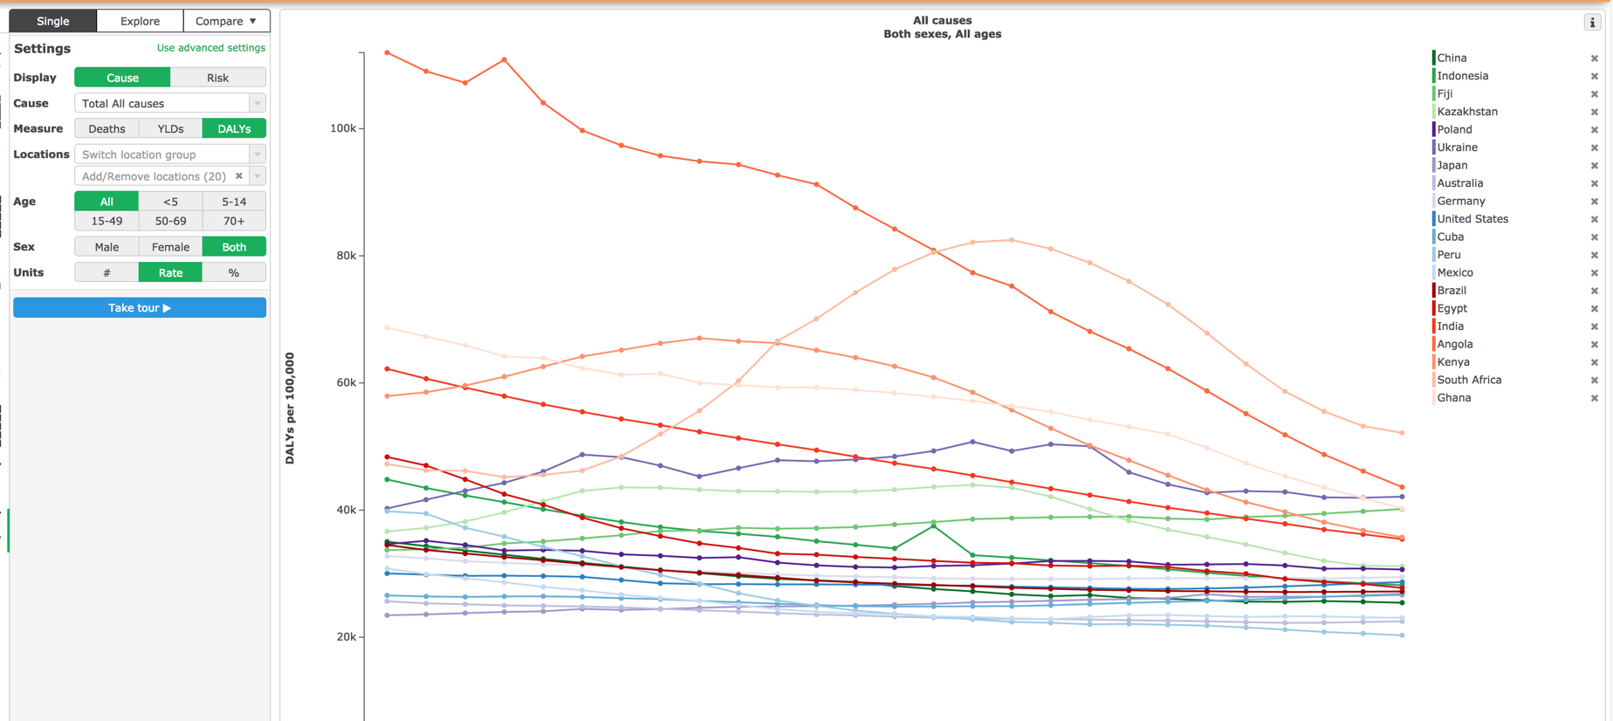
Instance|service|compare

