Slide 1
Flow-based programming for heterogeneous systems
with NoFlo and MicroFlo
Jon Nordby, FOSDEM 2014

Slide 2
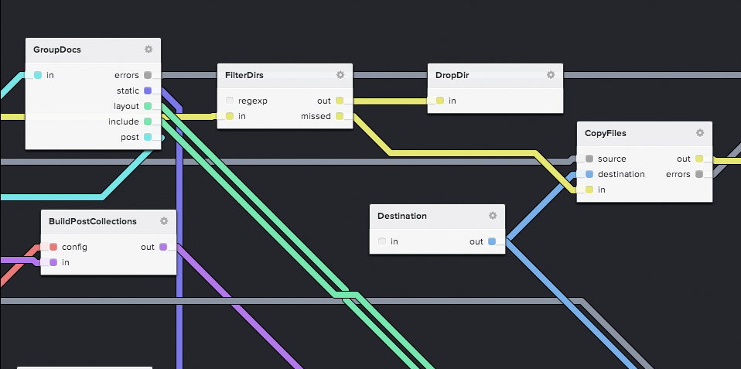
FBP 101
No source code generation!

Slide 3
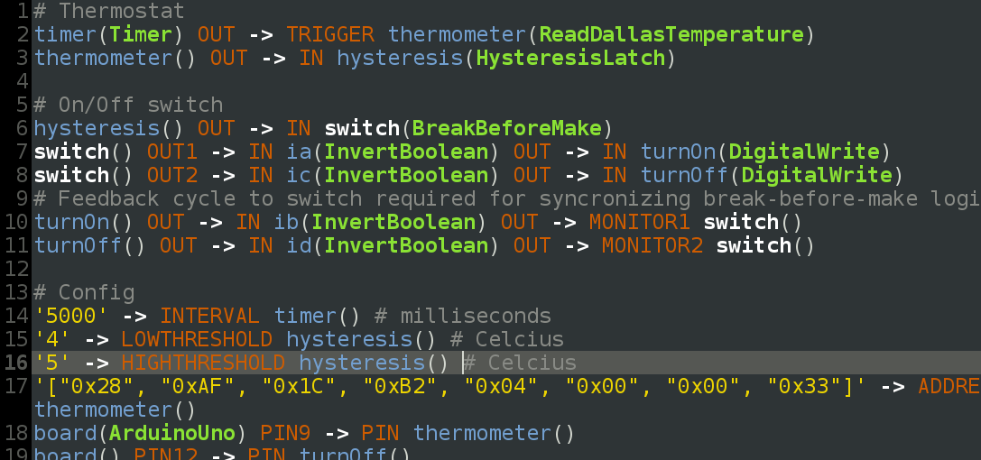
FBP: Not just visual programming
+ Both NoFlo and MicroFlo have embedding APIs

Slide 4
Case: Heating system
User Interface
Data aggregation/analysis
Sense & actuate
Tablet/phone/desktop
uC
uC
Embedded/Server
uC
Fluent
Many platforms
BYOD
JavaScript+HTML
ObjC,Java,C#
Secure
Python/Lua/Ruby
+++
Realtime
C/C++

Slide 5
Next
Finishing MicroFlo graphs as NoFlo components
More dynamic component registration
Subgraph editing UI
Node.js graphs as components in browser
FBP runtimes as peers, not just components
Specialized domains/runtimes
Proper case studies!

Slide 6
?
flowhub.io
noflojs.org, @noflo
microflo.org
Jon Nordby, jonnor.com, @jononor

Slide 7
!
Testing & verification
Device freedom
Visual programming
Audio/graphics processing
FPGA
GPGPU

Slide 8
Sensorblock
“universal” reprogrammable sensor
uController + collection of common sensors
+ battery, wireless, storage
Arduino priced, weather-proofed, pocket-size
Open hardware, fablab/hackerspace friendly
github.com/jonnor/sensorblock

