Slide 1

Death to Black Boxes
Open Hardware Summit 2014
Jon Nordby
@jononor

Slide 2
Developer vs User
Freedom
Open Source Software
vs
Free Software
Notes:
Open source software won. Massively successful
Google, Facebook, Twitter all built on OSS
Does not translate into freedom or control for users
Open source is about developer freedom
Free software however. End-users of software
Some see this as a PR failure, highlighting RMS and absolutist views (propriatery SW is immoral)
I think it is a failure of us as developers,
not keeping true to the goal and delivering
user experiences that make it easy to
make use of the freedoms that the SW/HW offers

Slide 3
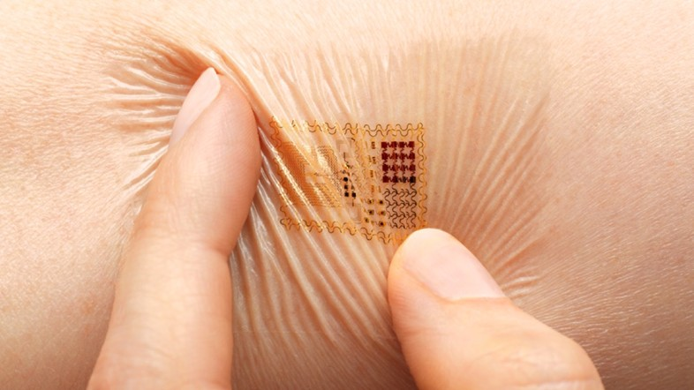
Embedded
Notes:
http://www.dazeddigital.com/artsandculture/article/18152/1/best-top-ten-wearable-tech-inventions
Embedded Devices
Increasing importance in our lives
We have one with us in our pocket at all times
Be on our body and in our clothes
Will soon be in our bodies
Similar or stock-hardware, differentiation in SW
(and services)
Cory Doctorow – war on general purpose computing
“we don't have cars, we have computers that drive
we don't have airplanes, we have computers that fly“
Difference between toaster and a SMD reflow-oven could just be the SW for the temperature curve

Slide 4
Second Digital Divide
Creators vs Consumers
Notes:
Majority of electronics made by a small minority
When you make technology, make a lot of changes
Bias of the creators
Cultural impact
Problems
* Diversity suffers
* Chasing markets instead of solving problems
Example: More spending on viagra 2than malaria

Slide 5

OSHW
http://mattkeeter.com/projects/bumpy/

Slide 6
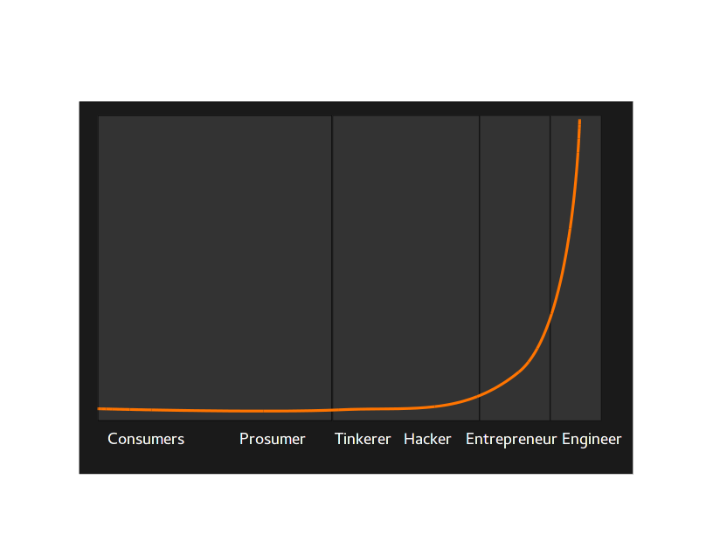
Engagement
Notes:
Raise the engagement of the tail
Move people up to the head

Slide 7
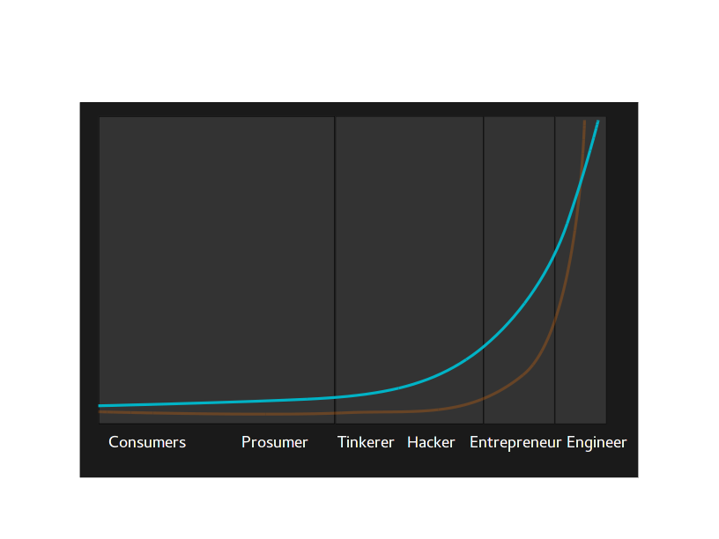
Smoothen the transition

Slide 8
NFC → live IDE
https://www.youtube.com/watch?v=EdgeSDFd9p0
Notes:
Video w/live commentary
alternativ: 3-5 slides slowing the flow

Slide 9
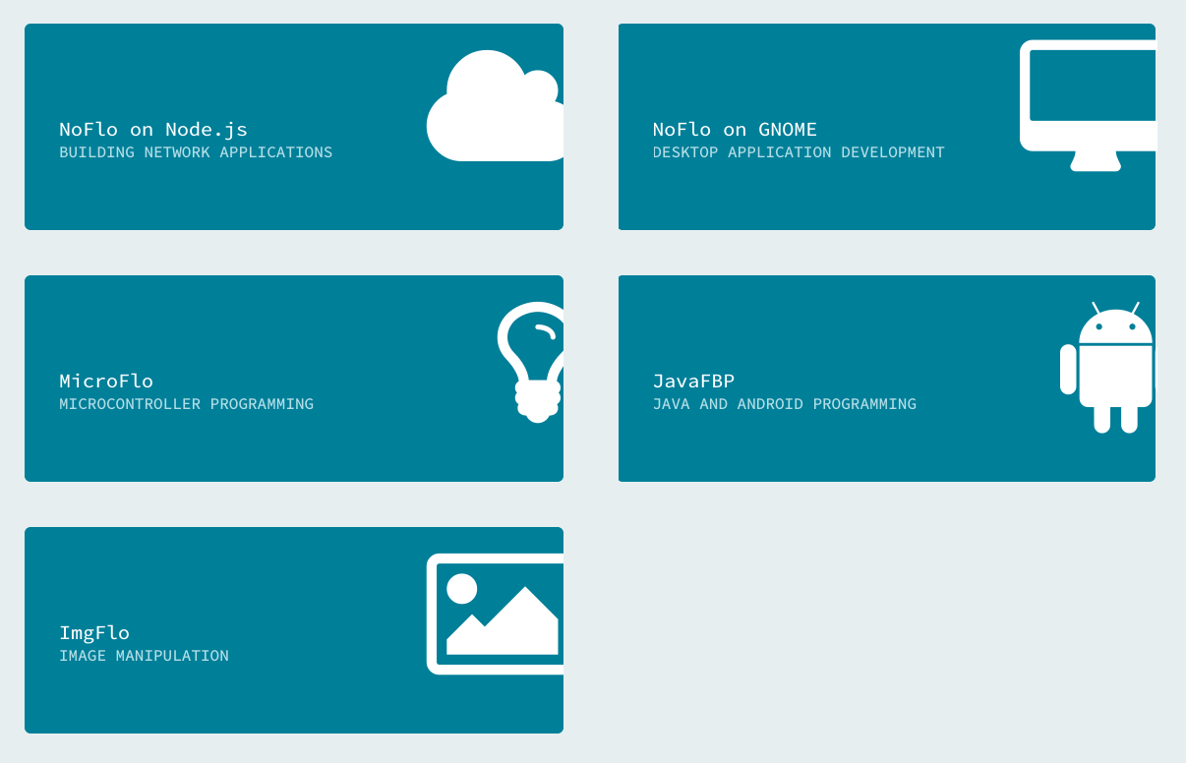
Full stack

Slide 10
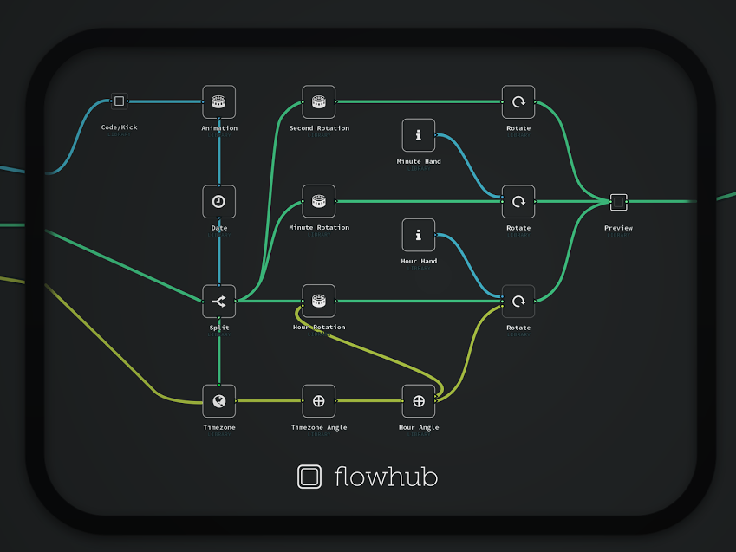
Death to Black Boxes!
Thank you!
@jononor
Notes:
Show

