Slide 1
MicroFlo
flow-based &
visual programming
for microcontrollers
http://microflo.org
Jon Nordby, MeshCon 2015

Slide 2
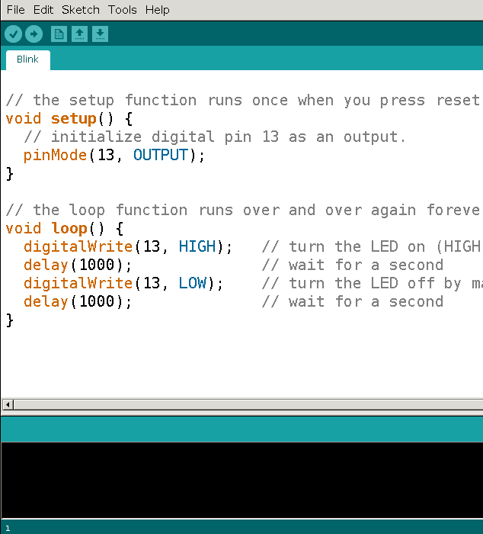
Programming Today
“Code”
Text
C/C++
Imperative
write→compile→flash→restart→

Slide 3
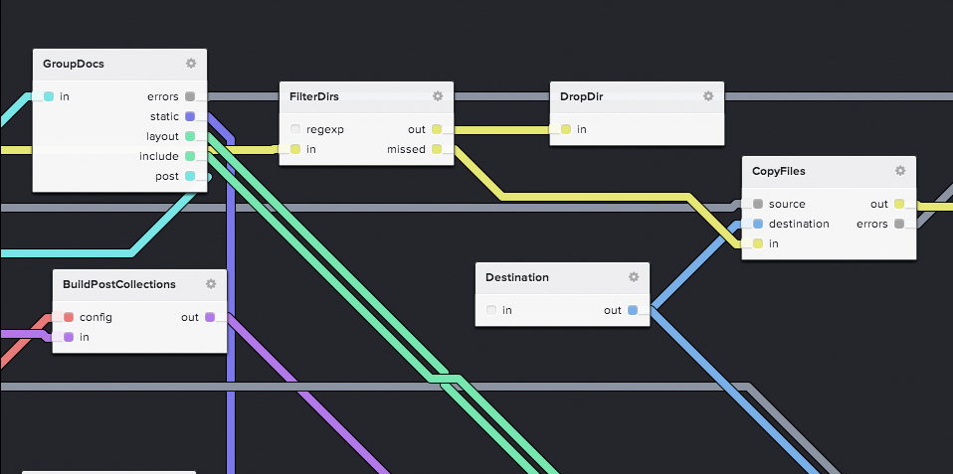
FBP 101
No source code generation!

Slide 4
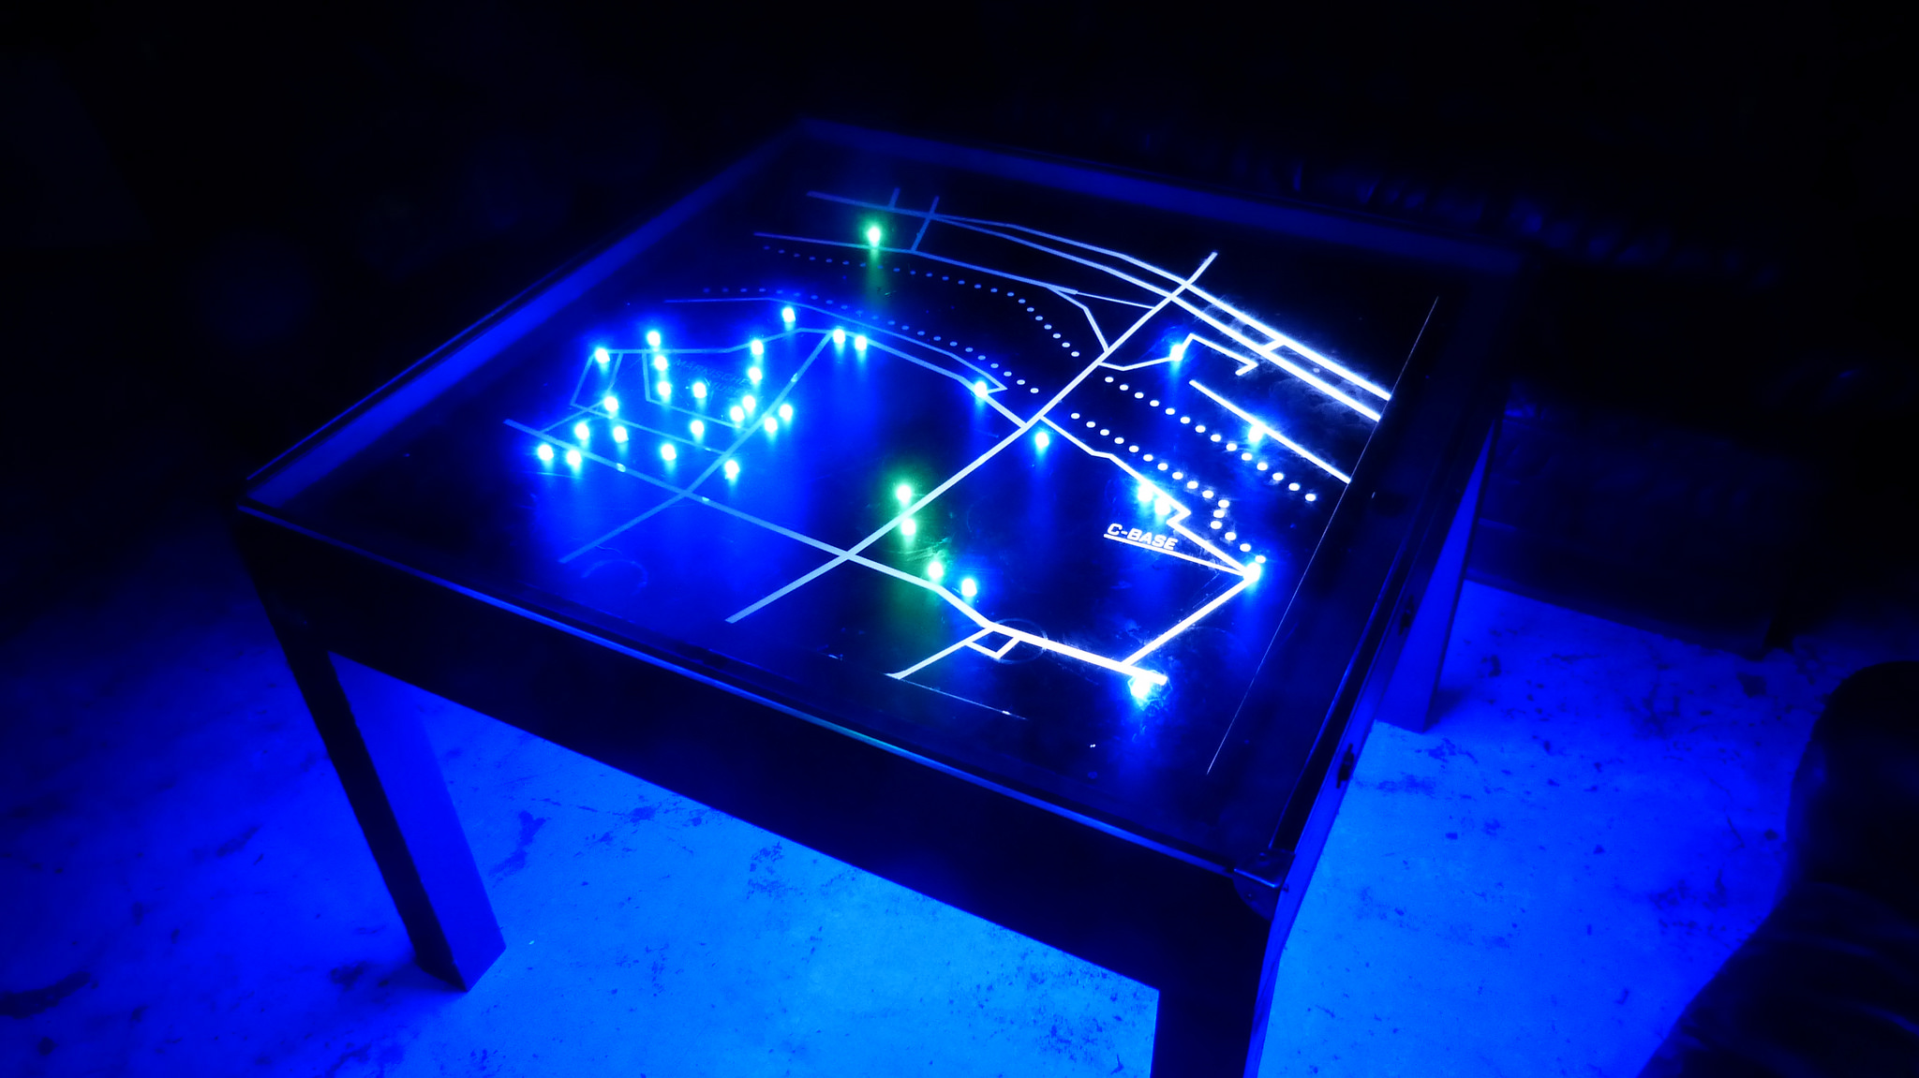
Case: Ingress Table
https://github.com/c-base/ingress-table

Slide 5
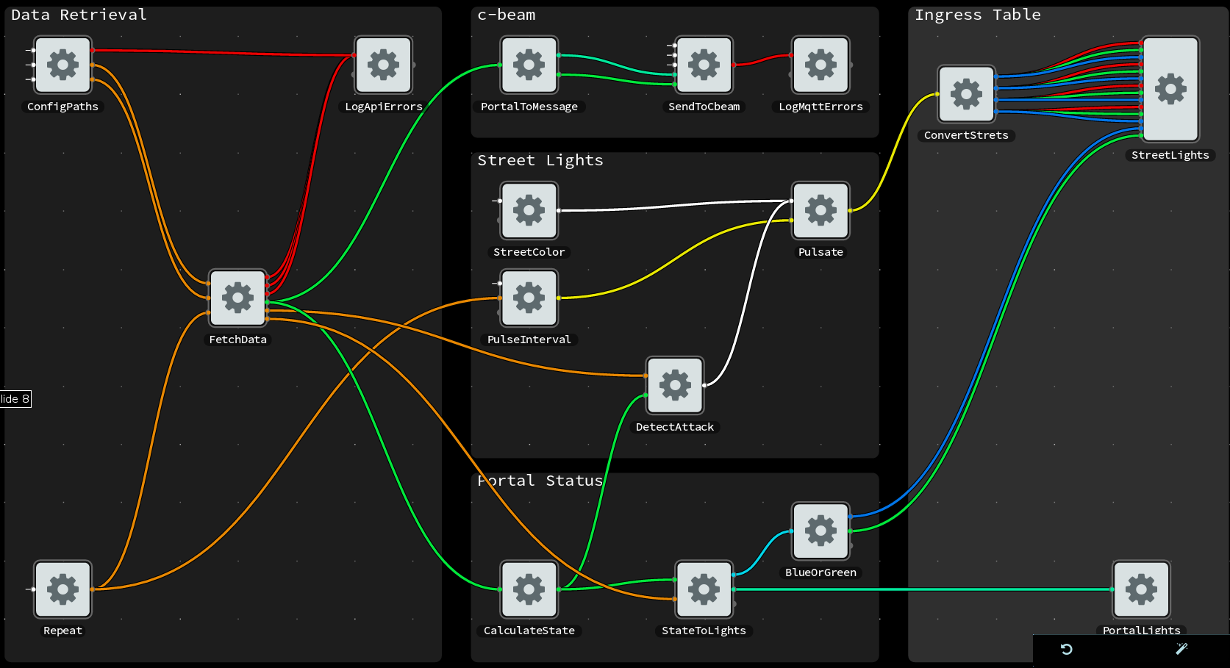
On Raspberry Pi

Slide 6
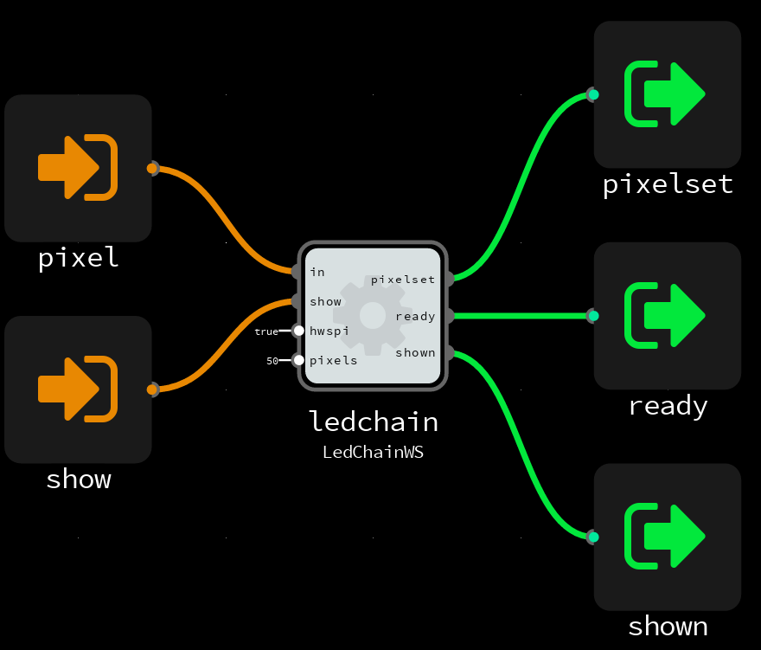
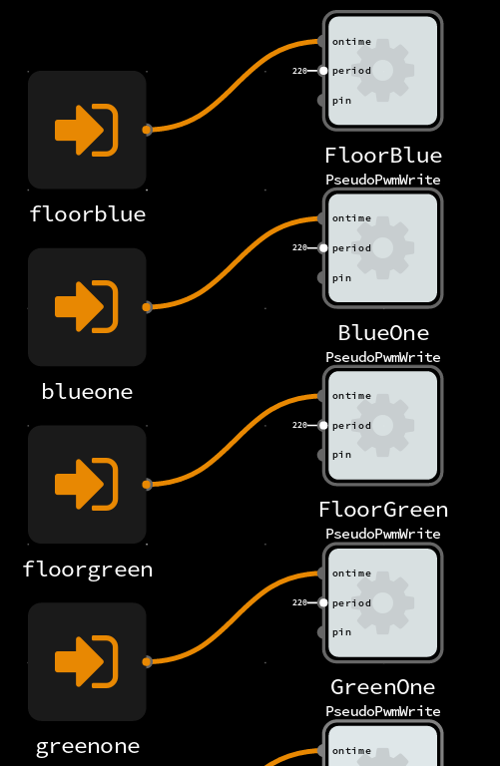
On microcontroller

Slide 7
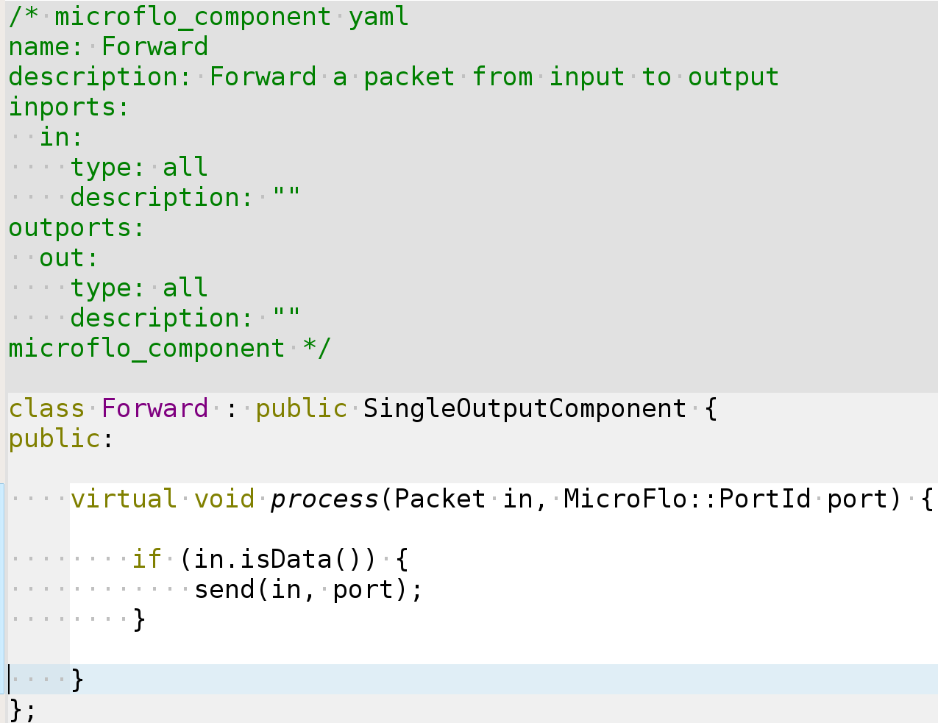
Inside component

Slide 8
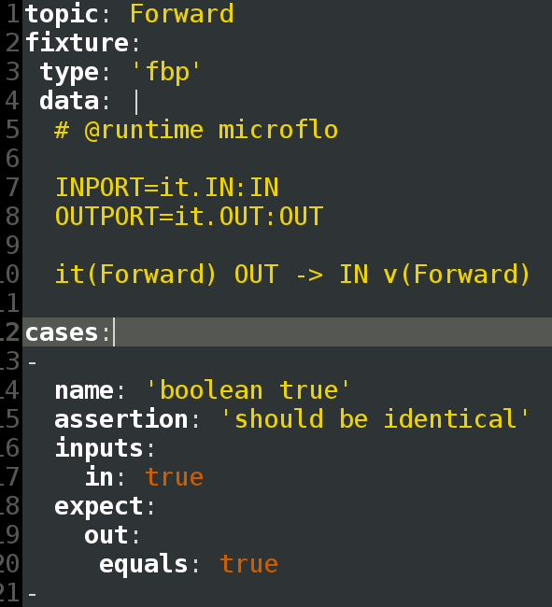
Data-driven testing
https://github.com/flowbased/fbp-spec

Slide 9
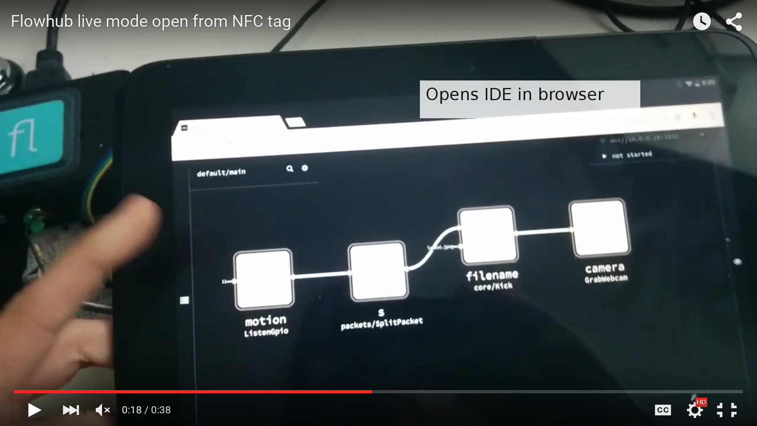
Live mode
https://www.youtube.com/watch?v=EdgeSDFd9p0

Slide 10
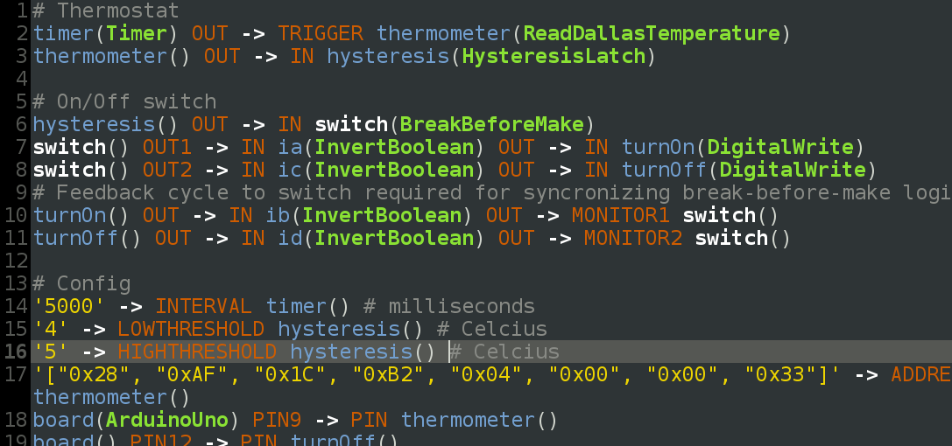
Visual programming optional
.FBP domain-specific language
+ embedding APIs

Slide 11
Get involved
MQTT workshop at c-base, Monday 18.00
At MeshCon, chat afterwards
Visit flowhub.io microflo.org
Jon Nordby, jonnor.com, @jononor

