Slide 1
Getting NGS data
Aim : Associate any NGS related study publication with the databases. Link the raw data files with the study and download all the relevant data.
Course Wiki: http://10.152.154.17/wiki/doku.php

Slide 2
Last Wednesday
NGS study types
  Genome Assembly
  Resequencing
  Gene Expression
  Metagenomics
  Epigenomics
Navigating NCBI Taxonomy
Species Specific information
Related Species information

Slide 3
Getting NGS data
Navigating NGS Data repositories
Understanding How data is arranged
Linkage between different datasets
Downloading NGS

Slide 4
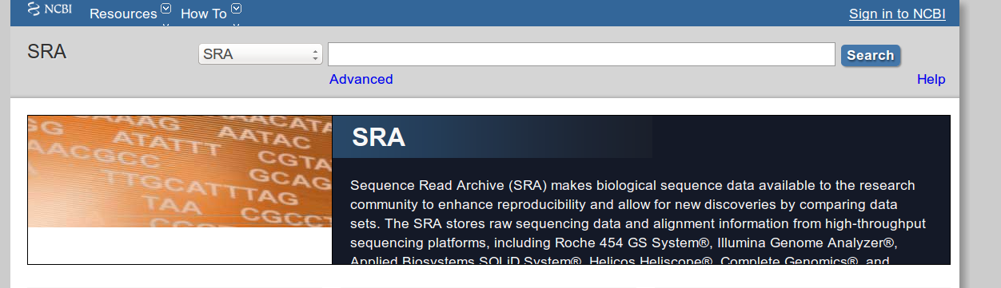


Data Repositories

Slide 5
Data repositories
NCBI SRA is the main repository
SRA links out to other NCBI databases (e.g. pubmed, bioproject, taxonomy )
DDBJ and ENA support SRA
All 3 are synced regularly
SRA ids can be used in DDBJ and ENA
Most Journals ask mandatory data submission to SRA
Embargos and privacy concerns might make some data unavailable
SRA has been criticized for its complexity and its future is uncertain

Slide 6
Main Goal
Take a relevant project (Publication)
Dissect it in different modules
Understand each module
Find each module in database
Get the data for each experiment
Access files
  .sra
  FastQ
  Bam
  Bed

Slide 7
Why now Download directly ?
Multiple Samples....
Multiple Substudies....
Multiple Species....
Sample 1
Assembly
Human
Sample 2
DNA-Seq
Mouse
One Paper
Sample 3
Resequencing
Expression
Sample n
Data Bundle

Slide 8
Basic Module
Study
Sample
(Tissue)
Liver
Leaf
Soil
….
Experiment
Purification
Sonication
Library Prep
Sequencing Run
Data
Raw machine output
Nucleotide calls
Alignment
….
S → E → D
Sample
Experiment
Data

Slide 9
Study
DNA Extraction
Sonication
Library Prep
DNA-Seq Run
Genomic Sequences
Leaf
RNA Extraction
RNA -> cDNA
Library Prep
RNA-Seq Run
Transcriptome/Gene_Expression

Slide 10
Study
Healthy
Leaf
Control Transcriptome
RNA Extraction
RNA -> cDNA
Library Prep
RNA-Seq Run
Infected Leaf
Case Transcriptome

Slide 11
Study Structure
S → E → D
S → E → D
S → E → D
S → E → D
S → E → D

Slide 12
BioProject: Complicated Studies
Called as BioProjects
Big projects (Initiative)
Organizations/Consortium
Many studies in one project

Slide 13
BioProject Structure
S → E → D
S → E → D
S → E → D
S → E → D
S → E → D
S → E → D
S → E → D
S → E → D
S → E → D
S → E → D
S → E → D

Slide 14
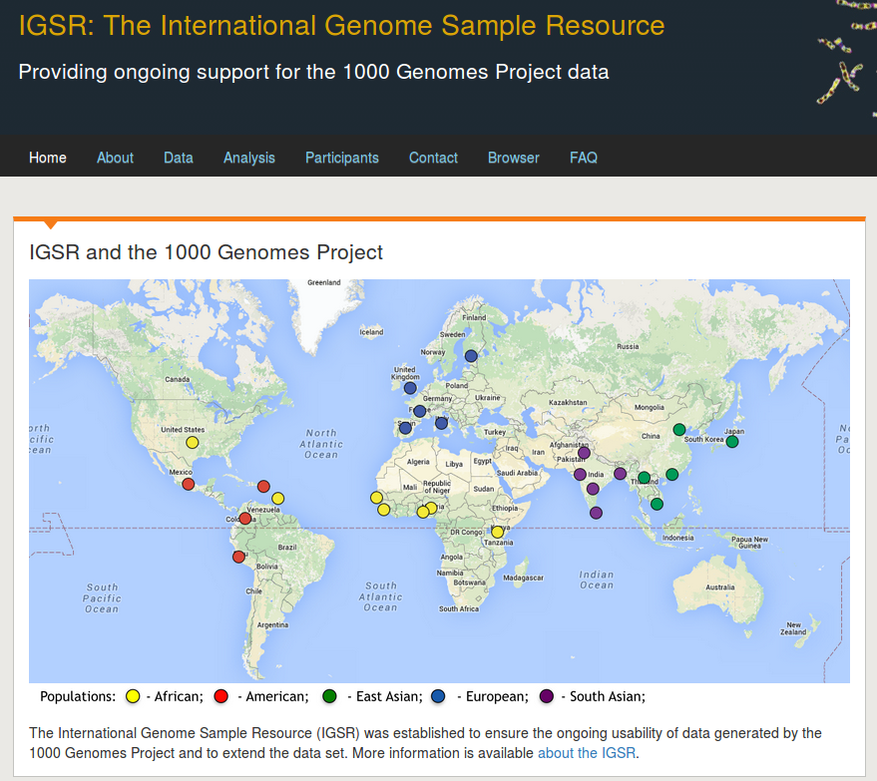
1000 genomes bioproject
Accession : PRJNA28889
http://www.1000genomes.org/

Slide 15
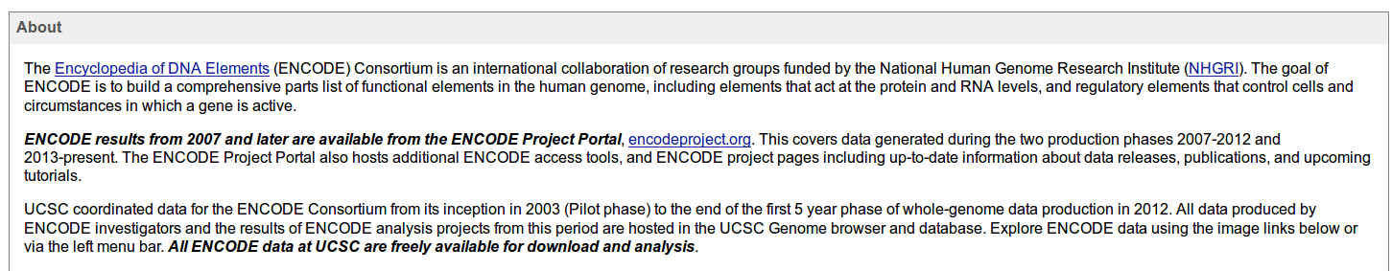
ENCODE Project
http://genome.ucsc.edu/ENCODE/
PRJNA30707

Slide 16
Linking by experiment type
?
NGS Experiment
?
?

Slide 17
Linking by experiment type
DNA-Seq
NGS Experiment
RNA-Seq
Chip-Seq Epigenetics

Slide 18
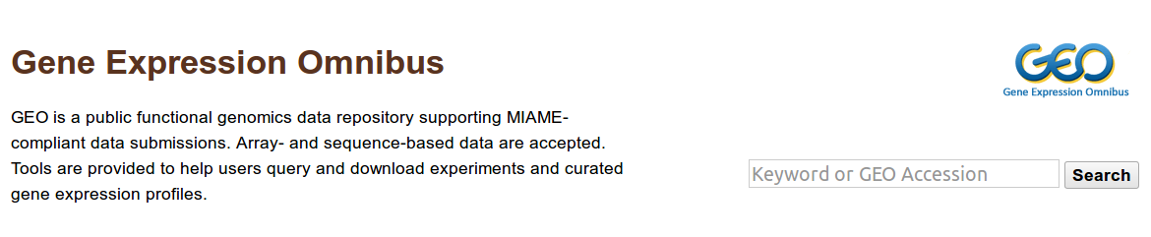
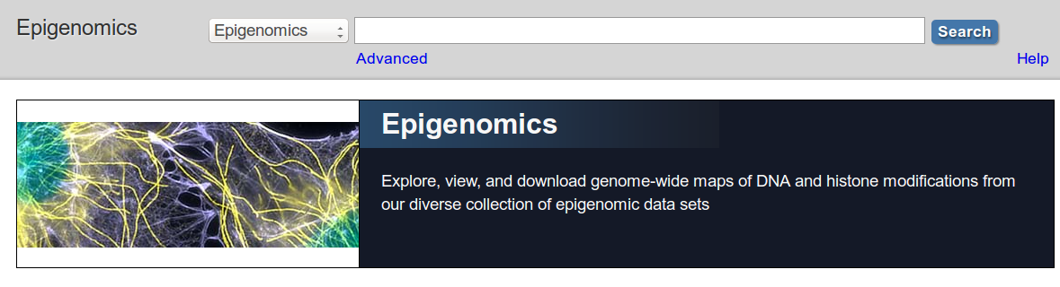
LinkOut
DNA-Seq
404
RNA-Seq
Epigenomics

Slide 19
LinkOut
NCBI GEO
S → E → D
S → E → D
RNA-Seq
S → E → D
S → E → D
S → E → D
S → E → D
S → E → D
S → E → D
Epigenomics
S → E → D
S → E → D
S → E → D
NCBI Epigenomics

Slide 20
Recap
S → E → D
Study [(S → E → D), (S → E → D), (S → E → D) ... ]
BioProject [ [(S → E → D), (S → E → D)... ], [(S → E → D), (S → E → D)...], [(S → E → D), (S → E → D)... ], ... ]
NCBI-GEO LinkOut
NCBI-Epigenomics LinkOut

Slide 21
BioProject
PRJNA*
BioSample
SRS*/ERS*
SAM
Organism
Tissue
...
Experiment
SRX*/ERX*
Machine
Protocol
...
Study
SRP*/ERP*
Who did it
Description
...
RUN
SRR*/ERR*
Data
….
...
Submission
SRA
Metadata
….
...

Slide 22
Different SRA ID types
Study (SRP)– A study is a set of experiments and has an overall goal.
Experiment (SRX) – An experiment is a consistent set of laboratory operations on input material with an expected result.
Sample (SRS)– An experiment targets one or more samples. Results are expressed in terms of individual samples or bundles of samples as defined by the experiment.
Run (SRR)– Results are called runs. Runs comprise the data gathered for a sample or sample bundle and refer to a defining experiment.
Submission (SRA) – A submission is a package of metadata and/or data objects and a directive for what to do with those objects.
Source : http://www.ncbi.nlm.nih.gov/books/NBK47533/

Slide 23
PROBLEM
Explain the type for each id, get the information listed in NCBI
  SRS372877
  SRS1165894
  SRX527715
  SRP039339
  SRR1262828

Slide 24
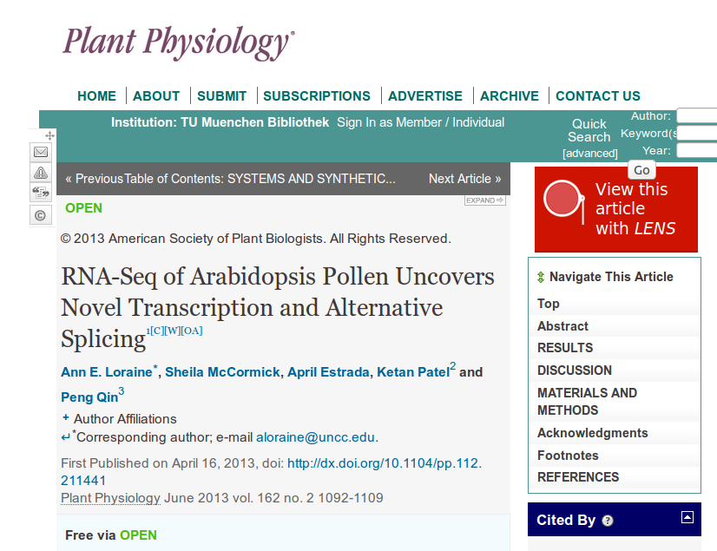
BioSample = ?
Experiment = ?

Slide 25
Study
BioSample = Pollen
Pollen → RNA-Seq → Data
Experiment = RNA-Seq
S → E → D

Slide 26
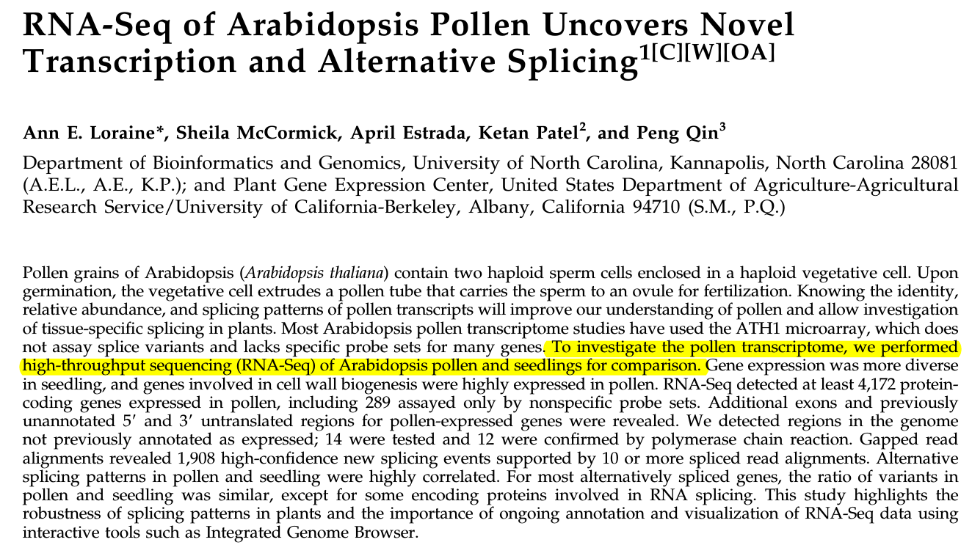
BioSample = Pollen, Seedlings
Seedlings → RNA-Seq → Data
Pollen → RNA-Seq → Data

Slide 27
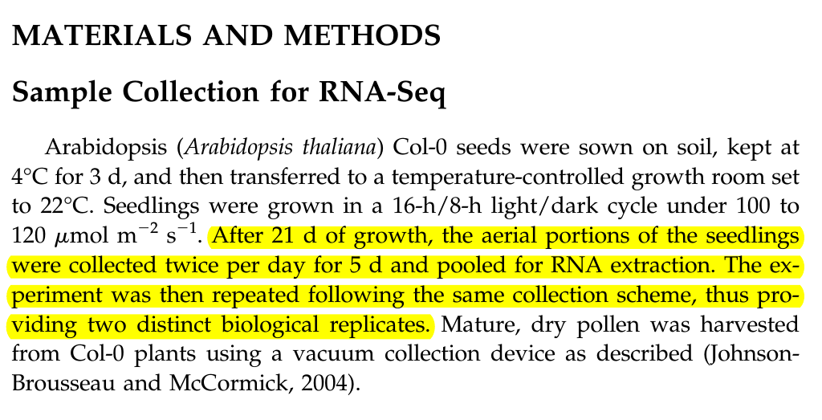
BioSample = Pollen, Seedlings (REP1), Seedlings (REP2)

Slide 28
Seedlings(R1) → RNA-Seq → Data
Seedlings(R2) → RNA-Seq → Data
Pollen → RNA-Seq → Data

Slide 29
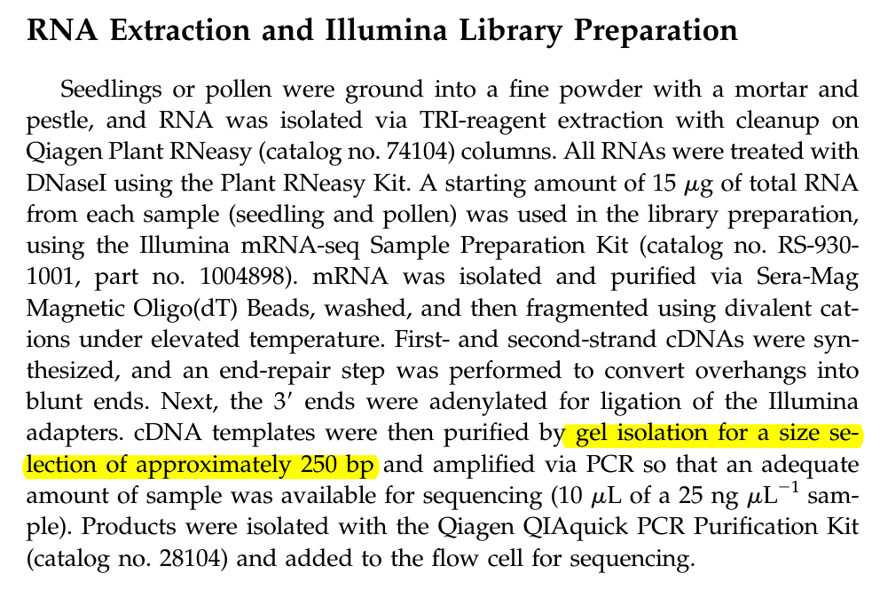

Slide 30
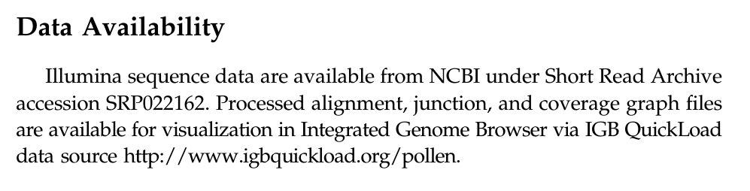
Testing Our Model!
Seedlings(R1) → RNA-Seq → Data
Seedlings(R2) → RNA-Seq → Data
Pollen → RNA-Seq → Data

Slide 31
Final Model
Seedlings(R1) → RNA-Seq → Data
Seedlings(R1) → RNA-Seq → Data
Seedlings(R2) → RNA-Seq → Data
Seedlings(R2) → RNA-Seq → Data
Pollen → RNA-Seq → Data
Pollen → RNA-Seq → Data

Slide 32
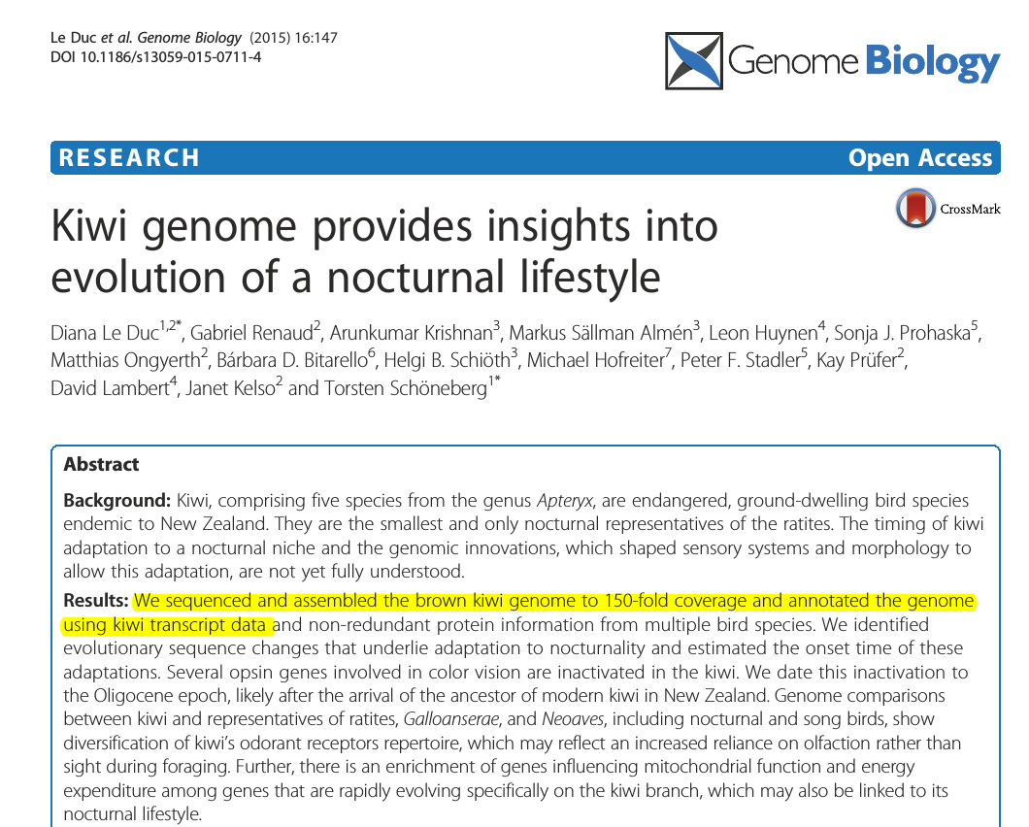
BioSample=?
Experiment=DNA-Seq,RNA-Seq ?

Slide 33
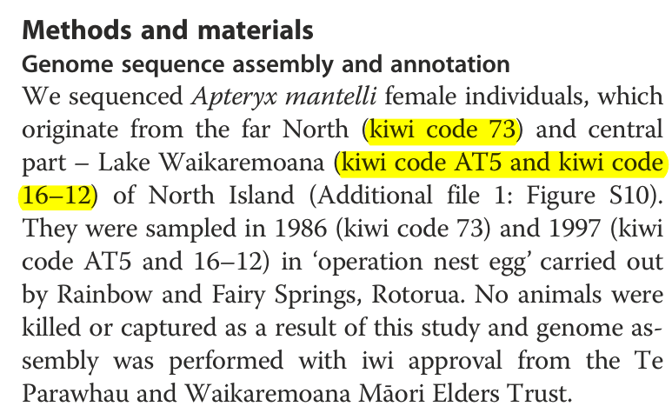
73
BioSample
AT5
16-12

Slide 34
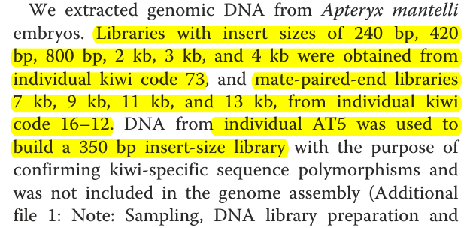
73
240bp, 420bp, 800bp, 2kb, 3kb, 4kb
6
BioSample
AT5
7kb, 9kb, 11kb, 13kb
4
16-12
350 bp
1

Slide 35
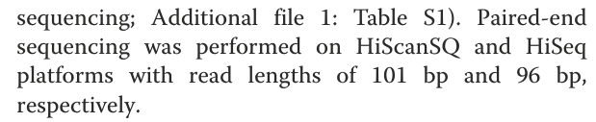
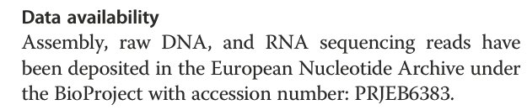
73
240bp, 420bp, 800bp, 2kb, 3kb, 4kb
6
BioSample
16-12
7kb, 9kb, 11kb, 13kb
4
AT5
350 bp
1

Slide 36
Model
DNA-Seq
73
DNA-Seq
AT5
S → E → D
S → E → D
S → E → D
S → E → D
S → E → D
S → E → D
S → E → D
DNA-Seq
16-12
RNA-Seq
???
S → E → D
S → E → D
S → E → D
S → E → D
S → E → D
12 entries in SRA ??

Slide 37
Validation
DNA-Seq
73
DNA-Seq
AT5
S → E → D
S → E → D
S → E → D
S → E → D
S → E → D
S → E → D
S → E → D
DNA-Seq
16-12
RNA-Seq
???
S → E → D
S → E → D
S → E → D
S → E → D
S → E → D

Slide 38

Problem
Prepare a conceptual model for the following paper.
  Get all sample, run and study identifiers.
  Add these identifiers to the model

Slide 39
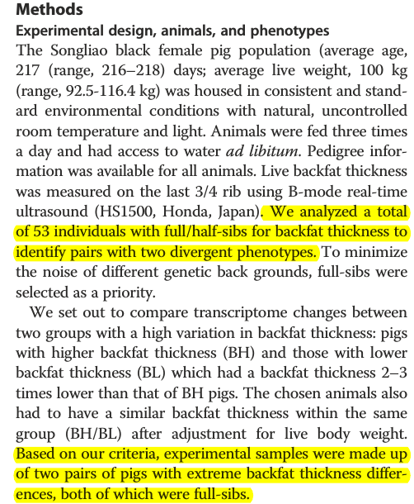

Slide 40
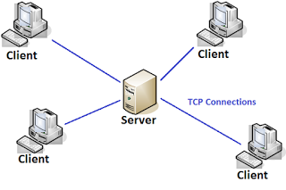
Client Server Architecture
10.152.154.1
All storage and computation happens on Server
Client connects securely (Encryption, Passwords)
Commands are issued by Client on terminal
These are sent to the server and executed
Screen Output of these commands is sent back to terminal
No computation happens on the client

Slide 41
Command Line Utilities
Filename
Multiple
Pattern
Print to Screen
Do Nothing
command arguments input output
Print to a file
Precede by > or >>
Essential
Only one
Optional
Change command behavior
Multiple
Space separated
Typically preceded by -
Can be key=value pairs
Pipe to another command
Precede by |

Slide 42
Example Commands
ls
head/tail
grep
wc
pwd
cat
mkdir
Touch
locate
cp
mv
cd
less
rm
df
cal
file
man

Slide 43
Example patterns
~ (Your home directory)
. (Current directory)
../ (Directory above current directory)
* (All files)
*.txt (All files with extension .txt)
*abc* (All files with character abc in filename)

Slide 44
Accessing Data
SRR/ERR entry is available for download
Navigate to ERR/SRR for download
Still library insert size is not mentioned in most cases
Aggregated data for a single BioProject

Slide 45
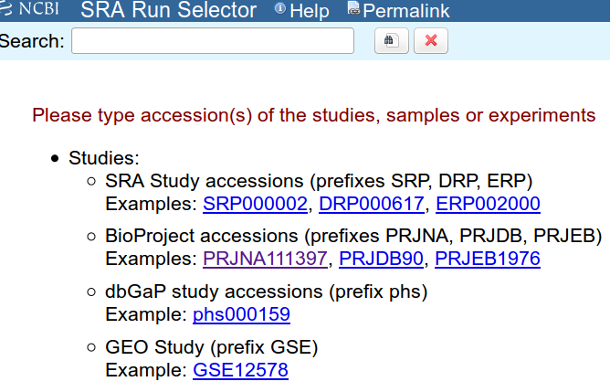
Getting a list of all Downloadable data for a Project
SRA Run Selector
Awesome Tool!

Slide 46
Direct Download
Direct Download (ftp, http, Aspera) (Browser or commandline)
Direct Download from EBI/DDBJ
sra-toolkit software has a command fastq-dump
Command | Argument | Input | Output
fastq-dump | -h |  | Print help
fastq-dump |  | SRR_ID | Download entire file
fastq-dump | -X <number> | SRR_ID | Download N spots
fastq-dump | --skip-technical | SRR_ID | Do not include technical reads
fastq-dump | -Z | SRR_ID | Print to terminal
fastq-dump | -F | SRR_ID | Get original id
fastq-dump | --split-files | SRR_ID | Print read pairs in separate files

Slide 47
FASTQ FORMAT

Slide 48
Simplified Sequencing Run
Single Stranded DNA Template primed at one end
Fluorescently labeled nucleotides are passed over the template
Each nucleotide type is labeled with different fluorophore A T G C
The complementary nucleotide at the position in the strand sequenced pairs
The fluorophore is excited using a light (lazer)
The corresponding color is registered by a detector
Software analyzes the color and intensity to make a nucleotide call

Slide 49
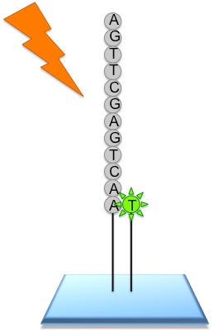
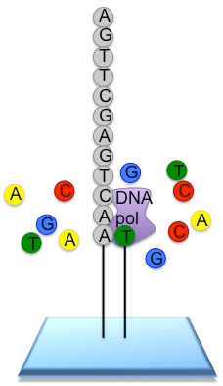
FASTQ Format
Laser
Source: http://www.ebi.ac.uk

Slide 50
A
A
T
T
A
Cycle 1
C
Cycle 4
C
G
A
A
A
G
C
G
C
A
T
Cycle 2
C
A
T
A
T
G
C
T
A
Cycle 5
C
G
A
T
A
G
C
Cycle 3
T
C
G
A
T
G
C

Slide 51
Cycle
1
2
3
4
5
Spot
Hardware
Photo Detector
Software
Color Intensity Processing
Call
G
A
C
T
A
Call
Quality
value1
value2
value3
value4
value5

Slide 52
Interpretation of call quality
The hardware detects and measures the color intensity
The machine is not perfect so every call has a quality!
The software makes an assessment of quality
The Biologist/End_User has to make sense of the call quality
Call Quality will govern the number sequencing mistakes the machine makes
Mistakes will influence downstream processing
Quality must be conveyed to the end user in a simple ,understandable and a quantitative framework

Slide 53
Trust in a call
Call
G
A
C
T
A
Call
Quality
value1
value2
value3
value4
value5
What
User
Wants
Awesome
Very
good
Good
OK
BAD!
Trust
In a
Call

Slide 54
Quantifying trust in a call
Trust
In a
Call
High
Low
Value
Higher the value higher the trust
Higher the value higher the probability that call is correct
Amenable to statistical and probablistic methods
Common across all studies/platforms/machines
Universally accepted
Easily encoded/printed in a file
Easily understood by the biologist

Slide 55
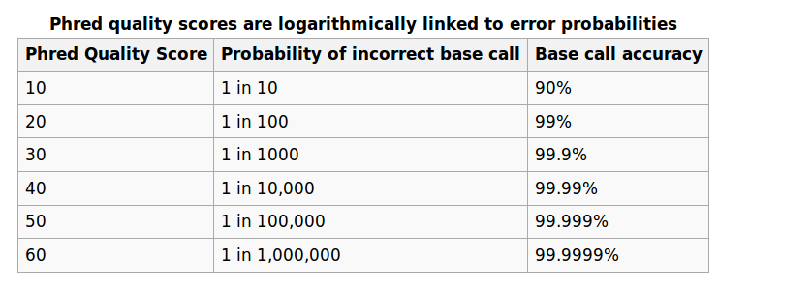
PHRED Scores
Denoted by letter Q
Q = - 10 log₁₀ P #P is the probability of error or the call being wrong
P = 10 ^{(-Q/10)}
Source: Wikipedia

Slide 56
Problem
You are 100% certain that the base call is Wrong. What is the Phred score ?
Call1 has a phred score of twice as call2. By how many times is the trust in call1 better than call2 when
  Q or call 1 is 10
  when Q of call 1 is 30?
Q = - 10 log₁₀ P
P = 10 ^{(-Q/10)}

Slide 57
Phred Scores
Easy to understand
Fits in a probablistic framework
Easy to do computations on
Easy to do compare two calls
Covers wide range of error probabilities (Is log scaled)
The calling software will calculate it for you :)

Slide 58
Encoding Phred Scores
Encoding ~ printing the phred scores along with base calls in a file.
Nucleotides are typically available as a fasta file

Slide 59
Fasta Format
>BC1G_00449
ATGTCAGCACGGAGAGTACACATCGCAC
GCCACAGAAGGATGTTGGAACATTCGAT
ACCCGAGGGATCAAAGTTTGACAGCACA
ATTGTCAAATTCAGCATGTATCGAGCAT
>BC1G_00062
ATGGCAGCCGTCGCAGCACAAGCACCAA
CTGGTGAACAAGTTGACTTGTCAACCAT
TCCAGTCTCGCCTGAAGGGGCCAGCAAT
TCAAATGAGAACACCAAGCCAGTCGCAG
AGGGTGATCAAATTACCGTTTTCCATGA
>BC1G_00372
ATGTCGTCCGCCTCTCGACCTCGCCCCA
ACCGACGGGTGAACAGTCTGGCAAATAG
TGAGCGCATGTCCATATCTCGAAATAGC
TCTCGATCACGACCGAAAGCTATTGGGT
ATACCGATGCATATACATTCGCCCTCAG
GGTTGCATACTTGCACCACCTTCTCCAA
CCGCGACGAAAGACCAAACAATATGTCC
CCGCAGAGAGAAAGATTATTTCAAGGAA
Each sequence starts with a > character followed by seq id and/or name
Sequence starts in the next line
Multiple sequence in each file

Slide 60
Problem
There is a fasta file test.fa in folder Lect_02 in your home directory. How many sequences does it contain ? Print only the id of each sequence. Hint: Use the commands introduced previously.

Slide 61
Encoding Phred Scores
Encoding ~ printing the phred scores along with base calls in a file.
Nucleotides are typically available as a fasta file
Quality scores could be added to the fasta file?
Cumbersome and space consuming
>read1
ATGC
>read1
10 20 30 40

Slide 62
Better Solution
Put calls and quality scores and one below another
A lot of space is wasted as space
Most Q scores are 2 characters long
What if 2 characters in Q score are compressed to one
read1
ATGC
10 20 30 40
Encode ~ Encrypt
10 = +
20 = 5
30 = ?
40 = I
read1
ATGC
+5?I

Slide 63
ASCII codes
American Standard Code for Information Interchange
Total 128 characters
Each character is assigned a number
Easier for binary conversion
Examples
  A = 65
  B = 66
  ? = 63 … and so on

Slide 64
Problem
Look at your ascii chart (Only columns decimal and char)
Write the word “CAT” in ascii
Write the word “cat” in ascii
Create a file called 'name' in your home directory and write your name in ascii.

Slide 65
Phred to ASCII
Depends on encoding
Sanger Encoding
  Add 33 to the phred score and convert the number to character
  Substract 33 from the ascii code of the character
Illumina encoding < 1.8 add 64
Illumina encoding 1.8+ add 33
Softwares like FASTQC will tell you the encoding

Slide 66
Problem
Convert following phred scores to sanger encoding. Hint: Sanger encoding is Phred+33
read1
ATGC
10 20 30 40

Slide 67
FASTQ Format
Store calls (ATGC … )
Store Phred scores (Encoded)
Store Machine make/ID
Store Flowcell id for each spot
Store coordinates of the spot
Store additional info (Seq names …. )
Easily parsed and stored.

Slide 68
FASTQ Format
Each read is 4 lines
Read starts with a character @ followed by the read descriptor
Sequence follows in the second line
Third line is reserved for additional info
Fourth line is the Phred score encoding
Read pairs are typically in different files
@61CFUAAXX:7:1:1206:12900
ACCAATAGGGCAAAACGCATCGGNGCCAGTGAACTTGGGGTCATCCANANACGCAGTGTCTAACATCCC
+
BCCCCCACACC?CCBCCCC?A??%>>>;>9;7%9%/%%%/0%%%%/0%/%//0/;7;9?BB9ABB<>BB

Slide 69
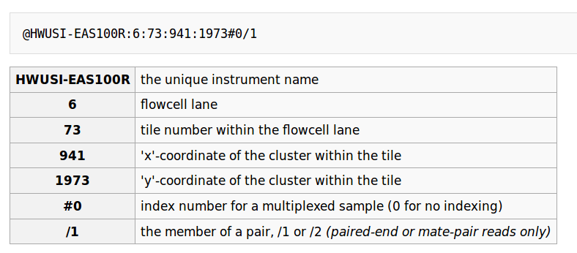
FASTQ Format
Source: Wikipedia

Slide 70
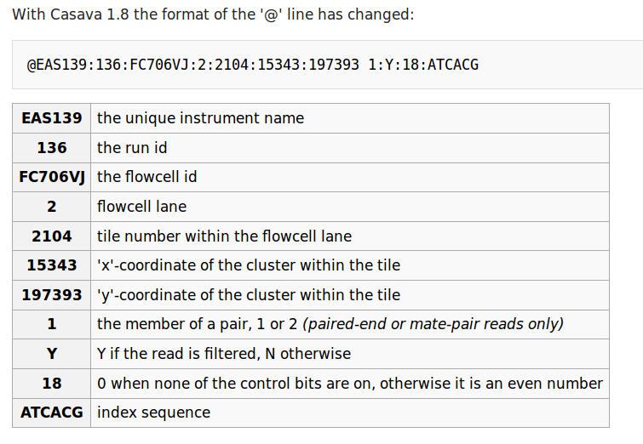
FastQ Format
Source: Wikipedia

Slide 71
Problem
In the folder Lect_02 in your home dir there are two fastq files named R1.fastq and R2.fastq. Find
How many reads are there in each file ?
What is the name of the machine ?
How many flowcells the data comes from ?
Which file contains the first read in pair and which one the second.

Slide 72
Problem
In the folder Lect_02 there is a file called 'test.fastq'. Find
How many reads ?
How many flowcells ?
Is there a problem with one flowcell? If yes which one ?

