Slide 1
Coverage and Depth
Often used interchangeably and differences are not clear
Coverage is the number of times a base-pair is read (called) by the machine
Coverage is represented as a average for a region/genome with letter X appended to it. It gives a rough estimate.
  Coverage = (Total Base pairs Sequenced)/(Sequenced Region length)
10X, 20X …
Coverage per base has a distribution and needs mapping information

Slide 2
Coverage
Average Estimated Coverage
* Based on sequencing output
* Before mapping
* Start out estimate
* Total basepairs sequenced/(Total haploid DNA length)
Per Site
* Based on mapping information (BAM)
* Forms a distribution for a genome/region
* Bedtools/Samtools
Average actual Coverage
* Mean of the persite distribution

Slide 3
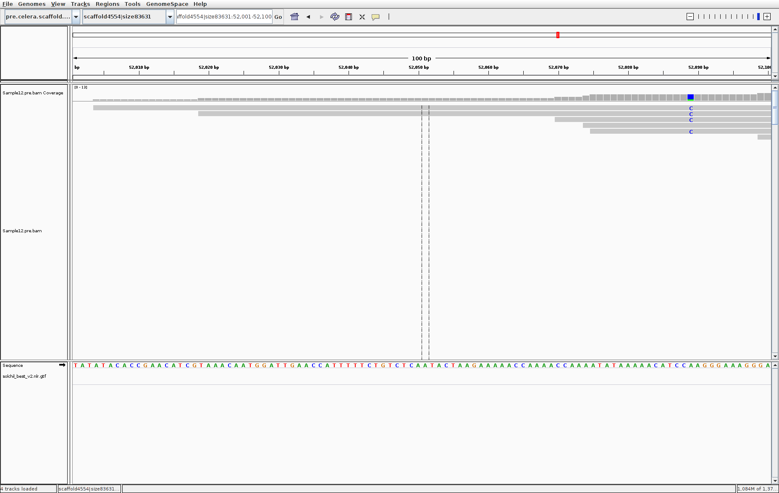
Per Site Coverage

Slide 4
Biological Implications
Coverage data has randomness and uncertainty. Due to random selection of DNA fragments
Coverage is proportional to the amount of DNA that comes from a region with some noise. Duplication of the region in the sample would increase the coverage.
Significant differences in WGS coverages could indicate
  Duplications (CNVs)
  Deletions
  Transposon insertions
  Disease associations and Adaptation
  Examples
    Anuoploidies XXY (Klinefelter syndrome), XYY, XXX
    Durg resistance
    Cancer

Slide 5
Tools for coverage calculations
Samtools and bedtools can calculate site coverage for a particular site.
Samtools idxstats <BAM> will give a the number of reads aligning to a particular chromosome.
  Technically it does not give coverage
  Its very fast

Slide 6
Problem
You just got resequencing data (fastq) for the organism A whose genome is 1Mb (10^6 bp). It contains 50 Million paired end reads of 100 base pairs. What is the average expected coverage ?

Slide 7
Problem
Your lab works on organism A whose genome is ~ one Megabase (10^6 bp). You are in-charge of resequencing a sample. A 10X mean coverage is desired. The NGS facility produces 100 base-pairs paired end reads. How many reads are needed. Would you sequence exactly whats needed ? If not why ?

Slide 8
Problem
You have enough money for resequencing at a 30X coverage largely for SNP discovery. But there are two samples from the same species but one is a wild line/strain and another is an inbred laboratory strain/line. Would you divide the coverage equally (15X,15X) ? If Not why?

Slide 9
Problem
In your home_directory/Lect_03/prob1 there are two bam files. The data is for human and both files have roughly the same number of reads. Which file has a female sample and which one has a male sample ?
HINT: Use idxstats, Human females are XX and males are XY

Slide 10
Problem
In your home_directory/Lect_03/prob2/ there are three bam files. The data is for human and all files have roughly the same number of reads. One sample has a disease. Can you -
Identify the abnormality ?
Which disease is it ?
HINT: Use idxstats

Slide 11
BAM and SAM
A Non Technical Analogy!

Slide 12
What is a BAM/SAM ?
…. ?
…. ?
…. ?
Analogy ?

Slide 13
What is BAM/SAM
Format/Specification
  Unification/Common Language
  Data Sharing
  Downstream Processing
  Flexibility/Evolvability
A File
  Human Readable?
  Indexed (Random and FastData Access)
  Data Visualization (Browsing, Zooming )
  Compression (Storage)

Slide 14

Bam as Alignment Storage
@Reference Info
@Aligner Info
Read
Phred encodings
Mapping Info

Slide 15
Who Fills the Closet?

Slide 16
Who does what
It is the aligner who fills the bam
Different aligners will produce different bams
SAM/BAM specify Flagsets but ultimate values are put there by aligner/user
Flags/Tags can modified in aligner settings
Some Flags values can be set/added by downstream programs manipulating bams
It is You who are ultimately responsible for the Flag values
Knowing what the aligner is putting as a tag value is important
Why?

Slide 17
Why ?

Slide 18
Downstream Program
No
EXIT
Do the Flags I need are there?
Downstream
Program
Yes
Go Ahead! :)
Do the tag values make sense?
Yes
BAM
No
GRACEFUL
EXIT

Slide 19
New Developments
CRAM

Slide 20
Central Dogma
TGA
TAG
TAA
ATG
5'UTR
3'UTR
INTRON
INTRON

Slide 21
RNA-Seq

Slide 22
What can be done ?
Unbiased Expression profiling
Differential expression analysis
Gene discovery
Splice variant Profiling/Discovery
Transcription start site discovery (CAGE)
Single cell Genomics
Strand specific RNA-Seq
…..

Slide 23
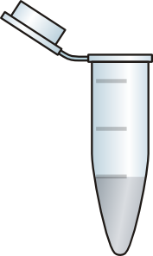
Cells

Slide 24
Cell

