Slide 1
RNA-Seq

Slide 2
UCSC genome browser
https://genome.ucsc.edu/
Authored by Jim Kent
Came out of human genome project
Major browser for vertebrate data
Specific instances exist

Slide 3
UCSC browser
Select Genome
Select Version
Hide All
Tracks
Display options

Slide 4
Problem
Your lab work on the SCN5A gene. The SCN5A gene belongs to a family of genes that provide instructions for making sodium channels. The sodium channels produced from the SCN5A gene are abundant in heart (cardiac) muscle and play a major role in signaling the start of each heartbeat, and maintaining a normal heart rhythm. Your lab has identifed 5 SNPs in SCN5A in Human which are related to heart failure Your advisor as asked you to choose 2 SNPs for mouse testing. Choose 2 of the 5. Hint: The bed file for these snps is available in the folder Lect_04/SCN5A_hg19.bed.
Also find:
  How many splice variants does SCN5A have ?
  Do all of them code for a protein ?
  Which Strand is SCN5A in ?
Disclaimer: This problem is completely imaginary! Any resemblance to real data is purely coincidental!

Slide 5
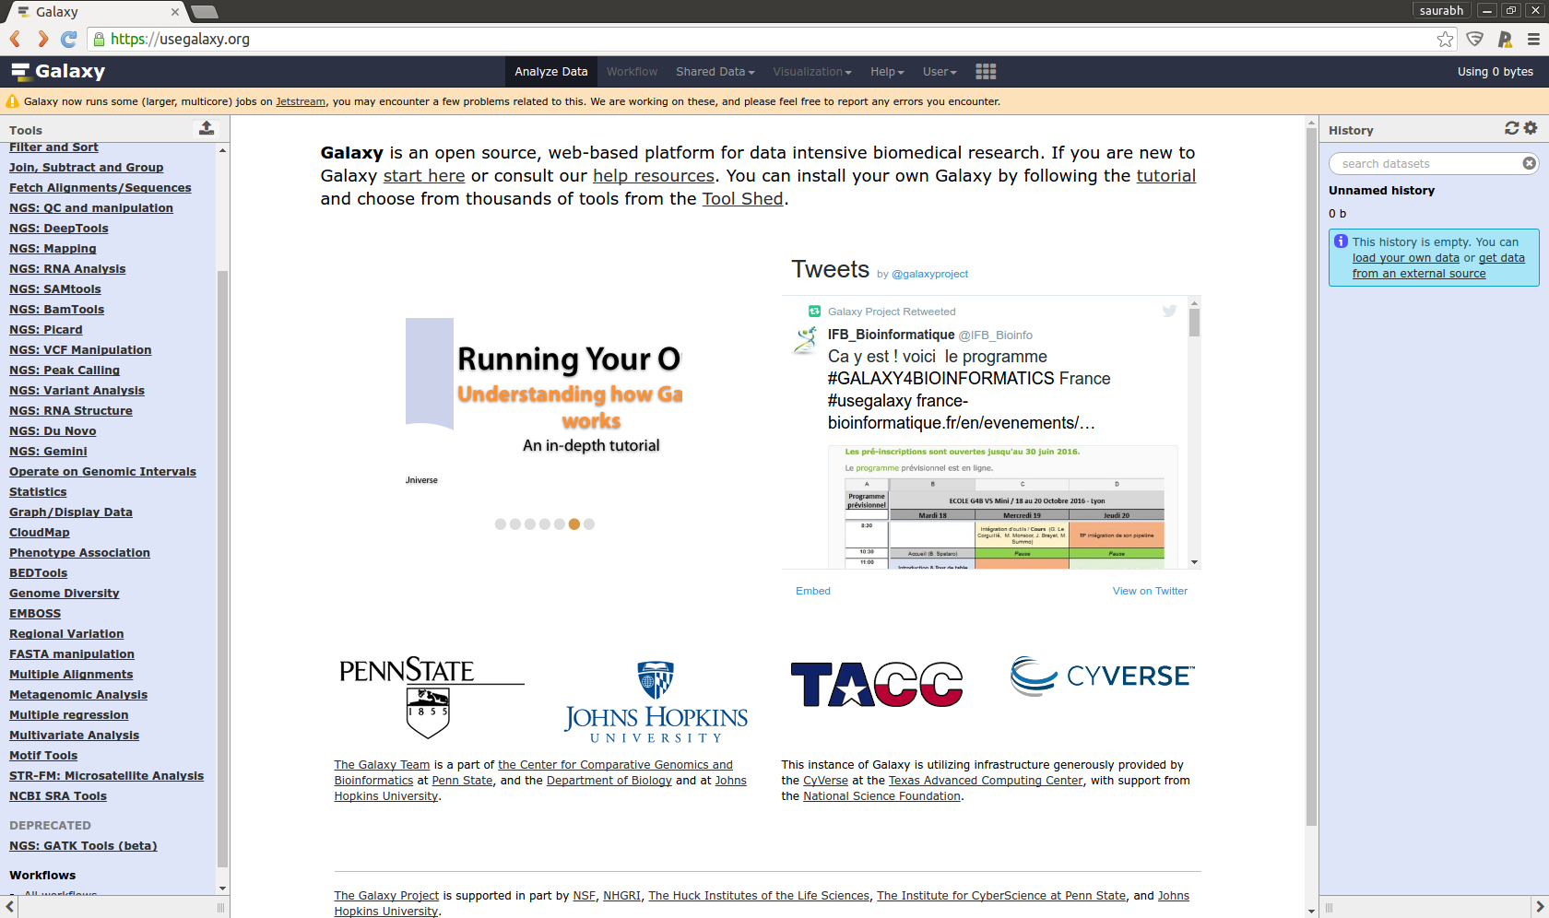
Galaxy

Slide 6
Exercise 1
Create a Galaxy account
Try not using TUM-ids instead use real name based email (firstname.lastname@tum.de) or any other email

Slide 7
Study Structure
S → E → D
S → E → D
S → E → D
S → E → D
S → E → D
Sample → Experiment → Data

Slide 8
BioProject
PRJNA*
BioSample
SRS*/ERS*
SAM
Organism
Tissue
...
Experiment
SRX*/ERX*
Machine
Protocol
...
Study
SRP*/ERP*
Who did it
Description
...
RUN
SRR*/ERR*
Data
….
...
Submission
SRA
Metadata
….
...

Slide 9
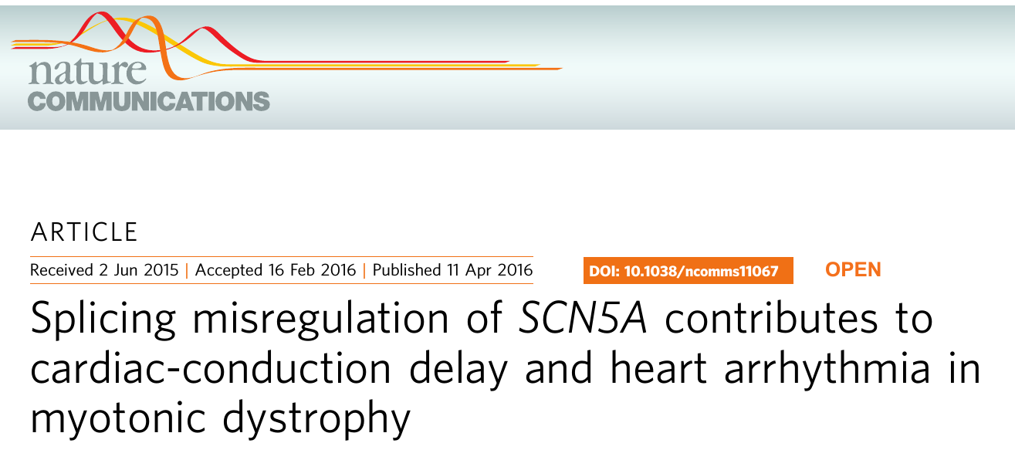

Slide 10
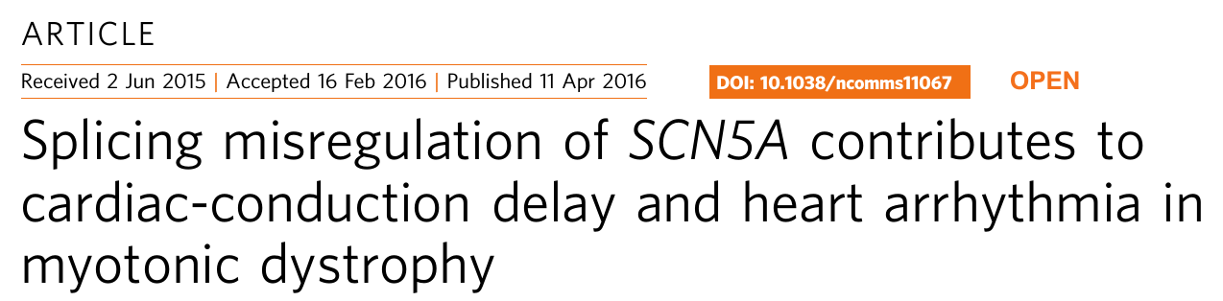
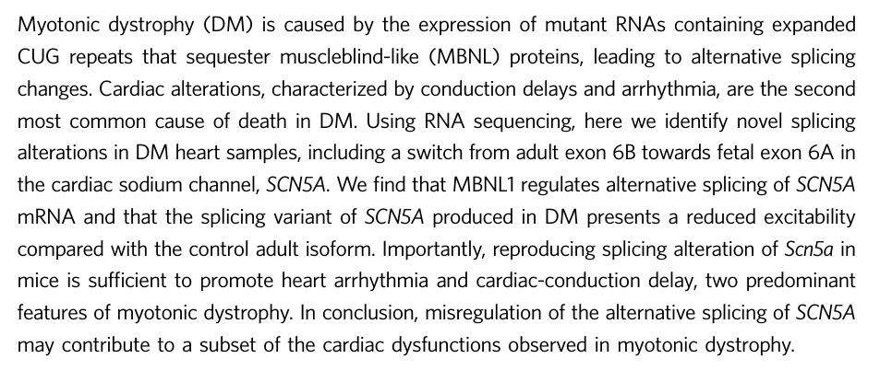

Slide 11
PRJNA280990
Locate the study in SRA run selector
How many case and control samples
How many technical replicates ?

Slide 12
RNA-Seq

Slide 13
What can be done
Unbiased Expression profiling
Differential expression analysis
Gene discovery
Splice variant Profiling/Discovery
Regulatory network
Transcription start site discovery (CAGE)
Single cell Genomics
Strand specific RNA-Seq
…..

Slide 14
Canonical Gene
TGA
TAG
TAA
ATG
5'UTR
3'UTR
INTRON
INTRON

Slide 15
Central Dogma
DNA
Nucleus
Transcription
RNA
Splicing
preRNA
Polyadenylation
mRNA
Cap
AAAAAAAAA
Poly A tail
Translation
Protein

Slide 16
RNA-Seq Protocol
Sample Homogenization/Prep
Data Processing
RNA Isolation
mRNA Isolation
Sequencing
mRNA → cDNA
Library Prep
Reduction

Slide 17
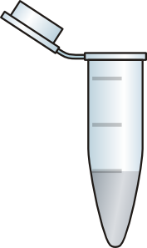
MRNA Isolation
TTTTTTT
DNA
RNA
mRNA
TTTTTTTTTT
TTTTTTTTTT
TTTTTTT
TTTTTTT
TTTTTTTTTT
TTTTTTT
TTTTTTTTTT
TTTTTTTTTT
TTTTTTTTTT
TTTTTTT
TTTTTTT
Magnetic Beads
TTTTTTT
AAAAAAAAA
AAAAAAAAA
TTTTTTTTTT
TTTTTTTTTT
AAAA
Magnet
TTTTTTT
AAAAAAA
Purified RNA

Slide 18
mRNA → cDNA
mRNA
Reverse Transcriptase
cDNA
Random Hexamers
Library Prep
Sequencing
RNA-Seq is actually cDNA-Seq

Slide 19
Splicing
Exon1
Intron1
Exon2
Intron2
Exon3
Pre-RNA
Exon Skipping
m-RNA
Intron Retention

Slide 20
Problem
Which case has an intron retention event ?
Gene
Gene

Slide 21
Gold Standards
RAW DATA
Default/Reasonable parameters
Program/Pipeline
No
New Params
Frustration
Is the output good?
Output
Yes

Slide 22
Deciding Factors
Study design
  Differing read lengths for case and control
  Differing insert sizes
  Cases and Controls in different flowcells
  Differing Library prep
Technical
  Differing FastQC results for cases and controls
  Low mapping in one/more samples

Slide 23
Deciding Factors
Biological
  Ts/Tv
  Previous Knowledge
  Hardy-Weinberg Eq
  Too many non-sense mutations
  Heterozygous SNPs
  Unexpected Read Mappings
  Housekeeping genes

Slide 24
Gold Standards
Sanger Sequencing
RT-PCR
Calculate False Positives and False Negatives

Slide 25
Problem
Sanger
NGS Param 1
NGS Param 2
Identify the number of false positives and false negatives in both cases and try to guess the possible problems and their solutions

Slide 26
Sampling Issue with RNA-Seq
Blue
Green
Red
Low expression
10 RNAs
Medium Expressed
40 RNAs
Highly Expressed
100 RNAs

Slide 27
Problem
You sample 20 reads from the cell. Assuming that all 3 genes R G and B have same length. How many reads do you expect for each gene ?
Blue
Green
Red
10
40
100
 | 20 Reads | 50 Reads
A
B
C

Slide 28
To Do
There is a file shuffle.sh in you Home directory. It randomly takes reads from each gene and prints the counts. The command is ./shuffle.sh n . Where N is the number of reads to sample. Run it for sample size 10, 50 ,100.
Blue
Green
Red
10
40
100

Slide 29
Coverage vs Discovery and accuracy
Low Advantage
Discovery/
Accuracy/
Improvement
Hi Advantage
Coverage/Cost

Slide 30
Problem
Two genes (A and B) were sequenced in the same library. Gene B is twice as long as gene A. Gene A has 100 reads mapped to it. How many reads would you expect for gene B to map ?
Gene A
Gene B

Slide 31


Replication
Case
Control

Slide 32
Technical Replication
Case
Control

Slide 33
Biological Replication
Case
Control

Slide 34
Replication
Microarrays need technical replication
Technical replicates for RNA-Seq are highly correlated
Technical replication is generally not required
Biological replication is considered good for differential expression
Pooling by barcoding is highly recommended

Slide 35
Coverage vs Replicates
Very High Coverage
Very High Coverage

Slide 36
Coverage vs Replicates
Low Coverage
Rep1
Low Coverage
Rep2
Low Coverage
Rep1
Low Coverage
Rep2

Slide 37
Which One to Choose ??
Think Over it!

Slide 38
Coverage vs Replicates
How many results you want (Sensitivity) ?
Is the project exploratory ?
Monitory Considerations (Barcoding costs money)
Type of sample
Noise Level
Quality of annotation
More replicates is better
Typically 3 replicates (more the better)

Slide 39
Randomizing
Gene expression is very noisy
Very plastic to conditions
Case
Control

Slide 40
Problem
You have 6 (C1 …. C6) case and 6 control samples (O1.... O6). You also have access to 3 lanes and 4 barcodes. How would you arrange the samples ?
 | Lane1 | Lane2 | Lane3
B1
B2
B3
B4

Slide 41
Checking for Splicing
Discovery of splice variants
Differential splicing between case and control

Slide 42
Coverage
Splice variants typically have varying expression
Coverage can be used to predict a splicing event
Tissue/Sample wise loss of coverage in an exon
Differential splicing has been linked to variety of biological effects

Slide 43
Problem
Can You guess the splice variants and expression of each variant (Qualitatively) ?
20X
10X
3X

Slide 44
18X
10X
5X
Highly expressed ~10X
Low expressed ~5X

Slide 45
Second Approach
Intron
Intron
Junction Read

Slide 46
Junction Read
Intron
Intron
mRNA
A well mapped Junction Read is a strong indicator of a splicing event

Slide 47
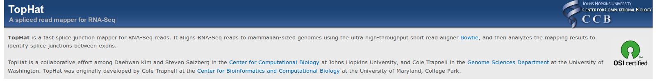
TOPHAT Aligner
Splice Junction Mapper
Will use bowtie to map reads normally
The unmapped reads will then be realigned with large gaps

Slide 48
Problem
How many splicing events. Which splice pattern does not occur ?
E1
E2
E3
E4

Slide 49
Its already Obsolete :(
Long Read
Sequencing
E1
E2
E3
E4

Slide 50
Expression Quantification
One value which estimates the abundance of a gene/transcript
Easy to compute
Unbiased
  Gene Length
  Depth
Comparable between different samples
Easily understood

Slide 51
No of Reads
Number of reads mapping to a given transcript is a good measure of abundance
But larger the gene more the reads mapping to it
More the sequencing depth more reads would be aligned

Slide 52
No of Reads
1Kb
2KB

Slide 53
Total Sequencing Output
Sample1
Sample2
1 Million Reads
10 Million Reads

Slide 54
RPKM and FPKM
Reads Per Kilobase (Transcript) Per Million Mapped Reads.
Fragments Per Kilobase (Transcript) Per Million Mapped Reads.
Total Reads mapped to a transcript
RPKM =
(Length of region (Kb)*(Total Mapped reads in Mb))

Slide 55
Problem
The genome consists of 3 genes. Calculate RPKM for the green gene.
100000 reads
50000 reads
25000 reads
1Kb
500bp
200bp

Slide 56
Problem
You are analyzing a case control study. The case bam file has 2 million mapped reads whereas the control bam file has 1.5 million mapped reads. Is gene A differently expressed and what is the ratio of case/control expression ?
50000 reads
30000 reads
Gene A
Gene A
Control
Case

