Slide 1
RNA-Seq

Slide 2
RNA-Seq
UCSC genome browser
Gene structure
BED file
RNA-Isolation
Splicing (Intron retention, Exon skipping..)
Gold Standards (RT-PCR)
Sampling uncertainty (Urn model)
Coverage

Slide 3
RNA-Seq
Biological vs Technical Replication
High coverage vs More replicates
Randomize samples over lanes and barcodes
Getting splice junction reads (Junction Reads)
Normalization for comparison
FPKM and RPKM calculations

Slide 4
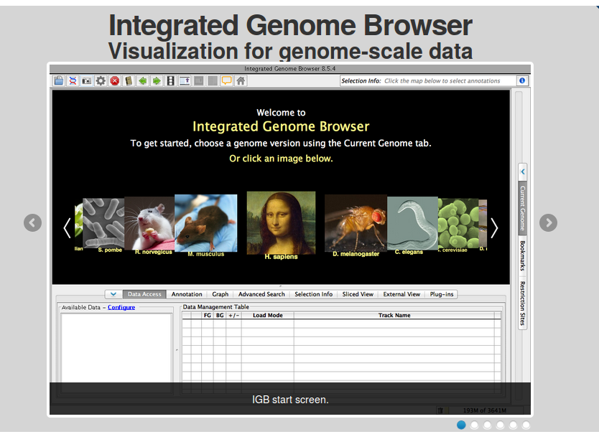
IGB

Slide 5
Download and Install IGB
http://bioviz.org/igb/index.html
Load Genome arb.fa (~/RNA_Seq/ref/arb.fa)
Load annotation arb.gtf (~/RNA_Seq/ref/arb.gtf)

Slide 6
Problem
Browse around IGB with the custom genome arb and find the following for the fist and the last gene-
  Strand
  Gene name /transcript name
  No of Splice variants
  No of Exons/Introns

Slide 7
GTF file format
General transfer format
http://www.ensembl.org/info/website/upload/gff.html
Inheritance
Parsing Nightmare
Exon 1
Transcript1
Exon 2
Gene
Transcript2
Exon 3
Transcript3
Exon 4
Exon 5

Slide 8

Problem for today

Slide 9
Aim for today
Get RNA-Seq study from SRA
Align with splice junction aligner
Construct transcripts from splice junctions
Compare with known transcripts
Get FPKM values for each Gene/Transcript
Do a differential expression testing
Look at differentially expressed genes

Slide 10
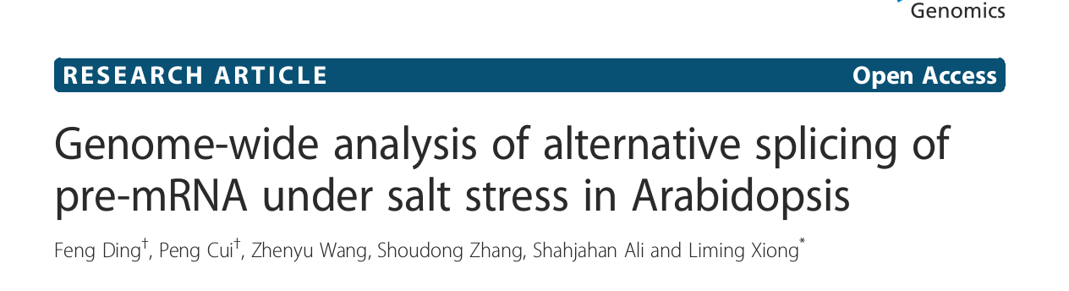
PRJNA233557
Problem : Get the bioproject details. What is the case condition ? Are the library details reported ? How many Replicates for case and control ? Is the study design good ?

Slide 11
Sample Data
The SRR files are stored in RNA_Seq folder in your home director
A mock genome (1 Mb) is also kept there (arb.fa)
Annotation GTF is also kept there (arb.gtf)
The SRR files contain sampled reads ~ 150000 so that the analysis runs faster
Locate the files

Slide 12
Tuxedo Suite
Bowtie2 [Genome Alignment]
Tophat [Splice Junction Alignment]
Cufflinks [FPKM Estimation, Transcript resconstruction]

Slide 13
Analysis Scenarios
Known Well studied genome
GTF is available
Uknown genome
No GTF
Forget the existence of GTF!

Slide 14
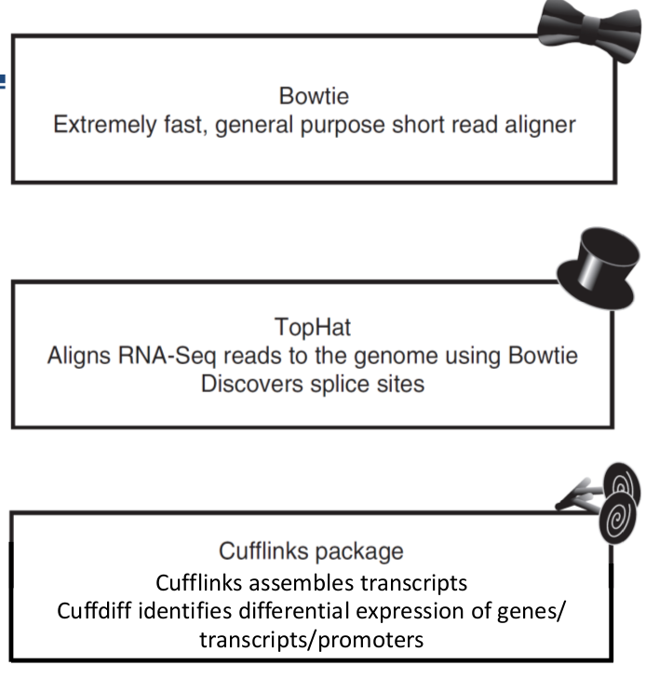

Slide 15
TOPHAT Run
Is a Mapper for mapping reads across splice junctions
Uses Bowtie2 for normal mapping
Unmapped reads are then tried to be mapped with large insertions
Reference
Bowtie2 index
Bowtie2
R_1.fastq
Tophat
R_2.fastq
Accepted hits (bam)
Splice Junction (junctions.bed)
Rejected hits (bam)
Indels
Log files
Annotation gtf

Slide 16
Task
Index genome using bowtie2-build
Map reads using tophat

Slide 17
PROBLEM
Load the bam file produced by tophat
Load junction.bed file produced by tophat
Find a gene with no expression in the sample!
Find a gene with high expression in the sample!

Slide 18
Transcript Assembly with Cufflinks
Deconvolutes transcript/splice_variant data
Create transcripts from junction reads
Use Coverage information
Get expression values (FPKM) for each gene
Uses complicated and sophisticated normalizations and statistical calculations
Too many options. Might not improve results
Takes long time to run

Slide 19
Running Cufflinks
Simplest cufflinks run
  Cufflinks -o <outdir> <input_bam>
Output
  Transcripts.gtf (GTF file of the assembled transcripts)
  *_fpkm_tracking (FPKM values)

Slide 20
Problem
Upload accepted_hits.bam in IGB
Upload transcripts.gtf in IGB
Upload arb.gtf (known genes) in IGB
Color the two GTFs differently
See how good cufflinks can predict splicing and existence of genes ?

Slide 21
Task
Run Tophat on the remaining 3 samples

Slide 22
Cufflinks with genome info
Cufflinks -g <known.gtf>
  Will take help from known genes for assembly
  Will still discover new genes
Cufflinks -G <known.gtf>
  Will only take known genes
  No new discovery
Rest is the same
We use -g

Slide 23
Task
Run cufflinks in each tophat_out directory
Use -g <arb.gtf>
Open transcripts.gtf in a text editor
Known transcripts will have their old ids (NM_) whereas newly discovered ones will have CUFF ids
Find a new transcript which was not previously known.

Slide 24
Merging Transcripts
Is using -g transcripts are called for each condition separately
So they may differ slightly among conditions
For differential expression testing the same transcript must be used in case and control samples
Cuffmerge merges transcripts across assemblies

Slide 25
Why Use Cuffmerge
Case
Merged
Control

Slide 26
Running Cuffmerge
cuffmerge -g <reference.gtf> -s <ref.fasta> -o <outdir> <file with location of gtf inputs>
copy the path to all gtf files in a file and give as input !!!

Slide 27
Cuffdiff
Does the actual differential expression testing
Replicates are given as comma separated bam files
Several bias correction steps involved
Calculates expression variability from replicates and uses it for differential expression testing
Does a FDR correction for multiple testing

Slide 28
Running cuffdiff
Cuffdiff -o <outdir> transcripts.gtf -L case,control case_rep1.bam,case_rep2.bam... control_rep1.bam,control_rep2.bam...
Output
The .diff files will contain differential expression results

Slide 29
Problem
Which Genes are over expressed in response to salt stress ?

Slide 30
Problem
Try running cuffdiff with only one case replicate. How many genes do you find to be differentially expressed ?

