Slide 1
Alternative statistical handling of ASV data for USVI spatiotemporal study
Sharon Grim
April 20, 2026

Slide 2
Background
16S rRNA gene V4 amplicon ASV dataset from Lameshur Bay Seagrass, Tektite Reef, and Yawzi Reef was initially processed for analyses:
ASV counts were transformed into relative abundances per sample, so that each sample had a 100% total relative abundance of bacterial ASVs.
Morisita-Horn dissimilarities were calculated between samples’ relative abundances of ASVs for NMDS, beta dispersions, etc.
Differential abundance and correlation testing was conducted on relative abundances of ASVs.

Slide 3
Feedback from reviewers recommended alternative data transformations
Reviewer recommended centered-log-ratio transformation for ASVs.
short answer: this does not work as well as rCLR or keeping original analyses because…
Reviewer suggested biplot presentation for ASVs overlaid on NMDS.
short answer: only with relative abundance input data, could I get NMDS results for the ASVs
Does a CLR-transformed ASV table generate similar results in NMDS? PERMANOVA? Differential abundance testing? Correlation analyses?
Short answer: ordination changes a little with a different transformation. PERMANOVA is still robust.

Slide 4
Compare NMDS results from different data transformations and dissimilarity metrics
Six data transformations explored:
Raw counts
centered-log-ratio + 1.0 pseudocount (CLR)
robust centered-log-ratio (rCLR)
Relative abundance
centered-log-ratio* + 0.1 pseudocount (this doesn’t seem necessary, but for thoroughness I transformed anyway)
robust centered-log-ratio* (see above note)
Four dissimilarity metrics
Euclidean (recommended for CLR and rCLR), Bray-Curtis, Morisita-Horn, Chord
Not all combinations of (data transformation):(dissimilarity metric) were examined, due to methodological limitations.

Slide 5
CLR sucks
Data transformation | Metric | Stress | Number of model attempts to reach convergence (max: 100) | Figure panel
CLR | Chord | 0.101 | 100 | A
 | Euclidean | 0.111 | 100 | B
 | Bray-Curtis | 0.353 | 100 | C
 | Morisita-Horn | NA
Relative abundance + CLR | Chord | 0.075 | 35
 | Euclidean | 0.076 | 100
 | Morisita-Horn | 0.076 | 60
 | Bray-Curtis | 0.087 | 42
Lower stress = better model fit

Slide 6
rCLR + Euclidean distance
Data transformation | Metric | Stress | Number of model attempts to reach convergence (max: 100) | Figure panel
Relative abundance | Morisita-Horn | 0.075 | 20 | G
 | Bray-Curtis | 0.075 | 20 | F
 | Euclidean | 0.078 | 20 | H
rCLR | Euclidean | 0.055 | 20 | D
 | Morisita-Horn | 0.162 | 20 | E
Relative abundance + rCLR | Euclidean | 0.055 | 20
 | Morisita-Horn | 0.174 | 20
Lower stress = better model fit

Slide 7
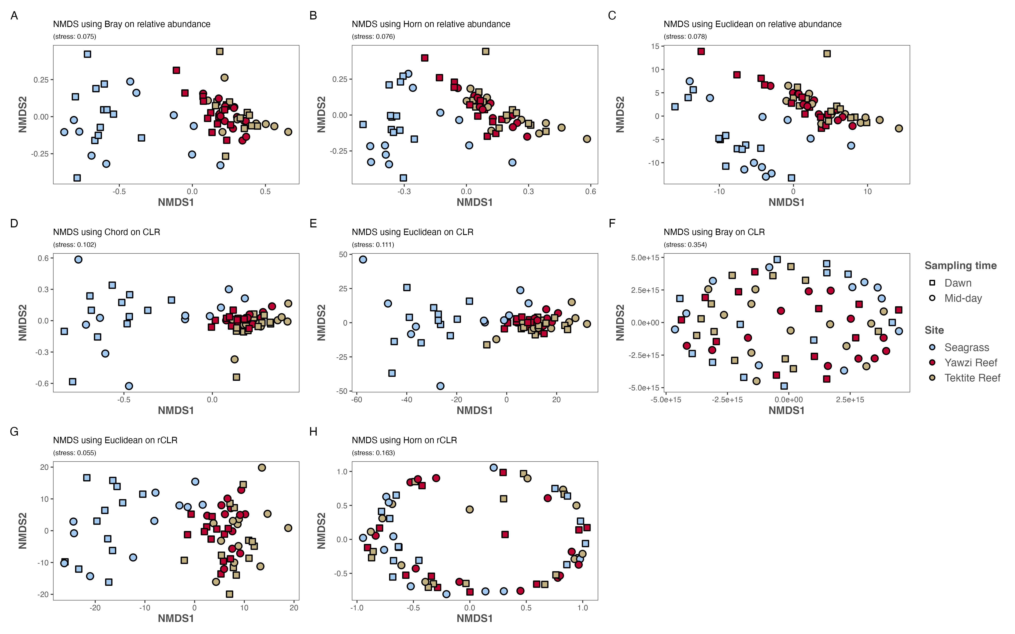
Lower stress = better model fit

Slide 8
Comparing significant differences in ordinations: Procrustes
“When comparing two ordinations based on data from the same sample units: orient them so that sample units from the same group are in the same relative location. Procrustes analysis is one method to do so.”
Two ordinations are considered similar when the Procrustes result has lower Sum of Squares (SS), higher correlation (t0), and significant test result (p < 0.05).

Slide 9
Curated Procrustes results
Panel | Ordination 1 | Ordination 2 | SS | t0 | significance
A | Relative abundance + Morisita-Horn | Relative abundance + Bray-Curtis | 0.121 | 0.938 | 0.001
B | Relative abundance + Morisita-Horn | CLR + Euclidean | 0.518 | 0.694 | 0.001
C | Relative abundance + Morisita-Horn | rCLR + Euclidean | 0.584 | 0.645 | 0.001
D | rCLR + Morisita-Horn | rCLR + Euclidean | 0.984 | 0.125 | 0.579

Slide 10
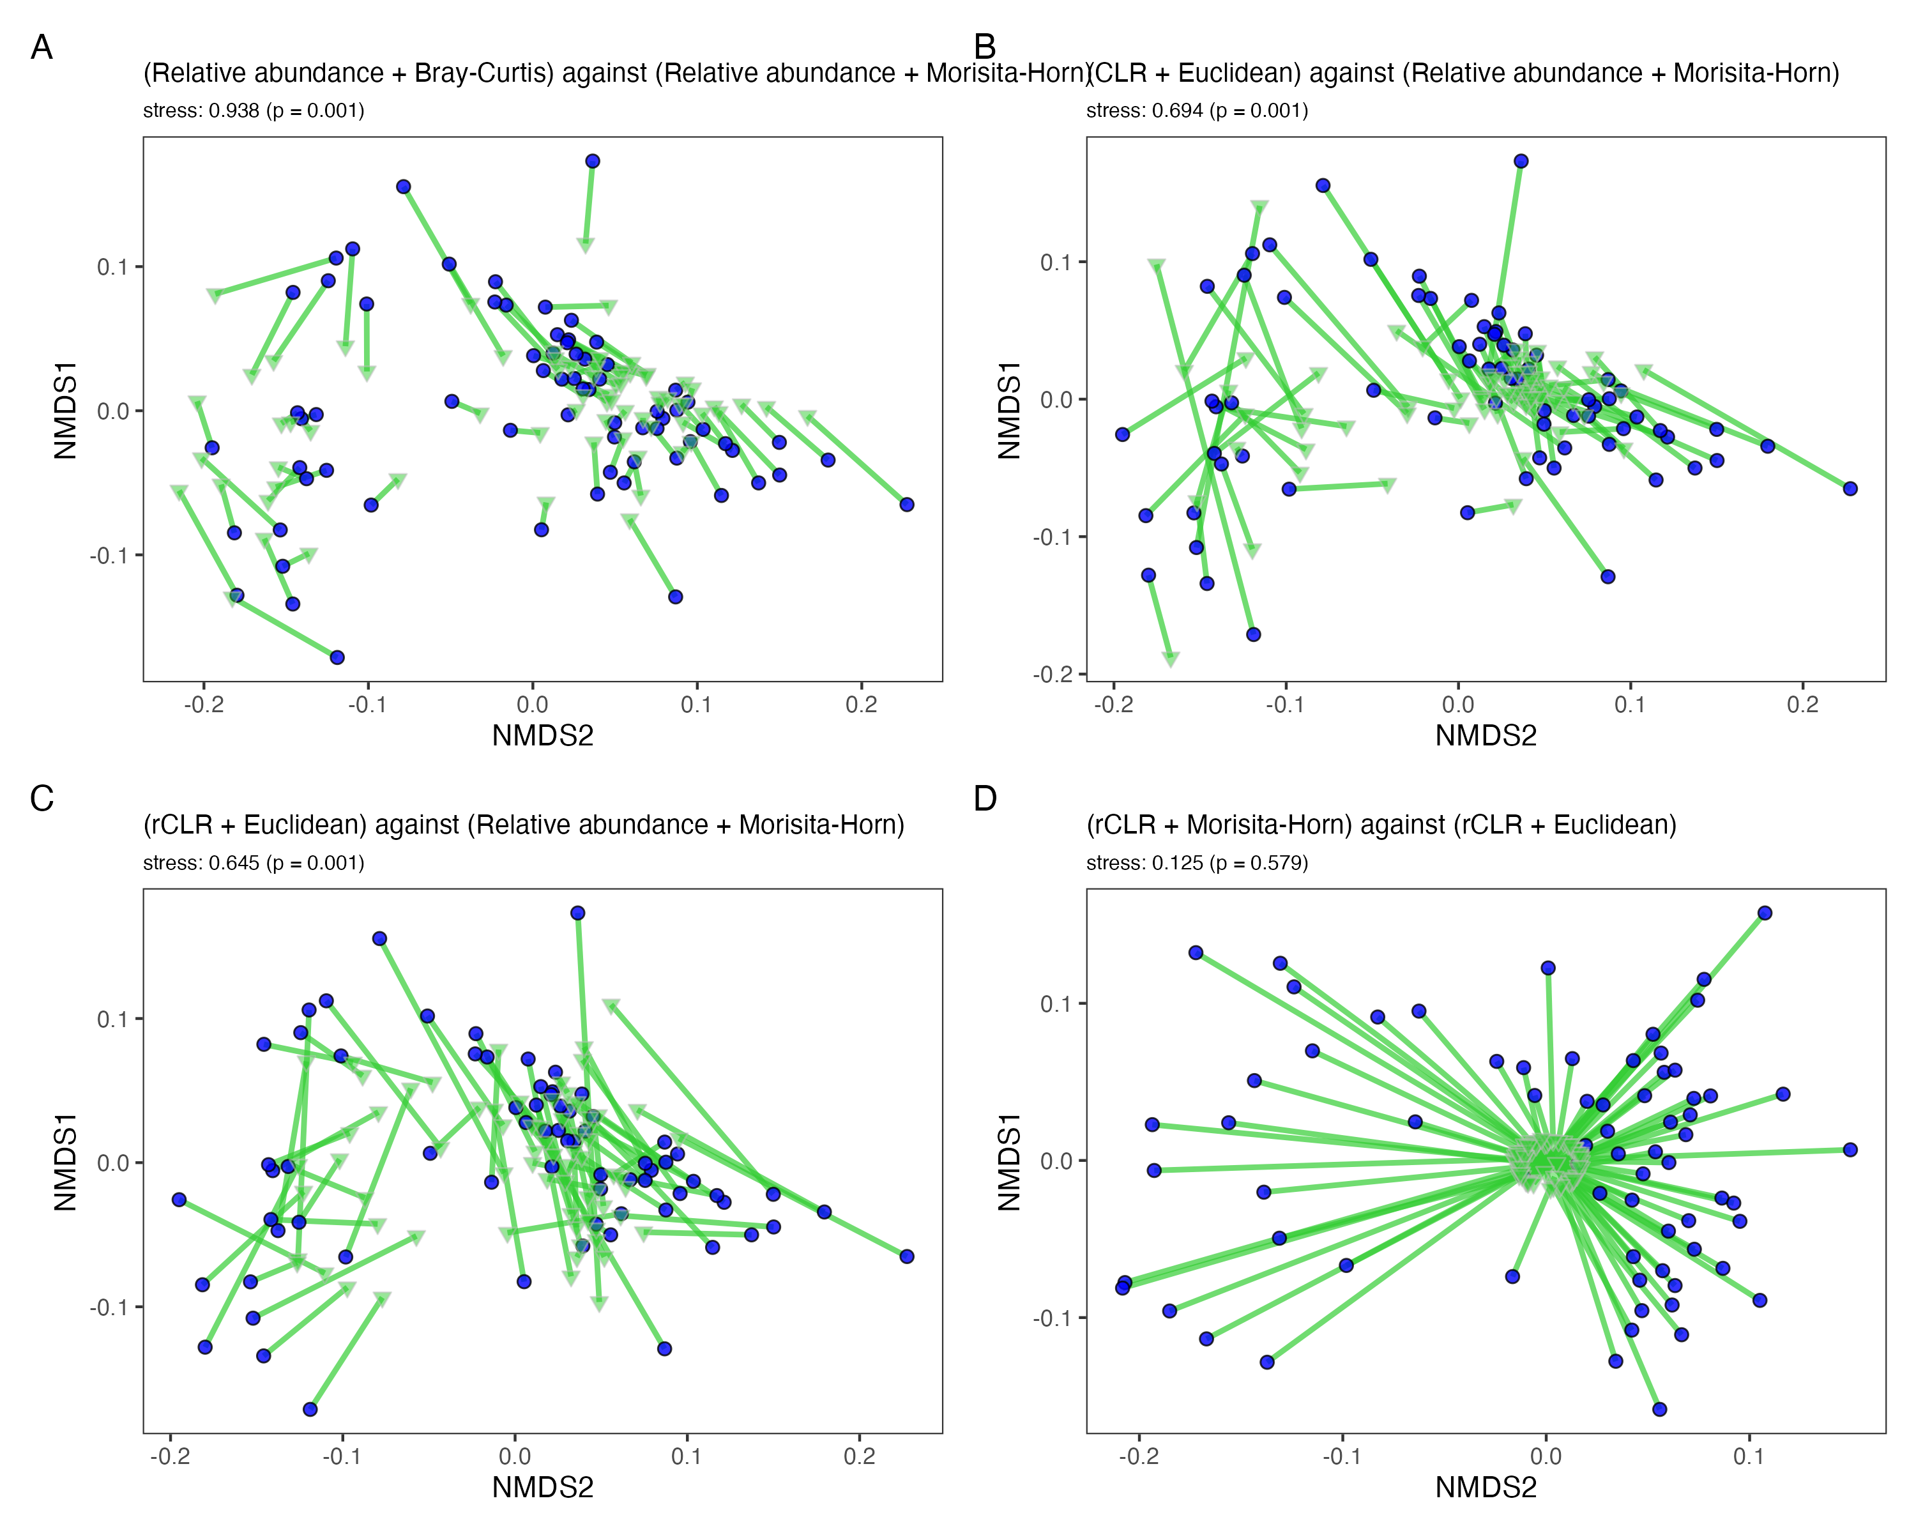
Panels A, B, and C compare the ordinations from the original transformation (relative abundance) + original dissimilarity metric (Morisita-Horn), against an alternative ordination:
A. A routine transformation and dissimilarity metric (BC)
B. Reviewer suggested-transformation (CLR) + most appropriate dissimilarity metric (Euclidean);
C. Transformation recommended for data that have natural 0s, such as ASV data (rCLR), and the most appropriate metric for that transformation;
D. A recommended transformation + dissimilarity metric, against that recommended transformation + Morisita-Horn, which is not recommended for data with negative entries such as that obtained with a CLR transformation.

Slide 11
Impact of ordination choice on adonis2 results
Permutation test for adonis under reduced model
Terms added sequentially (first to last)
Permutation: free
Number of permutations: 999
vegan::adonis2(formula = dist_mh_usvi_asv.d ~ sampling_time + sampling_day + site + (sampling_day:site)/sampling_time, data = meta.microb, permutations = 999, method = "horn", by = "terms", parallel = nthreads)
Df SumOfSqs R2 F Pr(>F)
sampling_time 1 0.07471 0.06034 15.6914 0.001 ***
sampling_day 3 0.10842 0.08757 7.5906 0.001 ***
site 2 0.74508 0.60182 78.2471 0.001 ***
sampling_day:site 6 0.06811 0.05502 2.3843 0.049 *
sampling_time:sampling_day:site 11 0.01796 0.01451 0.3430 0.953
Residual 47 0.22377 0.18074
Total 70 1.23805 1.00000
---
Signif. codes: 0 ‘***’ 0.001 ‘**’ 0.01 ‘*’ 0.05 ‘.’ 0.1 ‘ ’ 1
Sanity check: for the Morisita-Horn distance matrix on ASVs, these are the same results presented in the manuscript
Permutation test for adonis under reduced model
Terms added sequentially (first to last)
Permutation: free
Number of permutations: 999
vegan::adonis2(formula = dist_rclr_usvi_asv.d ~ sampling_time + sampling_day + site + (sampling_day:site)/sampling_time, data = meta.microb, permutations = 999, method = "euclidean", by = "terms", parallel = nthreads)
Df SumOfSqs R2 F Pr(>F)
sampling_time 1 466.2 0.02861 5.9322 0.007 **
sampling_day 3 2800.8 0.17188 11.8791 0.001 ***
site 2 7908.1 0.48531 50.3112 0.001 ***
sampling_day:site 6 757.0 0.04646 1.6054 0.099 .
sampling_time:sampling_day:site 11 668.9 0.04105 0.7737 0.736
Residual 47 3693.8 0.22669
Total 70 16294.9 1.00000
---
Signif. codes: 0 ‘***’ 0.001 ‘**’ 0.01 ‘*’ 0.05 ‘.’ 0.1 ‘ ’ 1
Using rCLR ordination and Euclidean distance, site, day, and time are still significant terms in adonis2 PERMANOVA.

Slide 12
Components of variation in adonis2 model
Source | % of variation explained in model
 | Morisita-Horn | rCLR
Site | 47.3% | 44.0%
Time | 21.2% | 15.1%
Day | 14.7% | 21.4%
Day x Site | 8.3% | 7.9%
Time x Day | 3.1% | 5.5%
Time x Site
Time x Day x Site
Residual | 5.3% | 6.2%
Terms in the adonis2 model using rCLR + Euclidean transformations of ASV data explain similar percentages of variation, as when we used ASV data transformed via Relative abundance + Morisita-Horn.

Slide 13
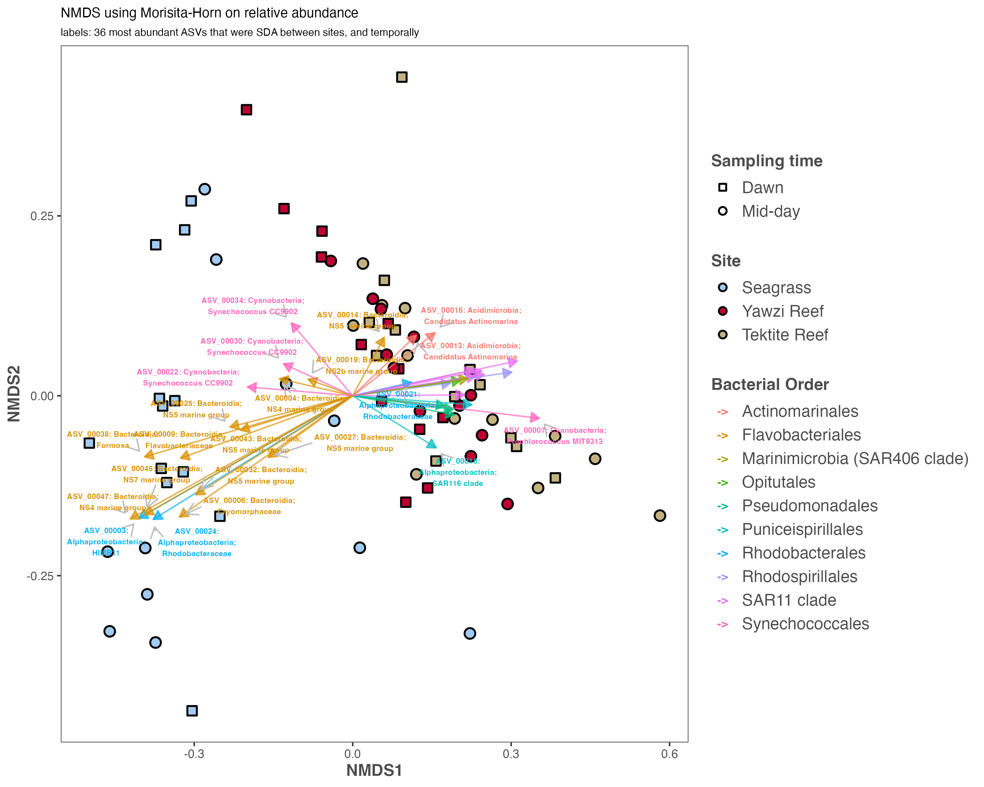
Overlaying ASVs on NMDS
rCLR and CLR generate distance matrices with negative values, so vegan::metaMDS output does not include NMDS coordinates for ASVs.
The NMDS models that used relative abundances of ASVs without further transformation, and any of the tested distance metrics (e.g. Morisita-Horn, Bray-Curtis, Euclidean), provided coordinates for ASVs.
Right: the 36 most abundant SDA ASVs overlaid on NMDS, colored by taxonomic order.

