Slide 1
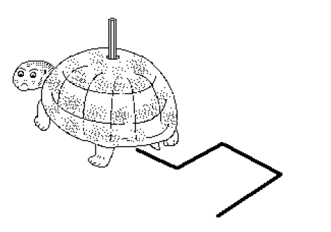
Turtle Graphics
Let’s see what we can draw on python!

Slide 2
CONTENTS
Getting to know the Python Turtle library.
Getting started with Turtle.
Programming with Turtle.
Moving the Turtle.
Drawing the Shape and Figures.
Changing the Screen color and Size.
Changing the Pen Size, Pen Color, Filling on Image, Pen Speed.
Picking the Pen Up and Down.

Slide 3
Getting to Know the Python turtle Library
Turtle is a pre-installed Python library.
Turtle library enables users to create Pictures, Drawings, Shapes, Graphics.
It was developed by Wally Feurzeing, Seymour Parpet and Cynthina Slolomon in 1967. It was a part of the original Logo programming language.
With the help of turtle library new programmers get an idea of how we can do programming with python.
It provides the on screen pen that we can use for drawing.

Slide 4
Getting Started With turtle
Before working with the turtle library, we must ensure the two most essential things to do programming.
Python Environment: We must be familiar with the working python environment. Such as IDLE, Pycharm, or Jupiter Notebook.
Python Version: We must have python 3 in our system, if not then download it from python official website.
Turtle library is built in library so we don’t need to intall separately, we just to import the library.

Slide 5
Programming With turtle Moving the Turtle
There are four directions that a turtle can move in:
forward(): It moves the turtle in the forward direction by a certain distance.
Backward(): It moves the turtle in the reverse direction.
right(): It moves the turtle right by angle units.
left(): It moves the turtle left by angle units.

Slide 6
Drawing the Shape and Figures
Now that you know the movements of the turtle, you can move on to making actual shapes.
You can start by drawing polygons since they all consist of straight lines connected at certain angles.
Here’s an example that you can try:

Slide 7

Cont…
import turtle as t t.fd(100) t.rt(90) t.fd(100) t.rt(90) t.fd(100) t.rt(90) t.fd(100) t.rt(90) t.fd(100)
>>>Output

Slide 8
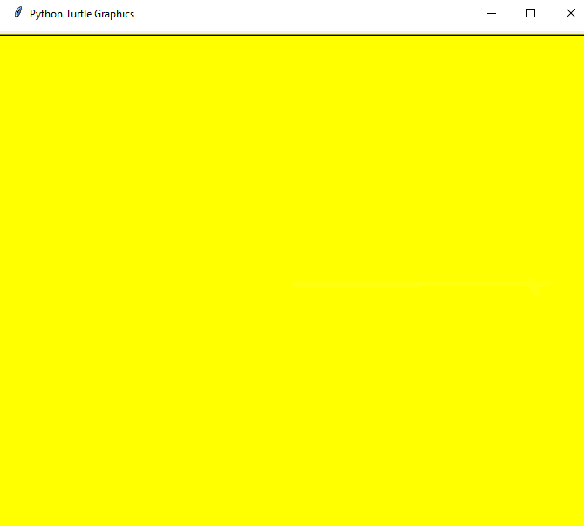
Changing the Screen Color and Size
Screen Color
By default, turtle always opens up a screen with a white background.
However, you can change the color of the screen at any time using the following command:
bgcolor()
Example:
import turtle as t
t.bgcolor(“yellow")
>>>Output

Slide 9
Cont…
Screen Size
We can change the Screen Size using the syntax:
Example:
import turtle as t t.screensize(100,100,bg=None)
Turtle.screensize(width, heght, background)

Slide 10
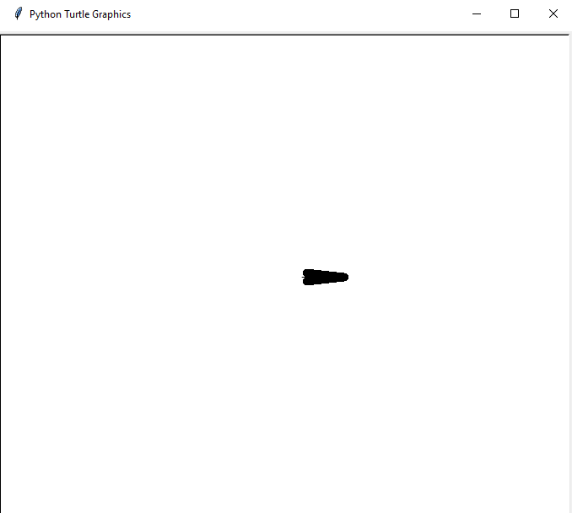
Changing the Turtle Size, Pen Size
Turtle Size
You can change the turtle size and this changes only the size of the turtle shape without affecting the output of the pen as it draws on the screen.
Syntax :
Example:
import turtle as t
t.shapesize(1,5,10)
turtle.shapesize(length, width, outline width)
>>>Output

Slide 11
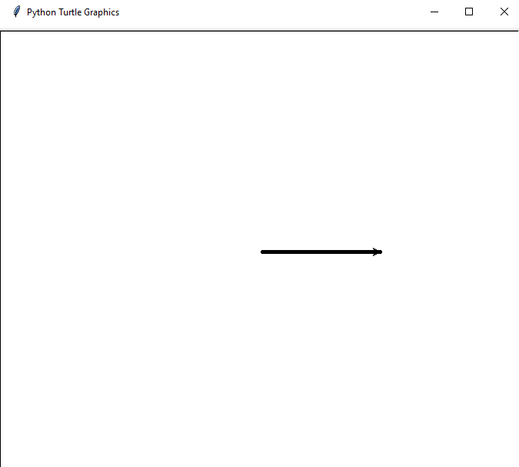
Cont…
Pen Size
Sometimes, if you want to increase or decrease the thickness of your pen. You can do this using the following command:
pensize()
Example
import turtle as t
t.pensize(5)
t.fd(200)
>>>Output

Slide 12
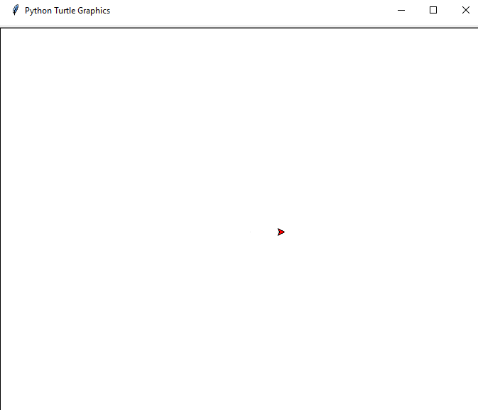
Changing the Turtle and Pen Color
Change the color of the turtle: This changes the fill color using this command:
fllcolor()
Example
import turtle as t t.fillcolor("red")
>>>Output

Slide 13
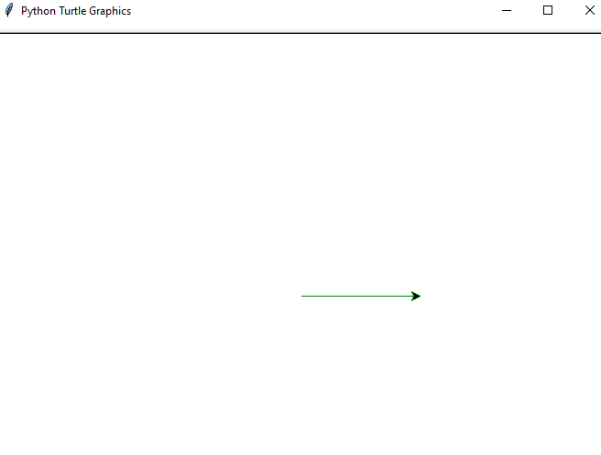
Cont…
Change the color of the pen: This changes the outline or the ink color using this command:
pencolor()
Example
import turtle as t t.pencolor("green") t.fd(200)
>>>Output

Slide 14
Filling on Image
The python turtle library gives you the option to add color to your drawings.
We must use the two commands to fillies an polygons
Begin_fill(): This command is used turtle you code that you're going to be drawing a closed shape which will need to be filled in.
End_fill(): To indicate that you’re drawing your shape and it can be filled in.

Slide 15
Cont…
>>>Output
import turtle as t t.begin_fill() t.fd(100) t.lt(120) t.fd(100) t.lt(120) t.fd(100)
t.fillcolor(“green”) t.end_fill()

Slide 16

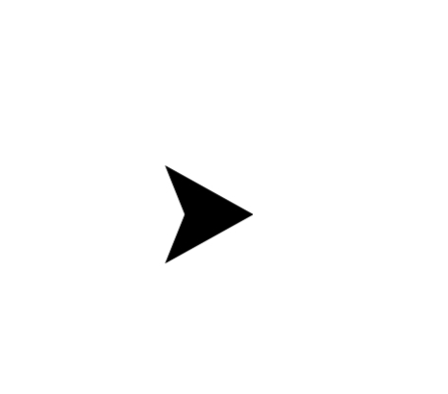

Changing the turtle shape
The initial shape of the turtle isn’t really a turtle, but a triangular figure. However, you can change the way the turtle looks such as arrow shape, turtle shape, triangle shape follow this command to change turtle shape.
t.shape(“turtle”) t.shape(“arrow”) t.shape(“triangle”)

Slide 17
Changing the pen speed
The speed of the turtle movement can be changed, in default. It moves at a moderate speed our the screen but we can increase and decrease it’s speed.
The turtle speed can vary integer value in the range of 0 to 10.
0 – Fastest
10 – Fast
6 – Normal
3 – Slow
1 – Slowest

Slide 18
Changing the pen Up and Down
Sometimes, you may want to move your turtle to another point on the screen without drawing anything on the screen itself. To do this, you use .penup(). Then, when you want to start drawing again, you use .pendown().
Example:
import turtle as t
t.fd(100)
t.rt(90)
t.penup()
t.rt(90)
t.pendown()
t.fd(100)

Slide 19
Indian Flag
import turtle turtle.bgcolor("white") #for creating turtle in variable v v=turtle.Turtle() v.hideturtle(),v.speed(0) #pipe start point v.up(),v.goto(-260,600),v.down(),v.pensize(3) #pipe and pipe color for i in range(2): v.begin_fill(),v.fd(30),v.rt(90),v.fd(1000),v.rt(90),v.fillcolor("gold"),v.end_fill() #circle in at the too of pipe v.begin_fill(),v.fd(15),v.circle(15),v.fillcolor("silver"),v.end_fill(),v.fd(15) for x in ["orange","white","green"]:
v.begin_fill(),v.fd(470),v.rt(90),v.fd(100),v.rt(90),v.fd(470),v.rt(90),v.fd(100),v.bk(100),v.rt(90),v.fillcolor(x),v.end_fill()

Slide 20
Cont…
#for ashoka chakra position v.lt(90),v.fd(200),v.rt(90),v.fd(470/2) #creating ashoka chakra circle v.lt(180),v.color("blue"),v.circle(50),v.up(),v.lt(90),v.fd(50),v.down() #for 24 a c lines for m in range(24): v.fd(50),v.bk(50),v.lt(15) v.penup() #end v.goto(-190,650) v.write("We Are Indians",font=("Arial",15)) turtle.done()

Slide 21
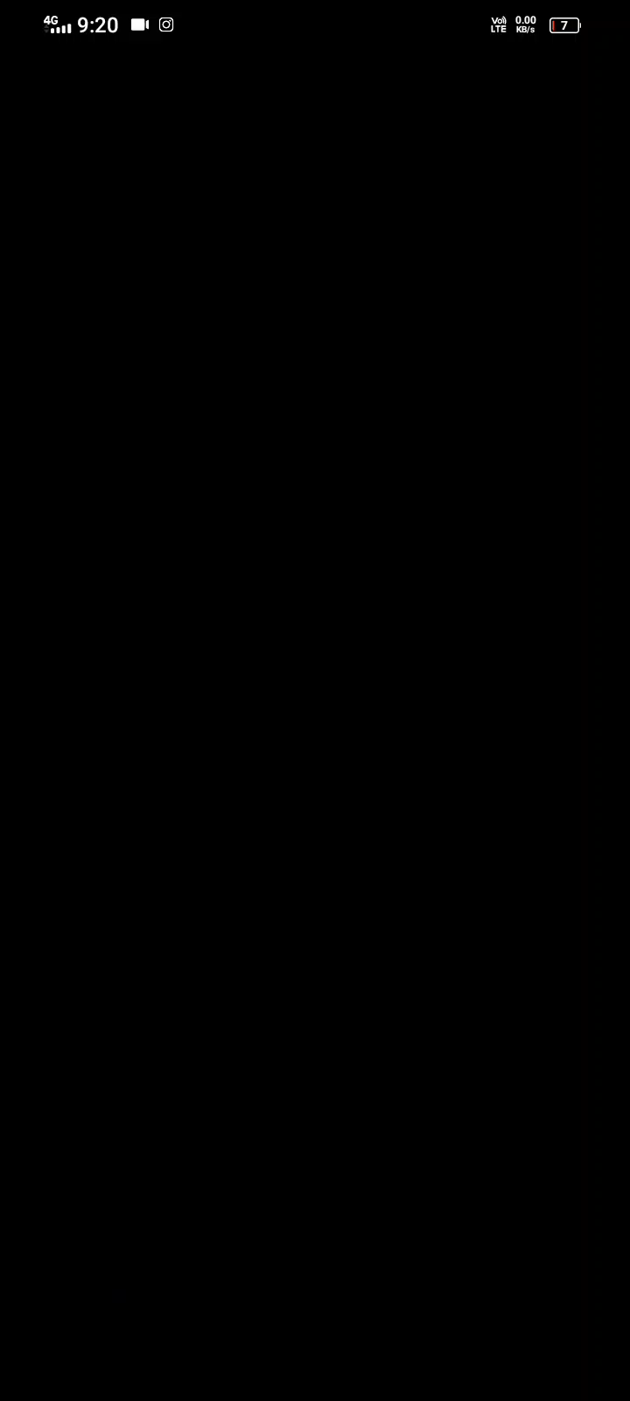
Drawing an Indian Flag by Python’s Turtle

