Slide 1
Flight Data

Slide 2
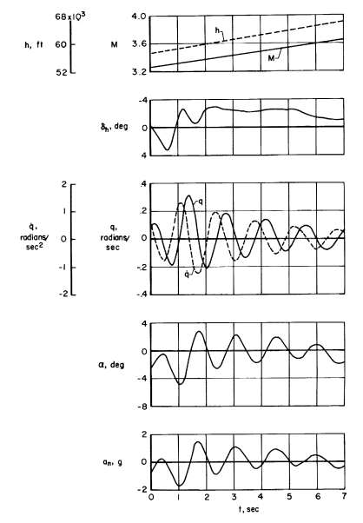
Nominal M = 3.4
1.4s, .3 r/s
5.6s, .1 r/s
Nominal AoA = 0 deg
Yancey64, page 27

Slide 4
Inertia Products and Moments

Slide 5
Jxx = 3600 slug-ft2
Jxz = -700 slug-ft2

Slide 6
Jyy = 86000 slug-ft2

Slide 7
Jzz = 88500 slug-ft2

Slide 8
Forces: Lift, Drag, and Sideforce

Slide 9
Digitized and integrated in simulation
CLwb = 0
Walker60, pdf page 66

Slide 10
Digitized and integrated in simulation, but not used given CL data.
Wind tunnel is dashed line
CLAlpha_pdeg = 0.03
M=0
M=12
Walker60, pdf page 73

Slide 11
Digitized and integrated in simulation
CLdele_pdeg = 0.005
M=0
M=12
Walker60, pdf page 73

Slide 12
Digitized and integrated in simulation

Slide 13
Digitized and integrated in simulation
Saltzmann66, pdf page 31
CDwb = 0.058

Slide 14
Digitized and integrated in simulation
Saltzmann66, pdf page 32

Slide 15
Digitized and integrated in simulation

Slide 16
Digitized and integrated in simulation

Slide 18
CDdele_pdeg=0
(Assumed zero)

Slide 19
CDdelsb_pdeg=0
(Not included)

Slide 20
Digitized and integrated in simulation
CYBeta_pdeg = -0.02
M=2.0
M=12

Slide 21
Digitized and integrated in simulation
CYP_prps = 0.017
M=2.0
M=12
Note, significant side force due to roll as AoA increases.

Slide 22
The effect of sidewash lag at the vertical tail is analyzed in
reference 50, in which it is shown that the derivatives are related
to the rate of change of sidewash angle with angle of sideslip as
follows... The sidewash variations at the tail , however, are not significant, and
the derivatives (CYbetadot and Cnbetadot) therefore have been dropped. – Walker 1960, page 32
Digitized and integrated in simulation
CYr_prps = -0.92
M=2.0
M=12
Assumed that CYbetadot_prps = 0

Slide 23
Digitized and integrated in simulation
M=2.0
M=12
CYdela_pdeg = -0.00030
Walker60, pdf page 115

Slide 24
Digitized and integrated in simulation
CYdelr_pdeg = 0.0057
M=2.0
M=12
Walker60, pdf page 113

Slide 25
Moments: Roll

Slide 26
Digitized and integrated in simulation
ClBeta_pdeg = 0
M=2.0
M=12

Slide 27
Digitized and integrated in simulation
ClP_prps = -0.185
M=2.0
M=12

Slide 28
Digitized and integrated in simulation
ClR_prps = -0.08
Assumed Clbetadot_prps = 0

Slide 29
Digitized and integrated in simulation
Cldela_pdeg = 0.0007
M=0.0
M=12

Slide 30
Digitized and integrated in simulation
Cldelr_pdeg = 0.00025

Slide 31
Moments: Pitch

Slide 32
Digitized and integrated in simulation

Slide 33
Digitized and integrated in simulation
CMAlpha_pdeg = -0.01
Walker60, pdf page 75

Slide 34
Digitized and integrated in simulation
CMQ_prps = -4.4
M=12
M=2.0
Walker60, pdf page 84

Slide 35
Digitized and integrated in simulation
Walker60, pdf page 84

Slide 36
Digitized and integrated in simulation
Walker60, pdf page 84

Slide 37
Digitized and integrated in simulation
Walker60, pdf page 84

Slide 38
Not Included in Simulation
CMAlphadot_prps = -0.1
M=2.0
M=12
Walker60, pdf page 84

Slide 39
Digitized and integrated in simulation
CMdele_pdeg = -0.008
Walker60, pdf page 77

Slide 40
CMdelsb_pdeg = 0

Slide 41
Moments: Yaw

Slide 42
Digitized and integrated in simulation
CnBeta_pdeg = 0.0046
M=2.0
M=12

Slide 43
Digitized and integrated in simulation
CnP_prps = -0.01
M=2.0
M=12

Slide 44
Digitized and integrated in simulation
CnR_prps = -1.19
M=2.0
M=12
Assume Cnbetadot = 0

Slide 45
Digitized and integrated in simulation
Cndela_pdeg = 0.00045

Slide 46
Digitized and integrated in simulation
Cndelr_pdeg = -0.0039
M=0.0
M=12

