Slide 1
CLI CRASH COURSE

Slide 2
What is a cli?
Notes:
The command line, or shell, provides a powerful, transparent interface between the
user and the internals of a computer. At least on a Linux or Unix computer, the com‐
mand line provides total access to the files and processes defining the state of the
computer—including the files and processes of the operating system.

Slide 3
Why bother learning it?
Notes:
Why? Because if you want to learn to code, then you must learn this. Programming languages are advanced ways to control your computer with language. The command line is the baby little brother of programming languages. Learning the command line teaches you to control the computer using language. Once you get past that, you can then move on to writing code and feeling like you actually own the hunk of metal you just bought.

Slide 4
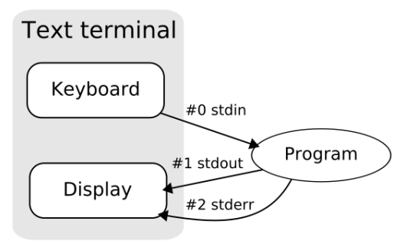
the three streams

Slide 5
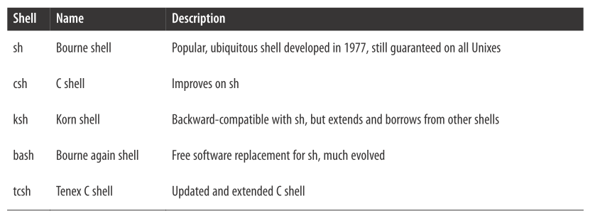

Slide 6
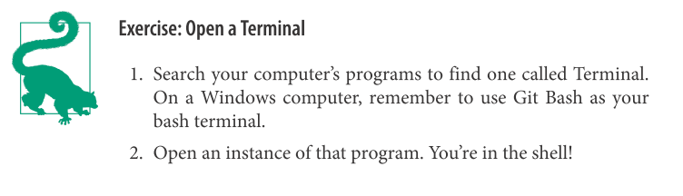

Slide 7
paths and pwd
The space where your files are—your file space—is made up of many nested directories (folders). In Unix parlance, the location of each directory (and each file inside them) is given by a “path.” These can be either absolute paths or relative paths.

Slide 8
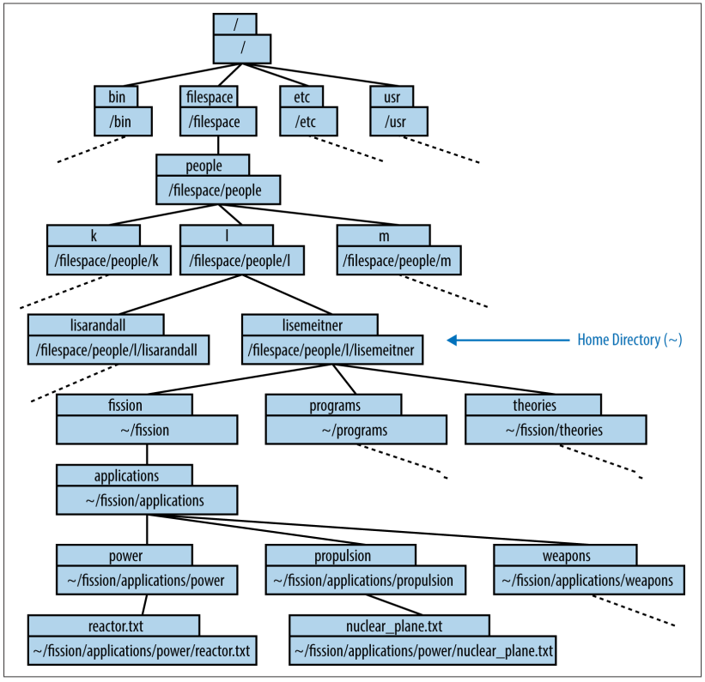
source: effective computation in physics

Slide 9
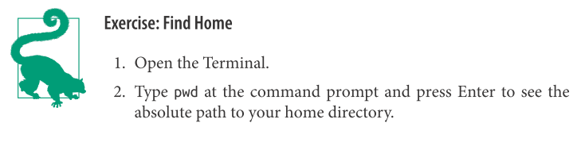

Slide 10
listing the contents
The ls command allows the user to print out a list of all the files and subdirectories in a directory.

Slide 11
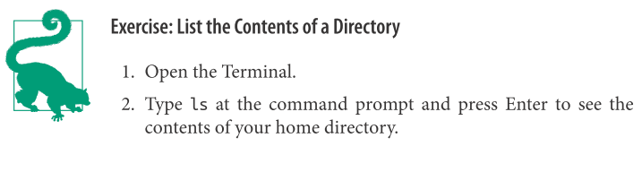

Slide 12
changing directories
The cd command allows the user to change directories

Slide 13
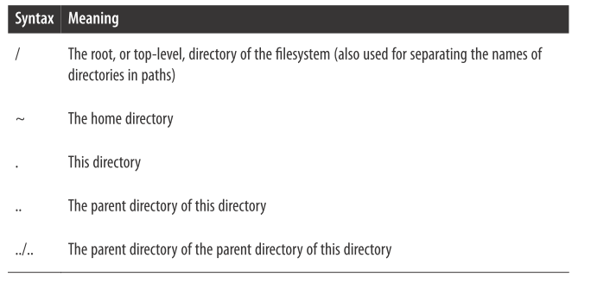

Slide 14
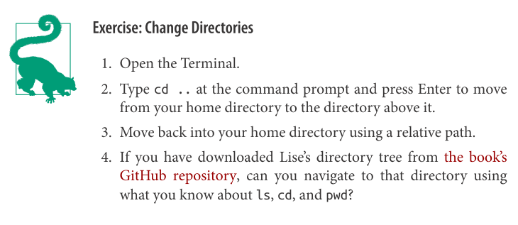

Slide 15
inspecting files
The command head prints the first 10 lines of the given file. Can you guess what tail does?
Notes:
When dealing with input and output files for scientific computing programs, you often only need to see the beginning or end of the file (for instance, to check someimportant input parameter or see if your run completed successfully).

Slide 16
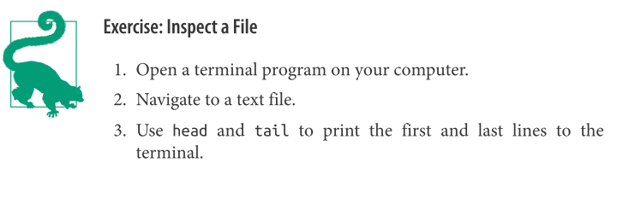

Slide 17
creating and empty file
The touch command, followed by a filename, will create an empty file with that name.

Slide 18
The simplest text editor
The cat command is meant to help concatenate files together. Given a filename as its argument, cat will print the full contents of the file to the terminal window.
Notes:
to use cat as a text editor
cat > output.txt

Slide 19
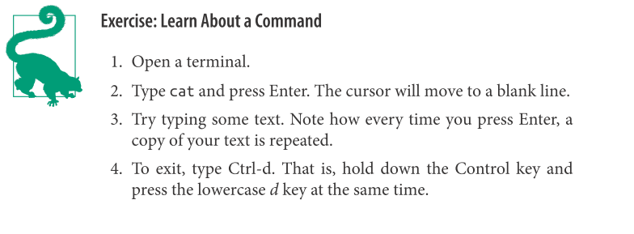

Slide 20
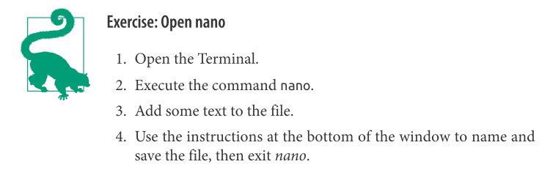

Slide 21
Copying and renaming files
To make a copy of a file, use the cp command. The cp command has the syntax cp <source> <destination>.

Slide 22
Copying and renaming files
If you don’t need to keep the original file during a copy, she can use mv (move),which renames the file instead of copying it.
Notes:
The command evokes “move” because if
the new name is a path in another directory, the file is effectively moved there.

Slide 23
making directories
You can make new directories with the mkdir (make directory) command.

Slide 24
deleting files and directories
Files and directories can be deleted using the rm (remove) command.

Slide 25
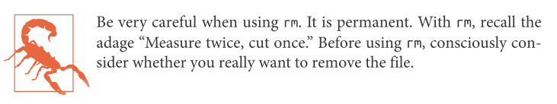
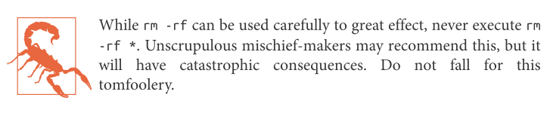

Slide 26
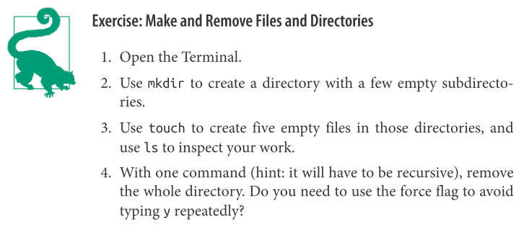

Slide 27
reading the manual
The program man (manual) is an interface to online reference manuals.
Notes:
If you pass the name of a command or program to man as an argument, it will open the help file for that command or program.

Slide 28
reading the manual
• Use the up and down arrows to scroll up and down.
• Use Page Up and Page Down (or the space bar) to move up or down by an entire page.
• Use a forward slash ( / ) followed by a search term and then Enter to search for a
particular word. The letter n (next) toggles through each occurrence.
• Use h to display help inside less —this displays all the possible commands that
less understands.
• Use q to quit.

Slide 29
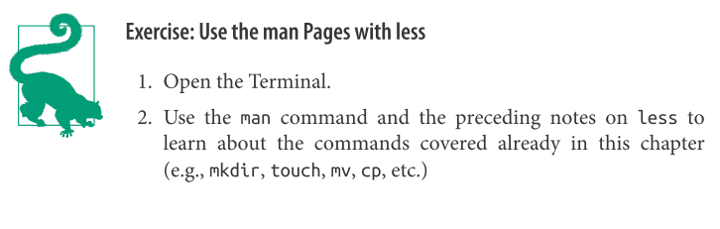

Slide 30
find the right tool
You can search the man pages for keywords with a command called apropos .

Slide 31
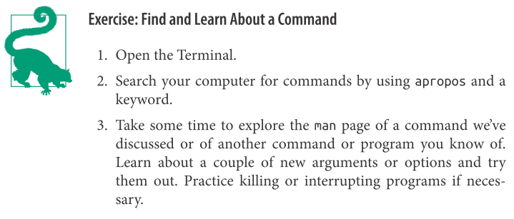

Slide 32
Thank you!

Slide 33
references
Effective Computation in Physics
https://github.com/physics-codes/examples
Learning the Shell
http://linuxcommand.org/lc3_learning_the_shell.php
CLI Crash Course
http://cli.learncodethehardway.org/book/introduction.html
Software Carpentry Shell Novice
http://swcarpentry.github.io/shell-novice/
https://github.com/swcarpentry/shell-novice

