Slide 1

UNIX Fundamentals Part I
Presented By:
Gerry Hounsell

Slide 2





FACILITIES
Training Hours
Building Hours
Restrooms
Meals
Telephones
Messages
Smoking Policy
Notes:
Training Hours
Start: 09:00
Finish:17:30
Building Hours
24 hours operation.
Restrooms
Female-
Male -
Meals/Breaks
Mid Morning -
Lunch -
Mid Afternoon -
Telephones
Please turn off mobile phones or leave them on silent.
Messages
Will be left with your trainer.
Smoking Policy
No Smoking in building.
Smoking area available ……

Slide 3






INTRODUCTIONS
Name
Company
Title/Function
Job Responsibility
UNIX Experience
Expectations From Training

Slide 4

UNIX Fundamentals COURSE AGENDA PART I
UNIX History
The Many Flavours’ of UNIX
The Structure of UNIX
Access to UNIX Systems
Processes
Filesystems & Directories
Devices

Slide 5
UNIX Fundamentals COURSE AGENDA PART II
vi Editor
Redirection & Regular Expressions
Scheduling
Logical Volume Management
Networking
Printing
UNIX Tools & Utilities
System Error Reporting
Manual Pages

Slide 6
UNIX Fundamentals Part I
UNIX History
The Many Flavours’ of UNIX
The Structure of UNIX
Access to UNIX Systems
Processes
Filesystems & Directories
Devices

Slide 7
UNIX History
1960’s - Multiplexed Information and Computing Service (Multics).
Ken Thompson continued to develop on the GE-645 Mainframe and wrote a game!
Further development experience in DEC PDP-7 Assembly Language and work with Multics gave rise to Uniplexed Information and Computing System (Unics)
Later renamed to UNIX
Notes:
In the 1960s, the Massachusetts Institute of Technology, AT&T Bell Labs, and General Electric worked on an experimental operating system called Multics (Multiplexed Information and Computing Service), which was designed to run on the GE-645 mainframe computer. The aim was the creation of an interactive operating system with many novel capabilities, including enhanced security. The project did develop production releases, but initially these releases turned out to have poor performance.
AT&T Bell Labs pulled out and deployed its resources elsewhere. One of the developers on the Bell Labs team, Ken Thompson, continued to develop for the GE-645 mainframe, and wrote a game for that computer called Space Travel. However, he found that the game was slow on the GE machine and was costly, apparently costing $75 per go in scarce computing time.
Thompson thus re-wrote the game in DEC PDP-7 Assembly language with help from Dennis Ritchie. This experience, combined with his work on the Multics project, led Thompson to start a new operating system for the DEC PDP-7. Thompson and Ritchie led a team of developers, including Rudd Canaday, at Bell Labs developing a file system as well as the new multi-tasking operating system itself. They included a command interpreter and some small utility programs as well. This project was called Unics, short for Uniplexed Information and Computing System, and could support two simultaneous users. The name has been attributed to Brian Kernighan, and was a hack on Multics. Following bad puns of Unics (homophone of eunuchs) being a castrated Multics, the name was later changed to Unix, and thus a legacy was born. The name is also a criticism of the overly general and bloated Multics system - Unix would do one thing, and do it well.

Slide 8
UNIX History
1970 – The Epoch
Unix was officially named and ran on the PDP 11/20
First funding for the development of UNIX from Bell Labs
1973 - UNIX rewritten in C to make the code portable to other machines
Numerous versions of UNIX developed (1-7)
Notes:
Up until this point there had been no financial support from Bell Labs, when the Computer Science Research Group wanted to use Unix on a much larger machine than the PDP-7. Thompson and Ritchie managed to trade the promise of adding text processing capabilities to Unix for a PDP-11/20 machine, and this itself led to some financial support from Bell. For the first time in 1970, the Unix Operating System was officially named and ran on the PDP-11/20. It added a text formatting program called roff and a text editor. All three were written in PDP-11/20 assembly language. This initial "text processing system", made up of Unix, roff, and the editor, was used by Bell Labs for text processing of patent applications at Bell. Runoff soon evolved into troff, the first electronic publishing program with a full typesetting capability. The UNIX Programmer's Manual was published on November 3, 1971.
In 1973, the decision was made to re-write Unix in the C programming language. The change meant that Unix could later easily be modified to work on other machines (thus becoming portable), and other variations could be created by other developers. The code was now more concise and compact, leading to an acceleration in the development of Unix. AT&T made Unix available to universities and commercial firms, as well as the United States government under licenses. The licenses included all source code except for the machine-dependent kernel, which was written in PDP-11 assembly code. However, bootleg copies of the annotated Unix machine-dependent kernel circulated widely in the late 1970's in the form of a much-copied book by John Lions of the University of New South Wales in Australia, which led to considerable adoption of Unix as an educational operating system.
Development expanded, with Versions 4, 5 and 6 being released by 1975. These versions added pipes, leading to the development of a more modular code-base, increasing development speed still further. By 1978, over 600 machines were running Unix in some form. Version 7 Unix, the last version of Research Unix to be released widely, was released in 1979. Versions 8, 9 and 10 were developed through the 1980s but were only ever released to a few universities, though they did generate papers describing the new work. This research led to the development of Plan 9, a new portable distributed system.

Slide 9
UNIX History
1980’s
AT&T developed UNIX System III
In 1982 AT&T combined UNIX 1-7 into UNIX System V Release 1
These commercial versions no longer included source code, the University of California, Berkeley (UCB) continued to develop BSD Unix as an alternative
BSD contribute TCP/IP network code into the mainstream UNIX kernel
Notes:
AT&T now developed UNIX System III, based on Version 7, as a commercial version and sold the product directly, the first version launching in 1982. However its subsidiary, Western Electric, continued to sell older Unix versions, based on the UNIX System (Versions 1 to 7). To end the confusion between all the differing versions, AT&T combined various versions developed at other universities and companies into UNIX System V Release 1. This introduced features such as the vi editor and curses from the Berkeley Software Distribution of Unix developed at the University of California, Berkeley (UCB). This also included support for the DEC VAX machine.
The new commercial Unix releases however no longer included the source code and so UCB continued to develop BSD Unix as an alternative to UNIX System III and V, originally on the PDP-11 architecture (the BSD 2.x releases, ending with 2.10). Perhaps the most important aspect of the BSD development effort was the addition of TCP/IP network code to the mainstream Unix kernel. The BSD effort produced eight significant releases that contained network code: 4.1c, 4.2, 4.3, 4.3-Tahoe ("Tahoe" being the nickname of the CCI Power 6/32 architecture that was the first non-DEC port of the BSD kernel), 4.3-Reno (to match the "Tahoe" naming, and that the release was something of a gamble), Net2, 4.4, and 4.4-lite. The network code found in these releases is the ancestor of almost all TCP/IP network code in use today, including code that was later released in AT&T System V UNIX and Microsoft Windows.

Slide 10
UNIX History
Further UNIX derivatives developed, mainly System V based
1982 SunOS developed
1980 Microsoft announced Xenix, the first UNIX for 16-bit microcomputers
1983 the Santa Cruz Operation (SCO) ported this to the Intel 8086 processor
Notes:
Other companies began to offer commercial versions of the UNIX System for their own mini-computers and workstations. Most of these new Unix flavors were developed from the System V base under a license from AT&T. Others chose BSD instead. One of the leading developers of BSD, Bill Joy, went on to co-found Sun Microsystems in 1982 and create SunOS (now Solaris) for their workstation computers. In 1980, Microsoft announced its first Unix for 16-bit microcomputers called Xenix, which the Santa Cruz Operation (SCO) ported to the Intel 8086 processor in 1983, and eventually branched Xenix into SCO UNIX in 1989.
In 1984, an industry group called X/Open was formed, with the aim of forming compatible open systems, that is, standardize the UNIX systems.

Slide 11
UNIX History
1980’s and 1990’s – The UNIX Wars
1984 X/Open founded to standardise UNIX
1987-89 AT&T and Sun Microsystems merged Xenix, BSD, SunOS and System V into System V Release 4 (SVR4)
1990 Open Software Foundation released OSF/1 based closely on BSD UNIX
Notes:
The Unix wars were the struggles between vendors of the Unix computer operating system in the late 1980s and early 1990s to set the standard for Unix henceforth. These battles are commonly held to have harmed the market acceptance of Unix and created a market gap that allowed the rise of Windows NT.
In the mid-1980s, the two common versions of Unix were BSD, from the University of California at Berkeley, and System V, from AT&T. Both were derived from the earlier Version 7 Unix, but had diverged considerably. (This conflict was also known as the "UNIX wars" to some degree.) Further, each vendor's version of Unix was different to a greater or lesser degree.
AT&T added various features into UNIX System V, such as file locking, system administration, job control (modelled on ITS), streams, the Remote File System and TLI. AT&T cooperated with Sun Microsystems and between 1987 and 1989 merged Xenix, BSD, SunOS, and System V into System V Release 4 (SVR4), independently of X/Open. This new release consolidated all the previous features into one package, and threatened the end of competing versions. It also greatly increased licensing fees.
In 1990, the Open Software Foundation released OSF/1, their standard Unix implementation, and it was more closely based on BSD than on SVR4. The Foundation was started in 1988 and was funded by several Unix-related companies that wished to counteract the collaboration of AT&T and Sun on SVR4. Subsequently, AT&T and another group of licensees formed the group "UNIX International" in order to counteract OSF. This escalation of conflict between competing vendors gave rise to the syntagma "Unix wars".

Slide 12
UNIX History
2000 - The dot-com crash
Lead to significant consolidation of UNIX users
Main derivatives of UNIX are now:
IBM’s AIX
Sun Microsystems's Solaris
HP’s HP-UX
Linux (many different Vendors)
Notes:
The dot-com crash has led to significant consolidation of Unix users as well; of the many commercial flavours of Unix that were born in the 1980s, only Sun's Solaris, Next's NextStep (now Apple's Mac OS X) and IBM's AIX are still doing relatively well in the market as players such as Digital Equipment Corporation, Data General, and the original Santa Cruz Operation (now known as Tarantella) have been bought out or gone out of business. The rise of UNIX and the open-source BSD implementations as a dominating force in the Unix space has also dealt a damaging blow to commercial Unix development, as some companies opt for open source over closed.

Slide 13
UNIX History
“Some Key Features/Factors”
Multi-tasking, Time Sharing
Multi-user
Network Capabilities
Portability
Flexibility
Software Available
Virtual Memory
Case Sensitivity
UNIX's philosophy is the same as the C language's:
IT ASSUMES USERS KNOW WHAT THEY ARE DOING!!!!
Notes:
Multi-tasking, Time Sharing UNIX is a multi-tasking operating system, which means that a number of programs can run at the same time. Those programs (called processes) can communicate with each other. For example, a C program could be compiling as mail is being read or a file is being edited. Processes that \wake-up" occasionally, and/or regularly, are called daemons. Daemons are used to synchronise disks, send and receive mail, print documents, and so on.
Multi-user UNIX is also multi-user: two, three, or more users are able to use the same processor to execute their programs.
Network Capabilities Most of today's UNIX workstations come with TCP/IP and Ethernet connections. At NRC the Ethernet network connects dozens of Suns, Silicon Graphics, VAXes, IBM RS/6000s, HPs, and an increasing number of PCs. From any of those nodes, it is simple to logon to a remote machine, send mail to a user on those machines, or transfer files to or from those nodes.
Portability Traditionally, most operating systems were written in Assembler, for a specific architecture. It was therefore VERY painful (if at all possible) to `port' the operating system to other architectures. UNIX, on the other hand, is mostly written in the C language. This alone allows UNIX to be portable to many architectures. Today, UNIX runs on more architectures than any other operating system in the world. Examples of such architectures/processors are the Motorola 680X0-based workstations, the 80X86 machines, the RISC based architectures (SPARC, MIPS, 88000), VAXes, IBM mainframes, Amdahl, Cray, and many more.
Flexibility UNIX is also a very flexible operating system, both for system administrators and users. Program names can be changed. aliases can be defined. Arguments to programs can also be changed. New programs can be built, and put in the user's own bin directory, thus allowing further customisation of the system.
Software Available Thousands of application packages are available for the UNIX/linux system. In addition to the commercial packages, many programs are written and made available in the public domain. Examples of such packages are the X Window system, written at the Massachusetts Institute of Technology, the TEX system produced at Stanford, and many other utilities/applications written by individuals and organisations, for the benefit of the \Open Source Community". For many, it is their way of thanking the \Internet Community" for the vast amount of resources available. Linux is a perfect example of the incredible amount of software available, at no cost to individuals.
Virtual Memory The UNIX operating system has virtual memory, or swap space, which means it can run programs bigger than the amount of RAM the computer actually has! The amount of virtual memory is decided upon by the system administrator.
Case Sensitivity The most common mistake for beginners involves the use of mixed case in UNIX commands: UNIX is case sensitive, i.e., \a" is different from \A".

Slide 14
UNIX Fundamentals Part I
UNIX History
The Many Flavours’ of UNIX
The Structure of UNIX
Access to UNIX Systems
Processes
Filesystems & Directories
Devices

Slide 15
The Many Flavours of UNIX
Main derivatives of UNIX are now:
IBM - AIX
Sun Microsystems - Solaris
Hewlett Packard - HP-UX
Linux
Novell – SUSE
Red Hat
Mandriva
Debian
Ubuntu

Slide 16
UNIX Fundamentals Part I
UNIX History
The Many Flavours’ of UNIX
The Structure of UNIX
The Kernel
The Shell
Filesystems
Access to UNIX Systems
Processes
Filesystems & Directories
Devices

Slide 17
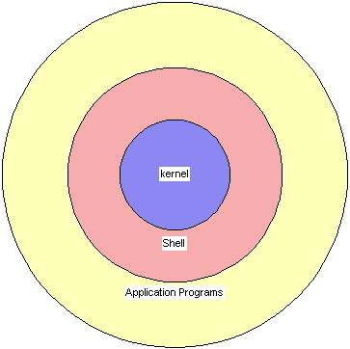
The Structure of UNIX
The Kernel
The Shell
Filesystems
Notes:
The kernel is that part of the system which manages the resources of whatever computer system it lives on, to keep track of the disks, tapes, printers, terminals, communication lines and any other devices.
The file system is the organising structure for data. The file system is perhaps the most important part of the UNIX operating system. The file system goes beyond being a simple repository for data, and provides the means of organizing the layout of the data storage in complex ways.
The shell is the command interpreter. Although the shell is just a utility program, and is not properly a part of the system, it is the part that the user sees. The shell listens to your terminal and translates your requests into actions on the part of the kernel and the many utility programs.

Slide 18
UNIX Fundamentals Part I
UNIX History
The Many Flavours’ of UNIX
The Structure of UNIX
The Kernel
The Shell
Filesystems
Access to UNIX Systems
Processes
Filesystems & Directories
Devices

Slide 19
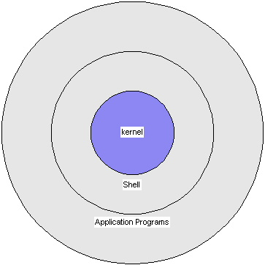
The Kernel
The kernel is the direct link to the hardware and controls all I/O requests.
The shell is a high-level link to the kernel.
The application layer normally sits above the shell.
Notes:
The kernel is the name given to the central core of the operating system.
Programs are called from the UNIX shell to interact with the kernel as required.

Slide 20
The Kernel
Manages the files on disk
Schedules multiple processes / users
Written in “c” with a ‘small’ amount’ of machine dependent assembler
Notes:
The kernel manages multiple processes which may be running on the system at any time.
The kernel controls the input and output systems of the machine, for example, terminals, printers, etc. It also manages disks connected to the system and controls access to files on them.
“c” compliers are developed for a particular hardware environment.
Porting of UNIX to a new environment involves compiling the “c” code of the kernel and developing the associated assembler routines.

Slide 21
UNIX Fundamentals Part I
UNIX History
The Many Flavours’ of UNIX
The Structure of UNIX
The Kernel
The Shell
Filesystems
Access to UNIX Systems
Processes
Filesystems & Directories
Devices

Slide 22
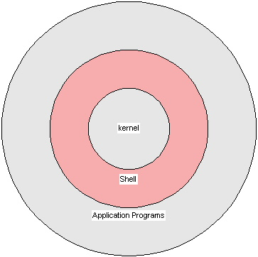
The Shell - I
The UNIX shell is a command interpreter
A shell is a program that interprets and runs the commands typed at the console by the user. The shell sends requests to the kernel, which executes them.
The three ‘best known’ shells are
C shell (csh)
Bourne shell (bsh)
Korn shell (ksh)
Each shell can be programmed.
Notes:
The shell is the command interpreter. Although the shell is just a utility program, and is not properly a part of the system, it is the part that the user sees. The shell listens to your terminal and translates your requests into actions on the part of the kernel and the many utility programs. Before Unix, interpreting the users' commands was done by a part of the operating system (OS). One of the best ideas in Unix was taking this job out of the OS and giving it to an ordinary program - the shell. This approach has several advantages, namely:
Users have a choice of shells.
Systems developers can give users menu-driven shells if needed.
the name of the chosen shell is held at the end of the user's entry in the passwd file.
You can even write your own if you don't like the standard ones.
Shells can be written in high-level languages by programmers who don' t need to be experts in writing OSs.
The OS is smaller and simpler.
Each shell has its own advantages. The general consensus of views from users familiar with both (C and Bourne) shells appears to be that the C shell is superior for interactive work, because of its process control features, while the Bourne shell has more powerful language constructs, and so is better for use in shell scripts. The Korn Shell is newer, and incorporates the features and functionality of both the C and Bourne shells, while retaining the speed of the Bourne shell (with which it is also upward compatible). Some useful features of the shell are:
history - which allows you to re-use old commands, either as they were or slightly modified.
alias - which allows you to execute rm –I instead of rm so that you have to confirm every file deletion. Any command can be aliased.
noclobber - lets you avoid overwriting files when using re-direction e.g.
date > precious would not overwrite precious.

Slide 23
The Shell -II
The Shell is similar to command line in DOS
The file separator in UNIX is a forward slash (/) and NOT a back slash (\) this has a special meaning/use.
The Shell is case sensitive: myfile, MYFILE and MyFile are three different names.
The Shell has very few built in commands to do the most basic tasks, e.g.
cp – copy.
mv – move.
rm – delete.
echo – print to screen.
clear – clear the screen.
cal – display calendar.
Date – display or change the date.

Slide 24
The Shell - III
Programs containing shell commands are called shell scripts.
Shell scripts are important because they:
are an easy way of adding new commands.
allow prototyping.
allow on-off systems to be developed easily.
The above are only possible because the standard shells provide a complete programming language.
Notes:
In Unix, the shell has very few built-in commands; mostly it calls self contained little programs such as rm, cp, and mv to do even the most basic tasks. This approach has several advantages.
It is very easy to add new commands to Unix because all you have to do is make an executable file available with a suitable name.
Apart from the built-in commands, the same set of Unix commands is available from all the different shells.
Since shells deal with the filename expansion (wild cards), programs such as rm, cp, and mv do not have to do it and their authors can concentrate on the main task of the program.
Since shells deal with input-output redirection, the little programs do not have to do it.
Many of the small programs do not even need to open files because they inherit them from the shell.
The shells are smaller and simpler.

Slide 25
The Shell - IV
Three files are automatically opened for each process in the system. These are:-
standard input
standard output
standard error
These defaults can be changed using redirection.
Notes:
standard input - abbreviated to stdin
standard output - abbreviated to stdout
standard error - abbreviated to stderr

Slide 26
The Shell V
The default file descriptors can be changed using redirection.
Redirection input from a file: <
Command < filename
Default Standard output:
Outputs to screen
Redirect output from a file: >
command > filename
Redirecting & appending output to a file: >>
command >> filename
Notes:
stdin - < 0
stdout - > 1
stderr - 2> 2
Examples:
Redirection input from a file: <
mail hounselg < letter
In this example the file letter can be created using an editor. It is then used as standard input to the mail program rather than typing from the keyboard. The symbol < tells mail to take input from the file instead of the keyboard.
Default Standard output:
$ ls
file1 file2 file3
Redirect output from a file: >
$ ls > ls.out
The output will go to the file ls.out
Redirecting & appending output to a file: >>
who >> who.there
The output will be appended to the file whos.there

Slide 27
The Shell - VI
Shell variables
Define your environment
HOME directrory
TERMinal type
Search PATH
Additional variables can be defined
Use the export command to declare the variable
ORAHOME=/home/oracle/9.1/
export ORAHOME
Use set or env commands to display the shell variables in your current environment.
Use unset to delete or remove the variable from the environment.
Notes:
“Variables are names known to a program that represent data whose value may change at any time while the program is running”.
To assign a value to a shell use the following convention:
NAME=value
e.g. STDDATA=/data/standard/stuff/etc
export STDDATA
To reference a variable, use the variable name with a $ in front, e.g.
$ echo $STDDATA
$ cd $STDDATA

Slide 28
The Shell - VII
Quoting Metacharacters
‘ ‘ Single Quotes: ignores the special meaning of all metachracters between the quotes
“ “ Double Quotes: Ignores the special meaning of all metacharacters except for $, ` and \
\ Backslash: Ignores the special meaning of the following character.
Notes:
‘ ‘ Single quotes example:
$ echo ‘$HOME’
$HOME
“ “ Double quotes example:
$ echo “$HOME”
/home/hounselg
\ Backslash example:
$ echo \$HOME
$HOME

Slide 29
The Shell VIII
A shell script is a collection of commands stored in a text file.
Shell scripts can be invoked in three ways:
$ ksh <scriptname>
$ <scriptname>
$. <scriptname>
A command returns a value to the parent process. By convention, zero means success and a non – zero means an error occurred.
Commands in a pipeline return a single value to their parent.
The environment variable $? Contains the return code of the previous command. e.g.
0 = success
1 = worked but not successful
2 = failure
127 = program does not exist in directory
Notes:
$ ksh <scriptname> - Must have read permission
$ <scriptname> - Must have read & execute permission
$. <scriptname> - Must have read permission

Slide 30
UNIX Fundamentals Part I
UNIX History
The Many Flavours’ of UNIX
The Structure of UNIX
The Kernel
The Shell
Filesystems
Access to UNIX Systems
Processes
Filesystems & Directories
Devices

Slide 31
Filesystems
The UNIX File System manages and controls access to files and directories.
UNIX keeps track of opened and closed files, and manages files on the hard disk.
The filing structure of the UNIX operating system is hierarchical.
It is a tree structured system, completely open (assuming necessary permissions) to every user on the system, with everything emerging from / (root) at the top.

Slide 32
Filesystems
Naming Conventions
Simple, any ASCII characters can be used
It is recommended that no ‘metacharacters’ are used
It is recommended to use only
Letters
Digits
Underscore ( _ )
Hyphen ( - )
Dot ( . )
Filenames/Directories beginning with a dot ( . ) are hidden.
Notes:
It is recommended that no ‘metacharacters’ are used, namely:
( * { } [ ] ? $ \ ~ > < | & )
Example of a hidden file is:
.profile

Slide 33
Structure of UNIX Checkpoint - 1
Which part of the operating system interacts directly with the hardware?
Which part of the operating system does the user interact with?
Shell
Kernel
Filesystem
What does the (.) in front of a filename or directory name mean?

Slide 34
Structure of UNIX Checkpoint - 2
Name the three file descriptors assigned by the shell when a program starts?
……………………………………
……………………………………
……………………………………
What characters are not recommended to be used when naming files & directories?

Slide 35
UNIX Fundamentals Part I
UNIX History
The Many Flavours’ of UNIX
The Structure of UNIX
Access to UNIX Systems
Logging on and off
whoami & whereami
Changing Users
Processes
Filesystems & Directories
Devices

Slide 36
Accessing UNIX Systems
Logon requires a username and password
UNIX is cAsE sensitive for both username and password
.profile used to initialise user preferences during logon
You can use telnet or ssh to connect to a UNIX system.
Notes:
Passwords
USE A PASSWORD.
do not choose a password that exists in the dictionary i.e.
(/usr/share/lib/dict/words).
change your password regularly.
use a combination of letters and numbers, if possible.
your password must be longer than ve characters.
do not write your password anywhere.
do not share your password with everyone who asks for it.
Root Password
To system administrators:
use the above rules.
make sure every user uses a password.
limit the number of people who know the root password, to at least one more than yourself, but not too many.
use the root account only when performing system administration work.

Slide 37
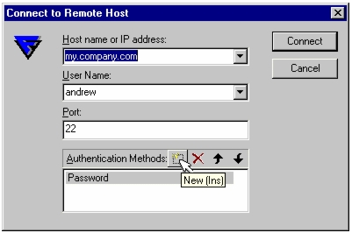
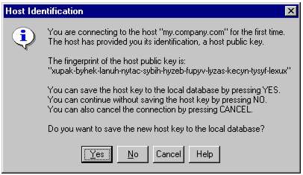
Logging on & off
You will need a username & password
You will need an ssh client
Putty
F-Secure Client
A UNIX host to connect to!
Example:
naac01.systems.uk.hsbc

Slide 38
Logging on & off
Logging on:
login as: hounselg
NOTICE TO USERS
This is a computer system owned by HSBC BANK plc. All programs and
data on this system are the property of, or licensed by HSBC BANK
plc. It is for authorised use only. Users (authorised or
unauthorised) have no explicit or implicit expectations of privacy.
Any or all uses of this system and all files and data on this
system may be intercepted, monitored, recorded, copied, audited,
inspected, and disclosed to relevant authorities.
By using this system, the user consents to such interception,
monitoring, recording, copying, auditing, inspection, and
disclosure at the discretion of HSBC BANK plc authorised personnel.
Unauthorised or improper use of this system may result in
administrative disciplinary action and civil and criminal
penalties. By continuing to use this system you indicate your
awareness of and consent to these terms and conditions of use.
LOG OFF IMMEDIATELY if you do not agree to the conditions stated
in this warning.
hounselg@naac01.systems.uk.hsbc's password:
Notes:
The message between the Login as and password prompt is known as the “system herald”. It can normally be found (for AIX at least!) in the file /etc/security/login.cfg

Slide 39
Logging on & off
Logged on:
WARNING
The programs and data held on this system are the property of,
or licensed by, a company in the HSBC Group.
If the company has not authorised your access to this system you
will commit a criminal offence if you do not immediately
disconnect.
UNAUTHORISED ACCESS IS STRICTLY FORBIDDEN AND IS
A DISCIPLINARY OFFENCE.
No mail.
naac01:/home/hounselg>
Notes:
Changing Your Password
Upon logging onto UNIX for the first time, it is STRONGLY recommended that the user change his/her password, using the passwd command:
passwd
UNIX will ask for the old password, then the new one (twice), always with the echo turned off. Some systems will provide restrictions on the password: IRIX will insist on a password of at least five characters and at least ones non-alphabetic character.
Also note that a maximum length of eight characters is used by the password algorithm: any password longer than eight characters will be truncated to eight.
The message displayed during a successful login (see above) is found in “the message of the day” (/etc/motd) file.

Slide 40
Logging on & off
Logging off:
Three easy ways to SAFELY log off
Type the command exit at the command prompt:
Use the key combination ctrl - d
Type the command logout at the command prompt:
naac01:/home/hounselg> exit
naac01:/home/hounselg> logout
Notes:
Three commands can be used to log out of the UNIX session. These are:
logout
exit
CTRL-D.
Some systems may not accept the CTL-D or exit. They are roughly equivalent when logging out from the console.

Slide 41
UNIX Fundamentals Part I
UNIX History
The Many Flavours’ of UNIX
The Structure of UNIX
Access to UNIX Systems
Logging on and off
whoami & whereami
Changing Users
Processes
Filesystems & Directories
Devices

Slide 42
whoami & whereami?
Who Am I?
Use the command whoami or id or whodo
Used to identify who you are logged in on the system and what they are doing
gbsrual0048:root:/opt/nmon/bin> whoami
root
gbsrual0048:root:/opt/nmon/bin> id
uid=0(root) gid=0(system) groups=2(bin),3(sys),7(security),8(cron),10(audit),11(lp)
gbsrual0048:root:/opt/nmon/bin> whodo
Mon Sep 17 13:17:38 2007
gbsrual0048
pts/0 irssl01 12:54
pts/0 3121296 0:00 ksh
pts/1 root 9:20
pts/1 2638026 0:01 ksh
pts/1 1376426 0:00 ksh
pts/1 2003172 0:00 whodo
Notes:
Who is On the system?
Typing who will display on the standard output the logon names of the users on the system, and the time at which they logged on. e.g. :-
gbsrual0048:root:/opt/nmon/bin> who
irssl01 pts/0 17 Sep 12:54 (A356BZD3WJHWCMR.in.hsbc)
root pts/1 17 Sep 09:20 (srumlms02)
tells us that user root and user irssl01 are logged on. Each on virtual devices connected remotely – pts/x and from separate remote hosts (A356BZD3WJHWCMR.in.hsbc, srumlms02).
Who is doing what on the system?
Typing whodo gives the jobs currently being run on a system:
gbsrual0048:root:/opt/nmon/bin> whodo
Mon Sep 17 13:14:51 2007
gbsrual0048
pts/0 irssl01 12:54
pts/0 3121296 0:00 ksh
pts/1 root 9:20
pts/1 2638026 0:01 ksh
pts/1 1376426 0:00 ksh
pts/1 2662432 0:00 whodo

Slide 43
whoami & whereami?
Where Am I?
Use the command pwd
Used to identify where you are (which directory) on the system
Use the hostname (or uname –a) to check which server you are logged onto.
syhp79# pwd
/capacity/scripts/newscripts
syhp79#
gbsrual0048:root:/opt/nmon/bin> hostname
gbsrual0048
gbsrual0048:root:/opt/nmon/bin> uname -a
AIX gbsrual0048 3 5 0002A587D600
Notes:
There is no such command as whereami, so we use the command pwd to identify which directory we are currently in.
pwd = print working directory
If you want the hostname and/or your username to be displayed in the command prompt, try using the following in your .profile:
PS1=`uname -n`":\$LOGNAME:\$PWD>\ "
export PS1

Slide 44
UNIX Fundamentals Part I
UNIX History
The Many Flavours’ of UNIX
The Structure of UNIX
Access to UNIX Systems
Logging on and off
Whoami & whereami
Switching Users
Processes
Filesystems & Directories
Devices

Slide 45
Accessing UNIX Systems
Why do we need to switch users?
Switch User to become another system user, typically root (super user).
System user accounts cannot (typically) directly login to a system, so su is used to become this user.
Switching users allows us to user another users environment, files, directories, programs, shell scripts, etc.
The su command is used to change users

Slide 46
Accessing UNIX Systems Checkpoint
Which command would you use to find out when a particular user is logged in?
whoami
who
finger everyone
finger <username>
What command do you use to switch users?
How do you log off ‘cleanly’?

Slide 47
EXERCISE 1 Accessing UNIX Systems

Slide 48
EXERCISE 2 UNIX Commands & Shell Basics

Slide 49
UNIX Fundamentals Part I
UNIX History
The Many Flavours’ of UNIX
The Structure of UNIX
Access to UNIX Systems
Processes
Filesystems & Directories
Devices

Slide 50
Processes
Operating systems are about managing resources
Files are about storage (and I/O) resources
Processes are about CPU resources
All programs that run on UNIX are termed “processes”.
A Definition : “A process is a single program running in its own virtual address space, and it receives a share (or time slice) of the CPU”
Processes are identified by their process identifier, an integer.
Processes and commands are not the same
A simple command (e.g. ls) generates a single process
complex commands or scripts can invoke several simultaneous executing processes
There are three types of processes in UNIX
Interactive
daemons
Batch
Notes:
A process is a program in execution.
Process control system calls

Slide 51
UNIX Fundamentals Part I
UNIX History
The Many Flavours’ of UNIX
The Structure of UNIX
Access to UNIX Systems
Processes
Process Types
Job Control For Processes
Process Lifecycle
Process Control
Process Attributes
Filesystems & Directories
Devices

Slide 52
Process Types - I
Interactive processes:
initiated and controlled by terminal session
can accept input from user as it runs
can output results to the terminal
Unix has job control to manage processes
Notes:
UNIX is a multitasking operating system. But how does it run a number of programs?
One answer: use a background process facility!
When typing command names and waiting for the output, the user is said to be in foreground mode: the user has to wait for the program/command to finish executing before typing the next one. But if the user types an ampersand (&) at the end of the command line, that particular command is executed in the background, and the command prompt immediately reappears, along with a process id number, called pid.

Slide 53
Process Types - II
Some processes run continuously listening for input, these are normally called “daemons”.
daemons are
server process running in the background
often started at boot time
offer a service to other processes
examples
ftpd - file transfer process daemon
cron daemon - scheduling daemon
httpd - web server
Notes:
Other examples of daemons are sendmail, nfsd, lpd and crond.

Slide 54
Process Types - III
Batch processes are
not associated with any terminal
jobs that are submitted to a queue to await scheduling
only basic support in Unix by default compared with other mainframe op sys.
3rd part system such as NASA’s Network Queue System can be used

Slide 55
UNIX Fundamentals Part I
UNIX History
The Many Flavours’ of UNIX
The Structure of UNIX
Access to UNIX Systems
Processes
Process Types
Job Control For Processes
Process Lifecycle
Process Control
Process Attributes
Filesystems & Directories
Devices

Slide 56
Job Control For Processes - I
foreground process
by default interactive processes run in the foreground and the shell must wait until they complete
only one process can be running in the foreground for each user.
But Remember that Unix is a multi-user system - foreground and background relate to user sessions. Hence multiple ‘foreground’ processes can be running.

Slide 57
Job Control For Processes - II
Background process
if a process has no output to terminal and will take some time to run, rather than waiting, it can be run as a background process
Once started in the background control returns immediately to the shell.
a user can initiate multiple simultaneous background processes
with the bash shell following a command with an & places in the background
eg makewhatis &

Slide 58
Job Control For Processes - III
The ‘jobs’ command show what process are suspended or running in the background
Moving a process from the foreground to the background takes two steps
A process running in the foreground can be suspended ( ctrl-Z)
A suspended process can be placed in the background (use bg command)
One suspended or background process can be brought to the foreground (fg command)

Slide 59
UNIX Fundamentals Part I
UNIX History
The Many Flavours’ of UNIX
The Structure of UNIX
Access to UNIX Systems
Processes
Process Types
Job Control For Processes
Process Lifecycle
Process Control
Process Attributes
Filesystems & Directories
Devices

Slide 60
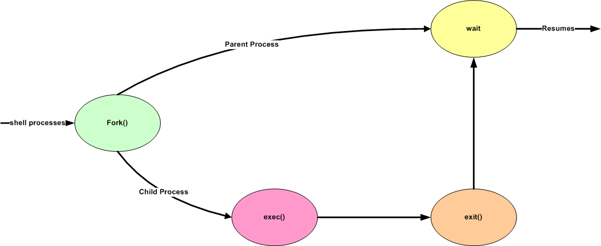
Process Lifecycle - I
Notes:
On startup a single process (called init, with PID 1) is created
All subsequent process are derived from by the fork-exec mechanism
When a process forks it creates an exact copy of itself called the child processes.
The exec system call them places the image of the new process over the copy before allowing it to be scheduled to run.
when a process dies (finishes or is killed) it sends a signal to its parent
Parent Processes create children processes, which in turn create other processes. Forming a tree of processes.
Resource sharing
Parents and children share all resources.
Children share subset of parents resources.
Execution:
Parent and children execute concurrently
Parent waits until children terminate.
Process control system calls:
fork creates a new process
execute is used after a fork to replace one of the two processes' virtual memory space with a new program
exit terminates a process
A parent may wait for a child process to terminate;
wait provides the process id of a terminated child so that the parent can tell which child terminated.
wait allows the parent to collect performance statistics about the child

Slide 61
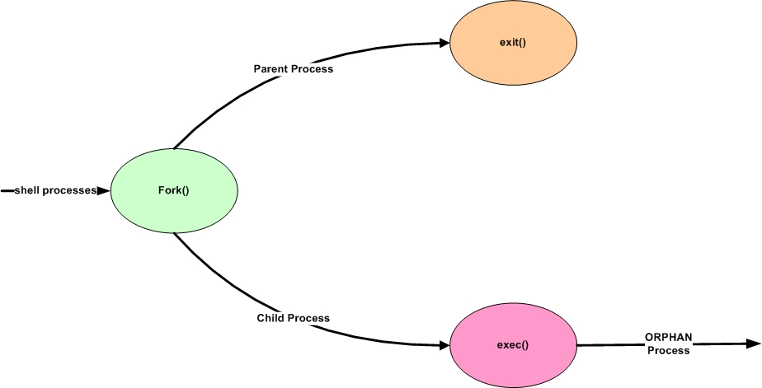
Process Lifecycle - II
Orphan Processes occur when a parent process dies without first killing its child processes which become orphans.
Notes:
Orphan processes
An orphan process is a computer process whose parent process has finished or terminated. A process can become orphaned during remote invocation when the client process crashes after making a request of the server. Orphans waste server resources and can potentially leave a server in trouble.
However there are several solutions to the orphan process problem:
Extermination is the most commonly used technique; in this case the orphan process is killed.
Reincarnation is a technique in which machines periodically try to locate the parents of any remote computations; at which point orphaned processes are killed.
Expiration is a technique where each process is allotted a certain amount of time to finish before being killed. If need be a process may "ask" for more time to finish before the allotted time expires.
A process can also be orphaned running on the same machine as its parent process. In a UNIX-like operating system any orphaned process will be immediately adopted by the special init system process. This operation is called re-parenting and occurs automatically. Even though technically the process has the "init" process as its parent, it is still called an orphan process since the process which originally created it no longer exists.

Slide 62
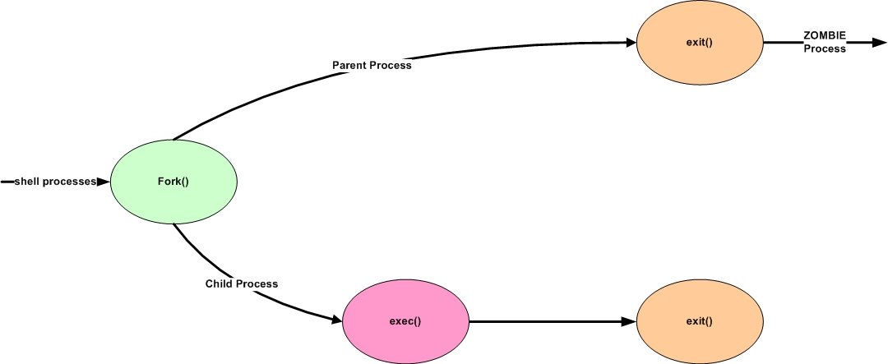
Process Lifecycle - III
A zombie process results when the parent of a defunct child process exits before the terminated child.
Notes:
Zombie processes
A zombie process is a dead process that is no longer executing but is still recognized in the process table (in other words, it has a PID number). It has no other system space allocated to it. Zombie processes have been killed or have exited and continue to exist in the process table until the parent process dies or the system is shut down and restarted. Zombie processes display as <defunct> when listed by the ps command.
When a process ends, all of the memory and resources associated with it are de-allocated so they can be used by other processes. However, the process's entry in the process table remains. The parent can read the child's exit status by executing the wait system call, at which stage the zombie is removed. The wait call may be executed in sequential code, but it is commonly executed in a handler for the SIGCHLD signal, which the parent is sent whenever a child has died.
A zombie process is not the same as an orphan process. An orphan process is a process that is still executing, but whose parent has died. They don't become zombie processes; instead, they are adopted by init (process ID 1), which waits on its children.
To remove zombies from a system, the SIGCHLD signal can be sent to the parent manually, using the kill command. If the parent process still refuses to reap the zombie, the next step would be to remove the parent process. When a process loses its parent, init becomes its new parent. Init periodically executes the wait system call to reap any zombies with init as parent.

Slide 63
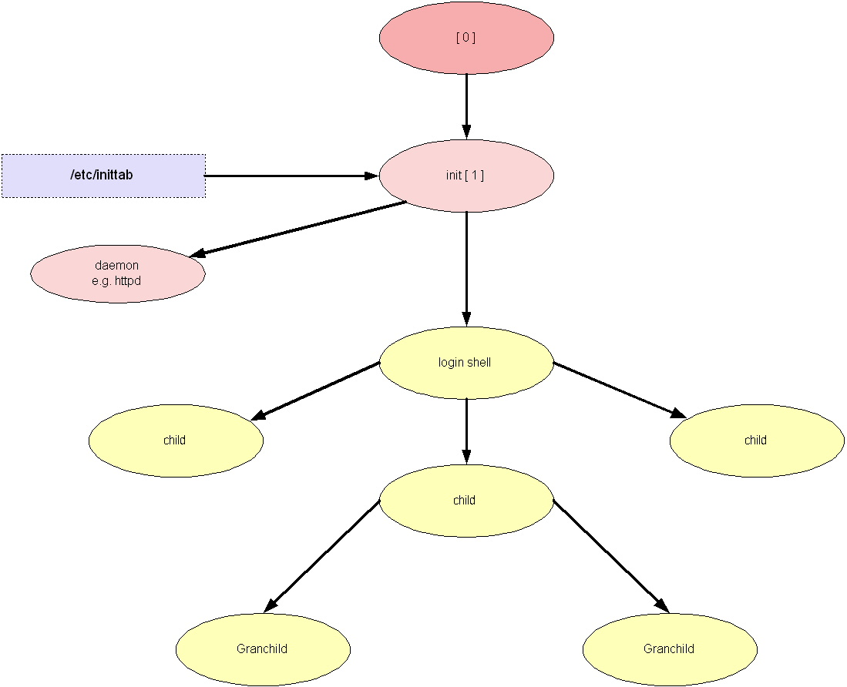
Process Lifecycle - IV
Process Hierarchy
Notes:
init process used during boot process to start the OS
init process has a PID of 1 and a PPID of 0
daemons are often started or have a PPID of 1
When the kernel has started itself (has been loaded into memory, has started running, and has initialised all device drivers and data structures), it finishes its own part of the boot process by starting a user level program, init. Thus, init is always the first process (its process number is always 1).
The kernel looks for init in a few locations that have been historically used for it, but the proper location for it (on a Linux system) is /sbin/init. If the kernel can't find init, it tries to run /bin/sh, and if that also fails, the startup of the system fails.
When init starts, it finishes the boot process by doing a number of administrative tasks, such as checking filesystems, cleaning up /tmp, starting various services, and starting a getty for each terminal and virtual console where users should be able to log in

Slide 64
UNIX Fundamentals Part I
UNIX History
The Many Flavours’ of UNIX
The Structure of UNIX
Access to UNIX Systems
Processes
Process Types
Job Control For Processes
Process Lifecycle
Process Control
Process Attributes
Filesystems & Directories
Devices

Slide 65
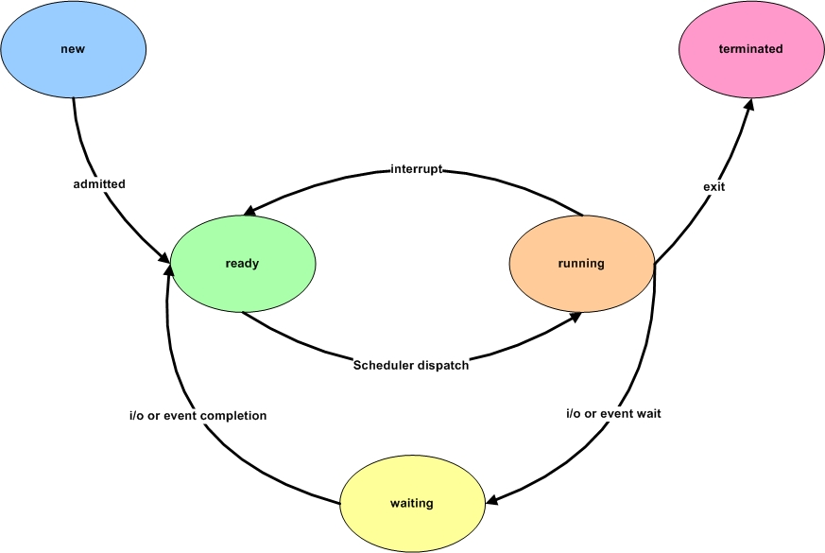
Process Control - I
Notes:
As a process executes it changes state:
New - The process is being created.
Running - Instructions are being executed.
Waiting - The process is waiting for an event to occur.
Ready - The process is waiting to run
Terminated - The process has finished execution.

Slide 66
Process Control – II Signals
Facility for handling exceptional conditions similar to software interrupts (kill –l shows signal list)
The interrupt signal, SIGINT, is used to stop a command before that command completes (usually produced by ^C).
Signal use has expanded beyond dealing with exceptional events.
Start and stop subprocesses on demand
SIGWINCH informs a process that the window in which output is being displayed has changed size.
Deliver urgent data from network connections.
Notes:
Kill –l from an IBM AIX server :-
1) HUP 14) ALRM 27) MSG 40) bad trap 53) bad trap
2) INT 15) TERM 28) WINCH 41) bad trap 54) bad trap
3) QUIT 16) URG 29) PWR 42) bad trap 55) bad trap
4) ILL 17) STOP 30) USR1 43) bad trap 56) bad trap
5) TRAP 18) TSTP 31) USR2 44) bad trap 57) bad trap
6) ABRT 19) CONT 32) PROF 45) bad trap 58) bad trap
7) EMT 20) CHLD 33) DANGER 46) bad trap 59) CPUFAIL
8) FPE 21) TTIN 34) VTALRM 47) bad trap 60) GRANT
9) KILL 22) TTOU 35) MIGRATE 48) bad trap 61) RETRACT
10) BUS 23) IO 36) PRE 49) bad trap 62) SOUND
11) SEGV 24) XCPU 37) bad trap 50) bad trap 63) SAK
12) SYS 25) XFSZ 38) bad trap 51) bad trap
13) PIPE 26) bad trap 39) bad trap 52) bad trap

Slide 67
Process Control - III
setuid bit sets the effective user identifier of the process to the user identifier of the owner of the file, and leaves the real user identifier as it was.
setuid scheme allows certain processes to have more than ordinary privileges while still being executable by ordinary users.

Slide 68
UNIX Fundamentals Part I
UNIX History
The Many Flavours’ of UNIX
The Structure of UNIX
Access to UNIX Systems
Processes
Process Types
Job Control For Processes
Process Lifecycle
Process Control
Process Attributes
Filesystems & Directories
Devices

Slide 69
Process Attributes - 1
the ps and top commands can be used to look at current processes (i.e. to view the process table).
PID - process ID : each process has a unique ID
PPID parent process ID : The process that ‘forked’ to start a process
nice value - priority (-20 highest to 19 = lowest)
TTY associated terminal (TTY teletype terminal)
The process table is a snapshot of all processes running at that time.

Slide 70
Process Attributes - 2
The “ps” command on its own will show you your own processes.
Each process has a process id (pid) that uniquely identifies it.
We can also see the tty device the process was started on and how long it has been running.
$ ps
PID TTY TIME CMD
9646 ttyp1 0:00 ksh
9655 ttyp1 0:00 sleep
9730 ttyp1 0:00 ps
10636 ttyp1 0:00 telnetd
$
Notes:
Each process has a process id (pid) that uniquely identifies it.
We can also see the tty device the process was started on and how long it has been running.

Slide 71
Process Attributes - 3
This process table shows the ps command itself, the shell used to invoke it and a telnetd process.
When you log in, you automatically start a shell.
To see what the PID of the current shell (a running process) type:
echo $$
$ ps
PID TTY TIME CMD
9646 ttyp1 0:00 ksh
9655 ttyp1 0:00 sleep
9730 ttyp1 0:00 ps
10636 ttyp1 0:00 telnetd
$

Slide 72
Process Attributes - 4
We can kill a process (providing we have permission to do so) using the PID.
The kill command is used to stop the sleep process.
$ ps
PID TTY TIME CMD
9646 ttyp1 0:00 ksh
9655 ttyp1 0:00 sleep
9730 ttyp1 0:00 ps
10636 ttyp1 0:00 telnetd
$
$ kill 9655
$ ps
PID TTY TIME CMD
9646 ttyp1 0:00 ksh
9730 ttyp1 0:00 ps
10636 ttyp1 0:00 telnetd
$

Slide 73
Process Attributes - 5
Using the options “-ef” with the “ps” command shows all the processes running on the computer.
Any user is allowed to do this.
$ ps -ef
UID PID PPID C STIME TTY TIME CMD
root 1 0 0 20:22:20 - 0:07 /etc/init
root 1940 1 0 20:23:12 - 0:00 /usr/lib/errdemon
root 2148 3638 0 20:23:32 - 0:03 sendmail: accepting connections
root 2886 1 0 20:23:11 - 0:37 /usr/sbin/syncd 60
root 3420 1 0 20:23:39 - 0:10 /usr/sbin/cron
root 3638 1 0 20:23:23 - 0:00 /usr/sbin/srcmstr
root 3904 3638 0 20:23:35 - 0:00 /usr/sbin/portmap
root 4160 3638 0 20:23:28 - 0:00 /usr/sbin/syslogd
root 4392 3638 0 20:23:39 - 0:00 /usr/sbin/inetd
$

Slide 74
Process Attributes - 6
Each process shows its owner (UID), the process ID (PID), the parent process ID (PPID), CPU utilisation, start time, the tty is was started on, and the total execution time.
$ ps -ef
UID PID PPID C STIME TTY TIME CMD
root 1 0 0 20:22:20 - 0:07 /etc/init
root 1940 1 0 20:23:12 - 0:00 /usr/lib/errdemon
root 2148 3638 0 20:23:32 - 0:03 sendmail: accepting connections
root 2886 1 0 20:23:11 - 0:37 /usr/sbin/syncd 60
root 3420 1 0 20:23:39 - 0:10 /usr/sbin/cron
root 3638 1 0 20:23:23 - 0:00 /usr/sbin/srcmstr
root 3904 3638 0 20:23:35 - 0:00 /usr/sbin/portmap
root 4160 3638 0 20:23:28 - 0:00 /usr/sbin/syslogd
root 4392 3638 0 20:23:39 - 0:00 /usr/sbin/inetd
$

Slide 75
Processes Checkpoint (1)
What are the three types of process?
……………………………………
……………………………………
……………………………………
Which command(s) can be used to check for background or suspended processes?
What is a process?

Slide 76
Processes Checkpoint (2)
What command is used to pass down the value of a variable into a subshell?
When would you execute a shell script using the (.) dot notation?
What is the PID & PPID of a process?

Slide 77
EXERCISE 3 UNIX Processes & Job Control

Slide 78
UNIX Fundamentals Part I
UNIX History
The Many Flavours’ of UNIX
The Structure of UNIX
Access to UNIX Systems
Processes
Filesystems & Directories
Devices

Slide 79
Filesystems & Directories
Directory Structures
Permissions/File Access Modes
Directory & File Commands

Slide 80
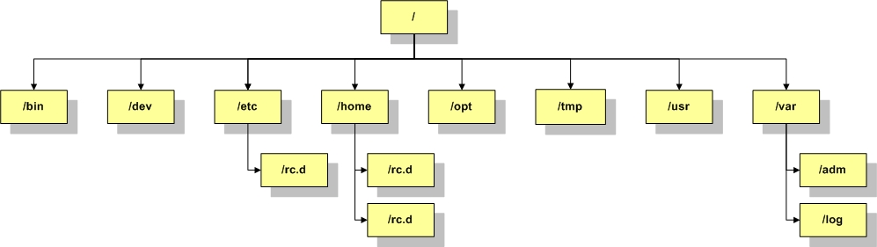
Directory Structures
Directories within UNIX are hierarchical and start with the root directory or “/”.
All other directories are underneath the root directory.
Every directory has a parent, and possibly one or more children. Children can in turn be parents.
A directory is a special type of file (so a file and a directory of the same name within the same directory is impossible).
Notes:
NOTE: that a file is a linear sequence of characters, including line feeds (nn); there is no specific file structure.
The top level directory “/” is called the “root”.
The /bin subdirectory contains the shells, and the most common used commands and utilities. Some of these may be “links” to the actual binaries elsewhere, such as in the /usr/bin subdirectory.
The /dev subdirectory contains file descriptors representing the devices attached to the system as files (i.e. console, hdisk1, tty0, etc), allowing their use using normal file handling APIs.
The /etc subdirectory contains system administration and configuration files, such as “passwd” for defining users, their passwords, and their shell, and “inittab” for controlling the machine initial startup, and “rc.d” which is subdirectory containing scripts to run at different phases of the startup to initialise different programs.
The /home subdirectory is where users store their own files and some of the user specific configuration files are stored (but hidden by starting the filename with a “.”.
The /opt subdirectory is sued on some Unix’s to store third-party “optional” programs or utilities to keep them distinct from the normal programs and utilities stored under /usr.
The /tmp subdirectory is used for temporary storage to support other commands, utilities, and application programs.
The /usr subdirectory contains libraries (/usr/lib), commands (usr/bin), and utilities (such as compilers and development tools in /usr/ccs) in a deep directory structure. On many Unix’s (such as AIX) it also stores additional third-party or application programs such as “WebSphere” or “IBMHTTPServer”, rather than having them stored in /opt.
The /var subdirectory contains variable information that changes frequently, such as log files.

Slide 81
Directory Structures
In this example the directories “tmp” and “var” are shown under “/”.
These directories are referenced as “/tmp” and “/var”.
/
tmp
var

Slide 82
Directory Structures
A directory is created within the “/tmp” directory called “ld”.
This is referenced as “/tmp/ld”.
/
tmp
var
ld

Slide 83
Directory Structures
Two new directories are created under “/tmp/ld” called “news” and “mail”.
What are these referenced as?
/
tmp
var
ld
news
mail

Slide 84
Directory Structures
There are two ways to reference a directory; relative or absolute.
So far we have seen absolute references.
/
This means, whatever my current directory is, using an absolute reference (or pathname) will get me to that directory.
tmp
var
ld
news
mail
Notes:
An absolute---or full---pathname starts with /. In other words, the path taken to get to the directory is given from the top of the tree, through all the nodes, to the destination
directory.
The relative pathname of the directory gives the route taken from the current directory, to the destination directory.

Slide 85
Directory Structures
With relative pathnames the reference used is relative to the current directory.
/
If your in the /tmp directory you can use just “ld” to reference the /tmp/ld directory.
tmp
var
ld
news
mail
You can use cd “ld/news” to get to /tmp/ld/news IF you are already in /tmp.

Slide 86
Directory Structures
Case sensitive. E.g. file1.tmp is a different directory (or file) to File1.tmp.
Large filename lengths. E.g. have_you_seen_the_size.of.this_filename.doc is a valid directory name (or filename).
Naming Conventions
Simple, any ASCII characters can be used
It is recommended that no ‘metacharacters’ are used.
It is recommended to use only
Letters
Digits
Underscore ( _ )
Hyphen ( - )
Dot ( . )
Filenames/Directories beginning with a dot ( . ) are hidden.
Notes:
At this point it is useful to point out some directory (and file) naming rules.
Naming files is very simple: any ASCII character can be used. It is, however, recommended that no metacharacters (, f, g, [, ], ?, $, n, ~, >, <, j, &) be used. It is also recommended to simply use letters, digits, underscore ( ), hyphen (-) and the dot (.).
By convention, files ending with .c are C language files. File names ending with .p, .f, .s are respectively PASCAL, FORTRAN, and assembler program files. Header (include) files usually end with .h.
File names beginning with a . (dot) are hidden files: they do not appear when files are listed. Those les are typically configuration files. Usually, their name consists of the package they represent followed by the rc (run command) string. .mailrc and .newsrc are two examples. Any file name may contain several dots and/or underscores. These are NOT separators.

Slide 87
Directory Structures
To move between these directories use the UNIX command “cd”.
/
For example, to move to the /tmp/ld/news directory use:
cd /tmp/ld/news
tmp
var
ld
news
mail
If I’m already in /tmp/ld, I can use “cd news”.
Notes:
If already in /tmp/ld, use “cd news”.
“cd –” will take you to the last visited directory
“cd ~” OR “cd” will take you home
cd: Change Directory
To move from one directory to another the cd command is used.
Use as:
cd [directory ]
directory may be an absolute, or a relative pathname. Or it may be nothing at all: if cd is used by itself, the user returns to his/her home directory.
Note that . (dot) means this current directory, .. (dot dot) means the previous directory, and that ~ (tilde) means the user's home directory. For example
cd ../testdir
means go up one directory, then down into the testdir directory at that node.
cd (by itself) is equivalent to cd ~.

Slide 88
Directory Structures
use “../” to go back a directory to /.
use “../var” to get to the /var directory.
/
tmp
var
ld
news
mail
Notes:
use “../var” to get to the /var directory.
If the current directory is /tmp/ld/mail, what relative pathname can be used to get to /var?
../../var

Slide 89
Directory Structures
To find out what your current directory is, use the UNIX command “pwd”.
/
tmp
var
ld
news
mail
$ pwd
/tmp/ld
$
Notes:
pwd: Print Working Directory
The command pwd is used to display the full pathname of the current directory; the display is always in the absolute format.
Example:
prompt> pwd
/usr/people/cantin/docs/unix

Slide 90
UNIX Fundamentals Part I
UNIX History
The Many Flavours’ of UNIX
The Structure of UNIX
Access to UNIX Systems
Processes
Filesystems & Directories
Directory Structures
Permissions/File Access Modes
Directory & File Commands
Devices

Slide 91
Permissions/File Access Modes
To see what files reside in the current directory use the UNIX command “ls”.
/
tmp
var
ld
news
mail
$ ls
file1.txt
$

Slide 92
Permissions/File Access Modes
Other options used with the ls command give more detail.
To see a long listing of files use “ls -l”.
/
tmp
var
ld
news
mail
$ ls -l
-rw-rw-rw- 1 root sys 34 Jul 15 12:50 file1.txt
$
Notes:
To find out more about a command the UNIX Manual can be used: man ls

Slide 93
Permissions/File Access Modes
Now we can see the permissions of the file, it’s owner, its group and the date/time it was last modified.
/
tmp
var
ld
news
mail
$ ls -l
-rw-rw-rw- 1 root sys 34 Jul 15 12:50 file1.txt
$
Notes:
A permission denies the ownership of a file and the access of all users to that file (or directory).
Each file and directory has permissions associated with it. Those permissions are made up of three groups of three characters: rwx rwx rwx (read, write and execute). The first group represents the owner permissions on the file, the second group represents the group permissions on the file, and the third group represents the world permissions on the file.

Slide 94
Permissions/File Access Modes
The permissions consist of...
- rw- rw- rw-
File type
owner
group
others
$ ls -l
-rw-rw-rw- 1 root sys 34 Jul 15 12:50 file1.txt
$
Notes:
-rwxrwxrwx -rwxrwxrwx -rwxrwxrwx
||| ||| |||
- - -
| | |
Owner Group Others
user
These permissions control the access that the owner of the file has. Use `ls -l' to list the owner of a file.
group
These permissions control the access that people in the file's group have. Use `ls -lg' to list a file's group.
others
These permissions control the access that everyone else has (``everyone else'' are people who are not the owner of the file and who are not in the file's group).
-rwSrwxrwx = SUID -rwxrwSrwx = SGID drwxrwxrwt = SVTX
value Meaning
- in any position means that flag is not set
r file is readable by owner, group or other
w file is writeable. On a directory, write access means you can add or delete files
x file is executable (only for programs and shell scripts - not useful for data files). Execute permission on a directory means you can list the files in that directory
s in the place where 'x' would normally go is called the set-UID or set-groupID flag.
b Block device file.
p pipe file (inter process communication).
f FIFO file (First In First Out).
l Symbolic link (pointer)

Slide 95
Permissions/File Access Modes
The file type indicates what sort of file it is. It could be a regular file, a directory, or a special file like a device.
- rw- rw- rw-
File type
owner
group
others
$ ls -l
-rw-rw-rw- 1 root sys 34 Jul 15 12:50 file1.txt
$

Slide 96
Permissions/File Access Modes
A file type of “d” would indicate that this file is a directory.
d rw- rw- rw-
File type
owner
group
others
$ ls -l
drw-rw-rw- 1 root sys 34 Jul 15 12:50 file1.txt
$
Notes:
If the first character is:
d The entry is a directory.
b The entry is a block special file.
c The entry is a character special file.
l The entry is a symbolic link, and either the -N flag was specified or the symbolic link did not point to an existing file.
p The entry is a first-in,first-out (FIFO) special file.
s The entry is a local socket.
- The entry is an ordinary file.

Slide 97
Permissions/File Access Modes
The other permissions are grouped in three’s, one for read, one for write and one for execute. The absence of one of these means there is no permission.
- rwx rw- rw-
File type
owner
group
others
$ ls -l
-rwxrw-rw- 1 root sys 34 Jul 15 12:50 file1.txt
$
Notes:
The next nine characters after the file type are divided into three sets of three characters each. The first set of three characters show the owner's permission. The next set of three characters show the permission of the other users in the group. The last set of three characters shows the permission of anyone else with access to the file. The three characters in each set indicate, respectively, read, write, and execute permission of the file. Execute permission of a directory lets you search a directory for a specified file.
Permissions are indicated as follows:
r Read
w Write (edit)
x Execute (search)
- Corresponding permission not granted

Slide 98
Permissions/File Access Modes
This file has read, write and execute for the owner, read and write for anyone in the same group, and read only for anyone else (others).
- rwx rw- r--
File type
owner
group
others
$ ls -l
-rwxrw-rw- 1 root sys 34 Jul 15 12:50 file1.txt
$

Slide 99
Permissions/File Access Modes
These show who owns the file and to which group it belongs.
Any user in this group has the group permissions seen earlier.
root sys
owner
group
$ ls -l
-rwxrw-rw- 1 root sys 34 Jul 15 12:50 file1.txt
$
Notes:
The owner is the user owning the file. Each user has an internal user number (UID), and an internal group number (GID), set by the system administrator. Everyone with the same group number is said to be in the same group. Group permissions apply to everyone else with the same group number. World/others is everyone else.
For example, the file file1.txt may have permissions set as
rwxrw-rw-.
This would mean that the owner of the file can read the file, write to it, and execute it. People in his/her group have the same privileges, except for executing the file.
Everyone else can read and write to the file; they cannot execute it.
The permissions of a file/directory can be changed with the chmod command.

Slide 100
Permissions/File Access Modes
File size, in bytes.
Last modification date and time.
34 Jul 15 12:50
size
Date stamp
$ ls -l
-rwxrw-rw- 1 root sys 34 Jul 15 12:50 file1.txt
$
Notes:
The touch command updates the access and modification times of a file. The command can also be used to create zero-length files.
touch <filename>
touch can be helpful when used in situations where an application checks a files last modification time before taking some action such as a backup or complile.

Slide 101
Permissions/File Access Modes
The name of the file itself, or filename.
file1.txt
File name
$ ls -l
-rwxrw-rw- 1 root sys 34 Jul 15 12:50 file1.txt
$

Slide 102
Permissions/File Access Modes
Other options used with the ls command give more detail.
To see hidden files and a long listing use “ls -al”.
$ ls -al
total 10
drwxrwxrwx 1 root sys 96 Jul 15 12:50 .
drwxrwxrwx 2 root sys 5120 Jul 15 12:50 ..
-rw-rw-rw- 1 root sys 0 Jul 15 14:39 .hidden_file
-rw-rw-rw- 1 root sys 34 Jul 15 12:50 file1.txt
$
Notes:
Here we see three more files, “.”, “..” and “.hidden_file”. “.” and “..” are directory files, they represent the current directory (.) and the parent directory (..) which is /tmp.

Slide 103
UNIX Fundamentals Part I
UNIX History
The Many Flavours’ of UNIX
The Structure of UNIX
Access to UNIX Systems
Processes
Filesystems & Directories
Directory Structures
Permissions/File Access Modes
Directory & File Commands
Devices

Slide 104
Directory & File Commands
ls command
pwd command
cd command
cat, pg & more
head & tail
mv, cp & rm
mkdir & rmdir
chown, chgrp, chmod
umask
Notes:
The general syntax of a command is
command [-flag(s)] [filename(s) ]
where:
command is the filename representing the command.
flag(s) are option(s) to the command. Most start with a minus (-) sign, followed by a number of single characters, each with a special meaning for the command.
filename(s) are files (input and/or output) to be used by the command.

Slide 105
Directory & File Commands
ls - list contents of a directory
pwd - print working (current directory)
cd - change directory
$ ls -al
total 10
drwxrwxrwx 1 root sys 96 Jul 15 12:50 .
drwxrwxrwx 2 root sys 5120 Jul 15 12:50 ..
-rw-rw-rw- 1 root sys 0 Jul 15 14:39 .hidden_file
-rw-rw-rw- 1 root sys 34 Jul 15 12:50 file1.txt
$ pwd
/tmp/ld
$ cd ..
$ pwd
/tmp
Notes:
ls command:
-a Lists all entries in the directory, including the entries that begin with a . (dot).
-d Displays only the information for the directory named. Directories are treated like files, which is helpful when using the -l flag to get the status of a directory.
-l (Lower case L) Displays the mode, number of links, owner, group, size (in bytes), and time of last modification for each file. If the file is a special file, the size field contains the major and minor device numbers. If the time of last modification is greater than six months ago, the time field is shown in the format month date year where as files modified within six months the time field is shown as month date time format.
-t Sorts by time of last modification (latest first) instead of by name.
-r Reverses the order of the sort, giving reverse alphabetic or the oldest first, as appropriate.
cd command:
cd .. To go up one level of the directory tree
cd - To return to repvious (last) directory.
pwd command:
-P Displays the absolute path name of the current directory. The absolute path name displayed with the -P flag does not contain file names that, in the context of the path name, refer to files of type symbolic link.

Slide 106
Directory & File Commands
We can use wildcards to list files with certain names.
* Any number of any characters
? Any single character
$ ls -l file*
-rw-rw-rw- 1 root sys 34 Jul 15 12:50 file1.txt
$ ls *.txt
file1.txt
$ ls -l f?le*
-rw-rw-rw- 1 root sys 34 Jul 15 12:50 file1.txt
Notes:
So, doing “ls -l file*” would show a long listing of all files that begin with the word “file”.
Doing “ls *.txt” would show a list of files ending in “.txt”.
Doing “ls -l f?le*” would show a long listing of files starting with “f”, followed by any single character, followed by “le”, followed by any number of any characters.

Slide 107
Directory & File Commands
To see the contents of a file we use the “cat” command.
$ cat file1.txt
this is the contents of file1.txt
$
For files that contain more data than will fit on a single screen we can use “more” or “pg” to show the data a screen at a time.

Slide 108
Directory & File Commands
To move a file use the “mv” command. This also serves as a renaming command.
To make a copy of a file, use “cp”.
$ mv file1.txt File2.txt
$ mv File2.txt /tmp
$ cp /tmp/File2.txt .
$

Slide 109
Directory & File Commands
To delete a file, use the “rm” command.
BEWARE : if you remove a file it is gone completely, there is no “recycle bin”!
$ rm /tmp/File2.txt
$ ls /tmp/File*
$

Slide 110
Directory & File Commands
Use “mkdir” to create a new directory.
Use “rmdir” to remove a directory.
$ mkdir test
$ ls -ld test
drw-rw-rw- 1 root sys 2046 Jul 15 15:02 test
$ rmdir test
$ ls -ld test
$

Slide 111
Directory & File Commands
To change the owner of a file (providing you are the owner or “root”), use “chown”.
To change the group of a file (providing you are the owner, have group permissions or are “root”), use “chgrp”.
$ ls -l file*
-rw-rw-rw- 1 root sys 34 Jul 15 13:55 test
$ chown train6 test
$ chgrp staff test
$ ls -l file*
-rw-rw-rw- 1 train6 staff 34 Jul 15 13:55 test
$

Slide 112
Directory & File Commands
To change the permissions of a file use “chmod”.
A symbolic notation can be used to select permissions or an octal value.
$ ls -l file*
-rw-rw-rw- 1 root sys 34 Jul 15 13:55 test
$ chmod u+x test
$ ls -l file*
-rwxrw-rw- 1 root sys 34 Jul 15 13:55 test
$ chmod 777 test
$ ls -l file*
-rwxrwxrwx 1 root sys 34 Jul 15 13:55 test
Notes:
chmod: Change Mode (Permissions)
The chmod command allows a user to change the permissions of a file/directory. To use chmod, the user must be the owner of the file. The general syntax, using the conventional method is
chmod [ugo]+j-[rwx] filename(s)
Where u : permission for user/owner.
g : permission for group.
o : permission for others.
r : read permission.
w : write permission.
x : execute permission.
Any combination of ugo, rwx may be used. If none is used, then all threeare assumed. It is also acceptable to put a combination of \[ugo]+j-[rwx]", as long as they are separated by a comma (,).
Typing the command chmod by itself will display the usage of the command.
Refer to the UNIX manual of your machine for more options on the command.
The syntax using the numeric method is:
chmod abcd (filename) Changes files/directory permissions
Where
a is (4 SUID) + (2 SGID) + (1 SVTX)
b is (4 read) + (2 write) + (1 execute) permissions for owner
c is (4 read) + (2 write) + (1 execute) permissions for group
d is (4 read) + (2 write) + (1 execute) permissions for others
0 = --- no permissions whatsoever; this person cannot read, write, or execute the file
1 = --x execute only
2 = -w- write only
3 = -wx write and execute (1+2)
4 = r-- read only
5 = r-x read and execute (4+1)
6 = rw- read and write (4+2)
7 = rwx read and write and execute (4+2+1)
Typing the command chmod by itself will display the usage of the command.
Refer to the UNIX manual of your machine for more options on the command.

Slide 113
Directory & File Commands
Files and directories have permissions set as they are created.
The permissions on newly created files/directories are set by the users profile and/or the umask filemode command
umask can also be used to display the current file mode creation mask.
gbsrual0048:root:/opt/nmon/bin> umask
027
gbsrual0048:root:/opt/nmon/bin> umask -S
u=rwx,g=rx,o=
gbsrual0048:root:/opt/nmon/bin> umask a=rx,ug+w
gbsrual0048:root:/opt/nmon/bin> umask -S
u=rwx,g=rwx,o=rx
Notes:
umask command:
umask [ -S ] [ Mask ]
The -S flag produces symbolic output. If the flag is not specified, the default output format is octal.

Slide 114
Filesystems & Directories Checkpoint (1)
Match the various options of the ls command with their functions:
-a
-t
-d
-r
-l
[ _ ] - Provides a long listing of files
[ _ ] - Will list hidden files
[ _ ] - List subdirectories & their contents
[ _ ] - Sort the output by last date/time modification
[ _ ] - Displays information about a directory in reverse order

Slide 115
Filesystems & Directories Checkpoint (2)
What command would change the permissions of a file from rwxrwxr-x to rwxr-xr-x?
What is the umask?
What command would you use to delete a directory?
What does the touch command do?

Slide 116
EXERCISE 4 Filesystems & Directories

Slide 117
UNIX Fundamentals Part I
UNIX History
The Many Flavours’ of UNIX
The Structure of UNIX
Access to UNIX Systems
Processes
Filesystems & Directories
Devices

Slide 118
Devices I
In UNIX everything is a file.
Resources within a UNIX/UNIX platform are accessed through file names as opposed to drive letters.
All hardware is represented as device files.
Example: /dev/cd0 can be a cdrom.
All of the devices for the computers resources reside in its devices directory, usually /dev.
Devices include
Hard disk (SCSI & IDE)
Tape drives
CDROMs
Floppy disks
ISDN terminal adapters / modems
mice
terminals (i.e. the screen)
keyboard
Notes:
In UNIX, every output device is referred to as a file.
For writing to the console (the monitor), the file to write to is /dev/console.
To write to tape, the file is /dev/nrst0 (on a Sun SPARCstation 2). Even the keyboard writes to a file (/dev/kbd) which is read by the operating system.

Slide 119
Devices II
A device driver is a program that manages the interaction between a piece of hardware and the kernel.
Device drivers implement a standardized set of function with a device interacts with the kernel
Functions include
Open, close, read, stop, write, timeout
Devices fall into two principle types
Block devices read and write block (usually multiples of 512 bytes)
Character devices can read and write one byte at a time Different UNIX platforms have different naming conventions for these devices.
The kernel maintains tables for the block and character devices
When programs perform operations on devices the kernel directs the control to the correct function in a device driver
Notes:
Devices are created using a special command (in AIX) – mknod. i.e. you do not ‘create a file’.

Slide 120
Device Examples

Slide 121
Devices Checkpoint
How are UNIX devices accessed?
Give an example of a device?
How does the kernel communicate to devices?

Slide 122

Fin (End of Part I)
Thank you for attending!
Any Questions?

