Slide 1


Slide 2
Use case
when an user places an order, order will be fulfilled
if the product’s price is within the user’s
credit limit/balance. Otherwise it will not be fulfilled

Slide 3


Database per service pattern
Order-service
Payment-service
Order-service
Payment-service
Monolithic e-commerce application
Create-order
Process-payment
Database

Slide 4
Saga Pattern
Choreography
Orchestration
Order-service
Payment-service
HTTP REQUEST
Is user have enough balance
OK (200)
Inventory-service

Slide 5

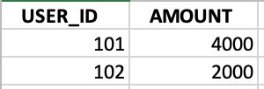
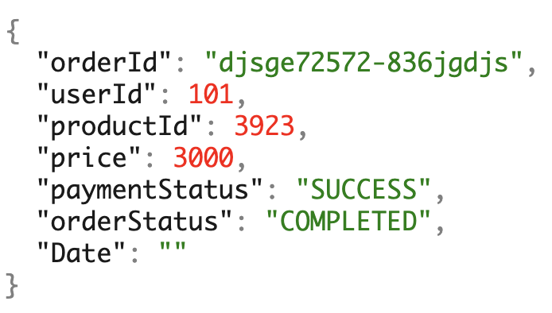
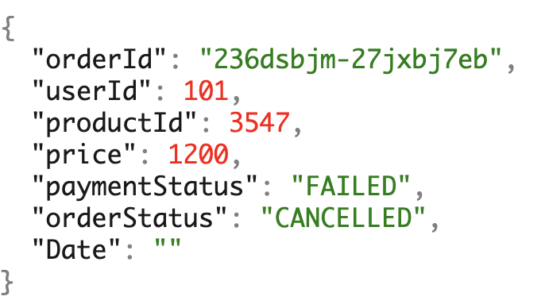
Order Service
{"userId":101,"productId":3547,"price":1200}
Payment Service
{"userId":101,"productId":3923,"price":3000}
produce
order-event
Consume
Consume
produce
payment-event
{"userId":101,"productId":3923,"price":3000,"paymentStatus":"SUCCESS"}
{"userId":101,"productId":3547,"price":1200,"paymentStatus":"FAILED"}
1000

Slide 6
Tech stack
Spring WebFlux
Apache Kafka
Spring Cloud Stream
Java 8
Multimodule project : Reuse component/classes

