Slide 1
Towards language support for programming microservices
Sanjiva Weerawarana, Ph.D. Founder & CEO, WSO2
Joint work with James Clark <jjc@jclark.com>

Slide 2
Overview
Ballerina programming language
The service abstraction
Ballerina services architecture
Future work
Conclusion

Slide 3
Ballerina programming language

Slide 4
Why?
Digital businesses are all about the network
Disaggregation is the norm
Applications compose functionality, often 3rd party SaaS
Minimalization of computing
Deployment: Hardware → VMs → Containers → Serverless
Architecture: SOA → Microservices → Functions
Technology for integrating smaller pieces is fundamental
Servers → sidecars → code
Middleware is dead; middleware is everywhere

Slide 5
Spectrum from system languages to glue languages
Assembly
Rust, C
C++
Go, Java, C#
Ballerina
TypeScript
Python, JavaScript
PowerShell, Bourne shell, TCL, AWK

Slide 6
Ballerina design goals
Provide abstractions for application networking
Use sequence diagrams as the visual programming model
Minimize cognitive load
Leverage familiarity
Enable a semantically-rich static program model
Provide a complete platform, not just a language
Allow multiple implementations, based on different runtime environments
https://blog.jclark.com/2019/09/ballerina-programming-language-part-1.html

Slide 7
Ballerina status
Project started in 2016
Now ~90 people working in the team
Complete platform under development for full software development lifecycle
Version 1 released in September 2019 - latest is 1.2.8
Ballerina “Swan Lake” release due in January 2021
Effectively version 2
Lots of strengthening of type system
Improving data orientation
Integrated query, transactions and more
Previews available for download (currently preview 3)
https://ballerina.io/downloads/
Working draft of specification: https://ballerina.io/spec/lang/master/

Slide 8
Unusual aspects of Ballerina
Structural type system with network friendly types and unions
First-class nature of application level network abstractions
Inherently graphical with sequence diagrams
Concurrency model based on sequence diagrams
Strong treatment of errors
Integrated query and streaming
Integrated transactions, both local and distributed
Language level security abstractions
Language extensibility with environment binding and compilation extensibility
Event driven runtime for nonblocking behavior with synchronous programming model
Not afterthoughts:
Documentation, version management, dependency management, testing, observability

Slide 9
Strong data orientation: type system vs. schema
Type system describes values occurring during program execution
Schema describes messages exchanged between programs
Type system and schema are usually completely unrelated
Data binding converts between the two
Creates a lot of friction for applications that exchange messages

Slide 10
Ballerina type system also works as a schema
Key features
Describes shape of a value - structural types
Types are just sets of values - semantic subtyping
Allows for choice of A or B - untagged unions
Extensibility - open records
Data binding is just a type cast
Mutability complicates things a bit
Most similar to TypeScript

Slide 11
Ballerina anydata
type anydata () | boolean | int | float | decimal | string | xml | anydata[] | map<anydata> | table<map<anydata>>;
type json () | boolean | int | float | decimal | string | json[] | map<json>;
Down-conversion of anydata to JSON
XML converted to serialized string
Tables converted to list of mappings
Reverse conversion recovers information from typedesc
Langlib functions to perform conversions both way

Slide 12
Services & sequence diagrams working together
Providing and consuming services
First-class language concepts with their own syntax and semantics, not a library
Inherently concurrent
Sequence diagrams
Graphical view of most fundamental aspect of the semantics of a network distributed application
Sequence diagram view only possible because syntax and semantics of the language were designed to enable it
Higher-level concurrency abstraction
Message sends/receives are matched up at compile-time

Slide 13
The service abstraction

Slide 14
What is a service?
Abstraction of logic or data made available over the network
Important aspects to consider
Size / granularity: Small / medium / large
Latency
Usage pattern: RPC / streaming / ...
Quality
Atomic vs. composite
Pre-defined composites
On-demand composites

Slide 15
RPC vs. resources
Verbs & nouns
RPC
All about verbs
Resources
Nouns to identify the resources
Verbs to indicate how/why/what to access the resource

Slide 16
RPC style programming
Many HTTP APIs
Even fine grained with HTTP2
gRPC

Slide 17
Resource style programming
REST
GraphQL
Web server doc root

Slide 18
Ballerina services architecture

Slide 19
Programming the network
BSD sockets
Network connections are just byte streams
Stubs & skeletons
Offers RPC experience that hides network details
Network realities
Unreliable, latent, event driven, concurrent, unsafe, data not objects
Most languages do not address networking aspects
Left to libraries and now to sidecars
That means no static verification possible

Slide 20
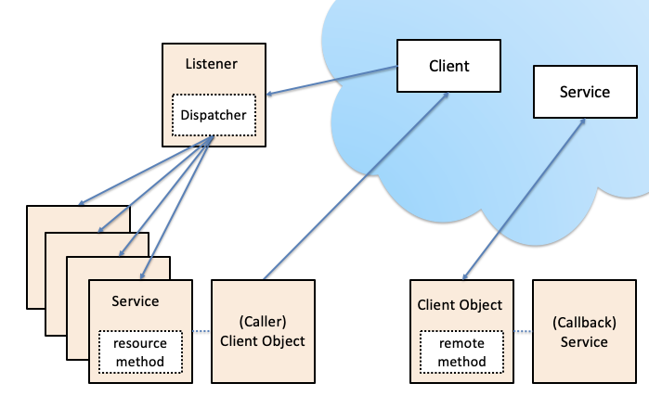
Ballerina network abstractions

Slide 21
Listeners
Responsible for network protocol execution
Complexity varies from protocol to protocol
Manages
Service instances
Dispatching
Execution of service resources functions & remote functions

Slide 22
Service objects
Service objects are attached to listeners to process requests
Services can have state as well as session state
Service state is managed by the service
Session state is managed by listener and passed into services
Two types of remotely accessible entry points
Remote functions
Resources
Stored
Computed

Slide 23
Remote functions in services
Like RPC methods
Verb-behavior
Takes anydata typed parameters and produces an anydata value
Can work at application type level or protocol level via callee-optional typing
service /calculator on new http:Listener(8080) { remote function add(int x, int y) returns int { return x + y; } }
% curl -H POST localhost:8080/calculator/add?x=10&y=20

Slide 24
Resources in service objects
Represents a named thing in the service
Can be accessed by indicating desired access and resource name
Two kinds
Stored resources
Computed resources

Slide 25
Stored resources
Remotely accessible service state
service / on new http:Listener(8080) { resource string greeting = “Hello, World.”; } % curl localhost:8080/greeting
Hello, World.

Slide 26
Computed resources
Generalization of getter/setter concepts
Accessors are service type defined
type Person record { string name; int age; }; service / on new http:Listener(8080) { resource function get Person(int id) returns Person|error { ... } } % curl localhost:8080/Person?id=3

Slide 27
Hierarchical resources
service / on new http:Listener(8080) { resource function get student/courses () returns Course[]|error { } }
% curl localhost:8080/student/courses [{..},{..},..]

Slide 28
GraphQL services
service on new gql:Listener(8080, "/graphql") { resource string greeting = "Hello GraphQL world!"; };
% curl -H POST localhost:8080/graphql --data 'query {greeting}'
{ "data": { "greeting": "Hello GraphQL world!" } }

Slide 29
GraphQL services
Queries implemented using resource function and stored resources
Resource functions for GraphQL computed fields
Mutations & subscriptions mapped to remote functions
Subscriptions use streams

Slide 30
Client objects
Standard library provides client objects for all well-known protocols
Currently only with remote client method
“Connectors” for remote services
Generated clients for a particular service

Slide 31
Service lifecycle
Program lifecycle is built on module lifecycle
Listeners can be attached to module lifecycle
Or created dynamically and maintained with normal variable lifecycle
Service values can be created & attached to a listener at any level
Lifetime of service is tied to listener lifecycle or until detached

Slide 32
Service concurrency
Ballerina Swan Lake adds “isolated” concept
Allows program to declare that execution of some aspect is safe to execute concurrently on multiple strands
Default is to execute all service calls in a single thread
Unless service object declares isolatedness

Slide 33
Deployment and cloud
Service concepts in Ballerina map naturally to Docker & Kubernetes
New “Code to Cloud” model will allow building with target cloud:
% ballerina build --cloud=k8s
Resulting code can be pushed to K8s directly
% kubectl -f apply target/k8s/deployment

Slide 34
Future work

Slide 35
More flexible service typing
Goal is to be able to write a useful type for the service object parameter of a Listener, so that the compiler can check that the service class resource and remote method definitions match the expectations of the Listener
Ideas under development
Optional methods, e.g. onText, onBinary etc. for WebSockets
Constraining application-level types for resources and remote methods
Callee-optional parameters

Slide 36
Session typing
Currently all Ballerina service typing is one-sided
Service side or client side
Session typing is about matching client and service interactions and statically guaranteeing type correctness
Easiest when client and server are both in Ballerina and we have strong type info available for the service
OpenAPI is a weak contract for services but better than nothing

Slide 37
Distributed choreography
Sequence diagrams currently used only to model concurrency and network interactions within a single program
Global sequence diagram can serve as a choreography description which gets projected into component programs
Each projection becomes a session type described interaction

Slide 38
Summary

Slide 39
Summary
Ballerina is taking a clean, deep and broad look at programming (micro)services
Service programming does not need to require jumping through hoops and lots of boilerplate code
Can support all modern service types including REST, GraphQL, gRPC and more
Strong, static typing makes distributed application development more predictable
Time to move on from languages that don’t understand the network!

Slide 40
Dive into Ballerina!
Download
https://ballerina.io/downloads/
100% open source, of course
Specification
https://ballerina.io/spec/lang/master/
Contacts
sanjiva@wso2.com

