Slide 1
MICROSOFT BUILD 2026 · EXPERT MEET-UP · STATION 4
Foundry Control Plane
Agent Operations & Management

Slide 2
THE CONTROL PLANE FOR AGENTS
One pane of glass for your entire agent fleet.
Foundry Control Plane (FCP) is the builder-facing execution and evidence layer. It connects your agents and resources, observes and improves their behavior, and enforces the policies and controls your organization depends on — surfaced in the new Operate tab.
Microsoft Build 2026 · Station 4 — Agent Operations & Management
2

Slide 3
WHAT IT COVERS
Four pillars, one control plane
01
02
03
04
Observability
Control
Security
Compliance
Traces, evals, and quality & safety signals for every agent.
Author and enforce policies, guardrails, and alerts across the fleet.
Runtime guardrails, jailbreak detection, and Defender insights.
Roll up fleet-wide evidence for auditors and regulators.
Microsoft Build 2026 · Station 4 — Agent Operations & Management
3

Slide 4
WHO IT'S FOR
Built for governance stakeholders
CEO
WHY NOW
CTO
Agent-specific regulation has arrived — from the EU AI Act onward. Companies must produce compliance evidence across every layer of their agent fleet, and roll it up for compliance officers and regulators in a single view.
Chief Compliance Officer
Regulatory bodies
Microsoft Build 2026 · Station 4 — Agent Operations & Management
4

Slide 5
HOW IT WORKS
From author to govern
1
›
2
›
3
›
4
AUTHOR
ENFORCE
OBSERVE
GOVERN
Create guardrails, policies, and alerts for your fleet.
Apply at runtime with Content Moderation & Agent Shield.
Collect traces, run evals, monitor quality & safety.
Roll everything up into the FCP dashboard.
Works for Foundry-native agents and open-source / third-party agents alike.
Microsoft Build 2026 · Station 4 — Agent Operations & Management
5

Slide 6
WHERE IT FITS
Foundry Control Plane × Agent 365
Agent 365
Foundry Control Plane
ENTERPRISE SYSTEM OF RECORD
AGENT-LEVEL EXECUTION & EVIDENCE
Fleet-level visibility and governance roll-up across the whole organization.
Traces, evals, runtime guardrails, mediation, and evidence — the four pillars at feature depth.
Integrate, don’t replace — drill down to the agent, roll up to the org.
Microsoft Build 2026 · Station 4 — Agent Operations & Management
6

Slide 7
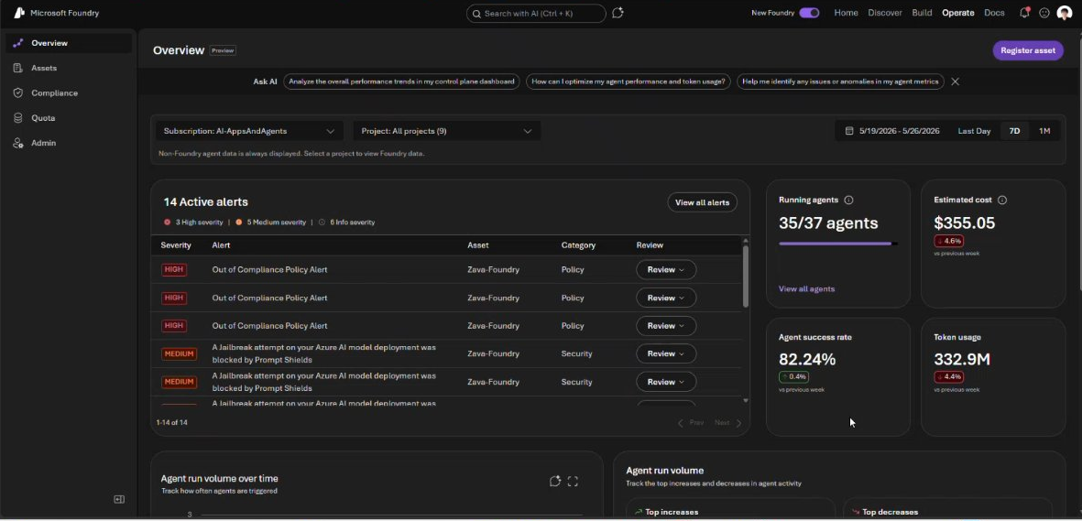
THE OPERATE TAB
Your fleet at a glance
35 / 37
agents running
$355.05
estimated cost · 7d
14
active alerts · 3 high
Policy and security alerts ranked by severity — review any alert to jump into the security portal.
Microsoft Build 2026 · Station 4 — Agent Operations & Management
7

Slide 8
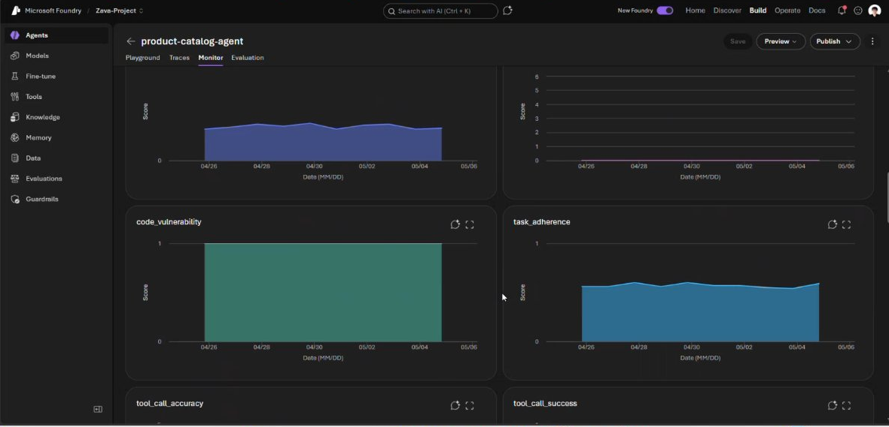
ASSETS · AGENT VIEW
Drill down to any agent
Quality & safety evals
Time-series monitoring
Red-teaming built in
Per-agent Monitor view — every evaluation tracked over time, so you can spot the day a metric moved.
Microsoft Build 2026 · Station 4 — Agent Operations & Management
8

Slide 9
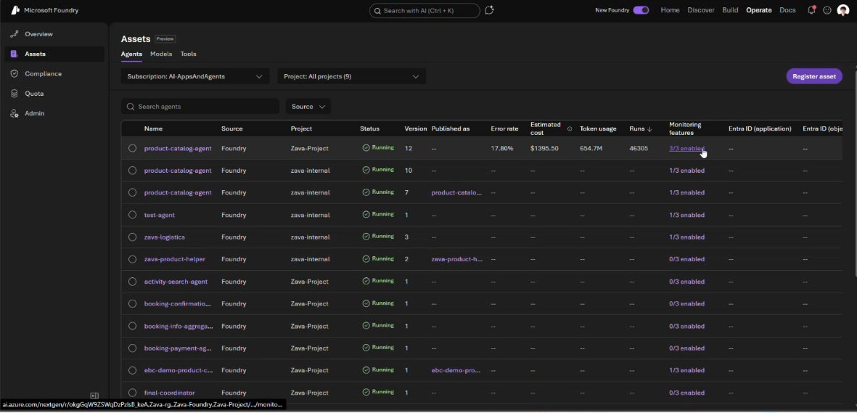
COVERAGE
Your whole fleet — native and beyond
Native + 3P
Foundry-native and open-source / third-party agents — one fleet view.
DEFENDER FOR CLOUD
Security recommendations and a risk level for every agent in the fleet.
Microsoft Build 2026 · Station 4 — Agent Operations & Management
9

Slide 10
AT THE BOOTH · BUILD 2026
Where to go deeper at Build
Observe & Operate
Govern & Control Plane
Guardrails, Evals & Trust
BRK252 Breakout
BRK251 Breakout
BRK250 Breakout
From observability to ROI for AI agents
Secure, enterprise-ready agents w/ Agent 365
Govern open-source AI agents, any framework
LAB540 Lab
OD840 Pre-recorded
LTG430 Lightning
Observe, optimize & protect hosted agents
Enable enterprise agents w/ Agent 365 SDK
Shield your agents: universal control layer
LTG429 Lightning
OD831 Pre-recorded
TT682 Table Talk
Debug & operate agents with Azure Monitor
Govern models, tools & agents with APIM
Trusted AI built for production
LTG451 Lightning
LTG467 Lightning
DEM369 Demo
Agentic FinOps: cost & quality in Foundry
Secure AI agents: AI Gateway, tools & trust
Responsible AI: principles to engineering
Microsoft Build 2026 · Station 4 — Agent Operations & Management
10

Slide 11
FOR THE BOOTH
When to bring up Foundry Control Plane
Controls
Observability
Governance
Security
Compliance
When a customer asks about any of these on their agent fleet — Foundry Control Plane is the answer.
Microsoft Build 2026 · Station 4 — Agent Operations & Management
11

Slide 12
STATION 4 · FOUNDRY CONTROL PLANE
Govern your agent fleet with confidence.
Foundry Control Plane
Visit Station 4 at the Microsoft Foundry booth

Slide 13
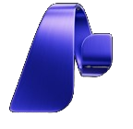
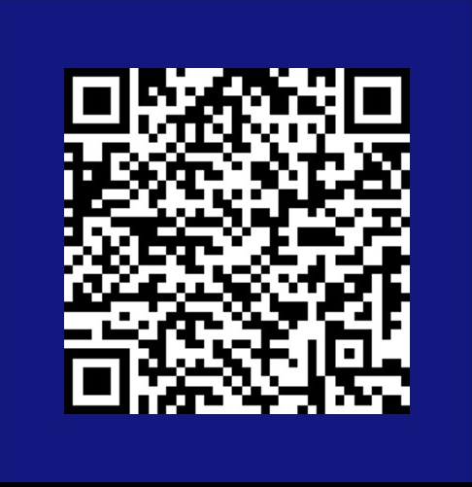
Microsoft Foundry
Survey to provide direct feedback to the product team
Scan the QR code to share your feedback on Foundry Control Plane.

