Slide 1

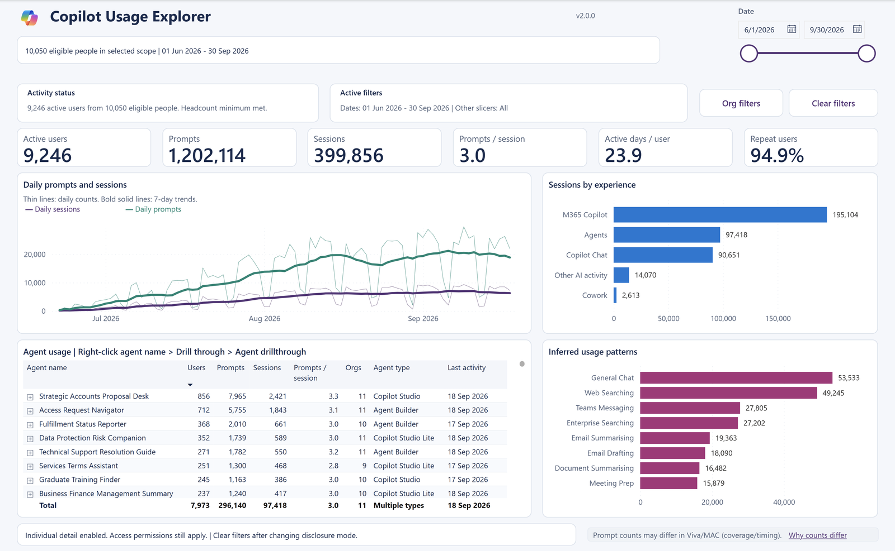

Tell your Copilot
adoption story.
AI-in-One Dashboard v2.0.0 · Storyboard
A ready-to-present walkthrough for leadership reviews, adoption councils and stakeholder briefings.
Microsoft Copilot Analytics Team
October 2026
Notes:
Use this deck to walk leaders through how people in your organization use Microsoft 365 Copilot, Copilot Chat and agents, with the AI-in-One dashboard v2.0.0.
Every screenshot uses made-up example data. The numbers show how the pages work; they are not benchmarks or targets.
Suggested flow: three questions, five steps, four short acts, then agree one next step. Plan for 20 to 30 minutes. Keep the live report open so you can switch to your own team and dates when a question comes up.

Slide 2
THE STORY
Three questions every leader asks
Answer them in order, keeping the same team and dates on every page.
01
02
03
Who is using Copilot?
Is it becoming a habit?
Where should we invest next?
How many people use Microsoft 365 Copilot, Copilot Chat and agents, and how much.
Whether people come back week after week, and how many active days they have each month.
Which agents to grow or review, and where a licensing conversation is worth having.
WHERE TO LOOK
WHERE TO LOOK
WHERE TO LOOK
Copilot Usage Explorer
Combined Trends
Combined Leaderboard
Habit Formation pages
M365 Copilot: Usage Trends
Chat (Web): Usage Trends
Agents pages
Agent Details
License Prioritization
SAY THIS
Today we'll see who is using Copilot, whether it's becoming part of how we work, and where to focus next.
AI-in-One Dashboard v2.0.0 · Storyboard · Example data
02 / 17
Notes:
Frame the session around three questions. Pick the one your audience cares about most and spend most of your time there.
Who is using Copilot? Start on Copilot Usage Explorer, then compare experiences on the two Copilot Overall pages.
Is it becoming a habit? The habit pages show how many days people used Copilot in a month. The usage-trend pages show whether people come back each week.
Where should we invest next? The agent pages show which agents reach people and keep them coming back. License Prioritization helps start a licensing conversation.
Keep the same team and dates as you move between pages; your selections follow you automatically.
Licensed activity includes every recorded experience, including agent-only users. Active plus inactive licensed users equals the licensed directory population after dates, scope, RLS and selected usage-band membership. A band selection cannot increase inactive licensed users.
The relevant tables and tooltips pair prompts and prompts per session with sessions. Weekly comparison bars and applicable month-over-month cards include prompt counterparts; line/area, top-N session and scatter series remain unchanged. Prompt counts reflect Purview audit coverage and are not guaranteed to match Viva Insights or Microsoft 365 admin center reports.
Usage bands recalculate from distinct prompts per active week among active users in the selected dates and authorized organization, reporting-team and license population. Each family is calculated independently, then selected memberships intersect. Ties share a band. No Usage includes eligible people without that family's recorded activity.

Slide 3
HOW TO PRESENT IT
Set the scene in five steps
A simple path through the report that works for any team or audience.
1
2
3
4
5
Choose the people
Choose the dates
See the whole picture
Look closer
Agree a next step
Open Org filters. Pick a company, division, department or a manager's whole reporting team.
Use the date slider. End on a full month so the habit pages describe a complete month.
Read the six headline numbers, the daily trend and which experiences people use.
Compare experiences, read habits, then look at agents and departments.
Pick one change to try, such as training, sharing an agent or reviewing licenses.
Org filters
Date slider
Copilot Usage Explorer
Overall, habit and agent pages
License Prioritization
BEFORE YOU PRESENT
Confirm the team size setting
Check who can see what
Know how fresh the data is
Ask the report owner which Minimum Group Size is approved. The default, 3, shows team-level results only.
The report uses row-level security. Make sure your audience has the right role before you share it.
Look at the last activity dates on the agent and usage tables, and keep the same dates on every page.
SAY THIS
Everything we look at today uses the same people and dates, so the pages tell one consistent story.
AI-in-One Dashboard v2.0.0 · Storyboard · Example data
03 / 17
Notes:
These five steps work for any audience.
1. Choose the people. Org filters, beside Clear filters, lets you pick company, division, department, reporting team, user and license. Reporting team includes a manager's direct and indirect reports.
2. Choose the dates. End on a full month: the habit pages describe the month before the end of your selected range.
3. See the whole picture on Copilot Usage Explorer.
4. Look closer on the comparison, habit and agent pages.
5. Agree one next step.
Before you present, confirm the approved Minimum Group Size and that each viewer has the right row-level security role. In Power BI Desktop, hold Ctrl when you select report buttons; in the Power BI service a normal click works.

Slide 4
ACT 1 · WHO IS USING COPILOT
Start with one view of your team
Copilot Usage Explorer brings people, prompts, sessions and agents together.
1
Six headline numbers
Active users, prompts, sessions, prompts per session, active days per user and repeat users.
1
2
3
2
The weekly rhythm
Thin lines show each day. Bold lines show the 7-day average, so the pattern is easy to follow.
3
Where people use Copilot
4
Sessions by experience: M365 Copilot, agents, Copilot Chat, other AI, unclassified activity and Cowork.
4
Every agent in use
Users, prompts, sessions, type and last activity. Right-click a name to open its details.
SAY THIS
This is our team at a glance: how many people use Copilot, how much, and where.
AI-in-One Dashboard v2.0.0 · Storyboard · Example data
04 / 17
Notes:
Copilot Usage Explorer is the starting page. It answers: how is my team, a manager's organization or one agent using Copilot right now?
1. Active users are people with recorded activity in the selected dates. Prompts are requests people sent. Sessions are conversations. Prompts per session shows depth, which can reflect useful work, retries or a difficult task. Repeat users have at least two sessions in the period.
2. The thin lines are daily values; the bold lines are 7-day averages.
3. One person can use several experiences, so these bars are not parts of one total.
4. The agent table lists every agent the selected people used. Right-click a name and choose Drill through, then Agent drillthrough, for that agent's details with the same team and dates.
Tip: Org filters, then Reporting team, lets you search for any manager by name.

Slide 5
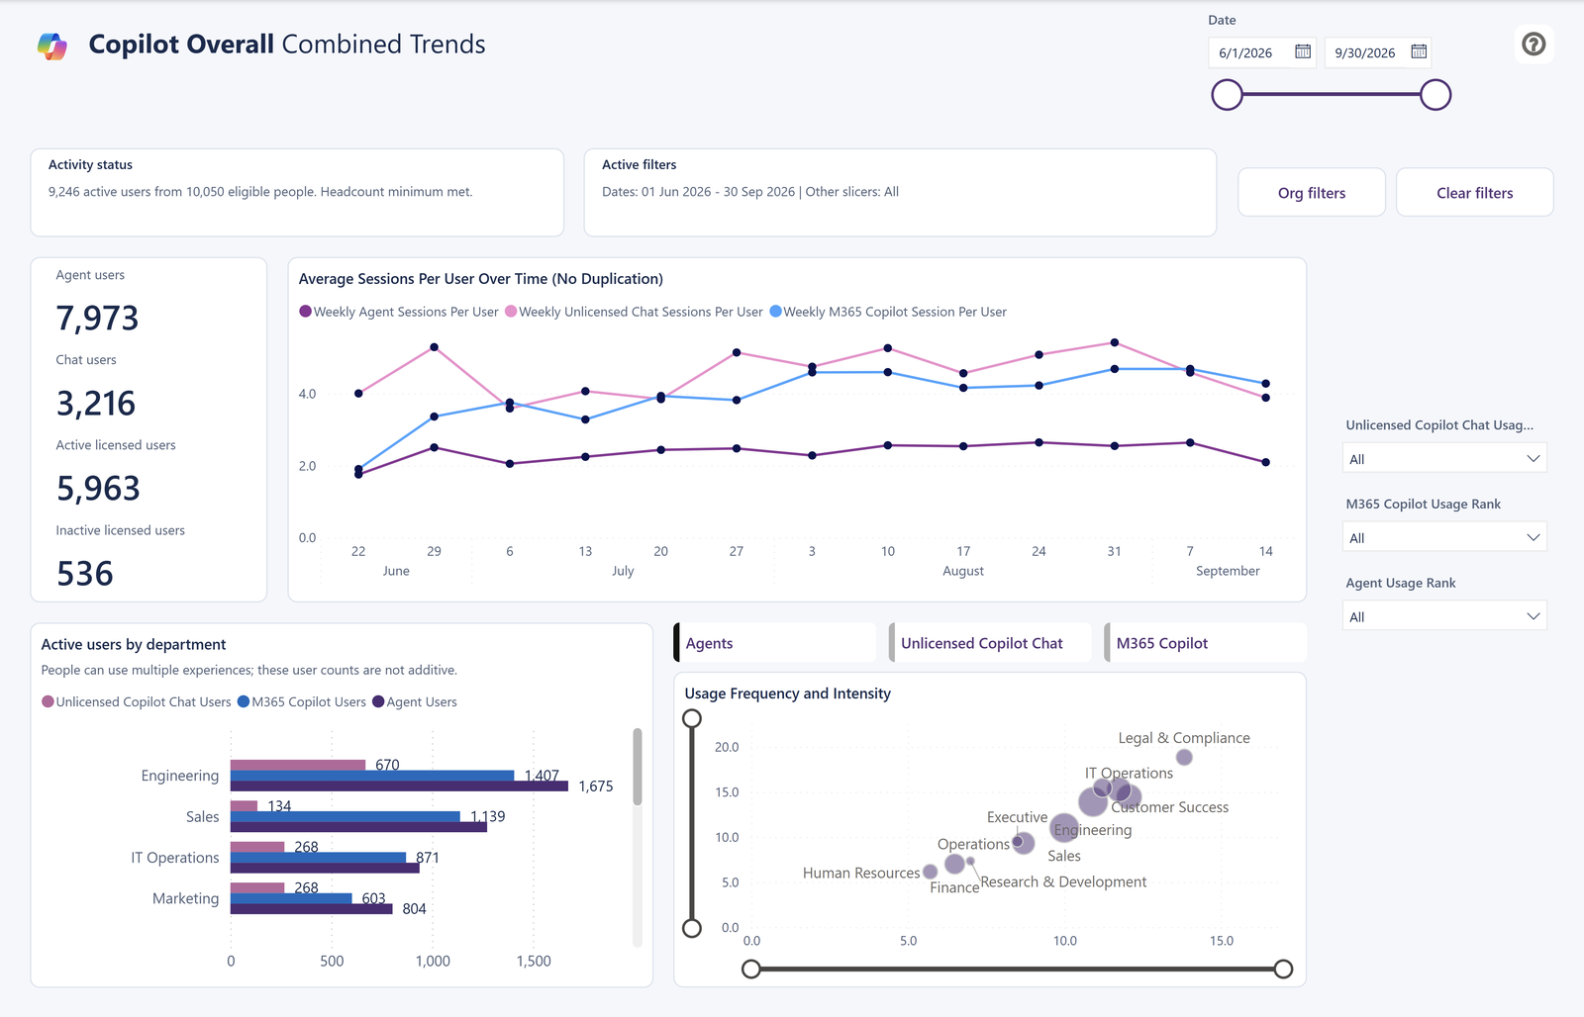
ACT 1 · WHO IS USING COPILOT
Compare experiences side by side
Combined Trends shows agents, Copilot Chat and licensed Copilot over time.
1
Who uses what
Agent users, chat users, and active or inactive licensed users across all recorded experiences.
1
2
2
Sessions per user over time
One line each for agents, unlicensed Copilot Chat and M365 Copilot.
3
4
3
Departments, not totals
Separate bars for each experience. They overlap, so read them side by side.
4
How often and how much
Departments plotted by frequency and intensity. Tabs switch between experiences.
SAY THIS
These experiences meet different needs, and many people use more than one of them.
AI-in-One Dashboard v2.0.0 · Storyboard · Example data
05 / 17
Notes:
Combined Trends compares the three main experiences over time: agents, Copilot Chat used without a Microsoft 365 Copilot license, and licensed Microsoft 365 Copilot.
The key message: one person can appear in several groups. Don't add the user counts together and don't assume people moved from one experience to another.
Weekly sessions per user is each active user's sessions divided by the weeks they were active, then averaged. It is not divided by every calendar week.
Inactive licensed users are licensed people with no recorded licensed-chat activity in the selected dates. That alone doesn't prove a license has no value; it's a reason to ask what would help.

Slide 6
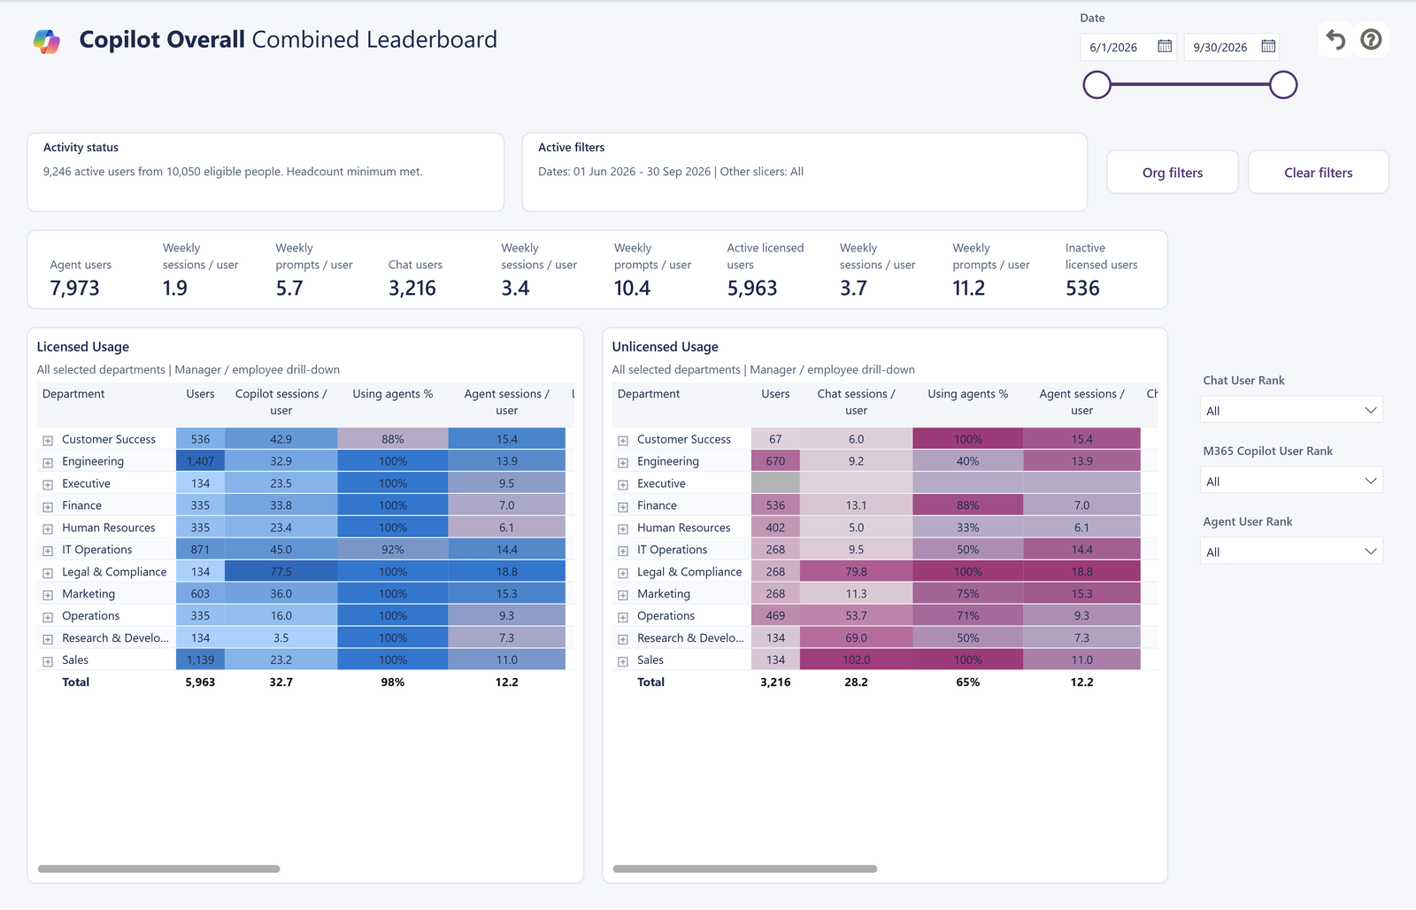
ACT 1 · WHO IS USING COPILOT
See which departments lead
Combined Leaderboard compares licensed and unlicensed use by department.
1
The headline comparison
Users, prompts, prompts per session and weekly prompt/session comparisons for agents, chat and licensed Copilot.
1
2
Licensed usage
2
3
Users, Copilot sessions per user, the share who also used agents and agent sessions per user.
3
Unlicensed usage
Chat users, sessions per user and the share who also used agents.
i
Read each percentage on its own
Of this table's chat users, how many also used agents? People with unknown license status are not counted as unlicensed.
SAY THIS
Here's where each experience is strongest, and how many chat users have also found agents.
AI-in-One Dashboard v2.0.0 · Storyboard · Example data
06 / 17
Notes:
Use heat colors to spot the busiest departments quickly.
The agent percentages answer one question per table: of this table's chat users, what share also used agents? Agent-only users and people with unknown license status don't inflate it.
License status comes from the people file supplied when the data was collected. It is a snapshot, not a history of every license change. Unknown is shown as Unknown, never treated as unlicensed.
Department results come first. Individual people appear only when the report owner has approved Minimum Group Size 1.

Slide 7
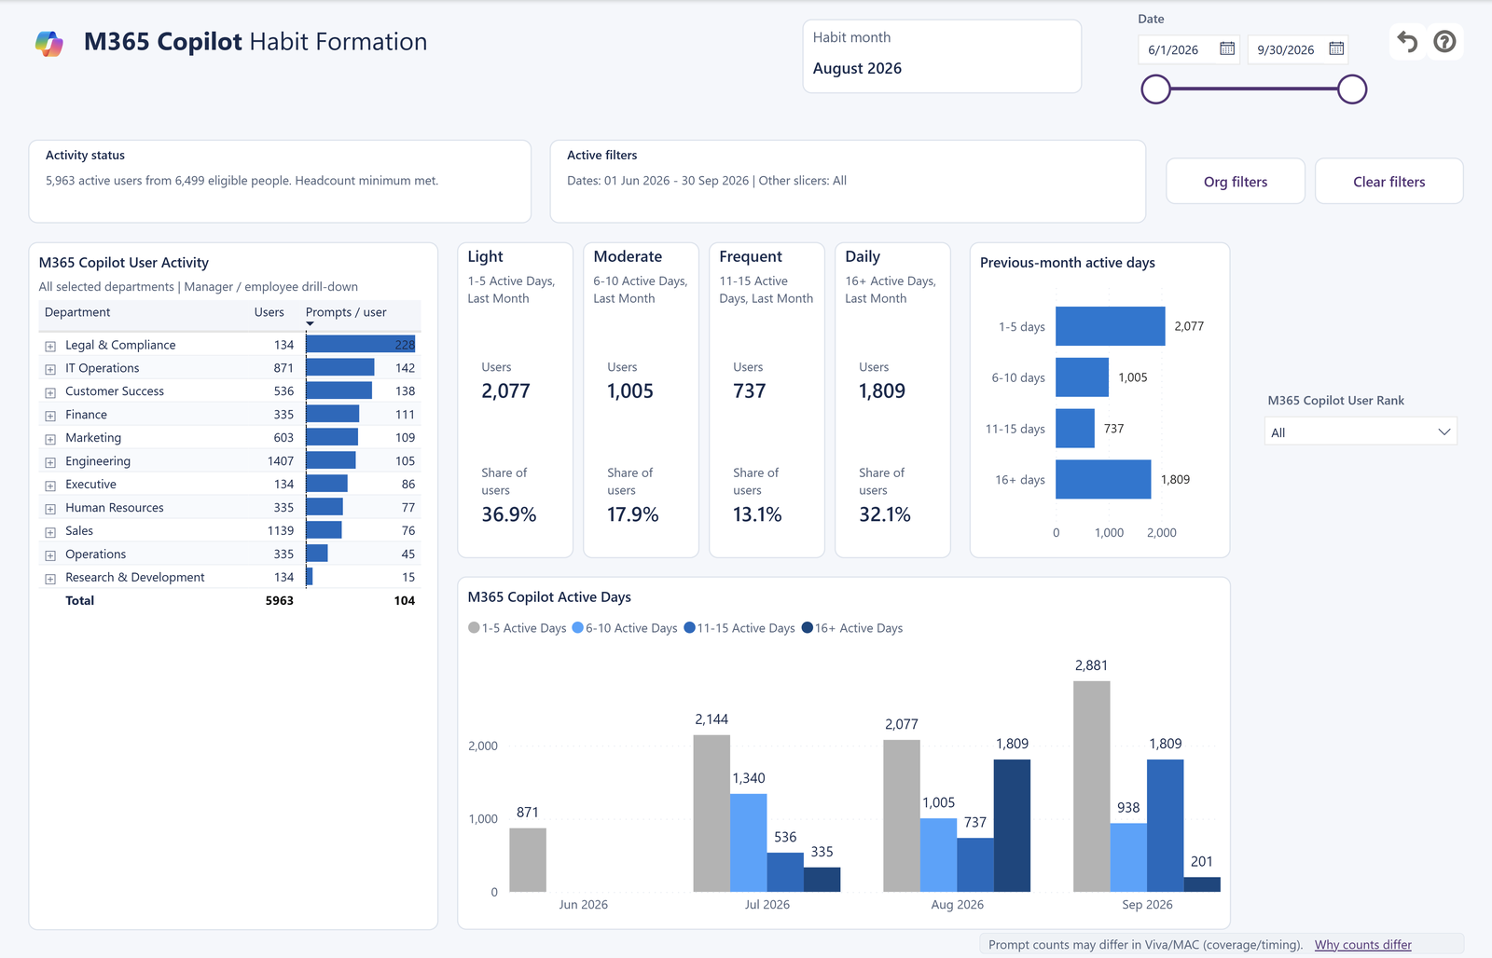
ACT 2 · IS IT BECOMING A HABIT?
Read habits one month at a time
Every habit page uses the same four groups and names the month at the top.
Light
Moderate
Frequent
Daily
1–5
6–10
11–15
16+
active days in the month
active days in the month
active days in the month
active days in the month
WHICH MONTH?
1
The habit month is the calendar month before the end of your selected dates.
2
Selected dates
1 Jun – 30 Sep 2026
→
Habit month
August 2026
The cards and bars describe that month. The tables beside them cover your whole selected period, so their totals won't match. "Daily" names the 16+ group; it doesn't mean every day.
SAY THIS
Habits tell us whether Copilot is becoming part of the routine, one month at a time.
AI-in-One Dashboard v2.0.0 · Storyboard · Example data
07 / 17
Notes:
There are three habit pages: agents, M365 Copilot and Copilot Chat. They all use the same four groups: Light is 1 to 5 active days in the month, Moderate 6 to 10, Frequent 11 to 15 and Daily 16 or more.
The habit month is printed at the top of each habit page. It is the calendar month before the end of your selected dates. If your dates end on 30 September, the cards describe August.
The cards and the previous-month bars describe that month. The department and agent tables describe the whole selected period, so their totals won't match the cards.
Use habits to discuss routines, not to rate people. Different roles naturally use Copilot on different numbers of days.

Slide 8
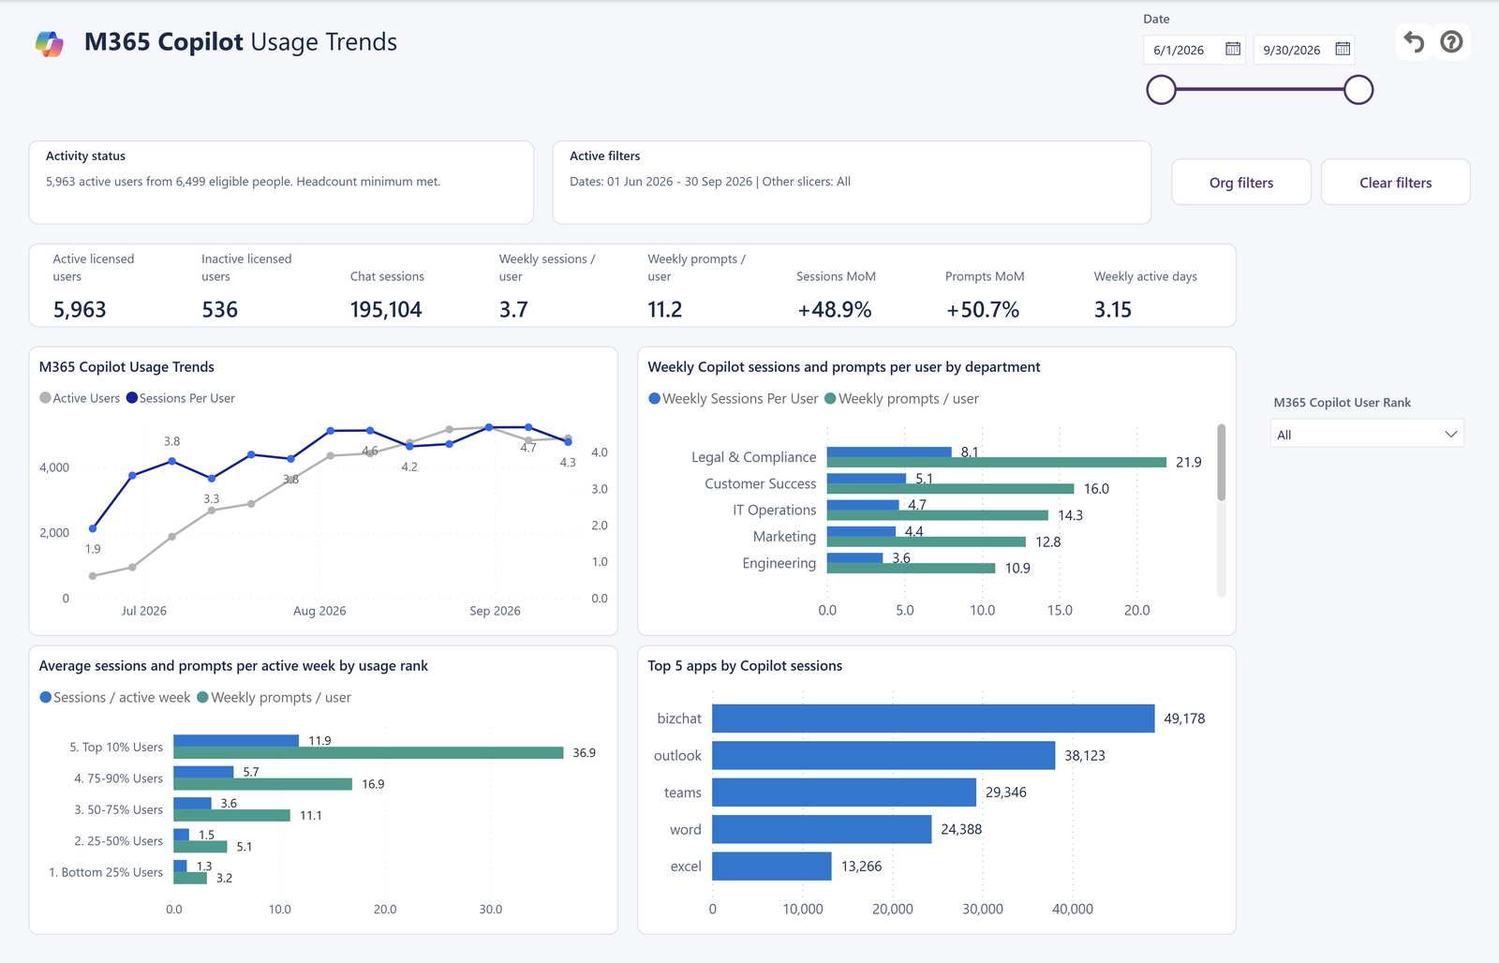
ACT 2 · IS IT BECOMING A HABIT?
Licensed Copilot: how often, and where
M365 Copilot: Usage Trends follows people with a Microsoft 365 Copilot license.
1
The licensed picture
Active and inactive licensed users, sessions, weekly prompts/sessions, prompt/session month-over-month change and weekly active days.
1
2
Week by week
2
Active users and sessions per user, so you can see growth and depth together.
3
From top users to light users
Weekly prompts and sessions by dynamic band. Distinct prompts per active week set the bands for the selected dates and population.
3
4
4
Which apps
Top 5 apps by Copilot sessions, such as Copilot Chat, Outlook, Teams and Word.
SAY THIS
Licensed people are using Copilot week after week, and here's where it shows up in their day.
AI-in-One Dashboard v2.0.0 · Storyboard · Example data
08 / 17
Notes:
This page focuses on people recorded with a Microsoft 365 Copilot license in the supplied people file.
Read users, sessions and apps together rather than choosing one number as a verdict on licenses. Some apps record more detail than others, so a small count can reflect how activity is recorded.
Month-over-month change compares sessions with the previous period for the selected dates. It isn't a target.
Usage alone doesn't prove productivity gains or that a license paid for itself. Use the pattern to ask the team what is working and where training or access would help.
Licensed activity includes every recorded experience, including agent-only users. Active plus inactive licensed users equals the licensed directory population after dates, scope, RLS and selected usage-band membership. A band selection cannot increase inactive licensed users.
The relevant tables and tooltips pair prompts and prompts per session with sessions. Weekly comparison bars and applicable month-over-month cards include prompt counterparts; line/area, top-N session and scatter series remain unchanged. Prompt counts reflect Purview audit coverage and are not guaranteed to match Viva Insights or Microsoft 365 admin center reports.
Usage bands recalculate from distinct prompts per active week among active users in the selected dates and authorized organization, reporting-team and license population. Each family is calculated independently, then selected memberships intersect. Ties share a band. No Usage includes eligible people without that family's recorded activity.

Slide 9
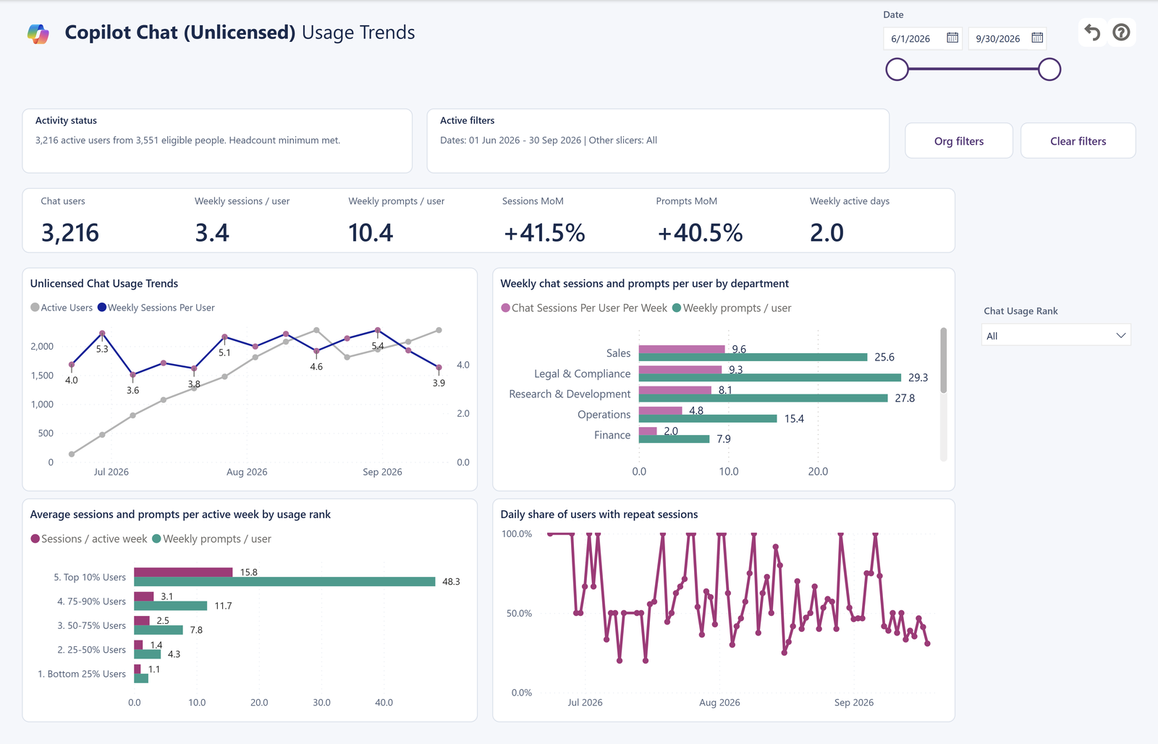
ACT 2 · IS IT BECOMING A HABIT?
Copilot Chat: regular use without a license
These pages are named Chat (Web) in the report.
1
Who uses chat
Chat users, weekly prompts and sessions per user, prompt/session month-over-month change and weekly active days.
1
2
Usage trend
2
4
Active users and weekly sessions per user for people without a Copilot license.
3
Same-day repeat use
The daily share of active people who had more than one chat session that day.
3
4
By department
Weekly chat sessions per user, so you can compare teams of different sizes.
SAY THIS
Many people already use Copilot Chat regularly, and some come back several times a day.
AI-in-One Dashboard v2.0.0 · Storyboard · Example data
09 / 17
Notes:
These pages count recorded Copilot Chat activity from people listed without a Microsoft 365 Copilot license. Agent activity, Cowork and activity the report can't identify are kept separate and aren't counted as chat.
The repeat-use line is a share of that day's active users. For example, 50% means half the people active that day had another chat session. It doesn't mean half the company used chat.
More sessions can mean useful work, retries or a difficult task. Ask the team what was happening before drawing conclusions.

Slide 10
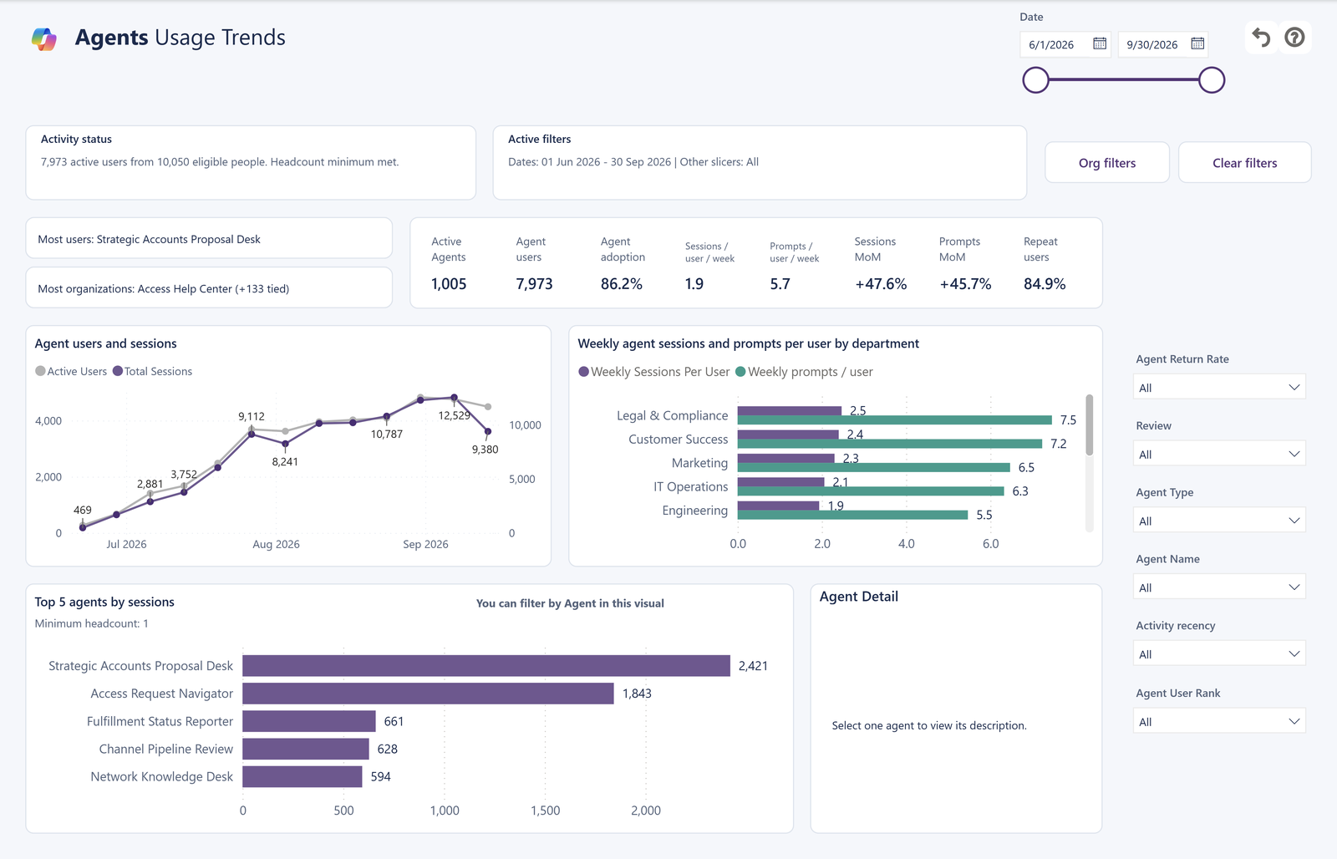
ACT 3 · WHAT AGENTS ARE DOING
Agents: who tries them, and who comes back
Agents: Usage Trends shows reach and repeat use across every agent.
1
The leaders
Which agent reaches the most people and the most organizations. Ties are shown.
1
2
2
The headline numbers
3
Active agents, agent users, adoption, weekly prompts/sessions, their month-over-month changes and repeat users.
3
Growth over time
4
Agent users and sessions over the selected dates.
4
Top 5 agents by sessions
Select an agent to filter the page and read its description.
SAY THIS
Agents are reaching more people, and most people who try one come back.
AI-in-One Dashboard v2.0.0 · Storyboard · Example data
10 / 17
Notes:
Reach and repeat use tell you different things. Reach is how many people used an agent. Repeat use is the share with at least two separate conversations in the selected period; it's not next-month retention.
Agent adoption is agent users divided by all active Copilot users.
A widely used agent with little repeat use raises a different question from a specialist agent used regularly by a small team. Look at several weeks, not one busy day.
The filters on the right let you focus by return rate, review status, agent type, agent name and recency.

Slide 11
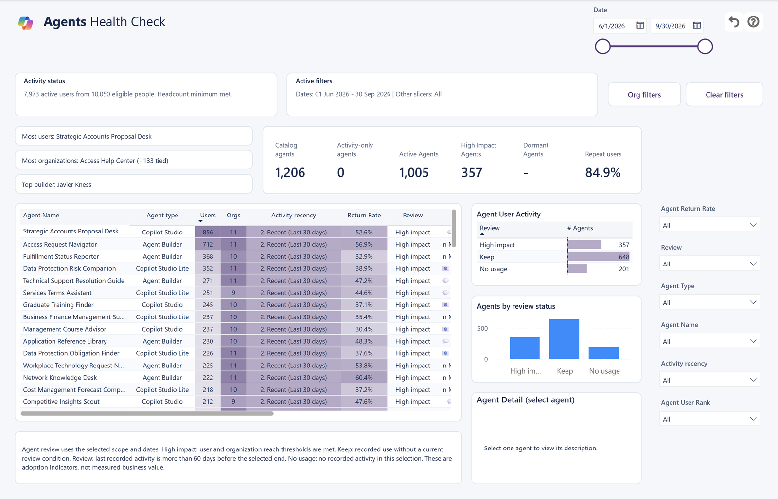
ACT 3 · WHAT AGENTS ARE DOING
Decide which agents need a conversation
Health Check separates catalog IDs from activity-only agents; review labels follow your scope.
High impact
Reaches many users and organizations for its type.
Keep
Used recently, without reaching the high-impact thresholds.
1
Review
Last used more than 60 days before the end of your dates.
2
No usage
No recorded activity for your team and dates.
High impact means at least 100 users and 10 organizations for Microsoft agents, 30 and 3 for Agent Builder agents, and 50 and 5 for others. These are starting points, not proof of value.
SAY THIS
Creator and Developer Name identify catalog ownership, even in aggregate mode. Review labels start conversations.
AI-in-One Dashboard v2.0.0 · Storyboard · Example data
11 / 17
Notes:
The review label combines reach and recency for the selected team and dates.
No usage: no recorded activity in this selection. Review: last activity more than 60 days before the end of the selected dates. High impact: user and organization thresholds are met for the agent's type (100 users and 10 organizations for Microsoft agents, 30 and 3 for Agent Builder, 50 and 5 for others). Keep: everything else with recent use.
These thresholds are rules of thumb built into the report, not validated benchmarks. An agent can be valuable for an occasional specialist task without much activity. Missing catalog details are different from no recorded use, and a group below the minimum size may not show at all.
Before improving, sharing or retiring an agent, ask its owner what it's for and what its users think.

Slide 12
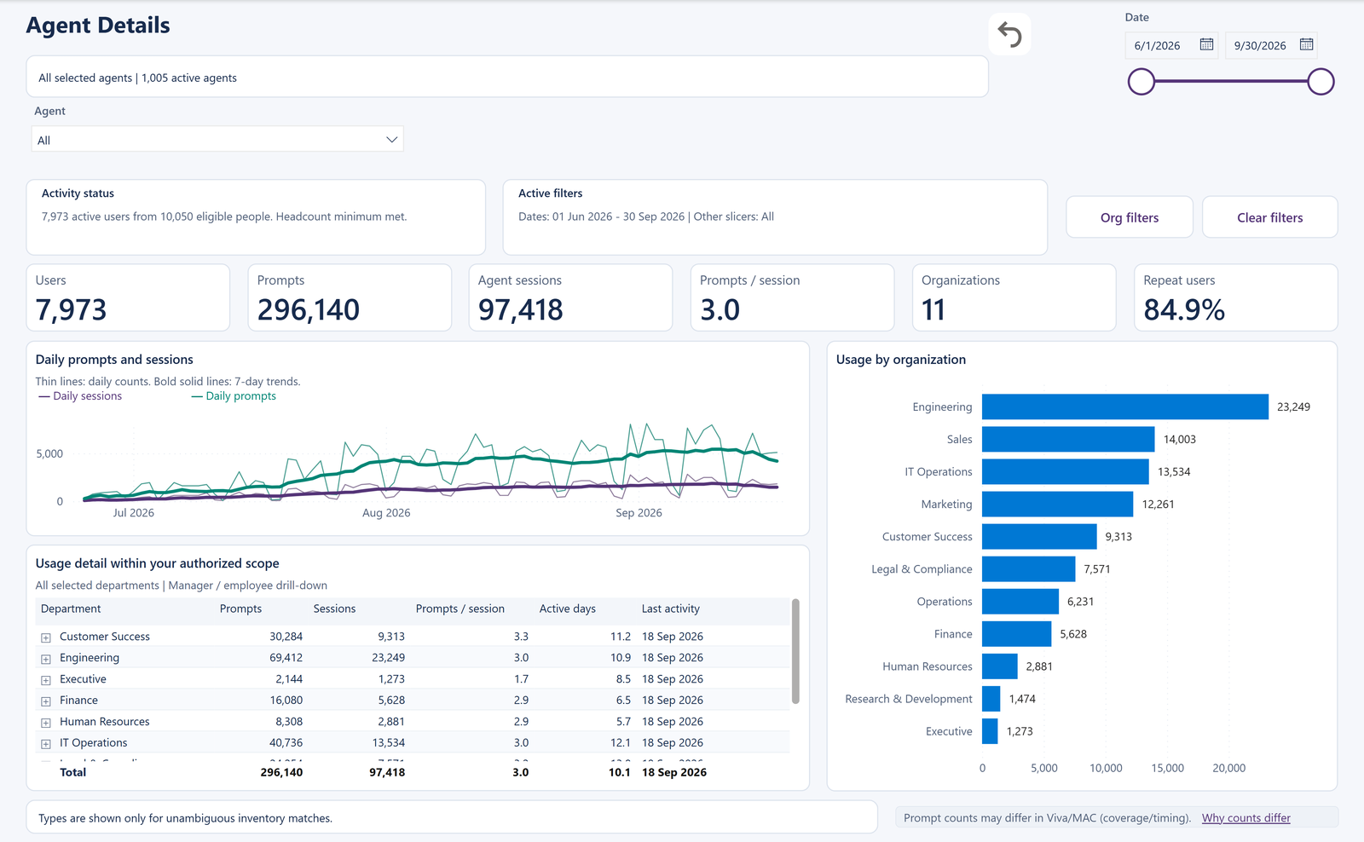
ACT 3 · WHAT AGENTS ARE DOING
Zoom in on one agent
Agent Details shows who uses an agent, how much, where and whether they return.
1
Six headline numbers
Users, prompts, agent sessions, prompts per session, organizations and repeat users.
2
Day by day
1
Daily prompts and sessions, with bold 7-day averages.
2
3
3
Who uses it most
Usage by organization shows which departments rely on the agent.
i
Two ways in
Open the Agent Details tab and pick from all agents, or right-click an agent name and choose Drill through > Agent drillthrough.
SAY THIS
Let's look at one agent closely: who uses it, how often, and in which teams.
AI-in-One Dashboard v2.0.0 · Storyboard · Example data
12 / 17
Notes:
There are two ways to reach agent details.
1. Open the Agent Details tab to browse freely. It starts with all agents.
2. On any page with agent names, right-click a name, choose Drill through, then Agent drillthrough. The details open for that agent with the same team and dates. Back returns you to where you were, and Explore all agents lets you pick another while keeping the team and dates.
Repeat users means people with at least two sessions in the selected period, not a later-month retention measure.
The agent's listed capabilities describe what it can do, not proof that every feature was used.

Slide 13
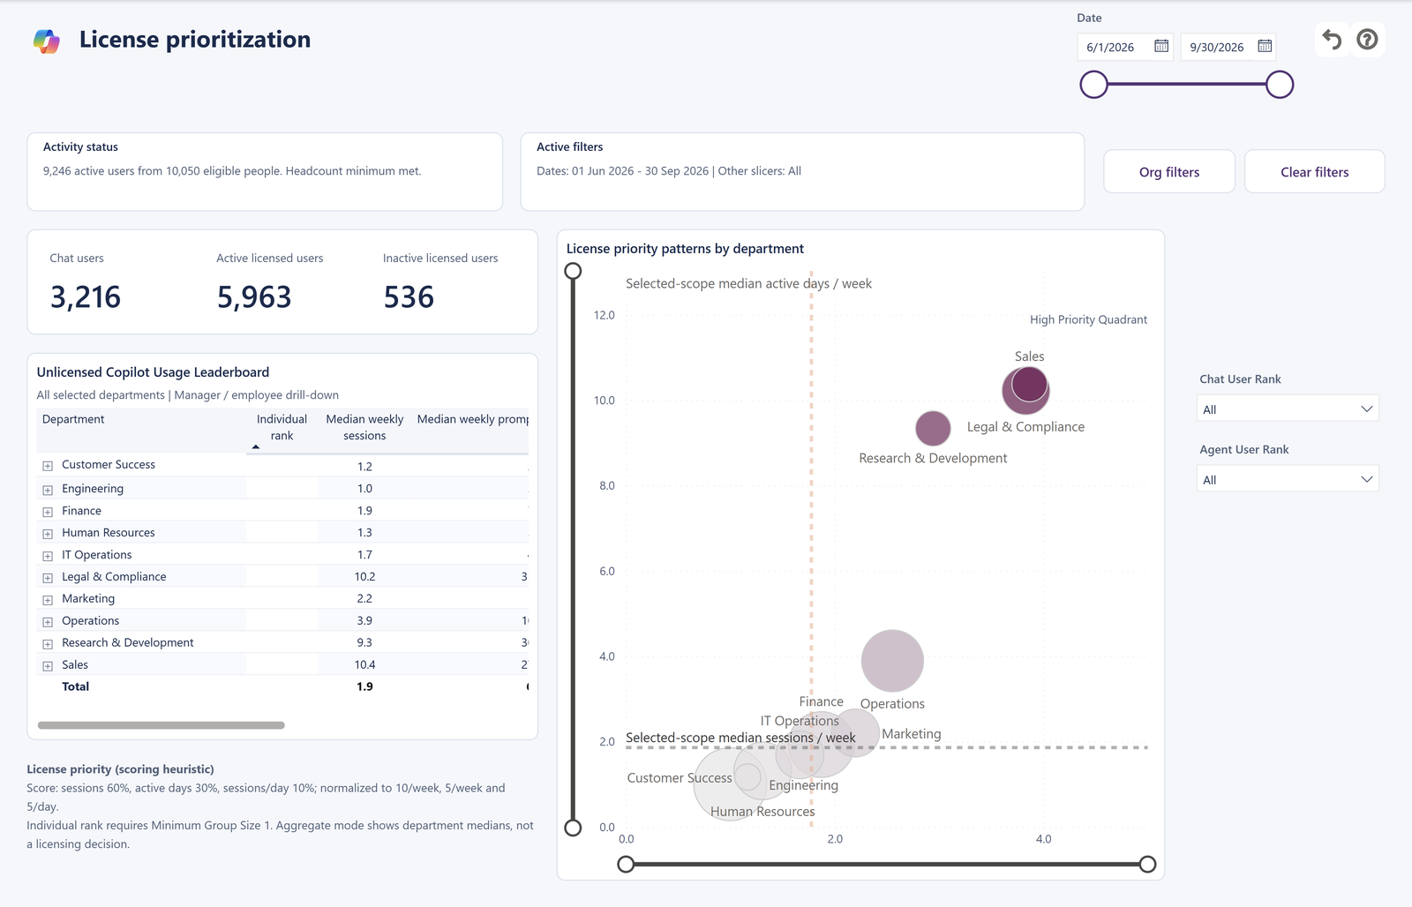
ACT 4 · WHERE TO INVEST NEXT
Start a licensing conversation
License Prioritization shows where Copilot Chat use could support a licensing discussion.
HOW THE SCORE WORKS
60%
Weekly sessions
1
3
30%
Weekly active days
2
10%
Sessions per active day
i
A conversation, not a decision
Combine it with job needs, cost and feedback. Individual ranks need Minimum Group Size 1.
SAY THIS
These teams use Copilot Chat often and regularly. Let's ask whether a license would help their work.
AI-in-One Dashboard v2.0.0 · Storyboard · Example data
13 / 17
Notes:
1. Chat users, active licensed users and inactive licensed users at a glance. Agent-only licensed users are active; active plus inactive reconciles to the licensed directory population.
2. The unlicensed usage leaderboard ranks departments by how much people without a Microsoft 365 Copilot license use Copilot Chat, with median weekly sessions and active days.
3. The scatter plots each department by how often and how regularly people use Copilot Chat. Departments toward the High Priority corner use it most. The reference lines are the selected group's medians, not targets.
The score weights weekly sessions 60%, weekly active days 30% and sessions per active day 10%. These weights are choices made for the score, not universal measures of value.
Use the page to identify a licensing conversation worth having. Bring in role, need, cost and colleague feedback. Individual rankings appear only when Minimum Group Size 1 has been approved.

Slide 14
BEFORE YOU DRAW CONCLUSIONS
Read the numbers responsibly
Six things to keep in mind on every page.
1
2
3
People in scope aren't all active
Groups overlap
Activity isn't value
People in scope are everyone in the selected group. Active users are those with recorded use. A large team can have few active users.
One person can use M365 Copilot, Copilot Chat and agents. Compare these groups side by side; don't add them up.
Prompts count requests and sessions count conversations. Neither measures time saved, quality or return on investment.
4
5
6
Habits use one month
License status is a snapshot
Categories are clues
Habit cards describe the month printed on the page. Tables nearby cover the whole selected period.
It comes from the people file at collection time. Unknown is shown as Unknown, never as unlicensed.
Inferred activity and agent use cases come from activity records and agent descriptions. Check them with the people doing the work.
SAY THIS
The report shows recorded activity. The team can tell us what it means for their work.
AI-in-One Dashboard v2.0.0 · Storyboard · Example data
14 / 17
Notes:
Use this slide when your audience starts drawing strong conclusions.
1. People in scope is the eligible headcount for the selected group; Minimum Group Size uses that headcount. Active users are those with recorded activity in the dates.
2. The same person can appear in several experience groups, so totals aren't additive.
3. The report counts user prompts and conversations. It doesn't measure answer quality, time saved, revenue or employee performance.
4. Habit cards use the month before the end of the selected dates.
5. License status comes from the people file supplied when the data was collected, not a history of every change.
6. Activity categories are inferred from audit records and agent descriptions; they aren't measured outcomes.
The Metric Glossary & Guide page in the report has a definition for every number.

Slide 15
PRIVACY BUILT IN
Team-level by default, detail only when approved
Two controls decide what each viewer can see. Agree them before you share the report.
MINIMUM GROUP SIZE
ROW-LEVEL SECURITY ROLES
The smallest number of eligible people a group needs before the report shows its results.
Reporting hierarchy
Managers see themselves and everyone who reports to them, directly or indirectly.
3
1
10
Default
Approved detail
Your choice
All data viewers
Team-level reporting. Individual activity stays hidden.
Individual views, such as By user. Use only when approved.
Any whole number. For example, 10 shows groups of ten or more.
Executive sponsors, analysts and adoption leads see the whole organization.
It counts eligible people in the group, not active users, so a qualifying team can still show zero, one or two active users. It's a display rule, not anonymization.
Viewers see no data until they're assigned a role.
SAY THIS
By default we only see team-level results, and each person sees only the data their role allows.
AI-in-One Dashboard v2.0.0 · Storyboard · Example data
15 / 17
Notes:
Minimum Group Size is set by the report owner. It counts eligible people in the group, not active users, so a qualifying team can show zero, one or two active users. The default of 3 keeps reporting at team level. A setting of 1 enables individual views, such as By user on the agent leaderboard, and needs approval.
The setting is a display rule, not anonymization, and it doesn't replace access permissions.
Row-level security decides whose data each viewer sees. Reporting hierarchy: viewers see themselves and everyone who reports to them, matched by sign-in name. All data viewers: everyone. Until people or groups are assigned to a role in the Power BI service, viewers can't see the report's data.

Slide 16
MAKE IT USEFUL
Turn patterns into conversations
The report shows the pattern. The team can explain it. Agree one change, then look again next month.
If you see… | Ask the team… | Try next…
Many licensed users are inactive | What gets in the way? Is it time, training or the type of work? | Run a short session on two everyday tasks
A team uses Copilot Chat often without a license | Would licensed features help their regular work? | Review on License Prioritization with cost and need
People try an agent but don't come back | Does it answer the questions people actually ask? | Ask the owner to improve it, then compare in a month
A small team relies on a specialist agent | Could other teams with similar work benefit? | Share it with one more team and watch reach
Habits stay Light month after month | Which tasks could become a weekly routine? | Agree one task to try with Copilot each week
SAY THIS
Let's agree one change to try and come back to the same view next month.
AI-in-One Dashboard v2.0.0 · Storyboard · Example data
16 / 17
Notes:
Finish with a practical question. A pattern might point to training, an agent worth sharing or a task worth exploring, but the chart alone can't tell you which explanation is right.
Agree one change and revisit the same team with comparable dates next period. Ask colleagues whether the change helped their work, not just whether the numbers went up.
If the report will be used for recurring reviews, ask its owner to confirm that scheduled refresh brings in new data.

Slide 17
MAKE THE MOST OF V2.0.0
From a clearer picture to a useful conversation.
01
02
03
Find the right view
Read the right numbers
Agree one next step
Start on Copilot Usage Explorer with a team and a full month, then follow the question to the right page.
Read people, prompts and sessions separately. Check the habit month and the license snapshot before comparing.
Share what works, improve an agent or start a licensing conversation, then look again next month.
KEEP LEARNING
Interpretation Guide
Metric Glossary & Guide
Screenshot tour
aka.ms/Analytics-Hub
What every number means, page by page
Definitions inside the report itself
All 17 pages on GitHub
More free Copilot analytics reports
Every screenshot uses made-up example data. Use the live report for your organization's results. Get the dashboard at aka.ms/AI-in-One.
17 / 17
Notes:
Close by agreeing one next step and a date to look again.
Point people to the Interpretation Guide for detail on every page and number, and to the Metric Glossary & Guide page inside the report. The dashboard at aka.ms/AI-in-One has the screenshot tour, setup instructions and the latest templates. More free reports from the Microsoft Copilot Analytics team are at aka.ms/Analytics-Hub.

